Slide 1
About OMICS Group
OMICS Group International is an amalgamation of Open Access publications and worldwide international science conferences and events. Established in the year 2007 with the sole aim of making the information on Sciences and technology ‘Open Access’, OMICS Group publishes 400 online open access scholarly journals in all aspects of Science, Engineering, Management and Technology journals. OMICS Group has been instrumental in taking the knowledge on Science & technology to the doorsteps of ordinary men and women. Research Scholars, Students, Libraries, Educational Institutions, Research centers and the industry are main stakeholders that benefitted greatly from this knowledge dissemination. OMICS Group also organizes 300 International conferences annually across the globe, where knowledge transfer takes place through debates, round table discussions, poster presentations, workshops, symposia and exhibitions.

Slide 2
About OMICS Group Conferences
OMICS Group International is a pioneer and leading science event organizer, which publishes around 400 open access journals and conducts over 300 Medical, Clinical, Engineering, Life Sciences, Phrama scientific conferences all over the globe annually with the support of more than 1000 scientific associations and 30,000 editorial board members and 3.5 million followers to its credit.
OMICS Group has organized 500 conferences, workshops and national symposiums across the major cities including San Francisco, Las Vegas, San Antonio, Omaha, Orlando, Raleigh, Santa Clara, Chicago, Philadelphia, Baltimore, United Kingdom, Valencia, Dubai, Beijing, Hyderabad, Bengaluru and Mumbai.

Slide 3
The Use of Localised Thermal Desorption for Extraction of Volatile Hydrocarbons from within a Fire Scene: A Multi-Study Analysis
Tom Smale, Bsci(Psy), BFor

Slide 4
The Cost of Fire
In Australia, the average cost of damages caused by bush fires per year is AUD$80-100 million [1]
The cost of arson-related fires in the United States was US$551 million in 2010 [2]
There are over 100 fire-related deaths and 3,000 fire-related injuries in Australia each year [3]

Slide 5
Causes of Fire In Australia

Slide 6
Evidence and Fire Scenes
Conviction rates for arson are exceedingly low
9% for Australia [4]
5% for the United States [5]
This is partly due to the nature of fire scene evidence
The presence of an accelerant in a scene indicates a likelihood of deliberate fire-setting
Unfortunately the accelerants used in arson are mostly consumed in the fire itself
However, small amounts of accelerant can still be present within a scene post-burn

Slide 7
Collecting Trace Accelerants
Trace amounts of liquid accelerants, known as Ignitable Liquid Residue (ILR), can remain on surfaces and debris within the scene
This ILR is a valuable source of evidence as it can be extracted and analysed using Gas Chromatography Mass Spectrometry (GC-MS)
Specialised extraction techniques must be used to remove the ILR from debris or surfaces

Slide 8
The Challenge
Most extraction techniques require the substrate be moved to a laboratory for testing
However, ILR may be present on large, fixed surfaces within a scene, such as concrete
It can be impractical or unsafe to try and remove sections of these fixed surfaces for transport and laboratory-based analysis

Slide 9
Extraction Methods
Numerous methods are possible, including distillation and dichloromethane rinsing
A common method involves thermal desorption
The sample is heated in a container, evaporating the ILR from the substrate
The evaporated ILR forms a gaseous cloud in the top of the container, known as a headspace
This headspace can be sampled using either activated charcoal or a solid-phase microextraction needle

Slide 10
Research at CIT has focused on finding a way to perform these procedures directly at the scene

Slide 11
Recent Research at CIT
Recent research has focused on using thermal desorption as a scene-based technique, rather than a lab-based technique
This has led to the creation of the Passive Headspace Residue Extraction Device (P.H.R.E.D.), designed to generate heat in a contained section of substrate via infrared radiation

Slide 12
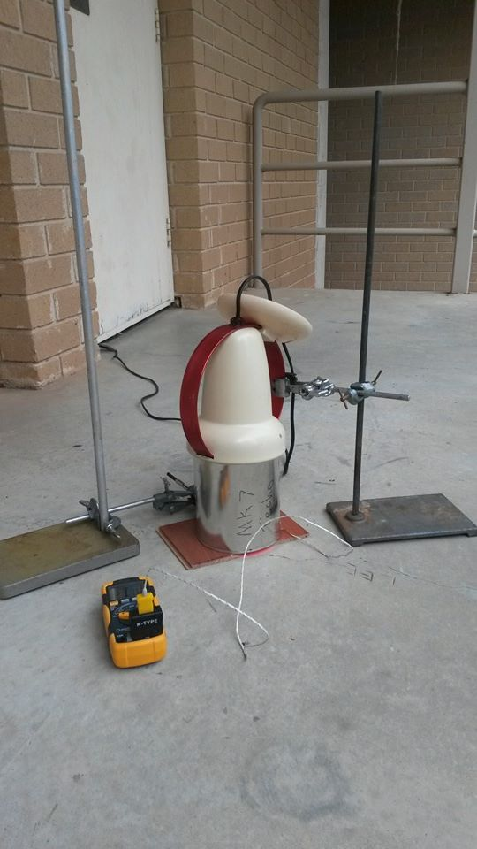
P.H.R.E.D. (Passive Headspace Residue Extraction Device)
Image courtesy of Canberra Institute of Technology

Slide 13
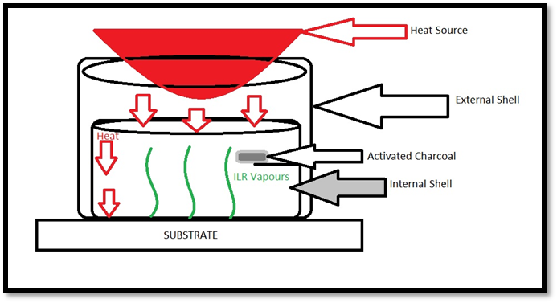
How P.H.R.E.D. Works
Image courtesy of CIT

Slide 14
Research 2011-2012
The first PHRED was constructed and used to sample E10 Petroleum Distillate from a fixed concrete surface
Collection was via activated charcoal with a subsequent dichloromethane (DCM) wash to extract the ILR compounds
The DCM wash was then analysed via GC-MS
The presence of petroleum ILR was indicated by the GC-MS detection of specific ASTM standard compounds used to identify petroleum [6]
The relative abundance of several of these compounds was later used to compare the sensitivity of PHRED to other techniques

Slide 15
Target Compounds for Petrol
Toluene | 1,2,3-Trimelthybenzene
Ethyl-benzene | Indene
m-Xylene | 1,3-Diethylbenzene
p- Xylene | 1-Methyl-3-Propylbenzene
o- Xylene | 1,4-Diethylbenzene
Propyl-benzene | 4-Ethyl-1,3-dimethylbenzene
1-Ethyl-3-Methylbenzene | 4-Ethyl-1,2-dimethylbenzene
1-Ethyl-4-Methylbenzene | 2-Ethyl-1,3-dimethylbenzene
1,3,5-Trimethylbenzene | 1,2,4,5-Tetramethylbenzene
1-Ethyl-2-Methylbenzene | 1,2,3,5-Tetramethylbenzene
1,2,4-Trimethylbenzene | Naphthalene
2-Methylnaphthalene | 1-Methynaphthalene

Slide 16
Target Compounds for Petrol
Toluene | 1,2,3-Trimelthybenzene
Ethyl-benzene | Indene
m-Xylene | 1,3-Diethylbenzene
p- Xylene | 1-Methyl-3-Propylbenzene
o- Xylene | 1,4-Diethylbenzene
Propyl-benzene | 4-Ethyl-1,3-dimethylbenzene
1-Ethyl-3-Methylbenzene | 4-Ethyl-1,2-dimethylbenzene
1-Ethyl-4-Methylbenzene | 2-Ethyl-1,3-dimethylbenzene
1,3,5-Trimethylbenzene | 1,2,4,5-Tetramethylbenzene
1-Ethyl-2-Methylbenzene | 1,2,3,5-Tetramethylbenzene
1,2,4-Trimethylbenzene | Naphthalene
2-Methylnaphthalene | 1-Methynaphthalene
Denotes compounds used for comparisons

Slide 17
2011-2012 PHRED on Concrete
Target Compound | Average Relative Abundance
Toluene | 72,000 units
Xylene | 39,000 units
Ethyl-benzene | 39,000 units

Slide 18
2013
The PHRED technique was used to extract kerosene samples from a concrete surface
PHRED was used against an alternative technique:
The loaded concrete surface was washed with boiling water, which was then retrieved via sponging the surface
The water was later analysed using a Solid-Phase Microextraction needle
Results indicated this washing technique was more sensitive than the activated-charcoal-based PHRED technique [7]

Slide 19
2013 PHRED vs Boiling Water Rinse
Target Compound | PHRED | Boiling Water
Naphthalene | 9,000 units | 9,000 units
Dodecane | 10,500 units | 100,000 units

Slide 20
2014
The PHRED technique was modified
SPME sampling from the headspace was used instead of activated charcoal

Slide 21
Analysis of Results- Petroleum
The results show a much higher degree of sensitivity for PHRED in conjunction with SPME than with charcoal

Slide 22
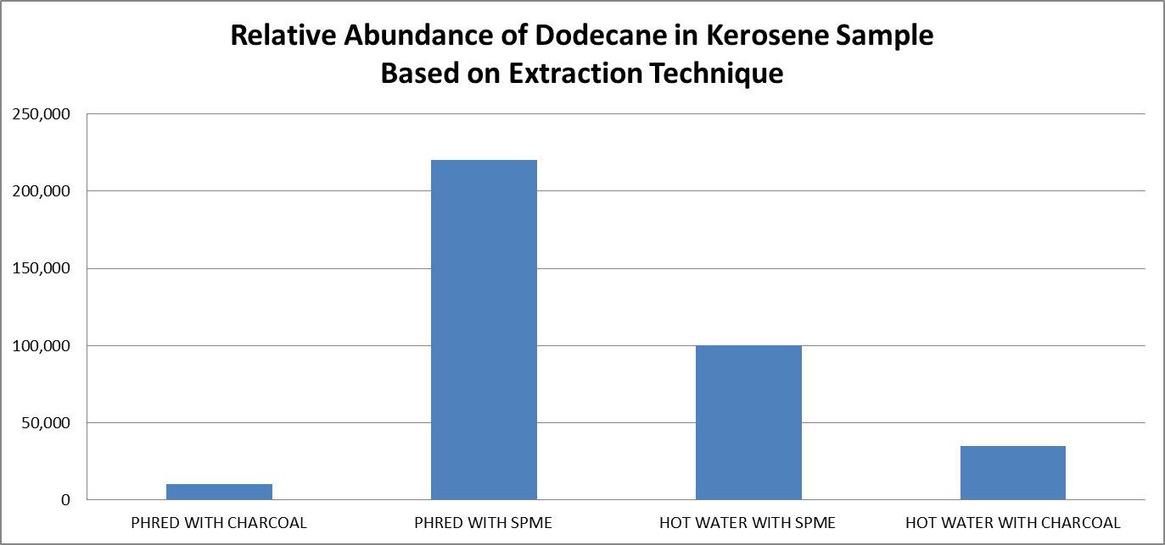
Analysis of Results- Kerosene

Slide 23
Conclusions
Localised thermal desorption was effective in retrieving volatile hydrocarbons from both E10 petroleum distillate and kerosene-covered substrates
Results indicate that the PHRED technique benefits greatly from the use of a SPME needle
The use of a hot water rinse is a viable alternative
The sensitivity of both techniques differs depending on the particular type of accelerant and the use of charcoal versus SPME

Slide 24
Future Research
Research is currently continuing to compare PHRED-SPME to other field-based extraction techniques, such as diatomaceous earth
Combining the PHRED technique with a portable GC-MS would completely remove the necessity for a laboratory stage.
Research is needed to determine the efficacy of this technique
The use of localised thermal desorption has not yet been applied to samples which have undergone heavy weathering or uncontrolled burning
Use of the PHRED in an authentic fire scene could provide data that would further develop the device

Slide 25
Acknowledgements
Canberra Institute of Technology Staff (past and present), especially Dr. Kym Turnbull, Dr. Isaac Arthur, Dr. Robert Berthon, Michaela Popham, Lavanya Kumarappan, Robert Ferguson, Russell Stuart, Greg Carnell, Lloyd Pieper, Peter Warne and David Royds, Yvonne Van Der Meer and Genevieve Williams
Canberra Institute of Technology Forensic Research Project students- Sarah Higgins, Louise Shields, Amy McMahon, Alexander Visotin and Amber Chalker
The National Centre for Forensic Studies

Slide 26
References
[1] Australian Institute of Criminology (AIC) 2004. The cost of bushfires. Bushfire arson bulletin no. 2. http://www.aic.gov.au/publications/current%20series/bfab/1-20/bfab002.aspx
[2] United States Fire Administration, 2010, Residential Arson Facts, http://www.usfa.fema.gov/fireservice/prevention_education/strategies/arson/aaw13/facts.shtm
[3] Ashe, B. & McAneney, J., 2012, “The Real Cost of Fire in Australia”, World Fire Statistics Bulletin, no. 28

Slide 27
References
[4] Australian Bureau of Statistics 2007, Sentences for arson in Victoria, Bushfire Arson Bulletin no. 41
[5] Bush, A.M. 2009, “Arson Difficult to Prosecute”, The Topeka Capital-Journal
[6] American Society for Testing and Materials (ASTM), Standard ASTM-E 1618-01 (Standard Test Method for Ignitable Liquid Extracts by Gas Chromatograph-Mss Spectrometry)
[7] Higgins, S. (2013), Comparison of Effectiveness in the Extraction of Gasoline Residues using Hot Water, SPME and PHRED, Canberra Institute of Technology

Slide 28
Let Us Meet Again
We welcome you all to our future conferences of OMICS Group International
Please Visit: www.omicsgroup.com
www.conferenceseries.com

