Slide 1
World Congress on Breast Cancer August 1-3, 2015, Birmingham, UK
Multiparameter characterization of breast carcinoma: subgross, microscopy, proteins, and genes
Tibor Tot
Falun, Sweden
Lake Varpan, Falun, Sweden

Slide 2
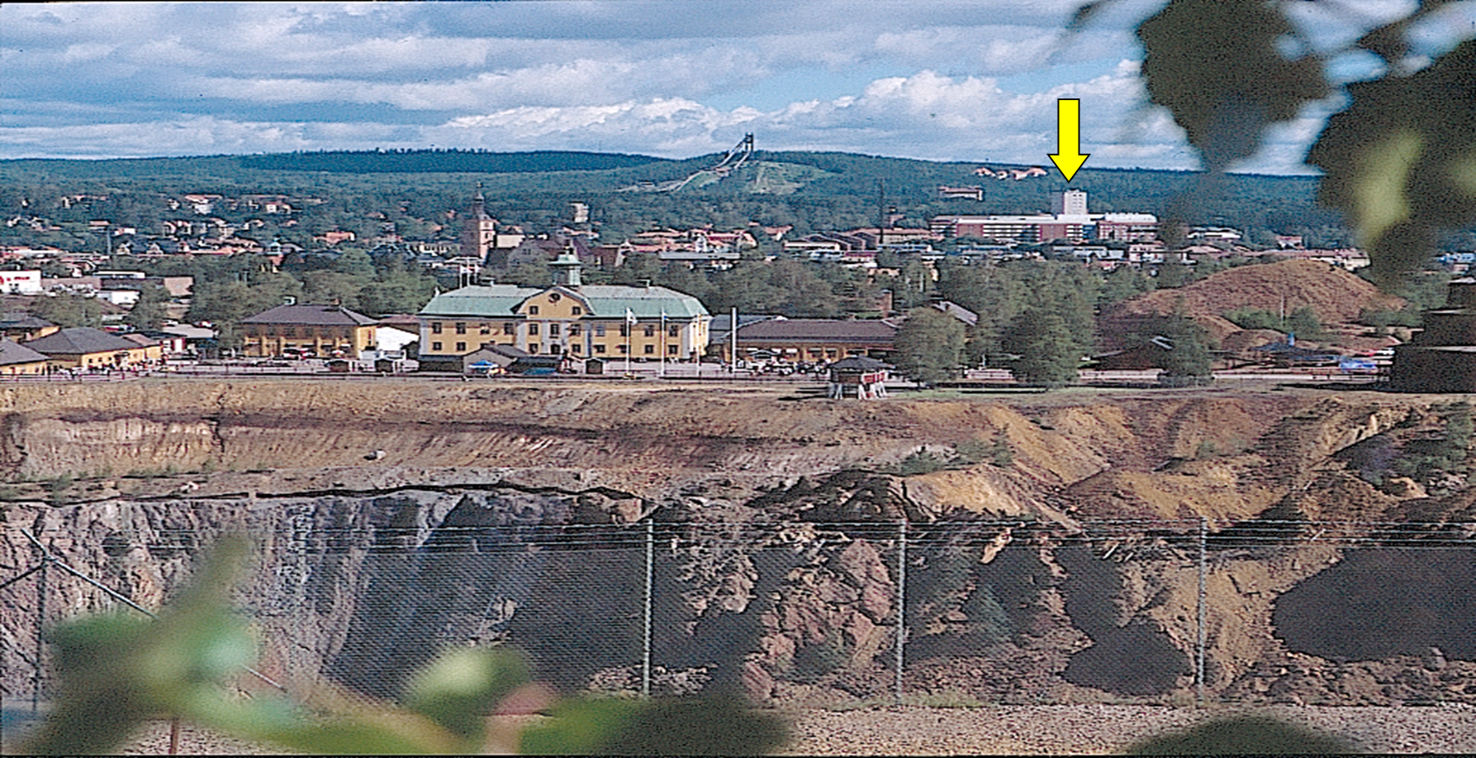

Slide 3
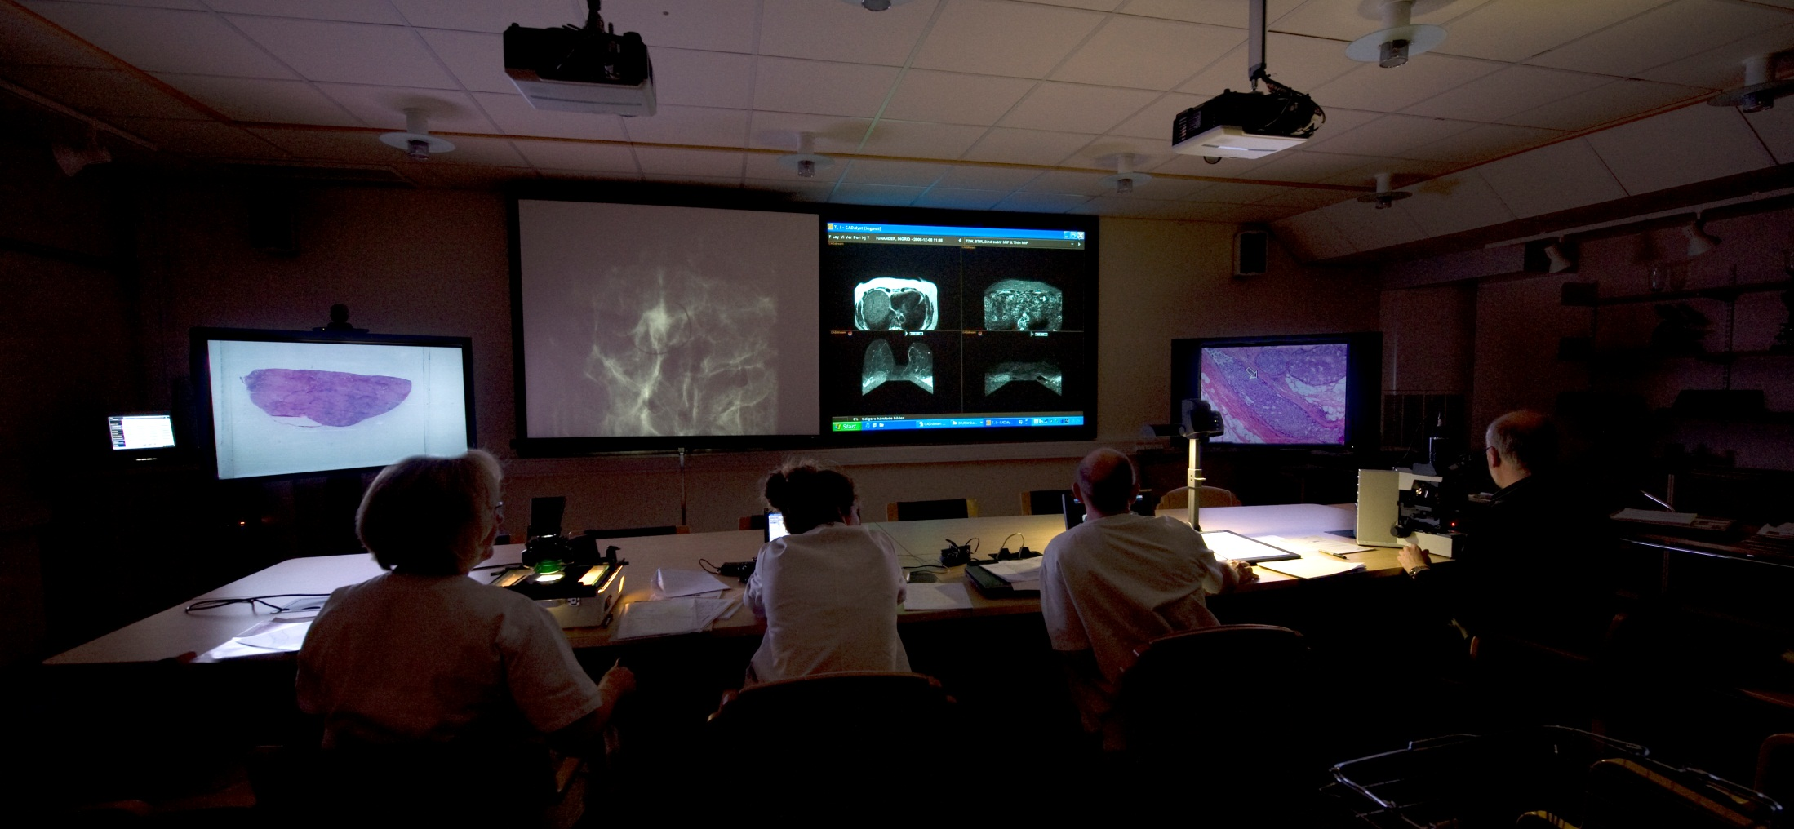
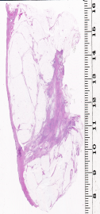
Radiological – pathological correlation is essential
in diagnosing breast carcinoma
The radiology images are courtesy of
Prof Laszlo Tabár, DRs Nadja Lindhe and Mats Ingvarsson

Slide 4
Macroscropy
Clinical information
Subgross
Radiological dg/
preop staging
FNAB/Core
Surgery
Detection
Microscopy
Biomarkers

Slide 5
Macroscropy
Clinical information
Subgross
Radiological dg/
preop staging
FNAB/Core
Surgery
Detection
Microscopy
Biomarkers

Slide 6
Macroscropy
Clinical information
Subgross
Radiological dg/
preop staging
FNAB/Core
Surgery
Detection
Microscopy
Biomarkers

Slide 7
Pathology
Oncology
ER
HER2
Ki67
Genetics
Molecular
%
Reproducibility
Surgery / radiology
Radicality
Extent
Size
Multifocality
Lymph nodes
mm
numbers
Histology
Benign/malignant
Invasive/in situ
Tumor type/grade
Immunohistochemistry
description

Slide 8
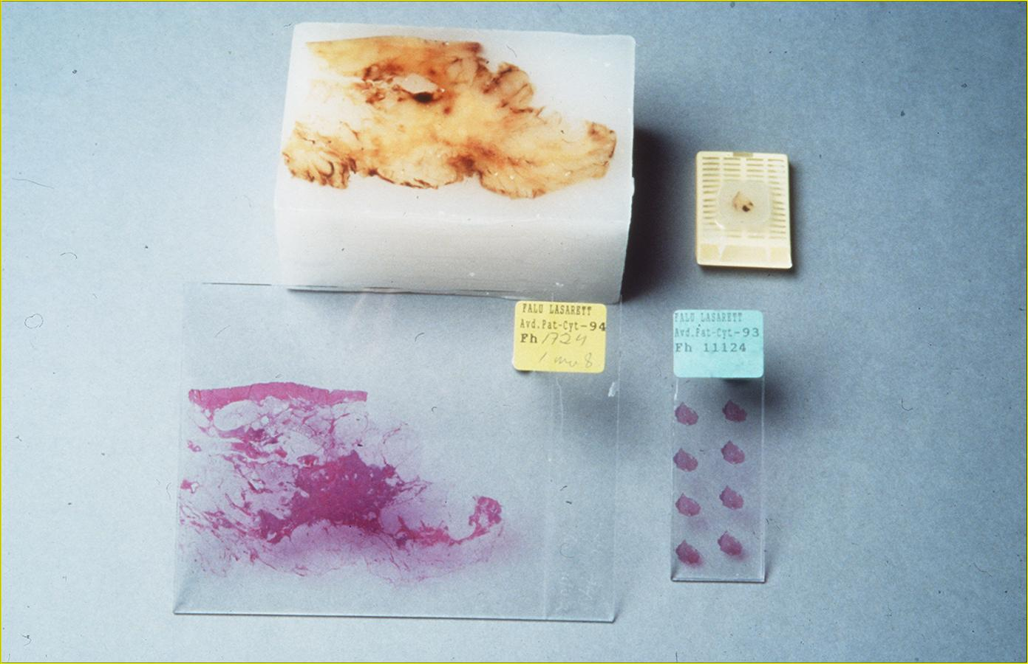
Large section histology
9 cm
12 cm

Slide 9
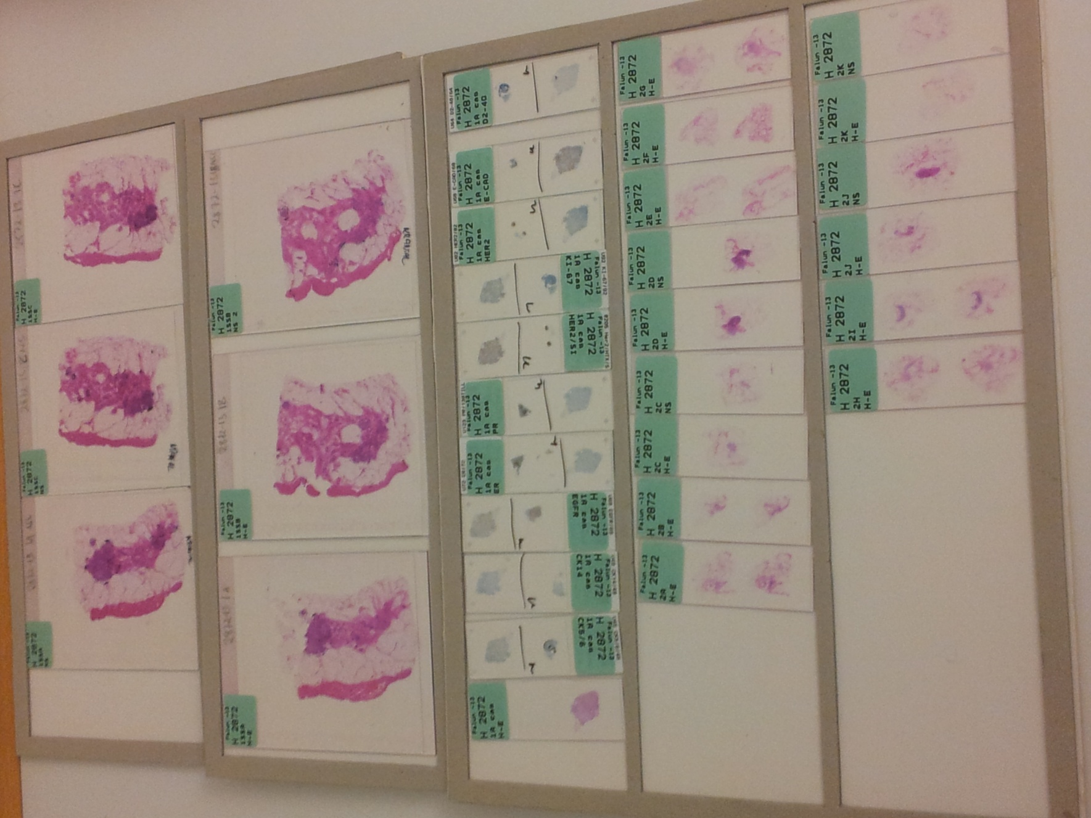
Extent
Distribution
Size
Heterogeneity
Margins
R-P correlation
Molecular phenotype
(ER, PR, HER2, Ki67, CK5/6, CK14, EGFR)
+ E-cadherin
+D2-40
LN status
Margins
Additional lesions

Slide 10
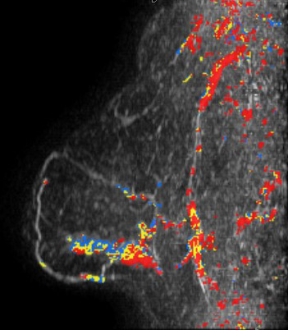
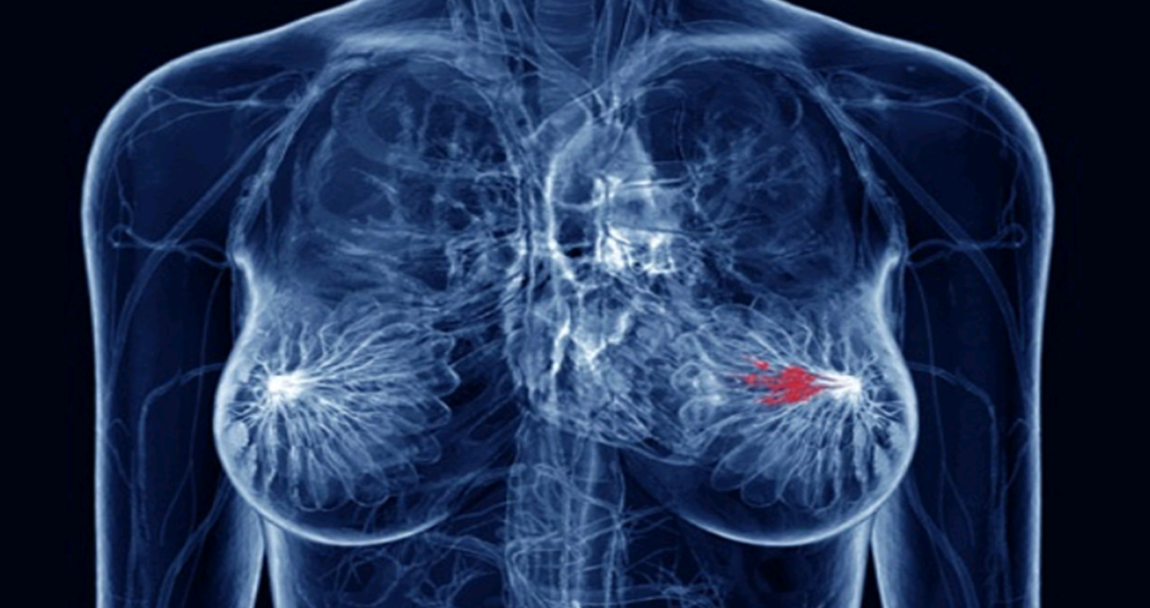

Slide 11
Breast carcinoma is a lobar disease in the
meaning that the simultaneously or
asynchronously appearing, often multiple,
in situ and/or invasive tumor foci originate
in a single lobe of one breast.
(The theory of the sick lobe)
Tot T: Correlating the ground truth of mammographic histology with the success or failure of imaging. Technology In Cancer Research and Treatment, 4(1):23-8; 2005,
Tot T: DCIS, cytokeratins and the theory of the sick lobe. Virchows Arch 447:1-8; 2005,
Tot T: The theory of the sick lobe and the possible consequences. Int J Surg Pathol 15(4:) 369-75, 2007
Notes:
11

Slide 12
Unifocal luminal B
invasive breast carcinoma
without diffuse lobar DCIS
Unifocal luminal B
invasive breast carcinoma
with diffuse lobar DCIS

Slide 13
Size
E X T E N T

Slide 14
When describing malignant lesions in the breast, the following
morphologic parameters should be listed (independent of the
used imaging method):
the distribution of the lesions (as unifocal, multifocal or
diffuse) separately for invasive and in situ lesions,
the extent of the disease (representing the whole area
including all the invasive, in situ and intravascular
malignant structures),
the size of the tumor corresponding to the largest
diameter of the lagest individual invasive tumor focus,
evidence for intratumoral or intertumoral heterogeneity.

Slide 15
Invasive breast carcinoma NST Invasive breast carcinoma NST

Slide 16
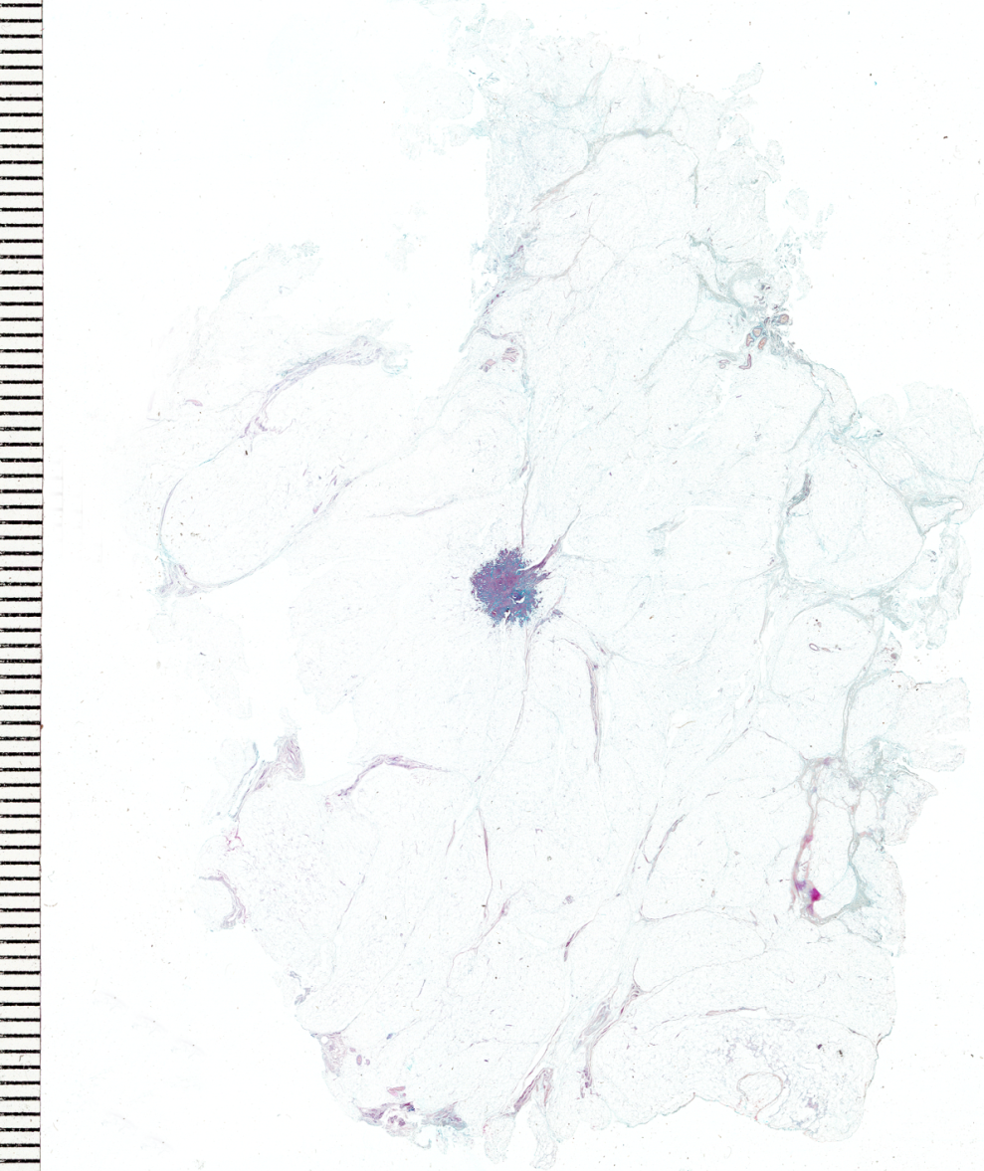
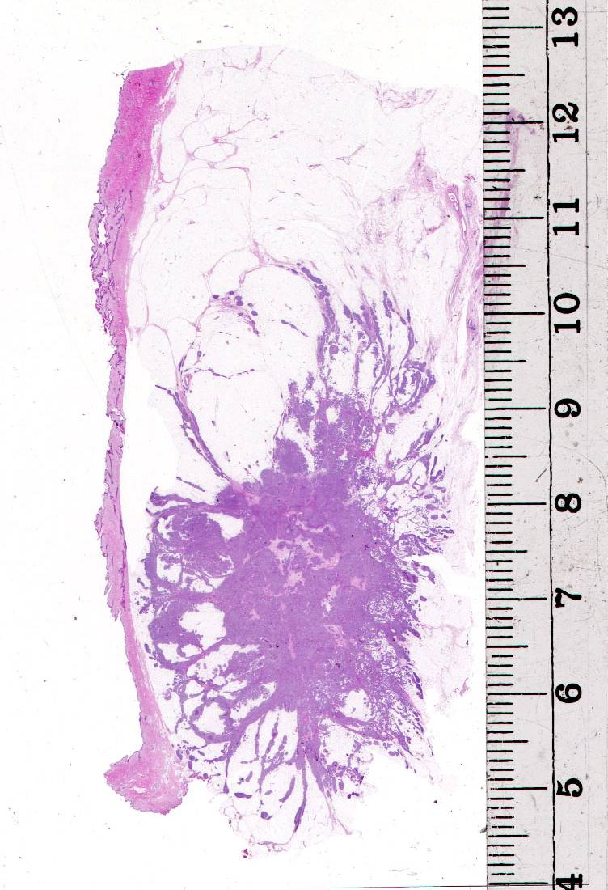
Early invasive breast carcinoma
Advanced invasive breast carcinoma

Slide 17
Cumulative survival in early (in situ and <15 mm invasive) breast carcinomas, Falun, 1996-1998
94.3%
Up to 12 years follow-up, 8.34 at average, SD+/- 3.47 years
Kahán Z, Tot T. Breast Cancer, a Heterogeneous Disease Entity.
The Very Early Stage, Springer 2011.

Slide 18
Life expectancy of screen-detected invasive breast cancer
Age matched invited women with and without screen detected cancer (858)
6 year shorter survival in those with s.d.c.
No difference in survival for those <15 mm comprising 40% of s.d.c.
>=15 mm: 6 – 12 year shorter survival, depending on tumor size
Otten JDM, Broeders MJM, Den Heeten GJ et al. Life expectancy of
screen-detected invasive breast cancer patients compared with women
invited to the Nijmegen Screening Program. Cancer 2010:116-586-91.

Slide 19
Carcinomas by detection mode and tumor size, Falun 1996-2003
 | Screening | Outside screening | Interval | Follow-up | Refusers | Sum
In situ | 18% (130) | 8% (52) | 8% (24) | 14% (6) | 0% (0) | 12% (212)
1 – 9 mm | 26% (193) | 8% (51) | 14% (42) | 35% (15) | 14% (2) | 18% (303)
10 – 14 mm | 23% (167) | 11% (69) | 18% (52) | 33% (14) | 14% (2) | 18% (304)
15 – 19 mm | 16% (123) | 17% (106) | 18% (55) | 2% (1) | 14% (2) | 17% (287)
20-29 mm | 11% (81) | 26% (163) | 26% (73) | 8% (4) | 42% (6) | 19% (327)
30 + mm | 6% (44) | 23% (140) | 16% (47) | 6% (3) | 14% (2) | 14% (236)
Sum | 740 2unknown | 620 41unknown | 297 2unknown | 43 | 14 | 1725 11unknown
67%
50%
Screening + interval = 78%
45 unknown size, 11 unknown detection mode

Slide 20
Molecular characteristics of early vs more advanced invasive breast carcinomas
 | Early BC < 15 mm | Advanced BC >= 15 mm | Total | P-value
Basal-like | 5.9% (12/203) | 15.1% (48/317) | 11.5% (60/520) | = 0.0035
ER negative* | 12.3% (42/342) | 18.2% (93/510) | 15.8% (135/852) | = 0.0238
Tripple negative | 6.4% (22/341) | 10.5% (53/507) | 8.8% (75/848) | = 0.0193
Her-2 positive | 8.9% (31/347) | 13.3% (68/511) | 11.5% (99/858) | = 0.0917
Grade 3 | 12.9% (46/355) | 29,5% (151/511) | 22.0% (197/866) | < 0.0005
Total | 41.5% (362/873) | 58,5% (511/873) | 100% (873/873)
Kahán Zs., Tot T., eds. Breast Cancer, a Heterogeneous Disease Entity: The Very Early Stage. Springer 2011

Slide 21
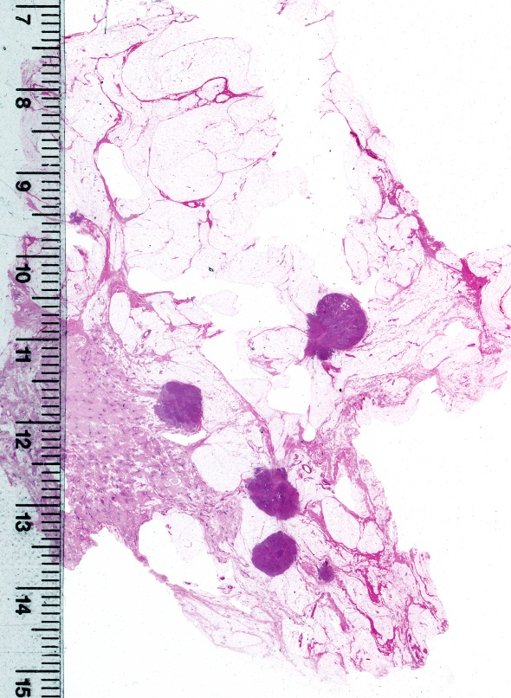
I n v a s i v e c o m p o n e n t
52%
33%
5%
10%
Unifocal Multifocal Diffuse

Slide 22
Cumulative survival in 499 invasive breast carcinoma cases by distribution of the invasive component, Falun, 1996-1998
89.6%
76.0%
63.6%
P < 0.0001
Distribution unknown in 40 cases
Tot et al. Breast cancer multifocality, disease extent, and survival. Hum Path 2011

Slide 23
Alice P Chung, Kelly Huynh, Travis Kidner, Parisa Mirzadehgan, Myung-Shin Sim,
Armando E Giuliano. Comparison of Outcomes of Breast Conserving Therapy
in Multifocal and Unifocal Invasive Breast Cancer
( J Am Coll Surg 2012;215: 137–147. © 2012 by the American College of Surgeons)
164 MF tumors (”2 or more distinct tumors in a single incision or segmentectomy”)
Only breast conserving surgery. Median follow-up 112 months.
Results: patients in the MF group had
higher 10-year LR (0.6% vs 6.1%, p<0.001)
and lower 10-year DFS (97.7% vs 89.3%, p<0.001)
and OS (98.4% vs 85.8%, p<0.001).
On multivariable analysis, multifocality was independently significantly associated
with local recurrence-free survival (LRFS), DFS, and OS.

Slide 24
Mutifocality appears to be associated
with a worse prognosis, however,
substantial inter-study heterogeneity
limits the precise determination of increased risk.
Francisco E et al. Effect of multifocality and multicentricity on outcome in early stage
breast cancer: a systematic review and meta-analysis. Breast Cancer Res treat 2014

Slide 25
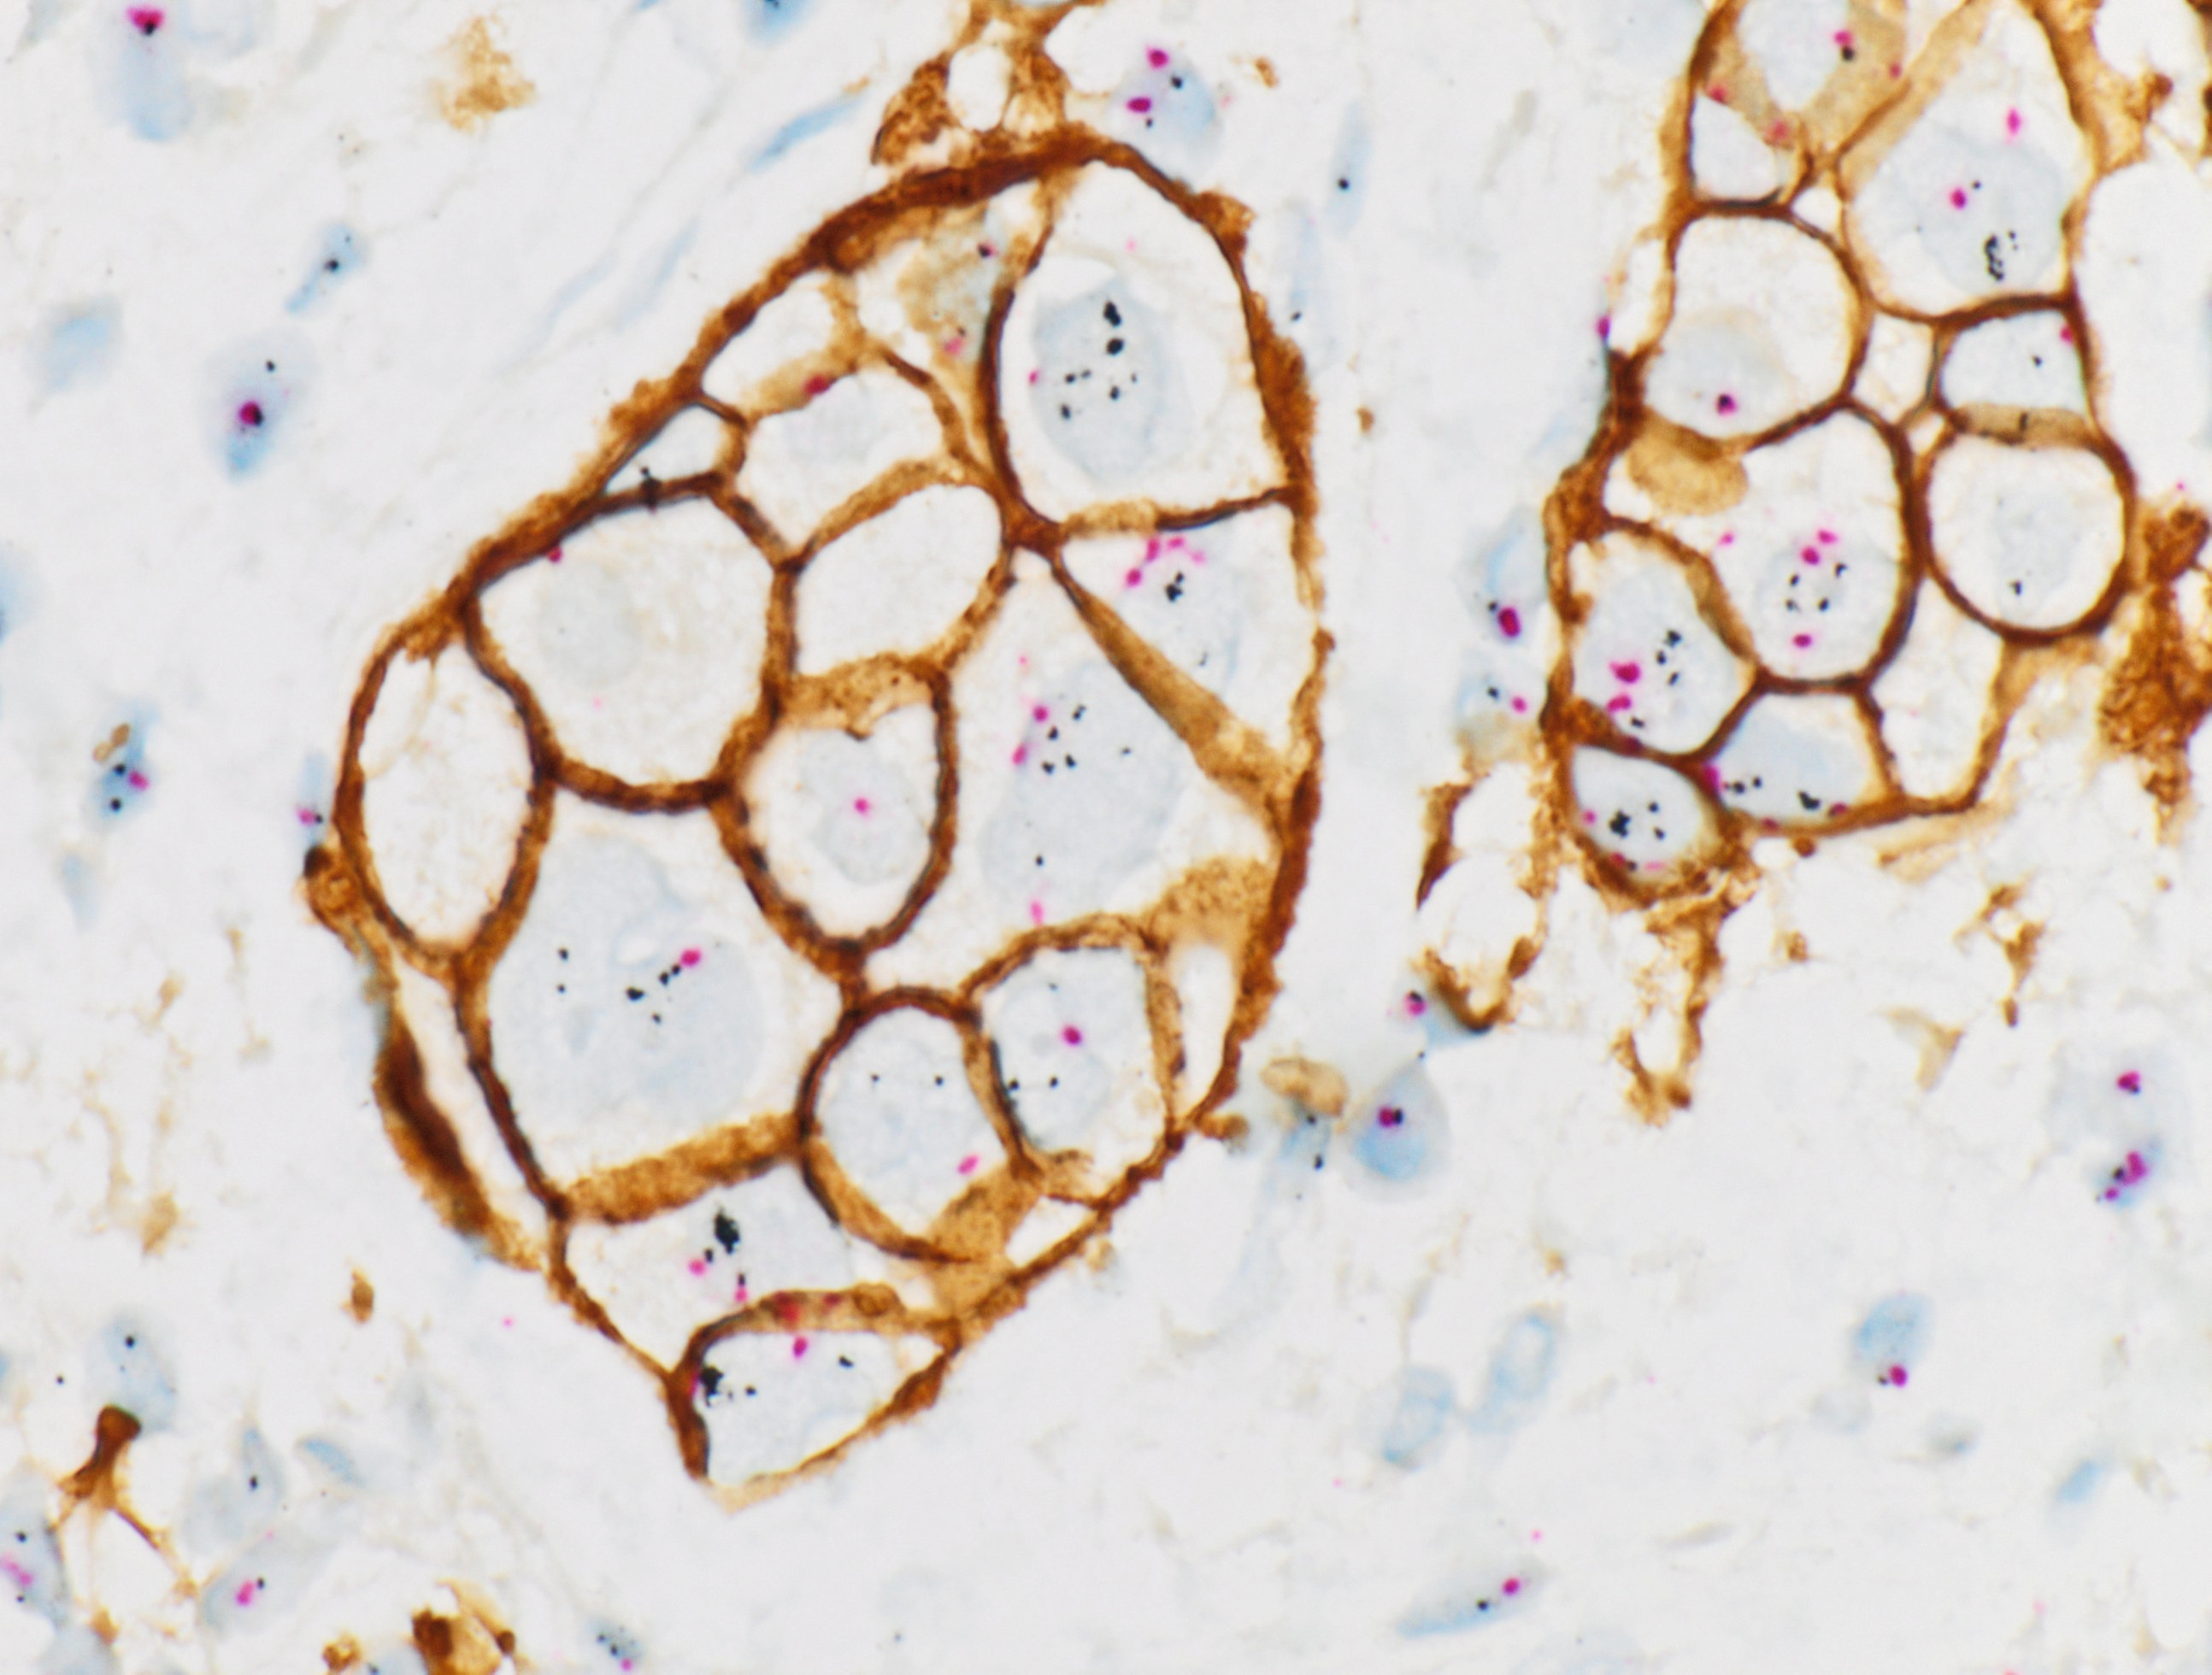
Invasive tumor focality by St Gallen 2013 molecular phenotypes, Dalarna County, 2008-13
Tot T. Breast Cancer Subgross MorphologicalParameters and Their Relation to Molecular Phenotypes and Prognosis. TJOP 2014;00:1–8
DOI: 10.13032/tjop.2052-5931.100106.
 | LA | LB | HER2 | TN | Total
U | 64.5% (267) | 56.6% (294) | 43.8% (14) | 63.4% (59) | 59.9% (634)
MF | 30.4% (126) | 36.3% (189) | 56.2% (18) | 35.5% (33) | 34.6% (366)
D | 5.1% (21) | 7.1% (37) | 0 | 1.1% (1) | 5.5% (59)
Total | 100% (414) | 100% (520) | 100% (32) | 100% (93) | 100% (1059)
 | LB HER2 - | LB HER2+ | HER2
U | 56.6% (249/440) | 56.2% (45/80) | 43.8% (14/32)
MF | 35.9% (158/440) | 38.9% (31/80) | 56.2% (18/32)
D | 7.5% (33/440) | 5.0% (4/80) | 0
Total | 100% (440/440) | 100% (80/80) | 100% (32/32)
HER2 Gene-protein assay, tricolor B-DISH method

Slide 26
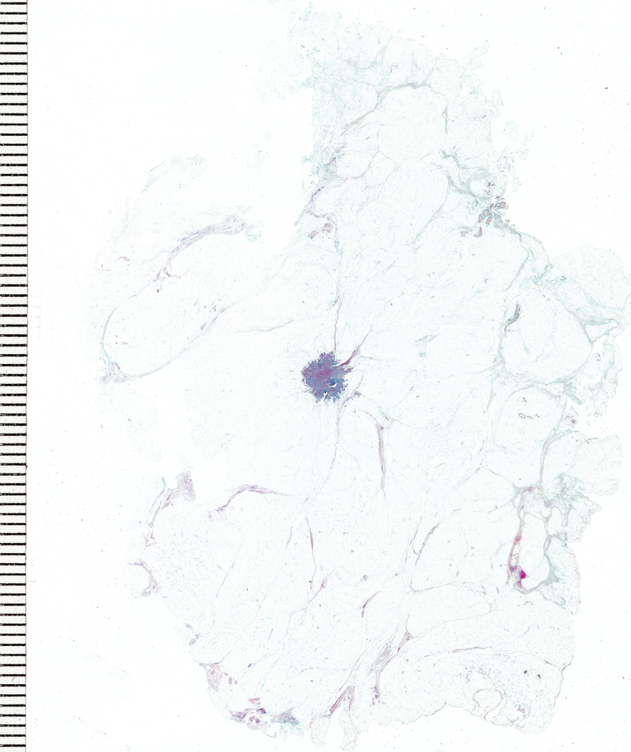
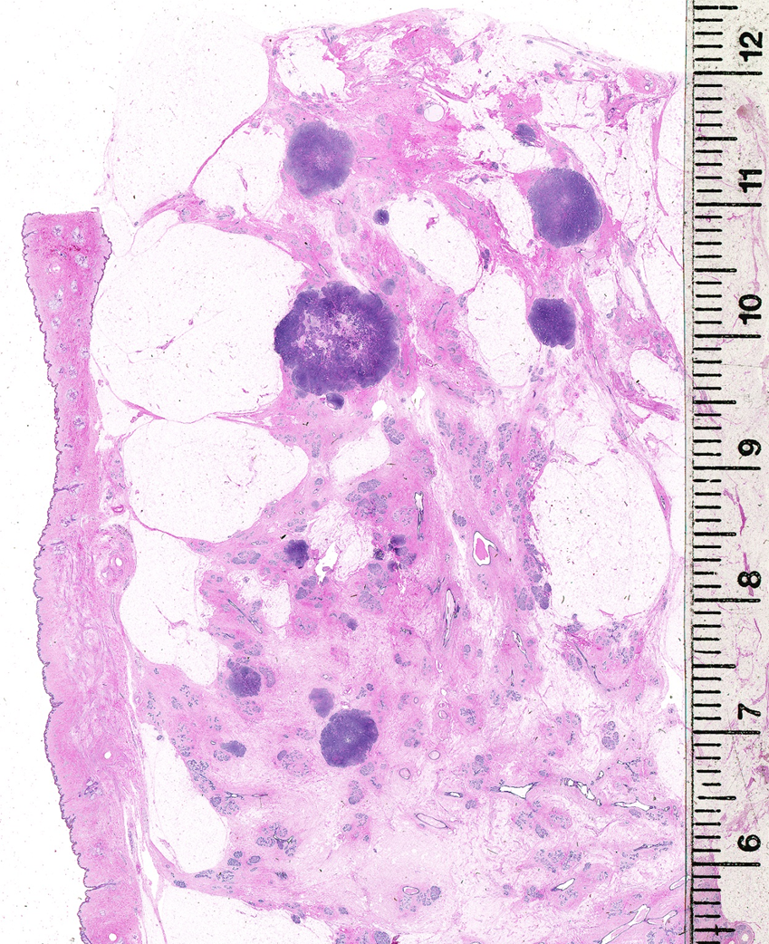
Unifocal invasive breast carcinoma
Multifocal invasive breast carcinoma

Slide 27
Cumulative survival in 499 invasive breast carcinoma cases by distribution of the invasive component, Falun, 1996-1998
89.6%
76.0%
63.6%
P < 0.0001
Distribution unknown in 40 cases
Tot et al. Breast cancer multifocality, disease extent, and survival. Hum Path 2011

Slide 28
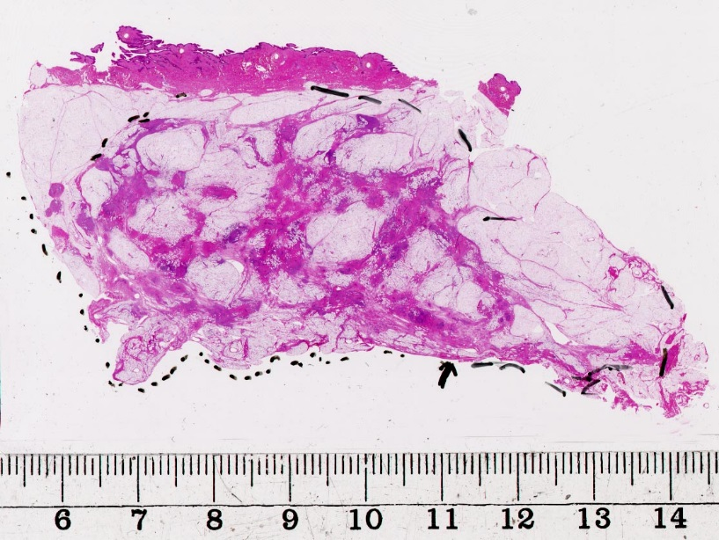
Diffuse invasive cancer
5% of all BCs (5.6%, 59/1059 cases),
75% gives clinical signs,
55% are architectural distortion on the mammogram (55.9% 33/59 cases)

Slide 29
Diffuse invasive carcinomas
75% are lobular,
98% are ER positive,
Rarely HER2 positive (6.7%, 4/59)
90% are grade 2, 10% grade 3
25% of the patients with diffuse lobular cancer and 50% of those with diffus ductal cancer died of the disease (series 1996-98).

Slide 30
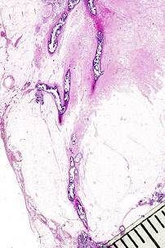
I n v a s i v e c o m p o n e n t
52%
33%
5%
10%
Unifocal Multifocal Diffuse
33%
33%
24%
10%
I n s i t u c o m p o n e n t

Slide 31
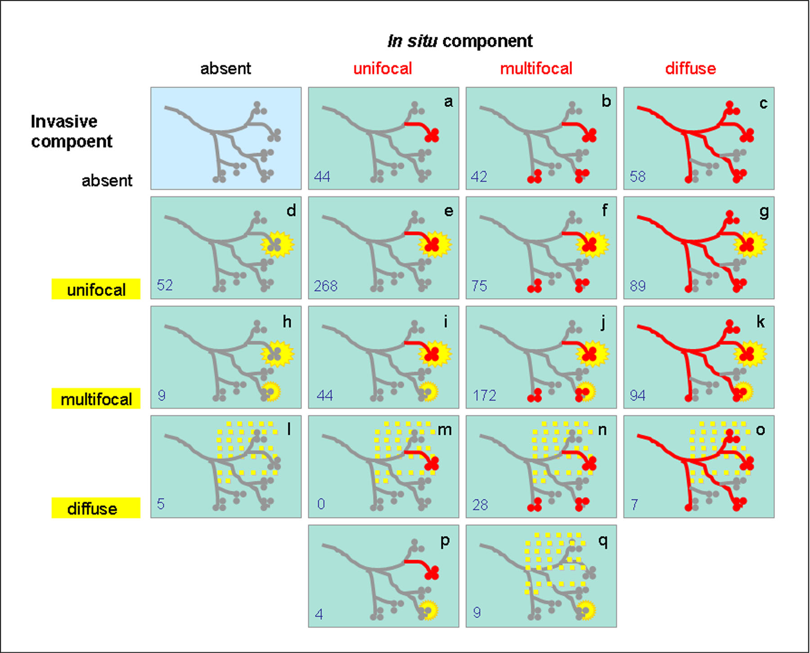
Tot T, Int J Breast Cancer, 2012

Slide 33
Diffuse in situ cancer
24% of all cancers
Large (extensive), > 40 mm
High grade
Occypying the large ducts
A single lactiferous duct
Lobar
Contiguous

Slide 34
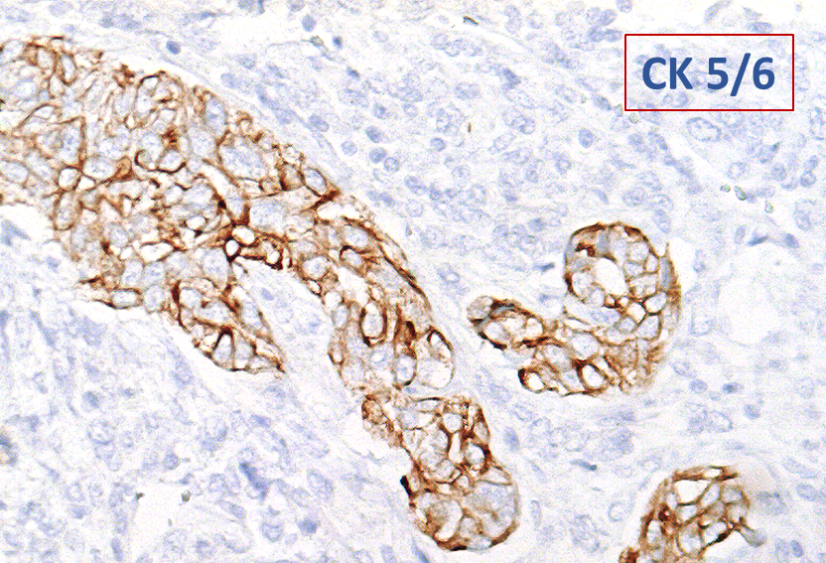
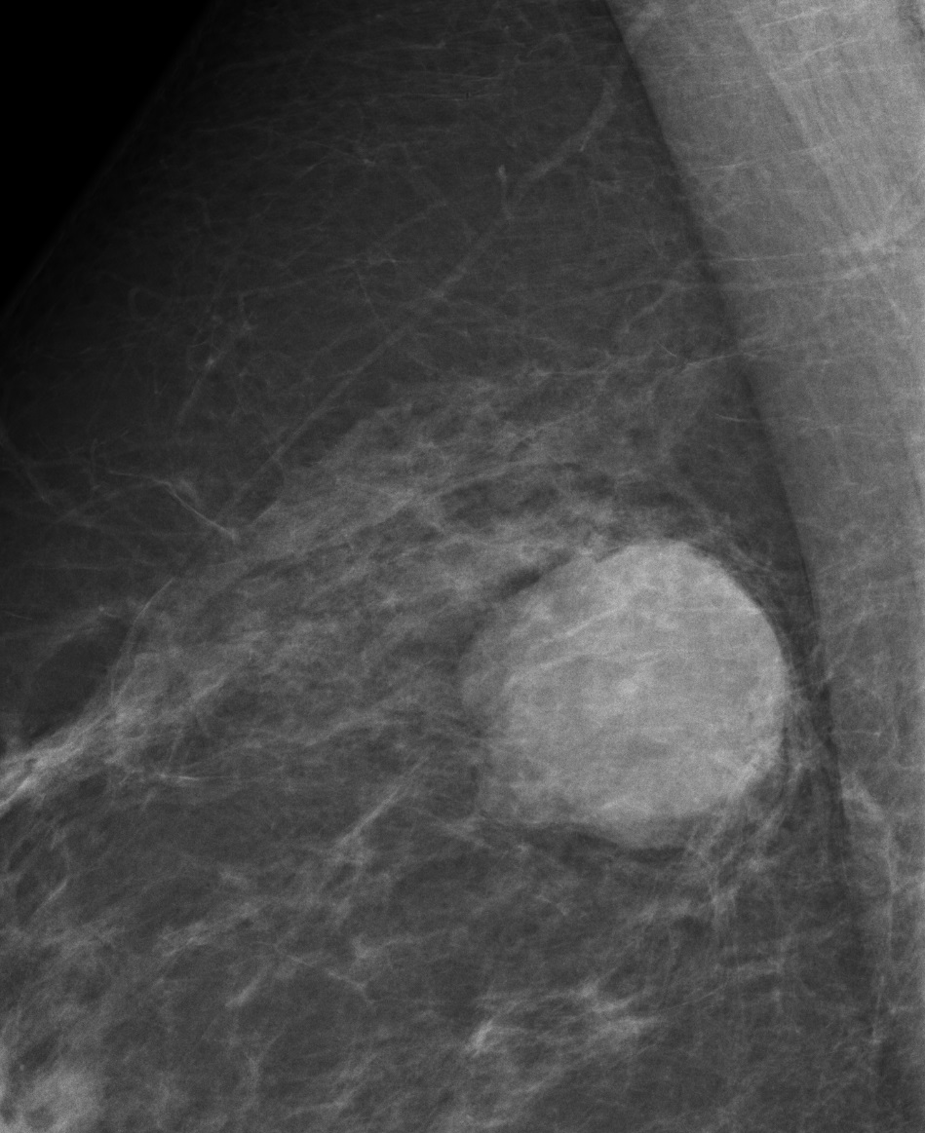
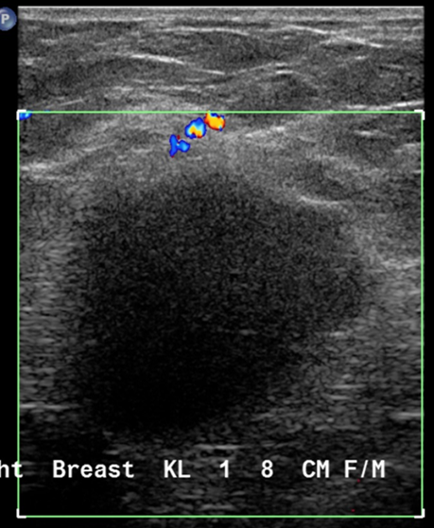
Mammographic – ultrasound – MRI – large-section correlation: basal – like cancer of the breast

Slide 35
Mammographic appearance | Basal phenotype | Histological lesion distribution | Tumor size | 10-year risk of BC death
Architectural distortion 4.8% (62/1280) | +/- | Diffuse invasive |  | 42.3%
Casting calcifications 6.1% (78/1280) | +/- | Diffuse aggregate |  | 27.7%
Circular mass 30.9% (396/1280) | Basal like (22%) | Multifocal (36.0%) |  | 15.6%
 |  | Unifocal (64.0%) | 15 mm+ (83%) | 22.7%
 |  |  | <15 mm (17%) | 1.9%
 | Non-basal like (78%) | Multifocal (31.1%) |  | 19.1%
 |  | Unifocal (68.9%) | 15 mm+ (56.5%) | 5.2%
 |  |  | <15 mm (43.6%) | 1.9%
Stellate mass 45.6% (583/1280) | +/- | Multifocal (34.5%) |  | 14.3%
 | +/- | Unifocal (65.5%) |  | 9.6%
Powdery calcifications 2.1% (27/1280) |  |  |  | 5.9%
Crushed stone like calcifications 10.5% (134/1280) |  |  |  | 3.9%
Abstract P4-03-07: RA Smith, WY-Y Wu, L Tabar, SL-S Chen, AM-F Yen, SW Duffy, T Tot, SY-H Chiu, JC-Y Fann, TH-H Chen. The contribution of mammographic appearance, basal-like phenotype, and disease extent to prediction of breast cancer death . Cancer Research 12/2013; 73(24 Supplement):P4-03-07-P4-03-07. DOI:10.1158/0008-5472

Slide 36
Breast cancer pathology - a manifesto for optimal care
The 10 essential / obligatory parameters
Tumour type (according to the actual WHO classification)
Tumour size / disease extent
Tumour grade (Nottingham histology grade by Elston and Ellis)
Lymph node status
Operative margins
Peritumoral vascular invasion
Multifocality/centricity
Hormone receptor status (ER/PR)
HER2 status
Ki67 labelling index
In addition, these services are likely to be needed in future:
Gene profiling
Biobanking
T. Tot; G. Viale; E. Rutgers; E. Bergsten-Nordström; A. Costa
Optimal breast cancer pathology manifesto. EJC, in press

Slide 37
Conclusion:
Molecular classification of breast cancer is a powerful tool but gains in power when combined with conventional subgross morphological parameters.

