Slide 1
About OMICS Group
OMICS Group International is an amalgamation of Open Access publications and worldwide international science conferences and events. Established in the year 2007 with the sole aim of making the information on Sciences and technology ‘Open Access’, OMICS Group publishes 400 online open access scholarly journals in all aspects of Science, Engineering, Management and Technology journals. OMICS Group has been instrumental in taking the knowledge on Science & technology to the doorsteps of ordinary men and women. Research Scholars, Students, Libraries, Educational Institutions, Research centers and the industry are main stakeholders that benefitted greatly from this knowledge dissemination. OMICS Group also organizes 300 International conferences annually across the globe, where knowledge transfer takes place through debates, round table discussions, poster presentations, workshops, symposia and exhibitions.

Slide 2
About OMICS Group Conferences
OMICS Group International is a pioneer and leading science event organizer, which publishes around 400 open access journals and conducts over 300 Medical, Clinical, Engineering, Life Sciences, Phrama scientific conferences all over the globe annually with the support of more than 1000 scientific associations and 30,000 editorial board members and 3.5 million followers to its credit.
OMICS Group has organized 500 conferences, workshops and national symposiums across the major cities including San Francisco, Las Vegas, San Antonio, Omaha, Orlando, Raleigh, Santa Clara, Chicago, Philadelphia, Baltimore, United Kingdom, Valencia, Dubai, Beijing, Hyderabad, Bengaluru and Mumbai.

Slide 3
Design and Applications of Redox Active Materials for Advanced Redox Flow Batteries
Tianbiao Leo Liu (Tianbiao.Liu@pnl.gov)
Wei, Xiaoliang; Xu, Wu; Cosimbescu, Lelia; Vijayakumar, Murugesan; Nie, Zimin; Liu, Jun; Wang, Wei; Sprenkle, Vincent
Pacific Northwest National Laboratory
902 Battelle Boulevard
P. O. Box 999
Richland, WA 99352, USA

Slide 4
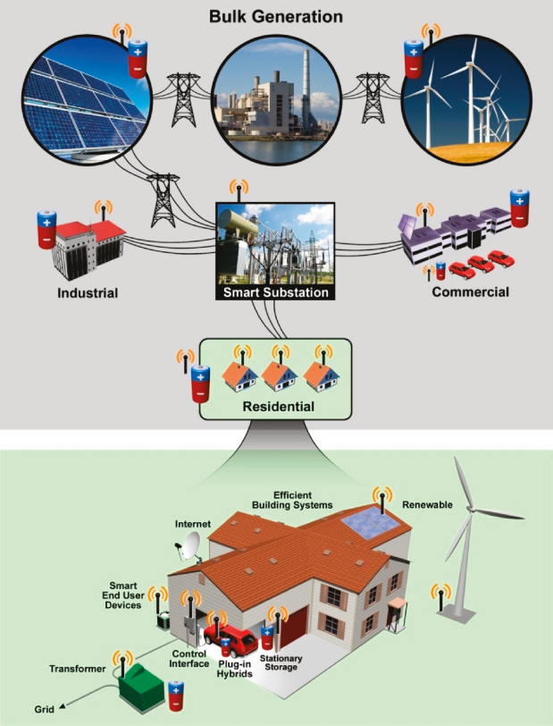
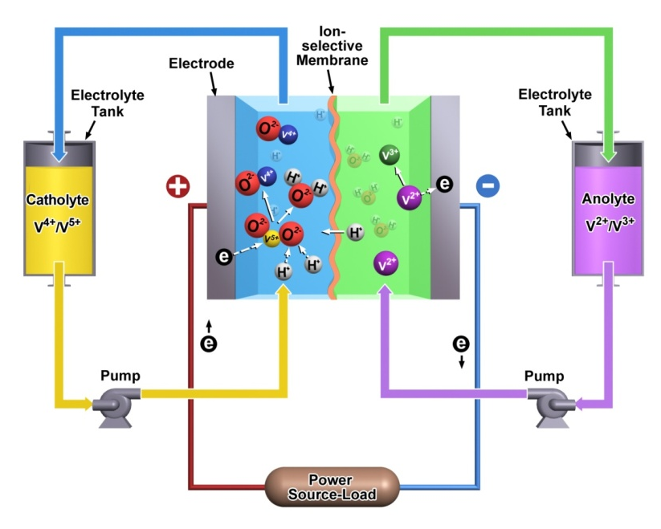
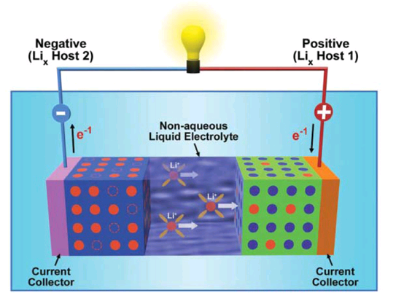
Redox flow batteries (RFB)
Flow Cell
Static Cell (e.g Li ion)
Advantages:
Separation of energy and power
Active heat management
Safety
Large scale energy storage
(MWs/MWhs)
Potential low cost
Manufacture easiness (modular)
Zhenguo Yang, et. al. Chemical Reviews, 111, 2011, 3577
Wei Wang, et. al. AFM, 2012,

Slide 5
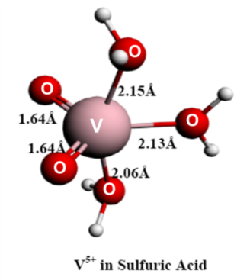
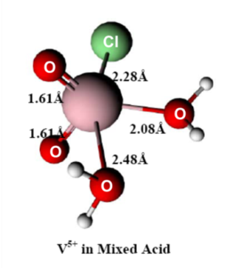
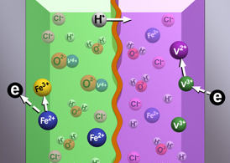
State-of-art aqueous RFB
Mixed-acid VRB
Fe/V RFB
Double Energy Density
Extend temperature window
Higher utilization, stable cycling
Low-cost membrane
2.5M, ~30Wh/L, -5~60ºC
1.5M, ~15Wh/L, -5~60ºC
Licensed to Unienergy Co. and other three
2013 FLC Award
W. Wang, et al, EES, 4, 4068, 2011
L. Li, et al. AEM, 1, 394, 2011
Notes:
1 度＝1000 Wh = 1000 * 3600 =3.6 E-7 J = 3600 kj
For 50 W light bulb to 24 hours, it requires 1200 Wh = 1.2 度。
Each liter VRB can support 0.6 h for a 50 W light bulb.
30 KWh/US/day. 1500 KWh (1.5 MWh) for 50 household. 150 kL= 150 m³ (ca. 1 MWh = 100 m³ and costs 0.5 M USD).
http://www.eia.gov/tools/faqs/faq.cfm?id=97&t=3
In 2012, the average annual electricity consumption for a U.S. residential utility customer was 10,837 kWh, an average of 903 kilowatthours (kWh) per month. Louisiana had the highest annual consumption at 15,046 kWh and Maine the lowest at 6,367 kWh.

Slide 6
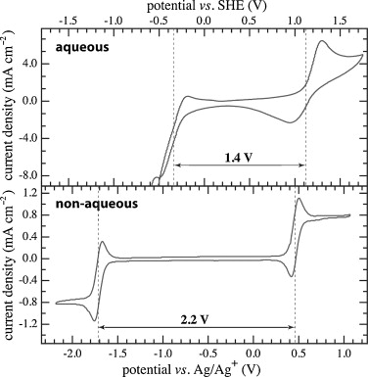
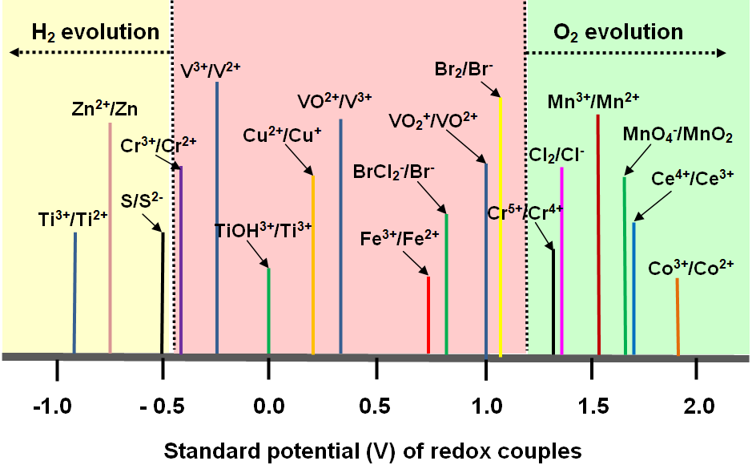
Limitation of Aqueous RFB
Shinkle, et al. JPS, 2012, 206, 490
Limitation of aqueous RFB
Low voltage (H₂/O₂ gas evolution)
Expensive, > $500 kWh
Low energy
Advantages of Nonaqueous RFB
High voltage
Potential high energy/power density
Free from gas evolution
Lower costs
Notes:
H2-Br2 flow: Braf, 2013 Nat. Commn.

Slide 7
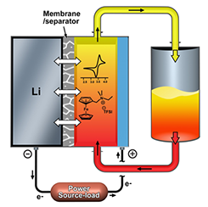
Background of Ferrocene (Fc)
Versatile ferrocene
  A foundation complex for the field of Organometallic Chemistry (also a Noble prize compound for Wilkinson and Fisher in 1973)
  Fc and its derivatives widely used in synthesis, catalysis, medicine, electrochemistry and material chemistry
  Cathode materials for rechargeable Li ion batteries
  Pristine Fc has poor solubility (ca. 0.2 M) in polar EC/PC/EMC and not good for NARFB (Li metal based semi-flow batteries).

Slide 8
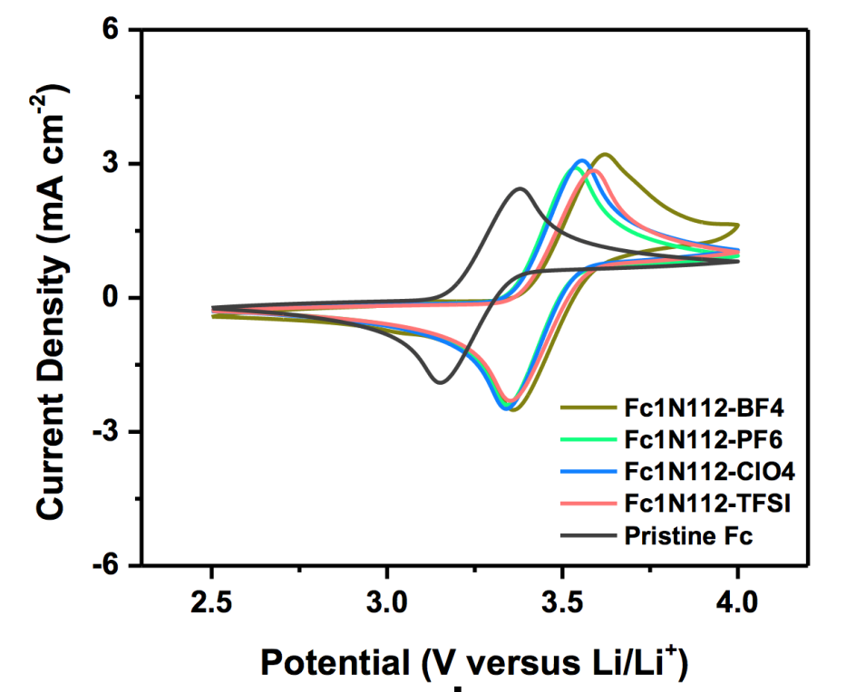
Functionalized Fc as Catholyte
1.73 M (79.5 Wh/L)
(EC/PC/EMC 4:5:1)
1.71 M
0.63 M
0.40 M (30 Wh/L)

Slide 9
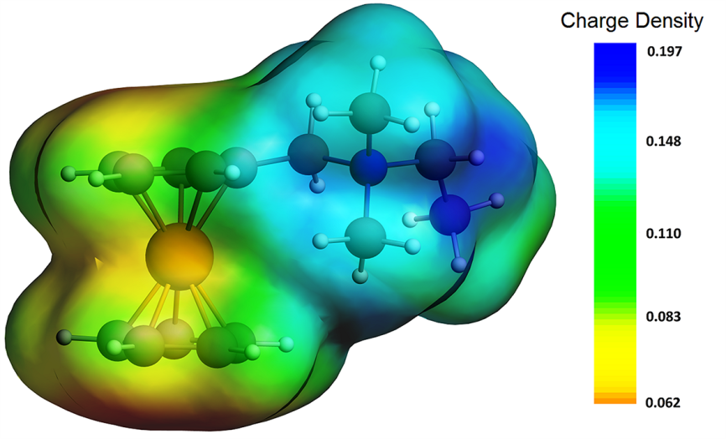




Understanding of Solvation Chemistry – DFT
DFT calculation suggests the tetraalkylammonium cation improves the interactions with solvent molecules
positive
negative

Slide 10
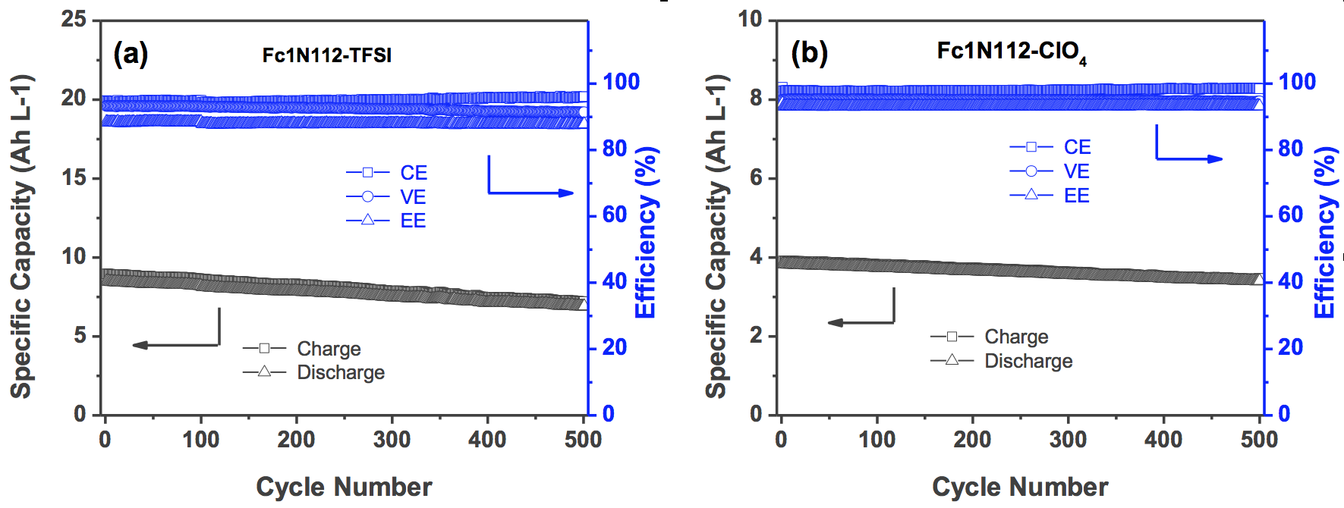
Static Cells of Functionalized Fc as Cathode
Model tests: Fc (cathode) / Li (anode) static cell configuration
High columbic efficiency (CE), voltaic efficiency (VE) and energy efficiency (EE), > 90%
Good capacity retention due to SEI mitigated self-discharge
Good candidates for RFB applications (FcTFSI-Li, 76 Wh/L)
Notes:
Perchlorate ClO₄⁻.

Slide 11
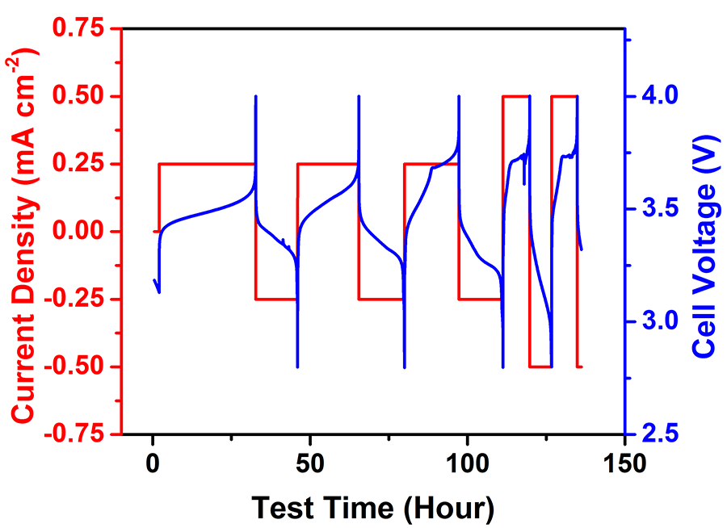
Flow Cell Cycling at High-Concentration Fc-TFSI
Not successful with a Li metal anode even at 0.2M Fc-TFSI with 15wt% FEC
The reason is the excessive Li dendrite with more redox species present.

Slide 12
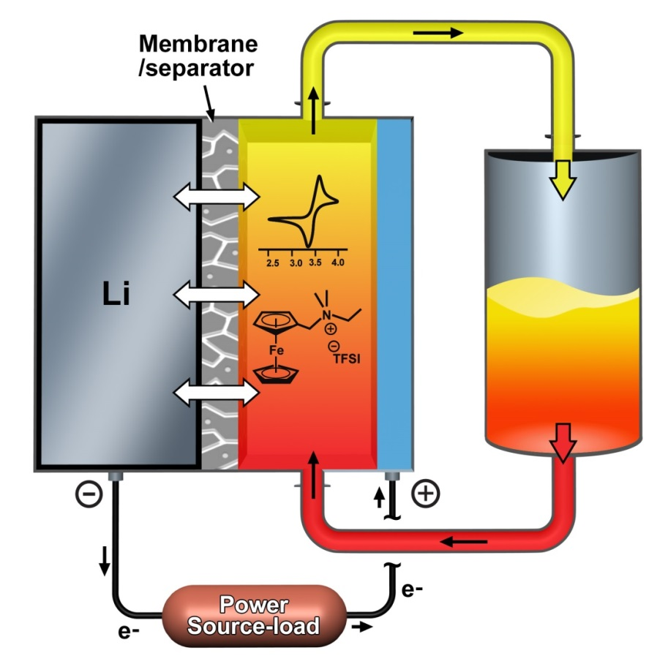
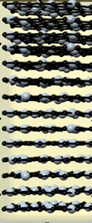
Hybrid Anode Assembly
graphite felt
Li metal
J. Liu et al Nat Commun. 2014,5,3015
Change Li deposition/stripping chemistry to Li⁺ ion intercalation → decreased involving of Li metal deposition
Anode side is a shortened cell → not sacrificing cell potential

Slide 13
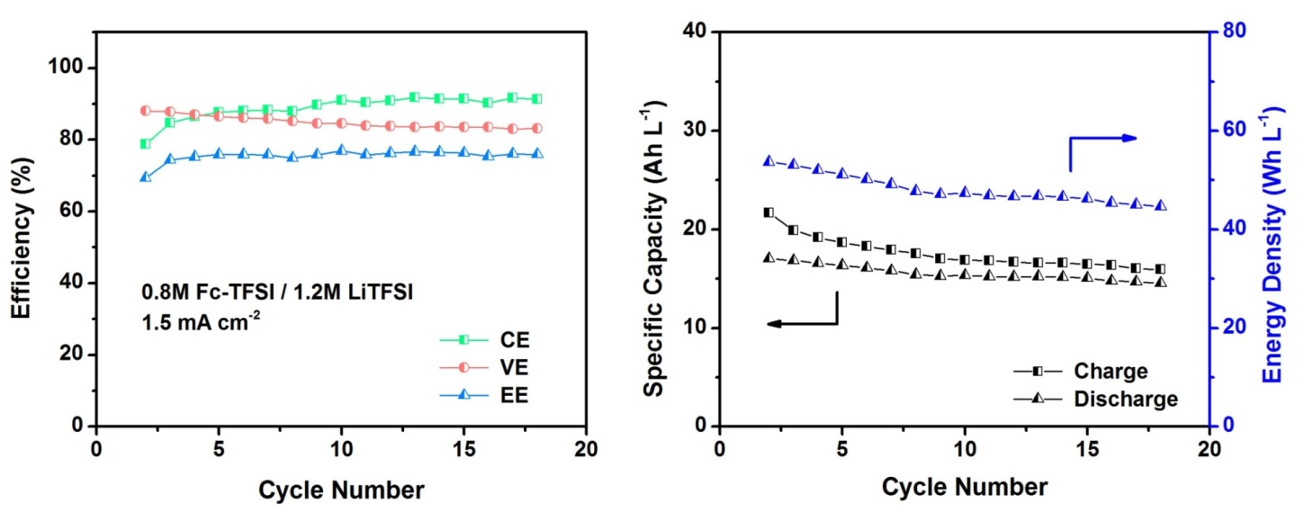
Hybrid Anode Enables High Concentration Cycling
0.8M Fc-TFSI / 1.2M LiTFSI / EC-PC-EMC / 15wt% FEC
2.8 – 4.0 V, 1.5 mA/cm²
CE: 85 – 91%, VE: 87 – 83%, EE: ~76%
Energy density delivery ~ 50 Wh L⁻¹
Moderate capacity retention

Slide 14
Conclusions
We have successfully demonstrated a hybrid Lithium-organic redox flow battery using ferrocene as the catholyte redox material.
Structural modification increases the ferrocene solubility by 20 times.
Li metal anode works at low Fc-TFSI concentration, while a hybrid anode enables decent cycling at high Fc-TFSI concentrations up to 0.8M.
Flow cell tests produce stable cyclability with EE >75% and energy density of 50 Wh L⁻¹.
Key challenge is long-term anode protection.

Slide 15

Acknowledgements
Financial Support from financial support from the U.S. DOE’s Office of Electricity Delivery & Energy Reliability (OE, Dr. Imre Gyuk).
Colleagues: Lelia Cosimbescu, Vincent Sprenkle, Wei Wang, Wu Xu, Jun Liu, M. Vijayakumar, Bin Li.
Professor C. Austen Angell (Arizona State University) for helpful discussions and comments.
15

Slide 16
Thanks for your attention!

Slide 17
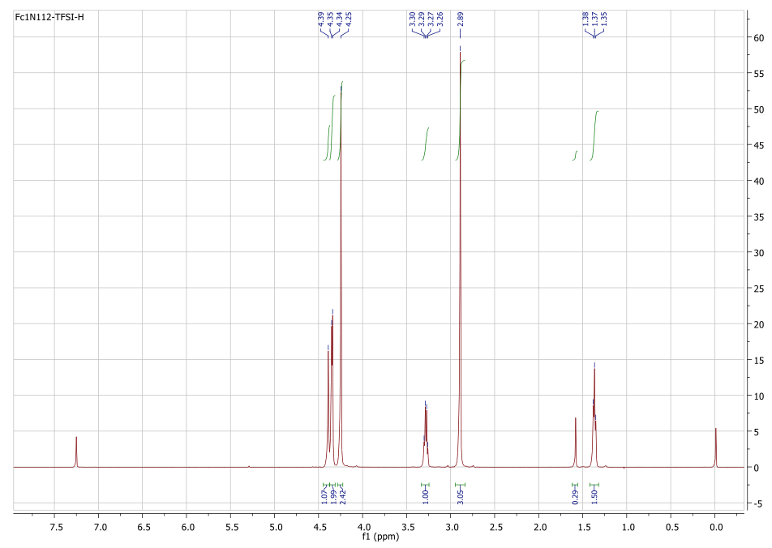
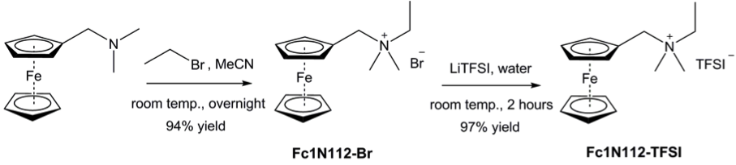
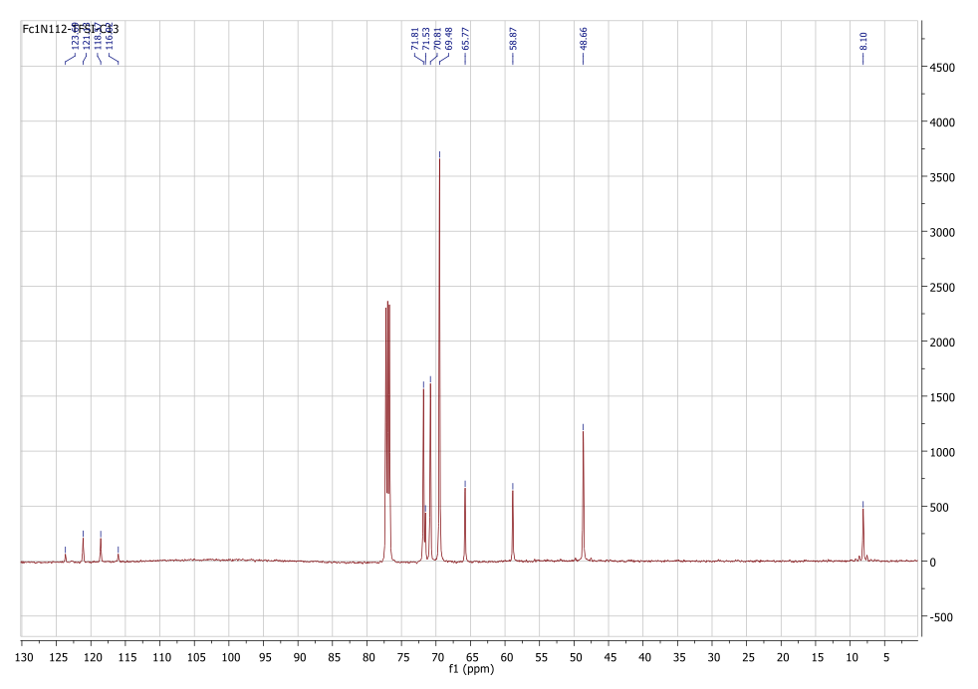
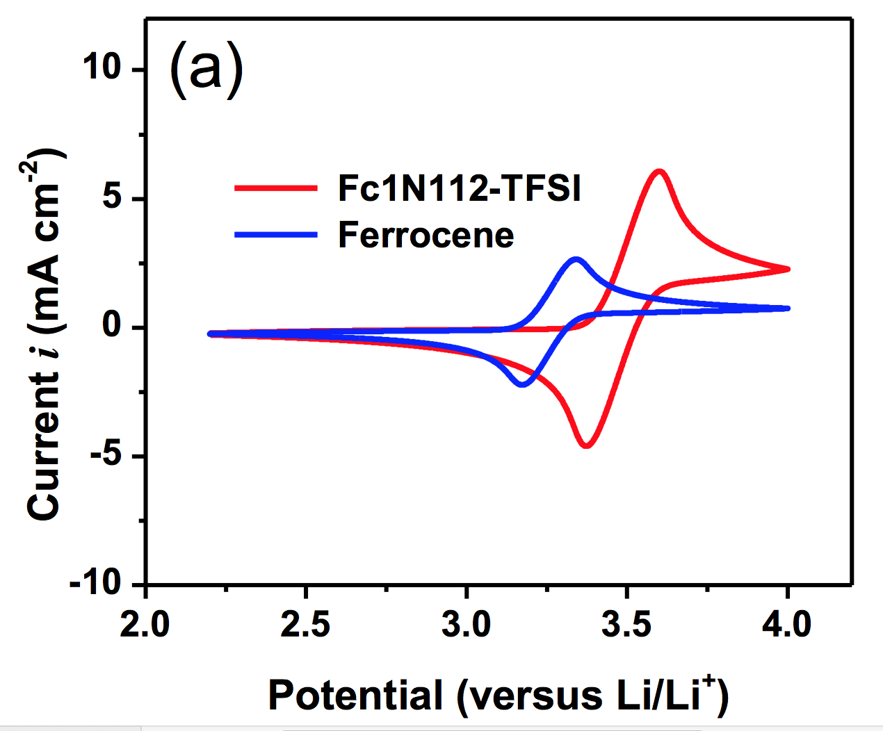
Functionalized Fc as Catholyte
¹H NMR
¹³C NMR
3.25 V
3.5 V
Notes:
Potential shift is due to the positive charged ammonium cation.

Slide 18
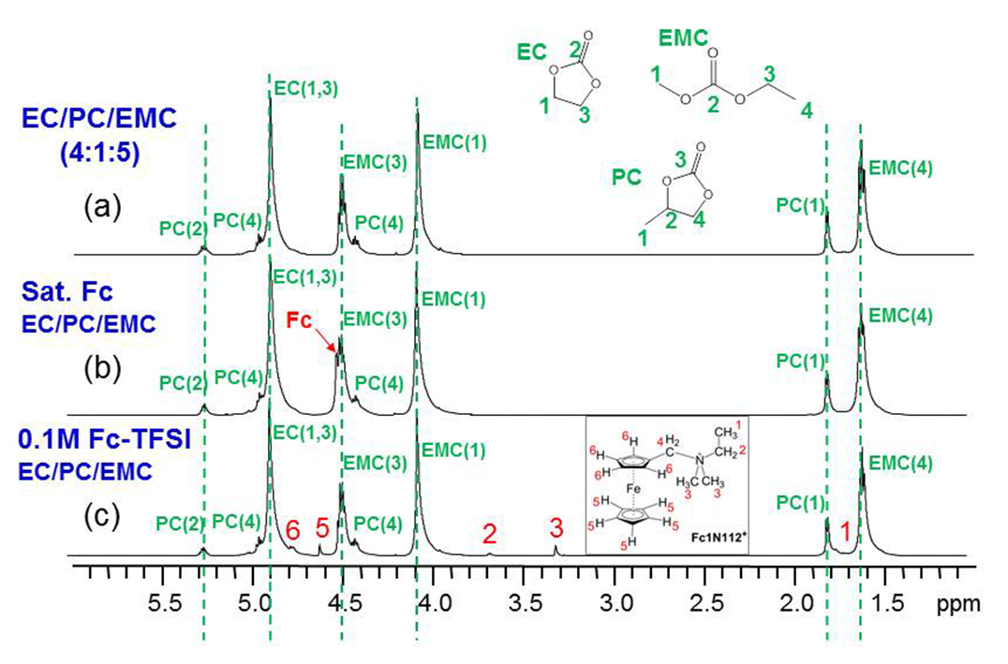
Understanding of Solvation Chemistry – NMR
Co-axial NMR to investigate the cation – solvent interactions
No chemical shift change at low concentrations of either pristine ferrocene or Fc-TFSI

Slide 19
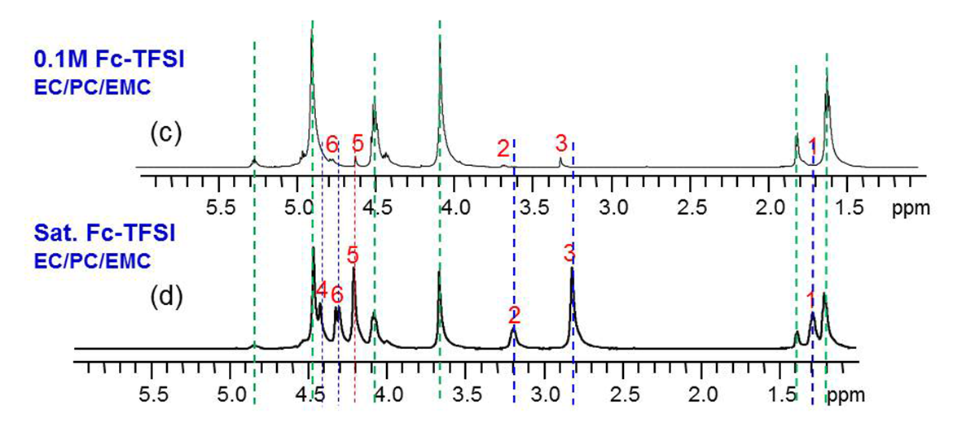
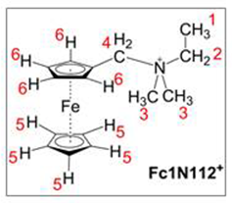
Understanding of Solvation Chemistry – NMR
NMR shift
Spacing between solvent peaks remain constant → no cation-solvent chemical binding
Parallel upfield shift for both solvents and Fc-TFSI → enhanced solvation interactions
Compared to solvent peaks, protons on unsubstituted ring remain unchanged while protons on substituted rings change significantly → solvation primarily on the cation
Presence of the quaternary ammonium increases the solubility

Slide 20
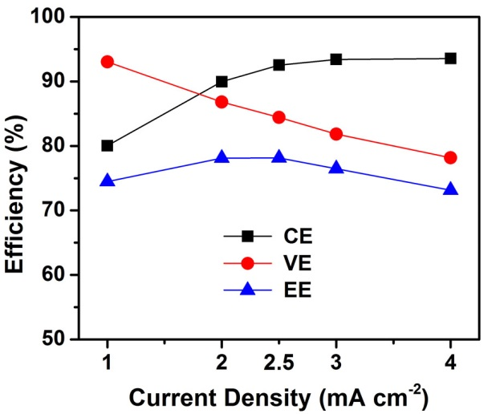
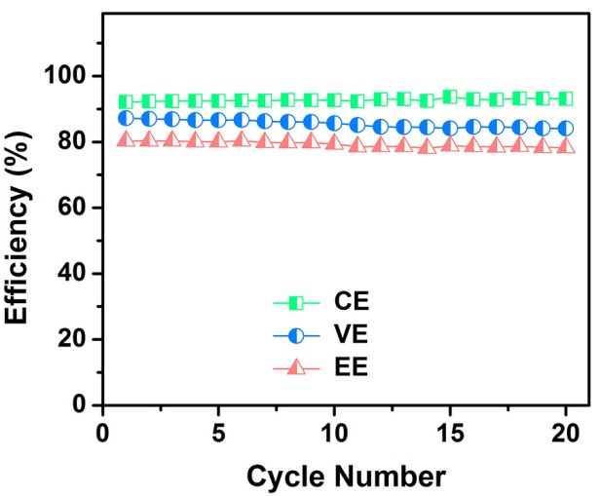
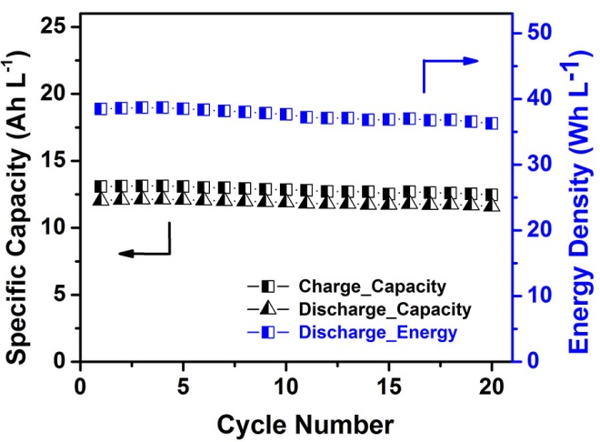
Hybrid Anode Enables High Concentration Cycling
0.5M Fc-TFSI / 1.0M LiTFSI / EC-PC-EMC / 15wt% FEC
2.8 – 4.0 V, 2.5 mA/cm²
CE: 92%, VE: 87%, EE: 80%
Energy density delivery ~ 38 Wh L⁻¹
Remarkable capacity retention over 20 cycles

Slide 21
Let Us Meet Again
We welcome you all to our future conferences of OMICS Group International
Please Visit:
http://materialsscience.conferenceseries.com/
Contact us at
materialsscience.conference@omicsgroup.us
materialsscience@omicsgroup.com

