Slide 1
Recent highlights of in vivo knockdown by intrabodies
5th European Immunology Conference
Dr. Thomas Böldicke
Helmholtz-Centre for Infection Research
Recombinant protein expression/Germany
Nb
scFv
Nb

Slide 2
Intrabodies targeted to subcellular compartments
scFv
Nb
Nb
Camelid VHH
Human VH
Human VL
Nb
Nb

Slide 3
Developments which are boosting the intrabody technology
ER intrabodies
Thousends of new V region antibody genes are already available as an attractive source of scFv fragments for ER intrabody construction
2. Sequences from hybridoma cell lines will also be available in larger numbers in the future
Cytosolic intrabodies
1. Single domain antibodies can be stable expressed as
intrabodies inside the cytoplasm

Slide 4
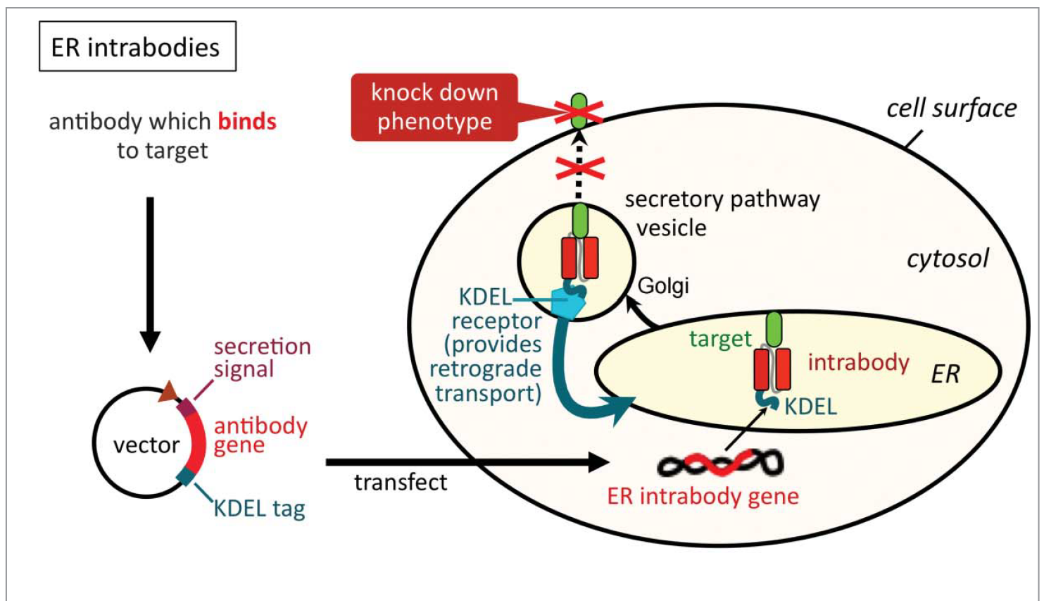
ER intrabodies inhibit translocation of targets passing the ER

Slide 5
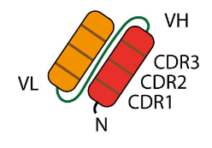
Generation of scFv from phage display ab repertoires or from hybridoma clone

Slide 6
Generation of ER intrabody for in vitro knockdown in mammalian cells
-
+
IB

Slide 7
Generation of a transgenic ER intrabody mouse

Slide 8
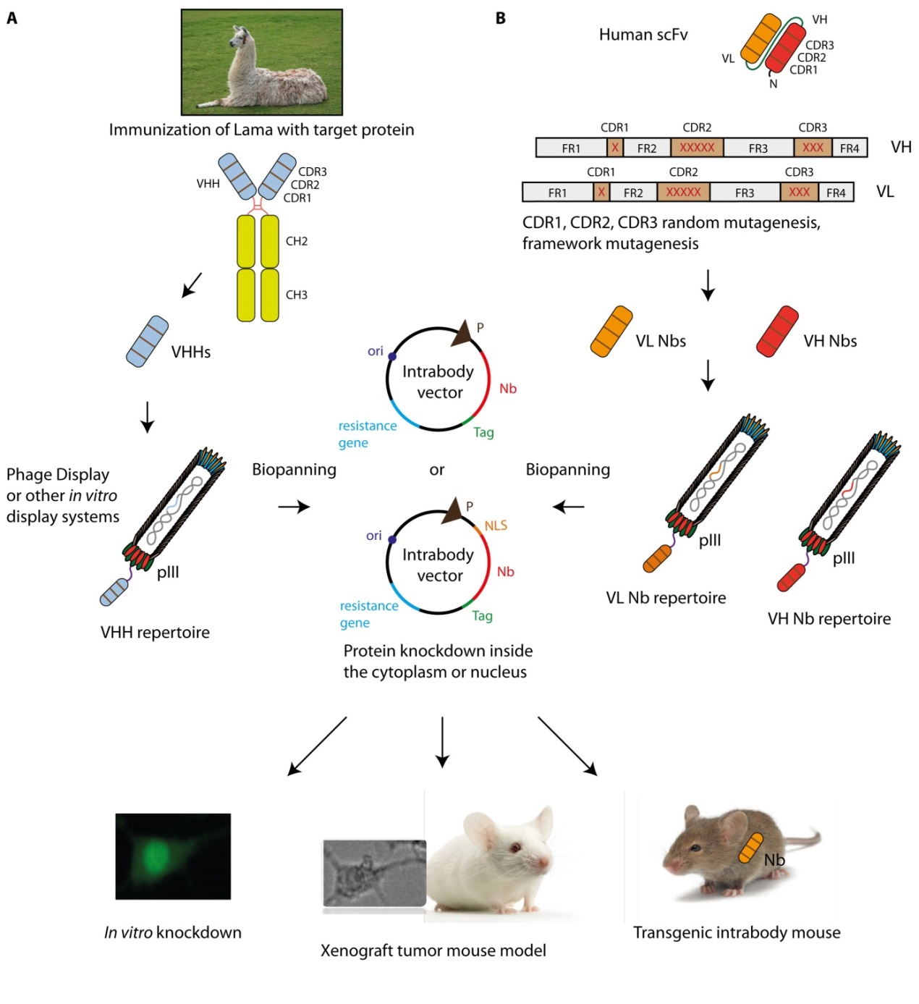
Construction of cytosolic camelid single domain antibodies

Slide 9
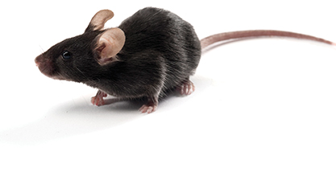
Anti-Interferon α intrabody project
IFN-α
● Development of a new anti-interferon α intrabody to study the in vivo function of IFN-α in macrophages and dendritic cells
● An IFN- α knockout mouse does not exist because there exist 14 mouse IFN- α isoformes
● Development of an intrabody from a hybridoma clone which binds to an epitope of different isoforms (mouse IFN α subtypes 1, 2, 4 and 6)
● In vitro characterization of the intrabody and establishment of a transgenic intrabody mouse

Slide 10
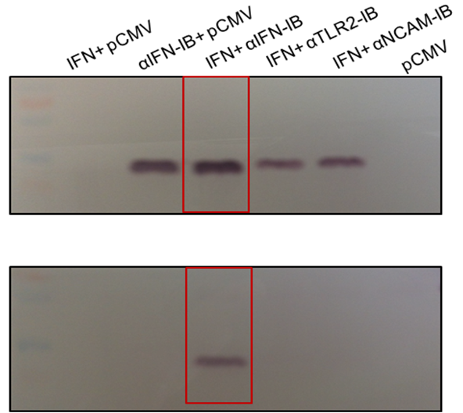
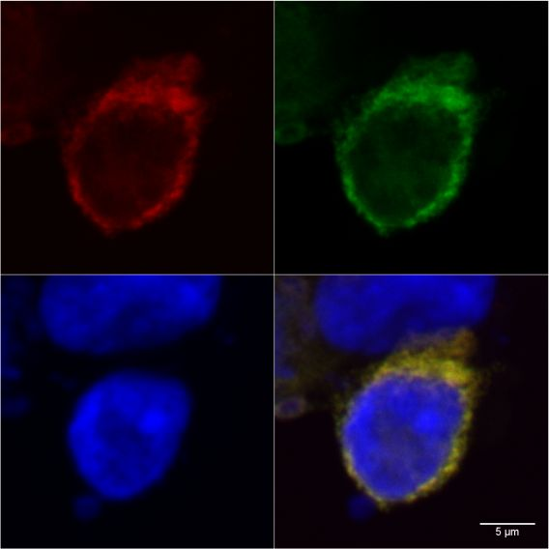
Co-localisation and Co-immunoprecipitation of IFN α-Strep tag and intrabody-myc in HEK293 cells.
A
B
I
Immunofluorescence
II
Co-Immunoprecipitation
(empty vector)
IFNα intrabody
IFNα
AA
C
B
D
Ib-myc
Dapi
CA
D
Interferon
α-Strep tag
Overlay
Colocalization and Co-immunoprecipitation indicates complex formation of IFN α-Strep tag and intrabody-myc and specific intracellular binding in HEK293 cells

Slide 11
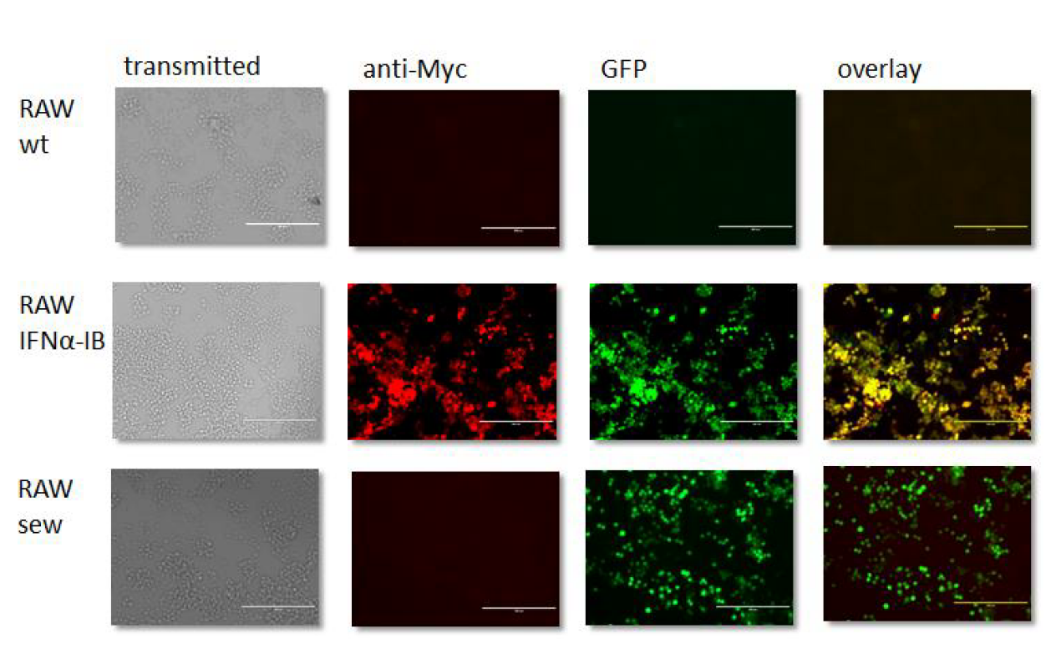
Immunofluorescence: Staining of reporter eGFP and α IFNα intrabody in stable intrabody expressing RAW 264.7 macrophages
e
Immunofluorescence shows clearly co-expression of eGFP and α IFNα intrabody in RAW 264.7 cells

Slide 12
Detection of IFN-α in stable intrabody expressing RAW 264.7 macrophages after stimulation with poly (I:C)
Anti-Interferon α intrabody inhibits secretion of IFN- α in RAW 264.7 macrophages

Slide 13
Summary
● New anti-IFN-α intrabody recognizing mouse IFN α subtypes 1, 2, 4 and 6 inhibits IFN α secretion in RAW 264.7 macrophages
● c DNA of anti-IFN-α intrabody is cloned into ES vector to transfect embryonic stem cells and to generate transgenic intrabody mice
Literature:
Marschall AL, Dübel S, Böldicke T. Recent Advances with ER targeted Intrabodies. Adv Exp Med Biol. 2016;917:77-93. doi: 10.1007/978-3-319-32805-8_5.
Marschall AL, Dübel S, Böldicke T. Specific in vivo knockdown of protein function by intrabodies. MAbs. 2015;7(6):1010-35. doi: 10.1080/19420862.2015.1076601.

Slide 14
Collaborations
Carsten J. Kirschning (Uni-Essen)
Ludger Grosse-Hovest (Tübingen)
Stefan Dübel (TU-Braunschweig)
HZI
Joop Van den Heuvel
Dagmar Wirth
Andrea Kröger
Konrad Büssow
Students
Claudia Harting
Oliver Backhaus
Sabine Luu
Paul Prentkowski
Technical Assistant
Astrid Hans

