Slide 1
ROLE OF ENDOTHERAPY VS SURGERY IN THE MANAGEMENT OF TRAUMATIC PANCREATIC INJURY - A TERTIARY CENTER EXPERIENCE

Slide 2
INTRODUCTION
The retroperitoneal location and close proximity to numerous vascular and GI structures explains the complexity and severity of pancreatic trauma.
The high associated mortality rates are a result of often concomitant duodenal perforation as well as damage to closely related vascular structures(1-7).
These injuries remain difficult to diagnose and require a high index of suspicion when approaching cases of abdominal trauma.

Slide 3
An abdominal CT often helps greatly in this regard by providing valuable information regarding severity of injury, associated duct damage as well as bleeding complications(8-11).
Delayed diagnosis or underestimation of severity of injury can lead to serious complications like fistula formation,intra-abdominal collections etc(12-14).
In this study we aim to report our experience in the management and treatment of pancreatic trauma at a tertiary care hospital.

Slide 4
Review of literature
The acceleration–deceleration nature of blunt trauma causes the pancreas to be crushed against the first and second lumbar vertebrae.
The body of the pancreas is most commonly injured in blunt trauma. Penetrating trauma (eg stab wound or gunshot wound) is rising in incidence and accounts for 70% of all traumatic pancreas injuries.
Damage to the main pancreatic duct occurs in 15% of cases and is crucial to ascertain before or during laparotomy as it necessitates pancreatic reconstruction by an experienced HPB surgeon

Slide 5
Pancreatic trauma occurs commonly in connection with multiple injuries after motor vehicle accidents in adults and bicycle handlebar injuries in children.
Conservative management is mainly advocated for pancreatic trauma without ductal injuries.
Computed tomography (CT) is routinely used as the first-line imaging modality in acute abdominal trauma cases and is helpful in recognizing injuries to the pancreas and other organs and their associated complications.

Slide 6
Ultrasonography (US) is useful in cases of pancreatic ascites and pseudocyst formation, which are more likely to occur in cases with traumatic pancreatitis.
Magnetic resonance cholangiopancreatography (MRCP) allows direct imaging of the pancreatic duct and its disruption[10]. The purpose of this paper is to review the findings of pancreatic trauma on various imaging modalities

Slide 7
American Association for Surgery of Trauma (AAST) - Classification of traumatic injury of the pancreas (15)
Grade 1: Minor contusion without ductal injury
Grade 2: Major contusion/laceration without ductal injury or tissue loss
Grade 3: Distal transection or parenchymal injury with ductal injury
Grade 4: Proximal transection or parenchymal injury involving ampulla
Grade 5: Mass destruction of the pancreatic head.

Slide 8
CT grading of blunt pancreatic injuries( Wong et al )
Grade A:
Pancreatitis / Superficial laceration
Grade B:
1 Deep laceration at distal pancreas
2 Transection at distal pancreas
Grade C:
1 Deep laceration at proximal pancreas
2 Transection at proximal pancreas

Slide 9
CT Specific signs of pancreatic injury
Fracture of the pancreas
Pancreatic laceration
Focal or Diffuse pancreatic enlargement
Pancreatic hematoma
Active bleeding or extravasation of iv contrast
Fluid separating the splenic vein from posterior aspects of pancrase

Slide 10
CT Non Specific signs of pancreatic injury
Inflammatory changes in peripancreatic fat and mesentry
Fluid surrounding the superior mesenteric artery
Thickening of the left anterior renal fascia
Pancreatic ductal dilation
Acute pseudocyst formation/ Peripancreatic fluid collection

Slide 11
CT Non Specific signs of pancreatic injury
Fluid in the anterior and posterior pararenal spaces
Fluid in transverse mesocolon
Hemorrhage into peripancreatic fat, mesocolon and mesentery
Extraperioneal and Intraperitoneal fluid

Slide 12
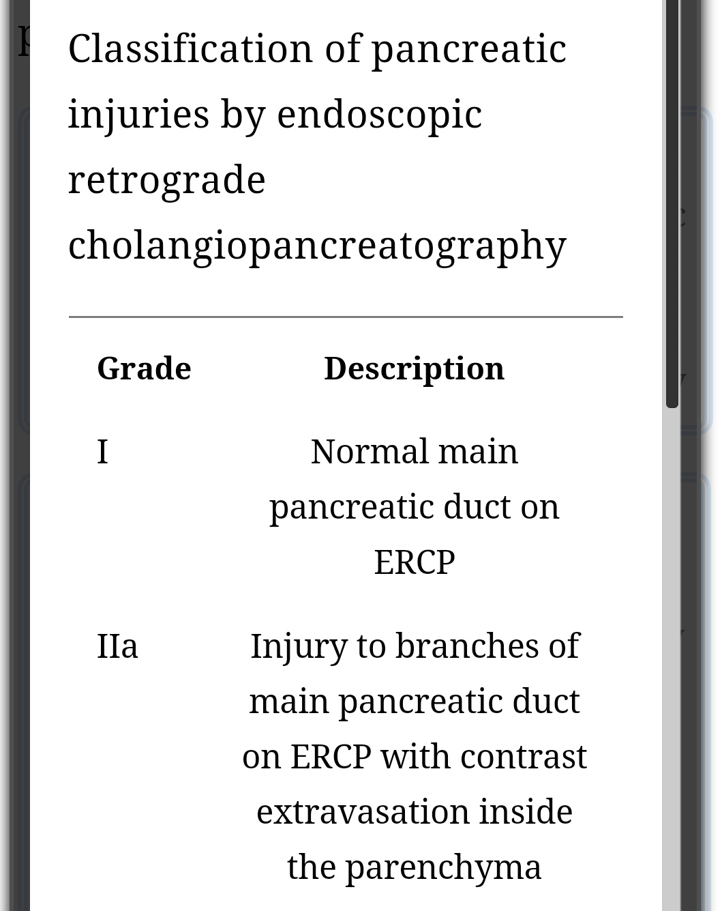
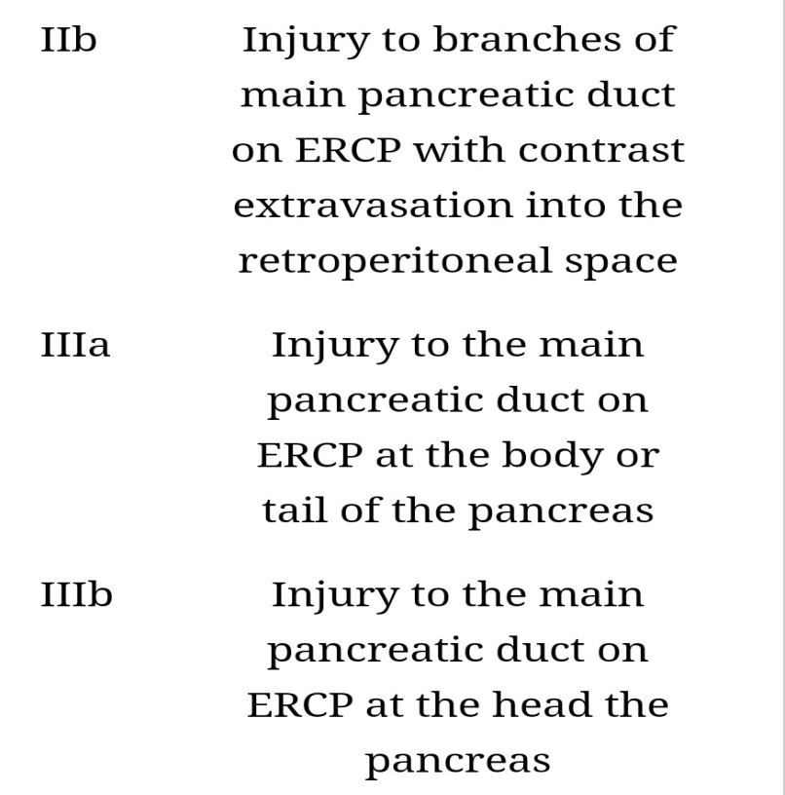
ERCP classification of pancreatic duct injury ( Takishima et al )

Slide 13
METHODS
Patients
All patients hospitalized for abdominal trauma with pancreatic injury at Madras medical college were identified from the hospital registry between 2013 and 2017.
Data includes the total no of patients, main diagnosis, associated diagnosis, age and sex of the patients, classification of pancreatic injury, type of management( Conservative vs operative ) and outcomes were analysed

Slide 14
Statistical analysis
Predominantly descriptive statistics were used in view of the non-homogenous nature of the patient population.
Qualitative variables were expressed as a percentage while the Mean+/- standard deviation was used for the quantitative ones.

Slide 15
RESULTS
Chart-1 represents a total of 35 patients analyzed. The majority of them were male (74%) and the average age was 35±18 years (10–70 years).

Slide 16
Mechanisms of pancreatic trauma
The above Chart-2 depicts the mechanism of abdominal trauma with a majority 26 (74%) being a result of blunt trauma.

Slide 17
GRADING OF SEVERITY
Chart 3 depicts the extent of severity of pancreatic injury in the study population as classified by the AAST. Class I,II,III clearly predominate accounting for 93% of patients

Slide 18
Management of traumatic injury of the pancreas
The above chart -4 depicts the management strategy utilized, with a nearly equal distribution of patients between the conservative and surgical management

Slide 19
Patient management strategies were in large part guided by a number of non-pancreatic factors including the patients hemodynamic status, degree of severity of associated injuries, hypothermia etc.
As demonstrated in Figure 1 – patients with similar grades of pancreatic injury may be managed very differently as a result of multiple other variables being taken into consideration

Slide 20
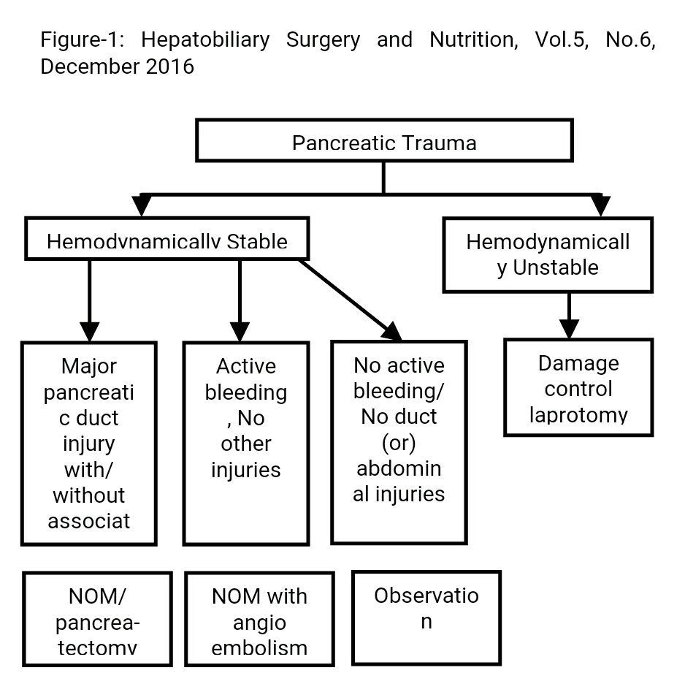

Slide 21
Discription of both group treatment modalities
Characteristics of patients who underwent exploratory laparotomy (n=19) in our study
10 patients were were diagnosed with pancreatic injury during exploratory laparotomy.
Preoperative CT scan yielded the diagnosis of pancreatic duct injury in the remaining 9 patients.
Among this group, 3 patients underwent a distal pancreatectomy with splenectomy and a pancreaticoduodenectomy was performed in 1 patient
Characteristics of patients who underwent non-operative management (NOM) (n=16) in our study
Of the 16 patients managed Non-operatively, 4 underwent endotherapy (3 stent placements and 1 endoscopic pseudocyst drainage).
3 patients underwent a radiological drainage procedure and the remaining 9 were managed conservatively.

Slide 22
Mortality in traumatic pancreatitis in our experience
Overall mortality was 28% (n=10). 8 patients died in the perioperative period as a result of sepsis and Ventilator associated pneumonia. The other 2 patients who had been managed non-operatively died of pulmonary embolism and ARDS

Slide 23
DISCUSSION
This retrospective analytical study shows that the prevalence of pancreatic trauma among all abdominal trauma patients hospitalized in our hospital was 8% with an overall mortality of 28%.
Pancreatic injuries were mostly blunt trauma (74%) and the etiology was dominated by motor vehicle accident followed by stab wounds and falls or crushing injuries.
The average age of patients is 30years old, which does not differ from other published series where the age is less than 40 years in 80% of the cases, in addition 74% of patients in our series are males, as well correspond to the literature data (1,16,17).

Slide 24
Isolated pancreatic trauma is rarely the case. The main causes of pancreatic trauma in this series were motor vehicle accident and stab wounds, unlike data from the United States where the main cause of pancreatic trauma is penetrating (firearms and knives) (1,3,18-20).

Slide 25
The decision to perform a pancreatectomy in the setting of trauma remains controversial. As for pancreatic injury grades 1 and 2 -NOM appears to be most effective as long as there is no involvement of the main pancreatic duct. This strategy is effective since morbidity is less than 20% and mortality is relatively low (21).

Slide 26
As for grade 3 and 4 pancreatic injury, distal pancreatectomy or surgical drainage appear to be the modalities of choice, especially for body-tail contused areas associated with distal duct injury (1,21).
Distal pancreatectomy is often preferred over drainage because it decreases mortality and has a lower risk of operative complications (1,22). In case of complete traumatic transection of the pancreatic neck, pancreaticojejunostomy of the distal stump and with closure of the cephalic stump may be considered

Slide 27
For pancreatic injury grade 5 several treatment options exist right from NOM to surgical drainage and even pancreaticoduodenectomy. Existing literature favors NOM (21), even in cases of duodenal or bile duct trauma (23).
This is likely due to the significantly lower mortality rates with conservative management (22-25%) when compared to Pancreaticoduodenectomy (45%) (23-25). Some authors have suggested the possibility of performing a staged pancreaticoduodenectomy, with an initial resection and reconstruction 24 to 48 hours later (26).

Slide 28
For non operative arm four patients underwent endotherapy , Three patient had a stent placement in the pancreatic duct and one patients underwent endoscopic drainage of a pancreatic pseudocyst, Three patient underwent radiological drainage procedure.
Remaining nine patient managed conservatively in non operative group.

Slide 29
The limitations of this study include its retrospective nature and the limited sample size. It is difficult to draw any robust conclusions from comparison of the two groups since it is not homogeneous groups.

Slide 30
In conclusion, though operative management of pancreatic trauma is associated with higher mortality, this is not necessarily related to pure procedural or pancreas related factors.
It is very likely that the high incidence of severe associated injuries contribute in large part to the worse outcomes in this subgroup.
This being said, we strongly recommend that Non-operative management and Endotherapy always be considered when appropriate prior to attempting surgical intervention.

Slide 31
REFERENCES
1. Cogbill TH, Moore EE, Morris JA Jr, et al. Distal pancreatectomy for trauma: a multicenter experience. J Trauma 1991;31:1600-6.
2. Heuer M, Hussmann B, Lefering R, et al. Pancreatic injury in 284 patients with severe abdominal trauma: outcome, course, and treatment algorithm. Langenbecks Arch Surg 2011;396:1067-76.
3. Jones RC. Management of pancreatic trauma. Am J Surg 1985;150:698-704.
4. Krige JE, Kotze UK, Hameed M, et al. Pancreatic injuries after blunt abdominal trauma: an analysis of 110 patients treated at a level 1 trauma centre. S Afr J Surg 2011;49:58, 60, 62-4 passim.

Slide 32
REFERENCES
5..Chinnery GE, Krige JE, Kotze UK, et al. Surgical management and outcome of civilian gunshot injuries to the pancreas. Br J Surg 2012;99 Suppl 1:140-8.
6. Lahiri R, Bhattacharya S. Pancreatic trauma. Ann R Coll Surg Engl 2013;95:241-5.
7. Wang GF, Li YS, Li JS. Damage control surgery for severe pancreatic trauma. Hepatobiliary Pancreat Dis Int 2007;6:569-71.
8. Bradley EL 3rd, Young PR Jr, Chang MC, et al. Diagnosis and initial management of blunt pancreatic trauma: guidelines from a multiinstitutional review. Ann Surg 1998;227:861-9.
9. Ilahi O, Bochicchio GV, Scalea TM. Efficacy of computed tomography in the diagnosis of pancreatic injury in adult blunt trauma patients: a single-institutional study. Am Surg 2002;68:704-7; discussion 707-8.

Slide 33
REFERENCES
10. Phelan HA, Velmahos GC, Jurkovich GJ, et al. An evaluation of multidetector computed tomography in detecting pancreatic injury: results of a multicenter AAST study. J Trauma 2009;66:641-6; discussion 646-7.
11. Tyburski JG, Dente CJ, Wilson RF, et al. Infectious complications following duodenal and/or pancreatic trauma. Am Surg 2001;67:227-30; discussion 230-1.
12. Biffl WL, Moore EE, Croce M, et al. Western Trauma Association critical decisions in trauma: management of pancreatic injuries. J Trauma Acute Care Surg 2013;75:941-6.

Slide 34
REFERENCES
13. Krige JE, Beningfield SJ, Nicol AJ, et al. The management of complex pancreatic injuries. S Afr J Surg 2005;43:92-102.
14. Lin BC, Chen RJ, Fang JF, et al. Management of blunt major pancreatic injury. J Trauma 2004;56:774-8.
15. Moore EE, Cogbill TH, Malangoni MA, et al. Organ injury scaling, II: Pancreas, duodenum, small bowel, colon, and rectum. J Trauma 1990;30:1427-9.
16. Akhrass R, Yaffe MB, Brandt CP, et al. Pancreatic trauma: a ten-year multi-institutional experience. Am Surg 1997;63:598-604.

Slide 35
REFERENCES
17. Vasquez JC, Coimbra R, Hoyt DB, et al. Management of penetrating pancreatic trauma: an 11-year experience of a level-1 trauma center. Injury 2001;32:753-9.
18. Patton JH Jr, Lyden SP, Croce MA, et al. Pancreatic trauma: a simplified management guideline. J Trauma 1997;43:234-9; discussion 239-41.
19. Smego DR, Richardson JD, Flint LM. Determinants of outcome in pancreatic trauma. J Trauma 1985;25:771-6.
20. Wisner DH, Wold RL, Frey CF. Diagnosis and treatment of pancreatic injuries. An analysis of management principles. Arch Surg 1990;125:1109-13.
21. Sharpe JP, Magnotti LJ, Weinberg JA, et al. Impact of a defined management algorithm on outcome after traumatic pancreatic injury. J Trauma Acute Care Surg 2012;72:100-5.

Slide 36
REFERENCES
22. Wilson RH, Moorehead RJ. Current management of trauma to the pancreas. Br J Surg 1991;78:1196-202.
23. Feliciano DV, Martin TD, Cruse PA, et al. Management of combined pancreatoduodenal injuries. Ann Surg 1987;205:673-80.
24. Mansour MA, Moore JB, Moore EE, et al. Conservative management of combined pancreatoduodenal injuries. Am J Surg 1989;158:531-5.
25. Strobel O, Schneider L, Philipp S, et al. Emergency pancreatic surgery--demanding and dangerous. Langenbecks Arch Surg 2015;400:837-41.
26. Degiannis E, Boffard K. Duodenal injuries. Br J Surg 2000;87:1473-9.

