Slide 1


Orange juice in association to low-caloric diet contributes to weight-loss and glucose metabolism
Carolina Ribeiro, Renata Benassi, Grace Dourado, Thais Cesar
Laboratory of Nutrition
Food and Nutrition Department, Pharmaceutical Sciences School
Sao Paulo State University- UNESP, Araraquara SP Brazil
Notes:
Good afternoon. It is a pleasure to be part of the International Citrus Conference, in its Brazilian version.
Thank you all for coming for this section on Citrus and Human Health.
Today, I will present a project carried out in the Nutrition Laboratory, at Pharmaceutical School in Araraquara city, of Sao Paulo State University.
We will show the results about the association between daily intake of orange juice intake combined to a low caloric diet, as a strategy to improve a weight loss program.

Slide 2
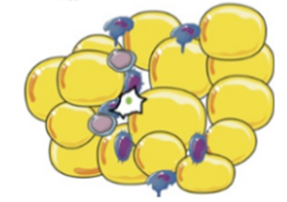
High adipose tissue stored
in Obesity:
Glucose intolerance
High Cholesterol and TG
Hypertension
Systemic inflammation
Cluster of complications
CVD, Diabetes
Premature death
Stoner, L.,Cornwall, J, 2014.
Notes:
Accumulation of high amount of adipose tissue in obesity is associated with a clustering of complications, including impaired glucose tolerance, dyslipidemia, hypertension and systemic inflammation, which are independent risk factors for cardiovascular disease and diabetes [1].

Slide 3
Diets rich in fruits and vegetables,
plenty of water and fibers
reduce the diet energy density
promote satiety
decrease caloric intake
Contribute to weight control
Regulate metabolic parameters
Fruits and their juices
Nutrient-dense foods, providing vitamins, minerals, and bioactive compounds with relatively few calories
Giugliano, et al, 2006; Tohill,2004.
Notes:
Currently it is well recognized that diets rich in fruits and vegetables contribute to weight control and regulation of the metabolism, preventing or reversing the conditions mentioned before [2].
Such foods, rich in water and fiber, reduce the energy density of the diet, promote satiety and decrease caloric intake [3].
Furthermore, fruits and their juices as part of these diets, are classified as nutrient-dense foods, providing vitamins, minerals, and bioactive compounds with relatively few calories [4], which can contribute for weight maintenance and regulate the energy metabolism.

Slide 4
Emerging speculations:
Do the fruit juices play a role in the obesity epidemic, contributing to weight-gain in children and adults?
Beverages containing fruit juice X 100% fruit juices
Nutritional composition: energy, sugars and bioactive compounds
different effects on body composition
Shefferly 2016, Pan et al 2013, Hyson 2015,
?
Rampersaud & Valim 2015; Dourado & Cesar 2015,
Silveira, Dourado & Cesar, 2015
Notes:
Assumptions have recently emerged about the role of consumption of fruit juices in the obesity epidemic, contributing to weight-gain in children [7] and adults [8].
Nevertheless, those studies have not distinguished "fruit juice containing beverages" and "100% fruit juices", which have distinct compositions, as energy, sugars and bioactive compounds, that distinguish affect body composition.

Slide 5
Recent evidences:
daily consumption of OJ does not contribute:
Adiposity or weight gain [Dourado & Cesar, 2015]
Insulin resistance and inflammation [Simpson & Macdonald, 2016,
Silveira et al, 2015]
Increasing cholesterol [Aptekmann & Cesar, 2015]
Counteracting negative reports about the consumption of OJ.
Notes:
Recent evidences have shown that the daily consumption of OJ does not contribute to adiposity/weight gain [11], insulin resistance and inflammation [12, 13], dyslipidemia [14], counteracting the negative reports about the consumption of OJ.

Slide 6
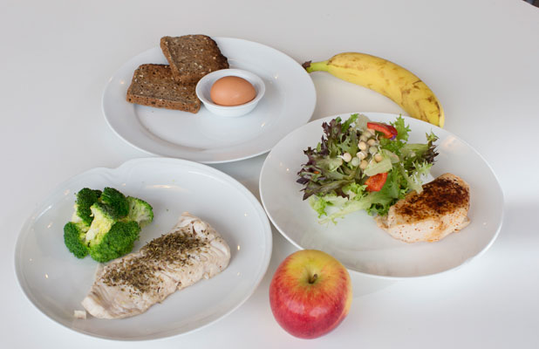
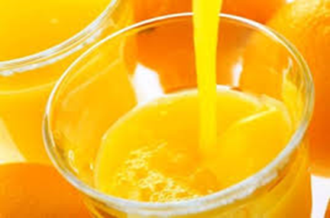
Study proposal:
Obese Subjects: men and women, apparently healthy
Eligibility criteria: 30 ≥ BMI ≤ 40 kg/m²
Subjects assigned to two groups:
“orange juice (OJ)” or “control” by a random-number generator program.
Treatment:
Low-caloric diet (LCD): Personal and balanced (DRI, 2006)
Six meals/day (breakfast, morning snack, lunch, afternoon snack, dinner, supper)
LCD + Orange juice: 250mL OJ morning snack + 250mL OJ afternoon snack
Notes:
78 volunteers completed the intervention and were included in the final analysis.
Subjects with BMI between 30 to 40 kg/m² are eligible to the study.
The exclusion criteria were:
dieting last year, use of drugs, vitamins and dietary supplements, alcohol consumption more than 20 g/d), and intense physical activity (more than 5 hours/week).
The Ethics Board of Pharmacy School, UNESP, approved the study (1.241.033).
All participants provided written informed consent.

Slide 7
Interventions
Trial design: A 12-week, parallel group, randomized (block size), controlled trial, conducted at the Pharmacy School, Sao Paulo State University, UNESP, Brazil.
Body composition measurements were collected monthly.
Blood samples and dietary questionnaires: collected every two weeks (Figure 1).
Primary endpoint: Reduction of weight-loss by 5% between to initial and final body weight
Secondary endpoint: modification of the levels of biomarkers related to obesity
Ethics Board of Pharmacy School, UNESP, approved the study (#1.241.033).
All participants provided written informed consent.
Notes:
Nutritionists prescribed a LCD that was estimated from total energy expenditure (TEE) for each individual minus 500 kcal per day (30% TEE) [15].
Both groups had the same diet plan based on individual weight.
The dietary plan was composed of six meals/day: breakfast; snack 1 (250 mL OJ / banana and free-fat yogurt); lunch; snack 2 (250 mL OJ / free-fat yogurt with oatmeal); and snack 3 (salty crackers or oat cookies, unsweet tea).
One-hundred percent OJ was obtained from Pera Rio oranges and provided by Citrosuco (Matao, SP, Brazil).

Slide 8
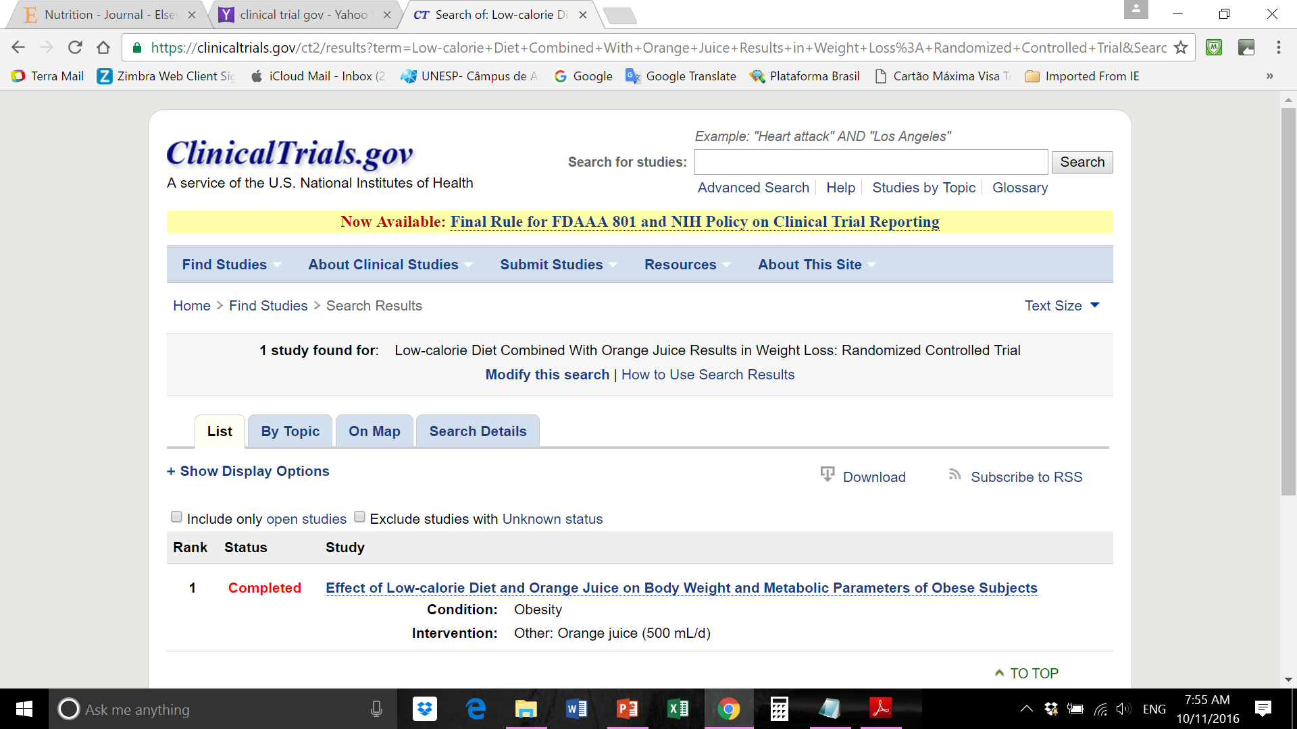
This clinical study has been declared to the website ClinicalTrials.com under the # NCT02914249.

Slide 9
Clinical Trial Design # NCT02914249.
Step 1 (4 weeks)
Step 2 (12 weeks)
Screening
September 8, 2015
October 8, 2015 - Intervention Groups (n=88)
1) Control: Low caloric-diet (n=39)
2) Orange juice: Low caloric-diet + Orange Juice (n=39)
Volunteers (n=190)
Week 0
Week 4
Week 8
Week 12
Anthropometric measurements
Clinical History
Dietetic History
Baseline
Follow-up
End of the study
Body composition
Blood collection
Dietary prescription and recomemendations
Assessment 3-d records
Supervision
Body composition
Blood collection
Checking meals
Body composition
Blood collection
Checking meals
Informed Consent
Notes:
A 12-week, parallel group, randomized controlled trial was conducted at UNESP.
The recruitment began in June 2015 and the intervention was carried out in August 2015.
Subjects were random assigned in one of the two groups:
“orange juice (OJ)” or “control”.
In the OJ group (n = 39) individuals consumed a LCD plus OJ (500 mL/d);
while in the control group (n = 39) individuals consumed only LCD.
Body composition measurements were collected (monthly);
blood samples and dietary questionnaires (every two weeks) (Figure 1).
Primary and secondary endpoints were the reduction of weight and modification of the levels of obesity-related metabolic biomarkers.

Slide 10
Body composition:
standardized procedures (weight, hight, BMI, wait, etc)
Bioelectrical impedance: InBody 720, Biospace, Tokyo, Japan
fat mass (kg), lean mass (kg), and % body fat
Biomarkers:
TG, total cholesterol, HDL-C, glucose, AST, ALT, AKP, γGT: commercial kits, Labtest, Brazil
ultrasensitive C-reactive protein (hsCRP): Dade Behring, USA
HOMA-IR: cutoff was set at ≥2.71 [Matthews et al 1985].
Lipid peroxidation: TBARS assay [Yagi, K 1998]
Total antioxidant capacity by radical ABTS^{•+} assay [Re et al 1999].
Diet: 3-day dietary records: Avanutri® e TACO (UNICAMP)
100% Orange Juice: provided by a local producer (Citrosuco, Matao, SP)
Chemical analysis: 0.7% total titratable acidity, 15 °Brix, 204 mg ascorbic acid, 34 mg phenolic compounds, 950 TEAC μmol antioxidant capacity, 240 kcal/500mL, 44 g total sugar, 162 mg hesperitin, and 7.7 mg naringenin [22] in two doses of OJ (500 mL).
Notes:
Next are the results

Slide 11
RESULTS
Notes:
Next are the results

Slide 12
Table 1. Baseline characteristics of the subjects
Low-caloric diet | Orange juice | Control | Subjects
 | (n = 39) | (n = 39) | (n = 78)
Age, years | 37 ± 1 | 35 ± 1 | 36 ± 1
BMI, kg/m² | 33 ± 3 | 34 ± 4 | 33 ± 3
Glucose, mg/dL | 87 ± 7 | 85 ± 8 | 86 ± 7
Insulin, µU/mL | 15 ± 6 | 15 ± 6 | 15 ± 6
HOMA-IR | 3.2 ± 1.5 | 3.1 ± 1.3 | 3.1 ±1.4
Total cholesterol, mg/dL | 185 ± 21 | 181 ± 31 | 183 ± 27
LDL-C, mg/dL | 119 ± 27 | 115 ± 27 | 118 ± 27
HDL-C, mg/dL | 44 ± 8 | 47 ± 11 | 45 ± 10
Non-HDLC, mg/dL | 145 ± 27 | 133 ± 29 | 139 ± 28
Triglycerides, mg/dL | 140 ± 40 | 141 ± 43 | 140 ± 41
hsCRP, mg/dL | 0.5 ± 0.1 | 0.5 ± 0.1 | 0.5 ± 0.1
Alcaline phosphatase, U/L | 73 ± 18 | 72 ± 16 | 73 ± 17
AST, U/L | 21 ± 9 | 21 ± 7 | 21± 8
ALT, U/L | 23 ± 8 | 20 ± 9 | 21 ±14
γ-GT, U/L | 25 ± 7 | 24 ± 6 | 25 ± 7

Slide 13
Table 2. Body composition over the 12 weeks experiment
Low-caloric diet | Orange juice (n = 39) |  |  |  |  | Control (n = 39)
 | 0-wk | 4-wk | 8-wk | 12-we |  | 0-wk | 4-wk | 8-wk | 12-wk
Body comp.
Body wt, kg | 97 ± 12ª | 94 ±12^{b} | 92 ± 12^{c} | 90 ± 11^{d} |  | 98 ± 12ª | 95 ±12^{b} | 93 ± 12^{c} | 92 ± 11^{d}
BMI, kg/m² | 33 ± 3 ª | 32 ± 3 ^{b} | 31 ± 3 ^{c} | 31 ± 3^{c} |  | 34 ± 4ª | 33 ± 3^{b} | 32 ± 3^{c} | 31 ± 3^{d}
Lean mass, kg | 31 ± 6ª | 30 ± 6^{b} | 30 ± 6^{b} | 30 ± 6^{b} |  | 30 ± 5 ª | 29 ± 5^{b} | 29 ± 5^{b} | 29 ± 5^{b}
Fat mass, kg | 36 ± 10ª | 34 ± 10^{b} | 32 ± 10^{c} | 31 ± 10^{d} |  | 38 ± 10ª | 36 ± 10^{b} | 34 ± 10^{c} | 33 ± 9^{d}
Body fat, % | 37 ± 9ª | 36 ± 9^{b} | 34 ± 9^{c} | 34 ± 9^{c} |  | 40 ± 8ª | 39 ± 9^{b} | 38 ± 9^{c} | 37 ± 8^{d}
Waist, cm | 104 ± 10ª | 100 ± 10^{b} | 97± 10^{c} | 96 ± 9^{c} |  | 102 ± 10ª | 98 ± 10^{b} | 95 ± 10^{c} | 93 ± 9^{d}
Hip, cm | 113 ± 9ª | 110 ± 9^{b} | 109 ± 10^{c} | 108 ± 8^{d} |  | 114 ± 9ª | 113 ± 9^{b} | 110 ± 8^{c} | 109 ± 8^{d}
waist/hip | 1.0 ± 0.1ª | 1.0 ±0.1ª | 0.9 ± 0.1^{b} | 0.9 ± 0.1^{b} |  | 1.0 ± 0.1ª | 1.0 ± 0.1ª | 0.9 ± 0.1^{b} | 0.9 ± 0.1^{b}

Slide 14
Table 3. Metabolic biomarkers in both groups (Orange Juice and Control) during 12-weeks.
Low-caloric diet | Orange juice (n = 39) |  |  |  |  | Control (n = 39)
 | 0-week | 4-week | 8-week | 12-week |  | 0-week | 4-week | 8-week | 12-week
Biomarkers
Glucose, mg/dL | 87 ± 10ª | 83 ± 8^{b} | 82 ± 7^{bc} | 80 ± 7^{c} |  | 85 ± 6ª | 81 ± 6^{b} | 81 ± 7^{b} | 81 ± 6^{b}
Insulin, µU/mL | 15 ± 6^{A,a} | 13 ± 5^{A,b} | 11 ± 4^{A,c} | 11 ± 4^{A,c} |  | 15 ± 6^{A,a} | 15 ± 7^{A,a} | 14 ± 5^{B,b} | 13 ± 6^{B,c}
HOMA-IR | 3.2 ± 1.5^{A,a} | 2.8 ±1.2^{A,b} | 2.2 ±0.8^{A,c} | 2.1 ± 0.8^{A,c} |  | 3.1 ± 1.3^{A,a} | 3.1 ± 1.4^{A,a} | 2.9 ± 1.4^{B,b} | 2.7 ±1.1^{B,c}
TC, mg/dL | 185 ±21^{A,a} | 173 ±21^{A,b} | 170 ±28^{A,c} | 155 ±20^{A,d} |  | 181 ± 30^{A,a} | 172 ± 30^{A,b} | 171 ± 28^{A,b} | 165 ± 28^{B,c}
LDL-C, mg/dL | 119 ±27^{A,a} | 111 ±24^{A,b} | 107 ±26^{A,b} | 85 ± 18^{A,c} |  | 115 ± 27^{A,a} | 109 ± 23^{A,b} | 108 ±26^{A,b} | 105 ±27^{B,b}
HDL-C, mg/dL | 44 ± 8ª | 42 ± 8^{b} | 43 ± 9^{a,b} | 44 ± 10ª |  | 47 ± 11ª | 44 ± 10^{b} | 44 ± 10^{b} | 44 ± 10^{b}
Non-HDL | 144 ± 27ª | 135 ± 24^{b} | 130 ± 25^{c} | 115 ± 24^{d} |  | 133 ± 30ª | 130 ± 30^{b} | 127 ± 29^{c} | 121 ± 27^{d}
TG, mg/dL | 140 ± 40ª | 127 ± 41^{b} | 117 ± 40^{c} | 109 ± 34^{d} |  | 141 ± 43ª | 133 ± 40^{b} | 119 ± 40^{c} | 112 ± 38^{c}
hsCRP, mg/dL | 0.5± 0.1^{A,a} | 0.4± 0.1^{A,b} | 0.4 ±0.1^{A,b} | 0.3± 0.1^{A,c} |  | 0.5± 0.1^{A,a} | 0.5 ±0.1^{A,a} | 0.4± 0.1^{A,b} | 0.4±0.1^{B,b}
Alcaline Phosp. | 73 ± 18ª | 71 ± 15^{b} | 70 ± 16^{b} | 68 ± 18^{c} |  | 72 ± 18ª | 69 ± 16^{b} | 68 ± 15^{b} | 67 ± 15^{b}
AST, U/L | 21 ± 9ª | 21 ± 6ª | 19 ± 5^{b} | 18 ± 5^{b} |  | 21 ±7ª | 20 ± 6^{a,b} | 19 ± 6^{b} | 19 ± 6^{b}
ALT, U/L | 22 ± 8ª | 22 ± 8ª | 19 ± 8^{b} | 19 ± 9 ^{b} |  | 20 ± 9ª | 23 ± 10^{b} | 21 ± 9^{a,c} | 20 ± 7^{a,c}
γGT, U/L | 25 ± 7ª | 22 ± 9^{b} | 22 ± 9^{b} | 21 ± 8 ^{c} |  | 24 ± 6ª | 23 ± 7^{b} | 23 ± 8^{b} | 23 ± 8^{b}
TAC, mM | 1.8 ±0.03ª | 1.8 ±0.04ª | 1.9 ±0.04^{b} | 1.9 ± 0.04^{b} |  | 1.8 ±0.08ª | 1.8 ± 0.08ª | 1.8 ± 0.05ª | 1.8 ±0.04ª
[MDA] mM | 1.5 ±0.9ª | 1.2 ± 0.6 ^{b} | 1.2 ± 0.6^{b} | 0.8 ± 0.4^{c} |  | 1.7 ± 0.8ª | 1.5 ± 0.7^{b} | 1.5 ± 0.7^{b} | 0.9 ±0.5^{c}

Slide 15
Table 4. Inflammatory biomarkers in both groups (Orange Juice and Control) during 12-weeks.
Time schedule | 0-week | 4-week | 8-week | 12-week
 | Control (n = 39)
Adiponectin (ug/mL) | 18 ± 6.^{B,a} | 20^{b} ± 7 ^{B,b} | 20 ± 7 ^{B,b} | 21 ± 7 ^{B,b}
Leptin (ng/mL) | 31 ± 9ª | 29 ± 8ª | 27 ± 9^{b} | 27 ± 9^{b}
IL-6 (pg/mL | 6.1 ± 1.8ª | 4.9 ± 1.7^{b} | 4.1 ± 1.7^{c} | 3.1 ± 1.6^{d}
TNF-α (pg/mL) | 7.5 ±2.4ª | 6.7 ± 1.7^{b} | 6.5 ±1.7^{b} | 5.7 ±1.7^{c}
 | Orange juice (n = 39)
Adiponectin (ug/mL) | 19 ± 5^{A,a} | 18 ± 5 ^{A,b} | 15 ± 5.3 ^{A,c} | 15 ± 5 ^{A,c}
Leptin (ng/mL) | 31 ± 14ª | 29 ± 13^{b} | 27 ±12^{c} | 27 ± 12^{c}
IL-6 (pg/mL | 6.0 ± 2.6ª | 5.5 ± 2.6^{b} | 4.6 ± 1.6^{c} | 3.3 ± 2.0^{d}
TNF-α (pg/mL) | 7.6 ±2.7ª | 7.4 ±2.1ª | 6.7 ± 2.0^{b} | 5.9 ±1.8^{c}

Slide 16

Conclusion:
OJ combined with low caloric-diet:
+
Improved the nutritional quality of the diet (↑ Vit C and ↑ Folate);
Improved biochemical (↓ LDL-C) and metabolic biomarkers (↓ IR and CRP), without increasing blood glucose;
OJ worked together with low-calorie diet for a sustained weight loss

Slide 17
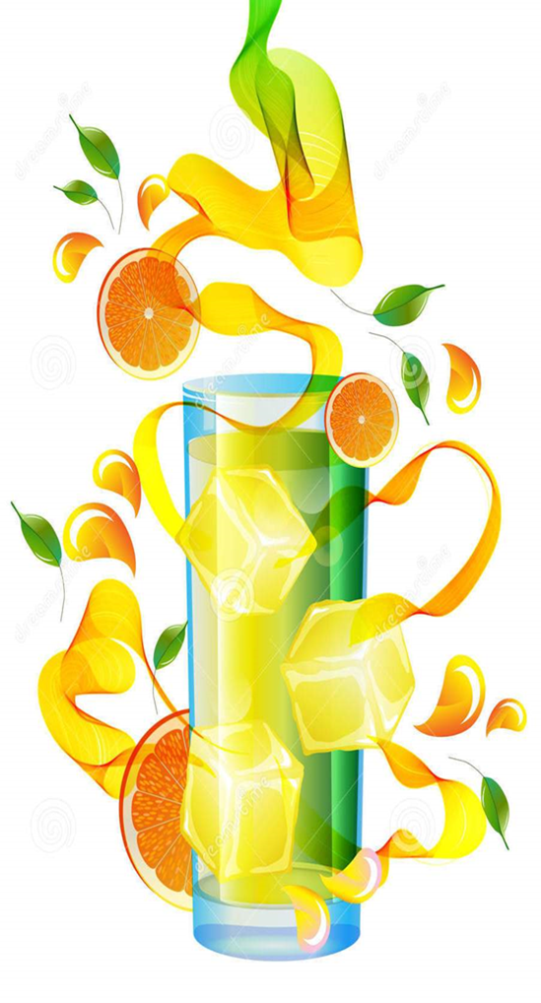

Thank you
Moderate consumption of OJ provides nutritional and dietary benefits with no adverse impact on body weight, while improves metabolic parameters in obese people

