Slide 1
Production of antisera to phenylbutazone and oxyphenylbutazone for use in immunochemical detection assays
Terry Fodey,
Chemical Surveillance Branch,
Veterinary Sciences Division,
Agri-Food and Biosciences Institute, Belfast, UK
Notes:
Note: Do not change background, font or font colours.

Slide 2
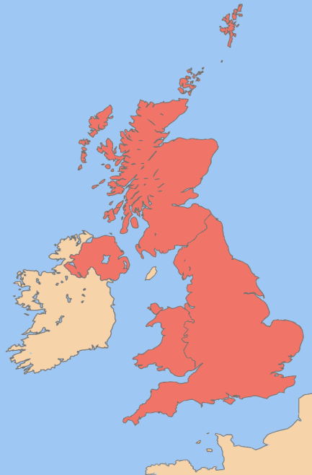
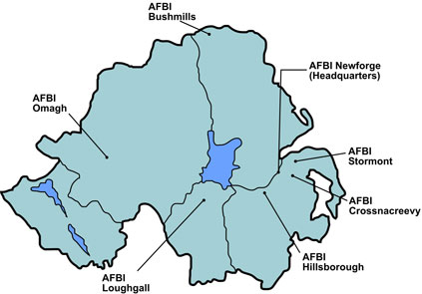
AFBI Location and Work Areas
Animal Health and Welfare
Crops and Grassland
Economics and Rural Development
Environment and Land-use
Fisheries and Aquatic Ecosystems
Food
Livestock
Notes:
Note: Insert duplicate slide to retain format of body copy slides. Do not change background, font or font colours.

Slide 3
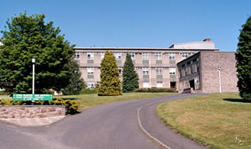
AFBI – Stormont, Veterinary Sciences Division
Virology
Bacteriology
Disease Surveillance and Investigation
Chemical Surveillance
National Reference Laboratory for veterinary drug residue control
Immunological screening assays - antibody production
Microbiological and TLC screening assays
Chromatography and mass spectroscopy chemical confirmation methods
Monitoring chemical residues in meat, milk, eggs and shellfish
Notes:
Note: Insert duplicate slide to retain format of body copy slides. Do not change background, font or font colours.

Slide 4
Scope of presentation
What is Phenylbutazone?
Why do we need an antibody to it?
Approaches to antibody production
Comparison of antisera performance
Conclusions
Notes:
Note: Insert duplicate slide to retain format of body copy slides. Do not change background, font or font colours.

Slide 5
What is Phenylbutazone?
A non-steroidal anti-inflammatory drug (NSAID)
Abbreviated to PBZ; often called “Bute”
Introduced to human medicine in 1949 for the treatment of rheumatoid and arthritic disorders
Found to induce disorders of the blood including aplastic anaemia, leukopenia, granulocytosis and thrombocytopenia, in some cases leading to death
Consequently, its use in human medicine became limited with the licence for use in man revoked in the U.K. in 1984
Notes:
Note: Insert duplicate slide to retain format of body copy slides. Do not change background, font or font colours.

Slide 6
Use in horses
Choice of NSAID for equines since its introduction to veterinary medicine in the 1950s
Substantial clinical history of efficacy and safety in horses accumulated over both short and long treatment periods
Horse meat is consumed in many countries
The CVMP assessed PBZ in 1997:
Health risks are blood dyscrasias and the genotoxic & carcinogenic potential
No thresholds identified so maximum residue limits could not be established
Therefore PBZ is not permitted for use in any food producing animals
Notes:
Note: Insert duplicate slide to retain format of body copy slides. Do not change background, font or font colours.

Slide 7
Eu protocols to prevent PBZ treated horses entering food chain
Since 2005 horses must have a passport for identification
Must be signed to declare if the animal is intended for human consumption
However PBZ prescribed without checking passport
Subsequent failure to sign out of food chain after prescription
Horses change owners with passport not signed to exclude from food chain
Medicated meal for one horse may be consumed by another animal
(VMD)
VMD (Veterinary Medicines Directorate)
http://aka-vmd.defra.gov.uk/VRC/pdf/PositionPaper_Phenylbutazone.pdf
Notes:
Note: Insert duplicate slide to retain format of body copy slides. Do not change background, font or font colours.

Slide 8
PBZ detection in Eu
From 2008-2012, 5.4% of equines tested were non-compliant
From 2008-2012, 0.3% of bovines tested were non-compliant
Notes:
Note: Insert duplicate slide to retain format of body copy slides. Do not change background, font or font colours.

Slide 9
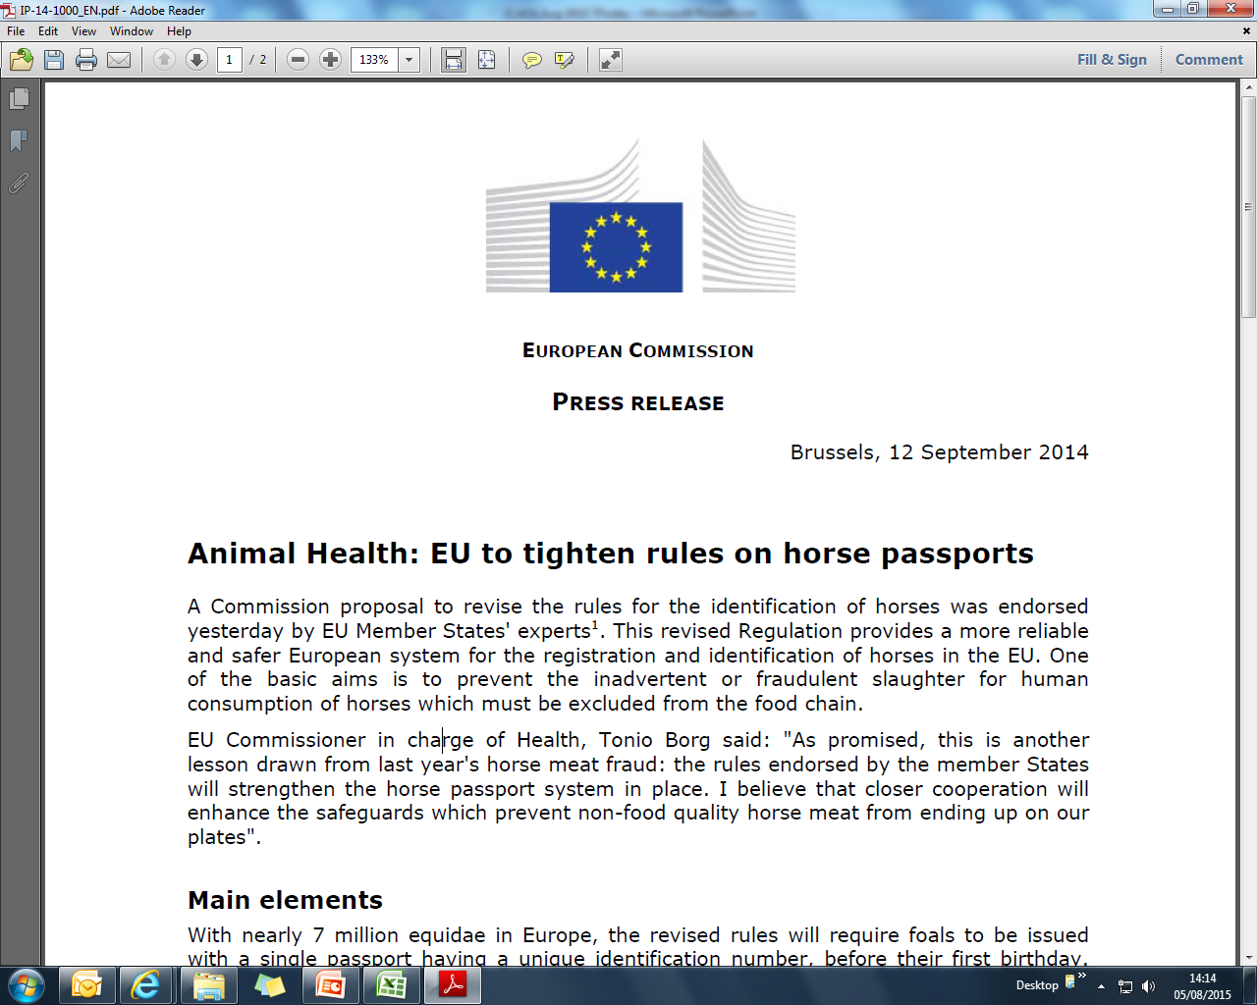
European Commission Press Release Brussels, 12 September 2014
Notes:
Note: Insert duplicate slide to retain format of body copy slides. Do not change background, font or font colours.

Slide 10
European Commission Press Release Brussels, 12 September 2014
Main elements
With nearly 7 million equidae in Europe, the revised rules will require foals to be issued
with a single passport having a unique identification number, before their first birthday.
The passport also serves as a medical record and will serve the horse over its lifetime. All
horses born after 1 July 2009 will need to be micro-chipped. Technical security features
aimed at reducing the risk of falsified passports have also been put in place.
The introduction of a compulsory centralised database in all Member States will assist the
competent authorities to better control the issuance of the passports by different passport
issuing bodies. It will also substantially simplify, for the keepers, the procedures for
updating the identification data in both the passport and the database of the issuing
bodies.
Next steps
The Regulation will apply from 1 January 2016. However, EU countries not already having
a centralised database will have until 1 July 2016 to put one in place.
Notes:
Note: Insert duplicate slide to retain format of body copy slides. Do not change background, font or font colours.

Slide 11
Residue sources
Feeding vessels can be contaminated
Untreated animals can become contaminated from treated ones
Fraudulent use of horsemeat as a substitute for beef
Uninformed use of drug
Illegal use of drug
Fodey, T. L., Smyth, W.G., Barnes, P., Traynor, I.M., Kennedy, D.G., Crooks, S.R.H. (2015) Investigation into sources of contamination of cattle with phenylbutazone. Veterinary Record 176(3) 74-76
Notes:
Note: Insert duplicate slide to retain format of body copy slides. Do not change background, font or font colours.

Slide 12
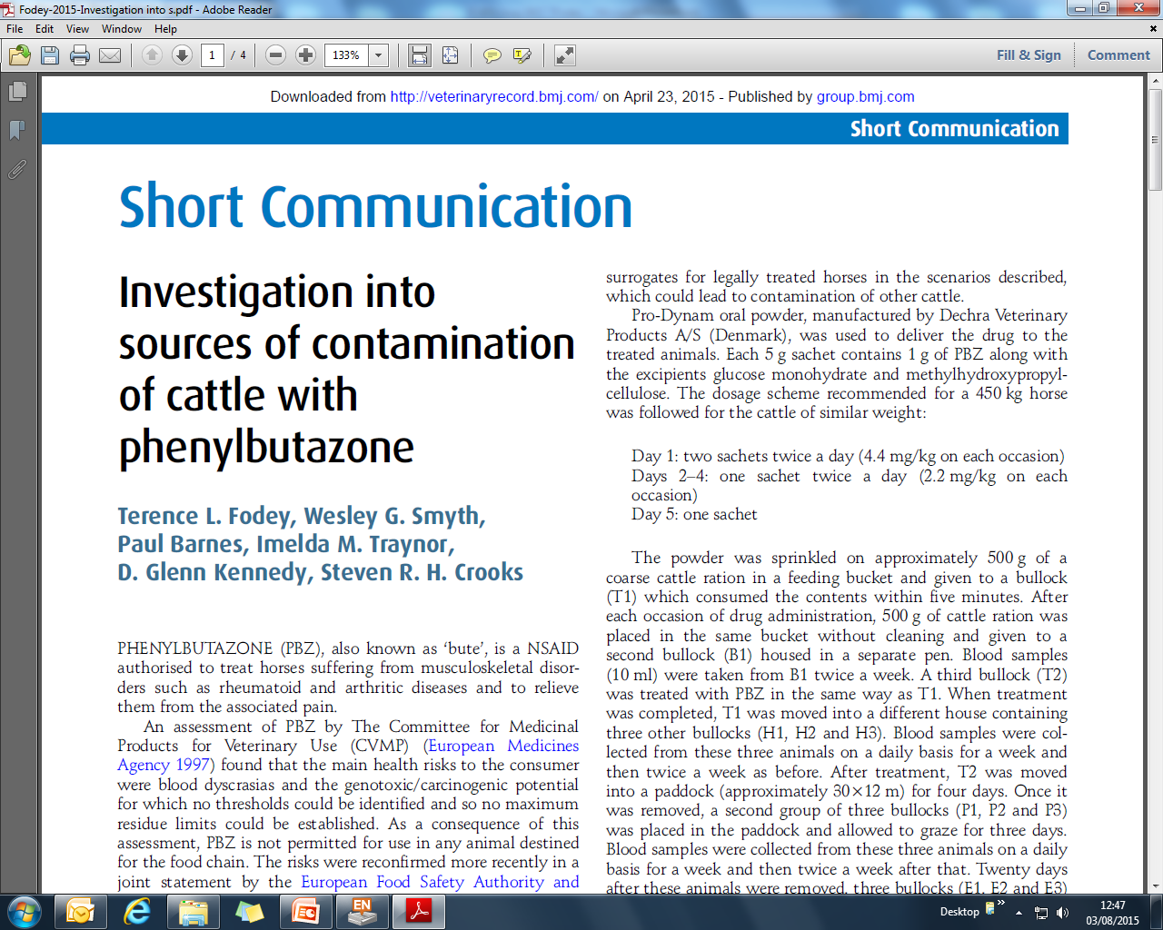
Contamination Investigation
Notes:
Note: Insert duplicate slide to retain format of body copy slides. Do not change background, font or font colours.

Slide 13
PBZ detection in Eu
From 2008-2012, 5.4% of equines tested were non-compliant
From 2008-2012, 0.3% of bovines tested were non-compliant
Physicochemical methods of analysis exist
Community reference laboratory recommended detection:
Substance | Matrix | Recommended conc
Phenylbutazone Oxyphenylbutazone | Muscle, kidney, liver, milk, plasma | 5 ppb
Notes:
Note: Insert duplicate slide to retain format of body copy slides. Do not change background, font or font colours.

Slide 14
Metabolites and analogues
The principal metabolites are oxyphenylbutazone and γ-hydroxyphenylbutazone
They possess analgesic/anti-inflammatory properties and thus contribute (probably small-moderate degree) to the pharmacological actions of phenylbutazone
For both metabolites, urine concentrations are much higher than those in plasma
Suxibuzone is a pro-drug of PBZ, designed to reduce gastro-intestinal disturbances. Also banned in food producing animals
Notes:
Note: Insert duplicate slide to retain format of body copy slides. Do not change background, font or font colours.

Slide 15
Immunogenicity
PBZ and its analogues are low molecular weight ranging from 308.4 Da (PBZ) to 428.5 Da (SBZ)
They need to be conjugated to large carrier proteins to render them immunogenic
Notes:
Note: Insert duplicate slide to retain format of body copy slides. Do not change background, font or font colours.

Slide 16
Hapten options for antibody production
Phenylbutazone
Oxyphenylbutazone
γ-Hydroxyphenylbutazone
Suxibuzone
Notes:
Note: Insert duplicate slide to retain format of body copy slides. Do not change background, font or font colours.

Slide 17
Suxibuzone-HSA (step 1)
Carboxylic acid activation via 1,1’-carbonyldiimidazole creates acyl imidazole reactive intermediate
Notes:
Note: Insert duplicate slide to retain format of body copy slides. Do not change background, font or font colours.

Slide 18
Suxibuzone-HSA (step 2)
Acyl imidazole intermediate species reacts with primary amine on carrier to generate stable amide linkage
Notes:
Note: Insert duplicate slide to retain format of body copy slides. Do not change background, font or font colours.

Slide 19
Oxyphenylbutazone-HSA (step 1)
Hydroxyl on OPBZ reacted with isocyanate group of N-(p-maleimidophenyl)-isocyanate (PMPI) leaving maleimide group available for reaction
N-succinimidyl-S-acetylthiopropionate (SATP) reacted with primary amine on carrier to add a sulfhydryl group for reaction
Notes:
Note: Insert duplicate slide to retain format of body copy slides. Do not change background, font or font colours.

Slide 20
Oxyphenylbutazone-HSA (step 2)
Maleimide and sulfhydryl groups brought together to create coupling of hapten to carrier
Notes:
Note: Insert duplicate slide to retain format of body copy slides. Do not change background, font or font colours.

Slide 21
γ-Hydroxyphenylbutazone-HSA (step 1)
Hydroxyl group on HPBZ is activated with N,N’-Disuccinimidyl carbonate to create succinimidyl carbonate intermediate
Notes:
Note: Insert duplicate slide to retain format of body copy slides. Do not change background, font or font colours.

Slide 22
γ-Hydroxyphenylbutazone-HSA (step 2)
Succinimidyl carbonate intermediate is reacted with amine on carrier to produce carbamate linkage
Notes:
Note: Insert duplicate slide to retain format of body copy slides. Do not change background, font or font colours.

Slide 23
Phenylbutazone-HSA (step 1)
p-Amino benzoic acid is diazotised before adding to PBZ
Kawashima, K., R. Dixon and S. Spector (1975) Development of radioimmunoassay for chlorpromazine. European Journal of Pharmacology 32(2)195-202
Notes:
Note: Insert duplicate slide to retain format of body copy slides. Do not change background, font or font colours.

Slide 24
Phenylbutazone-HSA (step 2)
The newly formed carboxylic acid is activated by carbodiimde reaction to allow coupling to carrier via amine
Notes:
Note: Insert duplicate slide to retain format of body copy slides. Do not change background, font or font colours.

Slide 25
Enzyme labels
Horseradish peroxidase was conjugated to each hapten by the same method as for the immunogen production
Each of the 4 enzyme labels were used for determination of antibody titre in direct competitive ELISA checkerboards for all sera samples
This created homologous and heterologous assay formats
Notes:
Note: Insert duplicate slide to retain format of body copy slides. Do not change background, font or font colours.

Slide 26
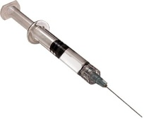
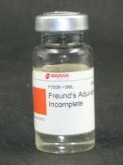
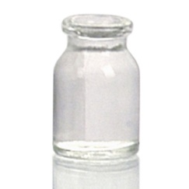
Immunisation
After conjugation the immunogens were purified and mixed with an adjuvant before administration to the host
Two rabbits were immunised for each immunogen
Immunise host under skin
+
=
Purified immunogen
Mineral oil adjuvant
Thickened emulsion
Re-immunise x 4-6
Remove blood to collect antisera containing specific antibodies
Y Y Y
Notes:
Note: Insert duplicate slide to retain format of body copy slides. Do not change background, font or font colours.

Slide 27
Immunisation
First boost after two weeks, then monthly
Blood samples taken 10 days after each immunisation were assessed for specific antibodies
Number of immunisations ranged from 6 to 8 before a satisfactory titre was obtained
Notes:
Note: Insert duplicate slide to retain format of body copy slides. Do not change background, font or font colours.

Slide 28
Homologous vs Heterologous
The SBZ-HRP enzyme label performed better than the other HRPs in combination with all antisera
Therefore for PBZ, OPBZ and HPBZ assays were heterologous while SBZ assay was homologous
Phenylbutazone
γ-Hydroxyphenylbutazone
Suxibuzone
Oxyphenylbutazone
Notes:
Note: Insert duplicate slide to retain format of body copy slides. Do not change background, font or font colours.

Slide 29
Antisera sensitivity and specificity
 | IC₅₀s (ng/ml) [% cross-reactivity]
Immunogen | PBZ | OPBZ | HPBZ | SBZ
PBZ-HSA (1) | 18.3 [100] | 53.9 [34] | >100 [ND] | 94.6 [19]
PBZ-HSA (2) | 5.5 [100] | 57.2 ]10] | >100 [ND] | 5.5 [100]
SBZ-HSA (1) | 4.6 [198] | 89.2 [10] | >100 [ND] | 9.1 [100]
SBZ-HSA (2) | 3.6 [39] | >100 [ND] | >100 [ND] | 1.4 [100]
OPBZ-HSA (1) | 5.8 [97] | 5.6 [100] | >100 [ND] | 2.2 [255]
OPBZ-HSA (2) | >100 [ND] | >100 [ND] | >100 [ND] | >100 [ND]
γ-HPBZ-HSA (1) | 7.7 [165] | >100 [ND] | 12.7 [100] | 7.3 [174]
γ-HPBZ-HSA (2) | 0.9 [433] | 9.3 [42] | 3.9 [100] | 3.7 [105]
ND = Not determined
All data produced using SBZ-HRP in direct competitive ELISAs
Notes:
Note: Insert duplicate slide to retain format of body copy slides. Do not change background, font or font colours.

Slide 30
Conclusions
Antisera to PBZ can be produced from all four haptens with γ-HPBZ and SBZ providing the best sensitivity
The most sensitive antisera to OPBZ are produced from OPBZ hapten
Only γ-HPBZ immunogen produced antisera capable of binding γ-HPBZ
As has been previously established there are significant variations in immune response between hosts
Phenylbutazone
γ-Hydroxyphenylbutazone
Suxibuzone
Oxyphenylbutazone
Notes:
Note: Insert duplicate slide to retain format of body copy slides. Do not change background, font or font colours.

Slide 31
Thanks
Colleagues from AFBI: Mr Paul Barnes and Dr. Steven Crooks for their assistance in this study
Professors Smith and Eremin for hosting this symposium and providing the opportunity for me to present this work
You for your attention
Notes:
Note: Insert duplicate slide to retain format of body copy slides. Do not change background, font or font colours.

