Slide 1

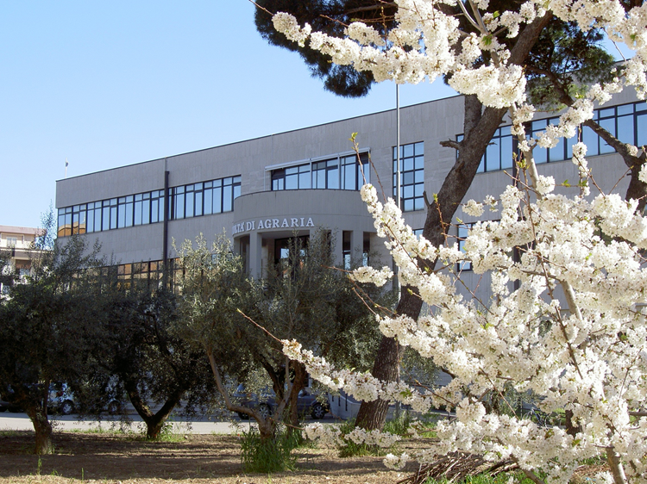





Department of Science of agriculture, Food and Environment (S.A.F.E.)
Via Napoli, 25 71122
Foggia, Italy
Ripening stage effect on nutritional value of low fat pastry filled with sweet cherries
(P. avium, cv. ‘Ferrovia’)
Teresa De Pilli*
Roma Giuliani
Carla Severini
Giuseppe Lopriore
Antonio Derossi
*Corresponding author, e-mail: teresa.depilli@unifg.it
Food Technology 2014 Conference, July 21-23, 2014 at Las Vegas, USA

Slide 2
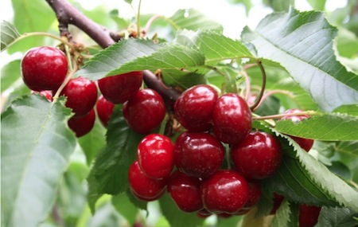

Focusing the problem
The consumption of high quantities of fat and sugar is associated with serious health problems such as coronary heart diseases and obesity.
Daily fat consumption in USA and Europe represents about 40% of total caloric intake against the 30% recommend by health specialists.

Slide 3
Focusing the problem
Despite those problems, fat and sugar cannot be easily replaced, especially in a complex food system such as soft pastries.
Fat provides flavour, mouth feel, appearance, palatability, texture and lubricity.
Sucrose provides volume, texture and sweetness.

Slide 4
TRADITIONAL TRENDS
Soft pastries are generally filled with creams with high content of sugars and fat rich in saturated fatty acids.
NEW TRENDS
The balancing of pastry recipe by decreasing the lipid fraction and substituting the sweet cream filling with minimally processed fruit.

Slide 5
Fruit and vegetable consumption is inversely associated with risk of cardiovascular diseases and it can be assumed that the protective role of fruit could be due to various nutrients such as fiber, vitamins and phytonutrients (Hsin-Chia et al., 2004).
Sweet cherry (Prunus avium L.) is one of the most appreciated fruit by consumer thanks to its excellent sensorial characteristics and its content of phenolics and anthocyanins that contribute to total antioxidant activity. It is also thought to alleviate the pain associated with arthritis and gout.
They contain both hydrosoluble (C, B) and liposoluble (A, E and K) vitamins, carotenoids (in particular beta-carotene) and minerals such as calcium, magnesium, phosphorous and potassium.

Slide 6
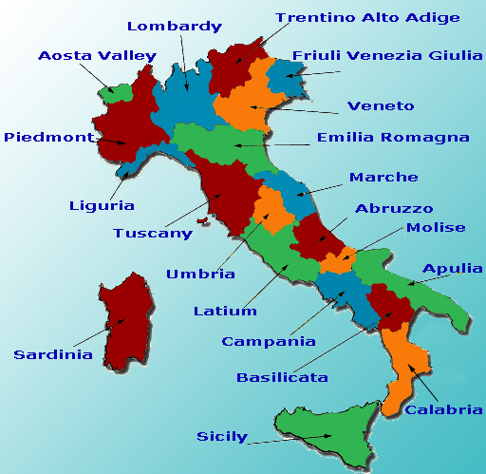
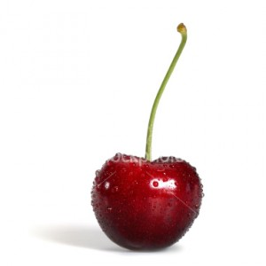
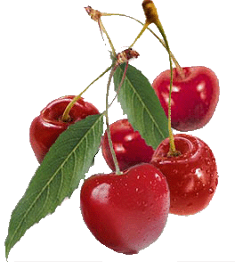

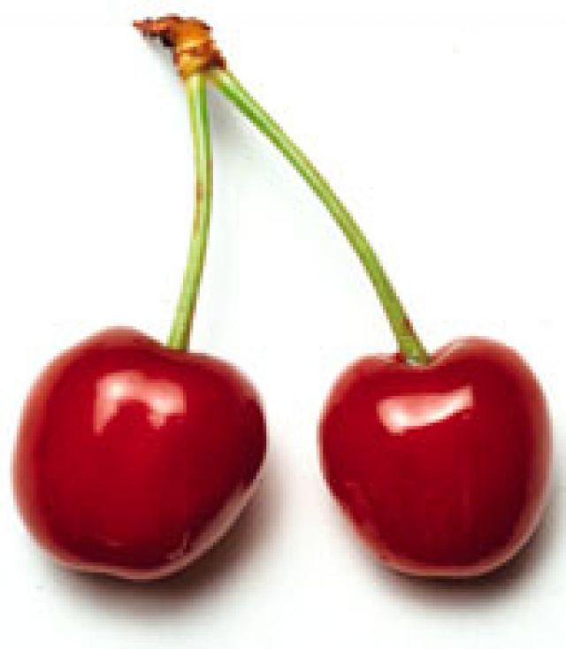
Sweet cherries for fresh consumption are one of the most popular spring-summer fruits across the temperate regions of Europe.
Apulia thanks to its geographic position is the main Italian region for harvesting and commercializing of sweet cherries. In particular, ‘Ferrovia’ cultivar, that ripens medium-late (between the first and second decade of June) is the most diffused variety.

Slide 7
Almost the whole production is addressed to fresh market even if a considerable percentage (15% EU production) is used in food industry.
In particular, France, Italy and Spain are oriented towards the processing industry.
The main uses are:
canning (cherries in syrup and other products),
preparations with alcohol (partly for the confectionery industry)
sugar-preservation (candied fruit, jam, etc.)
The quality of fresh fruit mainly
depends on ripeness stage.

Slide 8
Fruit ripening is a complex process influenced by several factors.
The changes in composition of sugars, organic acids and volatile compounds during ripening process play a key role in flavour development and can affect the chemical and sensorial characteristics of fruit (e.g., pH, total acidity, microbial stability, sweetness).
For this reason, many studies were carried out to evaluate the effects of ripening stage on quality of fresh sweet cherries.

Slide 9
Yet, scanty are the researches on the effects of ripening on processed sweet cherries.
This subject is very important because of the significant chemical, physical and nutritional changes occurring during ripening that could make the standardization of the final product very difficult.

Slide 10

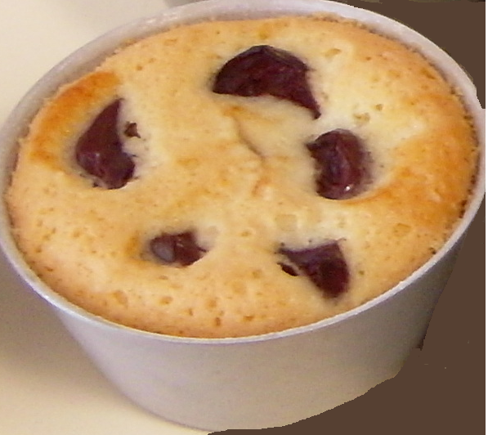
AIMS
Study of innovative pastry filled with partially osmo-dehydrated sweet cherries of ‘Ferrovia’ variety.
Evaluation of ripening stage effects on qualitative and chemical characteristics of final product during storage.

Slide 11
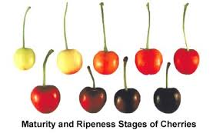
MATERIALS AND METHODS
Raw Materials
Sweet cherries ‘Ferrovia’ cultivar were supplied by Netti Lucia’s farm (countryside Sammichele, Bari, Italy).
Samples were picked from unique, 19 years old tree having a crop load of almost 40 kg, considering harvesting time referred to the date of commercial harvest for fresh consumption.
Two harvest dates were considered: medium ripening harvest (at commercial harvest) and late harvest (5 days after commercial harvest).
On each harvest date an approximately 2 kg sample of fruit was randomly collected. 1.5 kg of sweet cherries was osmo-dehydrated and the remaining the 0.5 kg was analysed.
Ingredients (wheat flour, sucrose, white eggs, maize starch, olive oil and baking powder, emulsifier and thickener) used to produce pastries were purchased on the local market.

Slide 12
MATERIALS AND METHODS
Osmo-dehydration treatment
Stems were removed from fruits and, after washing, sweet cherries were blanched by microwave oven Samsung mod. CE 116KT (Milan, Italy) at 900 W for 330 sec.
The blanching treatments were carried out dipping 500 g of sweet cherries into 1 L of distilled water.
Then, they were cooled by running water, drained and dipped into an osmotic solution at 60 °Bx.
The osmotic treatment was carried out stirring the solution with sweet cherries at room temperature for 150 min.
After osmo-dehydration treatment, sweet cherries were washed by running water to remove the surplus of osmotic solution and gently blotted by paper.
The partially osmo-dehydrated sweet cherries were packed in plastic bags and stored at + 4 °C before utilization.

Slide 13
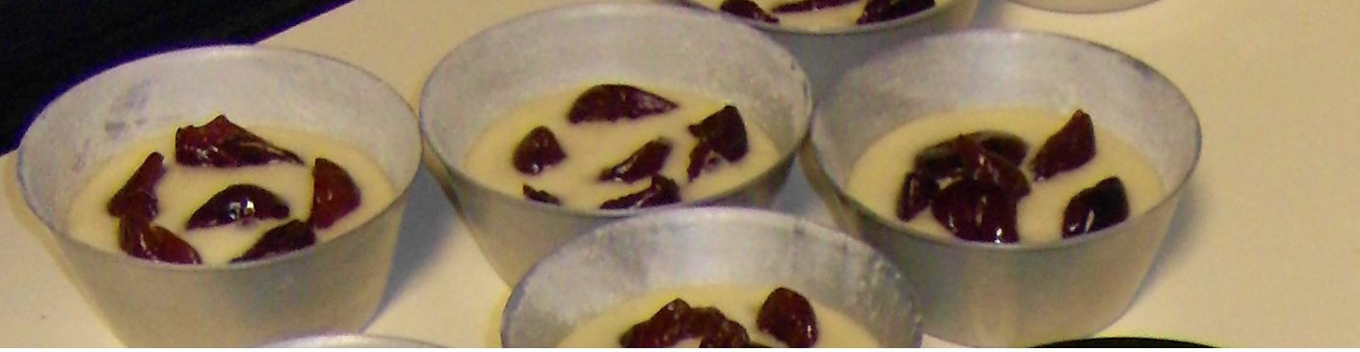
MATERIALS AND METHODS
Filled pastries production
Pastries were prepared by blending all ingredients by kneading mod. KJ-1302 Kennex (Sesto Fiorentino – FI, Italy) in order to obtain a sponge dough that was put into muffin mould with capacity of 50 mL.
Each mould contained 28 g of dough and 6 g of sweet cherries. Half of the samples were prepared using medium ripening harvest sweet cherries and the others with late harvest sweet cherries.

Slide 14


MATERIALS AND METHODS
Filled pastries production
All samples were baked at 180 °C for 20 min by convection oven Hot-Point ARISTON CP97SE2/HA INOX (Fabriano, Italy).
Samples were cooled, packed into plastics (PET12 – PP/EVOH/PP60) bags (5 samples each bag) and stored at room temperature for 85 days.
Two bags for each ripening stage were taken every 17 days to evaluate the chemical and mechanical characteristics changes of samples during storage.

Slide 15

MATERIALS AND METHODS
pH;
Soluble solids content;
Moisture content (%);
Water activity determination;
Texture profile analysis (TPA);
Determination of antioxidant capacity (DPPH method).
Statistical analysis
The two-way analysis of variance (ANOVA) test was carried out to evaluate the effects of ripening stage and storage time on results of considered analytical indexes by software StatSoft ver. 6.0 (Statsoft, Tulsa, USA). The means of these results were compared by the Fisher’s test.
Analyses

Slide 16
RESULTS

Slide 17
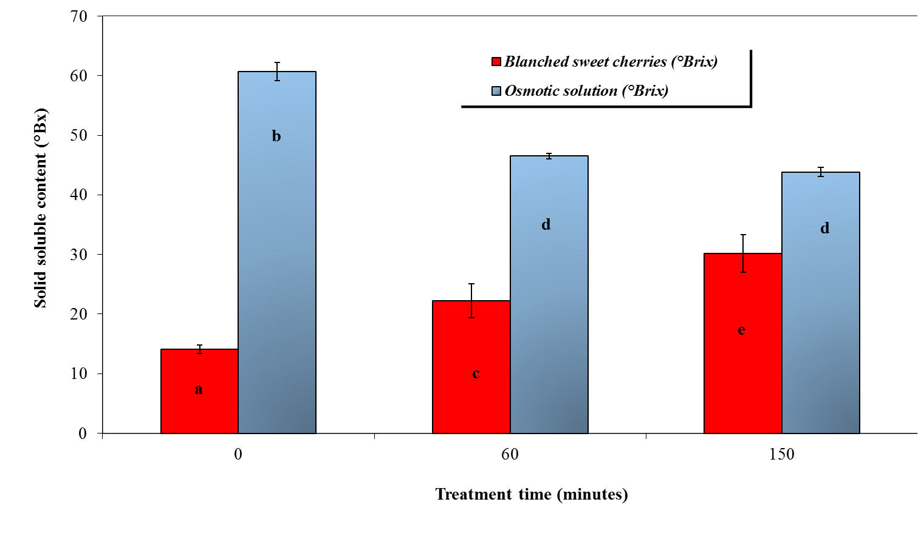
Figure 1: values of soluble solid content (°Brix) of blanched sweet cherries and osmotic solution at different treatment times.

Slide 18
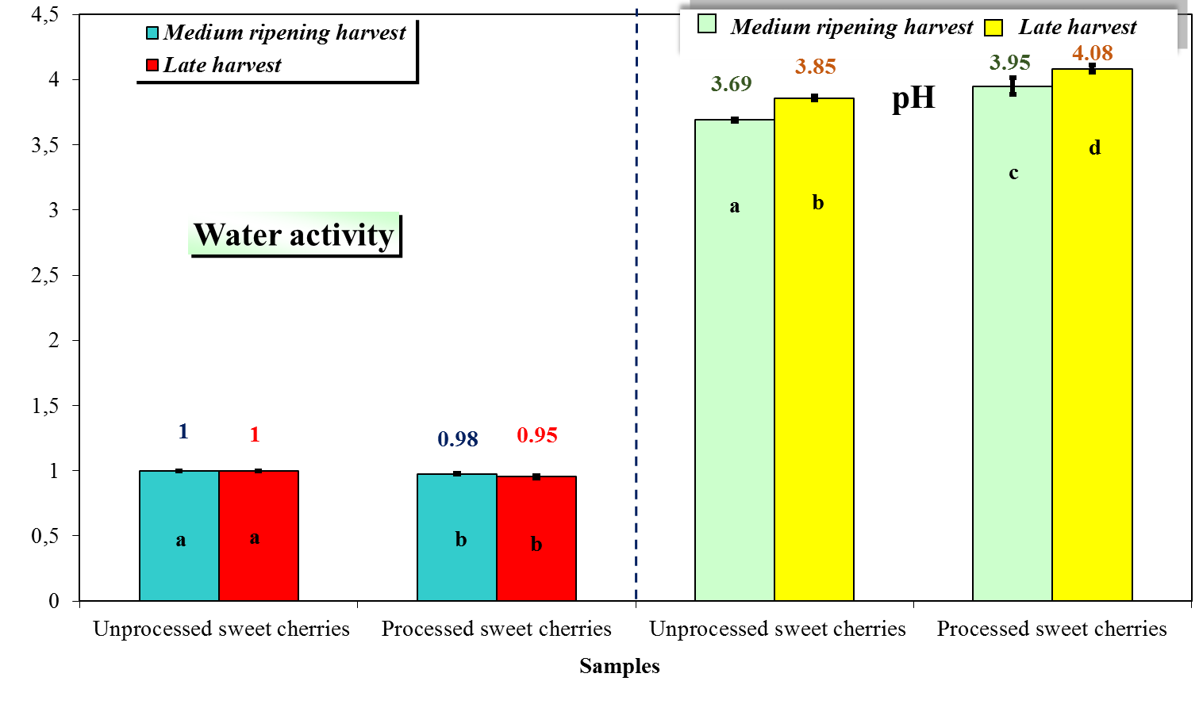
Figure 2: values of water activity and pH of unprocessed and processed sweet cherries harvested at different ripening stages.

Slide 19
Variance analysis results show a significant effects of both storage time and ripening stage on chemical and mechanical characteristics that we are evaluated.

Slide 20
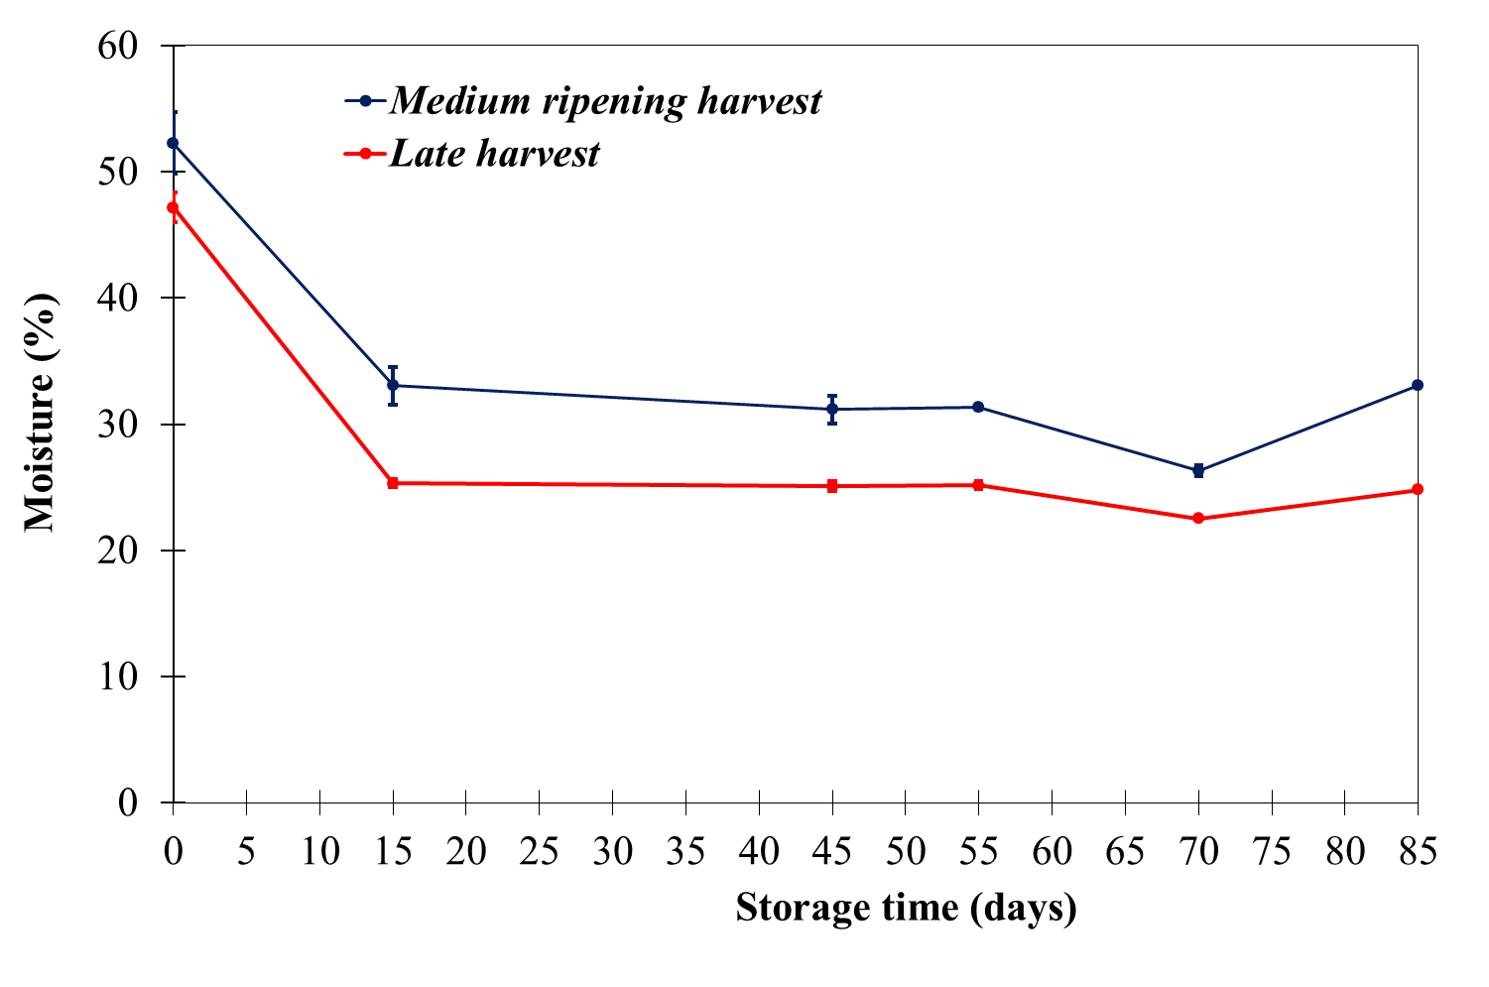
Quickly dehydration during backing
Moisture decrease very
quickly in the first 15 days
Moisture of LH fruit
was less than MH
Figure 3: moisture content of sweet cherries of both ripening stage used to fill pastries as a function of storage time.

Slide 21
Figure 4: water activity values of sweet cherries of both ripening stage used to fill pastries as a function of storage time.

Slide 22
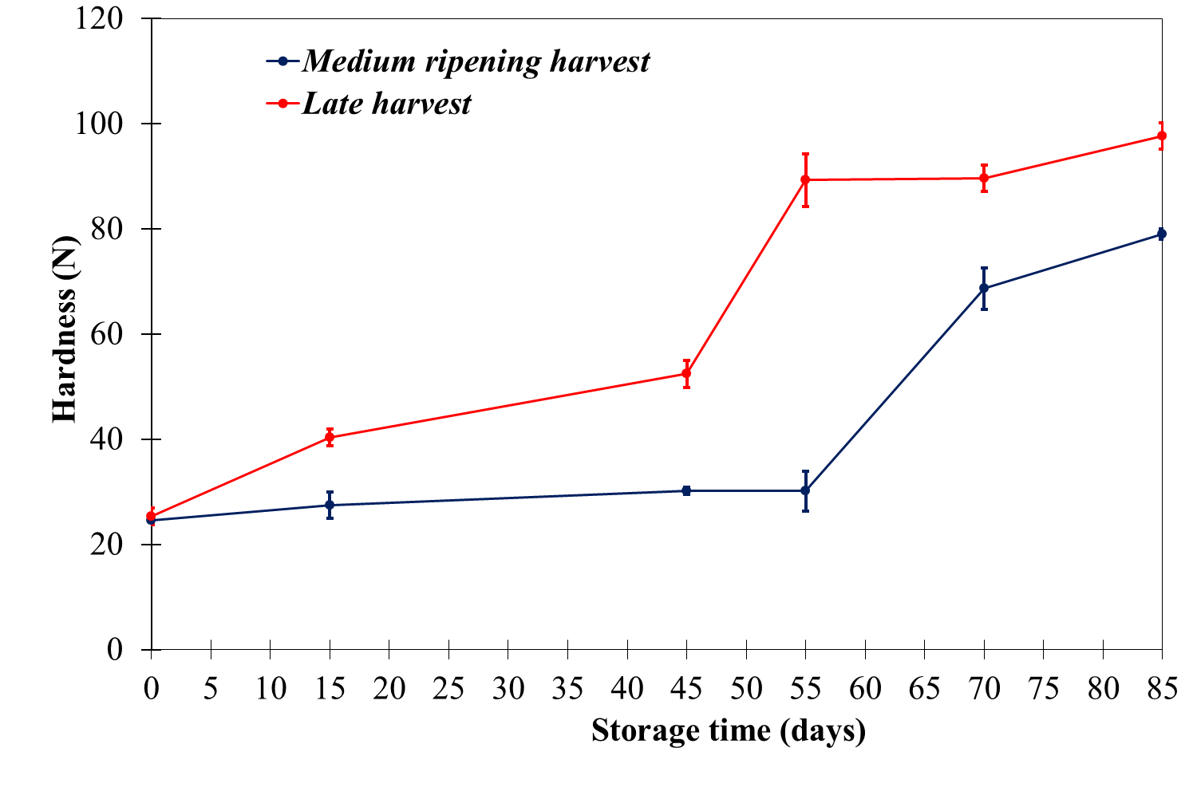
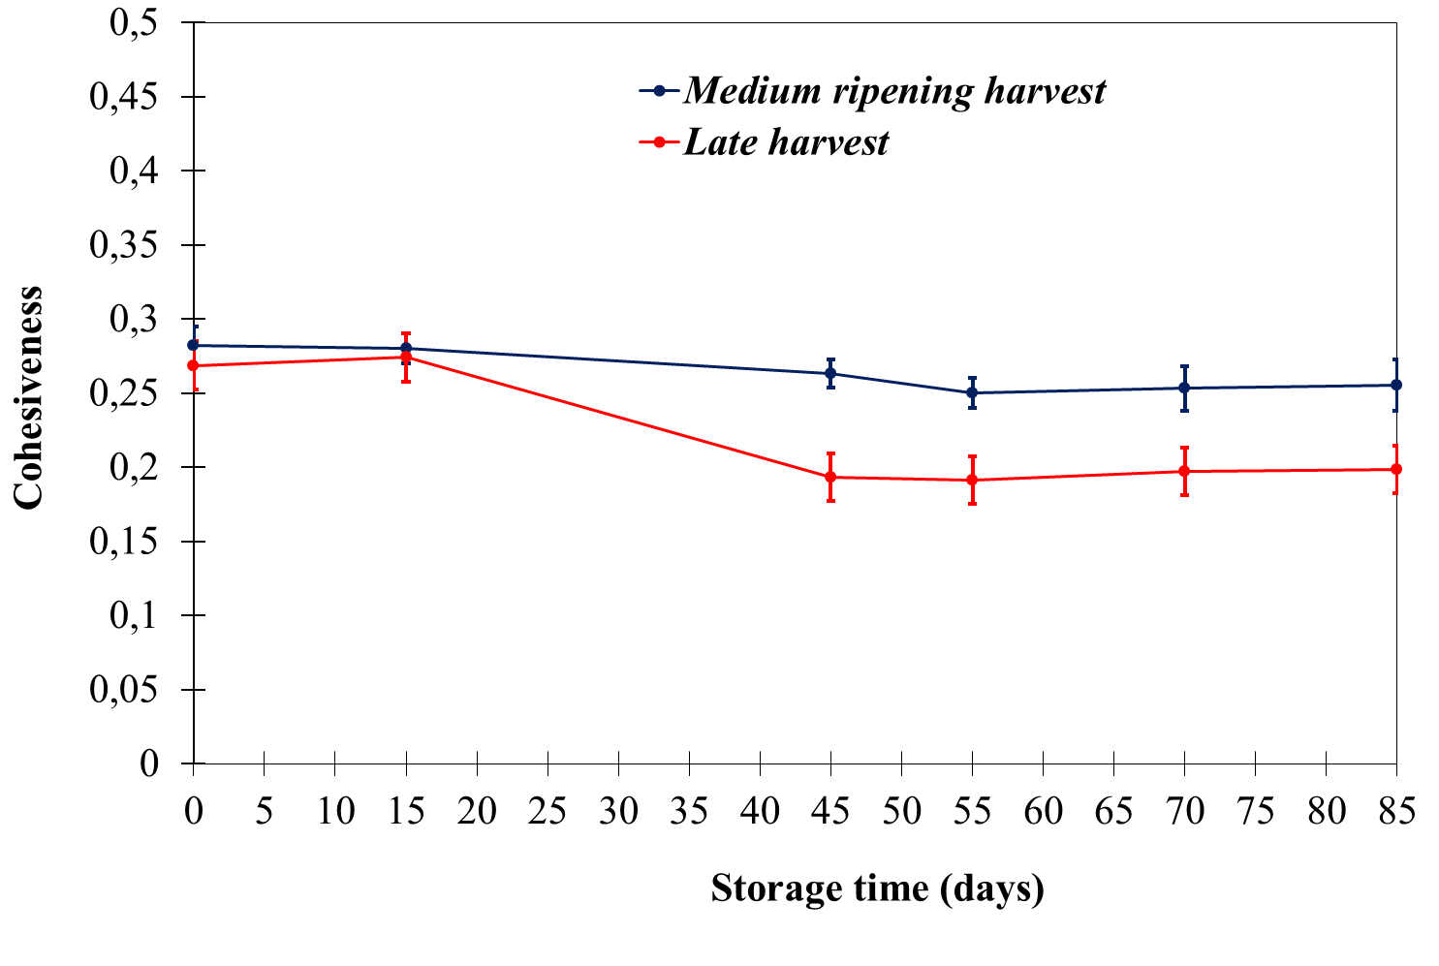
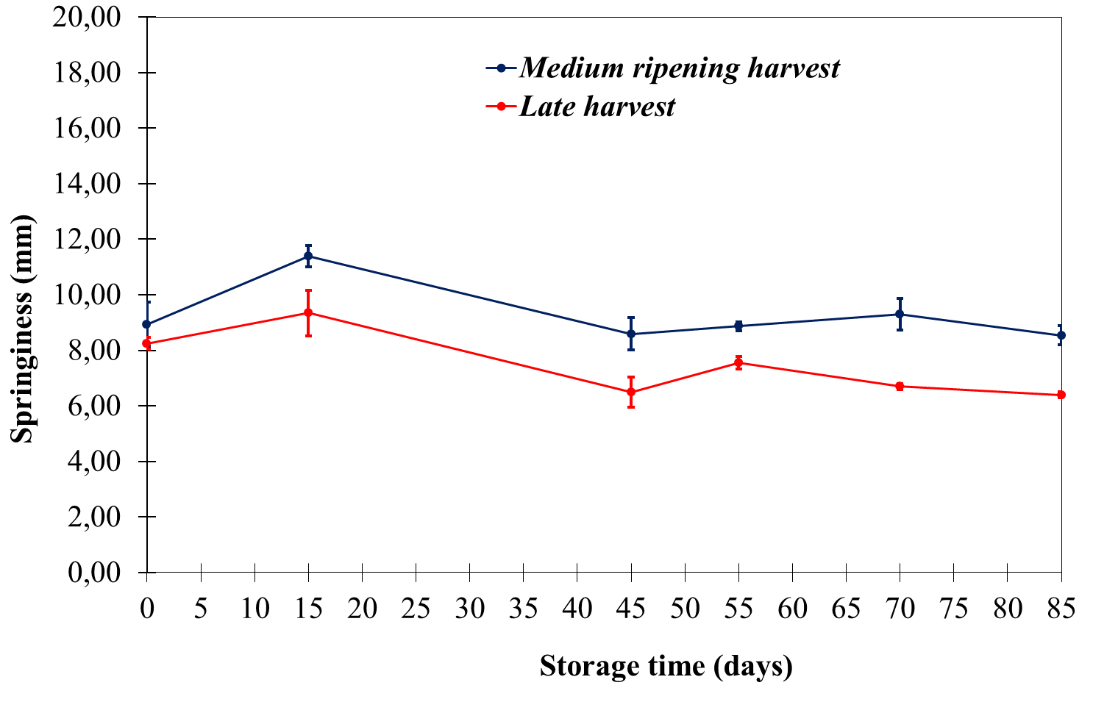
Figure 5: mechanical properties of pastries filled with sweet cherries of both ripening stage as a function of storage time.

Slide 23
Figure 8: antioxidant activity of fresh, processed and stored sweet cherries harvest at different ripening stages and used to fill pastries.

Slide 24
CONCLUSION
The ripening stage of sweet cherries is important not only for fresh consumption but also when this fruit is processed for industrial use.
Overripe cherries should not be used to produce filling for pastry particularly if packaging is not planned, because of the greater dehydration during cooking and storage that involves the product’s mechanical properties falling off.
The significant decrease of antioxidant capacity observed in late harvest sweet cherries after technological treatment and storage could compromise the functional properties of final product.
Finally, these results highlight the importance of ripening stage of processed fruit used as ingredient in complex food in order to obtain a product with good quality and functional properties.

Slide 25


