Slide 1
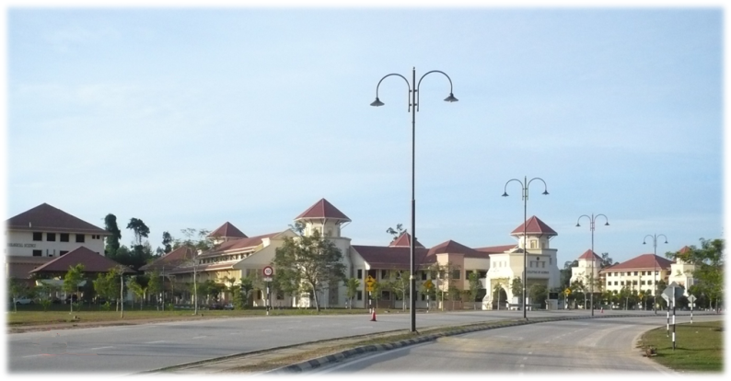
Anti-proliferative bacteriocins active against MRSA from coagulase negative Enterococcus mundtii strain C4L10 isolated from non-broiler chicken
Tengku Haziyamin Abdul Hamid, Moshood A. Yusuf, &
Solachuddin J. A. Ichwan
Department of Biotechnology,
Kulliyyah of Science, International Islamic University Malaysia, Bandar Indera Mahkota, Jalan Istana, 25200 Kuantan, Malaysia.
Tel: +609-61964000
Fax: +609-61966781
haziyamin@iium.edu.my

Slide 2
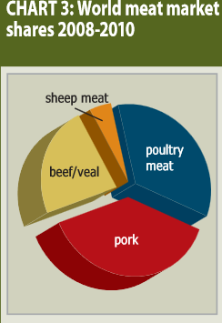
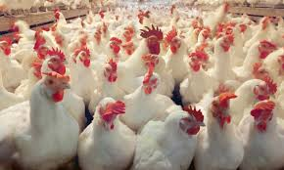
Global trend of poultry meat
In 2011, poultry meat reaches a production milestone of 100 million metric tones
Sources : The Watt Executive Guide (2011) Statistical reference for poultry executive2011.
Website: http:www.wattag.net.

Slide 3
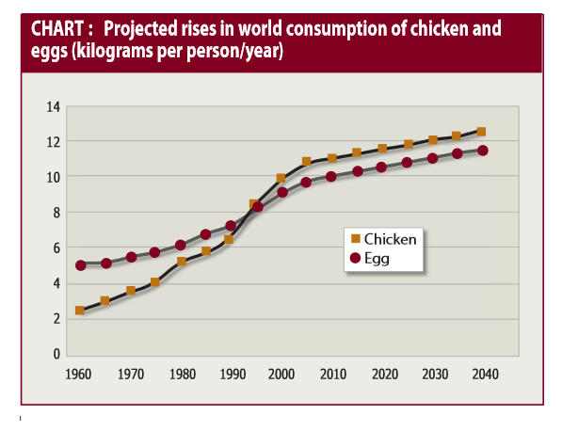
Global poultry demand: New challenges
Potential market size projected based on human population growth from 6 billion (in1999) to 7.5 billion (in 2020)
Emerging Issues:
Avian Influenza
Escalating animal feed prices

Slide 4
Probiotics fill the gap?
the increase poultry productivity - emergence of a large variety of pathogens and bacterial resistance.
the indiscriminate use of chemotherapeutic agents as a result of management practices in rearing cycles
(Kabir, 2009; Trafalska & Grzybowska, 2004)

Slide 5
The search for an alternative antibiotics
Residual antibiotics in meat
Growing interest in organic food
Enteric diseases in poultry and the contamination risk in meat products.

Slide 6
Lactic acid bacteria as the sources of bacteriocin
Ubiquitous gram positive, catalase-negative, non-sporulating, aerotolerant
Fermentative organisms that produce lactic acid as the major end product of carbohydrate metabolism
Many producing bacteriocin
Bacteriocins -
Proteinaceous antibacterial substances
ribosomally synthesized
produced by bacteria and probably by all prokaryotic species
(Axelsson ,1998 )
.

Slide 7
Class: 11 bacteriocin subclasses
Class IIa are the pediocin-like bacteriocins which have antilisterial activity
Class IIb are two-peptide bacteriocins, e.g. Lacticin F and Lactococcin G, while
Class IIc include other peptide bacteriocins secreted by a sec-dependent mechanism .
The class III bacteriocins, have been found in Lactobacillus, and include heat labile proteins of large molecular mass.
The class IV bacteriocins are a group of complex proteins, associated with other lipid or carbohydrate moieties, which appear to be required for activity. They are relatively hydrophobic and heat stable (Alpay et al., 2003).

Slide 8
Benefit of Bacteriocin in foods
Example: Nisins,
Prevents chlostridial spoilage of processed and natural cheeses
inhibits the growth of some psychrotrophic bacteria extending the shelf life of milk in warm countries
It has also been used in the control of Listeria monocytogenes in meats
(Ariyapitipun et al., 2000)

Slide 9
The potential benefits of using bacteriocin in livestock
Stimulation of animal productivity:
The inhibition of specific groups of organisms (Russell and Mantovani, 2002).
Reduction in amino acid degradation (Rychlik and Russell, 2002a).
Improvement of feed efficiency as a result of reduction in the amount of carbon lost in the form of methane by inhibiting methanogenic bacteria (Lee et al., 2002).

Slide 10
Scope and Aims
Non-broiler chicken as the target source for LAB which was further studied for future use as a probiotic in broiler chicken.
mainly fed with household food which is generally free of antibiotics
free of confinement in large-scale (commercial) production.
Main the objectives of the work
To isolate bacteriocin from LAB strains from non-broiler chicken
To investigate the antimicrobial potential of the protein or bacteriocin produced against common pathogenic strain such as Staphylococcus aureus.
To explore the potential bacteriocin against proliferation of huan neoplastic cell

Slide 11
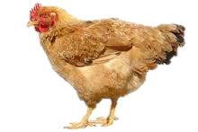
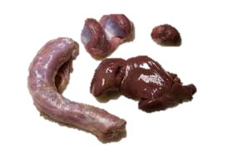

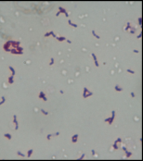
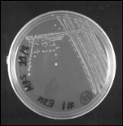
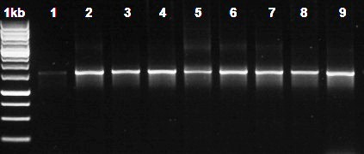
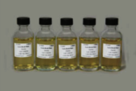
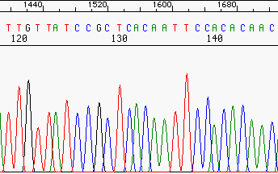
Methodology & Workflow
Protein extracted using three phase partitioning (TPP) (Denisson & Lovrein 1997)
Non-broiler Chicken
Protein Characterizations
SDS-PAGE
Disc diffusion
pH, temperatures stabilities
Tissues from various non-broiler organs (liver, gizzard, bile)
TPP Purification
Bacteriocin extract tests on neoplastic cell lines
PCR ribosomal rRNA gene (1.5kb) from isolates were amplified and sequenced using ribosomal RNA primers
Morphological and Biochemical Studies, Antagonistic test by Disc diffusion
Strain selected from MRS plates, purification of single colonies

Slide 12
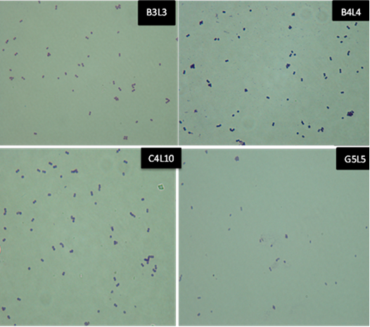
Characterisation of Isolates: Gram stains and morphology studies

Slide 13
Strain characterisations
Characteristics |  | Strains
 |  | B3L3 | B4L4 | G5L5 | B5L6 | B10L7 | I1L8 | C4L10
Gram stain reaction/ Morphology |  | +/C | +/C | +/C | +/C | +/C | +/C | +/C
Motility |  | - | - | - | - | - | - | -
Catalase activity |  | - | - - | - - | - | - | - | -
Glucose fermentation |  | + | + | + | + | + | + | +
Growth in 0.4% sodium azide |  | + | + | + | + | + | + | +
Gas formation |  | - | - | - | - | - | - | -
Citrate test |  | - | - | - | - | - | - | -
NH₃from Arginine |  | - | - | - | - | - | - | -
Growth at temperature (°C) | 4 | + | + | + | + | + | + | +
 | 10 | + | + | + | + | + | + | +
 | 28 | + | + | + | + | + | + | +
 | 37 | + | + | + | + | + | + | +
 | 45 | + | + | + | + | + | + | +
 | 65 | + | + | + | + | + | + | +
Utilization of | Malate | - | D | d | + | + | + | D
 | Serine | - | D | d | + | + | + | D
 | Gelatin | - | D | d | + | + | + | D
Growth at pH | 2 | + | + | + | + | + | + | +
 | 5 | + | + | + | + | + | + | +
 | 6 | + | + | + | + | + | + | +
 | 7 | + | + | + | + | + | + | +
 | 7.5 | + | + | + | + | + | + | +
 | 8 | + | + | + | + | + | + | +
 | 9 | + | + | + | + | + | + | +
 | 10 | + | + | + | + | + | + | +
Growth at 6.5% NaCl |  | + | + | + | + | + | + | +
Pigment production | - | - | - | - | - | - | - | +

Slide 14
Characterisation (cont’d)
Acid Production from | L- Arabinose | + | - | - | - | - | - | +
 | Esculin | + | + | + | + | + | + | +
 | Fructose | + | + | + | + | + | + | +
 | Galactose | + | + | + | + | + | + | +
 | Glucose | + | + | + | + | + | + | +
 | Lactose | + | + | + | + | + | + | +
 | Mannose | + | + | + | + | + | + | +
 | D-xylose | - | - | - | - | - | - | +
 | Melibiose | + | + | + | - | - | - | -
 | Raffinose | + | + | + | - | - | - | -
 | Sorbitol | - | - | - | - | - | - | -
 | Sucrose | - | - | - | + | + | + | -
 | Ribose | + | + | + | + | + | + | +
 | Cellobiose | + | + | + | + | + | + | +

Slide 15
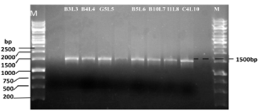
Ribosomal rRNA gene amplification
PCR amplification of 1500bp16S rRNA from isolated Enterococcus strains on 1% agarose gel. Legend: M: 1kb Marker (Fermentas GeneRuler 1kb DNA Ladder) B3L3: Ent. faecium, B4L4: Ent. hirae G5L5: Ent. hirae, B5L6=Ent. faecalis B10L7: Ent. faecalis; I1L8: Ent. faecalis; C4L10: Ent. mundtii.

Slide 16
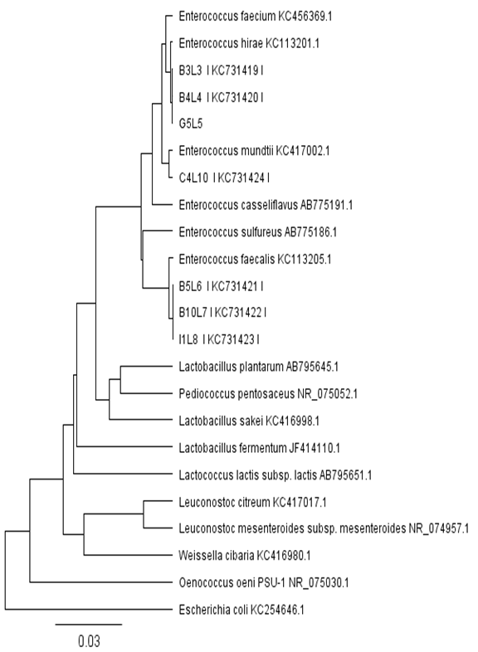
The Phylogenetic studies based on 16S rRNA gene sequences.
Assigned accession numbers for Enterococci isolate at Genbank NCBI database
Strains | Isolates | Total Score | Query Coverage | Max Indent (%) | Accession Nos.
B3L3 | Ent. faecium | 2034 | 100% | 97 | KC731419
B4L4 | Ent. hirae | 2006 | 98 | 97 | KC731420
G5L5 | Ent. hirae | 1803 | 98 | 96 | -
B5L6 | Ent. faecalis | 1406 | 92 | 89 | KC731421
B10L7 | Ent. faecalis | 1840 | 97 | 96 | KC731422
I1L8 | Ent. faecalis | 1893 | 99 | 96 | KC731424
C4L10 | Ent. mundtii | 1567 | 98 | 97 | KC731423
Yusuf M. A. and Tengku H. T. A. H (2013). Isolation of coagulase negative Enterococcus sp. strains from non-broiler chicken producing bacteriocin active against Staphylococcus aureus. J. Agrobiology. 30(1): 33-42

Slide 17
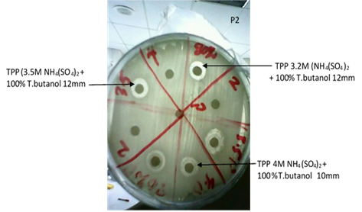
Inhibition studies
Strains showed antagonistic activities on S. aureus MRSA indicator strain in agar diffussion methods

Slide 18
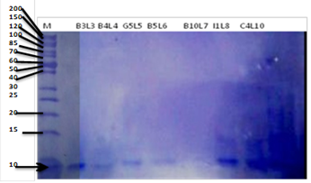
Purification of bacteriocins
Sample | Volume (ml) | Activity¹ (AU/ml) | Total Activity (AU) | Protein (mg/ml) | Total ⁵ protein (mg) | Specific Activity² (AU/mg) | Yield³ (%) | Purification Factor⁴
Crude Sample | 2 | 800 | 1600 | 13 | 26 | 61.5 | 100 | 1
TPP 3.2M NH₄(SO₄)₂ +100% Tert. butanol) | 0.2 | 400 | 800 | 7 | 1.4 | 571.4 | 50 | 9.291
SDS-PAGE analysis of purified extract on 12% SDS-PAGE gel.
Bands produced with an approximate molecular weight of the protein was 10kDa from purified extract of the isolated strains B3L3, B4L4, G5L5, B5L6, B10L7, I1L8 and C4L10. Standard protein marker Fermentas pageRuler 10-200).

Slide 19
Characterisaion of purified bacteriocins
Treatment | Residual antibacterial activity (%)
 | B3L3 | B4L4 | G5L5 | B5L6 | B10L7 | I1L8 | C4L10
Heat treatment
-20°C/15min | 50 | 50 | 50 | 50 | 50 | 50 | 50
100°C/15min | 50 | 50 | 50 | 50 | 50 | 50 | 50
121°C/15min | 20 | 20 | 20 | 20 | 20 | 20 | 20
pH
6 | 50 | 50 | 50 | 50 | 50 | 50 | 50
7 | 100 | 100 | 100 | 100 | 100 | 100 | 100
8 | 100 | 100 | 100 | 100 | 100 | 100 | 100
9 | 50 | 50 | 50 | 50 | 50 | 50 | 50
10 | 50 | 50 | 50 | 50 | 50 | 50 | 50
Enzymes (1mg/ml)
Proteinase K | 0 | 0 | 0 | 0 | 0 | 0 | 0
Trypsin | 0 | 0 | 0 | 0 | 0 | 0 | 0
Catalase | 100 | 100 | 100 | 100 | 100 | 100 | 100
Lysozyme | 100 | 100 | 100 | 100 | 100 | 100 | 100
Organic solvents
Ethanol | 100 | 100 | 100 | 100 | 100 | 100 | 100
Chloroform | 100 | 100 | 100 | 100 | 100 | 100 | 100
Acetone | 100 | 100 | 100 | 100 | 100 | 100 | 100
Methanol | 100 | 100 | 100 | 100 | 100 | 100 | 100
No treatment | 100 | 100 | 100 | 100 | 100 | 100 | 100

Slide 20
Amplification of Enterocin genes
Strains | Enterocin genes
 | Enterocin_A | Enterocin_B | Enterocin_P | Enterocin_L
I1L8 | + | - | + | +
B4L4 | - | + | + | +
C4L10 | - | + | + | -
Amplification using several bacteriocin gene primers
Du Toit, M., Franz, C. M. A. P., Dicks, L. M. T., & Holzapfel, W. H. (2000). Preliminary characterization of bacteriocins produced by Enterococcus faecium and Enterococcus faecalis isolated from pig faeces. J. App. Microb., 88, 482–494

Slide 21
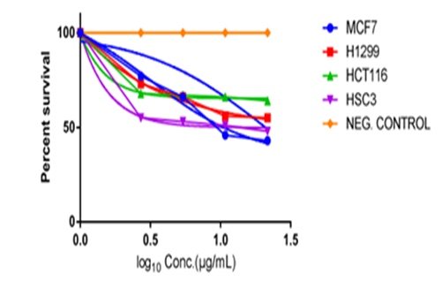
BACTERIOCIN ON CELL VIABILITIES
Concentration (µg/mL) | % Viable cells*
 | MCF7 | H1299 | HCT116 | HSC3
21.6 | 43.95 | 55.26 | 64.47 | 48.12
10.8 | 46.84 | 56.05 | 66.74 | 51.55
5.4 | 66.58 | 66.84 | 67.56 | 53.68
2.7 | 77.11 | 73.42 | 68.18 | 55.81
0 | 100 | 100 | 100 | 100
Dose-response of the effect of bacteriocin from isolate C4L10 on cell viability of cell lines Lung Cancer H1299, Breast cancer MCF7, Colon cancer HCT116 and Oral cancer HSC3. Incubation of the setup was done for 24 hr at 37°C under 5% CO₂ with 2.68, 5.35, 10.69 and 21.39µg/mL concentration of the bacteriocin. Cell viability was determined by the MTT assay. Estimation of the IC₅₀ of the analysed and plot generated using GraphPad software.

Slide 22
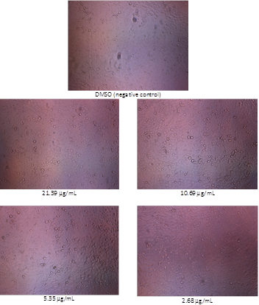
Effect on human cancer cell lines (eg. HSC-3)
DMSO
Control
Effect of bacteriocin extract from strain C4L10 on the viability of HSC-3 cancer cell line.
The non viable cells are seen floating.
Untreated cells, (Dimethyl Sulfoxide (DMSO) negative control),
Cells treated with increasing concentration
2.68 mg/ml (A), 5.35 µg/ml (B), 10.69 µg/ml (C), 21.39 µg/ml (D) of bacteriocin
(magnification: 20x, inverted)
D C
B A

Slide 23
Conclusions
Several strains isolated from local non-broiler chickens from genus coagulase negative Enterococcus ( strains B3L3, B4L4, G5L5, B5L6, B10L7, I1L8, and C4L10) capable of producing bacteriocin active against S. aureus MRSA.
Bacteriocin from strain C4L10 were purified by TPP method, and characterized to be 10kDa probably class IIa type bacteriocin
It is effective in vitro against human cell line at concentrations of 2.68-21.39 µg/ml as shown by decreasing cell viability in which the highest cytotoxic effect on oral cancer cells followed by breast cancer; while the least sensitive was colon cancer cell lines.

Slide 24
Acknowledgement
This project was funded by Ministry of Science and Technology Malaysia under grant RAGS 12 045 0045

Slide 25
Thank you & Grazie!

