Slide 1
Isolation and characterization of lytic bacteriophages against bacteria of veterinary importance
(Taruna Anand*, Rajesh.K. Vaid, B.C. Bera, Sanjay Barua, Riyesh T. and Praveen Malik)
Veterinary Type Culture Collection,
National Research Centre on Equines,
Sirsa Road, Hisar, Haryana, India
tarunandri@gmail.com

Slide 2
Phages have been preserved worldwide
Name of culture collection
American Type Culture Collection (ATCC), USA
National Biological Resource Center (NBRC), Japan
Laboratoire de Microbiologie et Génétique Moléculaires, France- largest collection of T4 superfamily of bacteriophages
Felix d’Herelle Reference Center for bacterial viruses, Canada
Deutsche Sammlung von Mikroorganismen und Zellkulturen – DSMZ – (German Collection of Microorganisms and Cell Cultures)
The Netherlands Culture Collection of Bacteria (NCCB)
National Collections of Industrial, Food and Marine Bacteria, NCIMB, Scotland
Korea National Research Resource Center- Bacteriophage Bank
China Center For Virus Culture Collection

Slide 3
Objectives
To isolate and characterize bacteriophages of different bacteria.
To develop repository of bacteriophages.

Slide 4
Sample of raw sewage, soil, sludge etc.
Isolation of different bacteria
Bacterial identification
Bacteriophage enrichment
Preservation of bacteria
PFU assay by double layer agar method
Confirmation of bacteriophage activity on host cells
Plaque purification
Phage titre determination
Investigation of phage susceptibility on a variety of host range
Characterization:
Molecular characterization of nucleic acid: Restriction enzymes/PCR/PAGE
Bacteriophage morphology- TEM study
Phage propagation in bulk and preservation

Slide 5
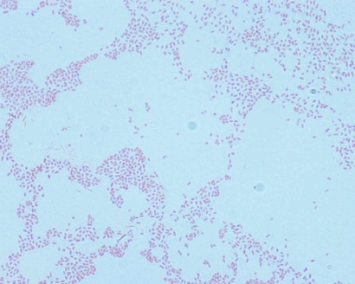
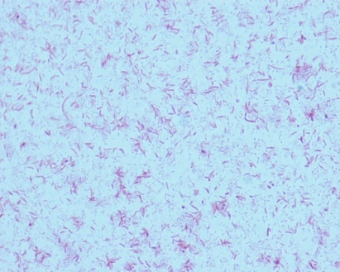
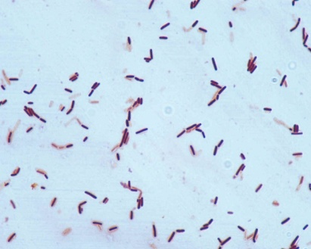
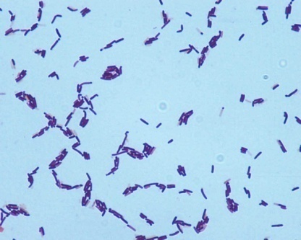
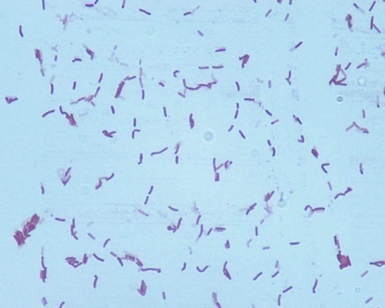
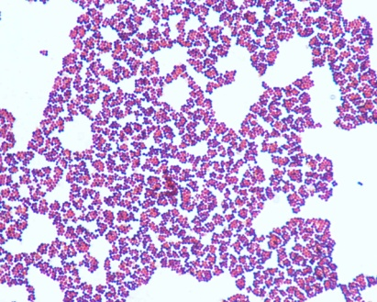
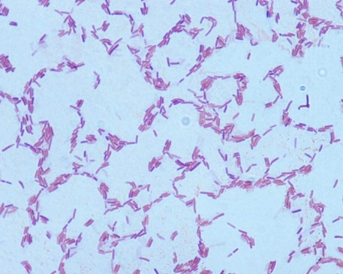
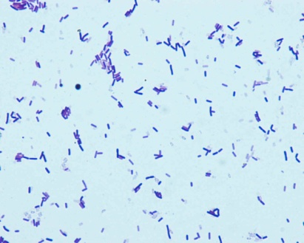
Bacterial host against which bacteriophages isolated
E. coli
Aeromonas hydrophila
Bacillus subtilis ssp. subtilis
Bacillus sp.
Bacillus sp.
Staphylococcus sciuri
Bacillus spp.
Bacillus spp.

Slide 6
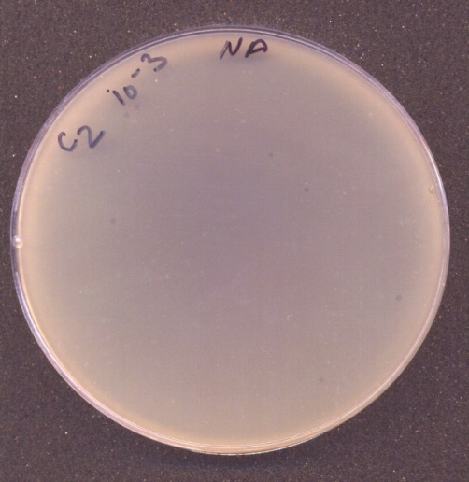
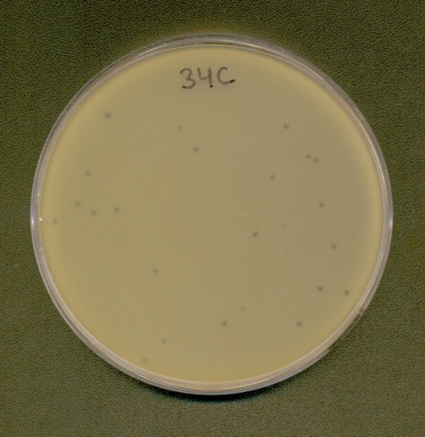
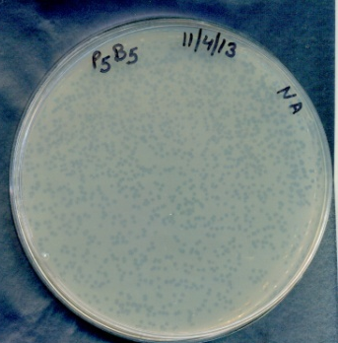
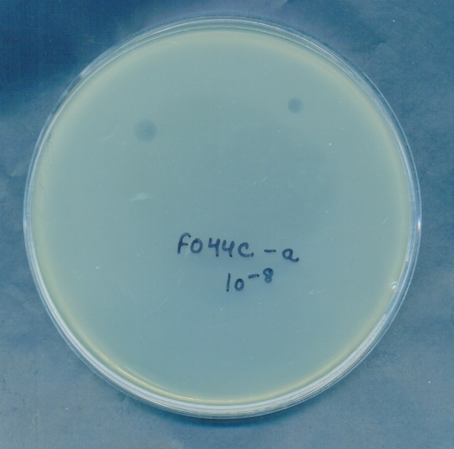
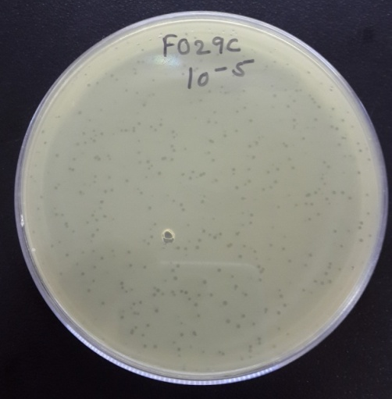
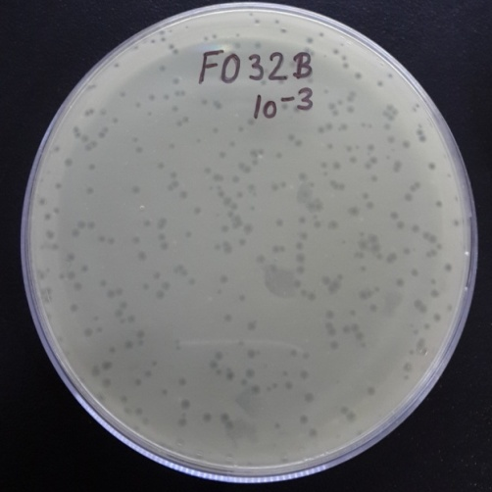
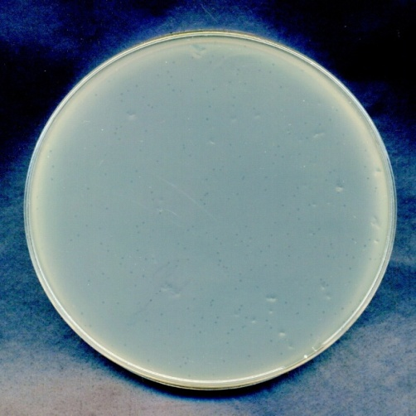
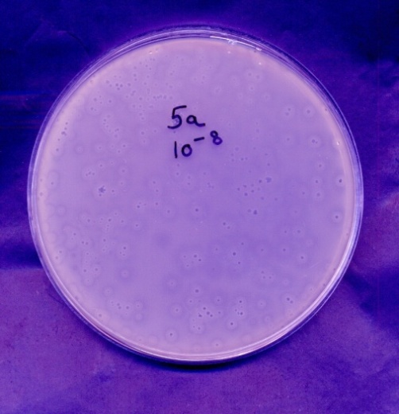
Plaque characteristics

Slide 7
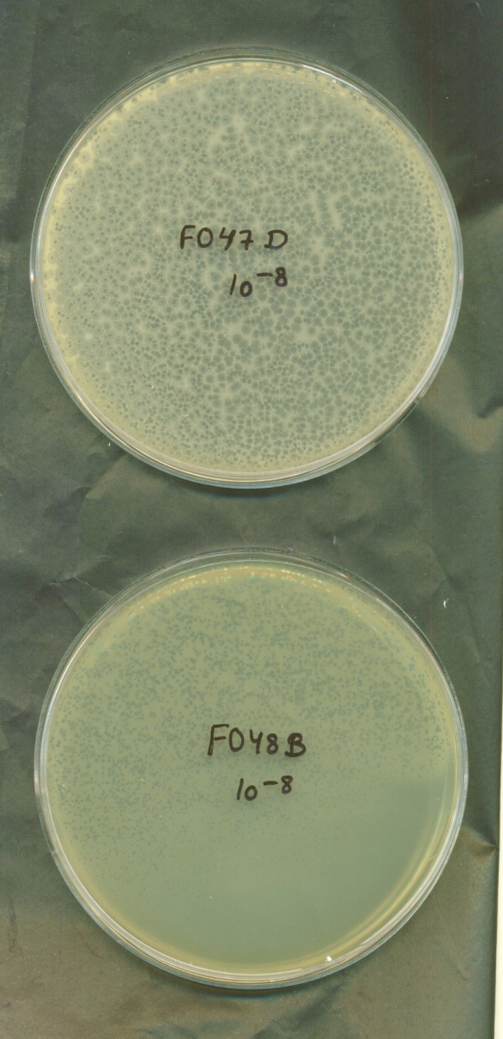
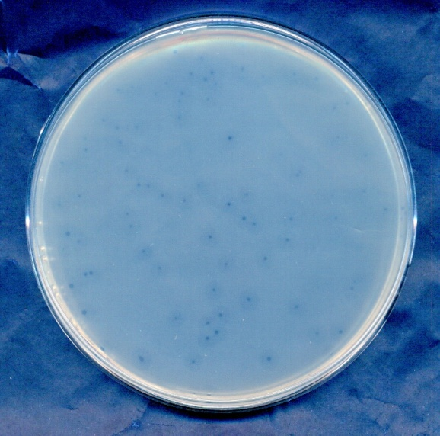
FO48E
Clear plaques with rough margins,
with a halo zone, 3-4mm dia
Clear plaques of 1-2mm dia
Clear plaques with a halo zone,
5-6mm dia
Pseudomonas mendocina
Bacillus pumilus
Paenibacillus sp.

Slide 8
Phages isolated-Plaque characteristics
Bacteria- lab ID | Source of phage | Plaque characteristics
 |  | Size | Type
Eq37-2 | Sewage | 1mm | Very clear with smooth margins
Eq16 | Soil | <1mm | Very clear in middle with hazy margin, circular
Eq53 | Soil | 1-2mm | Clear with hazy margins
Eq73-2 | Soil | <1mm | Very clear with smooth margins
C1/Fo38A | Soil | 1-2mm | Irregular shape, clear
C2/ Fo38B | Soil | 3mm | Clear plaques
Eq12B | Soil | 2mm | Clear with smooth margins, circular
Fo37 | Soil | <1mm, | Very small clear plaques
Fo23c | Sewage | 1-2mm | Turbid plaques
Fo34c | Soil | 2-3mm | Clear plaques
Fo32B (1) | Soil | 2-3mm | Clear plaques with a zone of halo
Fo32B (2) | Soil | 2-3mm | Clear plaques
Fo32c | Soil | 2-3mm | Clear plaques with hazy margins
Fo35B | Soil | 2-3mm | Clear plaques
Fo33A | Soil | 6mm, | Turbid plaques with a clear central zone of 1-2mm
The phage stocks have been preserved at -80°C

Slide 9
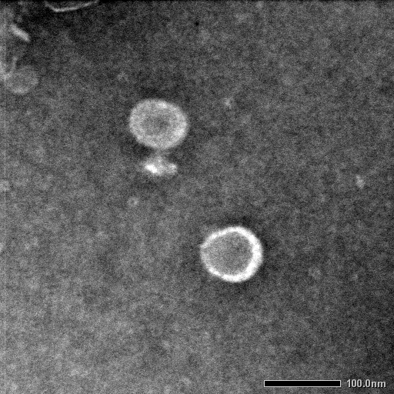
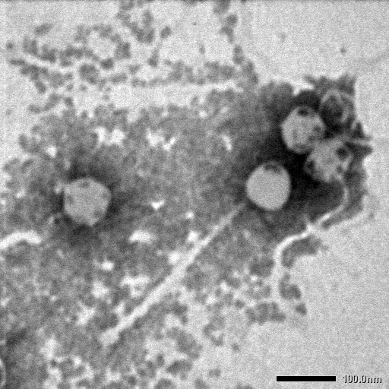
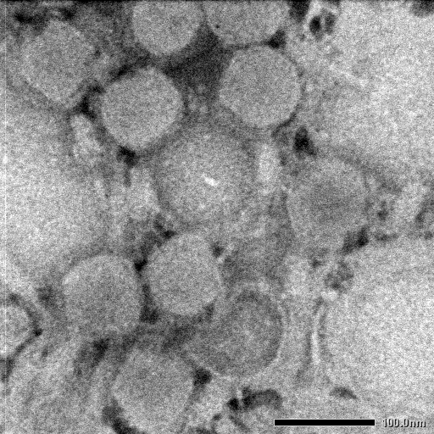
Eq37-2
Electron Microscopy
FO34c
Eq16
Capsid dia:88nm
Tail length: 5nm
Base plate width: 45nm
Tail width: 8nm
Podoviridae
Capsid dia: 78 nm
Tail length: 308 nm
Tail width: 16 nm
Base Plate width: 24nm
Base Plate Length:36 nm
Siphoviridae
Capsid dia: 86nm
Tail length: 100nm
Tail width: 20nm
Base Plate width: 33nm
Base Plate Length: 17nm
Myoviridae

Slide 10
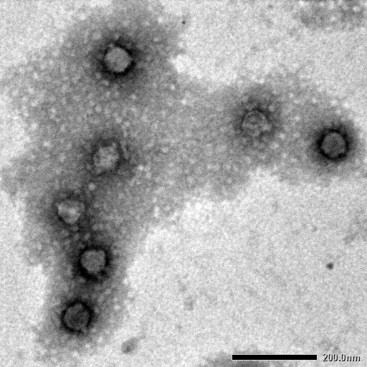
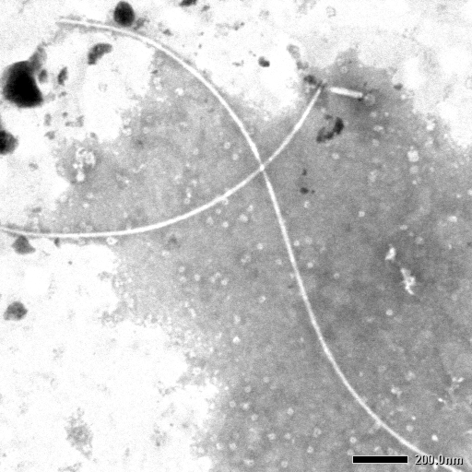
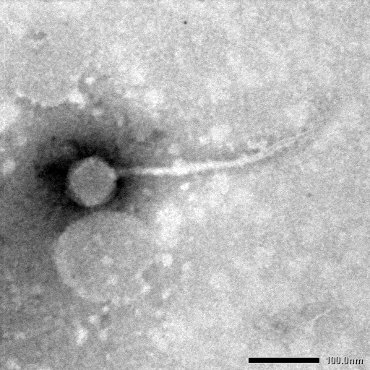
FO44ca
FO44a
FO35b
Capsid dia: 56nm
Tail length: 5 nm
Podoviridae
Length: 1.25-2.5um
Width: 17.7nm
Inoviridae
Capsid dia: 69 nm
Tail length: 265 nm
Tail width: 10 nm
Siphoviridae

Slide 11
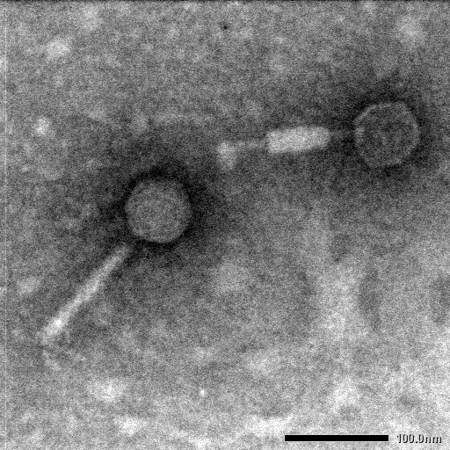
FO23c-Aeromonas hydrophila
Capsid dia: 62nm
Tail length: 138nm
Tail width: 13nm (contracted)
Tail width: 19nm (relaxed)
Base plate
Myoviridae

Slide 12
Phage Types
Sample Name | Host | Phage Type/ characteristics observed by TEM
Eq37-2 | E. coli | Podoviridae
FO34C | Staphylococcus sciuri | Siphoviridae
FO35B | Bacillus spp. | Siphoviridae
FO44A | Bacillus spp. | Inoviridae
Eq16 | E. coli | Myoviridae
FO44Ca | Aeromonas hydrophila | Podoviridae (Novel phage candidate)?
FO23c | Aeromonas hydrophila | Myoviridae

Slide 13
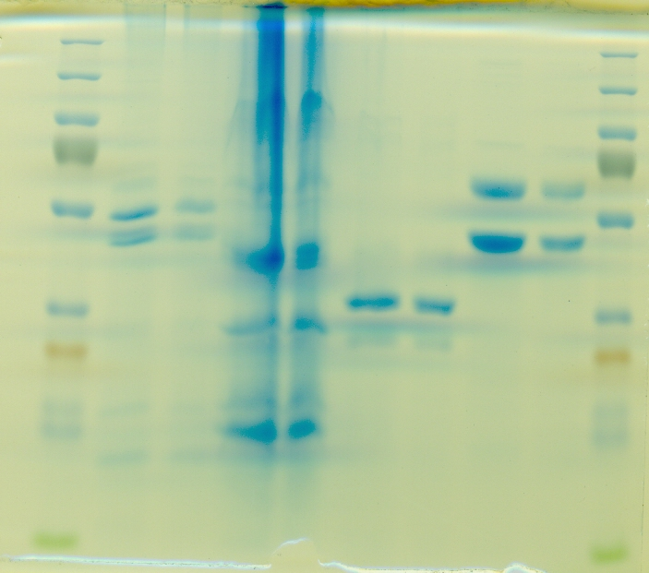
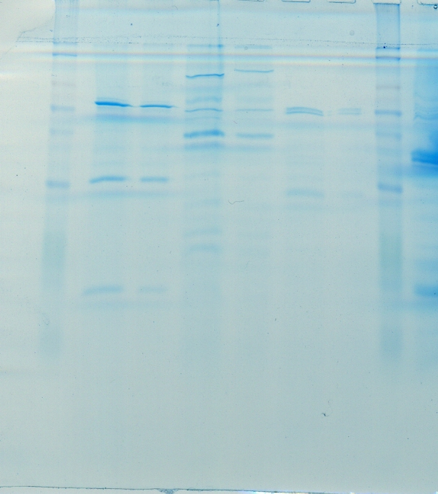
Protein profile of phage isolates
58kDa
63kDa
62kDa
48kDa
38kDa
32kDa
Fo34c
Fo35b
Fo44a
Fo44ca

Slide 14
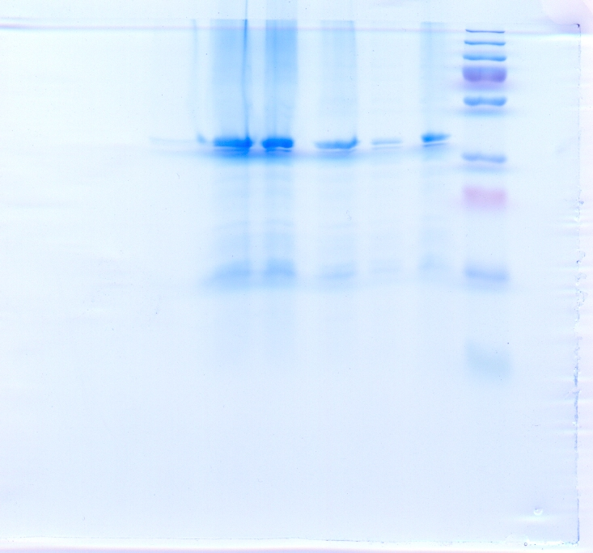
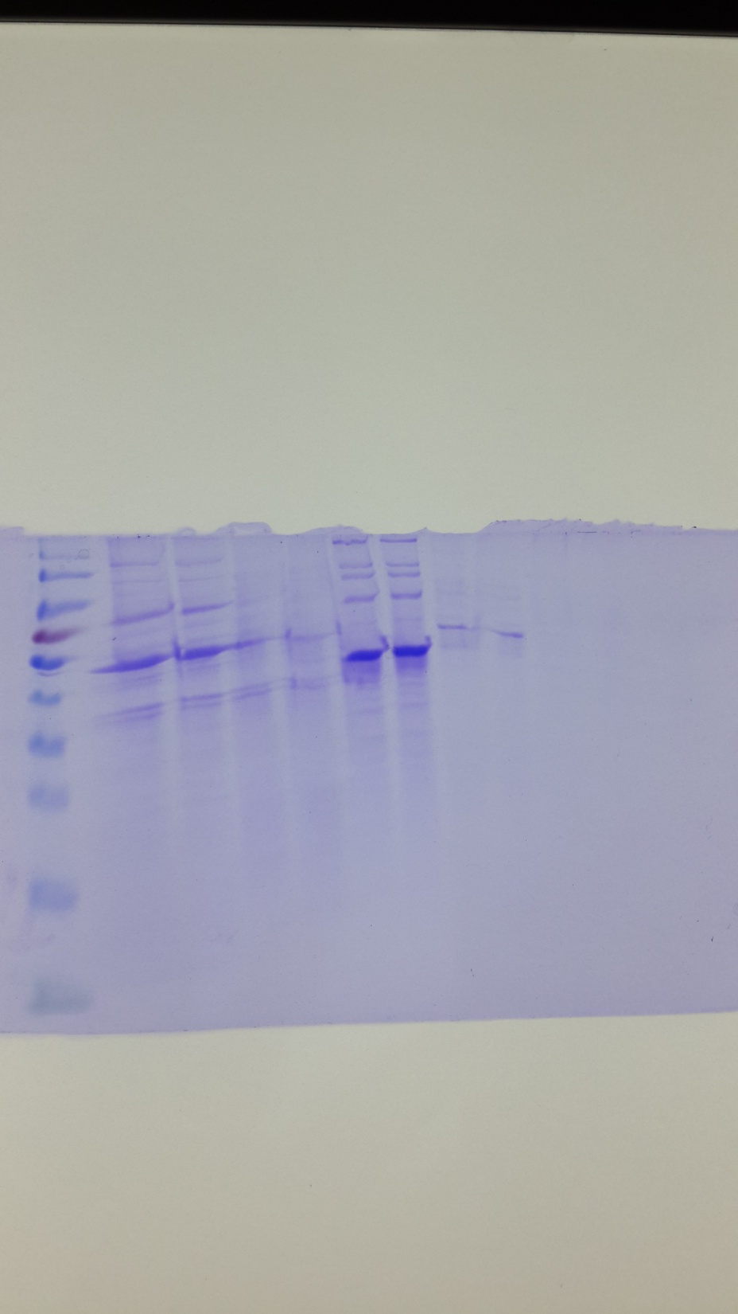
48kDa
54kDa
42kDa
50kDa
Eq16
Fo23c
Eq37-2

Slide 15
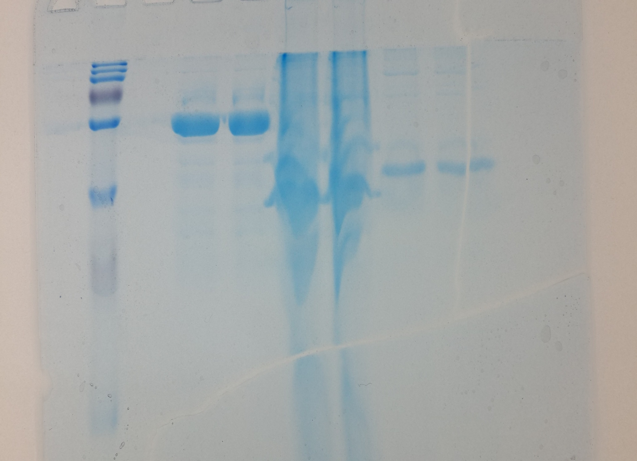
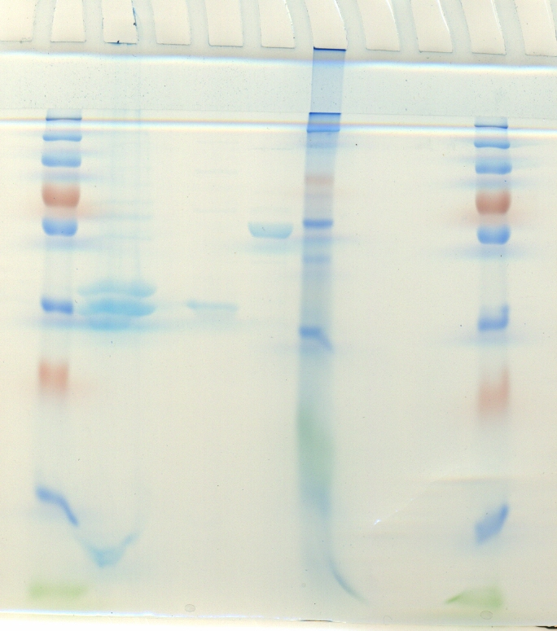

50kDa
40kDa
38kDa
35kDa
Fo48B
Fo47D
Fo48E

Slide 16
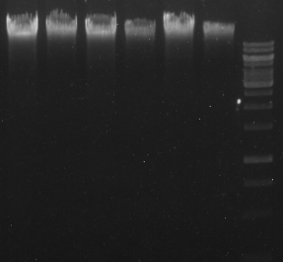
Phage DNA

Slide 17
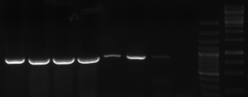
Phage identification by PCR
(gp23 gene)
850bp

Slide 18
Phylogenetic analysis

Slide 19
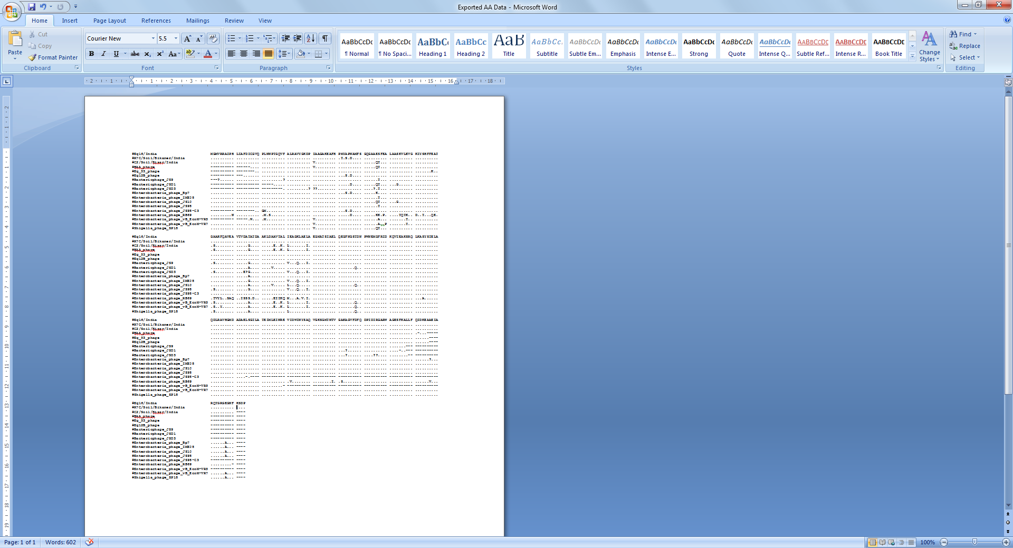
●
●
●
●
●
●

Slide 20
●
●
●
●
●
●

Slide 21
(Group) ds DNA
(Order) Caudovirales
(Family) Myoviridae
(Sub Family) Tenevirinae
(Genus) T4-like virus

Slide 22
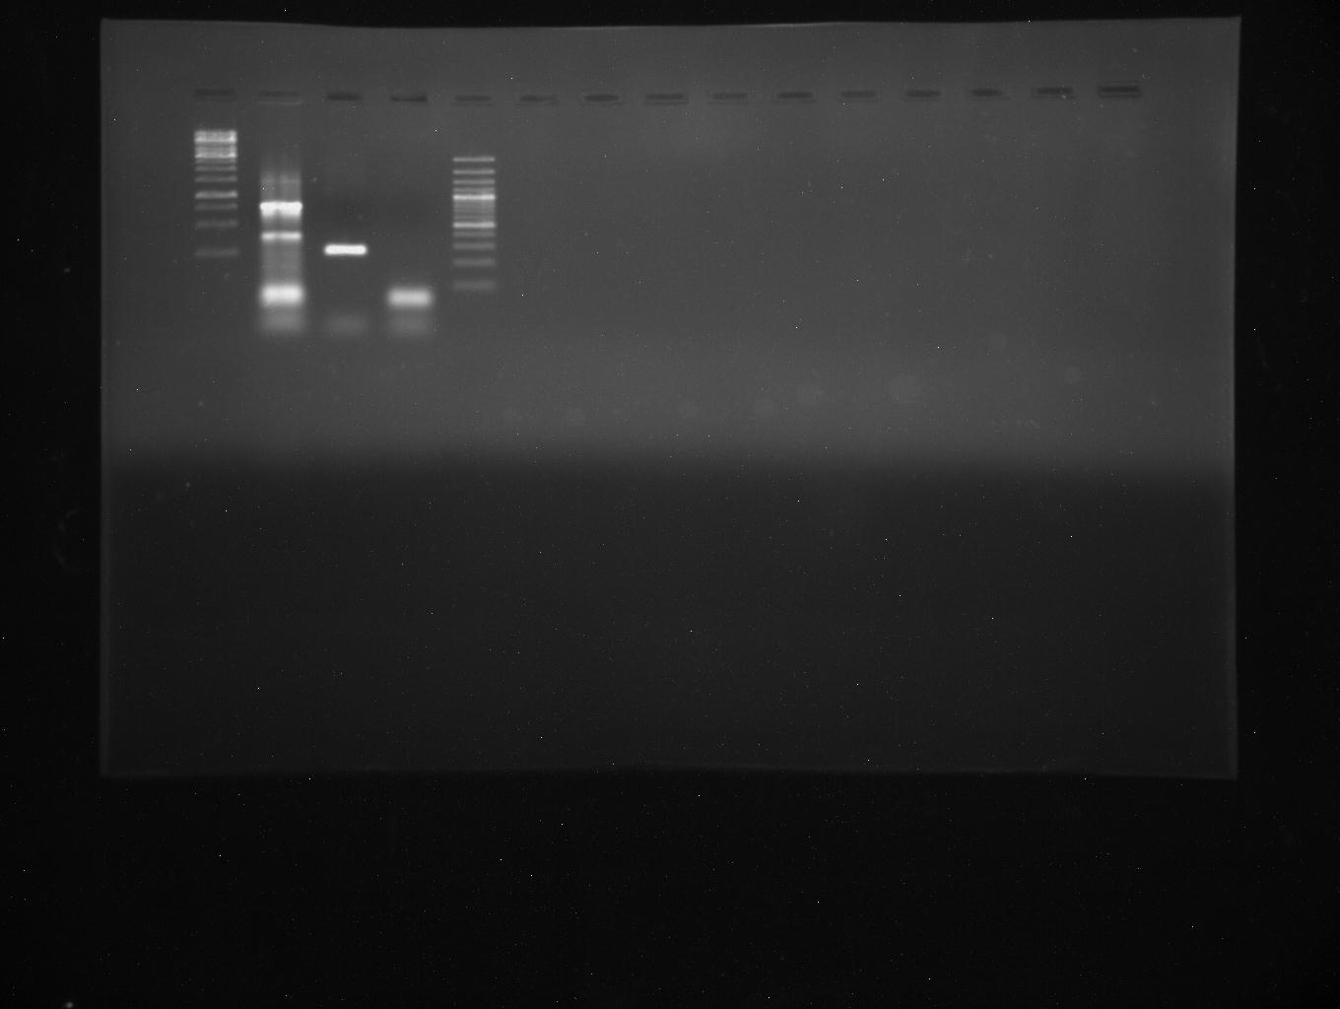
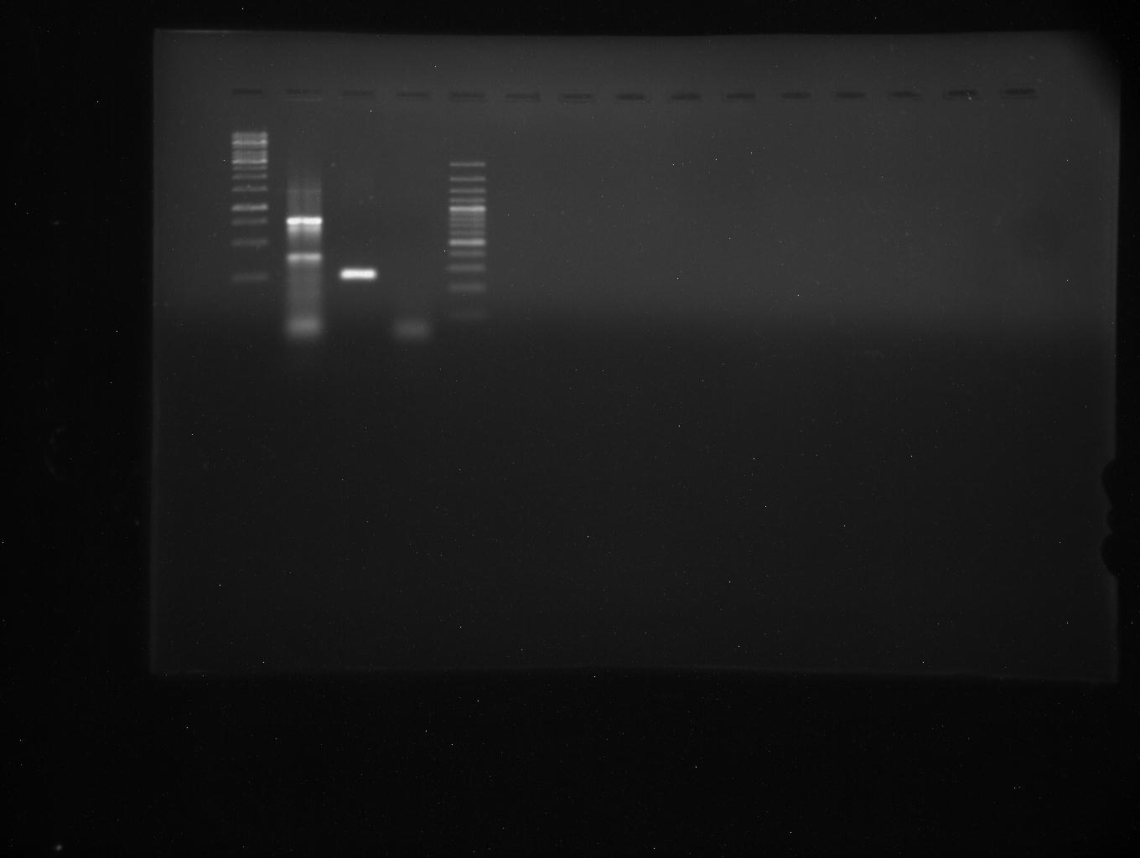
Aeromonas hydrophila phage
A
B
PCR detection of (A) aerolysin gene product (252bp)
and (B) lip gene product (760bp).
*
^

Slide 23
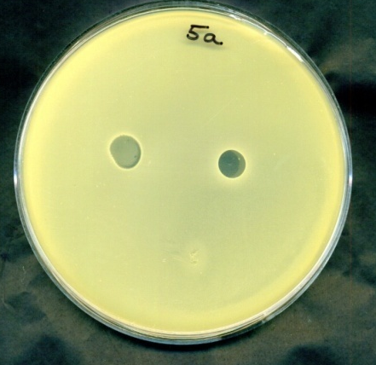
Biological activity against diarrhoeal isolates of E. coli analysed by Spot Test
Phage isolate | Accession no. of test host bacteria | Activity
Eq16 (4/9) | LLR001B1 | +++
 | LLR002A2 | +++
 | LLR003B1 | +
 | SDF007A1 | +
Eq37-2 (1/9) | LLR002A2 | +++

Slide 24
Conclusions
Diverse kind of bacteriophages were isolated from sewage and soil samples of animal farms.
Phages varied in plaque characteristics, morphology and protein profiles.
Electron microscopic analysis classified phages mainly into caudovirales-Myoviridae, Podoviridae and Siphoviridae families.
Few phages showed biological activity against E. coli isolated from calf diarrhoea………….potential application in phage therapy.

Slide 25
Thankyou…………….

