Slide 1
WELCOME
Earth Science and climate change conference
By: Tara Pokhriyal

Slide 2
“Effect of heavy metal
ion on the antioxidant properties of
Mentha spicata”

Slide 3
An Introduction

Slide 4
Antioxidant-mechanism and how they destroy radical’s
Recent year there is an increasing interest in antioxidant.
Main reason for this is the protection of cells,their organelle and metabolic pathways against oxygen free radicals and their derivatives (ROS).
ROS produced in biological system due to exposure of various physical and chemical toxin.
During metabolism intermediate metabolite(ROS) are generated and overload of these ROS leads to oxidative stress to macromolecules like DNA, lipids, Proteins, chromosome break, alteration in signal transduction and gene expression occur and they are implicated to various disorder like cataract, birth defect, reproductive anamolies neuro degenerative diseases and other asssociated with oxidative stress such as cancer, cardiovascular and neuro degenerative diseases

Slide 5
The balance between production and removal of reactive species Is required to maintain normal physiological function
Biological system is endowed with various antioxidants like superoxide dismutase, catalase, glutathioneS- Transferase
The in-vivo system of defense may not be adequate to neutralize all the ROS’s there is a need for an external source of antioxidants to neutralize the free radical load in the body.
Fruits vegetable, spices and various herbal resources recognized as external sources of antioxidants like phenolic acid, flavonoid etc
These acts as a free radical scavengers or activator of antioxidative defense system to supress radical damages in system
There fore there is a growing interest toward natural antioxidants
Plants are more prone to heavy metal stress due to manmade or natural activities
Keeping in mind the antioxidant potential of mint and role of abiotic stress in activating plant defense, the effect of heavy metal ion stress on antioxidant potential of M.spicata has been studied.

Slide 6
Plants are subjected to a number of abiotic stresses, like drought, temperature , radiation, salinity, soil pH, heavy metals, lack of essential nutrients, air pollutants, etc.
Metal toxicity can cause a redox imbalance and induce the increase of ROS concentration, activating the antioxidant defense mechanisms of plants.
Plants have developed different strategies to cope with these stresses. Some use an avoidance strategy to reduce trace element assimilation while others use internal defense mechanisms to cope with the increasing levels of the toxic species.
Antioxidants detoxify, neutralize, and/or metabolize reactive species and hence reduce the incidence and/or severity of some degenerative conditions.

Slide 7
Objective
Is to determine the change in the total polyphenol contents, TFC and characterize the free radical scavenging, ferric ion reducing capabilities of herbal plants Mentha spicata after treating with heavy metal.
Comparison of antioxidant activity of the plants, given heavy metal stress on the basis of days.
Validation of result by performing various assays for the same source.

Slide 8
Experimental Design
Plantation
Heavy metal Treatment
Sampling
Extraction
Result
&
Analysis
Assaying method

Slide 9
Plantation
Experimental Plant Variety(EVP)
Mentha spicata
Number of EVPs - 30 units
Area - Department of Biotechnology, Punjab Agricultural University(PAU) Ludhiana, INDIA
Why M.spicata?
Short life cycle
Perennial herb
Easy availability and
maintenance
Having high phenolic compound

Slide 10
Plant were raised in poly bags, containing 1 kg of garden soil.
Plants were divided into 6 groups, each group having five plants.
Two group of plants were kept as a control (given normal watering)
Other four group of plants were treated as a test plants (given the stress of heavy metal)

Slide 11
Heavy Metal Treatment
Different heavy metal at the rate of 10ppm concentration were given to plants,
Lead as a lead acetate
Cadmium as Cadmium Sulphate
Arsenic as Sodium Arsenate
Nickel as nickel sulphate
Treatment with heavy metal was not repeated

Slide 12
500 ml solution of each heavy metal was prepared
100 ml of heavy metal solution was given to each group of test sample containing five plants each.
Each group of plant sample was then watered(200 ml) two times for 30 days.
The leaves were then plucked after every fifteen days of time for experimentation.

Slide 13
Sampling
Leaves sampling
First generation leaves were plucked from the plants groups (treated with different heavy metal stress) after 15 days of heavy metal treatment.
Second generation leaves were plucked after 30 days of heavy metal treatment.

Slide 14
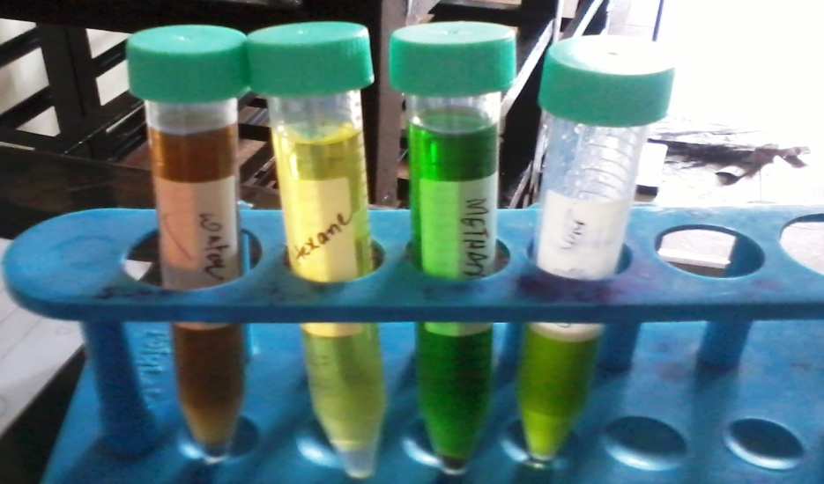
Extraction
Preparation of extract
5g wet wt. of Mentha spicata leaves were grinded in a pestle motor and mix with 50ml of methanol.
Allowed for 1 hr incubation at room temperature.
Centrifuged at 4000 rpm for 15 minutes
Mixture then filtered by using muslin cloth.
Filtrate is kept for further experimental purposes.

Slide 15
Assaying Method
Standardization
Total Phenolics Content
Total flavonoid content
Total reducing assay
Ferrous Ion Reducing Antioxidant Potential Assay (FRAP)
DPPH Scavenging Assay
Superoxide Scavenging Assay

Slide 16
Standardization
Gallic acid as a standard phenolic compound for TPC evaluation of test sample
Quercetin as a standard flavonoid compound for TFC evaluation of test sample
Ascorbic acid as a standard antioxidant for evaluation of antioxidant potential

Slide 17
Phenolic and flavonoid estimation
TPC
TFC
10µL test sample
490µL of dist water
1Hr incubation
500µL of folin reagent
2 mL Na2CO3
Absorbance at765nm
100µL test sample
500µL of dist water
500µL of methanolic AlCl3
2ml K2CO3
2mL Dist. H2O
Absorbance at 415 nm

Slide 18
Reducing potential estimation
Total Reducing Assay
FRAP Assay
100µL sample + 500µL PO4 buffer+500µL K[fe(CN)4]
incubation
50°, 20 min
500µL trichloro acetic acid
10min
centrifuge, 2500rpm
Supernatent+distH2O(2.9mL)
Soln made to 5ml adding H2O
Absorbance at 700 nm
2.5mL acetate buffer+2.5mL TPTZ +2.5mL FeCl3.6H2O
FRAP Solution +100µL sample
Solution made to 5mL Dist H2O
Absorbance 593 nm

Slide 19
Scavenging Capacity
DPPH scavenging activity
Superoxide scavenging activity
10µl sample + 2.5mL Tris HCl
+ 1mL DPPH
30 min
incubation
Absorbance at 517nm
100µL of NBT+100µl NADH(prepared in 2.6mL PO4 Buffer)
100µL of sample
Add 100µL PMS
25°C
5 min
Absorbance at 560nm

Slide 20
Calculation
Sample values inTPC, TFC, TRA, FRAP method are calculated in mg/g which is gram equivalent to the standard compound, obtained by the regrsession equation of standard compound
y= mx+ C
y=absorbance of sample
m= absorbance of standard compound
x= value to be determine (mg/g)
C= constant value

Slide 21
Calculation for DPPH and superoxide scavenging capacity
Formula used
Inhibiton% = [(A Blank-A sample)] x 100
A blank

Slide 22
Result and analysis
Various assaying method were performed by using ascorbic acid as a standard
TPC, TFC were measured as gallic acid and quercetin equivalent.
Total reducing assay, FRAP were measured as ascorbic acid equivalent.
DPPH and superoxide scavenging assay were examined by calculating % inhibition and also examined by seeing % change of test plants over the control.

Slide 23
Table 1:-*values in parenthesis represent change over the control
Treatment | Total Phenolics content |  | Total Flavonoids Content
 | 1st Generation leaves | 2ndGeneration leaves | 1st Generation leaves | 2ndGeneration leaves
Control | 21.5 | 16.9 | 6.9 | 2.80
Cd | 28.5(32.5) | 20.8(23.1) | 8.6(24.6) | 5.1(82.1)
Ni | 40.3(87.4) | 28.9(71.0) | 9.9(43.8) | 4.9(75.0)
As | 42.3(96.7) | 36.1(113.6) | 9.5(-37.7) | 3.7(32.1)
Pb | 41.2(91.6) | 30.1(78.1) | 8.14(17.4) | 4.8(67.8)

Slide 24
TPC
TFC

Slide 25
Graph showing change over the control

Slide 26
Graph showing change over the control

Slide 27
Table 2:-*values in parenthesis represent change over the control
Treatment | Total Reducing Power |  | FRAP
 | 1st Generation | 2ndGeneration | 1st Generation | 2ndGeneration
control | 31.4 | 21.5 | 39.15 | 43.33
Cd | 47.5 (51.3) | 31.8(47.9) | 46.8 (19.6) | 53.7 (24.2)
Ni | 46.8 (49.0) | 38.7 (80.0) | 47.4 (20.8) | 55.8 (28.7)
As | 50.5 (60.3) | 34.4 (60.0) | 52.15 (33.2) | 64.5 (48.9)
Pb | 49.8 (58.1) | 36.7(70.6) | 42.5 (8.55) | 58.3 (34.5)

Slide 28
Graph showing values in mg/g(gram equivalent to ascorbic acid)
Total reducing assay
FRAP assay

Slide 29
Graph showing change over the control
Graph showing change over the control

Slide 31
Table 3:-*values in parenthesis represent change over the control
Treatment | DPPH Scavenging potential (% inhibition) |  | Superoxide scavenging % inhibition
 | 1st Generation | 2ndGeneration | 1st Generation | 2ndGeneration
Control | 38.0 | 40.8 | 57.1 | 40.3
Cd | 51.6 (35.8) | 55.2 (73.5) | 96.02 (68.2) | 79.2 (96.6)
Ni | 51.5 (35.5) | 57.8 (81.8) | 62.39 (9.3) | 45.6 (13.2)
As | 47.8 (25.8) | 52.8 (66.03) | 62.87 (10.1) | 46.1 (14.4)
Pb | 49.9 (31.3) | 54.8 (72.3) | 68.24 (19.5) | 51.4 (27.6)

Slide 35
Conclusion
Mentha spicata plants test sample treated with different HM ions like Cd, Ni, Pb, As reveals that it contains antioxidants.
The antioxidant activities of the plant sample are due to the presence of phenolic compounds containing the hydroxyl group that confers the hydrogen donating ability.
The strong correlation observed in the present study between antioxidant activity, phenolics, and flavonoid content of different heavy metal on plant suggests a possible use of their parts in making the active ingredients of antioxidant supplement after removing their toxic ingredients.

Slide 36
The reducing properties are generally associated with the presence of different reductones. The antioxidant action of reductones is based on the breaking of the free radical chain by donating a hydrogen atom. Reductones also react with certain precursors of peroxide, thus preventing peroxide formation. The reductive power of different fractions may be the reason for their antioxidant activity.

Slide 37
Thank you !! Very much

