Slide 1


Role of Ultrafast Charge Dynamics in Photocatalytic Water Oxidation
Nanotek, December 2014
Tanja Cuk
Assistant Professor, Chemistry, UCB
Faculty Scientist, CSD, LBNL

Slide 2
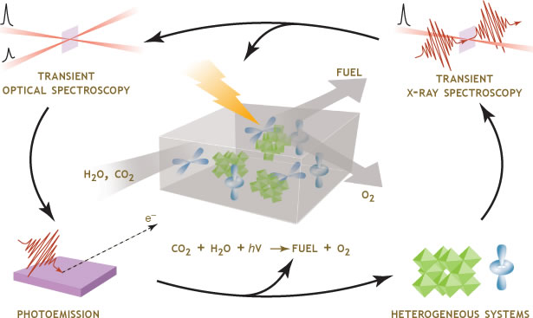
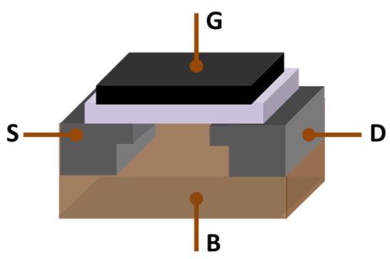
Fuel
Transient Optical, Infrared Spectroscopy
Transient X-Ray Spectroscopy
H₂O , CO₂
O₂
CO₂ + H₂O + hν →FUEL + O₂
Heterogeneous Catalysts
Controlling Charge Flow
Notes:
At the core, what I am interested in is control of the catalytic process to get at the principles behind ongoing, fast, and efficient reactivity. In order to do that we truly need to understand the complexity of the dynamics at interfaces that couple the catalyst, the reactant, and photoinitiated or at essence charge initated processes.
My approach is two fold:
Control how charge initiates that process in the lab now, to get at the dynamics from the initial time points
Use multi-color ultrafast spectroscopies that can get at the complexity of the different actors at the interface where heterogeneous catalysis takes place

Slide 3
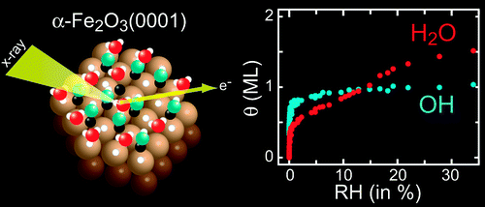
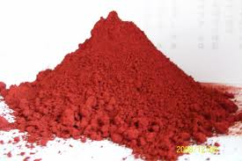
Water Oxidation Catalysts:
Transition Metal Oxides
4h⁺ + 2H₂O O₂ + 4H⁺ E₀ = 0.6 V vs. Ag/AgCl
Hydroxilated Surfaces
Robust Catalysis
Fe₂O₃
Bluhm, Salmeron, Nilsson et. al.,
J. Phys. Chem. C (2010)
Efficient and Sustainable Catalysis on TM Oxide Surfaces
Hydroxilated surfaces common to TM Oxide Surfaces
Notes:
Water Oxidation Reaction: Important for fuel storage and highly selective
Transition Metal Oxides are cheap, robust materials for sustainable water oxidation catalysis
What tends to unify these metal oxides is that they have hydroxilated surfaces, the start of the reaction (t=0)

Slide 4
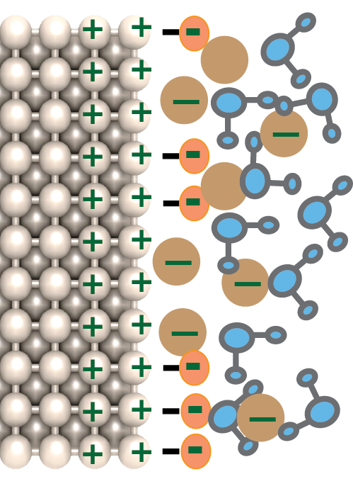
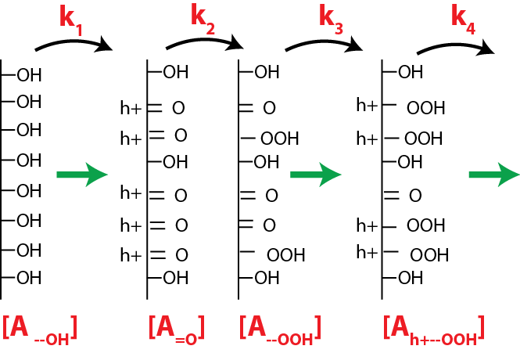
Heterogeneous Catalysis
Helmholtz Double Layer
Dynamic Catalytic Surface
Suggested First Hole Transfer (t=0):
[h+] + [OH⁻] [OH*]
Activation Barrier thru Transient Spectroscopy
Notes:
In heterogeneous catalysis a bath of charges can modify a large number of closely spaced sites… leads to a Helmholtz layer, essentially charge in the liquid screening the charge in the material and a dynamic catalytic surface, that changes as charges cross this layer and initiate bond reorganization. Steady state turnover rate related to kinetic rate constants and the amount of each intermediate covering the surface. Idea of applying ultrafast spectroscopy is to initiate the reaction at t=0 and follow sequentially these kinetics. One of the advantages of this is we know where we are starting from… a saturated, hydroxilated surface. These saturated and early surfaces are likely related to the faster steps of the reaction, while the later ones are more heterogeneous and involve slower reorganizations of the surface and surrounding liquid…
And the question is what happens next? What is the redox potential and activation barrier for this charge transfer? Follow the holes in the material with the optical pulse.

Slide 5
Challenges in Applying Ultrafast Spectroscopy to Catalysis
Interplay of recombination and interfacial charge transfer
Sensitivity to the surface
Studying hetero-junctions (solid-solid, solid-liquid)
Multi-electron transfer processes and “clocking” the cycle
Notes:
We need to initiate the reaction with a light pulse. So we need to separate electron-hole pairs to inject charge into the catalyst. The kinetics of separating those electron-hole pairs will compete with the charge transfer at the reactant interface.

Slide 6
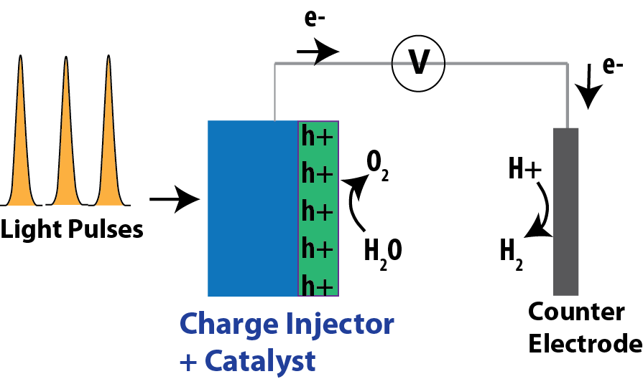
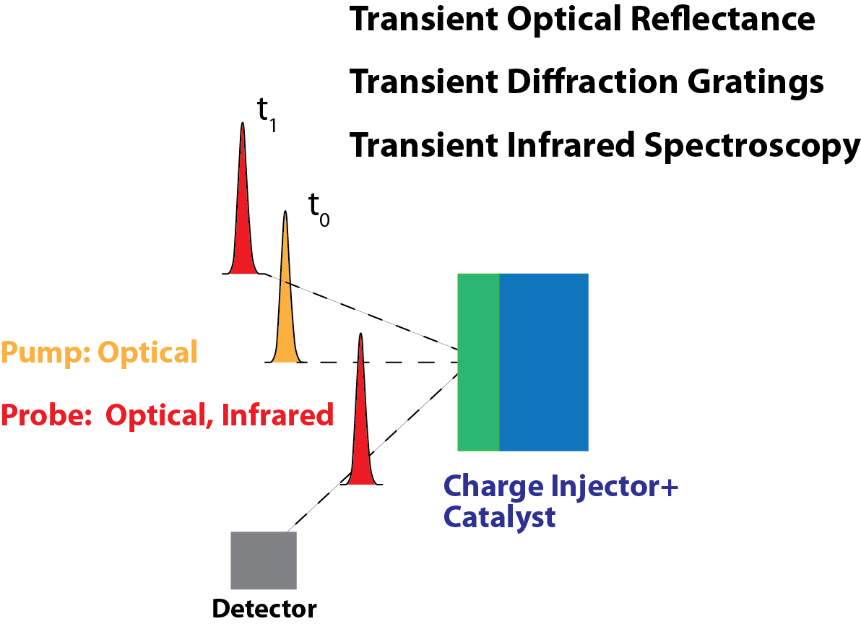
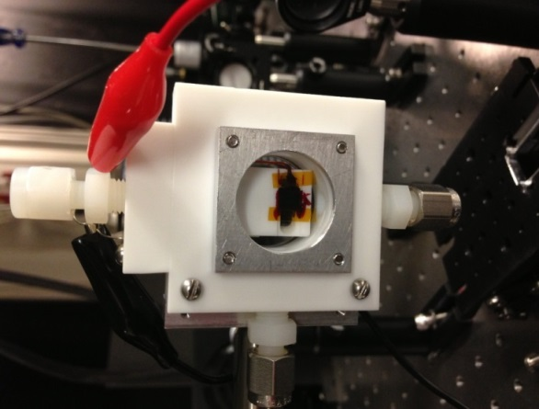
Strategy and Techniques
Counter
electrode
Working
electrode
h+
h+
h+
h+
h+
Reference electrode
Notes:
Control the charge flow with light pulses into a device that injects holes into the catalyst and sends electrons to the other electrode. This device basically separates the electron-hole pairs created by light. Investigate that surface with multi-color transient spectroscopies…. While the pump pulse that injects the charge is mostly optical, the probe pulse can vary from optical to infrared to x-ray. Here I will concentrate on the optical probe pulse that is sensitive to the charge dynamics within the catalyst… through Optical reflectance and diffraction gratings… Soon moving on to the infrared.
When we do this spectroscopy, it is really in-situ… so we have modified electrochemical cells to make the spectroscopy work.

Slide 7
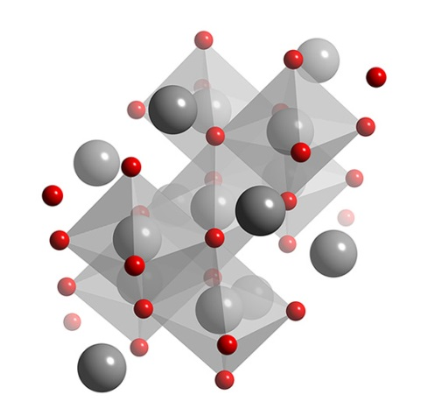
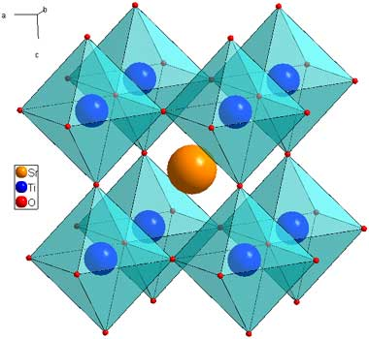
Catalysts & Devices Under Investigation
n-type SC/Liquid
Schottky Barrier
n-p GaAs photodiode/Co₃O₄
Hetero-junction
10 O₂/site-s
0.01 O₂/site-s
n-SrTiO₃, High Over-Potential
Co₃O₄ , Low Over-Potential

Slide 8
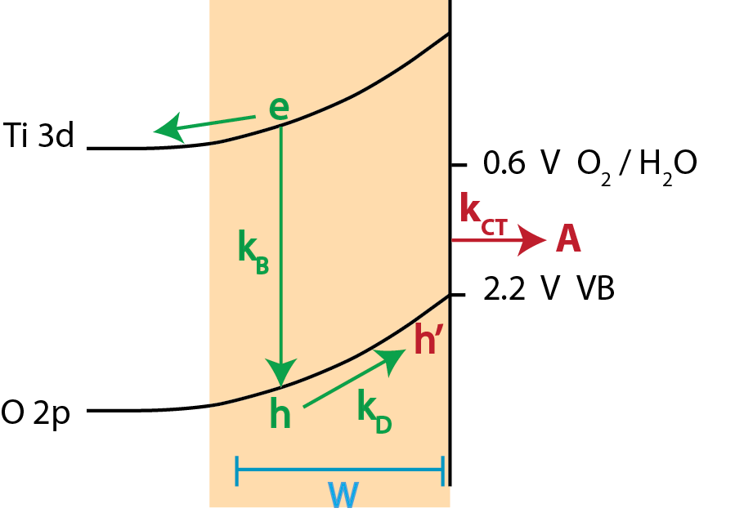
Photo-electrochemistry of n-SrTiO₃
High Quantum Efficiency with 1 kHz Laser (W ∼ α)
V_{RB}
V_{RB}
Single 150 fs Pulse Triggers Multi-electron Transfer Water Oxidation
Achieve high quantum efficiency (75%) under laser excitation
Notes:
To measure interfacial charge transfer rates, would like a large quantum efficiency… such that that time scale rather than recombination dominates the signal.
We can get a high quantum efficiency by creating the electron hole pairs within the depletion layer.
Here’s the n-type semiconductor, VB of SrTiO3 and the CB, with about 1.6 V over potential.
To achieve the high quantum efficiency we match the penetration depth of UV light to the depletion width.
This is a C-V under our laser conditions (150 fs, 1kHz laser). Red under light… Same characteristic as continuous Xenon lamp.
Diode like characteristic, this flat region is under reverse bias where you maximize the band bending/width of the space charge region and basically all the electron hole carriers are separated (different from the linear like of iron oxide). Magnitude is also large… 75%. Forward bias where you kill the band bending and get a small depletion width.

Slide 9
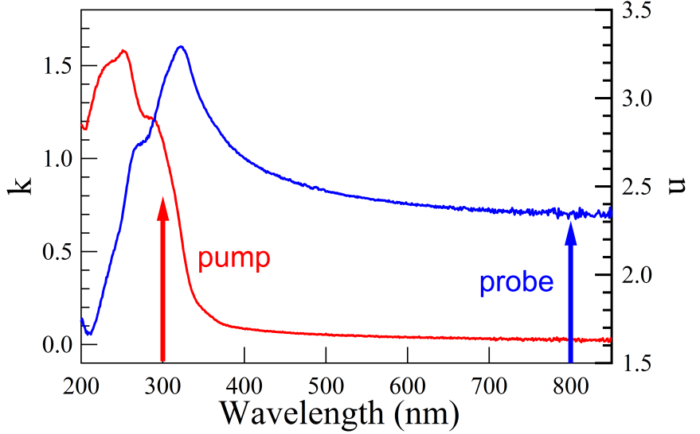
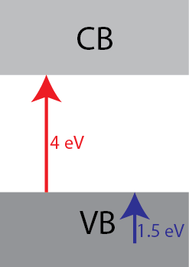
Transient Reflectance of n-SrTiO₃
Pump Band Gap, Probe Holes
Surface Sensitivity Thru Reflectivity
UV-VIS Ellipsometry
Width of Electric Field at High Q.E.:
W ∼ 25 nm
Pump Band Gap (300 nm, 4 eV):
α = λ/4πk ∼ 24 nm
Probe Hole Absorption (800 nm, 1.5 eV):
α_{REFL} = λ/4πn ∼ 27 nm
Experimental conditions needed to probe k_{CT} , [h] :
W = α_{PUMP} = α_{PROBE}
Notes:
In order to do that, we pump the band gap to create the electron-hole pairs, and probe the separated holes at longer wavelengths that are sensitive to free charges at the valence band edge.
To be sensitive to the interfacial charge transfer kinetics, we need the high quantum efficiency so the depth of the electric field should equal the penetration depth of the pump beam which we do get by pumping at the band gap (300 nm). The imaginary part leads to an absorption depth equal to ~25nm at 300nm.
The trick now is that the effective probe depth should also be on the order of 25 nm… If we measure in reflectance, rather than transmission, we can actually get this…. The depth in reflectance depends on the real part of the index, and it is nicely matched…
Now will show you some previous experiments that did not have these matching conditions…

Slide 10
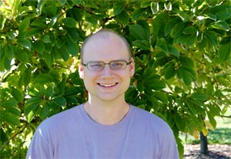


Interfacial Charge Transfer
SrNb_{0.001}TiO₃ (0.1%)
SrNb_{0.007}TiO₃ (0.7%)
W = 25 nm & α_{pump} , α_{probe} ∼24 nm
W = 9 nm & α_{pump} , α_{probe} ∼24 nm
Change in kinetics reflects k_{CT}, [h]
Notes:
Describe change in reflectance and absorption…
Looked at open circuit conditions (no steady state current) where we just changed the electrolyte from NaOH NaSCN, a much better hole acceptor.
With 0.1% Nb doping, that has a 25 nm depletion width, matching the penetration depth of the pump/probe, we observe a change in kinetics by a factor of 3.
We change this matching condition of the experiment by going to a higher doped sample, with a much lower depletion width, we aren’t anymore sensitive to the interfacial charge transfer.

Slide 11
Manipulating Interfacial Charge Transfer
SrNb_{0.001}TiO₃ (0.1%)
Interfacial charge transfer rate increases with increasing oxidative voltages
Rate changes while current and quantum efficiency constant
Notes:
Now we look at when we actually have a steady state current in the 0.1% doped sample. Here we have the current or q.e. vs. voltage under laser excitation.
The data corresponding to these voltage points is shown here… Change in reflectance over time. At 0.9V, we are like open circuit conditions (no steady state current). As the voltage increases to what would be more oxidizing potentials, the kinetics changes drastically.
For these voltages, the current and q.e. isn’t changing… which is another indication that we are truly very sensitive to the interfacial charge transfer rate. Kinetics that are underneath this steady state current, very affected by the free energy of the reaction…

Slide 12
Kinetics (V)
Kinetics are fit to a single exponential at early time scales
Rate constant depends exponentially on applied V (Arrhenius Law)
M. Waegele, X. Chen, D. Herlihy, T. Cuk, JACS 2014
Notes:
Transition: Now the question is why is this interfacial charge transfer rate affected by the voltage that we put on the back of the electrochemical cell. For that we have to think about how this voltage is distributed at the interface.

Slide 13

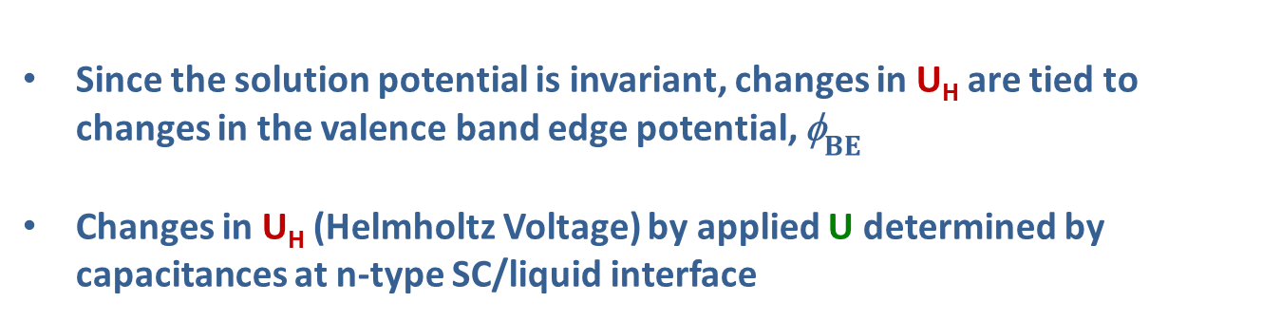


Voltage Distribution at the Surface
C_{SC}
C_{H}
U_{H}
U
U_{FB} + U = U_{H} + U_{SC}
C_{H}
CB
φ_{OH-/OH}
${\text{f}}_{BE}$ =
surface hole potential
U_{H}
C_{SC}
U_{SC}
U_{FB}
$${\text{f}}_{BE}$$
U_{SC}
$$U$$
U = applied voltage
VB
Since the solution potential is invariant, changes in U_{H} are tied to changes in the valence band edge potential, ${\text{f}}_{BE}$
Changes in U_{H} (Helmholtz Voltage) by applied U determined by capacitances at n-type SC/liquid interface
Notes:
Voltage due to the Schottky barrier, flatband voltage at equilibrium and any applied voltage drops across the depletion width in the semiconductor and the Helmholtz layer
The distribution will depend on the magnitude of the capacitance of the depletion width and the Helmoltz layer. Drop across the Helmholtz potential determines the surface hole potential/VB edge position… Any applied voltage can drop across the Helmholtz layer, depending on the distribution. This changes the potential of the valence band edge, or the surface holes… the over-potential of the reaction.
Two regimes: when the VB edge is largely pinned, or doesn’t change with applied potential, and when it moves.
We can figure out how the VB edge moves by measuring the distribution at equilibrium (no applied voltage) in the dark, and with light, and then use that as input to a calculation with an applied potential.

Slide 14


U_{H}(V): Changing Surface Hole Potential
(1) U + U_{FB} = U_{H} + U_{SC}
(2) U_{H} = (q_{sc} + q_{photo}) / C_{H}
U_{H}(0) = 0.65 V give C_{H} = 21 uF/cm²
n-SrTiO₃
Electrolyte
$${\text{f}}_{O_{2}/OH}−$$
U_{H}(0)
η(V)
U_{H}(V)
VB
${\text{f}}_{BE}(V$)
Brockeris, Bard, Bocarsly
Notes:
Can calculate voltage distribution from two equations… (1) how the flatband voltage and applied voltage is a sum of the voltage across the semiconductor and the Helmholtz layer
(2) Voltage across Helmholtz layer is due to balancing the positive charge in the semiconductor with negative ions. The dopant charge in the semiconductor (Usc) and the photoinduced charge (laser fluence). If the Helmholtz capacitance is known, these two equations wholly determines the voltage distribution and the Helmholtz voltage.
This capacitance is determined by making sure that the voltage on the Helmholtz layer is what we determined from the dark, equilibrium measurements (no applied voltage)
These are the results… UH increases with more anodic voltages, with a higher slope with illumination than in the dark (qphoto =0).
This increase in UH means that the valence band edge moves down with voltage… So here it is at equilibrium, and here at an applied voltage. Knowing the VB edge absolute potential at equilibrium from electron affinity, can recast what this means in terms of over-potential for water oxidation… covering this range with motion of the VB edge.

Slide 15
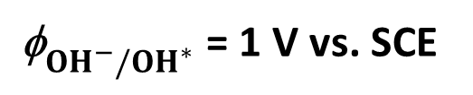

Activation Barrier of First Hole Transfer
k = k₀ exp (ΔG*/4k_{B}T)
k = k₀exp (α FU_{H} / RT)
h⁺
OH*
αe₀∆U_{H}(V)
k
[h+] + [OH⁻] [OH*]
e₀${\text{f}}_{{OH}^{−}/{OH}^{∗}}$
α = 0.2 ± 0.05
e₀U_{H}
k₀ = 7 x 10⁻⁷ ps⁻¹ (μs)
${\text{f}}_{{OH}^{−}/{OH}^{∗}}$ = 1 V vs. SCE
e₀ΔU_{H}(V)
[From Photoemission, 1.2 V]
Quantifies barrier to localizing VB hole onto a molecular O2p bond
Notes:
Plot rate constant versus the Helmholtz voltage directly tied to the VB edge or surface hole potential rather than the applied voltage. How changing the free energy of the reaction through the surface potential changes the kinetics…
Now we can determine a slope, akin to a Tafel slope, for this initial step of the reaction. Basically, the slope gives us the coefficient alpha, that describes how much of the applied potential goes to reduce the activation barrier for the reaction….
Here, the reaction being hole transfer to a hydroxyl group to create an activated OH* species.
The free energy diagrams look like this… so this is the hole in the VB edge, we move it down with the change in the Helmholtz voltage, and that reduces the activation barrier. Only by 20%...quantifies the difficulty…
UH is understood here to be the overpotential for this reaction. However determining alpha is independent of this interpretation… could be graphed as a function of over-potential for the water oxidation reaction, or as surface hole potential, independent of translating x-axis

Slide 16
Conclusions
Quantified interfacial charge transfer at n-type semiconductor/liquid interface
Activation barrier (α, k₀) for first hole transfer of water oxidation reaction in n-SrTiO₃
Next step on n-SrTiO₃: concomitant intermediates using ultrafast infrared spectroscopy
Investigate lower over-potential catalysts, and other n-type semiconductors stable in aqueous solutions (e.g. GaN)
Next Steps

Slide 17
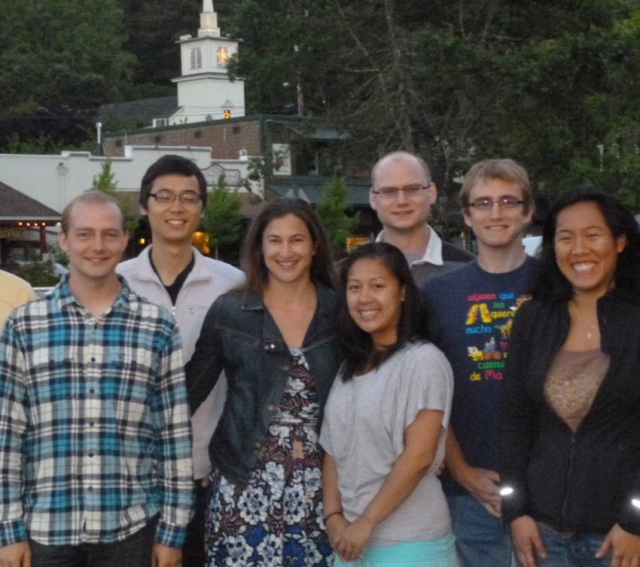

Acknowledgements
Graduate Students
Hoang Doan
Stephanie Choing
Kevin Pollack
David Herlihy
Xihan Chen
Jonathon Radberg
Facilities/Discussions
Heinz Frei
Steve Leone
Gabor Somorjai
Eli Yablonovitch
Ian Sharp (JCAP)
Joel Ager (JCAP)
Michelle Chang
Postdoc
Matthias Waegele
Aayush Singh (Undergraduate)
Joseph Mosley (Volunteer)
Funding
CPIMS Program
AFOSR Young Investigator (Co₃O₄)

Slide 18
Possible Intermediate Species Formed
k₁
k₁”
[h+] + [OH⁻] [OH*] [-OOH or -OOTi]
-OOH is a likely intermediate: ms-FTIR (Frei)
Single rate constant (k₁) implies a highly populated –OOH surface?
Probe nature of OH* (or O*) as surface trap (transient XAS)
k₁”
k₁

Slide 19
Ultrafast Transient IRRAS
Transient -SCN / -NSC at n-SrTiO₃
Decays with n-SrTiO₃ Free Carriers
2 ps
Small molecule rotations/bindings (-SCN, -NCS)
Reaction Intermediate Rise Times
Effects of surface potential/electric field vs. charge transfer

Slide 20
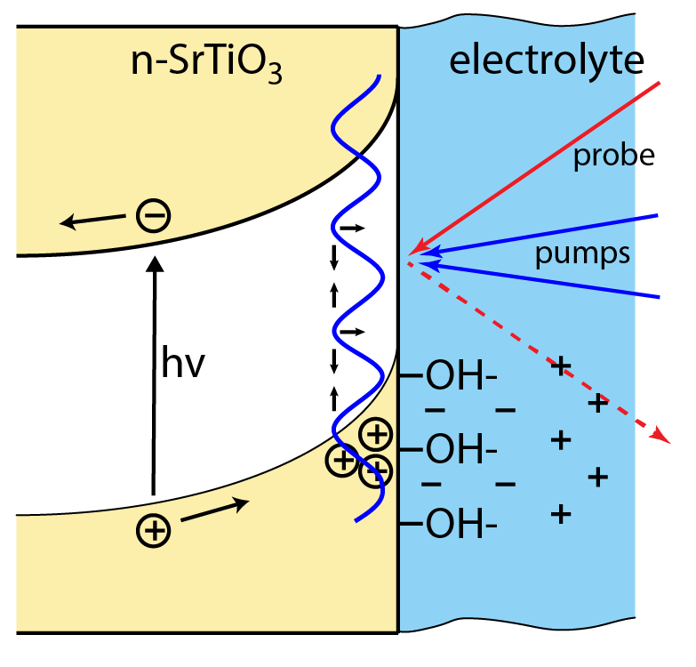
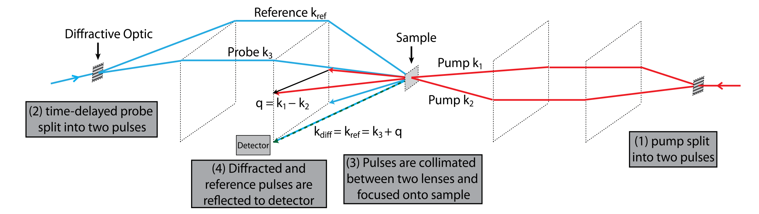
Transient Grating Diffraction
ΔI/I = R(t)cos(ϕ(t)) + TG(t)cos [Ψ - ϕ (t)]
Recombination (t) = R(t)cos(ϕ(t))
Diffusion (t) = ε (t) = TG(t)/R(t) = exp (-Dq²/t)
Heterodyne Detection: TG(t), R(t), ϕ (t) determined by varying Ψ, probe-ref phase
Notes:
Two pumps create an interference pattern on the surface, that creates a grating….
Diffract off of this grating to get spatal (diffusion/drift as well as surface/bulk recombination. Important in terms of the spatial diffusion/drift is how fast charges get into the catalyst overlayer, and how they diffusion along the surface before charge transfer.
Here is the Co3O4/GaAs junction… with deconvolved traces… Blue is a close up of what we just saw, a pure recombination signal and the black is the transient grating signal. The difference at early times may allow us to figure out when holes actually enter the catalyst…. Origin of this 10ps rise time. And some of the differences at later times may be related to surface diffusion.
Next step is to do this in an in-situ cell an understand how the kinetics of charges entering the catalyst, diffusing along the surface, and interfacial charge transfer are affected by the Helmholtz double layer and the chemical reaction…. In particular we can study this as we increase the number of injected charges, and the current/product produced.
EXTRA:
Implemented in heterodyne detection… basically means we get the phase and magnitude of the electric field which allows us to de-convolve the normal pump probe recombination from the kinetics related to the grating motion.

Slide 21

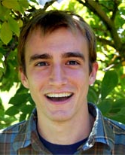
Catalysts & Devices Under Investigation
n-type SC/Liquid
Schottky Barrier
n-p GaAs photodiode/Co₃O₄
Hetero-junction
10 O₂/site-s
0.01 O₂/site-s
n-SrTiO₃, High Over-Potential
Co₃O₄ , Low Over-Potential

Slide 22
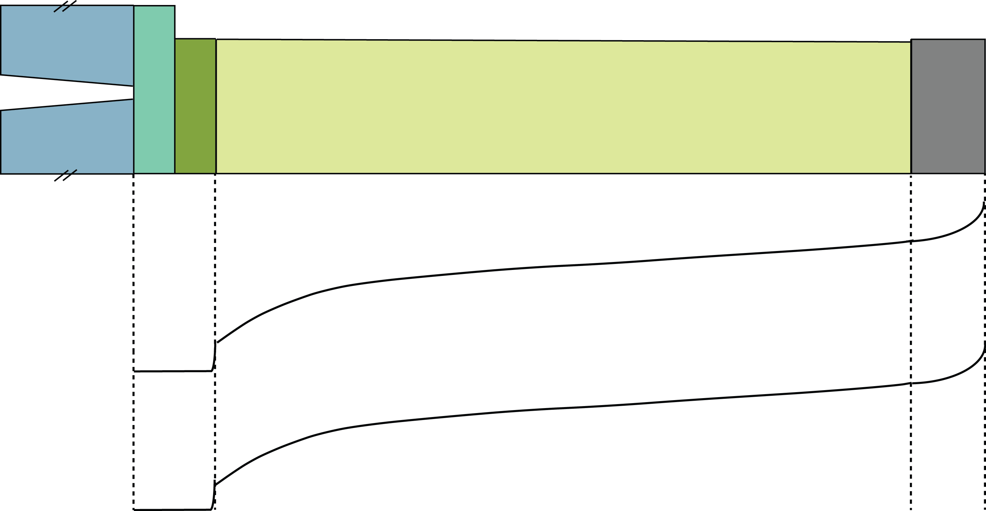
Transient Reflectivity on Hetero-junctions
Pump From Back, Probe From Front at Open Circuit
n+-GaAs
p-GaAs
Co₃O₄
-
-
-
-
-
-
+
+
+
+
+
+
+
Probe depth
e
τ_{R}
h
h
τ_{INJECT}
Charge separation spatially separated from hole injection into catalyst
Ultrafast charge injection (∼ 10 ps) unimpeded by slow diffusion kinetics
Can recombination kinetics in GaAs & hole kinetics in Co₃O₄ be separated in a transient reflectivity experiment?

Slide 23
Kinetics of Holes in Catalyst Over-layer
~0.5 mJ/cm²
GaAs
IrO₂ PVD
Hole
injection
Co₃O₄ ALD
Co₃O₄
Co₃O₄ Sputt
Surface sensitivity of ∆R w/ 400 nm probe
Strong signal of surface holes with catalyst
Time delay for hole injection (~10 ps)
Kinetics vary w/ catalyst type
Also with deposition technique
Reproducibility for same batch

Slide 24

Hole Carriers as an antenna to THz?
τ_{mobile} _{holes}
~5 mJ/cm²
0.87 THz
0.87, 0.44 THz
0.8 THz (& w/ 0.4 THz) signal generated from catalyst over-layer, independent of catalyst type
Strength and decay of THz signal depends on catalyst type and deposition technique
Potentially, mobile holes responding to THz in GaAs that decay to surface trapped states
THz Generation
THz Antenna
-
-
-
-
+
+
+
+
+
p-GaAs
Effects of Electrolyte?
Plasma frequency of p-dopants
responding to ΔE field
Free Carriers Injected in Catalyst
Responding to THz field

Slide 25
Conclusions
Activation barrier (α, k₀) for first hole transfer of water oxidation reaction in n-SrTiO₃
Next steps n-SrTiO₃: (1) concomitant intermediates using ultrafast infrared spectroscopy, (2) transient diffraction gratings for interfacial hole diffusion
Ultrafast photodiode for low over-potential catalysts: dynamics of charge-separated carriers at electrolyte interfaces

Slide 26
Acknowledgements
Graduate Students
Hoang Doan
Stephanie Choing
Kevin Pollack
David Herlihy
Xihan Chen
Jonathon Radberg
Facilities/Discussions
Heinz Frei
Steve Leone
Gabor Somorjai
Eli Yablonovitch
Ian Sharp (JCAP)
Joel Ager (JCAP)
Michelle Chang
Postdoc
Matthias Waegele
Aayush Singh (Undergraduate)
Joseph Mosley (Volunteer)
Funding
CPIMS Program
AFOSR Young Investigator (Co₃O₄)

Slide 27
Reaction via surface hole (valance band oxygen)

Slide 28
Reaction via hot hole (surface axial oxygen)

Slide 29
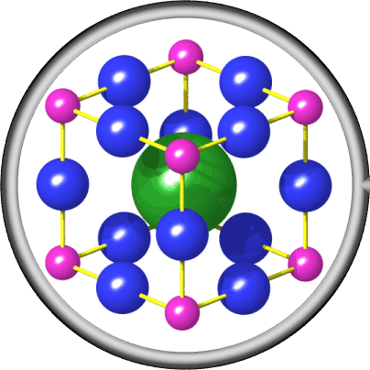
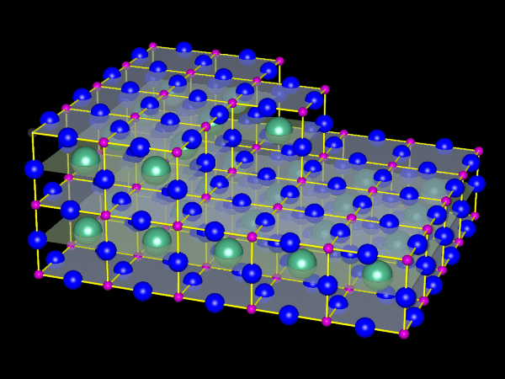
Number of surface site calculation
SrTiO3 has a lattice constant of a=3.905A
(1,0,0) surface for SrTiO3 is cubic, which looks like the graph on the right
Each (1,0,0) lattice has 3 surface atoms(1 Ti, 2 O)
Therefore, each lattice has area of A=a²=1.525*10^-15 cm²
Surface atom density=# of atoms on one lattice surface/lattice surface area
So, surface atom density= 3/1.525*10^-15cm² = 1.967*10^15 atoms/cm²

Slide 30
Voltage Distribution (Dark, Equilibrium)
Mott-Schottky: U_{FB} = 1.6 V
Photo-Voltage: U_{OC} = U_{SC} = 0.85 V
Photo-voltage at open circuit roughly half of U_{FB}
U_{H}= 0.65 V in the dark, at equilibrium (no applied U)
Notes:
Measure this distribution in the dark and at equilibrium (no applied voltage)
The flat band voltage is measured from Mott-Schottky plots. We get 1.6 V from the intercept.
What’s interesting is that when we illuminate the sample, we can only get 0.8V out… shown here Voc vs. the laser intensity. Further, this photovoltage onsets at very low light intensities and flattens out. This is all you can get out by illuminating the semiconductor
This suggest that the distribution at the surface in the dark and at equilibrium is with half the possible voltage on the semiconductor, and half across the helmholtz layer. Specifically, the U_{H} that determines the VB edge is 0.65 V under these conditions.
Now with laser light, its much higher than used for these photovoltage measurements and that can also change the Helmholtz voltage drop.

Slide 31
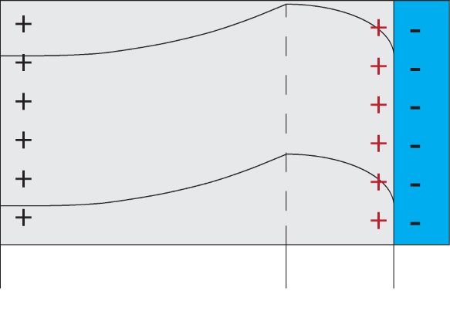
Voltage Distribution (Illumination)
Capacitance
Illuminated Junction
q_{sc}
q_{photo}
CB
VB
n-type
p-type
Reverse Bias
Forward Bias
Double
Layer
Turner, Nozik APL 37 (1980)
Photo-induced holes at interface create an interfacial p-type layer
This interfacial “carrier inversion” changes U_{H}, even with no applied U
Notes:
So, now we want to know the voltage distribution under under illumination.
Significant changes with light… U shaped curve
U shaped curve is due to two types of charges being involved: charge in the depletion layer and the photo induced charge. The photoinduced charge goes to the surface. It goes to flatten the bands… but then the left over charge is dumped at the surface, there’s a lot of left over charge (little intensity flattens the bands).
Dark, dopant charge causes C to decrease in this voltage range. The photo-induced charge creates a thin p-type layer at the surface that is forward biased along this same voltage range, so C increases with applied voltage. This is commonly called “carrier inversion”. Turner, Nozik.
This p-type inversion layer will become part of the Helmholtz voltage drop under illumination. So even with no applied U, we change the Helmholtz potential drop at high light intensities.

Slide 32
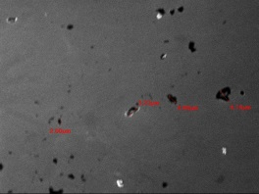
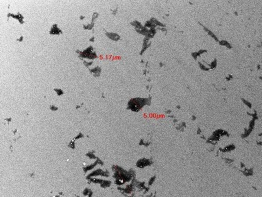
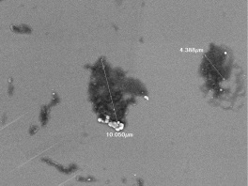
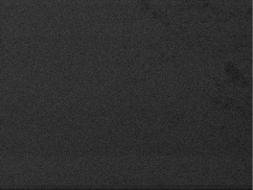
SEM images a)-d) show damage on 0.1% Nb doped SrTiO3 under laser and applied bias condition
a)
a)
b)
10μm
10μm
Damaged sample at 1500× magnification
Damaged sample at 1500× magnification
Damaged sample at 3500× magnification
Undamaged sample at 1500× magnification
c)
c)
d)
1μm
10μm
SEM image shows laser burned holes on sample surface, most of the holes have 5um as diameter while some big holes have 10um as diameter
No damage is observed if only laser is applied to our sample, damage happens when current is running through the sample and laser is applied.
Laser spot size is 500um(FWHM) but the peak is narrow around 10um
One possible mechanism for the damage is coulomb explosion where high density of excitons generated by laser accumulate at sample surface causes explosion

Slide 33
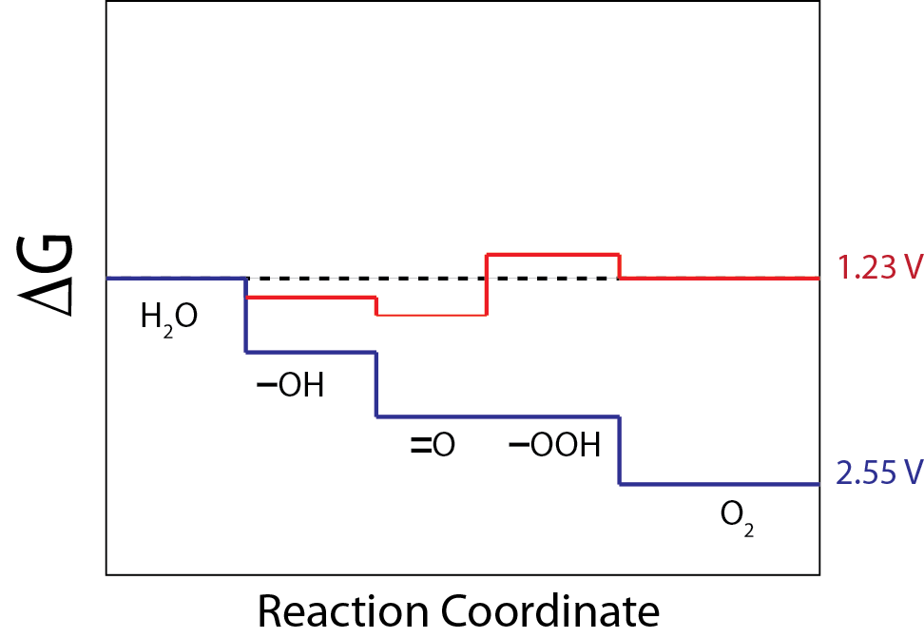
Water Oxidation & Over-Potential
Thermodynamic potential,
High kinetic barriers
~ 0.01 O₂ /site-sec
High over-potential,
Lower kinetic barriers
~10’s O₂ /site-sec
How do the surface dynamics modify the kinetic barriers and thermodynamics of each intermediate in the cycle?
Notes:
Two types of “catalysts” we will study
Free energy of the reaction as a function of the reaction coordinate, and these are some hypothesized intermediates of the reaction… one with an inherently high over-potential for the reaction while the other can drive the reaction close to the thermodynamic potential… the more “true” catalyst since it can run the reaction well without a large external driving force. Important to also study the over-driven material since it will gives us this range of turnover rates to look at, even if driven by an extra boost.
Essential question that we are asking…

