Slide 1

About OMICS Group
OMICS Group International is an amalgamation of Open Access publications and worldwide international science conferences and events. Established in the year 2007 with the sole aim of making the information on Sciences and technology ‘Open Access’, OMICS Group publishes 400 online open access scholarly journals in all aspects of Science, Engineering, Management and Technology journals. OMICS Group has been instrumental in taking the knowledge on Science & technology to the doorsteps of ordinary men and women. Research Scholars, Students, Libraries, Educational Institutions, Research centers and the industry are main stakeholders that benefitted greatly from this knowledge dissemination. OMICS Group also organizes 300 International conferences annually across the globe, where knowledge transfer takes place through debates, round table discussions, poster presentations, workshops, symposia and exhibitions.

Slide 2
About OMICS Group Conferences
OMICS Group International is a pioneer and leading science event organizer, which publishes around 400 open access journals and conducts over 300 Medical, Clinical, Engineering, Life Sciences, Pharma scientific conferences all over the globe annually with the support of more than 1000 scientific associations and 30,000 editorial board members and 3.5 million followers to its credit.
OMICS Group has organized 500 conferences, workshops and national symposiums across the major cities including San Francisco, Las Vegas, San Antonio, Omaha, Orlando, Raleigh, Santa Clara, Chicago, Philadelphia, Baltimore, United Kingdom, Valencia, Dubai, Beijing, Hyderabad, Bengaluru and Mumbai.

Slide 3
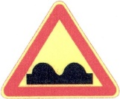
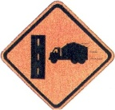
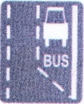
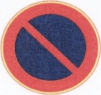
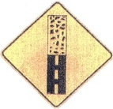
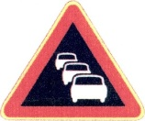
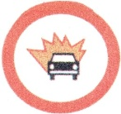

Israeli and American traffic signs similarities, differences and compliance with ergonomic principles of signs design
Tamar Ben-Bassat
Shamoon college of Engineering, Israel
Notes:
Hello everyone, my name is Tamar and I’m about to present a study on highway traffic signs.
Are there any American drivers here in the audience?
Please join me in a little quiz –

Slide 4
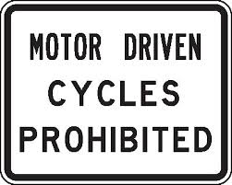
What does this sign mean?
No Motorcycles
Notes:
If you think you know or can guess what this sign means, please raise your hand.
This is the Israeli version
* And this is the American version of the same sign, meaning:
* “No Motorcycles”.

Slide 5
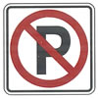
and this one…?
No Parking
Notes:
And what about this one? If you think you know what its means, please raise your hand.
* Here is the American version of the same sign
* And it means “No Parking”.

Slide 6
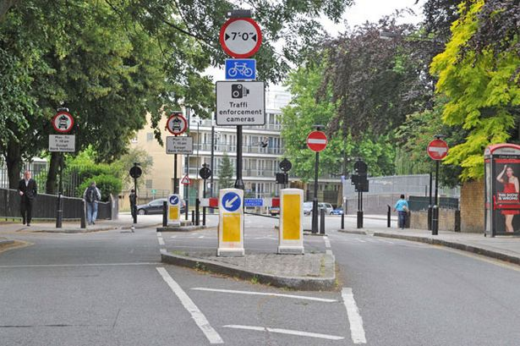
Notes:
Well, traffic signs represent one of the most common devices for controlling traffic.
They help regulate, warn, and guide road users.

Slide 7
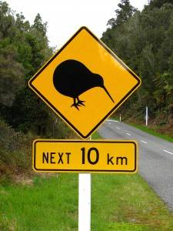
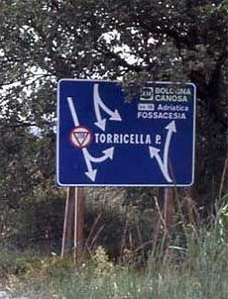
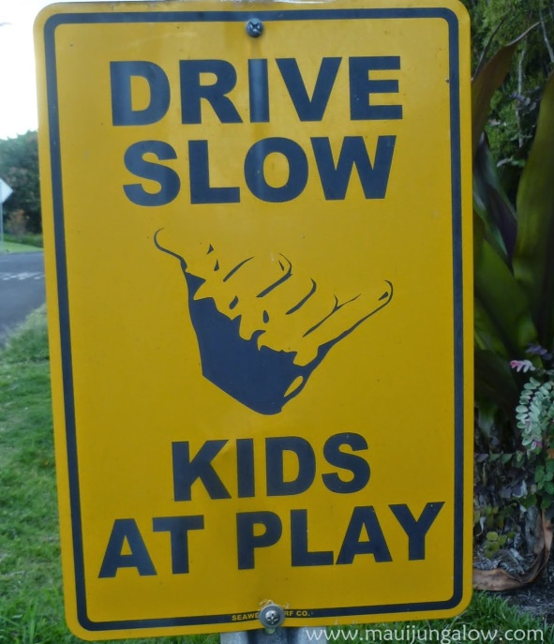
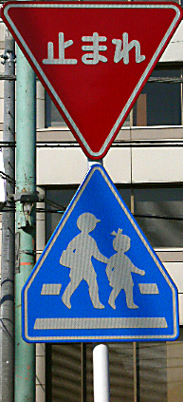
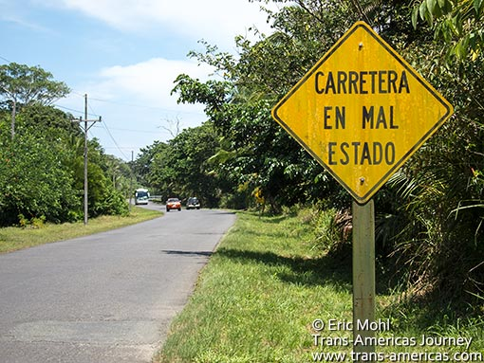
Notes:
Nevertheless, several previous studies have shown that in spite of their importance, traffic signs are not always clear to local drivers, and especially to foreign drivers.
Here you can see some examples of road signs from different countries.

Slide 8
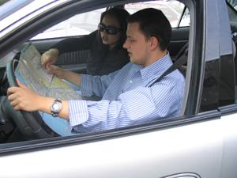
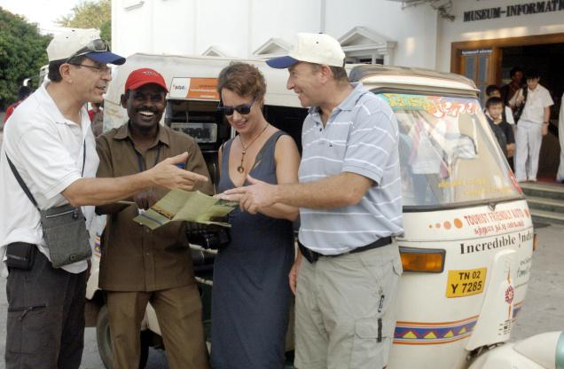
Notes:
The issue of comprehension level of signs used in different countries is critical. A driver, licensed in one country may rent a car and drive it in almost any other country, with signs that may be very different from those he is familiar with.

Slide 9
Background
Shinar, Dewar, Summala, and Zakowska (2003) compared sign comprehension of drivers of four different countries - Canada, Finland, Israel and Poland:
  There are large differences among signs in their comprehension by the drivers.
  Local traffic signs were understood by more people than non–local signs.
Notes:
In a cross-cultural research of Shinar and colleagues, published in 2003, it was found that:
There are large differences among signs in their comprehension by the drivers – Some of the signs, were fully understood by over 90% of the drivers from different countries, while others were not understood at all, or understood by only a small percent of the drivers.
As expected, they also found that local traffic signs were understood by more drivers than non–local signs.

Slide 10

Background
Ben-Bassat and Shinar (2006):
Familiarity is the most significant factor affecting road signs comprehension.
Notes:
There are two major reasons for the variability in road signs comprehension:
The first reason is familiarity – obviously, common signs are more understood by drivers, even if their design do not comply with ergonomic principles for symbol design.
* For example: No entry sign. This sign’s design has low compatibility level because the content of the sign do not resemble reality and it do not comply with people’s associations. But, in spite of its poor design, most drivers know its meaning because it is a very common sign.
The problem is that commonly used signs can be unfamiliar to non-local drivers.

Slide 11
Background
Ben-Bassat and Shinar (2006):
Familiarity is the most significant factor affecting road signs comprehension.
  Familiarity - The frequency of the sign in the road.
  Compatibility - The correspondence between the sign and the message it represents.
  Standardization - the extent to which the codes used for different dimensions like color and shape are consistent for all signs.
Notes:
In our study from 2006, we defined three principles for ergonomic signs design.
The first principle is familiarity
The second one is compatibility, which is a combination of three principles (Spatial compatibility, Conceptual compatibility and Physical representation), all relating to how the sign is perceived by the driver.
And the third principle is standardization, which is consistency, homogenous representation of forms/colors/symbols/directions and so on in all traffic signs for presenting a similar message.
The standardization and compatibility principles are significant issues when addressing the problem of non-local drivers who are unfamiliar with local signs.

Slide 12

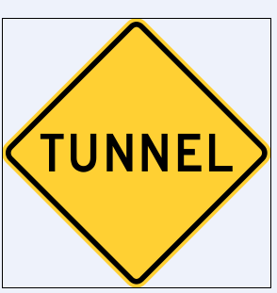
Background
Ben-Bassat and Shinar (2006):
Significant correlations were found between comprehension level and two ergonomic design principles - compatibility and standardization.
Notes:
When we tested drivers comprehension of road signs, we found that ergonomically designed traffic signs, that comply with these basic ergonomic rules for design, were more comprehendible by all drivers – local and non-local.
* For example: Can you guess what this sign means?
It means: Tunnel ahead
* In united states the sign looks like that, but still it can be assumed that most of the American drivers will understand the meaning of the equivalent European sign.

Slide 13


The goal of this study
Compare Israeli road signs design (Vienna Convention) and American road signs design (MUTCD).
vs.
Vienna Convention
MUTCD
Notes:
In the current study, the goal was to map the differences between Israeli road signs’ design, based on the Vienna Convention, and American road signs design, based on the Manual on Uniform Traffic Control Devices (MUTCD).

Slide 14

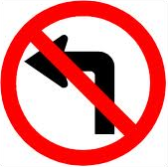


Method
Five categories of signs:
  Similar in all aspects
Notes:
The signs in this study were distributed into five categories:
The first category was similar signs (Israeli and American) in all aspects (meaning, shape, color and sign-content);
* for example: no left turn sign. As you can see, the signs are almost identical.

Slide 15


Method
Five categories of signs:
  Similar in shape and color
  but different in sign-content
Notes:
In the second category there are similar signs in shape and color but different in sign-content;
* for example: the stop sign.

Slide 16
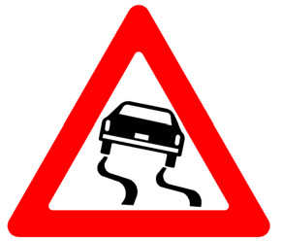
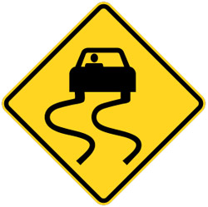
Method
Five categories of signs:
  Similar in sign-content
  but different in shape and color
Notes:
The third category is the opposite - similar in sign-content but different in shape and color;
* For example: the skid sign.

Slide 17
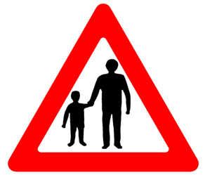
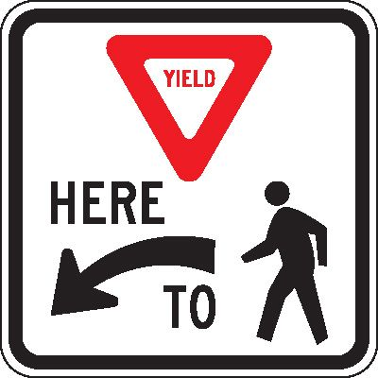
Method
Five categories of signs:
  Different in all aspects
Notes:
In the forth category there are signs who are different in all aspects – shape, color and content;
* for example: the sign “Yield here for pedestrians”

Slide 18
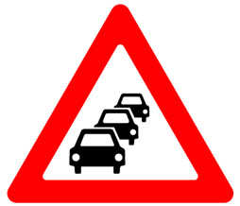
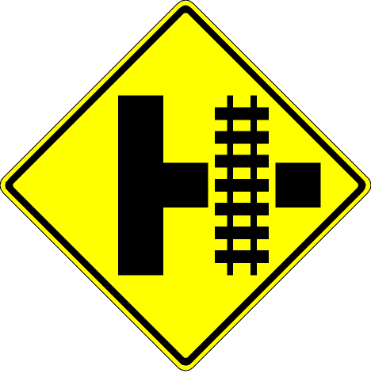
Method
Five categories of signs:
  Exists only in one country (Israel or USA)
Notes:
And the final category is signs that exists in one country (Israel or USA), but do not exist in the other.
* For example: heavy traffic sign from Israel. As far as we know there is no American equivalent.
* and another example: Parallel Railroad Crossing from united states.

Slide 19

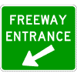
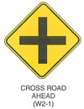
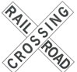
Results
Great variability in road signs design between Israel and USA
Notes:
Results of the signs mapping, revealed great variability in road signs design. We found much more signs that were different than similar signs, especially in terms of shape and color of the sign.

Slide 20
Method
Rate 30 signs according to two ergonomic principles:
  Sign-content compatibility
  Standardization (according to Israel standard)
  Participants: human factors and ergonomics students
Notes:
After we mapped all signs, we chose 30 Israeli signs - 6 from each category, and rated them according to two ergonomic principles:
sign-content compatibility
and standardization.
Of course, standards in Israel are very different from the us standards. But because we rated Israeli signs, and our final goal is to test sign comprehension of Israeli signs, the rate was according to the Israeli and Vienna convention standards.
The evaluation of the signs was conducted by human factors and ergonomics students, after they were familiar with the ergonomic principles for symbol design.

Slide 21
Results
Variability in compliance to ergonomic principles.
High compliance
Low compliance
Notes:
Among Israeli signs that were different from the equivalent American sign, there were signs that were poorly designed in terms of ergonomic principles and signs that got high rates in ergonomic design.
For example: the sign on the left – fallen rocks – can be understood quite easily even if you never saw this sign. Whereas the one on the right – which means…???? Closed lane – does not comply with the ergonomic principles, and therefore it can be assumed that non local drivers will find it difficult to understand its meaning.

Slide 22
Conclusions
Great differences between Israel and USA in road design.
Different standards between Vienna convention and MUTCD.
Can create difficulty among tourist drivers to understand local signs.
Notes:
In conclusion, we found that
There are great differences between Israeli and American road signs. Most of the signs are designed completely different.
These differences are mostly based on the different standards that are used in these two countries.
And therefore, it can be assumed that foreign drivers will find some of the poorly designed Israeli signs hard to comprehend.

Slide 23
Future research
Test traffic signs' meaning among American drivers:
  Similar in all aspects
  Similar in shape and color but different in sign-content
  Similar in sign-content but different in shape and color
  Different in all aspects
  Exists only in one country
Notes:
Future study will examine comprehension level of signs from the 5 categories mentioned, among American drivers.
Actually, this future study was already done. And I can say for sure that as we expected, local Israeli signs that are poorly designed in terms of compliance to ergonomic principles of signs designs were not understood by American drivers.

Slide 24
Thank you!
Tamar Ben-Bassat – tamarbe@sce.ac.il

