Slide 1
The management of health care workers’ latent tuberculosis infection at public hospitals of Vhembe district, South Africa.
DR Takalani Tshitangano takalani.tshitangano@univen.ac.za
+27824484111
South Africa

Slide 2
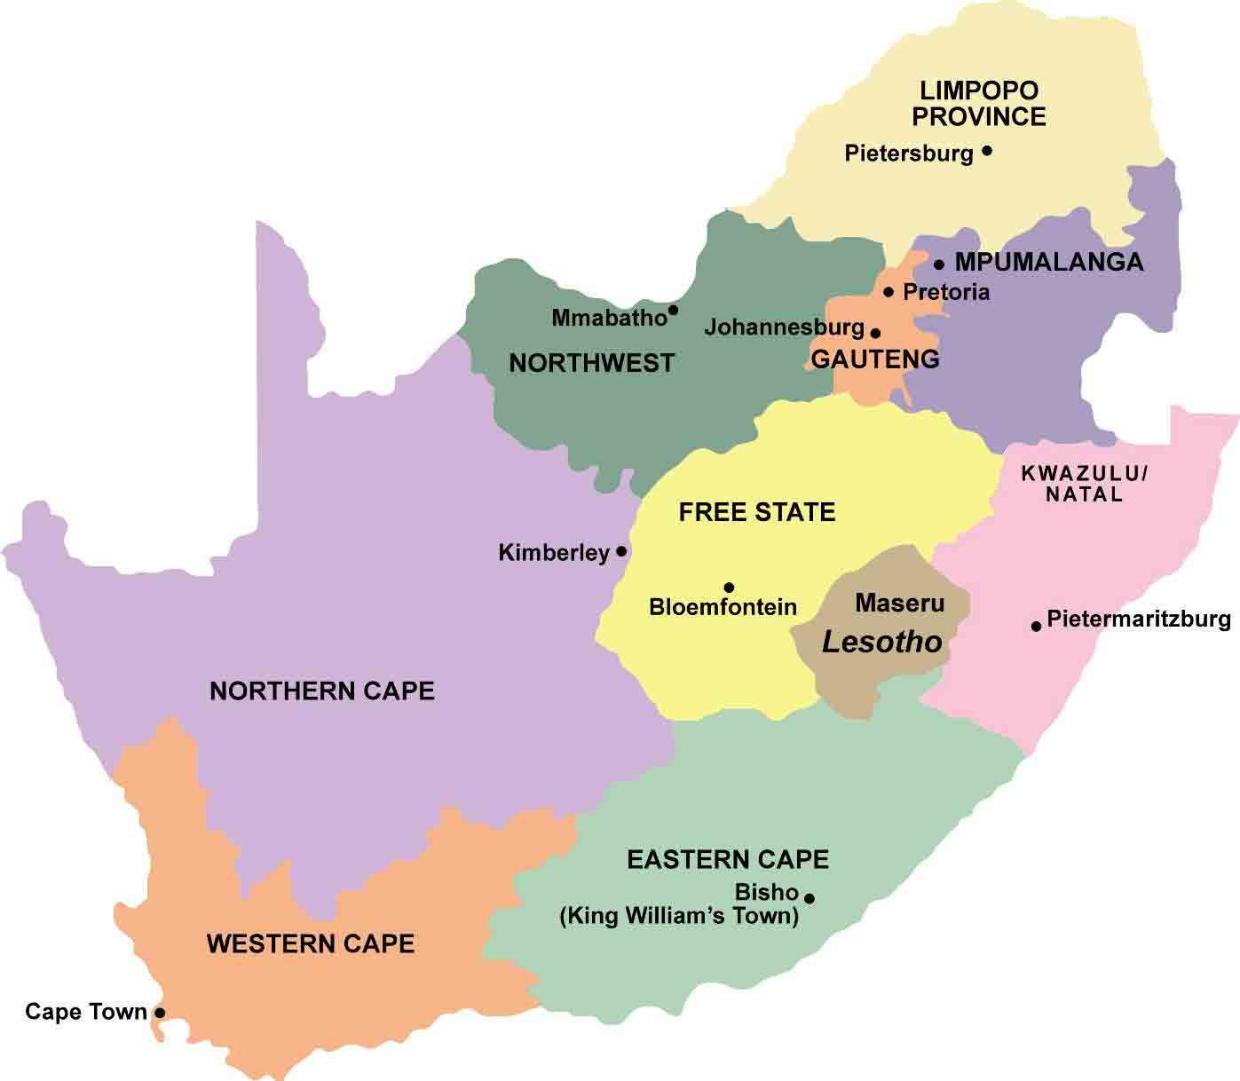
BACKGROUND

Slide 3
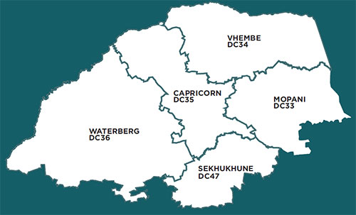

Slide 4
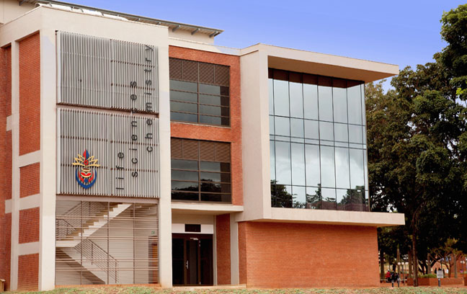

Slide 5
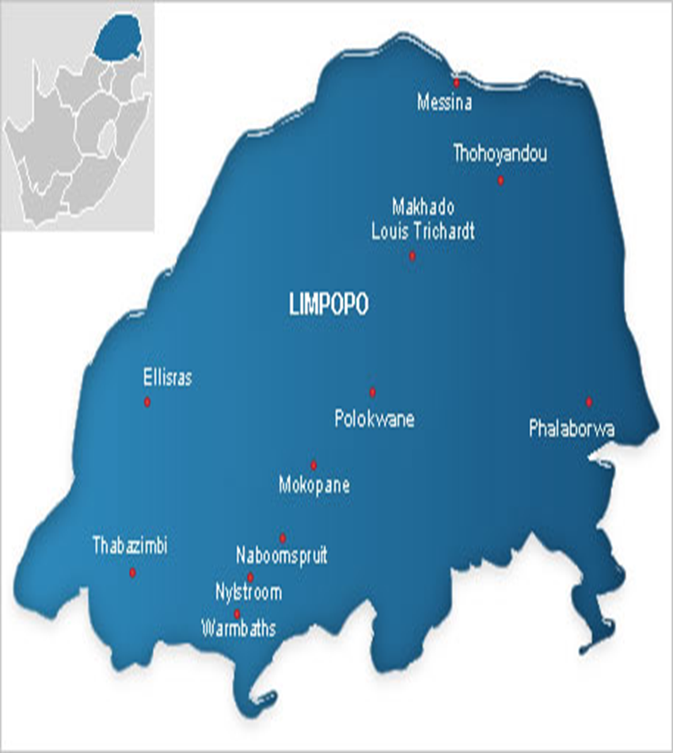
The district has many cities. The university of Venda is based in the city of Thohoyandou

Slide 6
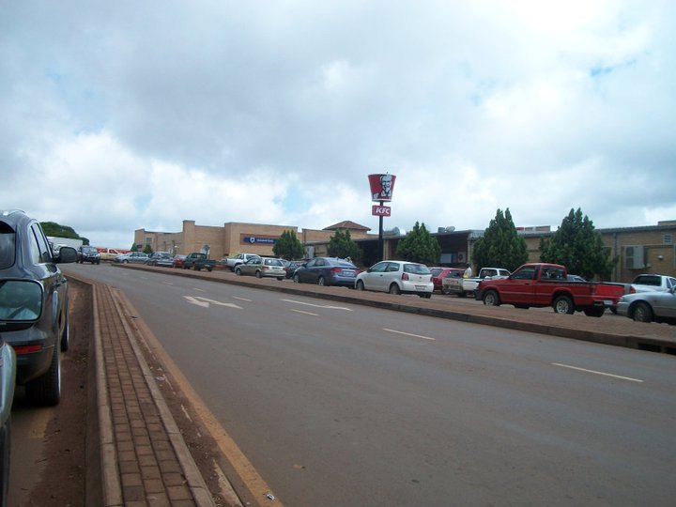

Slide 7
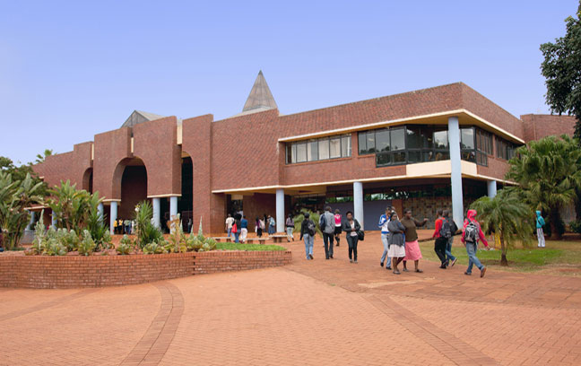


Slide 9
The district’s 08 hospitals, namely
Donald Fraser hospital,
Elim hospital,
Malamulele hospital,
Siloam hospital,
Louistrichardt hospital,
Musina hospital;
Hayani hospital; and
Tshilidzini hospital,
are distributed equitably amongst the four local municipalities.

Slide 11
However, Hayani hospital does not admit TB patients, it is a mental hospital.
Thus, this study was conducted in seven of the eight hospitals of the district.
Why an interest in the management of HCWs’ LTBI and not any other condition?

Slide 12
RATIONALE OF THE STUDY
Several authors concur that tuberculosis (TB) has become a major occupational hazard in low and middle-income countries with health care workers (HCWs) being the category of employees frequently exposed to infectious tuberculotic patients and developing latent tuberculosis infection (LTBI).
A 2013 study by Jo, Hong, Park, Bae, Eom, Lee, Cho, Choo, Heo, Woo, Shim discovered a high prevalence of LTBI among South Korean HCWs, which was associated with experience of working in tuberculosis (TB)-related departments.

Slide 13
Similarly, a 2013 study by Zhang, Jia, Liu, Pan, Xing, Gu, Du, Sun, Wei, Zhang revealed high TB prevalence among Chinese HCWs with an increased working duration in TB related departments as well as the history of household TB contact.
The CDC 2011 study confirm that TB among HCWs is consistently higher than the risk among the general population worldwide, which confirms that TB is an occupational disease (Baussano, Nunn, Williams, Pivetta, Bugiani,and Fabio Scano).

Slide 14
Though the prevalence rate of LTBI amongst HCWs is not known in Vhembe district,
The following slides showcases the factors, which might predispose HCWs to TB infection in public hospitals of Vhembe district, suggesting a possibility of high prevalence of LTBI amongst HCWs.

Slide 15
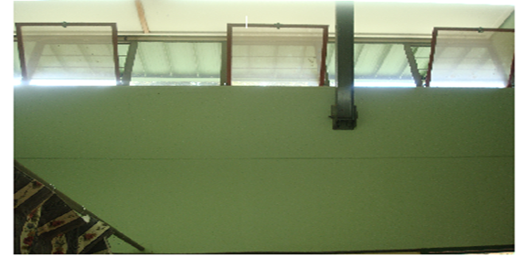
Windows at TB wards of some hospitals are at ceiling height and they flip in-wards

Slide 16
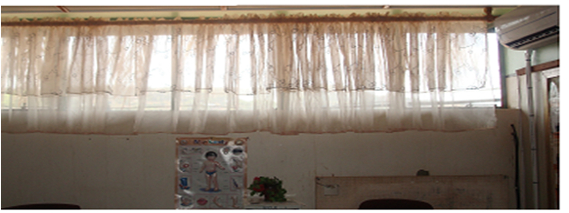
Window in OPD waiting areas of some hospitals are decorated with curtains, thus preventing maximum air entry

Slide 17
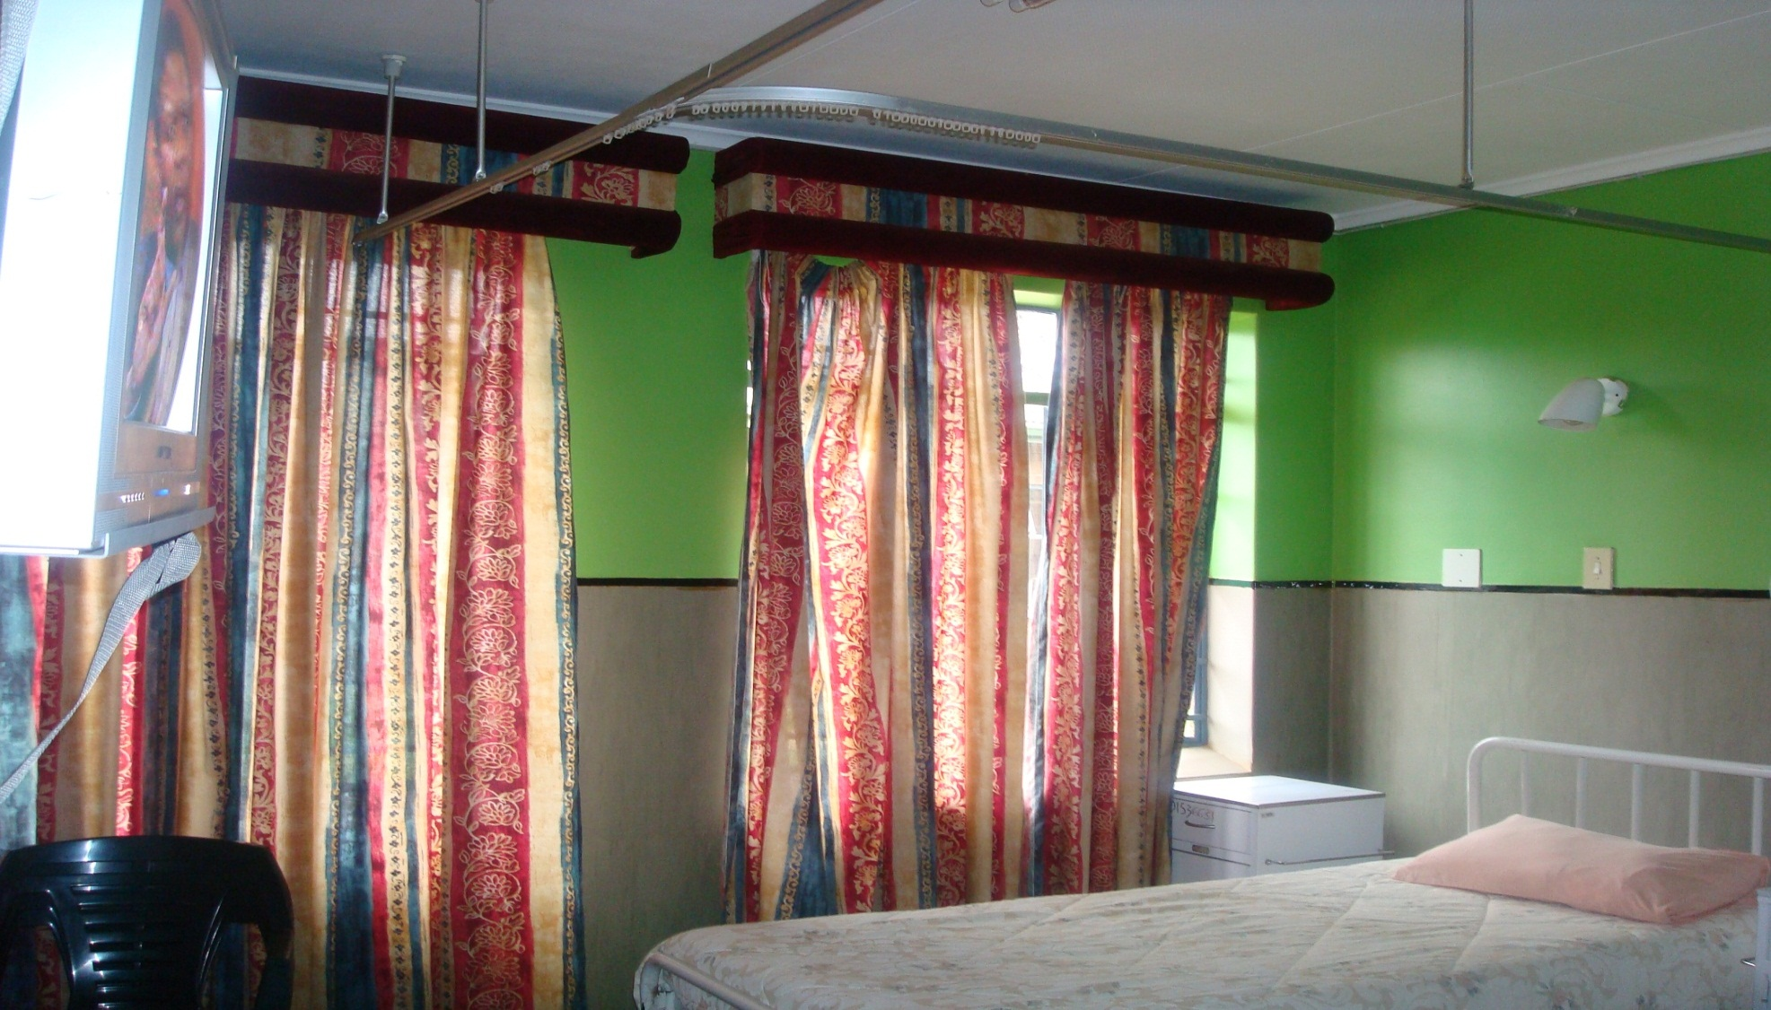
Window in TB wards of some hospitals are decorated with curtains, thus preventing maximum air entry

Slide 18
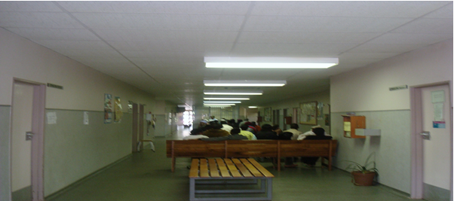
Lack of UVGI lamps, ceiling fans and windows in some hospital waiting areas increases the risk of TB transmissions.

Slide 19
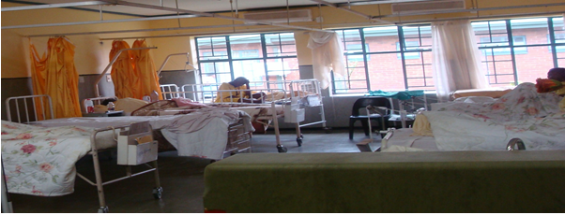
Isolation cubicle in a medical wards of some hospitals has half walls opening towards the nurses’ station increasing HCWs exposure to TB.

Slide 20
WHY ARE WE WORRIED ABOUT TB IN PARTICULAR?

Slide 21
TB is the second leading cause of death after HIV world- wide;
In 2012 alone, about 1.3 million people died from TB (WHO TB report, 2013);
About 5.7 million newly diagnosed cases were notified in national TB programmes world-wide in 2012.
What is worse is that, in 2012 alone, South Africa was amongst the three countries that had almost 60% of the world cases of MDR-TB (WHO Global TB report, 2013);

Slide 22
South Africa up till 2012 had not reached the global target of 85% TB cure rate.
In 2012 the South African cure rate was 79%, which was still 6% below target.
South Africa currently ranks the third highest in the world in terms of the TB burden, with an incidence that has increased by 400% over the past 15 years.

Slide 23
In 2012 alone, the total new TB cases notified in South Africa were 296 664 (WHO global TB report, 2013).
The increased incidence of new TB infections is attributed to the growing MDR-TB rates, with 15 419 confirmed MDR-TB cases in 2012 in SA.
Of the 15 419 confirmed MDR-TB cases, only 42% n= 6 494 patients were started on MDR-TB treatments.
The remaining 68% were not started on MDR-TB treatments, which suggest that they continued to transmit the MDR-TB infection to people around them (such as their relatives, friends, health care workers and other patients).

Slide 24
The burning issue is that all infectious TB and untreated MDR/XDR-TB patients in Limpopo province including Vhembe district are first admitted at non-specialised hospitals in medical or TB wards, whilst appearing on the often long waiting lists for admissions to specialised public TB hospitals.
The concern here is that Robinson et al in 2007 found in all SA’s nine provinces that non-specialised hospitals have no effective TB infection control programme in place, which suggest that there is an on-going substantial risk of hospital TB transmissions, HCWs being the victims.

Slide 25
The increased rates of new cases of TB, MDR-TB and XDR-TB, such as that found in the Vhembe district, is a major threat to achieving TB control and elimination by the year 2050 as advocated by the Millennium Development goals and Stop TB partnership.
Javis (2010) therefore emphasise that there is need to implement practices that seek to minimize the risk of contracting TB in public hospitals if the control of TB is to be achieved.
These include the management of LTBI.

Slide 26
This study in­vestigated practices of managing HCWs’ LTBI at hospitals of Vhembe district in order to:
1) Describe pre-employment or pre-placement LTBI screening practices at hospitals in Vhembe district, in the year 2013;
2) Determine what action is taken if HCWs are exposed to infectious tuberculotic patients at these hospitals;
3) Describe HCWs’ accessibility to LTBI screening at these hospitals; and
4) Describe the type of tests performed to diagnose LTBI in HCWs at these hospitals.

Slide 27
METHODOLOGY
A qualitative approach was adopted, using a cross-sectional descriptive design.
The target population was all the HCWs employed in the seven hospitals who were purposively sampled taking maximum variation into account.
There was one focus group per hospital, each comprising five to 10 members.
The central question for the focus group discussions was: “How would you describe the practices of managing LTBI in HCWs in this hospital?”

Slide 28
In response to participants’ answers, follow-up and probing questions in the form of unstructured focus group discussion guide were asked.
The content and construct validity of the discussion guide and the document study was checked and endorsed by the Vhembe district TB coordinator and then compared with the WHO TB infection control policy.
Data collection at the first hospital afforded the researcher an opportunity to pre-test the focus group discussion guide in order to check the reliability of the tool.

Slide 29
Permission to conduct this study was obtained from the School of Health Sciences and University of Venda (UNIVEN) Higher Degree Committees, as well as from the Limpopo Provincial Department of Health. Ethical clearance was obtained from the UNIVEN Ethics Committee.
Data were analysed using an open coding method, following Tesch’s 8-step criteria described by Creswell (2009).
Lincoln and Guba’s 1985 model, comprising four criteria or measures to ensure trustworthiness of the study findings was adopted

Slide 30
RESULTS
Hospitals did not conduct pre-employment or pre-placement LTBI screening tests such as TSTs and interferon gamma release assays
“In this hospital, no HCW is screened for TB, either upon employment or periodically”.
HCWs’ screening for LTBI was not accessible due to costs
“Any nurse who wishes to be screened for TB at this hospital has to take the initiative and is expected to pay for the screening tests. However, if a nurse is found to be sick with TB, he or she is put on TB treatment free of charge.”

Slide 31
Hospitals did not give prophylaxis TB ­treatment to HCWs exposed to TB infection
“It is not official that HCWs working in close contact with TB patients should take INH as a prophylaxis treatment. However, HCWs who realise the risk of contracting TB ‘take the treatments unauthorised’”.
Inappropriate tests are used to screen HCWs for LTBI
“Employees are offered pre-employment examination, which covers chest X-ray, ESR, FBC and hepatitis, the findings of which serve as baseline data.”

Slide 32
DISCUSSIONS
This study discovered that rural hospitals of Vhembe district in South Africa are failing to apply appropriate LTBI management practices amongst health care workers.
These findings are similar to the University Research Co. LLC and the Desmond Tutu Tuberculosis Centre who discovered in 2013 that only 40% of health care facilities in South Africa had LTBI screening programme or a written occupational health policy.

Slide 33
Furthermore, in 2008, Eshun-Wilson, et al. reported that pre-employment, pre-placement or periodic screenings for LTBI were not done in South Africa.
They found that, at Tygerberg Hospital, in Cape Town, South Africa, poor management of LTBI in HCWs was attributed to increased incidences of TB infection.

Slide 34
PRACTICAL IMPLICATIONS OF THE
RESULTS
Zungu and Malotle argue that occupationally-acquired TB has the potential to disrupt the provision of quality health care services by HCWs as a result of absenteeism, decreased morale and, in extreme cases, loss of HCWs.
Furthermore, HCWs can claim compensation for contracting TB infection at work

Slide 35
RECOMMENDATIONS
A call is hereby made to the South African National Department of Health for clarity on practices for the detection and management of LTBI.
Furthermore, there is a need for the enforcement of the Occupational Health and Safety Act and its regulations, and penalisation of employers who fail to comply with these, by the Department of Labour.

Slide 36
Acknowledgement
The University of Venda research directorate for funding this study.

Slide 37
Thank you FOR LISTENING

