Slide 1
Status of vaccination against seasonal influenza in pregnant Japanese women: effect on infection rate among primiparous and multiparous women
Takahiro Yamada
Hokkaido University Graduate School of Medicine, Japan
September 29, 2015

Slide 2
Today’s presentation
No maternal mortality from pandemic (H1N1) 2009 occurred in Japan (Letter BMJ 2010 Aug 6 )
Pandemic (H1N1) 2009 in pregnant Japanese women in Hokkaido (J Obstet Gynaecol Res 38: 130–6, 2012)
Vaccination during the 2013–2014 influenza season in pregnant Japanese women (Eur J Clin Microbiol Infect Dis 34:543-548, 2015)
Influenza 2014 - 2015 among pregnant Japanese women: primiparous vs. multiparous women (manuscript in preparation)

Slide 3
Background
Pregnant women are at an increased risk of severe influenza-related complications.
Evidence from several countries demonstrated increased hospitalization rates and higher rate of mortality in pregnant women during the influenza.

Slide 4
No maternal mortality from pandemic (H1N1) 2009 occurred in Japan (Letter BMJ 2010 Aug 6 ): Our first report
district/ country
Hokkaido, Japan
Japan
Australia
Calfornia, USA
USA
Canada
China
What is the reasons for this lack of maternal deaths in Japan?
Study period
Dec,2009-May, 2010
July, 2009- May, 2010
May, - Oct, 2009
Apr. - Aug.2009
Apr, -Aug. 2009
-Oct. 2009
-Dec. 2009
Admission
6
(2.25% of pregnant patients）
74
278
102
509
85
4328
ICU
0
47
(16.9% of admitted patients)
22
（21.6%% of admitted patients）
115
(22.6%% of admitted patients)
16
(18.8%% of admitted patients)
593
（13.7%% of admitted patients）
death
0
0
3(1.08% of admitted patients)
8（7.8% of admitted patients）
30 (5.89% of admitted patients)
4 (4.7% of admitted patients)
326（7.5% of admitted patients）

Slide 5
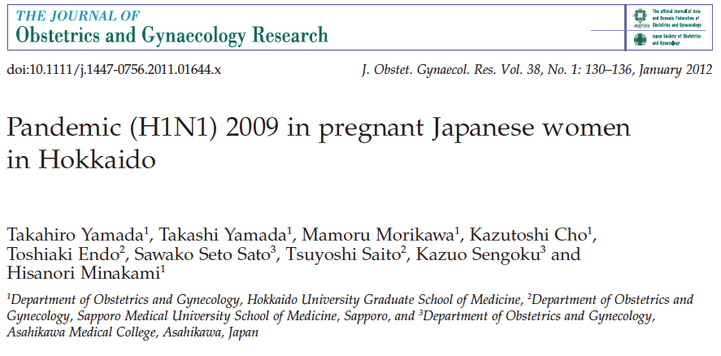
Pandemic (H1N1) 2009 in pregnant Japanese women in Hokkaido (J Obstet Gynaecol Res 38: 130–6, 2012): 2nd report
Background and Aims: The reasons for the lack of maternal deaths from pandemic (H1N1) 2009 remain unknown. This questionnaire survey was performed to investigate how many pregnant women were infected, how many women took antiviral drugs for prophylaxis or treatment, and the rate of vaccination effectiveness.
Methods: Questionnaire study for 20,500 postpartum women
Study period:
Dec 2009 - May 2010

Slide 6
Maternal age and birth weight of infants
Infected Non-infected p-value
No. of women 268* 7,267
Age (years old) 0.1823
-19 6 (2.2%) 85 (1.2%)
20-24 25 (9.3%) 816 (11.2%)
25-29 80 (29.9%) 2,209 (30.4%)
30-34 85 (31.7%) 2,571 (35.4%)
35-39 64 (23.9%) 1,335 (18.4%)
40- 6 (2.2%) 170 (2.3%)
unknown 2 (0.8%) 81 (1.1%)
Birth-weight of infants(g) 0.1319
-1,499 3 (1.1%) 28 (0.39%)
1,500-1,999 0 (0.0%) 51 (0.70%)
2,000-2,499 21 (7.9%) 457 (6.3%)
2,500-2,999 107 (39.9%) 2,809 (38.7%)
3,000- 135 (50.6%) 3,901 (53.7%)
unknown 2 (0.76%) 22 (0.30%)
There were no significant differences in the distributions of maternal age or birth weight of infants between the infected and non-infected women.
Respondents: 7535

Slide 7
Influenza and preterm delivery
Influenza did not significantly increase the rate of preterm delivery.
However, if the hospitalization needed, the risk of preterm birth is increased.
(Nakai A et al., J Infect. 2011; 62:232-233)
Risk of preterm birth/abortion among 181 women who needed hospitalization.
Characteristics Japanª Overall Pneumonitis
Absent Present
No. of women 1,091,156 181 164 17
Abortion at<22w NA 3/181(1.7) 2/164(1.2) 1/17(5.9)
Preterm birth
22-31 weeks 7876/1,091,156 (0.7) 5/178 (2.8)* 5/162 (3.1) * 0/16 (0)
32-36 weeks 54,932/1,091,156 (5.0) 21/178 (11.8) * 16/162 (9.8) * 5/16 (29.4) *#
Term birth 1,028,348/1,091,156 (94.2) 152/178 (85.4) * 141/162 (86.0) * 11/16 (68.8) *
*p < 0.01 vs Japan (national statistics) #p < 0.05 vs women group without pneumonitis.
ªNational data of Japan in 2008 were presented as a comparison group.

Slide 8
Vaccination, Antiviral drug
Infected(268) Non-infected(7267) p-value
Vaccination⁑ 11 (4.1%) 4,910 (67.6%) <0.0001
Antiviral drug
Prophylaxis only 4 (1.5%) 213 (2.9%) 0.1948
Treatment only 93 (34.3%) –
Both 136 (50.8%) –
More than 60% of candidates were vaccinated within 1.5 months after the availability of vaccine and half of all infected women had taken prophylactic antiviral drug after coming into close contact with an infected person

Slide 9
Vaccination reduced infection by 89% in pregnant Japanese women
Infection rate with pandemic (H1N1) 2009 according to the status of vaccination at after December in Hokkaido
Vaccinated Non-vaccinated p-value
No. of women 4,921 2,407
No. of infected 11 (0.224%) 50 (2.08%) <0.0001

Slide 10
Summery of first questionnaire survey
Pregnant Japanese women had a high level of concern regarding pandemin (H1N1) 2009, went to some effort to avoid contracting the influenza by taking antiviral drugs and vaccination.
This behaviour may have contributed to the lack of maternal mortality associated with this pandemic in Japan.
Vaccination reduced infection by 89% in pregnant Japanese women.

Slide 11
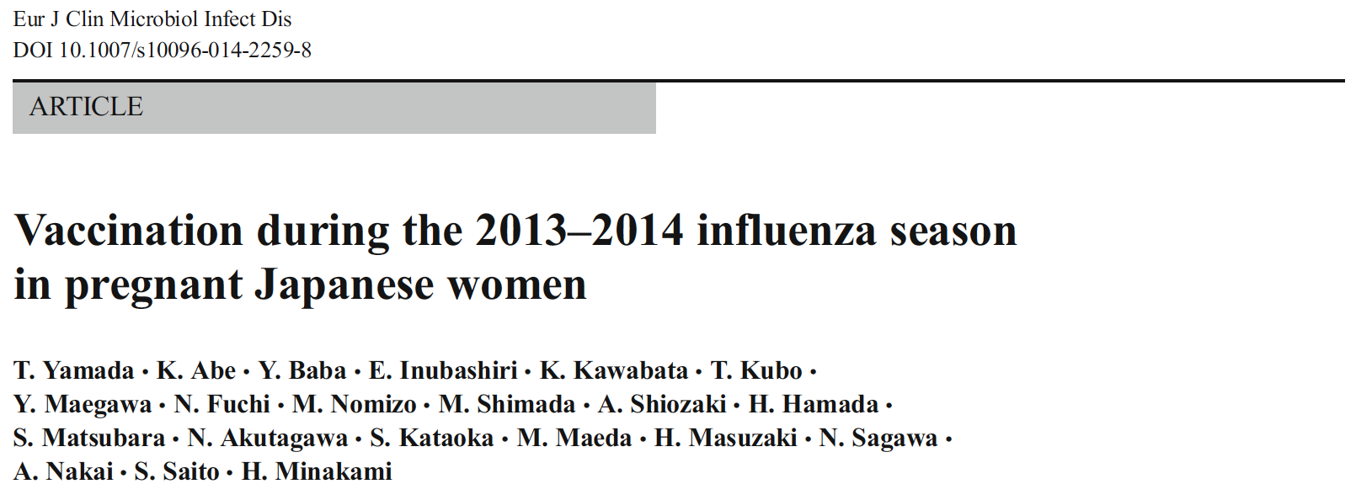
Vaccination during the 2013–2014 influenza season in pregnant Japanese women (Eur J Clin Microbiol Infect Dis 34:543-548, 2015): 3rd report
How many pregnant Japanese women are vaccinated against seasonal influenza?
How many pregnant Japanese women contracted seasonal influenza before or after the pandemic (H1N1) 2009?
The baseline level of concern regarding influenza among pregnant Japanese women?
To prepare for future avian influenza epidemics.

Slide 12
Vaccination during the 2013–2014 influenza season in pregnant Japanese women (Eur J Clin Microbiol Infect Dis 34:543-548, 2015)
We conducted the multi-center study to determine vaccination coverage against seasonal influenza and the prevalence rate of influenza infection among pregnant Japanese women during the 2013 – 2014 influenza season.
This is the first study focusing on the behavior of pregnant Japanese women with regard to seasonal influenza.

Slide 13
Vaccination rates according to maternal age and experience of prior birth
Age (year) Overall Primiparous Multiparous P-value*
≤ 24 39/124 (31%)¶ 29/92 (32%)¶ 10/32 (31%)† 0.9772
25 – 29 171/332 (52%) 112/198 (57%) 59/134 (44%) 0.0249
30 – 34 305/571 (53%) 156/299 (52%) 149/272 (55%) 0.5330
35 – 39 260/501 (52%) 106/222 (48%) 154/279 (55%) 0.0974
≥ 40 101/185 (55%) 44/92 (48%) 57/93 (61%) 0.0659
Overall 876/1713 (51%) 447/903 (50%) 429/810 (53%) 0.1525
*, Comparison between primiparous and multiparous women.
¶, P < 0.05 vs. any other age category.
†, P < 0.05 vs. any other age category except women aged 25 – 29 years.
876 (51%) reported having received vaccination against influenza in or after October 2013.
Women aged ≤ 24 years had a significantly lower vaccination rate than those aged ≥ 25 years (31% vs 53%, respectively; P=0.0000).

Slide 14
Comparison of women who did and did not contract influenza
Infection with influenza
Yes No P-value
No. of women 87 1626
Vaccinated 34 (39%) 842 (52%) 0.0210
Primiparous 26 (30%) 877 (54%) <0.0001
Maternal age (years)
≤ 29 21 (24%) 435 (27%) 0.7088
30 – 35 34 (39%) 537 (33%) 0.2450
≥ 35 32 (37%) 654 (40%) 0.5235
87 (5.1%) and 1626 (94.9%) women did and did not contract influenza, respectively. Although prior birth did not affect overall vaccination coverage (50% for primiparous vs. 53% for multiparous), multiparous women had a significantly higher rate of contracting influenza than primiparous women irrespective of vaccination status (5.6% vs. 2.2% [P=0.0216] with vaccination and 9.7% vs. 3.5% [P=0.0003] without vaccination, respectively).

Slide 15
Vaccination and infection with influenza virus A and B
Vaccinated Unvaccinated P-value
No. of women 876 837
Type of influenza virus
A 24* (2.7%) 27* (3.2%) 0.5542
B 7 (0.8%) 16 (1.9%) 0.0455
Unknown 4 (0.5%) 11 (1.3%) 0.0569
Overall 34 (3.9%) 53 (6.3%) 0.0272
*, One was also infected with influenza virus B.
The vaccination program of this season significantly reduced influenza infection rate by 35% (3.9% vs. 6.3% for women with and without vaccination, respectively; P=0.0272).
72 (83%) of the 87 infected women took antiviral agents for the treatment of influenza and 2 (2.3%) required hospitalization.

Slide 16
Summery of second questionnaire survey
Pregnant Japanese women had a high level of concern regarding seasonal influenza .
The higher vaccination level achieved during the pandemic (H1N1) 2009 was sustained.
Campaigns targeting young pregnant Japanese women as well as multiparous women for vaccination are needed to further reduce the incidence of influenza among pregnant Japanese women.

Slide 17
Status of vaccination against seasonal influenza in pregnant Japanese women: effect on infection rate among primiparous and multiparous women
CQ. Why multiparous pregnant women are more susceptible to flu than primiparous pregnant women?
We conducted 4th study to address this issue during 2014-2015 flu season

Slide 18
Influenza 2014 - 2015 among pregnant Japanese women: primiparous vs. multiparous women: 4th report
Objective:
To determine the reproducibility of the phenomenon, i.e., “multiparous pregnant Japanese women are more vulnerable to influenza than primiparous pregnant Japanese women”
To test a hypothesis that the risk of influenza increases with increasing number of cohabitants among pregnant Japanese women

Slide 19
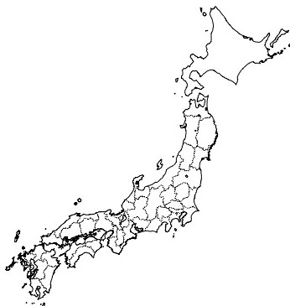
Materials and Methods
The multicentre questionnaire survey was conducted targeting postpartum Japanese women who gave birth during a 5-month period between March 1, 2015 and July 31, 2015.
A: Kagoshima City Hospital
B: Fukuda Hospital
C: Nagasaki University Hospital
D: Hiroshima University Hospital
E: Osaka Medical Center and Research Institute for Maternal and Child Health
F: Rakuwakai Otowa Hospital
G: Mie Chuo Medical Center
H: Toyama University Hospital
I: Kitasato University Hospital
J: Nippon Medical School Tama-Nagayama Hospital
S
K: Shirota Obstetrical and Gynecological Hospital
L: Showa University Northern Yokohama Hospital
M: Showa University Hospital
N: University of Tsukuba Hospital
O: Jichi Medical University Hospital
P: Hakodate Central General Hospital
Q: JCHO Hokkaido Hospital
R: Sapporo Toho Hospital
S: Hokkaido University Hospital
Q
R
H
P
F
O
E
N
M
D
J
L
C
I
B
K
A
G

Slide 20
Result 1: Maternal age distribution among all 6694 candidates and 5197 respondents (78%)
The 5197 women corresponded to approximately 1.2% of all expected 440,000 maternities occurring in the study period in Japan that has approximately population of 130,000,000.
All candidates (primiparous) Respondents (primiparous)
Maternal age
– 19 83 (70), [1.2% (2.0%)] 56 (50), [1.1% (1.9%)]
20 – 29 2036 (1313), [30.4% (37.8%)] 1437 (933), [27.7% (35.4%)]
30 – 34 2200 (1049), [32.9% (30.2%)] 1728 (791), [33.2% (30.0%)]
35 – 39 1793 (749), [26.8% (21.6%)] 1456 (607), [28.0% (23.0%)]
40 – 582 (294), [8.7% (8.5%)] 515 (251), [9.9% (9.5%)]
Unknown 0 (0), [0.0% (0.0%)] 5(3), [0.1% (0.1%)]
Overall 6694 (3475), [100% (100%)] 5197 (2635), [100% (100%)]
Percentages of all women (primiparous women) are indicated in square brackets

Slide 21
Result 2: Influenza infection rate in primiparous vs. multiparous women
Influenza infection during current pregnancy
Yes No Total
No. of women 364 4833 5197
Primiparous 131 (36.0%) 2504 (51.8%) 2635
Multiparous 233 (64.0%) 2329 (48.2%) 2562
Unknown 0 (0%) 0 (0%) 0
Infection rate was significantly higher for multi- than for primiparous women
9.1% [233/2562] vs. 5.0% [131/2635], P=0.0000
RR [95%CI]: 1.83 [1.49 – 2.25]

Slide 22
Result 2: Influenza infection rate in primiparous vs. multiparous women
□ Primiparous
■ Multiparous
Prevalence rate of influenza
Nineteen hospitals
The infection rate was higher in multi- than in primiparous women at 15 (79%) of the 19 hospitals

Slide 23
Result 3: Vaccination coverage rate and effect of vaccination on influenza infection
Overall vaccination coverage rate was 51% (2661/5197) and did not differ greatly between primi- and multiparous women.
Influenza infection during current pregnancy
Yes No total
Use of vaccination
Yes 195 (53.6%) 2466 (51.0%) 2661
No 169 (46.4%) 2357 (48.8%) 2526
Unknown 0 (0%) 10 (0.2%) 10
Vaccines against influenza used in Japan in this season did not work at all to reduce number of pregnant women with influenza infection.
Overall infection rate did not differ significantly between those with and without vaccination
(7.3% [195/2661] vs. 6.7% [169/2526]).

Slide 24
Result 3: Vaccination coverage rate and effect of vaccination on influenza infection
Women aged less than 30 years received vaccination significantly less often than those aged 30 years or more.
The infection rate did not differ significantly between those with and without vaccination among primiprous as well as multiparous women.
Thus, multiparous women had a higher risk of influenza irrespective of vaccination status compared to primiparous.
No consistent association was seen between maternal age and the risk of influenza infection.
*
*, P< 0.05 vs. primiparous
*
*
Prevalence rate of influenza (%)
Maternal age (years)
Vaccinated
Unvaccinated

Slide 25
Result 4: Effect of cohabitant number on influenza infection rate
Overall
No child aged 1 – 17 years
At least one child age 1 – 17
58
(53)
14
71
(65)
Prevalence rate of influenza (%)
121
100
Number of cohabitants
n=147
n=2090
(2005/85)
n=1618
(313/1305)
n=785
(142/643)
n=557
(91/466)
Number of cohabitants was greater in multiparous than in primiparous women.
The influenza infection rate increased with increasing number of cohabitants among pregnant women with at least one cohabitant.
The presence of at least one child aged 1 – 17 years increased consistently the risk of influenza in pregnancy at any family size.
Overall infection rate was higher for those with at least one child aged 1 – 17 years than in those without such children (9.0% [226/2499] vs. 5.1% [138/2698], P<0.0001).

Slide 26
Result 5: Risk of influenza infection in women whose main job was housekeeping during current pregnancy
Influenza infection during current pregnancy
Yes No Total
Job
Housekeeping 150 (41.2%) 2391 (49.5%) 2541
Outside home 212 (58.2%) 2404 (49.7%) 2616
Unknown 2 (0.5%) 38 (0.8%) 40
Neither maternal age nor number of cohabitants differed significantly between those who worked inside and outside home.
However, women with housekeeping had a significantly reduced risk of influenza approximately by 27% (5.9% [150/2541] vs. 8.1% [212/2616]; RR [95%CI], 0.73 [0.60 – 0.89]).

Slide 27
Summery of third questionnaire survey
Multiparous women had higher risk of influenza irrespective of vaccination status compared to primiparous women.
Number of cohabitants was greater in multi- than in primiparous women.
The risk of influenza increased with increasing number of cohabitants.
The presence of at least one child aged 1 – 17 years increased consistently the risk of influenza in pregnancy at any family size.
Women with housekeeping had a reduced risk of influenza.
Vaccine coverage was low in younger pregnant Japanese women.

Slide 28
Highlights
Pregnant Japanese women had a high level of concern regarding influenza, went to some effort to avoid contracting the influenza by taking antiviral drugs and vaccination.
This behavior may have contributed to the lack of maternal mortality associated with the pandemic in Japan.
Vaccine coverage was low in younger pregnant Japanese women.
Multiparous women had higher risk of influenza compared to primiparous women.
The risk of influenza increased with increasing number of cohabitants.
The presence of at least one child aged 1 – 17 years increased the risk of influenza in pregnancy.
Women with housekeeping had a reduced risk of influenza

Slide 29
Conclusion
Campaigns targeting young pregnant Japanese women as well as multiparous women for vaccination are needed to further reduce the incidence of influenza among pregnant Japanese women.

Slide 30
Acknowledgements
Collaborators
Shoichi Kawakami², Yushin Yoshida², Hiroshi Kawamura³, Shiyo Ohta³, Kanako Abe⁴, Hiromi Hamada⁴, Satoshi Dohi⁵, Kiyotake Ichizuka⁵, Hiroko Takita⁶, Yosuke Baba⁷, Shigeki Matsubara⁷, Junko Mochizuki⁸, Nobuya Unno⁸, Yuka Maegawa⁹, Makoto Maeda⁹, Eisuke Inubashiri¹⁰, Noriyuki Akutagawa¹⁰, Takahiko Kubo¹¹, Takuhiko Shirota¹¹, Yasunari Oda¹², Takashi Yamada¹², Emi Yamagishi¹³, Akihito Nakai¹³, Naoki Fuchi¹⁴, Hideaki Masuzaki¹⁴, Satoshi Urabe¹⁵, Yoshiki Kudo¹⁵, Mari Nomizo¹⁶, Norimasa Sagawa¹⁶, Takatsugu Maeda¹⁷, Masato Kamitomo¹⁷, Kosuke Kawabata¹⁸, Soromon Kataoka¹⁸, Arihiro Shiozaki¹⁹, Shigeru Saito¹⁹, Akihiko Sekizawa⁶, Hisanori Minakami¹
1 Department of Obstetrics and Gynecology, Hokkaido University Graduate School of Medicine, Sapporo, Japan
2 Department of Obstetrics and Gynecology, Fukuda Hospital, Kumamoto, Japan
3 Department of Maternal Fetal Medicine, Osaka Medical Center and Research Institute for Maternal and Child Health, Izumi, Japan
4 Department of Obstetrics and Gynecology, Faculty of Medicine, University of Tsukuba, Tsukuba, Japan
5 Department of Obstetrics and Gynecology, Showa University Northern Yokohama Hospital, Yokohama, Japan
6 Department of Obstetrics and Gynecology, Showa University Hospital, Tokyo, Japan
7 Department of Obstetrics and Gynecology, Jichi Medical University, Tochigi, Japan
8 Department of Obstetrics and Gynecology, Kitasato University Hospital, Sagamihara, Japan
9 Department of Obstetrics and Gynecology, Mie Chuo Medical Center, Tsu, Japan
10 Department of Obstetrics and Gynecology, Sapporo Toho Hospital, Sapporo, Japan
11 Shirota Obstetrical and Gynecological Hospital, Zama, Japan
12 Department of Obstetrics and Gynecology, JCHO Hokkaido Hospital, Sapporo, Japan
13 Department of Obstetrics and Gynecology, Nippon Medical School Tama-Nagayama Hospital, Tokyo, Japan
14 Department of Obstetrics and Gynecology, Nagasaki University Hospital, Nagasaki, Japan
15 Department of Obstetrics and Gynecology, Hiroshima University Hospital, Hiroshima, Japan

