Slide 1


Oxi1 mutant plays an important role in Arabidopsis resistance against aphid (Myzus persicae)
Dr. Tahsin Shoala
Assistant professor - College of Biotechnology - Misr University for Science and Technology – Egypt
Director of Innovation Centre at Misr University for Science and Technology – Egypt
M.Sc. - Molecular Microbiology - School of Biology - Newcastle University - UK
Ph.D. - Molecular Biology - School of Biology - Newcastle University - UK
Email address: tahsen.shoala@must.edu.eg
Mobile : (002) 01007816925

Slide 2
Outlines
Introduction
  Callose synthase.
  Beta-1,3-glucanase
  OXI1 mutant
  CAMTA 3-1 and CAMTA 3-2
Bioassay in Arabidopsis CAMTA 3-1 , CAMTA 3-2 , Oxi1 mutants, and Col-0 wild type.
Transcript level of selected callose and beta glucanase genes have been detected in Oxi1 mutant and col-0 wild type.
Genes have been used in this study beta-1,3-glucanase 1,2,3,4, and 5.
Callose synthase GSL 1,3 and 5.
Elongation factor as a reference gene.
Bioassay in beta glucanase 1,2 and 3 Arabidopsis mutants.

Slide 3
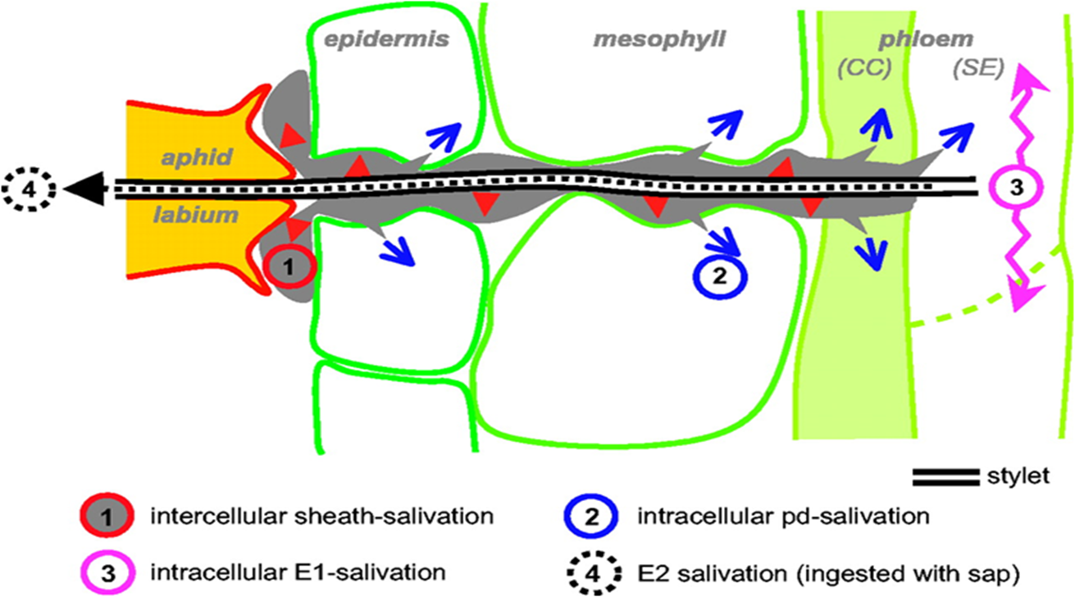
All salivation periods detected by the EPG
Fig 1. Model showing all salivation periods detected by the EPG (Tjallingii, 1995). E1 (Salivation into sieve elements), E2 (2nd salivation), SE (sieve elements), CC (companion cells) and pd (potential drop).
(Tjallingii et al., 1995)

Slide 4
Callose synthase
Insect
Callose is also deposited at plasmodesmata and at sieve plates to limit intercellular transport, often as a response to developmental cues or environmental signals, e.g., wounding and pathogen attack .
Genes encoding callose synthases (GSL) have now been identified in several plant species (Aidemark, 2009).
An Arabidopsis Callose Synthase, GSL5, Is Required for Wound and Papillary Callose Formation (Jacobs et al., 2003).
Aphid
BPH
Puncture
Plant
Callose synthase
Callose
Callose Deposition
Resistance
Fig 2. Schematic diagram showing the role of callose synthase in plant resistance.

Slide 5
Beta-1,3-glucanase interaction
Insect
Beta- 1,3- glucanase is a pathogenesis-related proteins .
Pathogenesis-related (PR) proteins are a group of heterogeneous proteins encoded by genes that are rapidly induced by pathogenic infections and by salicylic acid (SA), jasmonic acid (JA) and ethylene (ET).
They are widely used as molecular markers for resistance response to pathogens and systemic acquired response (SAR).
The PR proteins include all pathogen-induced proteins and their homologs, and are routinely classified into 17 families based on their biochemical and molecular biological properties, from PR-1 to PR-17.
Beta,1-3-glucanase belongs to PR2 Hydrolyse callose (Van Loon et al., 2006).
Aphid
BPH
Salivation
Puncture
Plant
Callose synthase
Beta-glucanse
Callose
Hydrolysis
Susceptibility
Callose Deposition
Resistance
Fig 3. Schematic diagram showing the role of beta-1,3-glucanase in plant susceptibility.

Slide 6
Oxi1 has been used in this study because expression of an Arabidopsis thaliana gene (OXI1) encoding a serine/threonine kinase is induced in response to a wide range of H₂O₂-generating stimuli.
OXI1 is required for full activation of the mitogen-activated protein kinases (MAPKs) MPK3 and MPK6 and MAPKs trigger calcium pathway that induce callose synthases and result in producing callose.
CAMTA 3-1 and CAMTA 3-2 Calmodulin-binding transcription activator.
CAMTA3 mutants accumulate high levels of reactive oxygen species (ROS) during development.
(Galon, 2008)

Slide 7
BPH feeding up-regulates callose synthase genes and induces callose deposition in the sieve tubes at the point where the stylet is inserted.
The compact callose remains intact in the resistant plants, but genes encoding β-1,3-glucanases are activated by BPH, causing unplugging of the sieve tube occlusions in susceptible plants.
BPH insects spend more time wandering over plants carrying the resistance Bph14 and Bph15, but less time ingesting phloem than on susceptible plants.
Tests with [14C]sucrose showed that insects ingest much less phloem sap from the resistant than the susceptible plants.
(Hao et al., 2008)

Slide 8
Hypothesis ,Aims and objectives of the work
Callose synthase play an important role in plant defence.
Insects (aphid –BPH) inducing beta glucanase to hydrolyse callose in susceptible plants.
Proof the theory by using Real Time PCR to see the transcript level of selected number of Callose synthase and beta glucanase genes.
Confirming the work by doing bioassay using number of Arabidopsis beta glucanase mutants.

Slide 9
Oxi1 has been used in this study because expression of an Arabidopsis thaliana gene (OXI1) encoding a serine/threonine kinase is induced in response to a wide range of H2O2-generating stimuli.
OXI1 is required for full activation of the mitogen-activated protein kinases (MAPKs) MPK3 and MPK6 and MAPKs trigger calcium pathway that induce callose synthases and result in producing callose.
CAMTA 3-1 and CAMTA 3-2 Calmodulin-binding transcription activator.
CAMTA3 mutants accumulate high levels of reactive oxygen species (ROS) during development.

Slide 10
Results
Fig 4. Aphid (Myzus persicae) bioassay in Camta3-1 mutant and Columbia (Col-0) wild type. Aphid (Myzus persicae) were reared on Arabidopsis Col-0 before starting the bioassay and experiment.

Slide 11
Fig 5. Aphid (Myzus persicae) bioassay in Camta3-2 mutant and Columbia (Col-0) wild type. Aphid (Myzus persicae) were reared on Arabidopsis Col-0 before starting the bioassay and experiment.

Slide 12
Fig 6. Aphid (Myzus persicae) bioassay in OXI1 mutant and Columbia (Col-0) wild type. Aphid (Myzus persicae) were reared on Arabidopsis Col-0 before starting the bioassay and experiment.

Slide 13
Fig 7. Aphid (Myzus persicae) bioassay in β-1-3 glucanase (Gns1) mutant and Columbia (Col-0) wild type. Aphid Myzus persicae were reared on Arabidopsis Col-0 before starting the bioassay and experiment.

Slide 14
Fig 8. Aphid (Myzus persicae) bioassay in β-1-3 glucanase (Gns2) mutant and Colombia (Col-0) wild type. Aphid (Myzus persicae) were reared on Arabidopsis Col-0 before starting the bioassay and experiment.

Slide 15
Fig 9. Aphid (Myzus persicae) bioassay in β-1-3 glucanase (Gns2) mutant and Colombia (Col-0) wild type. Aphid (Myzus persicae) were reared on Arabidopsis Col-0 before starting the bioassay and experiment.

Slide 16
Summary of bioassays
Oxi1 mutants has shown resistance to Aphid s and shift in the growth rate in both adults and nymphs compared to Col-0 wild type.
CAMTA3-1 and CAMTA3-2 died quickly and showed susceptibility against aphid compared to Col-0 wild type.

Slide 17
Summary of bioassays
Beta glucanase mutant 1 bioassay shown shift and delay in the growth of the adults compared to col-0 and they were tolerant to the insect and died after 24 time points and col-0 died after 19 time points.
Beta glucanase mutant 2 plants was holding higher number of insects compared to col-0 but shown clear shift in both adults and nymphs and plants died after 23 time points.
Beta glucanase mutant 3 plants was holding the highest number of adults and nymphs compared to col-0 and the other mutants but the survived until 23 time point.

Slide 18
Fig 10. Relative expression level of Callose synthase gene (GSL1), in Oxi1 Arabidopsis mutant and its background Columbia (Col-0), in response to aphid (Myzus persicae) feeding.

Slide 19
Fig 11. Relative expression level of Callose synthase gene GSL5 in Arabidopsis Oxi1 mutant and its background Columbia (Col-0) in response to aphid (Myzus persicae) feeding.

Slide 20
Fig 12. Relative expression level of β-1,3-glucanase two gene (Gns2) in Arabidopsis Oxi1 mutant and Columbia (Col-0) wild type in response to aphid (Myzus persicae) feeding.

Slide 21
Fig 13. Relative expression level of Callose synthase gene (GSL1) in Arabidopsis mutant Oxi1 in Wisconsin (Oxi1 in WS2) and its background Wisconsin (WS2) in response to aphid (Myzus persicae) feeding.

Slide 22
Fig 14. Relative expression level of Callose synthase gene (GSL5) in Arabidopsis Oxi1 in Wisconsin (Oxi1 in WS2) and its background Wisconsin (WS2) in response aphid (Myzus persicae) feeding.

Slide 23
Fig 15 . Relative expression level of β-1,3-glucanase gene (Gns2) in Arabidopsis OXI1 in Wisconsin(OXI1 in WS) and Wisconsin (WS) wild type at different time points in response to stressed and non-stressed plants with aphid (Myzus persicae).

Slide 24
Summary of relative expression results
The expression level of Callose synthase 1 reached the highest level 25 folds after 6 hours infestation with aphid and decreased to nearly 1 folds after 48 hours but in Oxi1 the highest level was after (3h + aphid) 14 folds and the lowest was 3.5 folds at time point (24 hours+Aphids).
Callose synthase 5 relative expression was 1.8 folds at time point (12+Aphids) and down regulated at time point (48 hours+ Aphid).on the other hand CSL5 expressed in the highest level 6.4 folds at time point (12h+Aphids) and the lowest level was 2.3 folds after 48h infestation with aphids.
Beta-1,3-glucanase 2 has been expressed in col-0 in the highest level 24 folds at time point (12h+aphid) and the lowest level was 1.25 folds after 3 hours infestation with aphids .
Beta-1,3-glucanase 2 has not been expressed at all in Oxi1.

Slide 25
Conclusion
Callose synthase is playing an important role in plant resistance especially callose synthase 5.
Bet glucanase play an important role in plant susceptibility against insects (Aphid-BPH) especially beta glucanase 2.
Oxi1 mutants shown resistance against insect because of inducing callose deposition via MAPK s .
Inducing ROS as an early response and signal transduction improve the resistance level of the plant.

Slide 26
References
van Loon, L.C., Rep, M. and Pieterse, C.M.J. 2006.Significance of inducible defense-related proteins in infected plants. Annu. Rev. Phytopathol. 44: 135–162.
Andrew K. Jacobs, Volker Lipka, Rachel A. Burton, Ralph Panstruga, Nicolai Strizhov, Paul Schulze-Lefert, and Geoffrey B. Fincher . 2003.An Arabidopsis Callose Synthase, GSL5, Is Required for Wound and Papillary Callose Formation PLANT CELL 2003 15: 2503-2513.
Hao, P., Liu,C. , Wang,Y. Chen,R. Ming Tang, M. , Du, B.,Zhu, L., and He, G. 2008. Herbivore-Induced Callose Deposition on the Sieve Plates of Rice: An Important Mechanism for Host ResistancePlant Physiol. 146: 1810 1820. doi:10.1104/pp.107.111484.
Petersen , L.N. , Ingle , R.A. , Knight , M.R. and Denby , K.J. 2009. OXI1 protein kinase is required for plant immunity against Pseudomonas syringae in Arabidopsis . J. Exp. Bot. 60 : 3727 – 3735 .

Slide 27
Tjallingii, WF. 1995. Regulation of phloem sap feeding by aphids. In: Chapman RF, De Boer G. eds, Regulatory mechanisms in insect feeding. New York: Chapman and Hall, 190–209.
Stone, B.A., Evans, N.A., Bonig, I., and Clarke, A.E. 1985. The application of Sirofluor, a chemically defined fluorochrome from aniline blue for the histochemical detection of callose. Protoplasma 122, 191–195.
Aidemark ,M. , Andersson ,C.J., Allan G Rasmusson , A.G., and Widell, S. 2009. Regulation of callose synthase activity in situ in alamethicin permeabilized Arabidopsis and tobacco suspension cells BMC Plant Biology 2009, 9:27doi:10.

Slide 28


