Slide 1
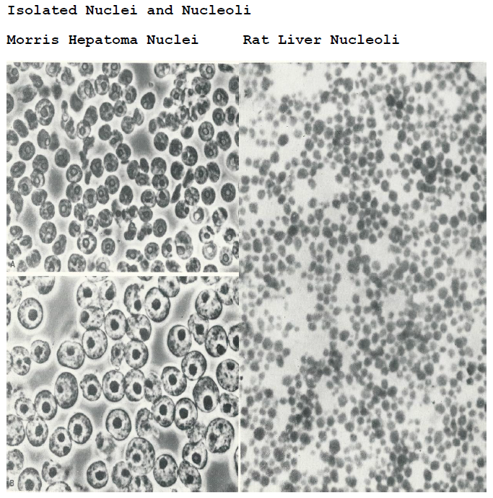

Slide 2
EM Pictures of Isolated Nuclei and Nucleoli of Rat Liver Cells
Notes:
Bar could be 1μm

Slide 3
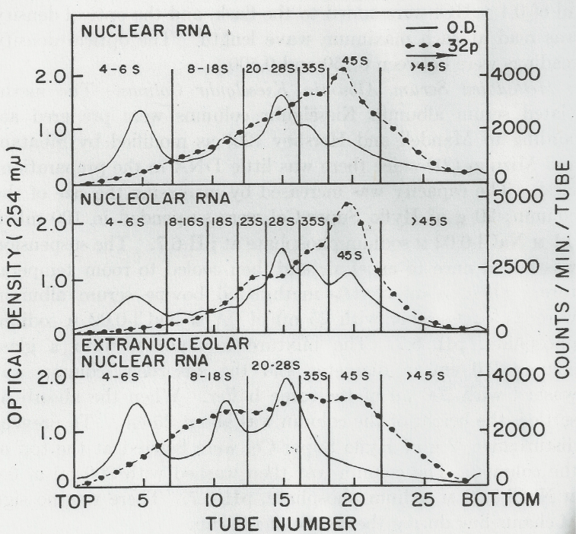
Nuclear RNA Sedimentation Profiles by Sucrose Gradient Centrifugation

Slide 4
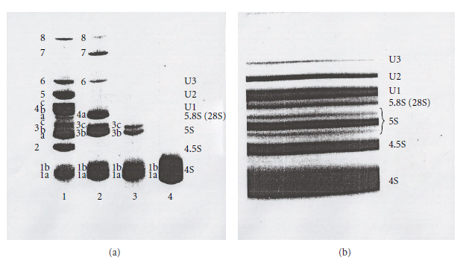
Acrylamide Gel Electrophoresis

Slide 5
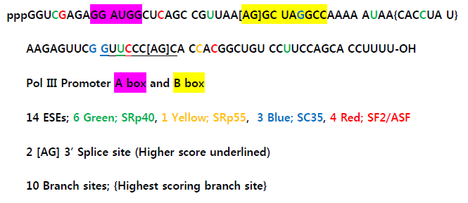
The Sequence of 4.5S RNA I (Novikoff hepatoma cell nuclei)

Slide 6
ESE Distribution in FMR1 Gene Transcript

Slide 7
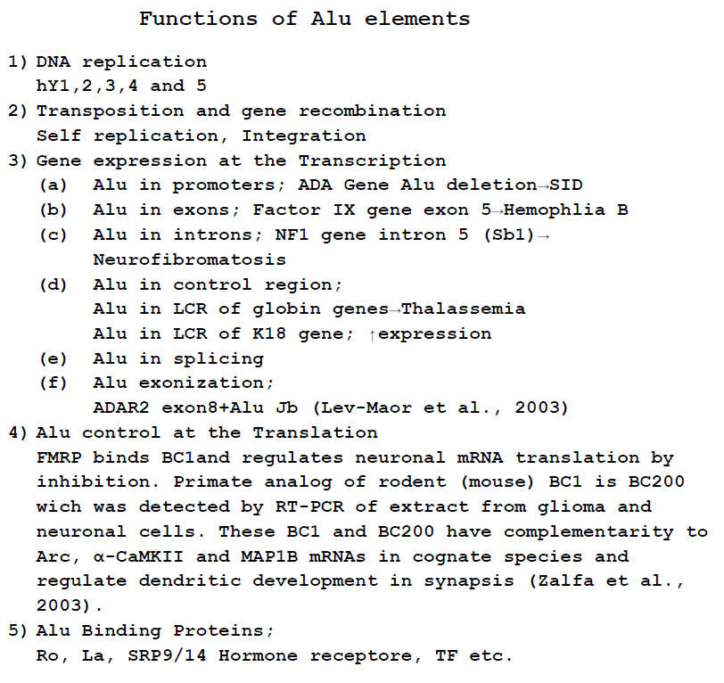
Notes:
Functions of Alu Elements
References;
Lev-Maor, G. Sorek, R., Shomron, N. and Ast, G. (2003) The Birth of an Alternatively Splices Exon: 3’ Splice-Site Selection in Alu Exons, Science, 300, 1288-1291.
Zalfa, F., Giorgi, M., Primerano, B., Moro, A., Di Penta, A., Reis, S., Oostra, B. and Bagni, C. (2003) The Fragile X syndrome Protein FMRP Associates with BC1 RNA and Regulates the Translation of Specific mRNA at Synapses. Cell 112, 317-327.

Slide 8
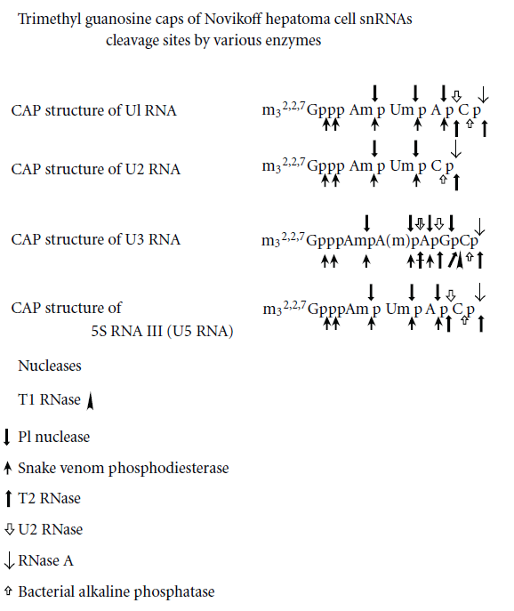
Notes:
Enzyme cleavages of 5’ oligo of U1, U2, and U3 snRNA

Slide 9
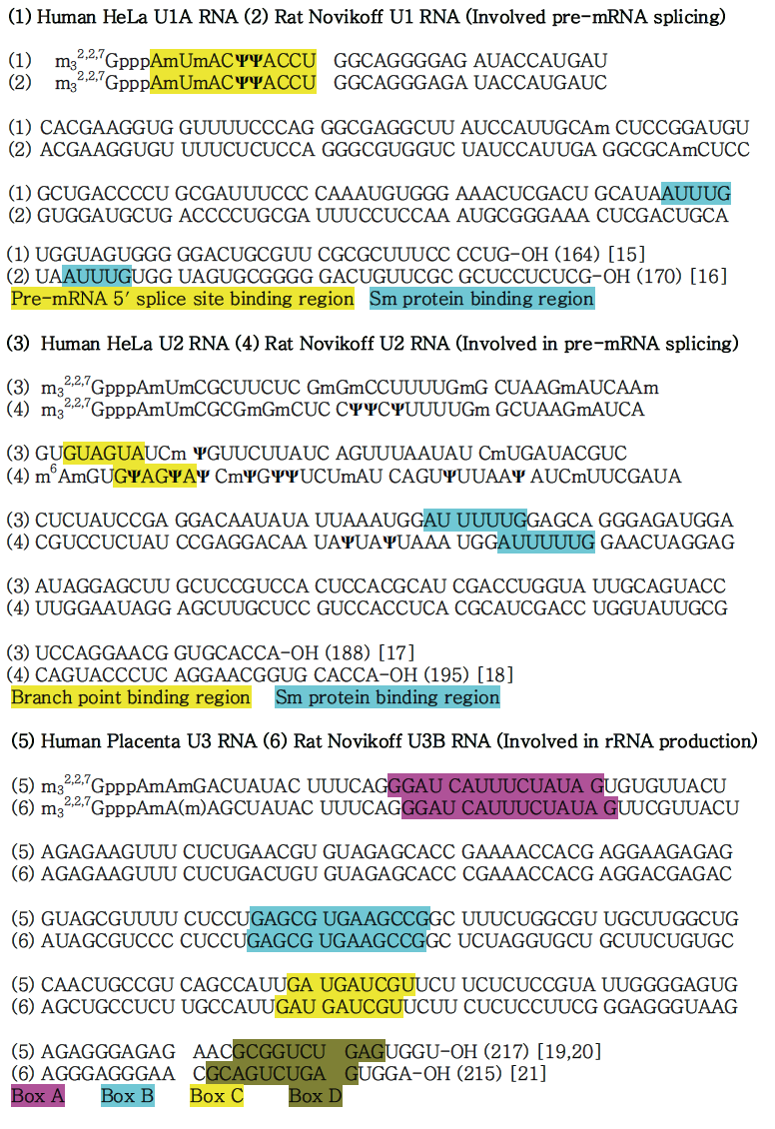
U1, U2 and U3 snRNA Sequences
Notes:
U1, U2 and U3 sequences

Slide 10
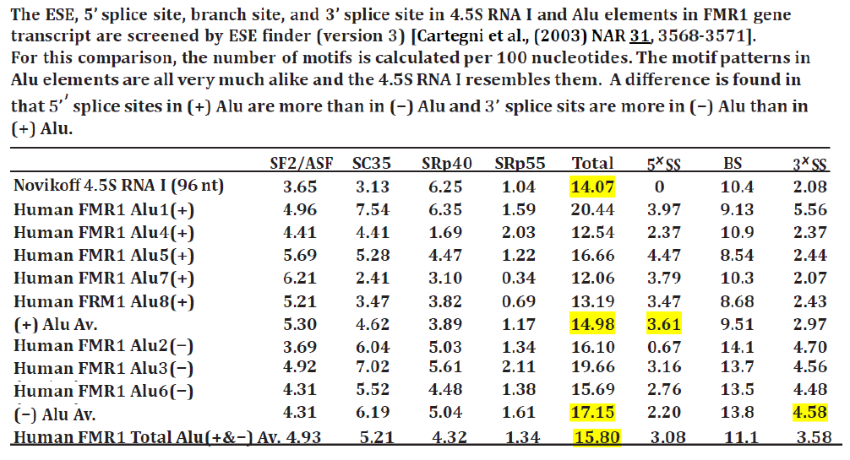
ESEs, 5’SS, BS & 3’ SS in Alu RNAs
Notes:
ESE in Alus

Slide 11
Notes:
Upper Fig. From the book “THE NUCLOLUS” by Busch & Smetana page 364 &514

Slide 12
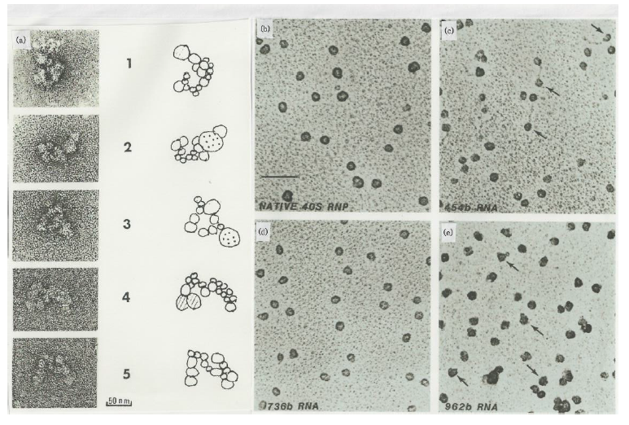
Electron Micrographs of hnRNP Fibrils (>60S), Native 40S and reconstructed hnRNP Particles (Jacob,The Cell NucleusVIII,193, Conway,Mol.Cell.Biol.8,2884)

