Slide 1

Nutritional Solutions for Healthy Life
Vitamin E - emerging benefits
Szabolcs Péter, MD, PhD
Peter Weber, MD, PhD
DSM Nutritional Products, Kaiseraugst, Switzerland
3rd International Conference on Nutrition & Food Science
23rd September 2014, Valencia

Slide 2
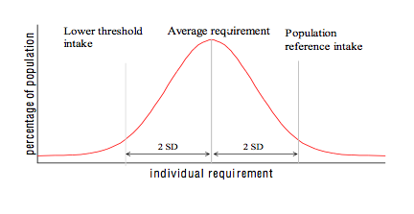
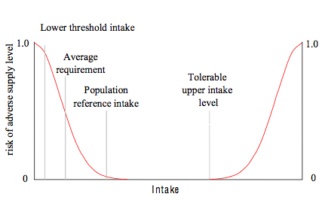

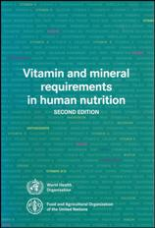
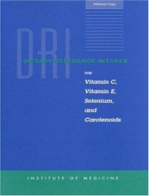
Nutrient requirements/recommended intakes
Dietary reference values for nutrient intake are:
Science-based
Dependent on the existing data available
Country or institution specific
Potentially politically driven
Reflect ‘eating cultures’
Page 1

Slide 3

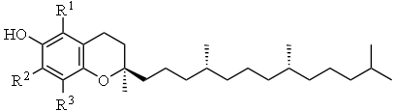
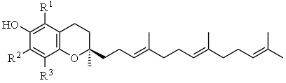

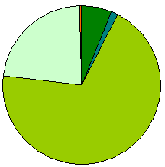
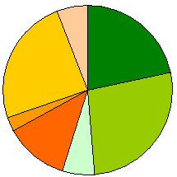

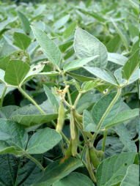
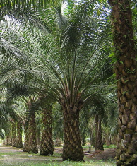
Vitamin E
tocopherols
Vitamin E is a generic term for eight related fat soluble molecules:
α-,β-, γ-, and δ- tocopherol and
α-,β-, γ-, and δ- tocotrienol.
The tocopherols and tocotrienols differ on the side chain, the
α-,β-, γ-, and δ- forms on the ring groups (R^{s})
Vitamin E is naturally produced in plants only. The relative tocopherol and tocotrienol content varies (e.g. sunflower oil is rich in α-, soybean oil rich in γ-tocopherol.
α-tocopherol is specifically selected & retained in the human body, therefore recommendations on intake and plasma levels are based on α-tocopherol
tocotrienol
Sunflower Oil
Soybean Oil
Palm Oil
Page 2

Slide 4
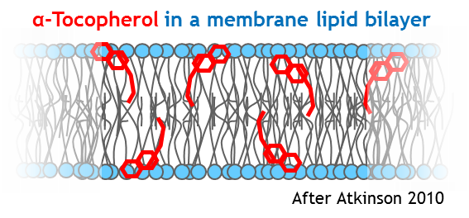
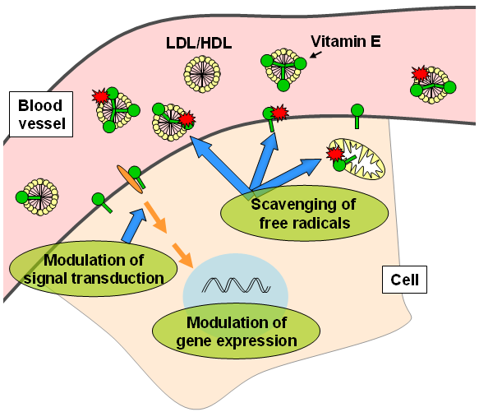
Function of vitamin E as antioxidant is established
Vitamin E is a powerful antioxidant. Once oxidized, it can be regenerated by vitamin C.
Due to its lipophilic nature, vitamin E localizes to lipid compartments, such as cell membranes (prevention of peroxidation of lipids and oxidation of proteins).
Furthermore, vitamin E depletion and repletion affects gene expression in vitro in cells and in vivo in animal models, indicating broader effects than just protection from oxidation.
Incorporation of vitamin E into cellular membranes can alter the activity of membrane-associated proteins and thereby changes signal transduction pathways.
EFSA Health Claim in 2011: “Vitamin E contributes to the protection of cells from oxidative stress”

Slide 5
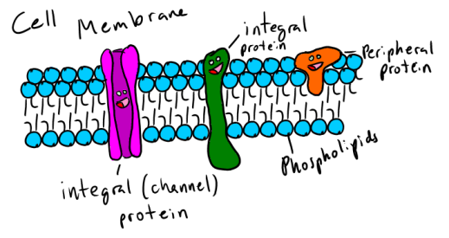
Current RDAs for vitamin E are based on markers of cell membrane integrity
1. Lysis of red blood cells
2. PUFA intake
Lysis of erythrocytes are associated with decreases erythrocyte survival (which can be corrected by vitamin E supplementation)
From research in a limited number of people, reported in the seventies a vitamin E serum level of 12 µmol/L was derived to prevent hemolysis
To achieve a serum level of 12 µmol/L α-tocopherol an intake of 12 mg vitamin E is required
12 mg vitamin E is the intake to meet the requirements of 50% of the population (EAR) and 15 mg vitamin E will suffice to meet the needs of 97% of the population (RDA)
Vitamin E requirements vary from 15 to 25 mg/day or more depending on PUFA intake → Additional vitamin E needs should become part of RDA
A higher intake of nutrients beyond nutritional requirements may provide additional benefits in defined groups
Page 4

Slide 6
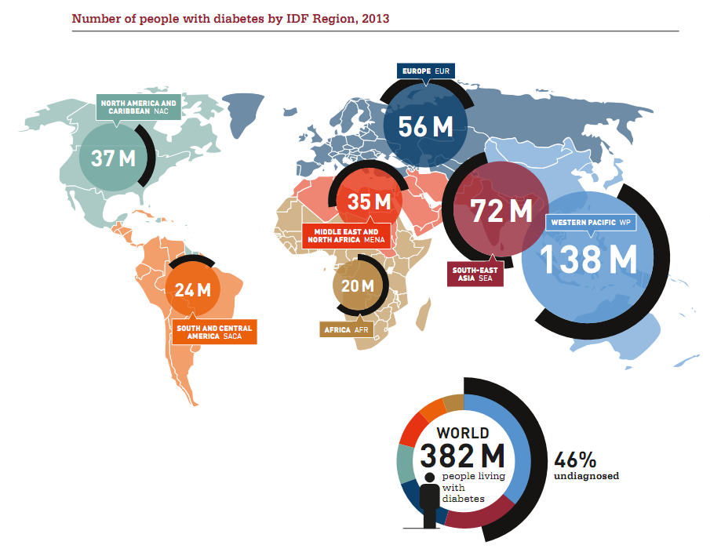
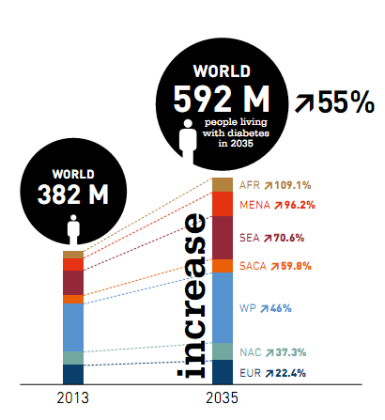
Diabetes is a huge and growing public health problem
At least 1 in 10 deaths among adults is attributable to diabetes
Diabetes deaths are projected to double between 2005 and 2030
>80% of diabetes deaths occur in low- and middle-income countries
IDF Diabetes Atlas, 6th ed. (2013)

Slide 7
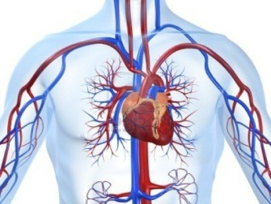
Epidemiological evidence for vitamin E benefits
Lower plasma level of vitamin E has been reported in type 2 diabetic subjects compared to controls.
Prospective epidemiological studies demonstrate that high serum vitamin E was associated with decreased risk of type 2 diabetes.
Evidence from various observational human studies indicated that vitamin E has beneficial effects on the cardiovascular system.
At least five studies reported that increased consumption of vitamin E is associated with decreased risk for heart attack or death from cardiovascular disease.
It was therefore hypothesized that vitamin E supplementation could reduce the risk for cardiovascular events.
Major coronary heart disease risk in women
(after Knekt et al. 2004)
Favors high vitamin E
Favors low vitamin E
Salonen et al. (1995)
Maxwell et al. (1997)

Slide 8
However, most RCTs find no vitamin E benefits for cardiovascular health
Several randomized clinical trials have been performed to examine the efficacy of vitamin E in improving human health.
Surprisingly, the results from the trials did not detect a consistent benefit of vitamin E supplementation on cardiovascular health.
New scientific findings provide an explanation why a benefit was not detected and shows that genetics matters.
Meta-Analysis of the effect of Vitamin E on Myocardial Infarction, Stroke, or Death from Cardiovascular Causes in large trials (modified from Yusuf et al. 2000)
Study | Dose | Duration | Cases
ATBC | 50 | 5yr | 3859
CHAOS | >400 | 1.3 | 105
GISSI | 300 | 3.5 | 1155
HOPE | 400 | 4.5 | 1511
Total |  |  | 6630
Relative Risk
0.97 (0.92-1.02)
0.6
0.8
1.0
1.2
1.4
Favors vitamin E
Favors placebo

Slide 9
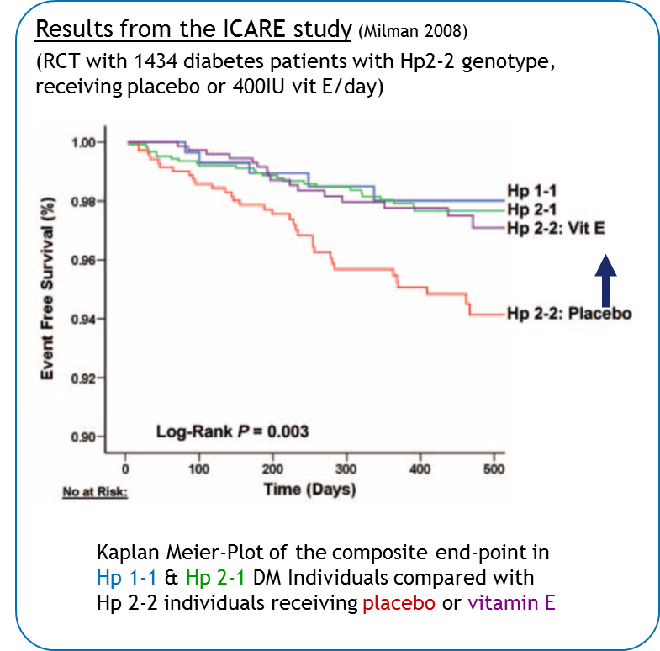
Vitamin E reduces cardiovascular events in diabetics and Hp 2-2 genotype
Haptoglobin (Hp) is a protein that scavenges free hemoglobin in the blood.
The Hp gene exists in two variants, the Hp1 and the Hp2 variant. In Western societies, 36% have haptoglobin genotype 2-2 (Hp 2-2)
Diabetic individuals with Hp 2-2 have a marked increased oxidative stress
Increased risk for cardiovascular events has been linked to Hp 2-2 genotype in diabetics.
Vitamin E supplementation at a dose of 400 mg reduces and normalizes the risk for cardiovascular events in diabetics with Hp 2-2
Page 8

Slide 10
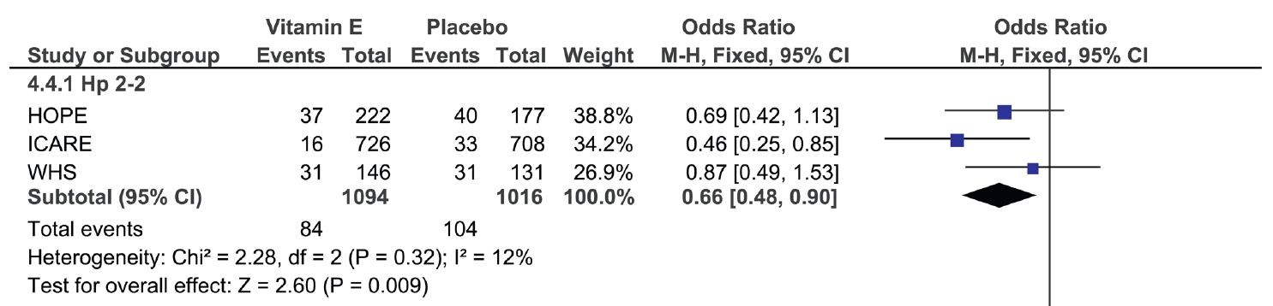
Findings from the ICARE Study were confirmed in the HOPE study
N = 2545 women and 6996 men 55+ yrs, CVD or diabetes + one other risk factor, 400 IU/d vitamin E or ACE-inhibitor or placebo for 4.5 years, composite endpoint
Vitamin E had no apparent effect on cardiovascular outcomes
Findings from the ICARE Study were confirmed in a post-hoc retrospective subgroup analysis of the HOPE study:
Risk for cardiovascular events (CV death and nonfatal myocardial infarction) was significantly reduced only in the diabetics carrying the Hp 2-2 gene
Yusuf et al. (2000)
Levy et al. (2004)
Blum (2010)
Vardi et al. (2012)

Slide 11

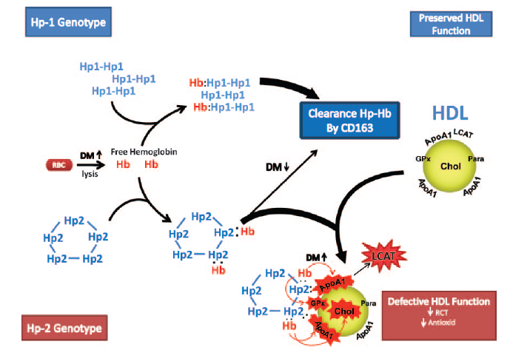
Proposed vitamin E function in diabetic Hp 2-2 individuals
Haptoglobin binds and inhibits the oxidative activity of free hemoglobin (Hb), and targets it for clearance from the blood.
The Haptoglobin 2 protein forms aggregates which affects its function. Hemoglobin is not cleared as efficiently.
Furthermore, Hb-Hp2-2 complex binds to HDL, oxidizes proteins and lipids in HDL and renders HDL dysfunctional and prothrombic.
Vitamin E protects lipids and proteins in HDL from oxidation
Protection by vitamin E
Asleh et al. (2008)

Slide 12
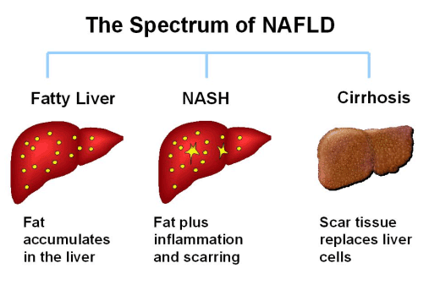
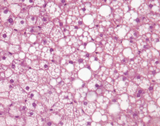
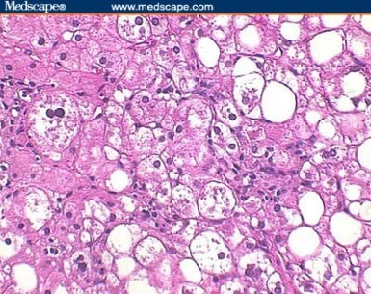
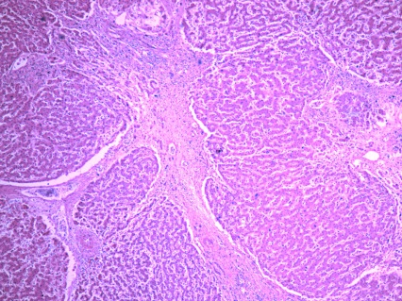
The spectrum of Non-Alcoholic Fatty Liver Disease (NAFLD)
The spectrum of fatty liver disease associated with metabolic determinants and not resulting from alcohol (NAFLD) extends from hepatic steatosis through steatohepatitis to cirrhosis.
15-25%
30-40%
LIVER-RELATED DEATH

Slide 13

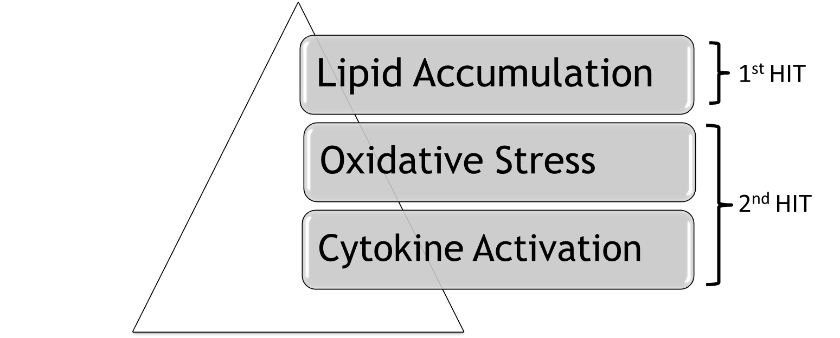
Impact and development of NAFLD/NASH
High prevalence in urbanized communities with affluent economies (NAFLD: 17–33%, NASH: 6% - 17%)
Most common cause of abnormal liver tests
Standardized mortality of liver disease in type 2 DM greatly exceeds vascular disease
NASH recurs after liver transplantation
At present, there is no approved drug for the treatment of NASH
Fatty Liver Disease: NASH and Related Disorders, Blackwell Publishing, 2005
Day CP, James OF., Gastroenterolgy 1998; 114: 842-5.
Erhardt A. et al. Eur J Med Res 2011; 16:76–78.
Cankurtaran M. et al. Acta gastro-enterologica Belgica 2006; 69 (1) p.5-11.

Slide 14
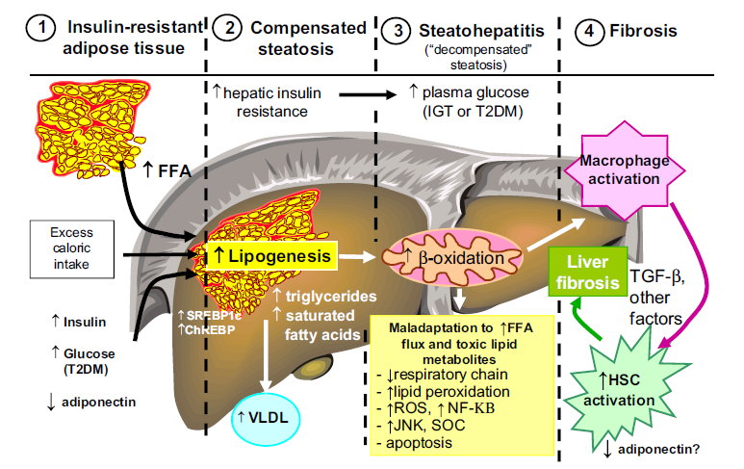
Possible role of adipose tissue insulin resistance and lipotoxicity
Cusi K., Curr Opin Endocrinol Diabetes Obes 2009; 16:141–9

Slide 15
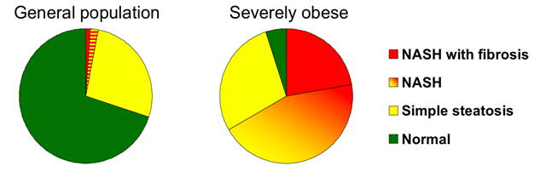
Vitamin E reduces risk for non-alcoholic fatty liver disease
In 2010, more than 1,5 billion adults, 20 and older, were overweight worldwide
As a consequence the risk for non alcoholic liver disease is increasing
Supplementation with vitamin E (at a dose of 400 mg) was superior to placebo for the treatment of nonalcoholic steatohepatitis in adults without diabetes
www.who.int
Sanyal et al. N Engl J Med, 2010.
Pacana et al. Curr Opin Clin Nutr Metab Care, 2012.
Lomonaco et al. Drugs, 2013.
Page 14

Slide 16
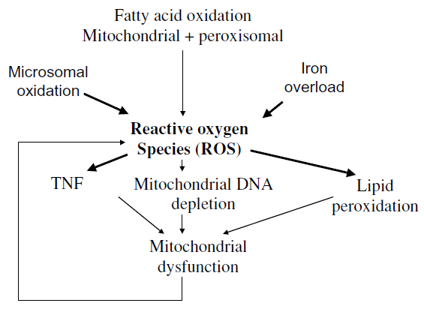
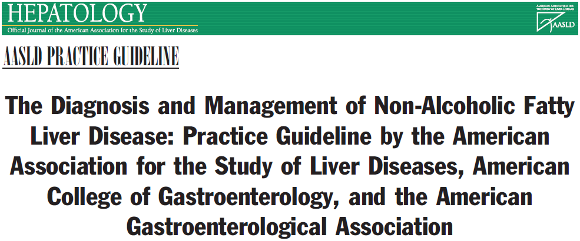
Possible mechanisms of action of vitamin E
  Chain-breaking antioxidant, quenching free radicals
  Anti-inflammatory compound, antagonizing the production of inflammatory mediators
  There are measurable differences in the metabolomics profile of subjects who are likely (vs unlikely) to respond to vitamin E treatment for NASH
  Vitamin E supplementation of the diet of mice led to PPAR-γ mediated increased adiponectin expression. This shows a potential gene expression regulating role for vitamin E.
Vitamin E (800 IU/day) improves liver histology in non-diabetic adults with biopsy-proven NASH and therefore it should be considered as a first-line pharmacotherapy for this patient population.
Wu D, Meydani SN., Leukoc Biol, 2008. 84(4):900-914.
Cheng J. et al. PLoS ONE 2012. 7(9):e44106.
Landrier JF. et al. Endocrinology. 2009;150:5318–5325.
Chalasani et al. Hepatology, vol. 55, no. 6, 2012

Slide 17
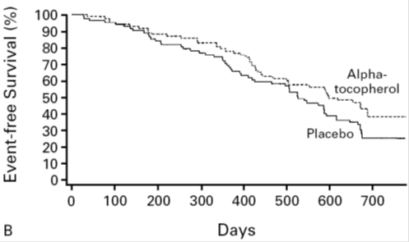
Vitamin E slows the progression of Alzheimer’s disease
AD is a age-dependent progressive neurological disease, is the leading cause of dementia and the fourth-leading cause of death in industrialized societies.
Numbers of deaths due AD increased by 60% within 8 years.
There is no pharmacological therapy available to causally prevent AD.
Survival time w/o pathological “event”
Level of dependency
Supplementation with vitamin E (at a dose of 2000 IU) delays the pathologies.
No severe adverse effect was associated with the vitamin E treatment
www.alz.org
Sano et al., N Engl J Med 1997;336:1216-22
Dysken et al., JAMA. 2014;311(1):33-44. doi:10.1001/jama.2013.282834,
Ortega et al., J. Nutr. 132: 2065–2068, 2002
Mohajeri et al., 2014
Page 16
Notes:
Event-free survival was defined as survival until the occurrence of death, institutionalization, loss of the ability to perform the activities
of daily living, or severe dementia (defined as a Clinical Dementia Rating of 3). Panels show Kaplan–Meier curves.

Slide 18
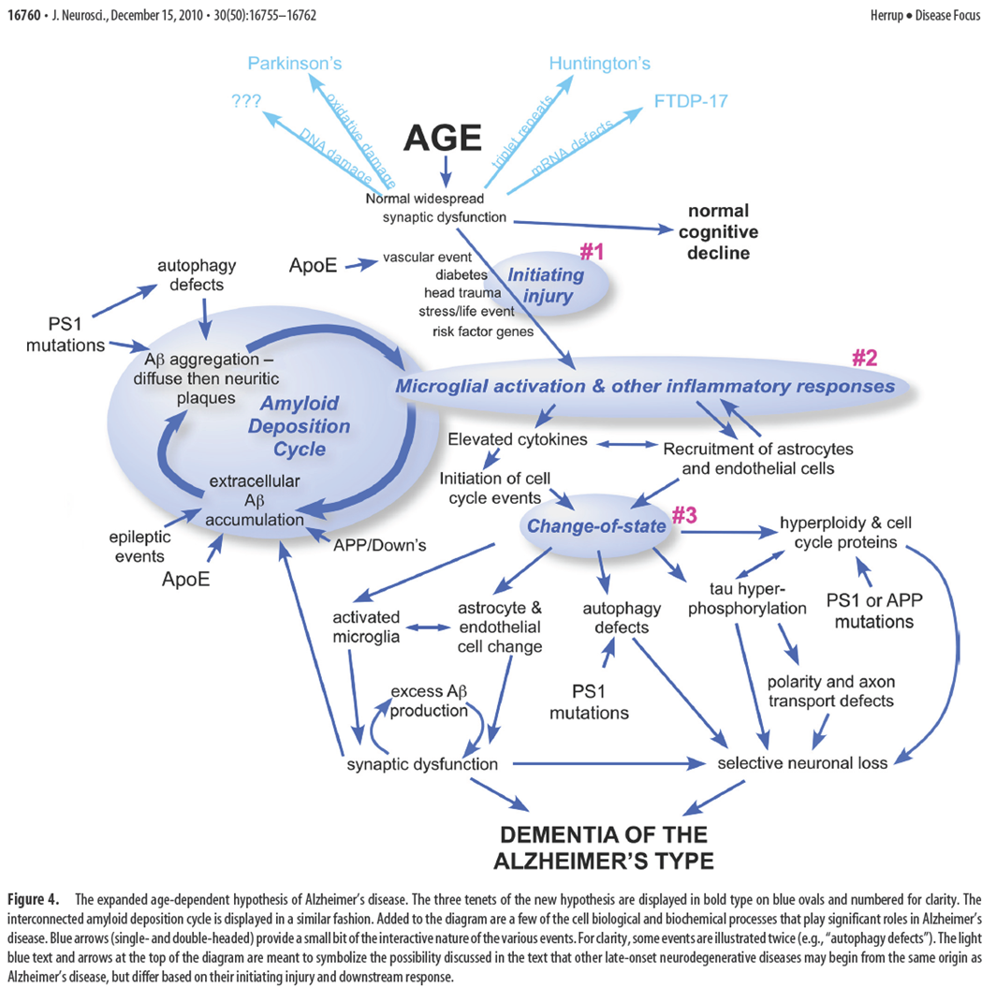
Age is the only proven risk factor for AD
Herrup, J Neurosci. 2010

Slide 19
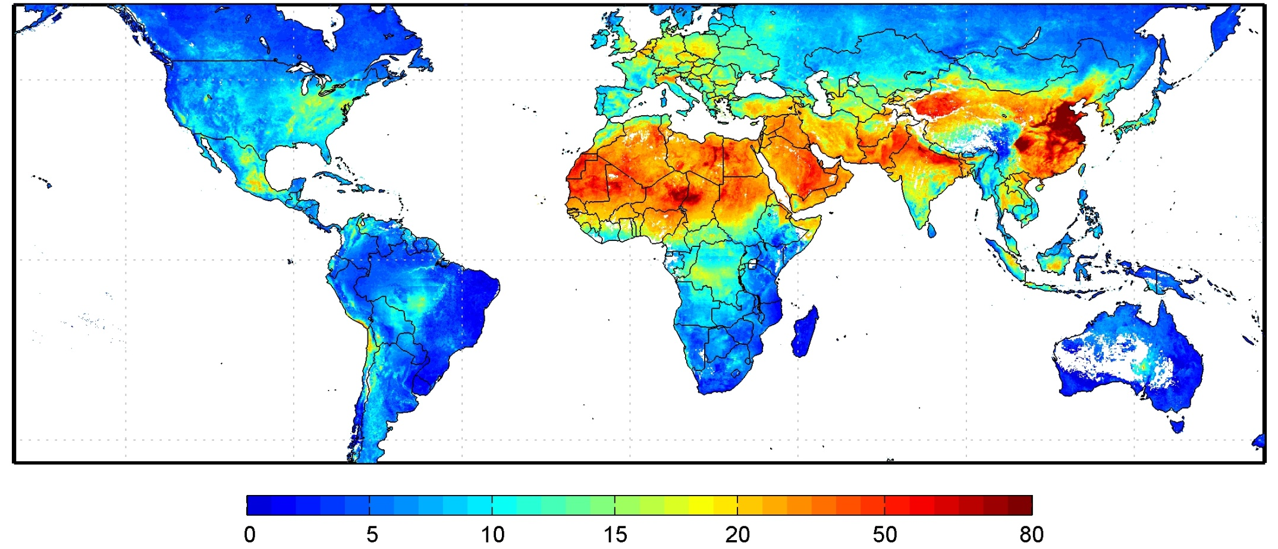
Global satellite-derived PM2.5 averaged over 2001–06
μg/m³
Environ Health Perspect 2010;118:847
http://www.nasa.gov/topics/earth/features/health-sapping.html

Slide 20
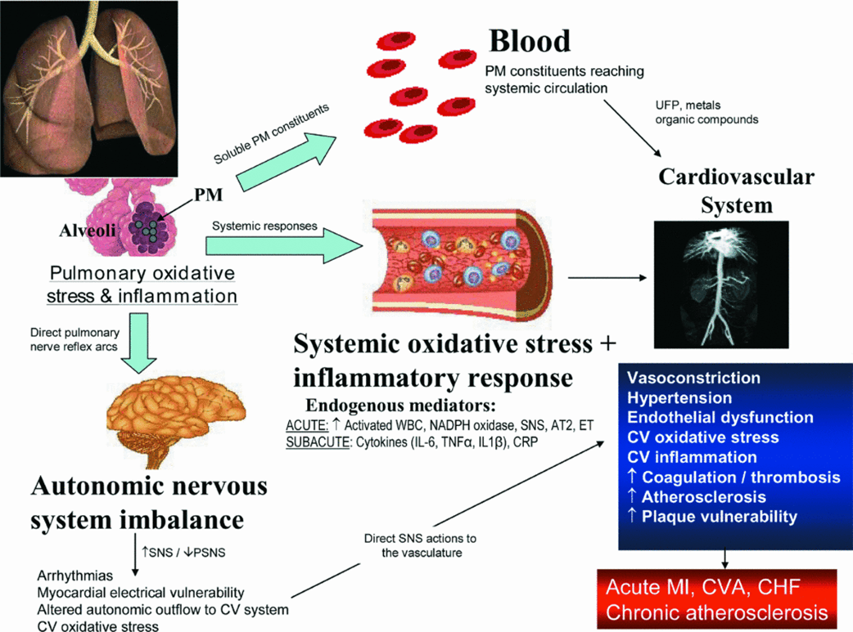
PM exposure is associated with an increased risk of CV morbidity and mortality
Brook et al. 2008

Slide 21
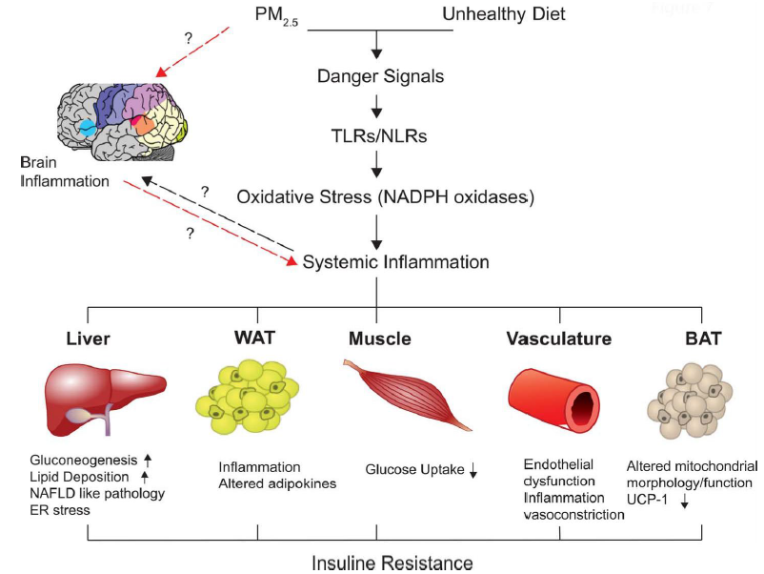
Mechanisms linking air-pollution &
type 2 diabetes / insulin resistance
Liu et al. 2013
Page 20

Slide 22
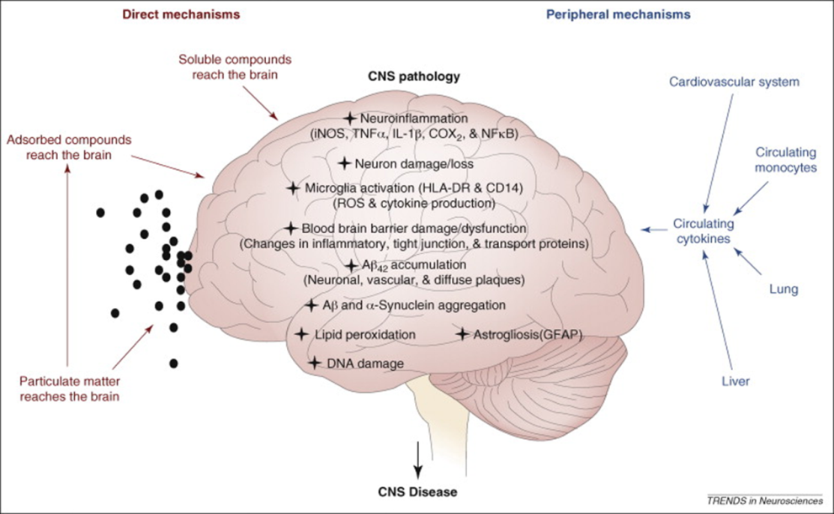
Air pollution, neuro-inflammation & brain function
Block et al. 2009
Page 21

Slide 23

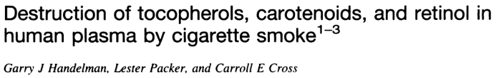
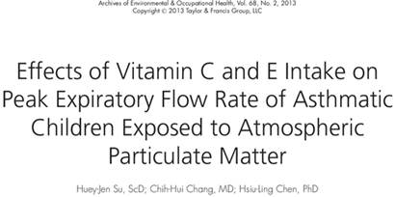
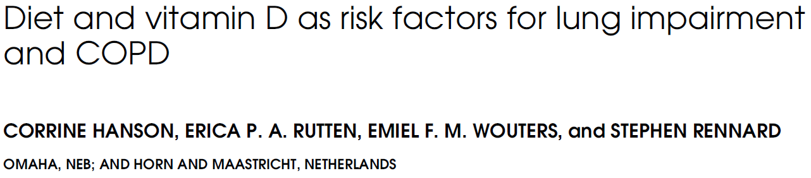
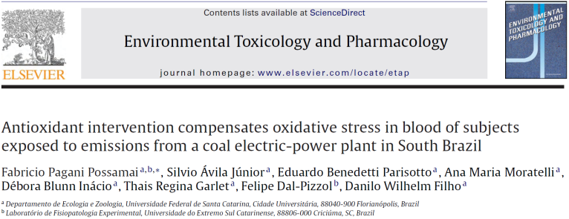
Combination of PUFAs and vitamins as solution to counteract negative impact of air pollution
PM enters respiratory (lung) system when we inhale
PM 2.5 travels all the way to alveoli and causes local and systematic harm including:
- Increased oxidative stress
- Increased inflammation
- Systemic effects on complete human system
Antioxidants, vitamins and PUFAs reduce
negative impact of PM 2.5
New concept for combination of PUFAs and antioxidants in development which requires further evaluation and substantiation
Page 22

Slide 24
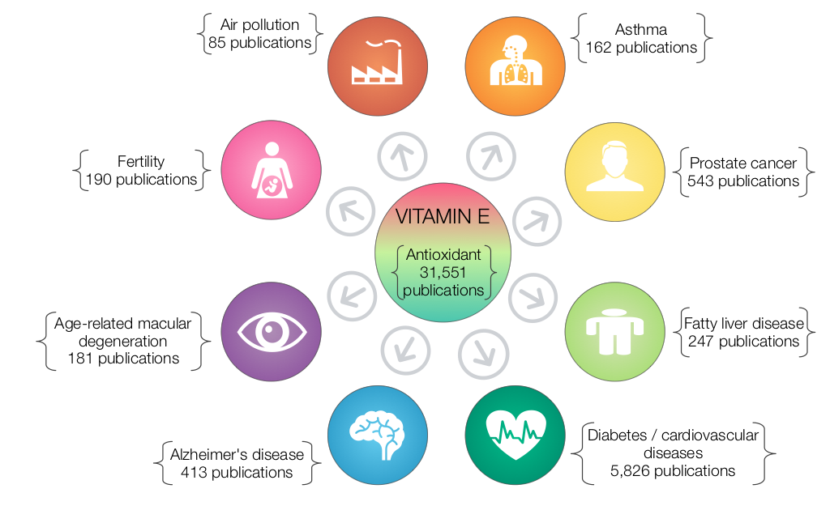
Demonstrated benefits of Vitamin E go beyond essentiality
No. of publications based on general search in PubMed with the indicated keywords (Status: June 30, 2014)
Page 23

Slide 25

THANK YOU!

