Slide 1






Anal intraepithelial neoplasia in HIV-positive patients: a review
3rd International Conference on HIV/AIDS, STDs & STIs
Sylvia Heloisa Arantes Cruz, MD, PhD

Slide 2
AIN in HIV +
HIV-positive patients are described with a high rate of anal dysplasia
Main causes for the progress of this disorderly epithelial growth in anal mucosa is the concomitant HIV and HPV infection

Slide 3
AIN in HIV +
This dysplasia is described: high-grade anal intraepithelial neoplasia (HAIN) or low-grade anal intraepithelial neoplasia (LAIN)
HPV acts as a cofactor for the persistent anal dysplasia in HIV-positive patients
Precursor lesion for anal squamous cell carcinoma

Slide 4
AIN in HIV +
The rate of anal cancer has increased nowadays
Screening: high-risk HPV DNA test, anal Pap smear protocol and high resolution anoscopy
Cost-effective

Slide 5
AIN in HIV +
Aim of this study is to compare the findings of the screening in HIV-positive and negative patients and perform a review of the literature

Slide 6
AIN in HIV +
Evaluated 131 HIV-positive and negative patients at CRT/AIDS São Paulo who had previously anal intercourse from January 2013 to December 2014
Board Ethical in research was aproved
No disclosures

Slide 7
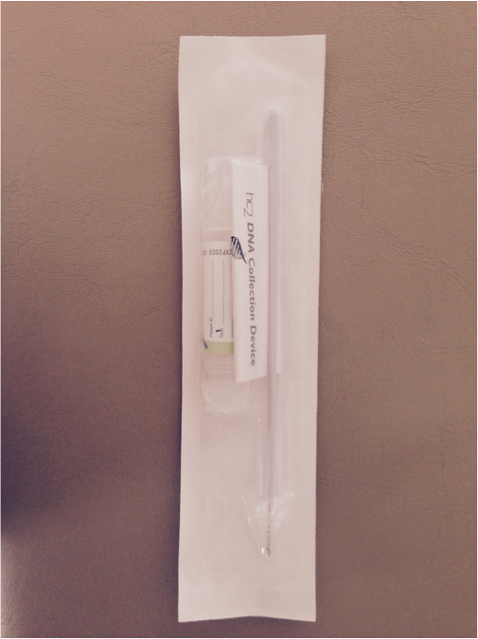
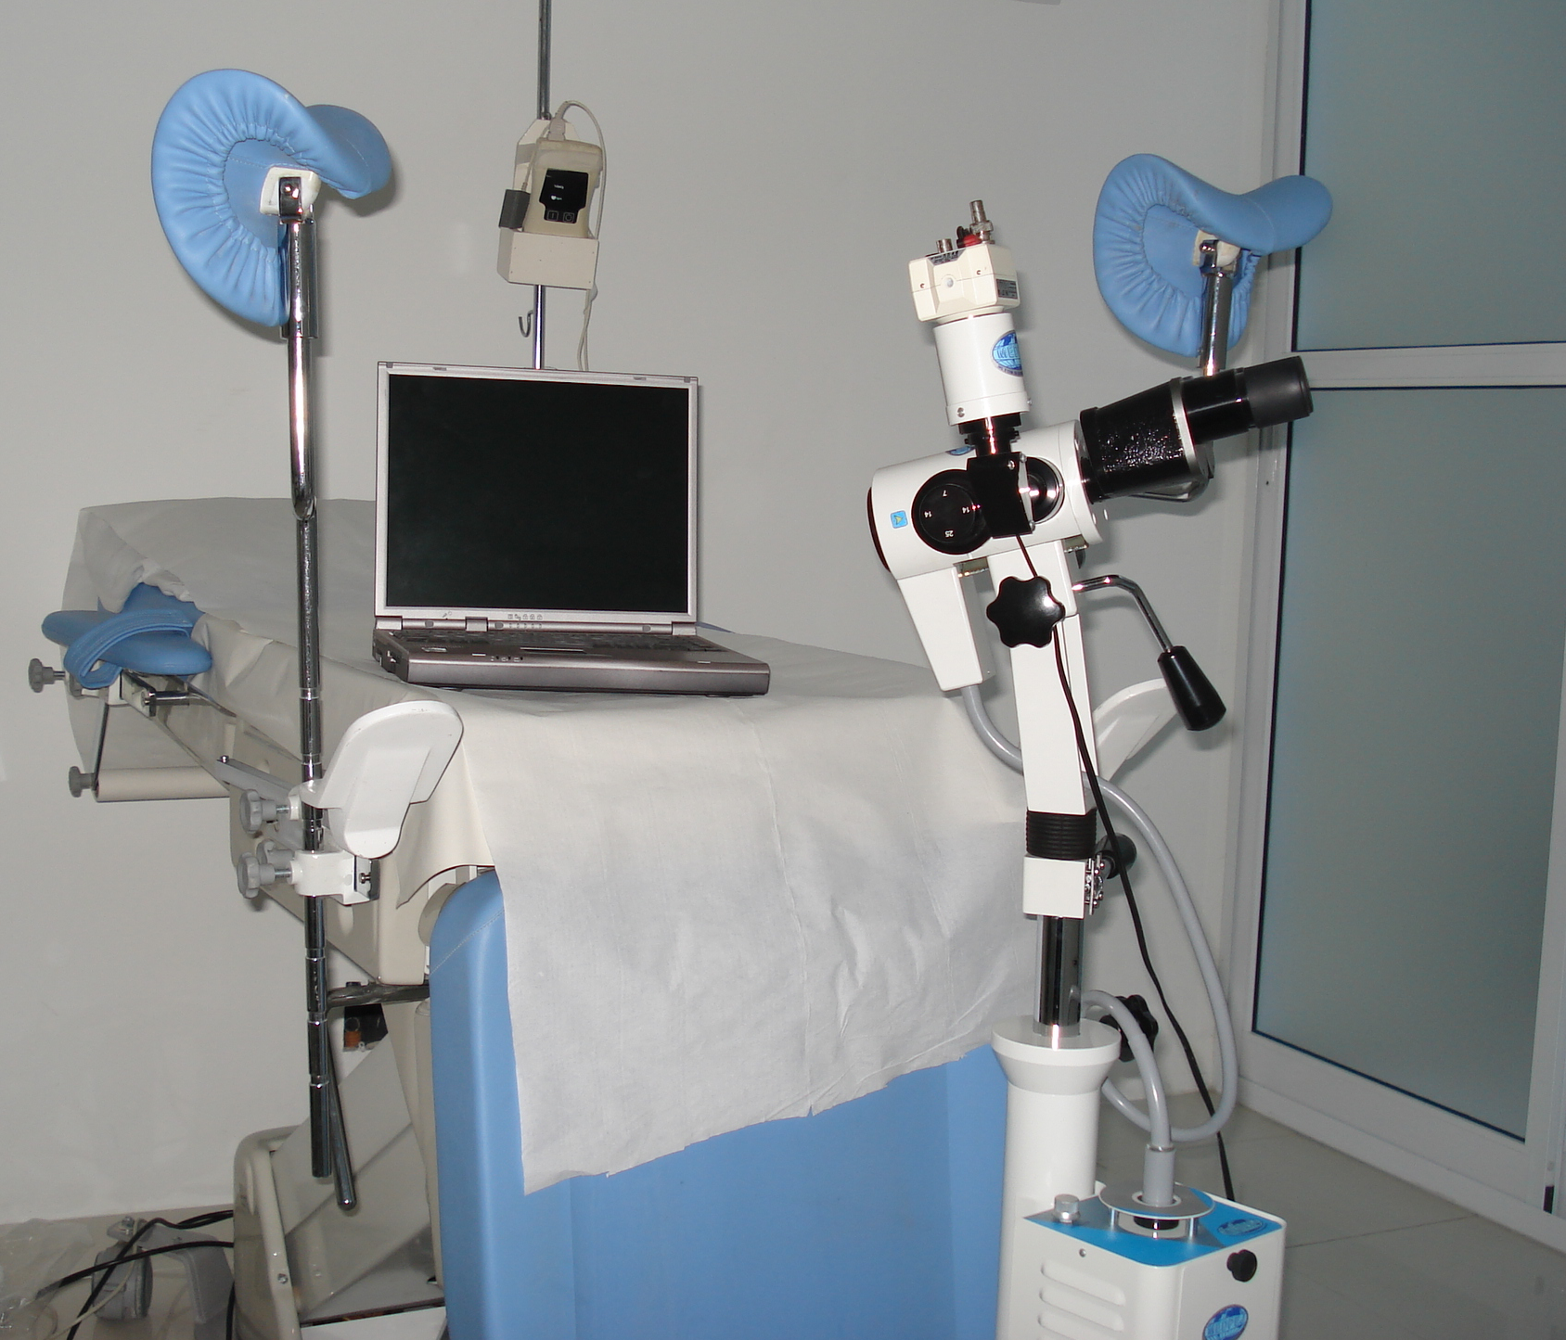
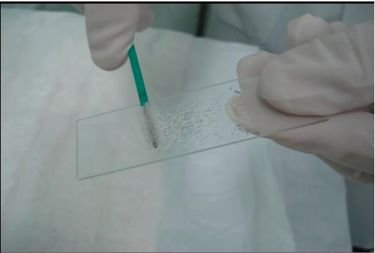
AIN in HIV +
All of the patients underwent the high-risk HPV DNA test, anal Pap smear protocol and high resolution anoscopy

Slide 8
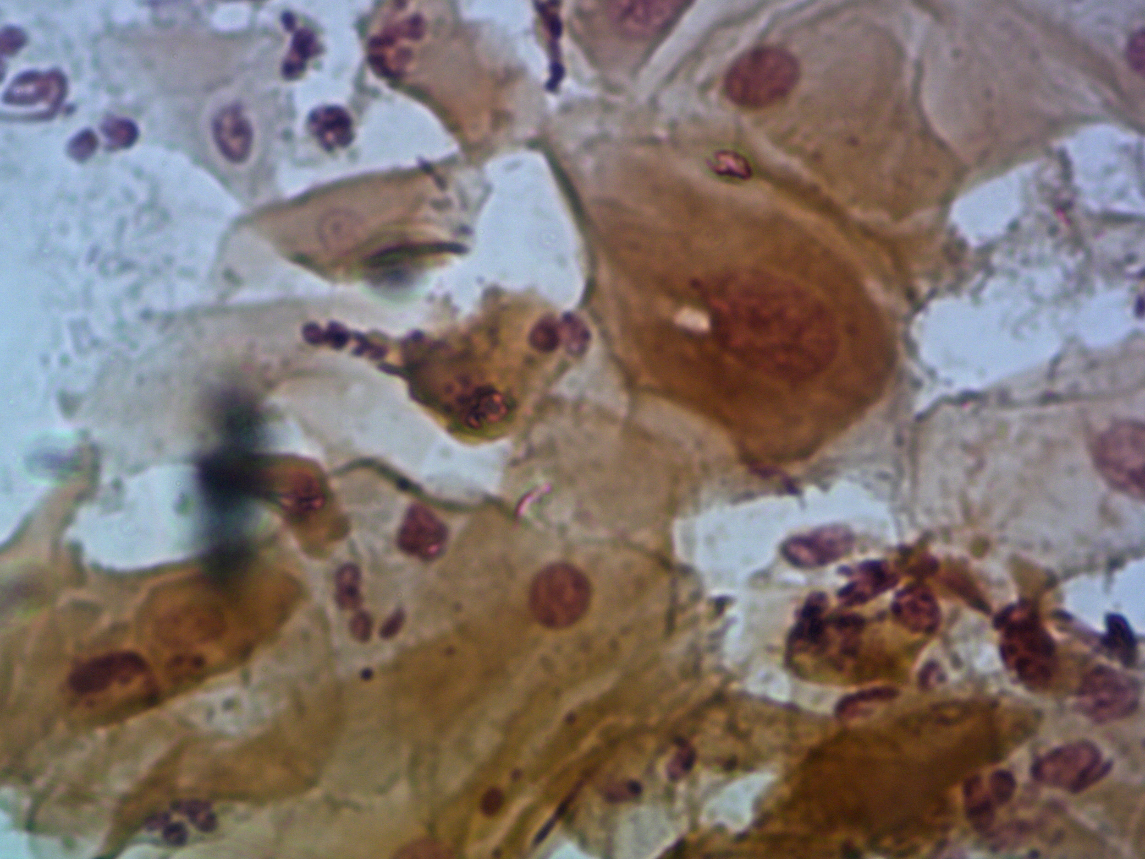
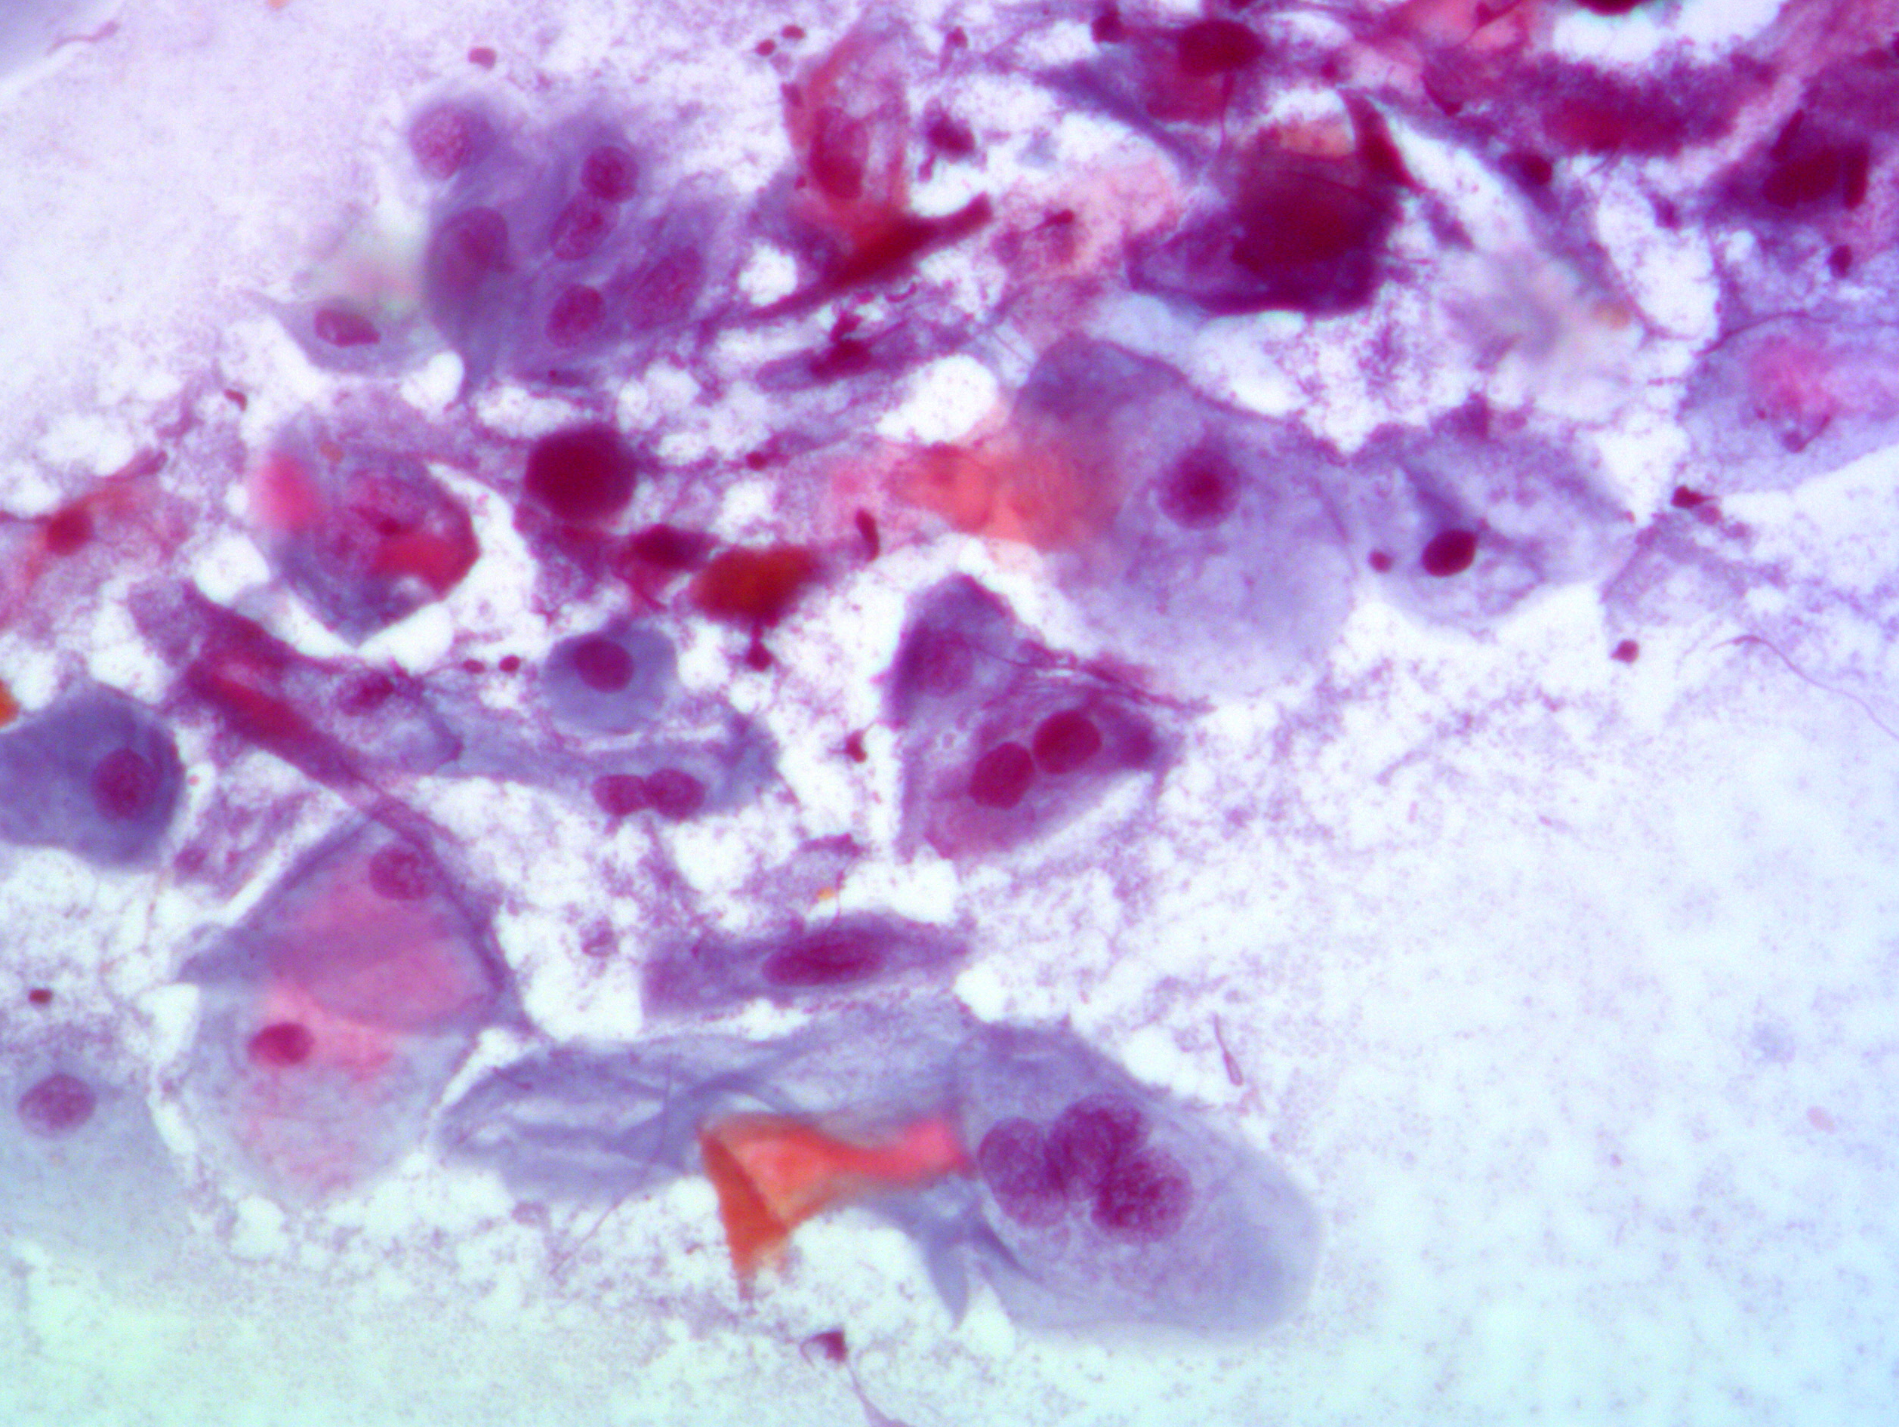
AIN in HIV +

Slide 9
AIN in HIV +
Palefsky 2009

Slide 10
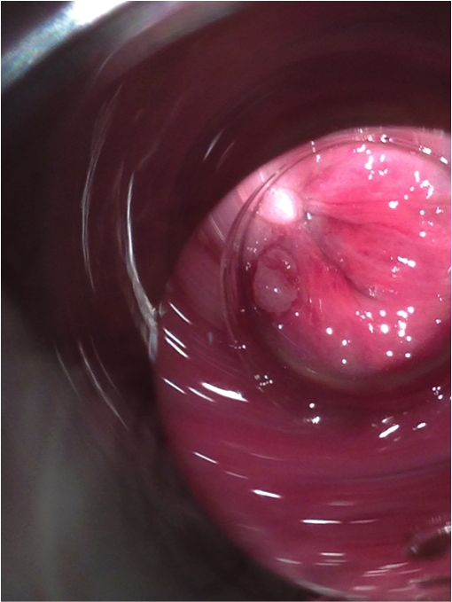
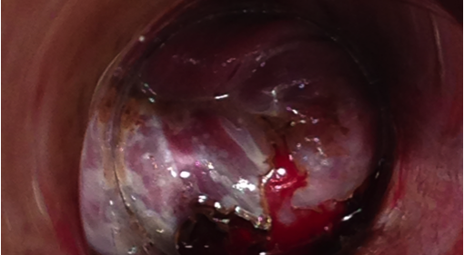
AIN in HIV +

Slide 11
AIN in HIV +
Anal lesions were treated with 90% trichloroacetic acid (TCA) and 5% imiquimod for 12 weeks
The statistical analysis was performed using chi-squared test and the significance level was set at less than 5%

Slide 12
AIN in HIV +
Sample: 57 HIV-positive male patients, 35 HIV-negative male patients and 39 HIV-negative female patients
18 HIV-positive patients had anal lesions and 43 patients were positive for the high-risk HPV DNA test and had anal dysplasia
2 HIV-positive patients had anal cancer

Slide 13
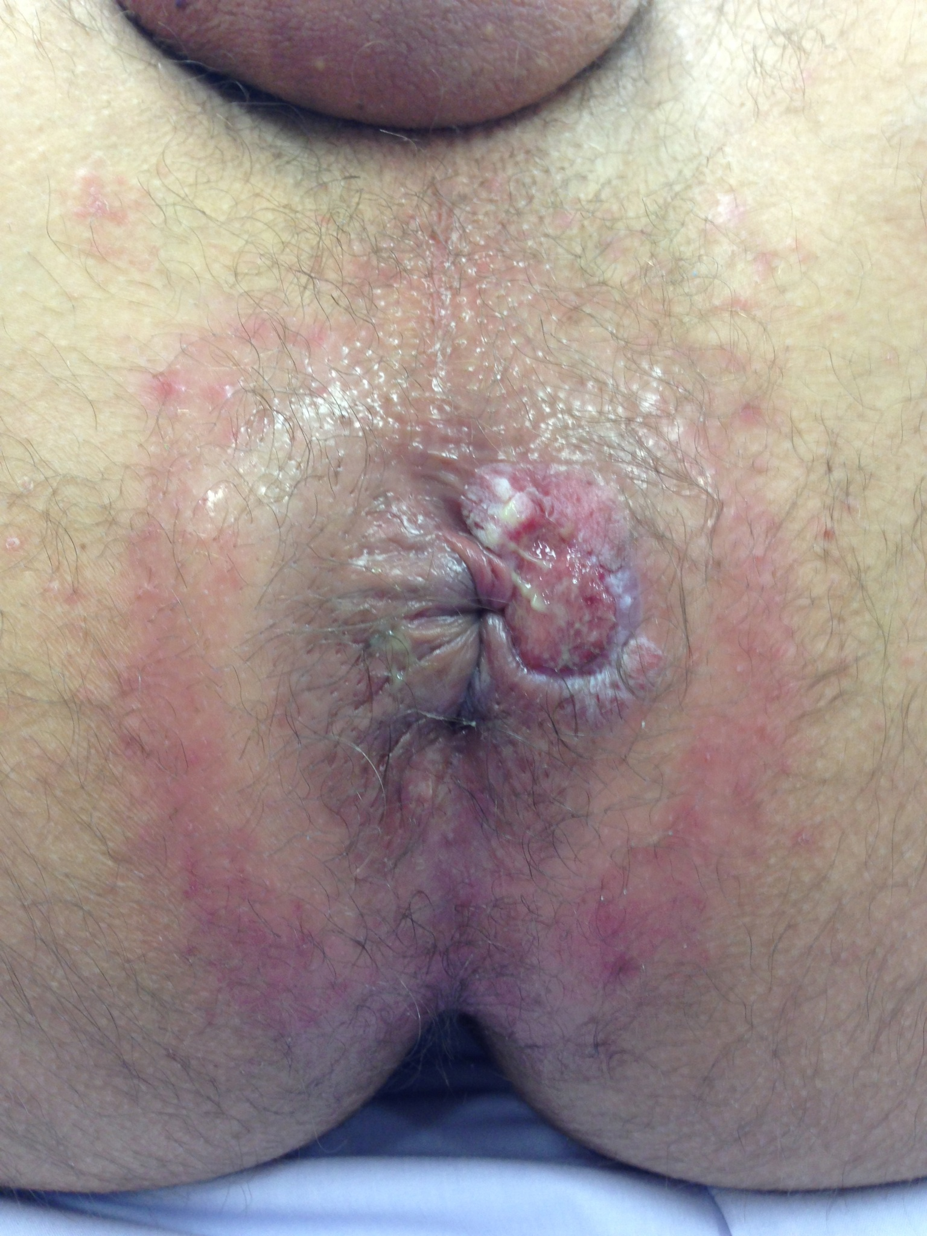
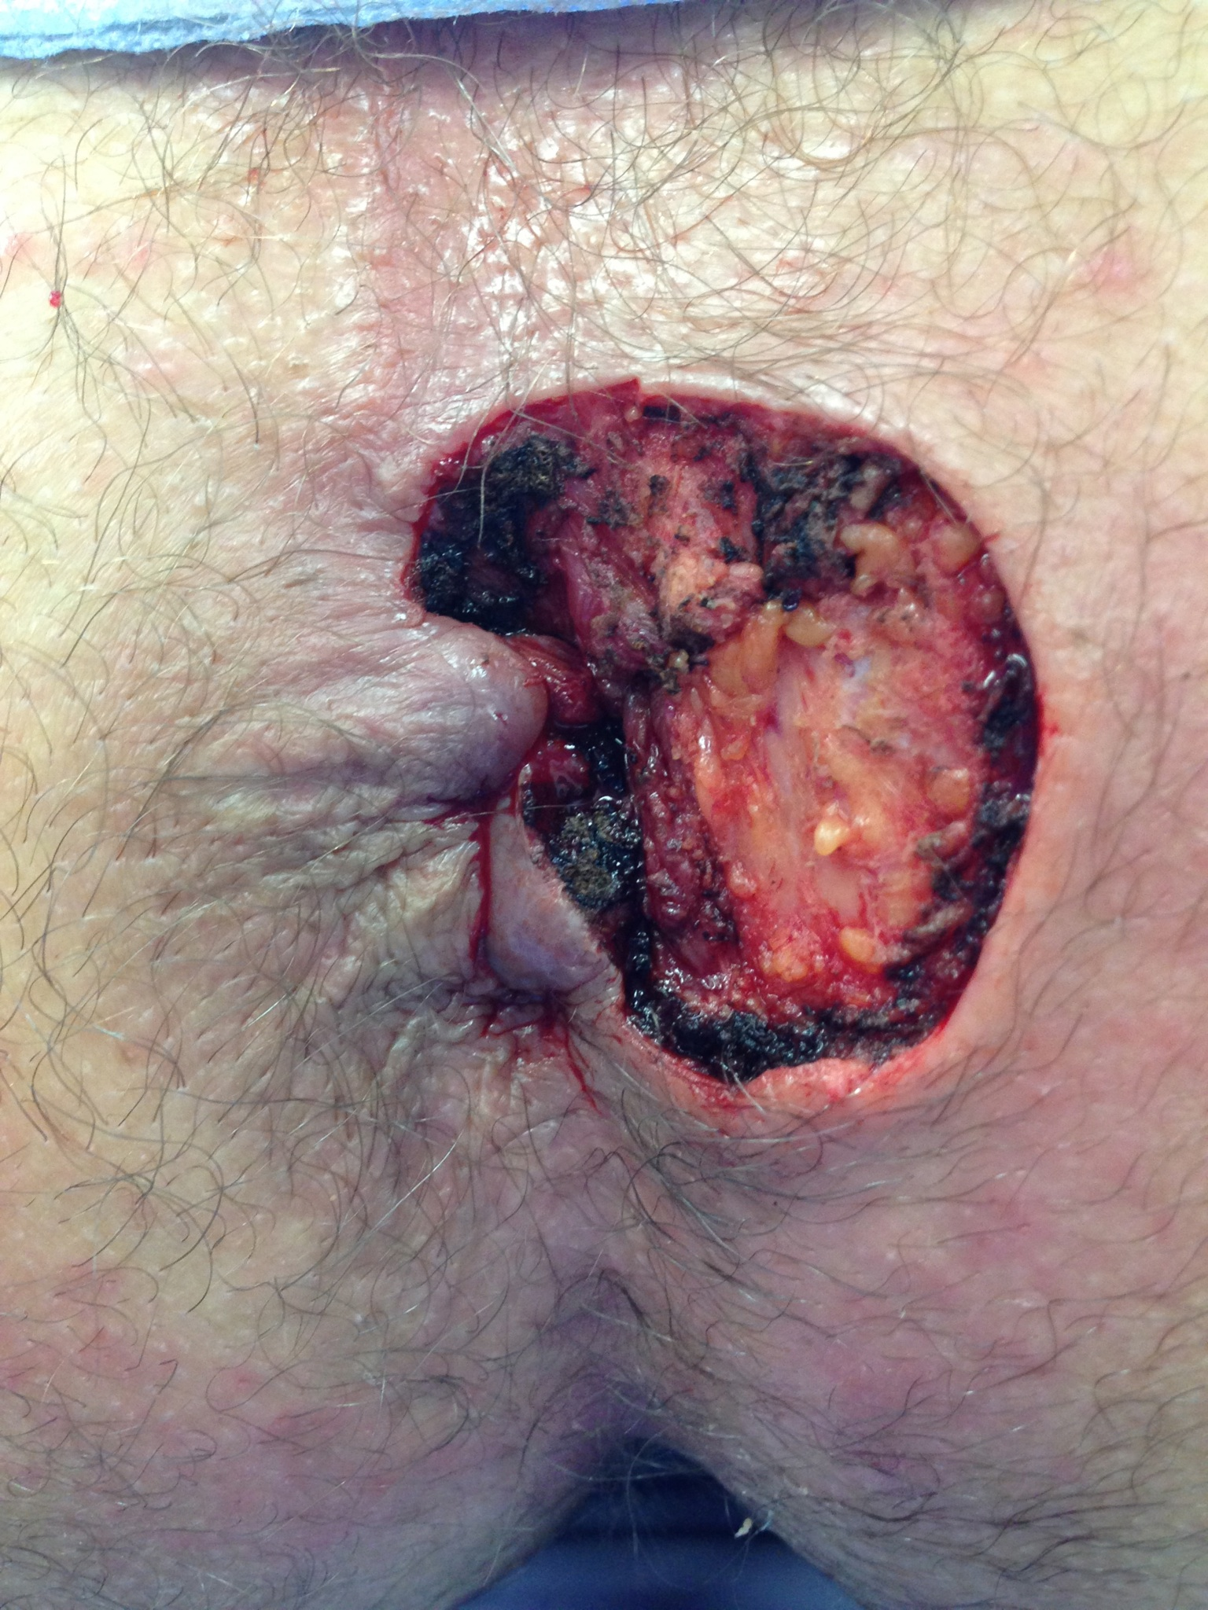
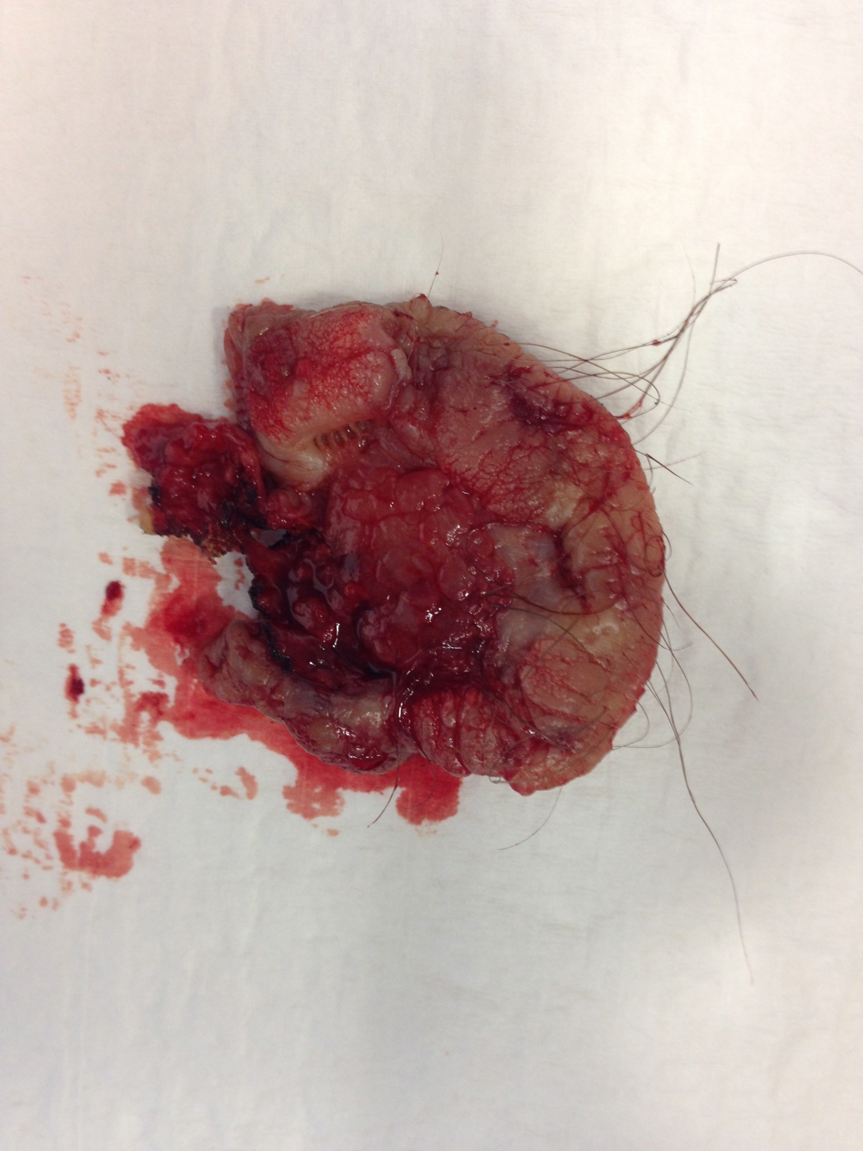
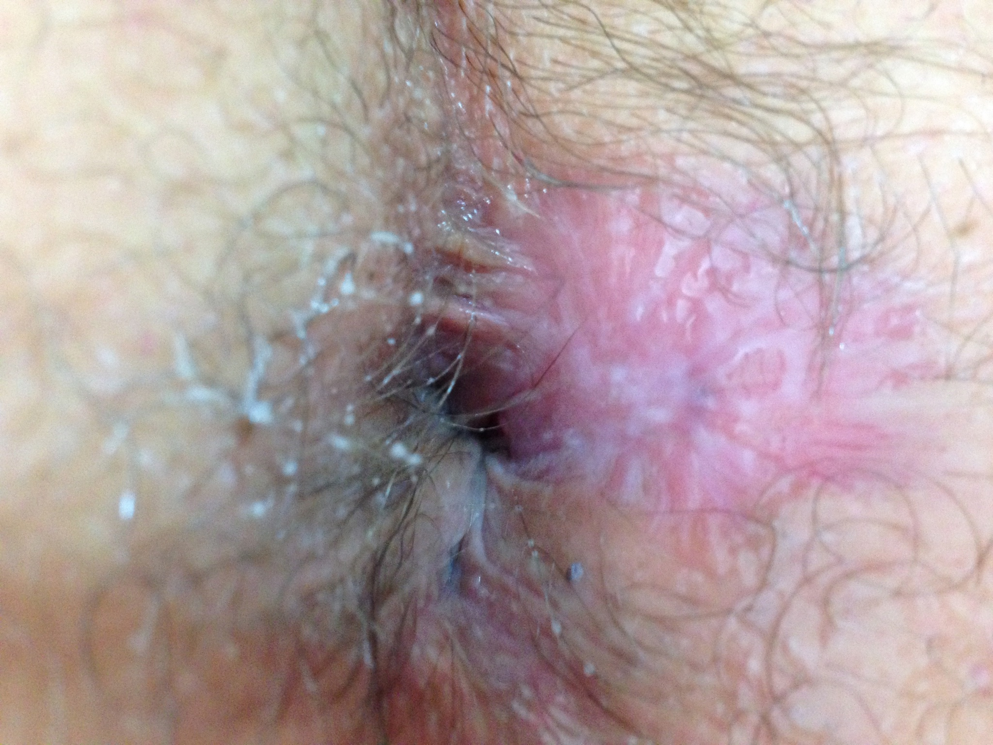

Slide 14
AIN in HIV +
Presence of anal warts in HIV positive and negative patients

Slide 15
AIN in HIV +
Positive high-risk HPV DNA test in HIV positive and negative patients

Slide 16
AIN in HIV +
Presence of anal dysplasia in HIV positive and negative patients

Slide 17
AIN in HIV +
Anal intraepithelial neoplasia (AIN) describes the dysplastic changes in the anal canal that are precursors to invasive anal carcinoma
The natural history of AIN is not entirely known
The assessment and treatment of these precursor lesions is extrapolated from the management of cervical intraepithelial neoplasia (CIN), given the biological similarities between AIN and CIN

Slide 18
AIN in HIV +
Extrapolating from cervical cancer, screening programs for AIN have been initiated with the assumption that screening will have an impact
Metrics for AIN progression are not documented, but it is inferred that immunosuppressed and HIV-positive patients will likely have a higher rate of progression than other patients
Nagle 1999

Slide 19
AIN in HIV +
There is early evidence that the benefits of highly active antiretroviral therapy (HAART) in terms of restoring immune function and reducing opportunistic infections and some neoplasms may not extend to regression of AIN
Martin 2001

Slide 20
AIN in HIV +
Under these circumstances it might be predicted that AIN and subsequent progression to invasive anal cancer would rise as HAART prolongs the lives of seropositive people
Martin 2001

Slide 21
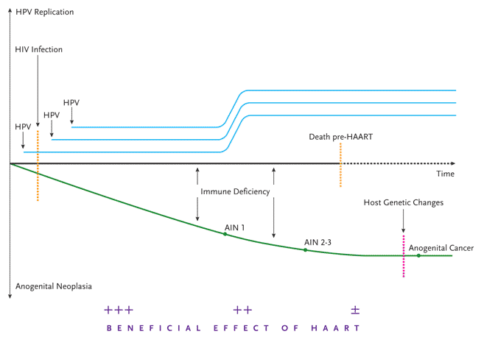
AIN in HIV +
Palefsky 2009

Slide 22
AIN in HIV +
Recent analysis has projected that annual screening for HIV-positive men who have sex with men and biennial or triennial screening for HIV-negative men who have sex with men is cost-effective to prevent anal squamous cell carcinoma in these groups, and offers quality-adjusted life-expectancy benefits comparable to other clinical preventive measures
Goldstone 1999
Goldie 1999

Slide 23
AIN in HIV +
In a recent long-term follow-up study of a group of AIN patients that completely cleared their disease with imiquimod, 74% remained free of AIN during a mean follow-up period of 30 months
High-risk HPV viral loads remained significantly lower than before imiquimod treatment, and persisted at low levels
Kreuter 2009

Slide 24
AIN in HIV +
In conclusion, anal dysplasia was more common in HIV-positive patients. High-risk HPV infection was related to anal dysplasia.

Slide 25
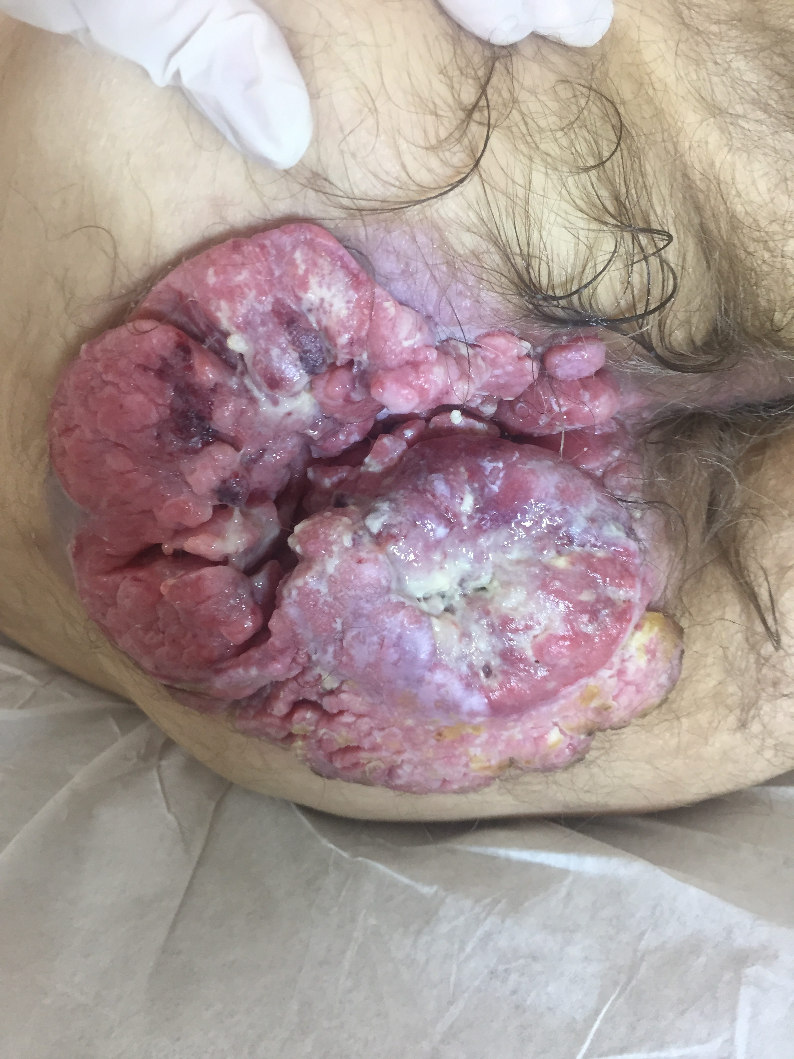

Slide 26

