Slide 1
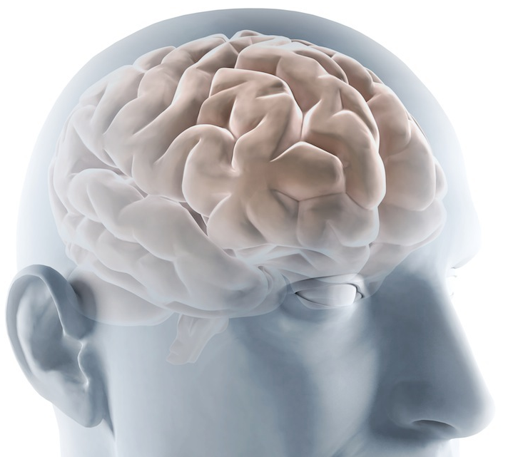
Tuning the Brain: Neuromodulation as a Possible Panacea for treating non-pulsatile tinnitus?
Prof. Sven Vanneste
The University of Texas at Dallas
School of Behavioral and Brain Sciences
Lab for Clinical & Integrative Neuroscience

Slide 2
Tinnitus
At some point most people experience tinnitus
This has been related to listening to loud music, use of medication, trauma or other causes
This sensation is reversible and subsides approximately between a few seconds to a few days

Slide 3
Tinnitus
In an adult population 10 to 15% perceives tinnitus continuously

Slide 4
Tinnitus
In an adult population 10 to 15% perceives tinnitus continuously
Increasing up to 33% in the elderly population

Slide 5
Tinnitus
In an adult population 10 to 15% perceives tinnitus continuously
Increasing up to 33% in the elderly population
Up to 25% of the affected people report interference with their lives as tinnitus causes a considerable amount of distress

Slide 6
Tinnitus treatments
Counseling
Hearing aid
Masking
Active amplification
Medication
Neuromodulation (Non-invasive)
30% no treatment
Most treatment are based on symptomatic relief.
No causal treatment
Subtypes?

Slide 7
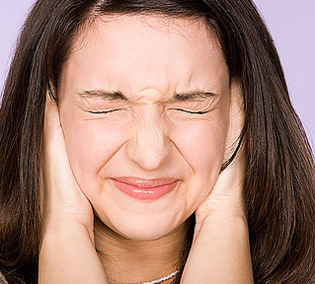
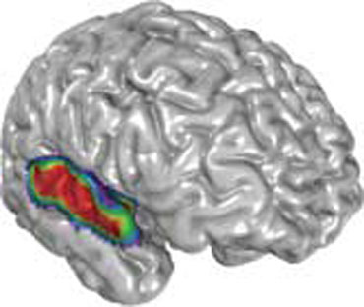
Loss of auditory input
Loss of auditory input sets up a cascade of neurophysiologic changes in the central auditory system culminating to the perception of a phantom sound

Slide 8
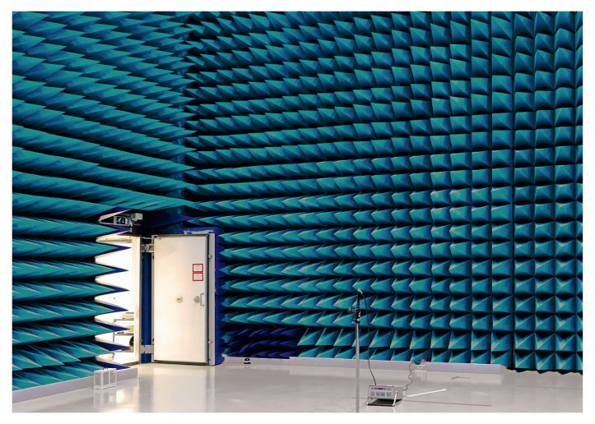
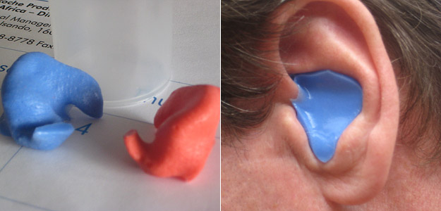
Loss of auditory input
Healthy subjects
Gilles & Vanneste, submitted
N =18
Healthy subjects
Schaette et al., Plos One, 2012

Slide 9
The brain involved in tinnitus
Supplementary Motor Area
Dorsal lateral prefrontal cortex
Orbitofrontal cortex
Auditory cortex
Insula
Insula
Supplementary Motor Area
Dorsal anterior cingulate cortex
Precuneus
Posterior cingulate cortex
Frontopolar cortex
Parahippocampus
Subgenual anterior cingulate cortex
Vanneste & De Ridder, Frontiers in
System Neuroscience, 2012
Song, De Ridder & Vanneste,
Journal Nuclear Medicine, 2012

Slide 10
Why a phantom sound?
Active “Bayesian” Brain
bottom-up
top-down
The predictive brain - the architecture of the cortex implements a top-down prediction algorithm that constantly anticipates incoming bottom-up sensory stimuli (Wacongne et al., PNAS, 2011).
Prediction ↔ External Stimuli
↓
Prediction error
(Bayesian updating)
To reduce the uncertainty of future events
Prediction = External Stimuli
↓
No Prediction error
(No updating)
No reduce the uncertainty of future events
De Ridder, Vanneste & Freeman, Neuroscience & Biobehavioral Reviews, 2014

Slide 11
Why phantom sound?
Why does the brain generates tinnitus?
bottom-up
top-down
Sensory deprivation leads to limits the amount of information the brain can acquire
increases uncertainty present in the environment
to reduce the uncertainty will look for information or fill in the missing information
reduction the prediction error
De Ridder, Vanneste & Freeman, Neuroscience & Biobehavioral Reviews, 2014

Slide 12
The brain involved in tinnitus
bottom-up
Auditory cortex
Auditory cortex
top-down
Pregenual ACC
Pregenual ACC
Mohan, De Ridder & Vanneste, submitted

Slide 13
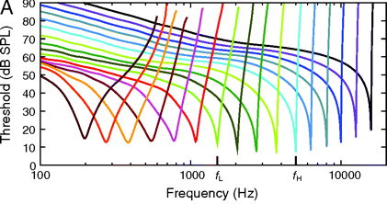
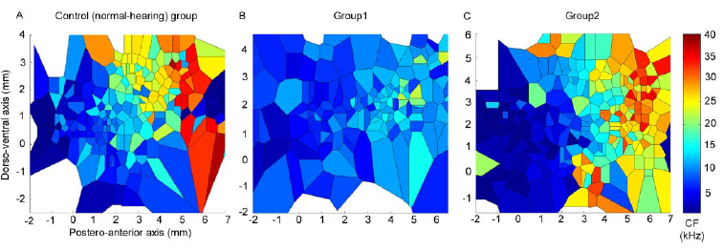
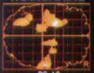
Hub: Auditory cortex
1. Little deafferentation
Spontaneous Hyperactivity
2. More deafferentation
Map plasticity
3. Very large deafferentation
Memory

Slide 14
1. Hyperactivity within the auditory cortex
a. fMRI
Increased BOLD activity within the auditory cortex
De Ridder& Vanneste, JNS, 2011
b. Source localized EEG
A positive correlation between the tinnitus loudness and the current density within the auditory cortex at the gamma frequency band (r = .65)
Van der Loo, Vanneste et al., Plos one, 2009

Slide 15
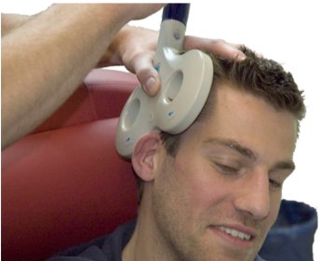
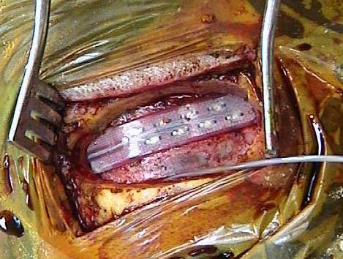
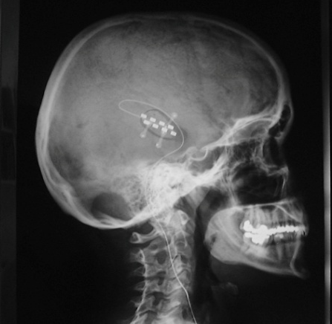
1. Hyperactivity within the auditory cortex
a. Transcranial magnetic stimulation (TMS)
b. Auditory cortex implant
Tonic stimulation
Burst stimulation
N =84
16 responders
13 responders
N= 43
27 non-responders
14 non-responders
De Ridder, Vanneste et al., JNS, 2011
De Ridder & Vanneste, WJN, 2014
Vanneste et al., European Journal of Neurology, 2010

Slide 16
Hub: Auditory cortex
1. Little deafferentation
Spontaneous Hyperactivity
2. More deafferentation
Map plasticity
3. Very large deafferentation
Memory

Slide 17
2. Map plasticity
The tonotopic reorganization of the auditory cortex
Cortical reorganization in the auditory cortex in after noise trauma has been associated with tinnitus
Norena et al., Journal of Neuroscience, 2006
Mühlnickel et al., PNAS, 1998
Engineer et al., Nature, 2011

Slide 18
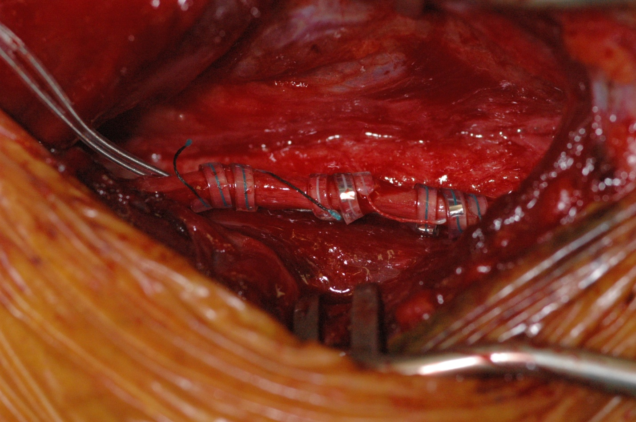
2. Map plasticity
N =10
N =10
4 week of treatment
De Ridder & Vanneste., Neuromodulation, 2014
De Ridder & Vanneste, Otology Neurotology, 2015

Slide 19
Hub: Auditory cortex
1. Little deafferentation
Spontaneous Hyperactivity
2. More deafferentation
Map plasticity
3. Very large deafferentation
Memory

Slide 20
3. Memory
Schmidt et al., Plos One, 2013
Song & Vanneste, Journal Nuclear Medicine, 2012
Landgrebe et al., Neuroimage, 2009
Maudoux et al., Plos One, 2012

Slide 21
3. Memory
The more hearing loss…
…the more information goes from the parahippocampus to AC
Vanneste et al., submitted

Slide 22
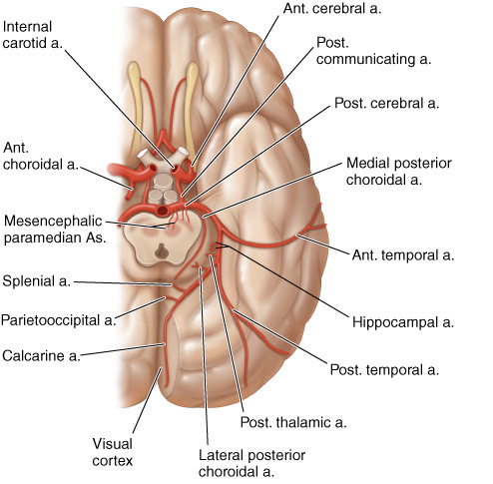
3. Memory
Selective anterior choriodal artery amytal injections
N = 6
Amytal injection ipsilaterally resulted in a maximal suppression of tinnitus of 30%, and contralaterally of 60-70% in three patients with unilateral chronic tinnitus
De Ridder et al., Acta Oto-Laryngologica, 2006

Slide 23
3. Memory
N = 1
Temporal relief of 3 weeks
De Ridder & Vanneste, JNS, 2015

Slide 24
The brain involved in tinnitus
bottom-up
Auditory cortex
Auditory cortex
top-down
Pregenual ACC
Pregenual ACC
Mohan, De Ridder & Vanneste, submitted

Slide 25
Hub: Pregenual ACC
Vanneste & De Ridder, J Neurosurg Sci 2013

Slide 26
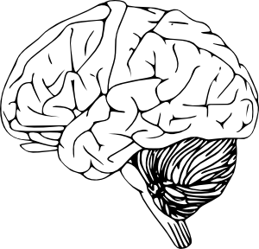
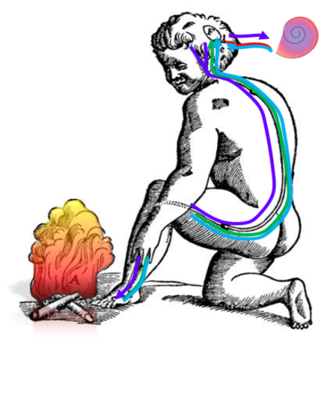
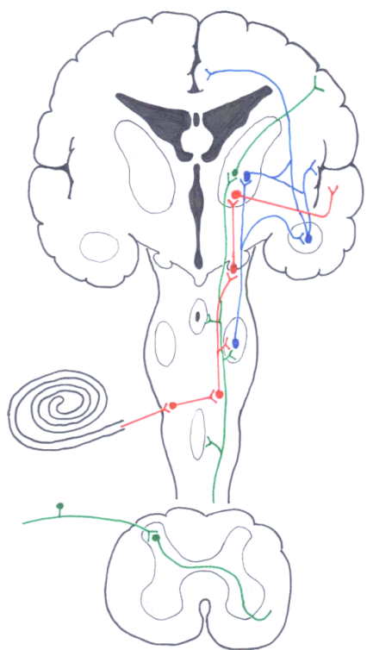
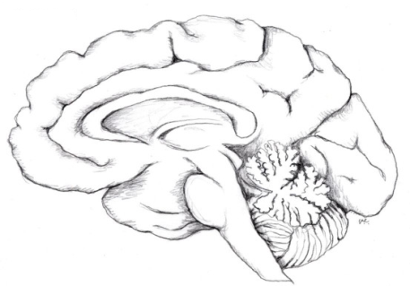
Hub: Pregenual ACC
Ascending
Bottom up
Noise-sensing
Descending
Top down
Noise-canceling
Anterior
Cingulate
Somatosensory
Cortex
Insula
Thalamus
Auditory
Cortex
Amygdala
Cochlea
Nociceptor
Vanneste & De Ridder, J Neurosurg Sci 2013

Slide 27
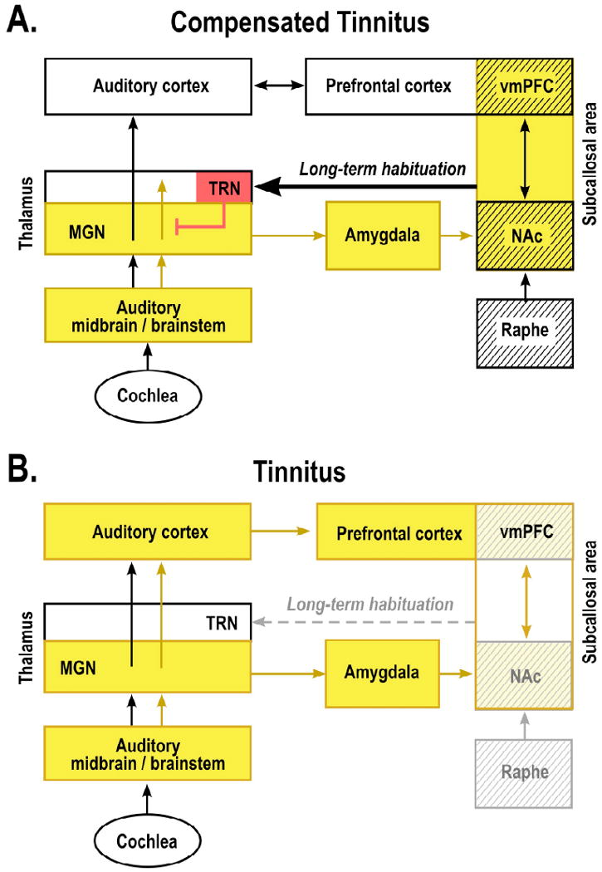
Hub: Pregenual ACC
Noise cancelation system
Rauschecker, Neuron, 2010
Song & Vanneste, Plos One, 2015

Slide 28
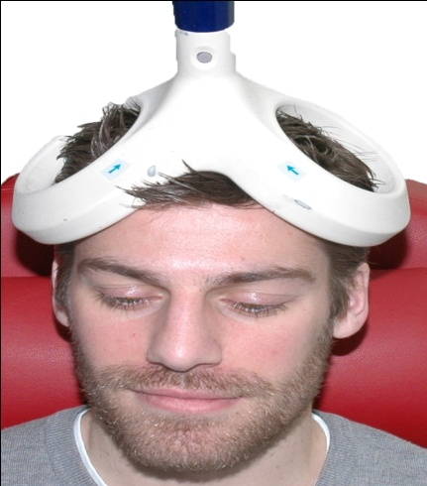
Hub: Pregenual ACC
Noise cancellation system
a. Transcranial magnetic stimulation (TMS)
b. AAC deep brain implant
Vanneste et al., Brain Stimulation, 2012
N = 2
N = 2
Permanent relief
De Ridder & Vanneste, 2015, neurosurgery

Slide 29
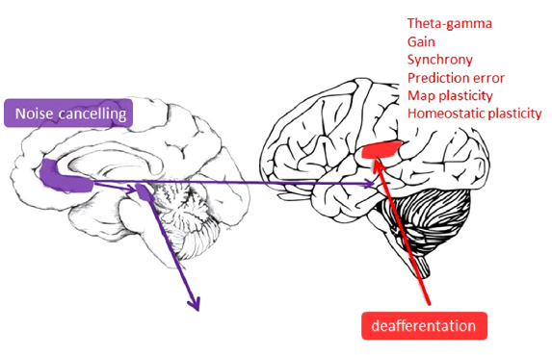
Conclusion
Different subtypes of tinnitus
Top-down
Bottom-up
Dependening on the underlying mechanism: different treatment?

