Slide 1
Visceral smallpox in a sheep flock in Andhra Pradesh, India- A case report
Dr. Supriya. B
Assistant Professor
Department of Veterinary Anatomy,
College of Veterinary Science
Sri Venkateswara Veterinary University, Tirupati, Andhra Pradesh.

Slide 2
Sheep and goat pox are contagious viral diseases of small ruminants.
The virus can replicate in cattle but does not cause clinical disease. The disease has not been detected in wild ungulate populations.
Family Pox viridae
Subfamily Chordopox virinae
Genus Capripox virus
These diseases may be mild in indigenous breeds living in endemic areas, but are often fatal in newly introduced animals.
Incubation Period :4 to 21 days

Slide 3
Temperature: Susceptible to 56°C/2 hours; 65°C/30 minutes. Some isolates inactivated at 56°C/60 minutes
pH: Susceptible to highly alkaline or acid pH
Disinfectants/chemicals: Inactivated by phenol (2%) in 15 minutes. Sensitive to detergents, ether (20%), chloroform, formalin (1%), and sodium hypochlorite (2-3%), iodine compounds (1:33 dilution), quarternary ammonium compounds 0.5%.
Survival: Susceptible to sunlight, but remains viable in wool/hair and dry scabs on skin for up to 3 months. Persists in unclean shaded pens for as long as 6 months. Survives freeze–thaw cycles, but infectivity may be reduced .

Slide 4
Impact on Production
High mortality
Reduced milk yield
Decreased weight gain
Increased abortion rates
Damage to wool and hides
Increased susceptibility to pneumonia and fly strike
Restriction of the export of meat, wool and skin

Slide 5
Epidemiology
Mainly susceptible host are sheep, goats, buffaloes, cow, horse, swine, fowl as well as human beings also.
Worldwide distribution. Sheep and goat pox is highly contagious and enzootic prevalent in north and central Africa, India, Bangladesh and middle eastern countries, china.

Slide 6
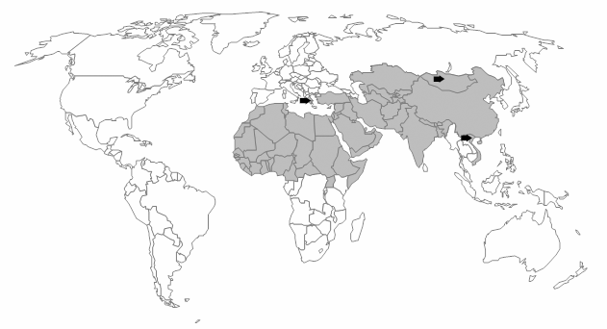
Geographic Distribution Sheep pox and goat pox are found in parts of Africa and Asia, the Middle East, and most of the Indian subcontinent.

Slide 7
Transmission
Aerosol transmission
Contact with infected wool or bedding
Insect vectors biting flies mosquitoes likely can act as vectors but it is not proven
Virus is stable in the environment for weeks
Ulcers on the mucous membranes are important sources of virus.

Slide 8
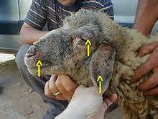
Fever
lymphnode swelling,
Edema of the eyelids,
Nasal discharge,
Inappetence,
lacrimation,
Coughing,
Salivation
.
Breathing became laboured and noisy due to pressure on the upper respiratory tract from the swollen retro- pharyngeal lymph nodes, due to the developing lung lesions.
This animal died of acute infection before the development of skin lesions
In Papulovesicular form of the disease was not observed.

Slide 9
The autopsy of the animals with visceral smallpox revealed extensive pock lesions along the length of trachea, on the heart and lungs.

Slide 10
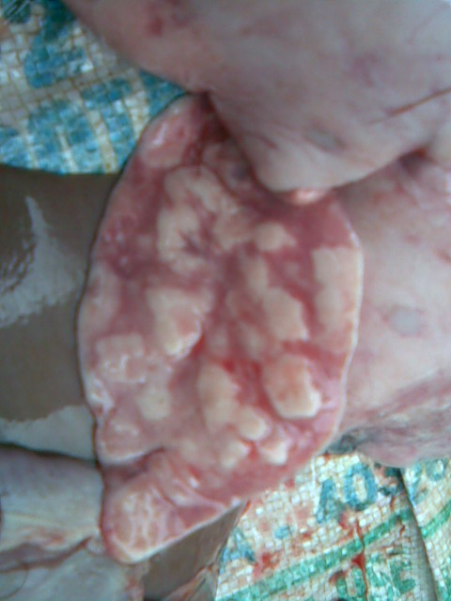
Numerous hard lesions of up to 2 cm in diameter were observed throughout the lungs.

Slide 11
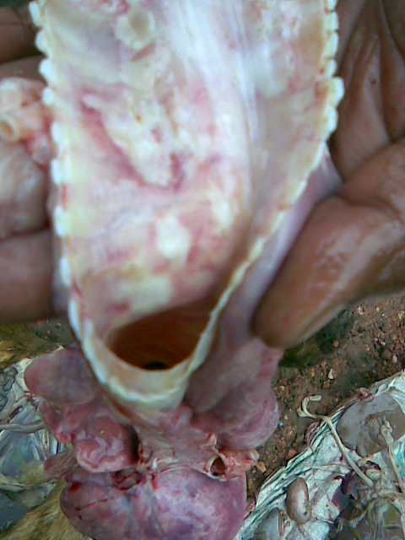
Lesions in trachea

Slide 12
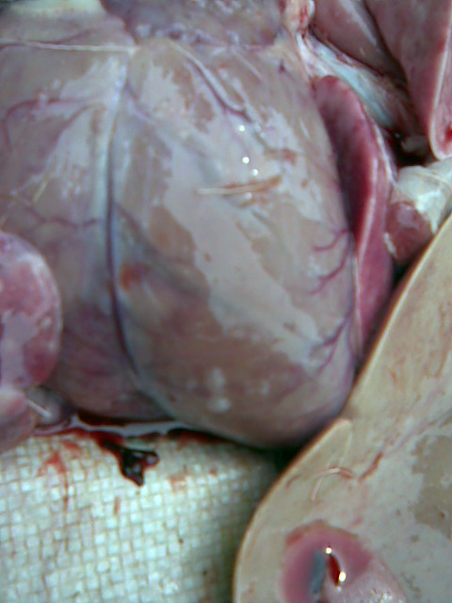
Lesions on heart

Slide 13
SAMPLE COLLECTION
Trachea
lung
lymph node
Buffy coat from blood
Blood in heparin or EDTA
Skin
Samples for virus isolation must be sent to the laboratory as soon as possible. They should be kept cold and shipped on wet ice or gel packs. If these samples must be shipped long distances without refrigeration, glycerol (10%) can be added. The tissue samples must be large enough that the medium does not penetrate into the center of the tissue and destroy the viruses there.

Slide 14
Diagnosis
History
Clinical signs
Autopsy
Polymerase chain reaction
Histopathology
Transmission electron microscope
Animal inoculation
Fluorescent antibody tests
Agar gel immunodiffusion test (AGID)
Enzyme-linked immunosorbent assay (ELISA)
Virus neutralisation
Indirect fluorescent antibody test
Western blot analysis

Slide 15
Differntial diagnosis
Parasitic pneumonia
Contagious ecthyma (orf)
Insect bites
Bluetongue
Peste des petits ruminants
Photosensitisation
Dermatophilosis
Caseous lymphadenitis
Mange

Slide 16
Treatment
Antibiotic
Anti inflammatory
B- complex
Gruels, chopped tender leaves feeding

Slide 17
Care to be taken
If culling is not possible, isolation of infected herds and sick animals for at least 45 days after recovery.
Slaughtering of infected herd if possible
Proper disposal of cadavers and products - burning or burial is often used
Stringent cleaning and disinfection of farms and equipment.
Quarantine of new animals before introduction into herds.
Animal and vehicle movement controls within infected areas.
Vaccination may be considered when the disease has spread more widely.

Slide 18
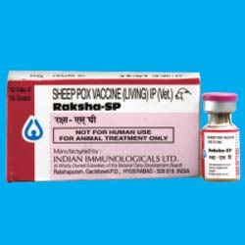
Vaccination is the only effective way to control the sheep pox and goat pox outbreaks in endemic countries. Unfortunately, currently no marker vaccines allowing the differentiation of infected from vaccinated animals are available.
Sheep Pox Vaccine
Composition: Raksha - SP vaccine contains live attenuated sheep pox virus grown on primary lamb testicle cell culture and freeze dried. The virus is comprised of “ Romanian “ strain.
The Kenya O 180 strain is possibly the vaccine with the best safety and efficacy.

Slide 19
Conclusion
Sheep and goat pox can limit trade and prevent the development of intensive livestock production.
Capripox viruses have the potential to become emerging disease threats because of global climate change and changes in patterns of trade in animals and animal products.
They also could be used as economic bioterrorism agents.
Best way of combating is by using prophylactic vaccine.

Slide 20
Acknowledgments
Animal Disease Diagnostic Laboratory
Vijayawada

Slide 21
Somayeh Sadeghi , Pouya Amjadi , Nasroallah Moradi kor. Detection of visceral smallpox in a ewe: a case report. Int J Biol Med Res. 2012; 3(4): 2662-2665.
Balinsky CA, Delhon G, Smoliga G, Prarat M, French RA, Geary SJ, Rock DL, Rodriguez LL. Rapid preclinical detection of sheeppox virus by a real-time PCR assay. J Clin Microbiol. 2008;46:438-42.
Bhanuprakash, V., A. R. Moorthy, G. Krishnappa, R. N. Srinivasa Gowda, and B. K.Indrani, 2005: An epidemiological study of sheep pox infection in Karnataka State, India.Rev. Sci. Tech. 24, 909–920.
Bhanuprakash V, Indrani BK, Hosamani M, Singh RK. The current status of sheep pox disease. Comp Immunol Microbiol Infect Dis. 2006;29:27-60.
Thrusfield, M. 1988. Veterinary Epidemiology, 2nd ed. Blackwell, UK.
World Organisation for Animal Health (2012). - Terrestrial Animal Health Code. OIE, Paris.
World Organisation for Animal Health (2012). - Manual of Diagnostic Tests and Vaccines for Terrestrial Animals. OIE, Paris.

Slide 22
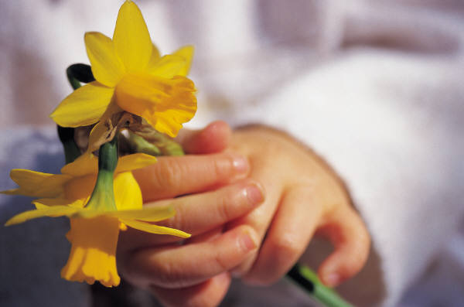
Thank you

