Slide 1
第三章
Survivin siRNA nano particles are capable of inhibiting liver cancer cell growth both in vitro and in vivo
Suoqin Tang,MD, Kuiyao Qu,MD, Yi Zhang,MD.
Department of Pediatrics, PLA General Hospital,
28 Fuxing Road, Beijing 100853, China.

Slide 2
Background
1.Hepatocellular carcinoma (HCC) is one of the most common malignances with high rate of recurrence and metastasis, and is ranked as the third leading cause of cancer-related death worldwide
2.Less than 20% of patients are eligible for surgical management involving hepatic resection or transplantation
3.Molecularly targeted therapy has emerged as a new and potential treatment paradigm for HCC. Survivin, a member of the inhibitor of apoptosis (IAP) family, is well known as one of the most cancer-specific proteins identified up to now

Slide 3
4.Since the stability of siRNA molecules in the blood and efficiency of siRNA delivery into target organs or tissues following systemic administration have been the major issues that limit applications of siRNA in human patients, we try to explore if siRNA liposome entrapment works in the development of novel therapeutics.

Slide 4
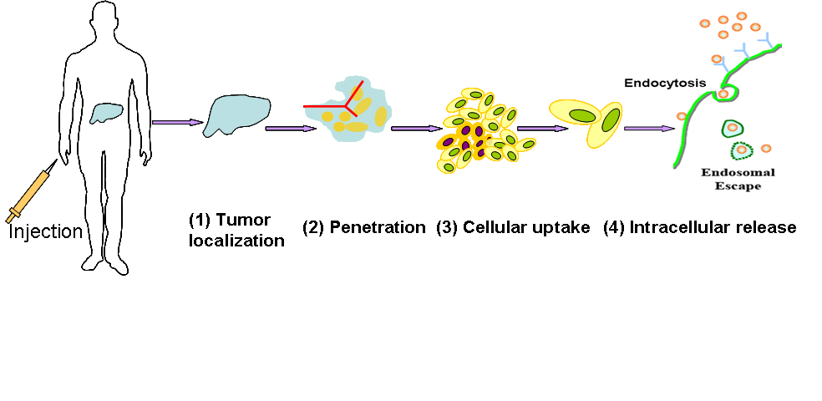
Novel Survivin siRNA therapy
Survivin siRNA sequence
Novel liposome components and production
Efficacy study(in vitro & vivo)
Safety
Nano particles

Slide 5
Aims
Our study aims to evaluate the therapeutic effect of survivin siRNA nano particles, on liver cancer both in vitro and in vivo

Slide 6
Materials and methods
Cell Lines: Human hepatocellular carcinoma (HCC) cell line MHCC-97H
2. Construction of survivin siRNA nanoliposomes

Slide 7
3. Gene transfection in MHCC-97H cells
4. Reverse transcription-quantitative polymerase chain reaction
5 .Western blot
6. MTT assay
7. Hoechst and Annexin V-fluorescein isothiocyanate (FITC)/propidium iodide (PI) staining

Slide 8
Table 1 Sequences of RT-qPCR primers
Gene | Sequence (5’-3’) |  | Length
Survivin | Forward | ACGACCCCATAGAGGAACAT | 175 bp
 | Reverse | TCCGCAGTTTCCTCAAATTC
GAPDH | Forward | GAAGGTGAAGGTCGGAGTC | 225 bp
 | Reverse | GAAGATGGTGATGGGATTTC

Slide 9
8. MHCC97H xenograft model and treatment
MHCC97H cells (4-6×10⁶/0.2 mL) were subcutaneously inoculated in male BALB/c nude mice
Four groups (n=6)
siRNA nanoliposome (3 mg/kg, twice a week,4 weeks)

Slide 10
9. Histological and immunohistochemical analysis
10. Statistical analysis

Slide 11
Results

Slide 12
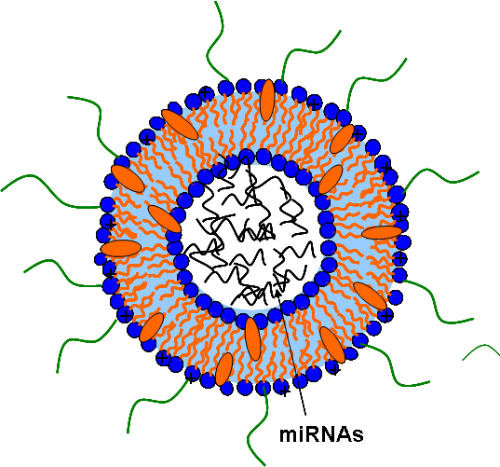
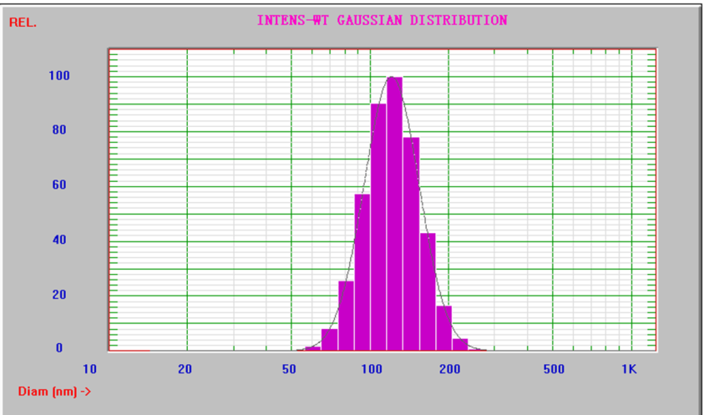
Nano lipisome/nuclear acid
Size of nano particles
Fig 1. Structure of nano particles
Under scan electrilca mocroscope
Stability

Slide 13
Tumor
Heart
Liver
Spleen
Lung
Kidney
Fig 2. Distribution of nano Survivin RNAi particles in vivo

Slide 14
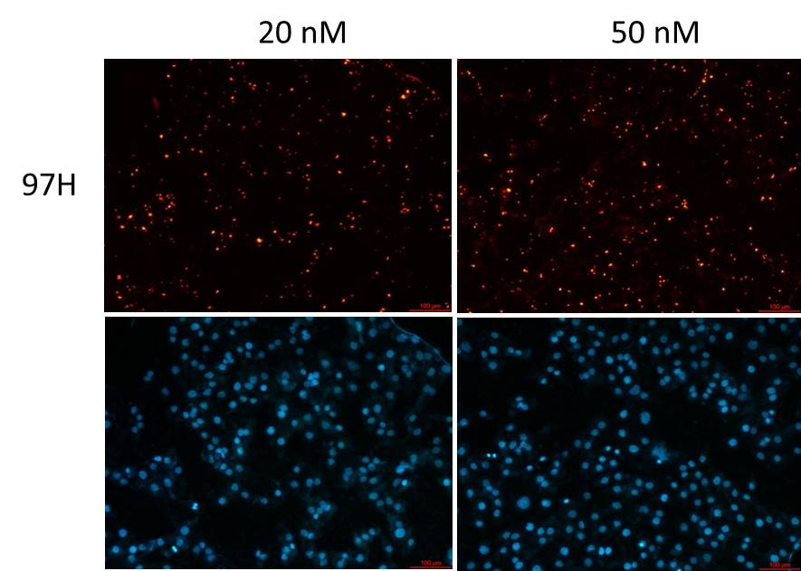
Fig 3. Transfection at different dosage of siRNA

Slide 15
Fig. 4 mRNA and protein expression of survivin following siRNA nanoliposome transfection in MHCC97H cells, as demonstrated by RT-qPCR and Western blot analysis. **p<0.01 vs the control group.

Slide 16
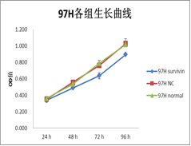
Fig. 5 The viability of MHCC97H cells after survivin siRNA nanoliposome transfection, as determined by the MTT assay. *p<0.05 vs the control group.

Slide 17
Fig.6 Apoptosis of MHCC97H cells induced by survivin siRNA nanoliposome transfection. (A) Hoechst staining, nuclear morphology of cells stained with Hoechst-33258 as analyzed by fluorescence microscopy; (B) Annexin V-FITC/PI staining as analyzed by flow cytometry.

Slide 18
Fig. 7 Survivin siRNA nanonanoliposomes inhibited tumor growth in xenograft mouse model, and the representative picture of dissected tumor tissues.

Slide 19
Fig 8. Efficacy of siRNA nano particles on relative tumor volume in mice bearing HCC-97H cells

Slide 20
Fig 9. Changes of mice body weight

Slide 21
Table 2 In vivo antitumor effects of survivin siRNA nanonanoliposome on Balb/c nude mice bearing MHCC97H tumor cells.
Note: RTV: Relative tumor volume; BW: Body weight; *p<0.05, **p<0.01 vs the NC-IV group.
 | NC-IV |  | SU-IT |  | SU-IV |  | DOX
 | RTV | Tumor volume/g | RTV | BW/g | RTV | BW/g | RTV | BW/g
Day 0 | / | 20.50±1.26 | / | 21.33±0.62 | / | 21.33±0.62 | / | 21.00±0.82
Day 3 | 1.85±0.39 | 22.00±0.41 | 1.31±0.20 | 22.50±0.82 | 1.33±0.59 | 22.17±0.37 | 1.28±0.29 | 22.17±0.80
Day 6 | 2.88±0.72 | 22.75±0.56 | 2.12±0.69 | 23.00±0.65 | 1.98±1.02 | 23.17±0.37 | 2.08±1.03 | 23.08±0.89
Day 10 | 5.07±1.33 | 23.42±0.84 | 2.69±0.93** | 23.92±1.27 | 2.99±1.63* | 24.08±0.53 | 3.67±2.03 | 23.58±1.20
Day 13 | 10.38±2.97 | 23.42±1.06 | 5.74±1.70** | 24.08±1.20 | 5.39±3.47* | 24.08±0.53 | 6.40±3.60 | 24.00±1.35
Day 17 | 14.71±2.76 | 23.50±1.00 | 7.90±2.25** | 24.25±1.18 | 8.77±6.24 | 24.50±0.58 | 8.85±4.58* | 23.58±1.20
Day 20 | 29.86±8.76 | 24.17±0.69 | 14.47±4.62** | 24.92±1.20 | 13.72±9.82* | 24.75±0.25 | 16.28±8.98* | 23.50±1.12
Day 24 | 39.54±11.55 | 25.25±0.75 | 19.64±3.61** | 26.00±0.91 | 19.62±12.47* | 26.08±0.34 | 23.34±12.45* | 24.17±0.85
Day 27 | 61.77±17.38 | 25.58±0.89 | 31.68±10.34** | 26.08±0.79 | 24.62±15.27** | 26.50±0.65 | 32.09±21.34* | 23.58±0.73
Day 31 | 76.94±23.28 | 25.17±1.03 | 39.75±11.75** | 26.17±0.85 | 34.53±21.35** | 26.25±0.48 | 40.86±25.85* | 24.00±1.29

Slide 22
Table 3 Effect of survivin siRNA nanoliposome transfection on
The tumor growth in MHCC97H xenograft
 | NC-IV | DOX | SU-IV | SU-IT
Tumor weight (g) | 0.90 ± 0.29 | 0.62 ± 0.42 | 0.61 ± 0.33 | 0.57 ± 0.26
Tumor inhibition rate (%) | / | 31.11 | 32.22 | 36.67

Slide 23
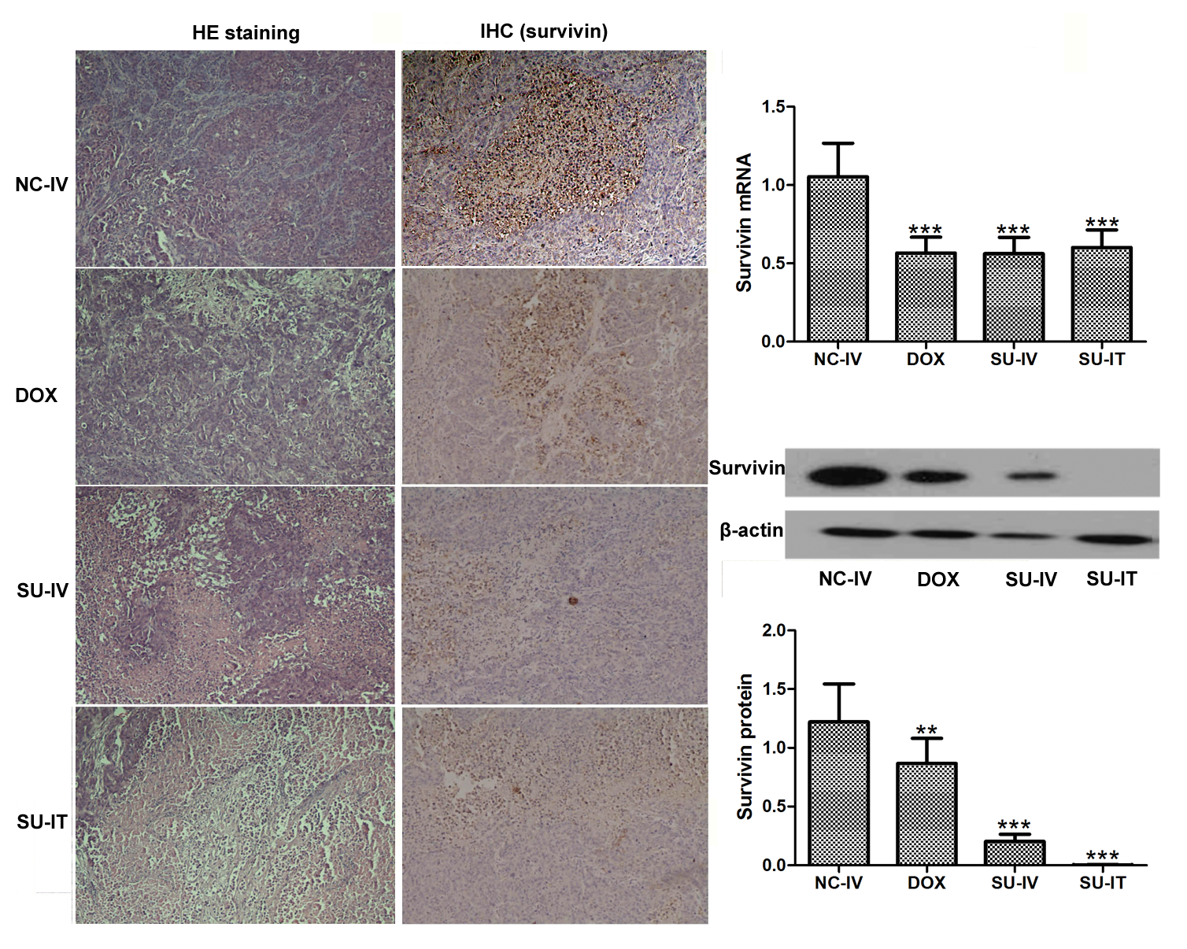
Fig. 10 Tumor samples were harvested for histological analysis (HE staining), and RT-qPCR, immunohistochemical, Western blot analysis of survivin expression. IHC: Immuohistochemistry; **p<0.01, ***p<0.001 vs the NC-IV group.

Slide 24
Conclusions
1.A cationic nanoliposome-based survivin siRNA nanoliposome delivery system was successfully constructed and was demonstrated to be effective in survivin siRNA delivery both in vitro and in vivo
2.Our results showed that survivin down-regulation could significantly attenuate proliferation and induce apoptosis of HCC MHCC97H cells, as well as inhibit tumor cell growth in MHCC97H xenograft models, indicating

Slide 25
that survivin suppression by siRNA may contribute to tumor inhibition through both the proliferation inhibition and apoptosis promotion effects
3. Our study has confirmed the stability of siRNA molecules in the blood and efficiency of siRNA delivery via siRNA liposome entrapment into target organs or tissues following systemic application

Slide 26
THANK YOU !

