Slide 1
Intelligent LED Brightness Control System Using Internet-of-Things Technology
July 20, 2015
Suk-Ju Kang
Intelligent Signal System Laboratory
Dong-A University

Slide 2
Outline
Introduction
1st Proposed algorithm (Intelligent LED brightness control system)
Algorithm description
Simulation results
2nd Proposed algorithm (Automatic chlorophyll estimation algorithm)
Algorithm description
Simulation results
Summary

Slide 3
Introduction
Internet of things (IoT)
The connectivity among objects and humans is more and more important, and the key technology is the internet of things
IoT uses various types of multiple sensors
Light, humidity, temperature….
The Internet of Things(IoT)

Slide 4
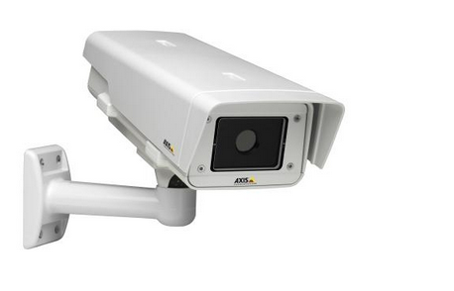
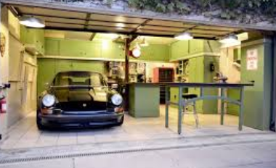
Introduction
Benefits of Internet of Things
Information : Providing more information helps making better decisions
Monitor : monitoring environmental conditions can help users
Time : the amount of time saved because of IoT’s convenience
Place information acquisition
Monitoring System for user

Slide 5
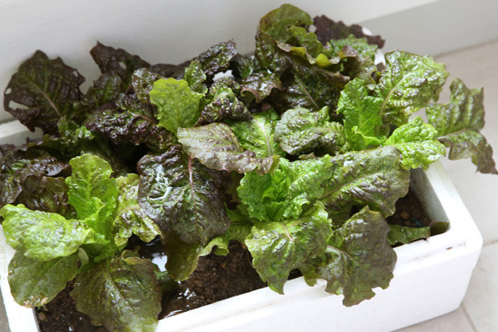
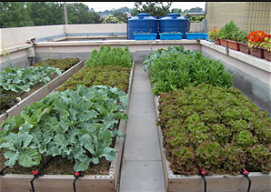
Introduction
Conventional home plant cultivation
Many people have been cultivating vegetables at home to get vegetables
In this way, people can easily get fresh vegetables
The way cultivate lettuce
The old way home plant cultivation

Slide 6
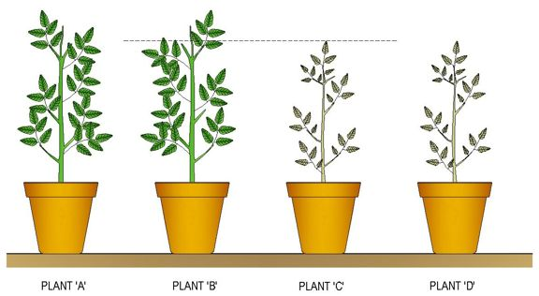
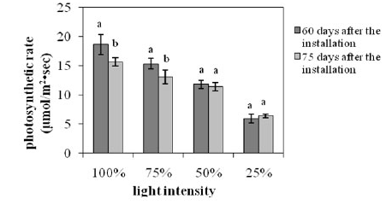
Introduction
Limitation of conventional home plant cultivation
To make an environment for home plant cultivation, the amount of sunshine and water are required
Due to changing weather conditions, it is difficult to provide the amount of sunshine to plants
Photosynthetic rate decreases in dark environment
Plant growth in different light conditions
Photosynthetic rate in different light intensity

Slide 7
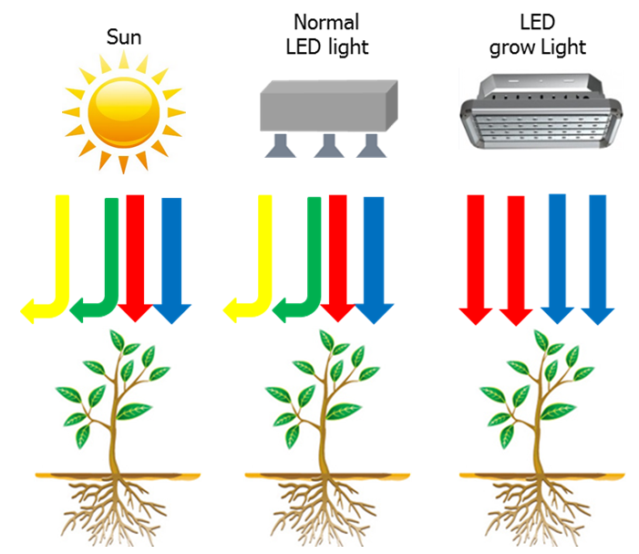
Introduction
There is a method to use the LED grow light for providing the amount of sunshine artificially
Advantages for the LED grow light
Supplying light efficiently
Saving electric energy
Saving household budget
Adding the beauty at home
Comparison between LED grow light and other systems

Slide 8
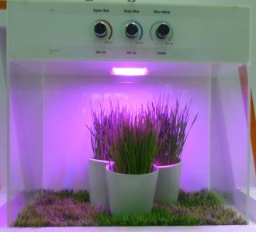
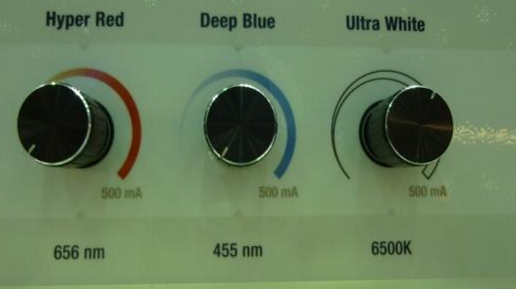
Introduction
Conventional LED system for plant growth
Users should control several conditions such as LED wavelength for plant
Difficulty for automation
Conventional LED system
LED controller

Slide 9
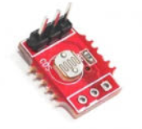
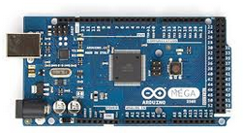
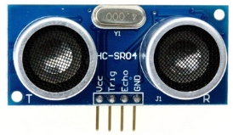
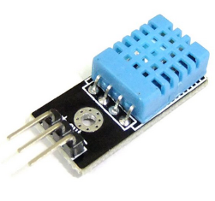
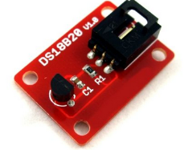
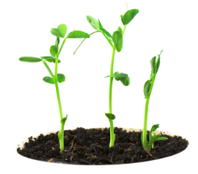
Introduction
IoT-based LED system for plant growth
It can control a proper led wavelength automatically checking several sensors around the plant
Also, plant information can be used for the automatic control
Microcontroller
Grow lights
Sensors
Monitor

Slide 10
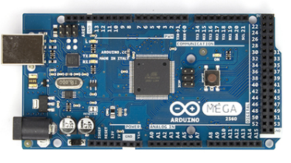
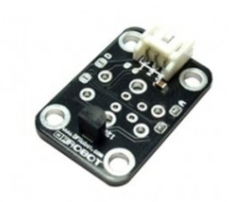
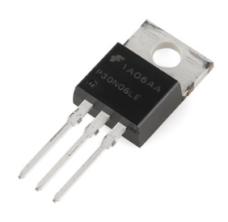
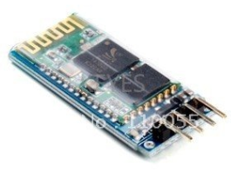
Components of system
1st Proposed System
Controller
Sensors
Infrared distance
Cds light
Temperature
Arduino mega 2560
Information display
Light
LED controller
Telecommunication
Grow light LED
Mosfet
Bluetooth

Slide 11
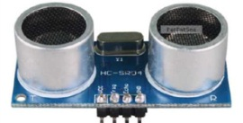
Concept of system
1st Proposed System
IoT system concept based on microcontroller
Calculating the distance between plant and led using Infrared sensor
If distance is long, a PWM signal has large value
If distance is short, a PWM signal has small value
The case that distance is long
The case that distance is short

Slide 12
Proposed algorithm
1st Proposed System
Input target lux
First, the proposed algorithm calculates several data for distance and light intensity
Then, it generates database based on a LED model
$y_{1}\left[m\right]= x_{1}\left[lux\right]$
$$y_{2}\left[m\right]= x_{2}\left[lux\right]$$
$$y_{3}\left[m\right]= x_{3}\left[lux\right]$$
$$y_{4}\left[m\right]= x_{4}\left[lux\right]$$
$y_{1},y_{2}$,$y_{3}$,$y_{4}$ : The distance between a target plant and LED
$x_{1}{\text{,}x}_{2}$,$x_{3}$, $x_{4}$: The lux corresponding to $y_{1},y_{2}$,$y_{3}$,$y_{4}$
Input Target lux
Infrared sensor operation
Plant point extraction
Distance data calculation
PWM level generation
Linear Interpolation
Light emission

Slide 13
Proposed algorithm
1st Proposed System
Infrared sensor operation and plant point extraction
The proposed system recognizes the position of the target plant
Input Target lux
Infrared sensor operation
Plant point extraction
Distance data calculation
PWM level generation
Linear Interpolation
Light emission

Slide 14
Proposed algorithm
1st Proposed System
Distance calculation
The PWM levels are computed based on the pre-determined target intensity($x_{1}\text{,}x_{2}$,$x_{3}$, $x_{4}$) and the bilinear interpolation technique
$y_{1},y_{2}$,$y_{3}$,$y_{4}$ : The distance between a target plant and LED
$x_{1}{\text{,}x}_{2}$,$x_{3}$, $x_{4}$: The lux corresponding to $y_{1},y_{2}$,$y_{3}$,$y_{4}$
Input Target lux
Infrared sensor operation
Plant point extraction
Distance data calculation
PWM level generation
Linear Interpolation
Light emission

Slide 15
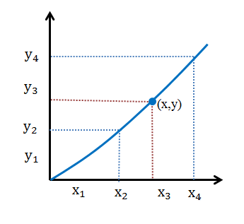
Proposed algorithm
1st Proposed System
Bilinear interpolation technique
It is used to generate new pwm levels
Using $x_{i}$ and $y_{i}$ depends on plant position (x)
$x_{i}$ : one of $x_{1}{\text{,}x}_{2}$,$x_{3}$, $x_{4}$ is determined by plant position
$y_{i}$ : one of $y_{1},y_{2}$,$y_{3}$,$y_{4}$ is also determined by plant position
Y$\left(x\right)$ = Y$\left(x_{i}\right)+\frac{\text{Y}\left(x_{i+1}\right)−\text{Y}\left(x_{i}\right)}{x_{i+1}−x_{i}}×(x−x_{i}$)
Y : the interpolation function
Proposed system uses 8 bit for the intensity level
Bilinear interpolation for PWM

Slide 16
Proposed algorithm
1st Proposed System
PWM level generation
In this module, the proposed system calculates real LED intensity level, which is related with the power consumption
For this, it converts a unit of lux to that of lumen, and calculates the LED power consumption which is based on a unit of lumens/watt
Therefore, the proposed LED system can adaptively control the LED power consumption based on the position of a target plant
Input Target lux
Infrared sensor operation
Plant point extraction
Distance data calculation
PWM level generation
Linear Interpolation
Light emission

Slide 17
Proposed algorithm
1st Proposed System
Light emission
PWM | Prototype
255
180
100
30
Input Target lux
Infrared sensor operation
Plant point extraction
Distance data calculation
PWM level generation
Linear Interpolation
Light emission

Slide 18
Simulation environment
1st Proposed System
Target lux
Test distances: 30, 50, 80, 100(cm)
Several comparison between LED and plant is used for simulation in various height
PWM is used to 8bit intensity level
Target lux (lux) | Height (cm) | PWM
100 | 30, 50, 80, 100 | 0~255 8bit intensity level
134
200

Slide 19
Simulation environment
1st Proposed System
Watt from PWM
Power is calculated by Look-up table (LUT)
Typical luminous efficacy is 60 lm/W
$Φ_{v\left(lm\right)}$ : luminous flux in lumens(lm)
$E_{v(lx)}$ : illuminance of lux
$A_{({ft}^{2})}$ : surface area in light
$η_{(lm/W)}$ : lumen / watt
$$Φ_{v\left(lm\right)}=0.09290304×E_{v(lx)}×A_{({ft}^{2})}$$
$$P_{\left(w\right)}=Φ_{v\left(lm\right)}÷ η_{(lm/W)}$$
Light Type | Typical luminous efficacy (lumens/watt)
Halogen lamp | 16 – 24 lm/W
Fluorescent lamp | 45 – 75 lm/W
Metal halide lamp | 75 – 100 lm/W
LED lamp | 30 – 90 lm/W

Slide 20
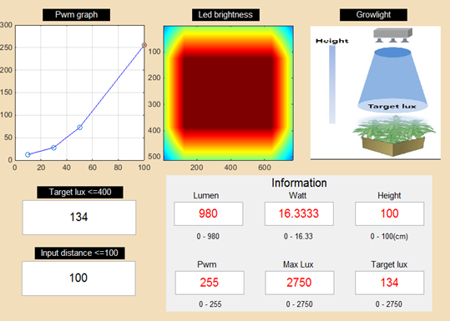
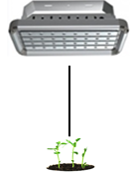
Simulation results
1st Proposed System
PWM level simulation

Slide 21
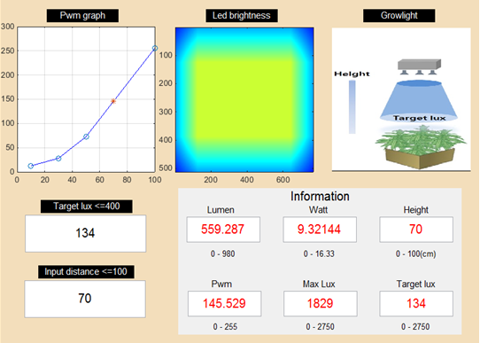
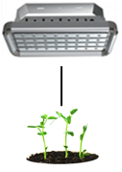
Simulation results
1st Proposed System
PWM level simulation

Slide 22
Simulation results
1st Proposed System
Target lux | Height | PWM | Watt
134 (default) | 100 | 255 | 16.333
 | 80 | 182.02 | 11.659
 | 50 | 72.55 | 4.647
 | 30 | 28.12 | 1.801
200 | 100 | 255 | 16.333
 | 80 | 196.31 | 12.574
 | 50 | 108.28 | 6.936
 | 30 | 41.98 | 2.689
100 | 100 | 190.30 | 12.189
 | 80 | 174.66 | 11.187
 | 50 | 54.14 | 3.468
 | 30 | 20.99 | 1.344

Slide 23
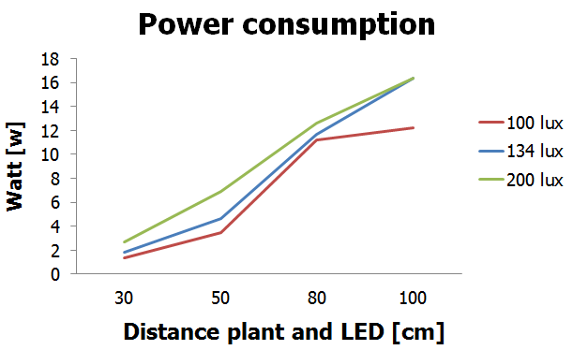
Simulation results
1st Proposed System

Slide 24
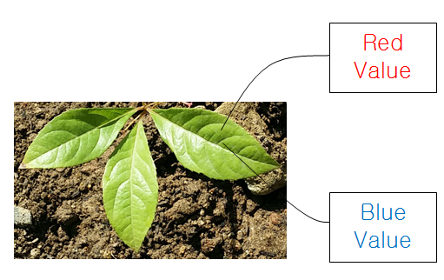
Motivation
2nd Proposed System
For better plant cultivation environment, we suggest a new estimation algorithm using image segmentation
It measures the health status of plants from their leaves
This algorithm is based on a chlorophyll (Chl) value
Using image processing calculates Red and Blue values
It substitute these values in Chl formula
[1] Mahmoodi, Mahmood, et al. "Chlorophyll Content Estimation Using Image Processing Technique.“WORLD APPLIED SCIENCES JOURNAL, pp.5~7, JANUARY 2013

Slide 25
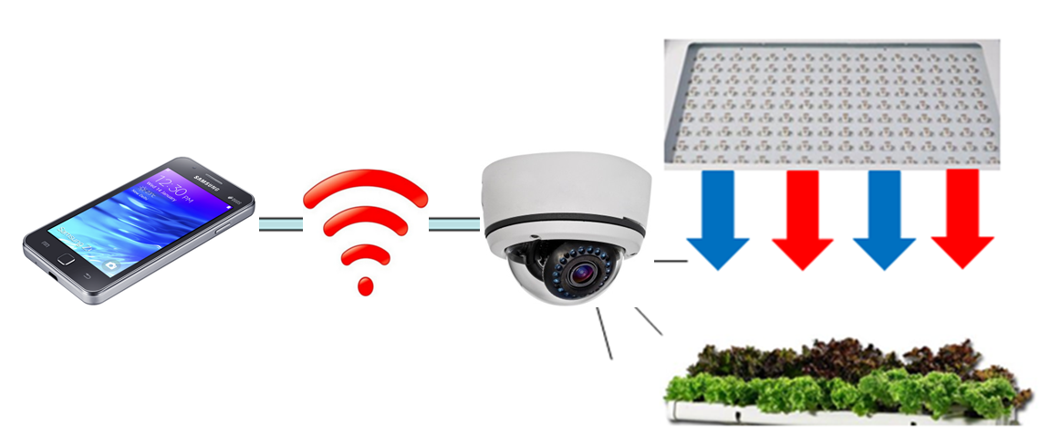
Motivation
2nd Proposed System
IoT system in home plant cultivation
With IoT system that uses various web communication devices, we can check cultivation environment more efficiently
Chlorophyll of the plant
Growth
Humidity
…
We proposed chlorophyll a new estimation algorithm using image segmentation-based plant recognition
Home plant cultivation system with IoT technologies

Slide 26
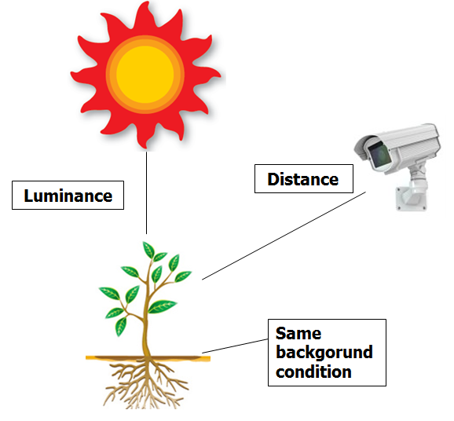
Pre-processing
2nd Proposed System
To take high quality pictures of the plants, we controlled some conditions
Luminance
Same background conditions
Distance
For the better accuracy of leaf detection, we classified leaves and the background of the pictures
Leaf color : Green
Background color : gray

Slide 27
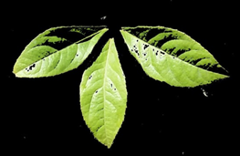
Main processing
2nd Proposed System
Image Input
Color masking
Binarization of an image
Image restoration
Calculating chlorophyll
Chlorophll Level

Slide 28
Main processing
2nd Proposed System
Leaf extraction process
Estimating typical size of a leaf in an input frame image
Image Input
Color masking
Binarization of an image
Image restoration
Calculating chlorophyll
Chlorophyll Level

Slide 29
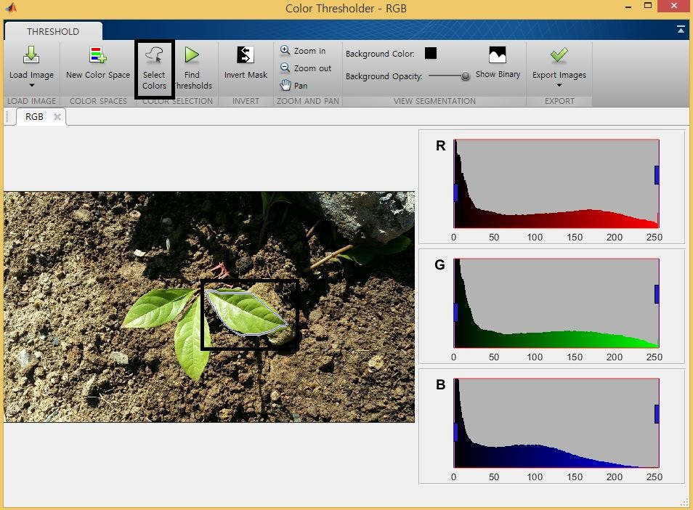
Main processing
2nd Proposed System
Image Input
Leaf extraction process
Separating separate leaves and a background from the input image
RGB color map was used
It is important to select unique colors of the leaves
Color masking
Binarization of an image
Image restoration
Calculating chlorophyll
Chlorophyll Level

Slide 30
Main processing
2nd Proposed System
Image Input
Leaf extraction process
After binarization, the image has zero and one values
Leaf area: the area where the intensity are non-zeros
To get a color image, multiplication is performed
Original image.*binary Image (Vectorization)
Color masking
Binarization of an image
Image restoration
Calculating chlorophyll
Chlorophyll Level

Slide 31
Main processing
2nd Proposed System
Image Input
Leaf extraction process
For improving the accuracy of the calculation, background components are deleted
Zero values are assigned in a background
Calculating Chl with ‘R’ and ‘B’ in the training image
Chl=R-B/R+B
Color masking
Binarization of an image
Image restoration
Calculating chlorophyll
Chlorophyll Level

Slide 32
Main processing
2nd Proposed System
Image Input
Leaf extraction process
Calculating Red and Blue values
Comparing chlorophyll values from the image of leaves
Classifying normal leaves and bad leaves
Color masking
Binarization of an image
Image restoration
Calculating chlorophyll
Chlorophyll Level
[1] Mahmoodi, Mahmood, et al. "Chlorophyll Content Estimation Using Image Processing Technique.“ WORLD APPLIED SCIENCES JOURNAL, pp.5~7, JANUARY 2013

Slide 33
Simulation results
2nd Proposed System
Original Image | Result Image
leaf_h_31 (RGB:0.0262 / H:0.0178)
Original Image | Result Image
leaf_hl_05 (RGB:0.0434 / H:0.0093)

Slide 34
Simulation results
2nd Proposed System
Original Image | Result Image
leaf_h_33 (RGB:0.0220 / H:0.0152)
Original Image | Result Image
leaf_hl_19 (RGB:0.0433 / H:0.0105)

Slide 35
Simulation results
2nd Proposed System
Chlorophyll value

Slide 36
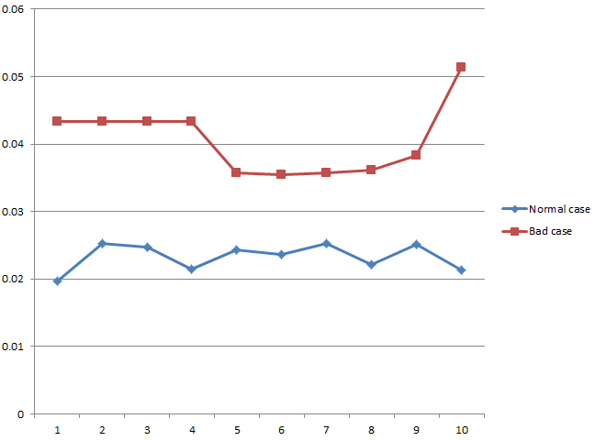
Simulation results
2nd Proposed System
Training information
Chlorophll value
Comparison between chlorophyll value normal case and bad case

Slide 37
Simulation results
2nd Proposed System
There are difference between normal leaves and bad leaves
Compared chlorophyll value(minimum,Maximum,mean)
In this case, chlorophyll value of normal case is lower than the value of the other case
Leaf with low chlorophyll values has high probability for normal case
 | Normal case | Bad case
Chl (Min.) | 0.0192 | 0.0229
Chl (Max.) | 0.0369 | 0.0621
Chl (Mean) | 0.0288 | 0.0337

Slide 38
Summary
We proposed a new intelligent LED control system for the plant cultivation
The proposed system..
Detected the target plant position, and controlled the LED intensity according to the distance between the target plant and system
Extracted the leaf portion using color mask and binarization and measured chlorophyll value using image processing
The simulation results…
Shows the proposed system preserved the appropriate LED intensity for the target plant
Reduced the power consumption significantly
Normal leaf chlorophyll value is more lower than bad leaf chlorophyll

