Slide 1

Challenges in Consumer Behaviour Change based on
Colour Coding System for Beverages as a NCD Control Mechanism in Sri Lanka
Sujeewa Gunaratne. PhD
President
Institute of Food Science & Technology Sri Lanka

Slide 2
Discussion Points
Introduction of country
Background to colour coding regulations for beverages
Objectives of study
Method and results
Findings
Recommendations

Slide 3
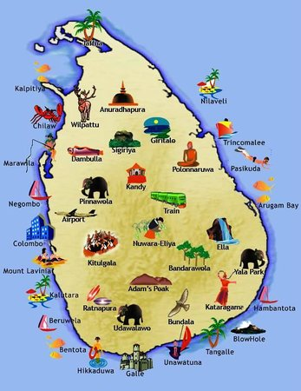
Introduction of Country
A small beautiful island in Indian ocean
Capital: Colombo
Area: Apprx 62 700 sq km
Population: 21.4 Mn (2017)
Population density: 342 persons per sq km (2017)
GDP: 87.2 Bn USD (2017)
GDP per capita: 4065 USD (2017)
Literacy rate: 95.7%
Life expectancy at birth: males 72, females 78.6 (2013, 2011)
Free health care system: with 631 state hospitals (2015)
With 80 581 hospital beds (2015)
Source: Central Bank Annual Report, Annual Health Bulletin

Slide 4




Slide 5
Background to colour coding regulation for beverages
CSD
Kottu
Breads & buns
pizza
burger and chips
snacks
cakes
Sri Lanka has enjoyed open economy for 40 years (since 1977)
A transition of socio economic conditions
A vast amount of fast food, convenient food available in market
Consumption of ‘take away’ convenient foods for dinner has become a trend among urban families
Increasing affordability among upper and middle classes
More and more convenient food stores coming up!
No restriction at the moment on advertising and promotion

Slide 6
Background to colour coding regulation for beverages
An increasing tendency of non-communicable diseases (NCDs)
In 2014, 75% of all annual deaths due to NCDs
NCDs (CVD, diabetes, cancers, respiratory diseases)
20% of population is either diabetic or pre-diabetic
18.6 % diabetic in Western province (includes Colombo) [2011 National Study]
25.2% population overweight
9.2% obese
26.2% centrally obese
Source: National Multi-sectoral Action Plan, Katulanda et al

Slide 7
Source: National Health Bulletin 2015

Slide 8
Source: National Health Bulletin 2015

Slide 9
Diabetes Map of Sri Lanka
18.6% Western Province Population diabetic
Source: Katulanda et al, 2011

Slide 10
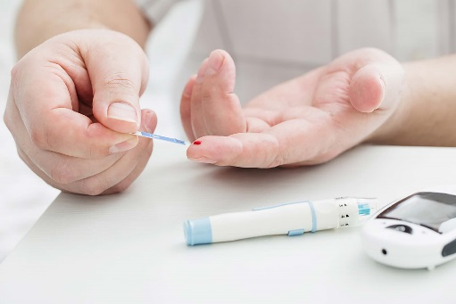
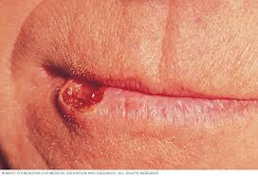

Background to colour coding regulation for beverages
Ministry of Health National Multi-Sectoral Action Plan proposes to achieve several health goals
25% relative reduction in premature mortality from CVD, cancer, diabetes, or chronic respiratory diseases

Slide 11
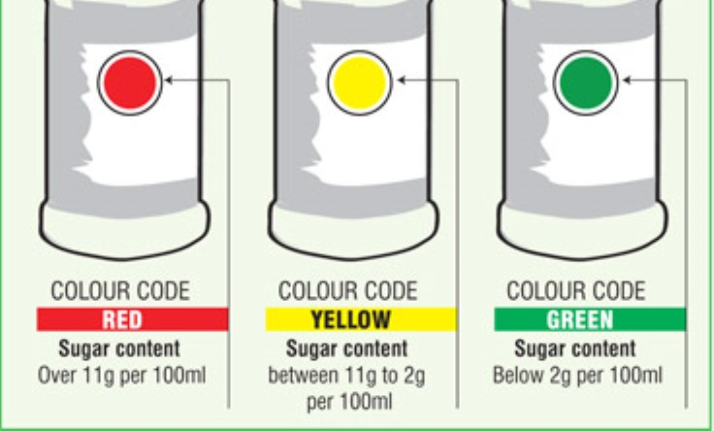
Background to colour coding regulation for beverages
A colour coding regulation for sugar implemented for beverages from 1st Aug 2016
Types of beverages covered
Carbonated beverages
RTS other than milk based products
Fruit nectars
Fruit juices

Slide 12
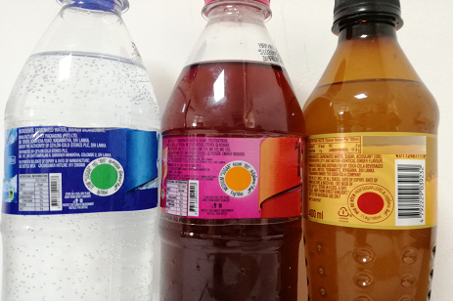
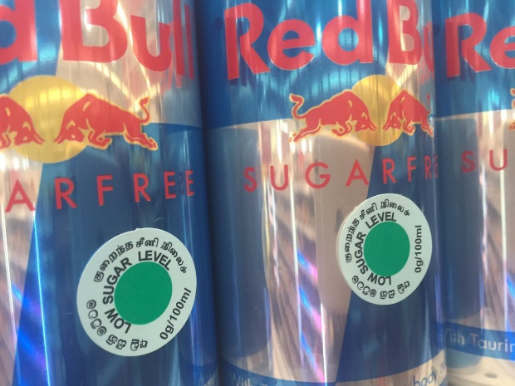
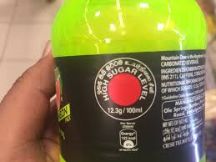
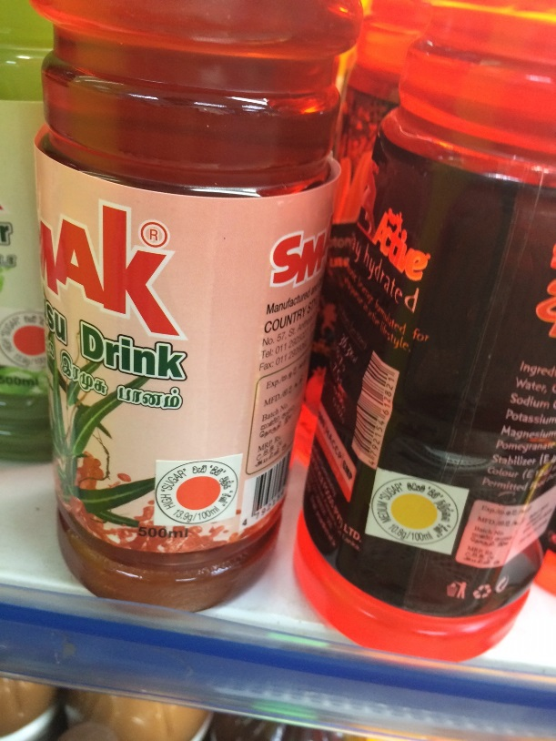
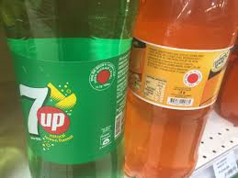

Slide 13
Objectives of the Study
Understand the level of awareness of colour coding system for beverages in the population
To study the ability of colour coding system on beverages to create behaviour changes in the population

Slide 14
Method & Results
A convenience sampling method adopted
Questionnaire on colour coding system distributed among population in Western Province (Colombo, Kalutara, Gampaha districts)
Western is the most populated district, including the capital
A few respondents from adjoining districts
Questionnaire distributed by e mail, use of snow balling method, and manual completion
125 questionnaires issued, 71 responses received

Slide 15
Method & Results
1. The districts of respondents’ residence was as follows
2. Age breakdown of respondents
Respondent district | %
Colombo | 48
Gampaha | 31
Kalutara | 17
Ratnapura | 04
Age of respondent | Number | %
< 20 yr | 10 | 14
20-30 yr | 28 | 39
31-40 yr | 21 | 30
> 40 yr | 12 | 17

Slide 16
Method & Results
3. Awareness of colour coding regulation for beverages
4. Awareness of different beverage types covered by the regulation
Awareness | %
Yes | 68
No | 32
Age of respondent | % not aware
< 20 yr | 50
20-30 yr | 48
31-40 yr | 08
> 40 yr | 20
Awareness of types | %
Yes | 0
No | 100

Slide 17
Method & Results
5. Method of knowing the regulation
6. Knowledge of colour code with highest sugar level
Awareness method | %
Newspapers & TV | 40
Gazette notifications | 0
Label display on beverages | 80
Any other means * | 30
Knowledge on highest sugar level | %
Identified Red code | 98
did not identify Red code | 02

Slide 18
Method & Results
7. Is purchase and consumption based on colour code on beverages?
8. Reduced consuming any beverages since this colour code regulation?
Age of respondent | % not considering colour code
< 20 yr | 22
20-30 yr | 31
31-40 yr | 35
> 40 yr | 07
 | Consider colour code?
Yes | 76 %
No | 24 %
Consumption reduction? | %
Yes | 54
No | 46

Slide 19
Method & Results
9. Will colour coding system be helpful to the population to maintain health?
10. Do you wish other food products to have colour coding?
Is colour coding system helpful | %
Yes | 85
No | 15
Colour coding for other food? | %
Yes | 100
No | 0

Slide 20

Method & Results
In Depth Interviews
Interview with respondent who didn’t show behaviour change said that a healthy diet is based on overall balanced food intake, not just controlling sugar intake, hence not willing to change beverages taken purely on impulse
Interview with respondent who changed behaviour said colour code helps to know which drink has more sugar, and when purchasing a drink, a choice can be made to select one with less sugar

Slide 21
Findings
Were consumers aware of colour coding system for beverages? Yes
Was the colour coding system able to create behaviour changes in population? ` Not at satisfactory level
research on behaviour change and healthy foods (Chance et al 2014) explains that long term goals/ preferences are thwarted by immediate desires

Slide 22
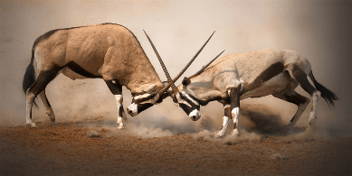
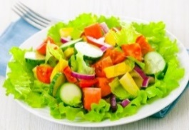
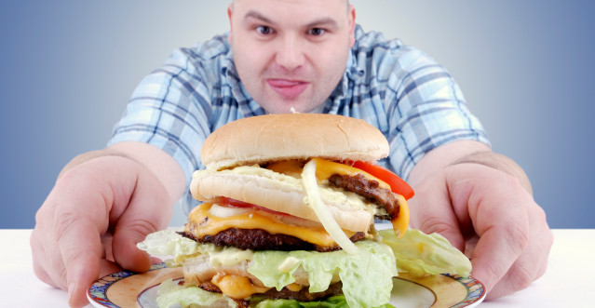
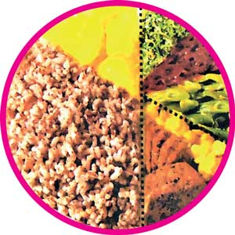
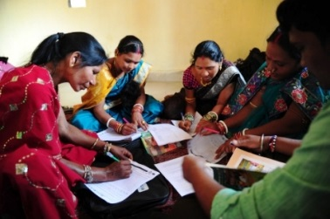

Immediate desires
Long term goals and preferences
Behave
Prefer
Control Impulse
Take time to decide/ act
Eat unhealthy
Impulse
Act without thinking
Behaviour change interventions
Eat healthy

Slide 23
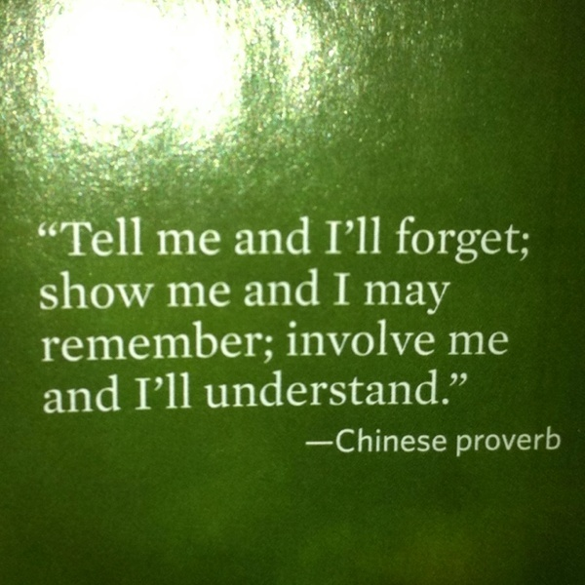
Recommendations
More grass root level activities such as community training programs, school curriculum changes, behaviour change activity programs needed to generate behaviour changes in sugar reduction

Slide 24
References
1. National multi-sectoral action plan for the prevention and control of non communicable diseases 2016 -2020
2. Annual Health Bulletin of Sri Lanka (2015) published in 2017
3. Katulanda et al, 2011. Province and ethnic specific prevalence of diabetes among Sri Lankan adults, Sri Lanka Journal of Diabetes Endocrinology and Metabolism
4. Chance et al, 2014. Why choosing healthy food is hard, and how to help: presenting the 4Ps framework for behaviour change, Cust. Need. and Solut 1: 253-262
5. Food (colour coding for sugar levels) regulations 2016
6. Central Bank Annual Report Key Indictors 2017

Slide 25


