Slide 1
Improving Innovative Mathematical Model for Earthquake Prediction
By: Suganth Kannan
President, MathforUS LLC
Florida, USA

Slide 2
Objective
The objective of this research is to improve upon a previously developed Innovative Mathematical Model for Earthquake Prediction.

Slide 3
Background Research
M8-algorithm
Vapor theory and the earthquake cloud for prediction
Geoelectrical signals near Wak-Air and Boe-Air Dipoles during Izu Island Earthquake cluster

Slide 4
Background Research
Richter Scale - Logarithmic
Epicenter – Point on surface above origin of earthquake
Intensity - Depends on distance from epicenter and earthquake’s magnitude

Slide 5
Background Research
Spanish Researcher Earthquake Correlation Theory and Magnet Theory
Low levels of Dilatancy before major earthquakes
US, EU, Japan experiment on factors – Land deformations, Seismic wave velocities, Geomagnetic/electric phenomenons

Slide 6
Materials
Personal Workstation with 1 GB Graphic Card
USGS NEIC Data on past earthquakes
Google Earth Program
KML earthquake data files
Microsoft Excel
Photoshop Program

Slide 7
Past Research
California, Central USA, Northeast USA, Hawaii, Turkey, and Japan
Spatial Connection Model
Poisson Range Identifier (Pri) Function
Distance Factor (Df)

Slide 8
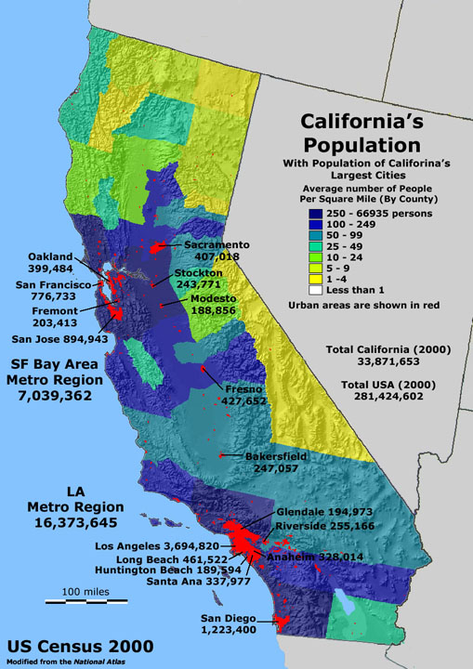
Current Research
California Zone Split into Two for Validation
Incorporation of Population Centers

Slide 9
Zonal Limits

Slide 10
Procedure
Using NEIC database, earthquake data collected in KML files
Analyzed using Spatial connection model – Based on logical assumption that all earthquakes in a fault zone are related to one another

Slide 11
Procedure
Range Identifier Function
f(ri) = {[x1 * time lag 2] / [ Cos(ϴ) * x2 * time lag 1]}
Relationship exists based on Angle, Distance, and Time

Slide 12
Procedure
Poisson Distribution operation applied for all Pri values
Utilizing Distance Factor, Pri value for set is determined

Slide 13
Procedure
Exponential Distribution operation applied for all Range Identifier values
Utilizing Distance Factor, Exponential value for fault zone is determined

Slide 14
Results

Slide 15
Discussion-Interpretation of Results
Fault zones have identifiable patterns in a predictable fashion
Future Predictions can be made using the improved model

Slide 16
Significance of Study
Major Improvement
Greater accuracy in combination
FEMA can allocate necessary resources

Slide 17
Applications and Future Research
Save millions of lives by creating an evacuation timeframe
Fewer Insurance claims
Save money for various industries
Potentially could save billions of $$$$ for economy.
Team up with Leading Seismology Departments and utilize developed software

Slide 18
Thank You for listening to my Presentation.
Are there any questions?
Q & A?

