Slide 1
VITAMIN D & CARDIOVASCULAR HEALTH
Dr. Subarna Mitra, MD, Obstetrics & Gynaecology
Senior Resident, All India Institute of Medical Sciences, India

Slide 2
Introduction
Vitamin D – a pro-hormone rather than a vitamin
Orchestrates the ‘calcium-vitamin D-parathyroid hormone’ endocrine axis
Classic role - maintaining calcium homeostasis and bone health
Multiple pleiotropic non-skeletal effects – subject of intensive research with conflicting results
Most potent source is sunlight exposure – yet hypovitaminosis D is a global pandemic

Slide 3
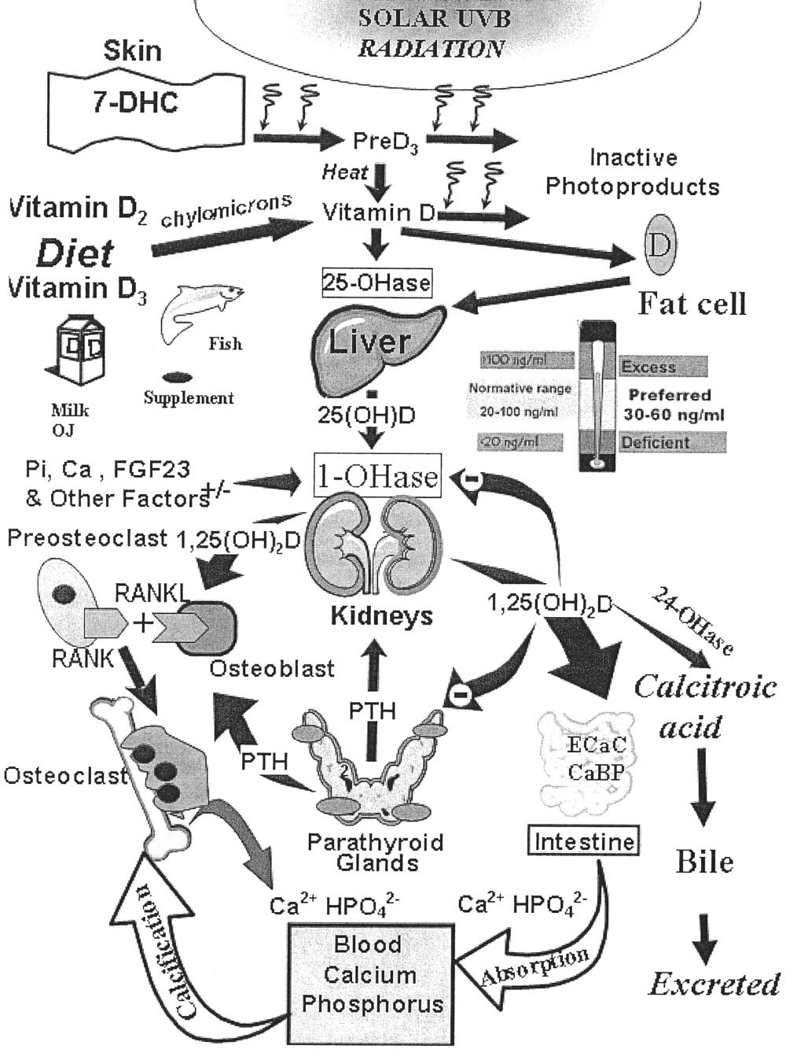
Vitamin D metabolism
Sources
Sunlight exposure
Diet – oily fish, egg yolk, mushrooms, dairy products
Reasons for deficiency
Inadequate sunlight exposure – latitude, season, clothing, sunscreen use, indoor activity
Obesity, skin pigmentation, ageing, genetics
Fortified food items – milk, cheese, orange juice, cereals
Pharmaceuticals – multivitamins or vitamin D supplements
Repeated, unplanned pregnancies in deficient mothers
Food fads – low dietary intake, high fibre diet, lack of universal food fortification

Slide 4
Optimal levels – debate on unknown!
LEVELS OF VITAMIN D (ng/ml) | LEVELS OF VITAMIN D (nmol/l) | CATEGORY
>30 | >75 | Sufficiency
20-29 | 50-75 | Insufficiency
<20 | <50 | Deficiency
Holick MF, Binkley NC, Bischoff-Ferrari HA, et al. Evaluation, treatment, and prevention of vitamin D deficiency: an Endocrine Society clinical practice guideline. J Clin Endocrinol Metab 2011;96:1911-30
Classification of hypovitaminosis D
LEVELS OF VITAMIN D (ng/ml) | LEVELS OF VITAMIN D (nmol/l) | SEVERITY OF DEFICIENCY
10-20 | 25-50 | Mild
5-10 | 12.5-24 | Moderate
<5 | <!2.5 | Severe
Lips P. Vitamin D deficiency and secondary hyperparathyroidism in the elderly: consequences for bone loss and fractures and therapeutic implications. Endocr Rev 2001;22:477–501
Notes:
Read IOM recommendations

Slide 5
Prevalence – global scenario
US – 69.5%¹
Europe – 86.4%¹
Asia – 85%²
Highest rates as well as more severe deficiency in Middle East & South Asia³
Chowdhury R, Kunutsor S, Vitezova A, Oliver WC, Chowdhury S, Kiefte-de-Jong JC et al. Vitamin D and risk of cause specific death: systematic review and meta-analysis of observational cohort and randomised intervention studies BMJ 2014; 348:g1903
Lim S, Kim MJ, Choi SH, Shin CS, Park KS, Jang HC, Billings LK, Meigs JB. Association of vitamin D deficiency with incidence of type 2 diabetes in high-risk Asian subjects. Am J Clin Nutr 2013;97:524–30.
Wahl DA, Cooper C, Ebeling PR et al. A global representation of vitamin D status in healthy populations. Arch Osteoporos 2012;7:155–72
Mithal A, Wahl DA, Bonjour JP, Burckhardt P, Dawson-Hughes B, Eisman JA, et al.; IOF Committee of Scientific Advisors (CSA) Nutrition Working Group. Global vitamin D status and determinants of hypovitaminosis D. Osteoporos Int 2009; 20:1807-20.

Slide 6
Prevalence – Indian perspective
Presumed misconception
Proved reality
Vitamin D deficiency along with low calcium intake is very common in India (50-90%) in all the age groups and both sexes across the country
Vast tropical country extending from 8.4°N to 37.6°N latitude with ample sunshine throughout the year so vitamin D deficiency is unlikely
Harinarayan CV and Joshi SR. Vitamin D status in India-Its implications and remedial measures. J Assoc Physicians India. 2009 ;57;40-48.

Slide 7
VDD, female gender & postmenopausal status – troublesome trio!
VITAMIN D DEFICIENCY AND FEMALE GENDER
Vit D deficiency is more likely in women than in men.
Females have lower Vit D levels, even after adjusting for age, central obesity, HDL-C & DBP.
Gender differences are possibly due to clothing, sun protection behaviour and positive correlation with testosterone levels.
van der Wielen RP, Lowik MR, van den BH, et al. Serum vitamin D concentrations among elderly people in Europe. Lancet 1995;346:207-10
Choi HS, Oh HJ, Choi H, Choi WH, Kim JG, Kim KM, Kim KJ, Rhee Y, Lim SK: Vitamin D Insufficiency in Korea–A Greater Threat to Younger Generation: The Korea National Health and Nutrition Examination Survey (KNHANES) 2008. J Clin Endocrinol Metab 2010.
Moy FM, Bulgiba A. High prevalence of vitamin D insufficiency and its association with obesity and metabolic syndrome among Malay adults in Kuala Lumpur, Malaysia. BMC Public Health 2011, 11:735.
Lips P: Worldwide status of vitamin D nutrition. J Steroid Biochem Mol Biol 2010, 121:297-300.
Ginde, A.A.; Liu, M.C.; Camargo, C.A., Jr. Demographic differences and trends of vitamin D insufficiency in the US population, 1988–2004. Arch. Intern. Med. 2009, 169, 626–632.
Mithal A, Wahl DA, Bonjour JP, Burckhardt P, Dawson-Hughes B, Eisman JA, et al.; IOF Committee of Scientific Advisors (CSA) Nutrition Working Group. Global vitamin D status and determinants of hypovitaminosis D. Osteoporos Int 2009; 20:1807-20.

Slide 8
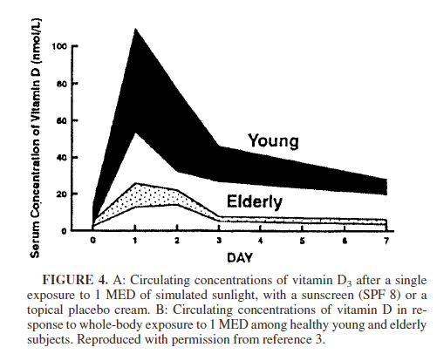
VITAMIN D & AGEING “NOT MADE FOR EACH OTHER”
Older people are prone to develop VDD because of various risk factors like decreased dietary intake, diminished sunlight exposure, reduced skin thickness, impaired intestinal absorption and impaired hydroxylation in liver and kidneys.
McKenna MJ, 1992 Differences in vitamin D status between countries in young adults and the elderly. Am J Med, 93;69–77.
Lips P: Vitamin D status and nutrition in Europe and Asia. J Steroid Biochem Mol Biol 2007, 103:620-625.
Lips P: Worldwide status of vitamin D nutrition. J Steroid Biochem Mol Biol 2010, 121:297-300.
Mithal A, Wahl DA, Bonjour JP, Burckhardt P, Dawson-Hughes B, Eisman JA, et al.; IOF Committee of Scientific Advisors (CSA) Nutrition Working Group. Global vitamin D status and determinants of hypovitaminosis D. Osteoporos Int 2009; 20:1807-20.

Slide 9
VDD – “fuel to postmenopausal health problems”
Study & year | Country | Prevalence of VDD (%)
Gaugris et al, 2005 | Eastern Asia | 71
Laktasic-Zerjavic et al, 2010 | Croatia | 92.5
De Cock et al, 2008 | France | 89.9
Holick et al, 2005 | North America | 52
Harinarayan et al, 2005 | India | 82
Menopause represents an important transition in vitamin D requirements due to the dependence of the VDR on oestrogen .
Vitamin D inadequacy is a primary concern for post-menopausal women as they are already predisposed to the osteoporosis and cardiovascular diseases due to decreased oestrogen levels.
Duque, G.; El Abdaimi, K.; Macoritto, M.; Miller, M.M.; Kremer, R. Estrogens (e2) regulate expression and response of 1,25-dihydroxyvitamin D3 receptors in bone cells: Changes with aging and hormone deprivation. Biochem. Biophys. Res. Commun. 2002, 299, 446–454.

Slide 10
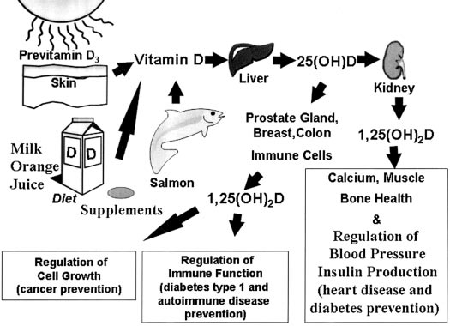
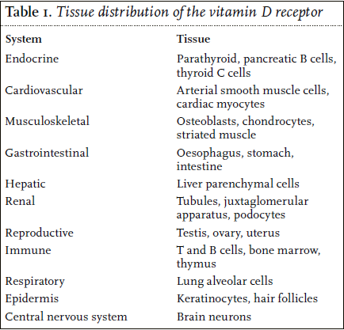
VITAMIN D RECEPTOR - UBIQUITOUS
NOVEL PLEIOTROPIC NON-SKELETAL EFFECTS

Slide 11
Vitamin D & cardiovascular diseases
An under-appreciated or over-hyped risk factor?

Slide 12
VITAMIN D & CVS HEALTH
Vitamin D deficiency seems to predispose to cardiovascular risk factors like hypertension, DM, metabolic syndrome, left ventricular hypertrophy, chronic vascular inflammation and calcification.^{1,2}
Epidemiologic studies have linked vitamin D deficiency with increased risk of major adverse CV events like CAD, MI, CHF, stroke and total mortality.^{3,4}
1. Holick MF. Vitamin D deficiency. N Engl J Med 2007;357:266–81.
2. Zittermann A. Vitamin D and disease prevention with special reference to cardiovascular disease. Prog Biophys Mol Biol 2006;92:39–48.
3. Wang TJ, Pencina MJ, Booth SL, et al. Vitamin D deficiency and risk of cardiovascular disease. Circulation 2008;117:503–11.
4. Anderson J.L., May H.T., Horne B.D.;Intermountain Heart Collaborative (IHC) Study Group Relation of vitamin D deficiency to cardiovascular risk factors, disease status, and incident events in a general healthcare population. Am J Cardiol. 106 2010:963-968.

Slide 13
ASSOCIATION BETWEEN VITAMIN D & CORONARY ARTERY DISEASE
Inverse association between serum 25(OH)D levels and risk of AMI or coronary artery stenosis, attributable to inverse relationship with MMP-9, a marker for myocardial remodeling after AMI.
Karakas, M.; Thorand, B.; Zierer, A.; Huth, C.; Meisinger, C.; Roden, M.; Rottbauer, W.; Peters, A.; Koenig, W.; Herder, C. Low levels of serum 25-hydroxyvitamin D are associated with increased risk of myocardial infarction, especially in women: Results from the MONICA/KORA Augsburg case-cohort study. J. Clin. Endocrinol. Metab. 2013, 98, 272–280.
Khalili, H.; Talasaz, A.H.; Salarifar, M. Serum vitamin D concentration status and its correlation with early biomarkers of remodeling following acute myocardial infarction. Clin. Res. Cardiol. 2012, 101, 321–327.
Scragg R, Jackson R, Holdaway IM, Lim T, Beaglehole R. Myocardial infarction is inversely associated with plasma 25-hydroxyvitamin d3 levels: A community-based study. Int J Epidemiol. 1990;19:559–563.
Lim S, Shin H, Kim MJ, Ahn HY, Kang SM, Yoon JW, Choi SH, Kim KW, Song JH, Choi SI, et al. Vitamin D inadequacy is associated with significant coronary artery stenosis in a community-based elderly cohort:the Korean Longitudinal Study on Health and Aging. J Clin Endocrinol Metab 2012;97:169–78
Those with VDD but no prior CVD had 2-fold increased risk of 1st cardiovascular event or AMI after 5-7 yrs follow up.
Giovannucci E, Liu Y, Hollis BW, Rimm EB. 25-hydroxyvitamin D and risk of myocardial infarction in men: a prospective study. Arch Intern Med Jun 9;2008 168(11):1174–80.
Wang TJ, Pencina MJ, Booth SL, Jacques PF, Ingelsson E, Lanier K, Benjamin EJ, D'Agostino RB, Wolf M, Vasan RS. Vitamin D deficiency and risk of cardiovascular disease. Circulation Jan 29;2008;117(4):503–11

Slide 14
Vitamin D levels and CVD risk – Dose-response relationship
Linear inverse relationship over the range of 25(OH)-vitamin D from 20 to 60 nmol/L, with a modest and marginally significant pooled RR of 1.03 (95% CI: 1.00-1.06) per 25 nmol/L decrement in 25(OH)D.
Wang L, Song Y, Manson JE, Pilz S, März W, Michaëlsson K, Lundqvist A, Jassal SK, Barrett-Connor E, Zhang C, Eaton CB, May HT, Anderson JL, Sesso HD. Circulating 25-hydroxy-vitamin D and risk of cardiovascular disease: a meta-analysis of prospective studies. Circ Cardiovasc Qual Outcomes. 2012 Nov;5(6):819-29.
May be nonlinear and reach a plateau between 50-75 nmol/L.
Ross AC, Manson JE, Abrams SA, Aloia JF, Brannon PM, Clinton SK, Durazo-Arvizu RA, Gallagher JC, Gallo RL, Jones G, Kovacs CS, Mayne ST, Rosen CJ, Shapses SA. The 2011 report on dietary reference intakes for calcium and vitamin d from the institute of medicine: What clinicians need to know. J Clin Endocrinol Metab. 2011; 96:53–58.
Possible U-shaped relation, with slight increase in CVD risk at both low (<50 nmol/L) and high (>125 nmol/L) levels of 25(OH)D. Risk was more apparent in hypertensive subjects.
Melamed ML, Michos ED, Post W, Astor B. 25-hydroxyvitamin d levels and the risk of mortality in the general population. Arch Intern Med. 2008; 168:1629–1637.
Wang TJ, Pencina MJ, Booth SL, Jacques PF, Ingelsson E, Lanier K, Benjamin EJ, D’Agostino RB, Wolf M, Vasan RS 2008 Vitamin D deficiency and risk of cardiovascular disease. Circulation 117:503–511

Slide 15
Vitamin D – A prognostic factor in CAD
Vitamin D levels predict risk of adverse events after AMI and cardiac surgery with 40% risk reduction for levels >7.3ng/ml.
Ng LL, Sandhu JK, Squire IB, Davies JE, Jones DJ. Vitamin D and prognosis in acute myocardial infarction. Int J Cardiol. 2013 Oct 3;168(3):2341-6.
Zittermann A, Kuhn J, Dreier J, Knabbe C, Gummert JF, Börgermann J. Vitamin D status and the risk of major adverse cardiac and cerebrovascular events in cardiac surgery. Eur. Heart J. 2013, 34, 1358–1364.
In over 3000 subjects undergoing CAG, severely deficient individuals (<10 ng/mL) had 3-5 times risk of dying from sudden cardiac death or heart failure and 50% increased risk of fatal stroke over a 7 year follow-up period.
Pilz S, März W, Wellnitz B, Seelhorst U, Fahrleitner-Pammer A, Dimai HP, Boehm BO, Dobnig H. Association of vitamin D deficiency with heart failure and sudden cardiac death in a large cross-sectional study of patients referred for coronary angiography. J Clin Endocrinol Metab Oct;2008;93(10):3927–35.
Pilz S, Dobnig H, Fischer JE, Boehm BO, März W. Low vitamin D levels predict stroke in patients referred to coronary angiography. Stroke 2008;39:2611–2613.

Slide 16
Is vitamin D deficiency an independent risk factor for CVD?
VDD is associated with cardiovascular risk factors such as hypertension, hypercholesterolemia, hypertriglyceridemia, microalbuminuria, obesity and diabetes mellitus.
Martins D, Wolf M, Pan D, Zadshir A, Tareen N, Thadhani R, Felsenfeld A, Levine B, Mehrotra R,Norris K. Prevalence of cardiovascular risk factors and the serum levels of 25-hydroxyvitamin D in the United States: data from the Third National Health and Nutrition Examination Survey. Arch Intern Med Jun 11;2007 167(11):1159–65.
Without adjustment, chance of being affected by CAD in individuals with VDD is 3.49 (1.59-7.64) times versus those with normal vitamin D. After adjustment with risk factors, i.e., BP, DM, smoking, obesity, physical activity and hypercholesterolemia, this chance becomes 5.8 times (1.77-18.94).
Siadat ZD, Kiani K, Sadeghi M, Shariat AS, Farajzadegan Z, Kheirmand M. Association of vitamin D deficiency and coronary artery disease with cardiovascular risk factors. J Res Med Sci. 2012 Nov;17(11):1052-5.

Slide 17
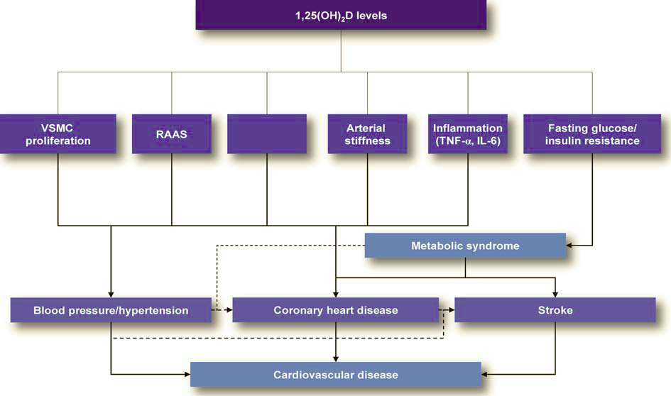
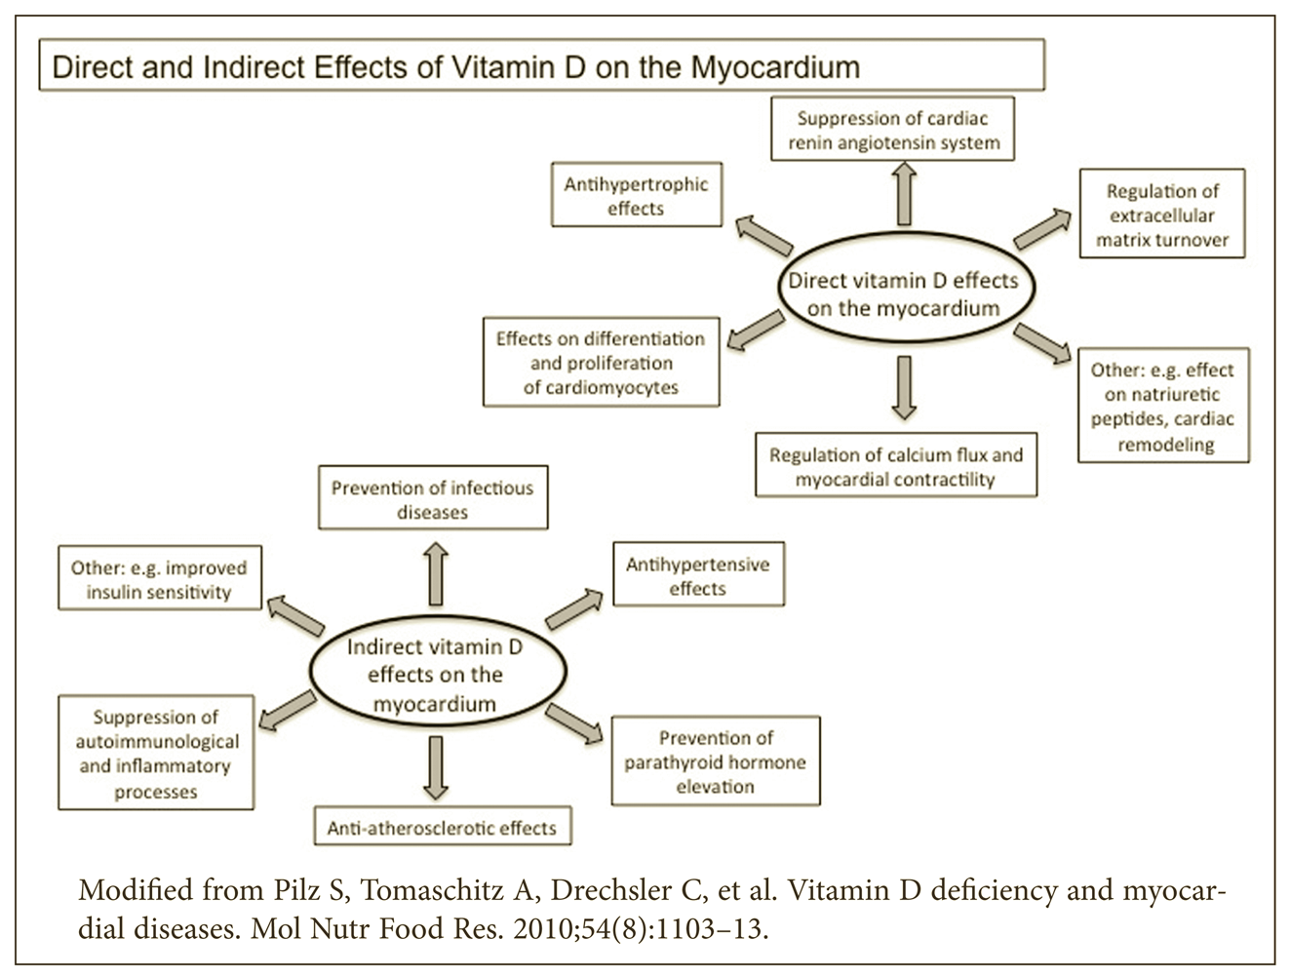
Possible cardioprotective mechanisms
NF-kβ

Slide 18
EVIDENCE FROM RCTs
RCTs have failed to prove a consistent causal relation between vitamin D repletion and reduction of CV risk factors and CVD.
Possibly due to small sample sizes or inappropriate study designs (CVD events were not primary end-points).
Most trials have shown beneficial effects of supplementation in patients with severe deficiency and these patients seem to be at the highest risk for CVD. But whether supplementation is beneficial for healthy people is still not validated.
Hsia J, Heiss G, Ren H, et al. Calcium/vitamin D supplementation and cardiovascular events. Circulation. 2007; 115(7):846–54.
Prince RL, Austin N, Devine A, Dick IM, Bruce D, Zhu K. Effects of ergocalciferol added to calcium on the risk of falls in elderly high-risk women. Arch Intern Med. 2008; 168(1):103–8.
Trivedi DP, Doll R, Khaw KT. Effect of four monthly oral vitamin D3 (cholecalciferol) supplementation on fractures and mortality in men and women living in the community: randomised double blind controlled trial. Bmj. 2003; 326(7387):469.

Slide 19
EVIDENCE FROM META-ANALYSIS
Publication | Study selection | Key findings
Parker et al, 2010 | 28 studies with 99,745 participants | Highest levels of serum 25OHD were associated with a 43% reduction in cardiometabolic disorders [OR 0.57, 95% CI 0.48-0.68].
Wang et al, 2012 | 19 independent studies with 6123 CVD cases in 65 994 participants | Pooled RR was 1.52 (95% CI: 1.30-1.77) for total CVD, 1.42 (95% CI: 1.19-1.71) for CVD mortality, 1.38 (95% CI: 1.21-1.57) for coronary heart disease, and 1.64 (95% CI: 1.27-2.10) for stroke
Pittas et al, 2010 | 13 observational studies and 18 trials | No statistically significant effect of vitamin D supplementation on cardiometabolic outcomes. Meta-analysis could not be performed due to heterogeneity of outcomes and interventions.

Slide 20
ROLE OF VITAMIN D IN CHF
Calcitriol enhances cardiac contractility by increasing Ca2+ uptake by cardiomyocytes. It also suppresses synthesis and secretion of ANP in cardiac cells.
Lower levels of 25(OH)D and higher levels of PTH have been reported in CHF patients.
Shane E, Mancini D, Aaronson K, et al. Bone mass, vitamin D deficiency, and hyperparathyroidism in congestive heart failure. Am J Med 1997;103:197–207
Kim DH, Sabour S, Sagar UN, Adams S, Whellan DJ. Prevalence of hypovitaminosis D in cardiovascular diseases (from the National Health and Nutrition Examination Survey 2001 to 2004). Am J Cardiol Dec 1;2008 102(11):1540–4.
There is an inverse nonlinear correlation of 25(OH)D and calcitriol with NT-proANP levels, a marker of severity of CHF.
25(OH)D levels above 40 ng/ml would be necessary to reduce NT-proANP levels of almost all subjects close to the normal range of 0.11 to 0.60 nmol/l.
Zittermann A, Schleithoff SS, Tenderich G, Berthold HK, Körfer R, Stehle P. Low vitamin D status: a contributing factor in the pathogenesis of congestive heart failure? J Am Coll Cardiol. 2003 Jan 1;41(1):105-12.

Slide 21
VITAMIN D & STROKE – EVIDENCE FROM OBSERVATIONAL STUDIES
Low vitamin D intake and low serum vitamin D levels are associated with increased incident stroke (especially ischemic) and stroke death.^{1,2,3}
Association was more robust for lacunar infarction. The dose –response relationship was non-linear as risk of stroke did not start decreasing until 25(OH)D levels exceeded 40 nmol/L (threshold effect).⁴
Low levels predict stroke severity and poor early functional outcomes.^{5,6}
Possible mechanisms – pro-thrombotic and inflammatory state, reduced neuroprotective factors like IGF-1, associated hypertension & diabetes
1. Pilz S, Dobnig H, Fischer JE, Wellnitz B, Seelhorst U, Boehm BO,et al: Low vitamin D levels predict stroke in patients referred to coronary angiography. Stroke 2008; 39: 2611–2613.
2. Kilkkinen A, Knekt P, Aro A, Rissanen H, Marniemi J, Heliovaara M, et al. Vitamin D status and the risk of cardiovascular disease death. Am J Epidemiol. 2009; 170:1032–1039.
3. Kojima G, Bell C, Abbott RD, Launer L, Chen R, Motonaga H, et al. Low dietary vitamin D predicts 34-year incident stroke: the Honolulu Heart Program. Stroke. 2012;43:2163–7.
4. Chowdhury R, Stevens S, Ward H, Chowdhury S, Sajjad A, Franco OH. Circulating vitamin D, calcium and risk of cerebrovascular disease: a systematic review and meta-analysis. Eur J Epidemiol. 2012;27:581–91.
5. Sun Q, Pan A, Hu FB, Manson JE, Rexrode KM. 25-Hydroxyvitamin D levels and the risk of stroke: a prospective study and meta-analysis. Stroke. 2012 Jun;43(6):1470-7.
6. Daubail B, Jacquin A, Guilland JC, Hervieu M, Osseby GV, Rouaud O, et al. Serum 25-hydroxyvitamin D predicts severity and prognosis in stroke patients. Eur J Neurol. 2013;20:57–61.

Slide 22
EVIDENCE FROM INTERVENTIONAL STUDIES
Limited and less promising data from RCTs
No significant beneficial effects of vitamin D on stroke incidence but trials were not powered or designed for evaluating this effect.
However, in stroke patients, supplementation helps to prevent falls and fractures and improves endothelial function and possibly cardiovascular risk. This can serve as a rationale for the evaluation, prevention and treatment of vitamin D deficiency in individuals with arterial hypertension and stroke.
Hsia J, Heiss G, Ren H, Allison M, Dolan NC, Greenland P, et al. Calcium/vitamin D supplementation and cardiovascular events. Circulation. 2007;115:846–54.
Sato Y, Iwamoto J, Kanoko T, Satoh K. Low-dose vitamin D prevents muscular atrophy and reduces falls and hip fractures in women after stroke: a randomized controlled trial. Cerebrovasc Dis. 2005;20:187–92.
Iwamoto J, Takeda T, Matsumoto H. Sunlight exposure is important for preventing hip fractures in patients with Alzheimer's disease, Parkinson's disease, or stroke. Acta Neurol Scand. 2012;125:279–84.
Witham MD, Dove FJ, Sugden JA, Doney AS, Struthers AD. The effect of vitamin D replacement on markers of vascular health in stroke patients - a randomised controlled trial. Nutr Metab Cardiovasc Dis. 2012;22:864–70.
Kienreich K, Grubler M, Tomaschitz A, Schmid J, Verheyen N, Rutters F, Dekker JM, Pilz S. Vitamin D, arterial hypertension & cerebrovascular disease. Indian J Med Res. 2013 Apr;137(4):669-79.

Slide 23
PUTATIVE VASCULOPROTECTIVE ACTIONS OF VITAMIN D
Improves endothelial function by reducing BP
Stimulates nitric oxide production thereby mitigating arterial stiffness
Suppresses expression of adhesion molecules on endothelial cells & activation of NF-κB
Attenuates expression of PAI-1 & TF thus inhibiting platelet aggregation and thrombogenesis
Inhibits macrophage to foam cell formation
Decreases oxidative stress
Inhibits osteoblastic gene expression and osteoblastic differentiation of VSMC thus protecting against vascular calcification
Suppresses production of proinflammatory Th-1 cytokines and stimulates anti-inflammatory Th-2 lymphocytes, leading to reduction in MMPs thereby reducing plaque production and/or instability

Slide 24
Vitamin D & vascular health -Evidence from observational studies
Inverse association of vitamin D levels and PAD^{1,2,3}
Independent association with endothelial function (brachial artery FMD), microvascular function (digital reactive hyperemia index) and arterial stiffness (carotid-femoral PWV and radial tonometry-derived central augmentation index and subendocardial viability ratio) in healthy as well as diseased individuals like diabetes, stroke^{4,5,6}
1. Melamed ML, Muntner P, Michos ED, Uribarri J, Weber C, Sharma J, Raggi P. Serum 25- hydroxyvitamin d levels and the prevalence of peripheral
arterial disease: Results from NHANES 2001 to 2004. Arterioscler Thromb Vasc Biol. 2008; 28:1179–1185.
2.Fahrleitner A, Dobnig H, Obernosterer A, Pilger E, Leb G, Weber K, Kudlacek S, Obermayer-Pietsch B. Vitamin D deficiency and secondary
hyperparathyroidism are common complications in patients with peripheral arterial disease. J Gen Intern Med. 2002;17:663–9.
3. Brewer, L.C.; Michos, E.D.; Reis, J.P. Vitamin D in atherosclerosis, vascular disease, and endothelial function. Curr. Drug Targets 2011, 12, 54–60.
4. Al Mheid I, Patel R, Murrow J, Morris A, Rahman A, Fike L, Kavtaradze N, Uphoff I, Hooper C, Tangpricha V, Alexander RW, Brigham K, Quyyumi AA.
Vitamin D status is associated with arterial stiffness and vascular dysfunction in healthy humans. J Am Coll Cardiol. 2011 Jul 5;58(2):186-92.
5. Jablonski, K.L.; Chonchol, M.; Pierce, G.L.; Walker, A.E.; Seals, D.R. 25-hydroxyvitamin D deficiency is associated with inflammation-linked vascular
endothelial dysfunction in middle-aged and older adults. Hypertension 2011, 57, 63–69.
6.Yiu, Y.F.; Chan, Y.H.; Yiu, K.H.; Siu, C.W.; Li, S.W.; Wong, L.Y.; Lee, S.W.L.; Tam, S.; Wong, E.W.K.; Cheung, B.M.Y.; et al. Vitamin D deficiency is
associated with depletion of circulating endothelial progenitor cells and endothelial dysfunction in patients with type 2 diabetes. J. Clin. Endocrinol. Metab.
2011, 96, E830–E835

Slide 25
EVDIDENCE FROM RCTs
STUDY | SUBJECTS | INTERVENTION | RESULTS
Schleithoff et al, 2006 | 93 CHF patients | 50 µg Vit D3 + 500 mg Ca daily vs placebo + 500 mg Ca daily for 9 months | Significant ↓ in PTH & ↑ in IL-10, no ↑ in TNF-α, no effect on survival
Sugden et al, 2008 | 34 type 2 DM & VDD | Single dose of oral 1,00,000 IU D2 vs placebo | 2.3% ↑ in FMD after adjusting for changes in BP
Witham et al, 2010 | 61 type 2 DM | 1 lac or 2 lac IU Vit D3 vs placebo | No ↑ in FMD but ↓ SBP at 8wks
Dong et al, 2010 | 49 normotensive Black youth | 400 IU (control group) vs 2000 IU (intervention group) Vit D daily for 16wks | Significant ↓ in carotid-femoral PWV [baseline 5.41 ± 0.73 m/sec to posttest 5.33 ± 0.79 m/sec]
Harris et al, 2011 | 57 overwt African-American adults | 60,000 IU Vit D3 monthly for 16 weeks vs placebo | ↑ FMD (1.8 ± 1.3%).
Gepner et al, 2012 | 114 PMW | 2500 IU/d Vit D3 vs placebo for 4 months | No effect on FMD, PWV or AIx
Witham et al, 2012 | 58 community-dwelling stroke patients with VDD | Single dose of oral 1,00,000 IU D2 vs placebo | ↑ FMD (6.9% vs 3.7%, adjusted P = 0.007) at 8wks but no effect on BP

Slide 26
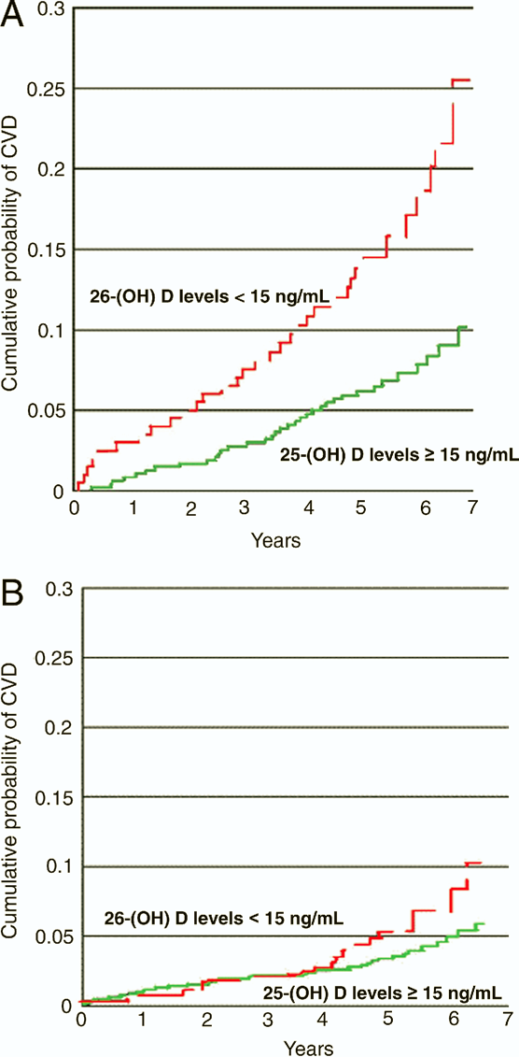
Association with HTN Evidence from case-control studies
Most case-control studies have shown an inverse association between vitamin D levels and BP.
Scragg, R.; Sowers, M.; Bell, C. Serum 25-hydroxyvitamin D, ethnicity, and blood pressure in the third national health and nutrition examination survey. Am. J. Hypertens. 2007, 20, 713–719.
Judd, S.E.; Nanes, M.S.; Ziegler, T.R.; Wilson, P.W.; Tangpricha, V. Optimal vitamin D status attenuates the age-associated increase in systolic blood pressure in white americans: Results from the third national health and nutrition examination survey. Am. J. Clin. Nutr. 2008, 87, 136–141.
Pilz, S.; Tomaschitz, A.; Ritz, E.; Pieber, T.R. Vitamin D status and arterial hypertension: A systematic review. Nat. Rev. Cardiol. 2009, 6, 621–630.
In a study of more than 1700 Framingham Offspring Study participants (mean age 59 years; 55% women; all white) , Wang et al suggested that low serum 25(OH)D levels appear to interact with pre-existing hypertension to dramatically raise risk of future cardiovascular events.
Wang, T.J.; Pencina, M.J.; Booth, S.L.; Jacques, P.F.; Ingelsson, E.; Lanier, K.; Benjamin, E.J.; D’Agostino, R.B.; Wolf, M.; Vasan, R.S. Vitamin D deficiency and risk of cardiovascular disease. Circulation 2008, 117, 503–511.

Slide 27
Evidence from prospective studies
Evidence from meta-analysis of RCTs
Evidence from RCTs
Experimental & Case-control studies
Favour hypothesis that vitamin D ameliorates high BP
Longitudinal observational studies
Mixed results
RCTs
Inconclusive especially among PMW
Effects more prominent in hypertensive patients with severe VDD
Meta-analysis of RCTs
Urgent need
Larger effect on SBP than DBP
Larger, adequately powered, well-designed RCTs using higher doses in hypertensive patients with severe VDD
Study | Participants | Follow up | Results
Forman et al, 2007 | 613 men from Health Professionals’ Follow-Up Study and 1198 women from Nurses’ Health Study | 4 yrs | RR of 2.67(95% CI 1.05 – 6.79) for women and 6.13 (95% CI : 1.00 to 37.8) for men with 25(OH)D levels <15ng/ml compared to those with ≥30 ng/ml
Margolis et al, 2012 | 4863 PMW recruited in WHI trial | 7 yrs | No association with vit D levels & change in BP but 50% ↑ risk in lowest quartile (<14 ng/mL) vs 3rd quartile (19- 26 ng/ml)
Jorde et al, 2010 | 2385 normotensive subjects | 14 yrs | 4 mm Hg mean ↑ in SBP in lowest quartile (<16 ng/mL) vs highest quartile (>25ng/mL; P for trend <0.05). The odds of incident hypertension did not differ(OR 1.15, 95% CI 0.79 – 1.68)
Pittas et al, 2010 | Meta-analysis of 3 cohorts | 7-8 yrs | RR 1.8, 95% CI :1.3-2.4 in lowest (<37–51 nmol/L) vs highest (>75–81 nmol/L)
Kunutsor et al, 2013 | Meta-analysis of 11 prospective studies with 283,537 participants and 55,816 cases of HTN | Mean 9 yrs | Pooled RR 0.70 (95% CI 0.57–0.86) Risk ↓ by 12% per 10 ng/mL increment of 25(OH)D
Study, year | Type of intervention | Results
Pfeifer et al, 2001 | 1200 mg Ca or 1200 mg Ca + 800 IU vit D daily in 143 women >70 yrs | ~7mmHg ↓ in SBP in Ca + Vit D group, no difference in DBP
Sugden et al, 2008 | Single dose of 1,00,000 IU D2 vs placebo to 34 type 2 diabetics with VDD (<50nmol/L) | ~14mmHg ↓ in SBP
Margolis et al, 2008 | 400 IU vit D + 1000 mg Ca vs placebo in 36,282 postmenopausal women (WHI CaD trial) | No difference in change in SBP, DBP or frequency of incident HTN
Jorde et al, 2010 | Weekly 30,000 or 40,000 IU D3 vs placebo for 1 yr in 438 obese/overweight | No effect on SBP or DBP
Larsen et al, 2012 | 3,000 IU D3 daily vs placebo in 130 hypertensive subjects | Non-significant ↓ in BP overall but significant ↓ in SBP & DBP (4 & 3 mmHg respectively) in VDD
Wood et al, 2012 | 400 or1000 IU D3 daily vs placebo for 1 yr in 305 healthy PMW aged 60-70 yrs | No effect on any CVD risk markers like BP, lipids or endothelial function
Forman et al, 2013 | 1000, 2000 or 3000 IU daily Vit D vs placebo for 3 months in 283 subjects | ↓ of 0.2 mmHg of SBP for each ↑ of 1 ng/mL of vit D
Study, year | Studies analyzed | Results
Witham et al, 2009 | 11 RCTs of supplemental or activated vit D or UVB radiation for effect on HTN | Non-significant reduction of −3.5 mm Hg (95% CI: −8.0 – 0.7 mmHg) in SBP with significant reduction in DBP of −3.1 mm Hg (95% CI: −5.5 – −0.6) in uncontrolled hypertensive but no effect in normotensive. Supplemental vit D had larger effect on SBP than activated vit D (-6.2 mmHg, 95% CI -12.32 to -0.04, vs. +0.7 mmHg, 95% CI -4.8 to 6.2)
Wu et al, 2010 | 4 double-blind RCTs of oral Vit D for effect on HTN | Reduction in SBP by 2.44 mm Hg (95% CI: −4.86 – −0.02), but no effect on DBP (−0.02 mm Hg [95% CI: −4.04 – 4.01]
Elamin et al, 2011 | 51 RCTs for effect on various CVD outcomes (MI, stroke, CV death) | No change in weighted mean of either SBP (−0.06 [95% CI: −1.98 – 1.87]; P=0.95) or DBP (−0.34 [95% CI: −1.03 – 0.35]; P=0.33).
Pittas et al, 2010 | 10 RCTs for effect on cardiometabolic outcomes | Only non-significantly reduction in SBP by 2 mmHg (WMD−1.9; 95% CI −4.2, 0.4 mmHg) and no reduction in DBP (WMD −0.1; 95% CI −0.7, 0.5 mm Hg)
Liu ZM, Woo J, Wu SH, Ho SC. The Role of Vitamin D in Blood Pressure, Endothelial and Renal Function in Postmenopausal Women. Nutrients. Jul 2013; 5(7): 2590–2610.
Tamez H, Kalim S, Thadhani RI. Does vitamin D modulate blood pressure? Curr Opin Nephrol Hypertens. 2013 Mar;22(2):204-9.

Slide 28
ADIPOSE TISSUE – AN IRREVERSIBLE SINK FOR VITAMIN D!
Inverse association of serum 2(OH)D levels with BMI and waist circumference, after adjusting for age & sex.¹⁻⁶
After equivalent exposure to UVB radiation or a bolus dose of vitamin D2, obese individuals showed 50% lower blood levels of vitamins D3 and D2 compared with nonobese individuals, probably because of sequestering of 25(OH)D in adipose tissue.^{7,8}
Obesity is a significant confounder in observational studies.
Gallagher JC, Sai A, Templin T 2nd, Smith L. Dose response to vitamin D supplementation in postmenopausal women: a randomized trial. Ann Intern Med. 2012 Mar 20;156(6):425-37.
Moy FM, Bulgiba A. High prevalence of vitamin D insufficiency and its association with obesity and metabolic syndrome among Malay adults in Kuala Lumpur, Malaysia. BMC Public Health 2011, 11:735.
McGill AT, Stewart JM, Lithander FE, Strik CM, Poppitt SD: Relationships of low serum vitamin D3 with anthropometry and markers of the metabolic syndrome and diabetes in overweight and obesity. Nutr J 2008, 7:4.
Rueda S, Fernandez-Fernandez C, Romero F, Martinez de Osaba J, Vidal J: Vitamin D, PTH, and the metabolic syndrome in severely obese subjects. Obes Surg 2008, 18:151-154.
McCarty MF: Poor vitamin D status may contribute to high risk for insulin resistance, obesity, and cardiovascular disease in Asian Indians. Med Hypotheses 2009, 72:647-651.
Konradsen S, Ag H, Lindberg F, Hexeberg S, Jorde R: Serum 1,25-dihydroxy vitamin D is inversely associated with body mass index. Eur J Nutr 2008, 47:87–91.
Yin X, Sun Q, Zhang X, Lu Y, Sun C, Cui Y, Wang S. Serum 25(OH)D is inversely associated with metabolic syndrome risk profile among urban middle-aged Chinese population. Nutr J. 2012 Sep 9;11:68.
Blum M, Dolnikowski G, Seyoum E, et al. Vitamin D(3) in fat tissue. Endocrine 2008;33:90–4.

Slide 29
Obesity leads to lower vitamin D levels and not the other way around!
Each unit ↑ of BMI was associated with a 1.15% ↓ of 25(OH)D after adjustments for typical confounders. Thus obesity can be regarded as a causal risk factor for VDD, accounting for approximately 1/3rd cases..
Vimaleswaran KS et al. Causal relationship between obesity and vitamin D status: Bi-directional Mendelian randomization analysis of multiple cohorts. PLoS Med. 2013;10(2):e1001383.
Reasons for low serum vitamin D levels in obesity:-
Sequestration of fat soluble Vit D in adipose tissue, which is in abundance in metabolic syndrome making stores less bioavailable^{1,2}
PTH (↑ in Vit D deficiency) ↑ cytosolic Ca²⁺ level in isolated adipocytes, thus impeding catecholamine-induced lipolysis and promoting expression of fatty acid synthetase.³
1. Wortsman, et al. Decreased bioavailability of vitamin D in obesity. Am. J. Clin. Nutr. 2000, 72, 690–693.
2. Earthman et al. The link between obesity and low 25-hydroxyvitamin D concentrations: Considerations and implications. Int. J. Obes. (Lond.) 2012, 36, 387–396.
3. McCarty MF, Thomas CA: PTH excess may promote weight gain by impeding catecholamine-induced lipolysis-implications for the impact of calcium, vitamin D, and alcohol on body weight. Med Hypotheses 2003,61:535–542.

Slide 30
Association with diabetes – protective mechanisms
TYPE 2 DM
β cell function - expression of VDR & 1α hydroxylase on pancreatic β cells and Ca²⁺ mediated insulin synthesis and secretion
Insulin sensitivity - stimulation of osteocalcin, expression of insulin receptors and calcium homeostasis in insulin-responsive tissues
TYPE 1 DM
Modulates expression and activity of macrophages and lymphocytes
Down-regulates pro-inflammatory cytokines thereby protecting against cytokine-induced β cell destruction and death
Vit D & PTH regulate adipogenesis

Slide 31
Evidence from observational studies
Cross-sectional studies – lower 25(OH)D levels in prevalent type 2 DM and IGT than NGT
Need AG, O’Loughlin PD, Horowitz M,Nordin BE. Relationship between fasting serum glucose, age, body mass index and serum 25 hydroxyvitamin D in postmenopausalwomen. Clin Endocrinol (Oxf) 2005;62:738–741.
Scragg R, Sowers M, Bell C; Third National Health and Nutrition Examination Survey. Serum 25-hydroxyvitamin D, diabetes, and ethnicity in the Third National Health and Nutrition Examination Survey. Diabetes Care 2004;27:2813–2818.
Prospective studies – Inverse association between baseline 25(OH)D levels and incident DM, independent of other risk factors like HTN, obesity, dyslipidemia, family history
Lim S, Kim MJ, Choi SH, Shin CS, Park KS, Jang HC, Billings LK, Meigs JB. Association of vitamin D deficiency with incidence of type 2 diabetes in high-risk Asian subjects. Am J Clin Nutr. 2013 Mar;97(3):524-30.
Forouhi NG, Ye Z, Rickard AP, Khaw KT, Luben R, Langenberg C, Wareham NJ. Circulating 25-hydroxyvitamin D concentration and the risk of type 2 diabetes: results from the European Prospective Investigation into Cancer (EPIC)-Norfolk cohort and updated metaanalysis of prospective studies. Diabetologia 2012;55:2173–82.
Liu E, Meigs JB, Pittas AG, Economos CD, McKeown NM, Booth SL, Jacques PF. Predicted 25-hydroxyvitamin D score and incident type 2 diabetes in the Framingham Offspring Study. Am J Clin Nutr 2010;91:1627–33.
Knekt P, Laaksonen M, Mattila C, Harkanen T, Marniemi J, Heliovaara M, Rissanen H, Montonen J, Reunanen A. Serum vitamin D and subsequent occurrence of type 2 diabetes. Epidemiology 2008;19:666–71.
Gagnon C, Lu ZX, Magliano DJ, Dunstan DW, Shaw JE, Zimmet PZ, Sikaris K, Grantham N, Ebeling PR, Daly RM. Serum 25-hydroxyvitamin D, calcium intake, and risk of type 2 diabetes after 5 years: results from a national, population-based prospective study (the Australian Diabetes, Obesity and Lifestyle study). Diabetes Care 2011;34:1133–8.

Slide 32
Increasing 25(OH) D from 10 to 30 ng/mL can improve insulin sensitivity by 60%.
20-90% decreased risk of incident diabetes in various prospective studies depending upon vitamin D intake and serum 25(OH)D levels.
In diabetics, low levels predict severity, disease progression, cardiovascular risk and all-cause mortality
Anderson JL, May HT, Horne BD, Bair TL, Hall NL, Carlquist JF, et al. Relation of vitamin D deficiency to cardiovascular risk factors, disease status, and incident events in a general healthcare population. Am J Cardiol. 2010; 106:963–968.
Knekt P, Laaksonen M, Mattila C, Harkanen T, Marniemi J, Heliovaara M, et al. Serum vitamin D and subsequent occurrence of type 2 diabetes. Epidemiology. 2008; 19:666–671.
Kirii K, Mizoue T, Iso H, Takahashi Y, Kato M, Inoue M, et al. Calcium, vitamin D and dairy intake in relation to type 2 diabetes risk in a Japanese cohort. Diabetologia. 2009; 52:2542–2550.
Liu E, Meigs JB, Pittas AG, Economos CD, McKeown NM, Booth SL, et al. Predicted 25-hydroxyvitamin D score and incident type 2 diabetes in the Framingham Offspring Study. Am J Clin Nutr. 2010; 91:1627–1633.
Liu S, Song Y, Ford ES, Manson JE, Buring JE, Ridker PM. Dietary calcium, vitamin, D and the prevalence of metabolic syndrome in middle-aged and older US women. Diabetes Care. 2005;28:2926–2932.
Pittas AG, Dawson-Hughes B, Li T, Van Dam RM, Willett WC, Manson JE, et al. Vitamin D and calcium intake in relation to type 2 diabetes in women. Diabetes Care. 2006; 29:650–656.
Braun TR, Been LF, Blackett PR, Sanghera DK (2012) Vitamin D Deficiency and Cardio-Metabolic Risk in a North Indian Community with Highly Prevalent Type 2 Diabetes. J Diabetes Metab 3: 213
Joergensen C, Hovind P, Schmedes A, Parving HH, Rossing P. Vitamin d levels, microvascular complications, and mortality in type 1 diabetes. Diabetes Care. May 2011;34(5):1081-5.

Slide 33
EVIDENCE FROM RCTs
No effect on incidence of type 2 DM in those with normal glucose tolerance at baseline or on measures of glycemia (fasting plasma glucose or HbA1c) and insulin resistance (HOMA-IR) in both NGT & type 2 DM
May attenuate rise in fasting glucose that occurs with time in those with IFG
Avenell A, Cook JA, MacLennan GS, McPherson GC. Vitamin D supplementation and type 2 diabetes: a substudy of a randomised placebo-controlled trial in older people (RECORD trial,ISRCTN 51647438). Age Ageing. 2009; 2009; 38:606–609.
de Boer IH, Tinker LF, Connelly S, Curb JD, Howard BV, Kestenbaum B, et al. Calcium plus vitamin D supplementation and the risk of incident diabetes in the Women’s Health Initiative. Diabetes Care. 2008; 2008; 31:701–707.
Hsia J, Heiss G, Ren H, Allison M, Dolan NC, Greenland P, et al. Calcium/vitamin D supplementation
and cardiovascular events. Circulation. 2007; 2007; 115:846–854.
Jorde R, Sneve M, Torjesen P, Figenschau Y. No improvement in cardiovascular risk factors in overweight and obese subjects after supplementation with vitamin D3 for 1 year. J Intern Med.2010a; 267:462–472.
Pittas AG, Harris SS, Stark PC, Dawson-Hughes B. The effects of calcium and vitamin D supplementation on blood glucose and markers of inflammation in nondiabetic adults. Diabetes Care. 2007a; 30:980–986.
von Hurst PR, Stonehouse W, Coad J. Vitamin D supplementation reduces insulin resistance in South Asian women living in New Zealand who are insulin resistant and vitamin D deficient – a randomised, placebo-controlled trial. Br J Nutr. 2010; 103:549–555.
Jorde R, Figenschau Y. Supplementation with cholecalciferol does not improve glycaemic control in diabetic subjects with normal serum 25-hydroxyvitamin D levels. Eur J Nutr. 2009; 2009; 48:349–354.
Sugden JA, Davies JI, Witham MD, Morris AD, Struthers AD. Vitamin D improves endothelial function in patients with Type 2 diabetes mellitus and low vitamin D levels. Diabet Med. 2008;25:320–325.
Witham MD, Dove FJ, Dryburgh M, Sugden JA, Morris AD, Struthers AD. The effect of different doses of vitamin D(3) on markers of vascular health in patients with type 2 diabetes: a randomised controlled trial. Diabetologia. 2010; 53:2112–2119.

Slide 34
EVIDENCE FROM META-ANALYSIS
STUDY, YEAR | STUDIES INCLUDED | RESULTS
Mitri et al, 2011 | 8 cohort studies & 11 RCTs | 13% decreased risk with Vit D intake >500 IU/d vs 200 IU/d and 43% decreased risk with serum 25(OH)D > 25ng/ml vs <14ng/ml Beneficial effects of supplementation in those with baseline IGT or IR vs NGT
Song et al, 2013 | 21 prospective studies involving 76,220 participants and 4,996 incident type 2 DM | Each 10 nmol/L increment in 25(OH)D levels was associated with 4% lower risk of type 2 diabetes. RR was 0.96 (95% CI 0.94–0.97) per 10 nmol/L increment in 25(OH)D. A significantly lower risk of type 2 diabetes became evident when 25(OH)D approximated 50 nmol/L.
Biological plausibility exists but currently available data insufficient to recommend supplementation for prevention or treatment of DM

Slide 35
DYSLIPIDEMIA & HYPOVITAMINOSIS D
Cross-sectional analysis have linked VDD with dyslipidemia.¹⁻⁵
Biological mechanisms involved :-
Higher serum 25(OH)D levels increase intestinal Ca²⁺ absorption, which may bind to fatty and bile acids and form insoluble lipid- Ca²⁺ complexes, thereby inhibiting absorption of cholesterol and increasing fecal excretion.
Reductions in hepatic TGs formation or secretion in response to increased hepatocellular Ca²⁺ amounts.
SHPT leads to decreased peripheral removal of triglycerides.
Vit D may have an effect both on insulin secretion and insulin sensitivity and thereby indirectly influence lipid metabolism
1. Martins D, Wolf M, Pan D, Zadshir A, Tareen N, Thadhani R, Felsenfeld A, Levine B, Mehrotra R, Norris K. Prevalence of cardiovascular risk factors and the serum levels of 25-hydroxyvitamin D in the United States: data from the Third National Health and Nutrition Examination Survey.Arch Intern Med. 2007; 167:1159–1165
2. Cheng S, et al. Adiposity, cardiometabolic risk, and vitamin D status: the Framingham Heart Study. Diabetes. 2010; 59:242–248.
3.Jorde R, Figenschau Y, Hutchinson M, Emaus N, Grimnes G. High serum 25-hydroxyvitamin D concentrations are associated with a favorable serum lipid profile. Eur J Clin Nutr. 2010; 64:1457–1464.
4. Yin X, Sun Q, Zhang X, Lu Y, Sun C, Cui Y, Wang S. Serum 25(OH)D is inversely associated with metabolic syndrome risk profile among urban middle-aged Chinese population. Nutr J. 2012 Sep 9;11:68.
5. Jorde R, Grimnes G. Vitamin D and metabolic health with special reference to the effect of vitamin D on serum lipids. Prog. Lipid Res. 2011, 50, 303–312.

Slide 36
Vitamin D deficiency – a surrogate marker or causal factor?
Longitudinal studies and clinical trials have produced inconsistent results and conflicting evidence. Most have reported no improvement in lipid profile. Reasons may be small sample size, suboptimal dose, confounding by concurrent Ca2+ supplementation and study design not targeting VDD specifically.
Ponda MP, Huang X, Odeh MA, Breslow JL, Kaufman HW. Vitamin D may not improve lipid levels: A serial clinical laboratory data study. Circulation 2012, 126, 270–277.
Ponda, M.P.; Dowd, K.; Finkielstein, D.; Holt, P.R.; Breslow, J.L. The short-term effects of vitamin D repletion on cholesterol: A randomized, placebo-controlled trial. Arterioscler. Thromb. Vasc. Biol. 2012, 32, 2510–2515
Heikkinen AM, Tuppurainen MT, Niskanen L, Komulainen M, Penttila I, Saarikoski S. Long-term vitamin D3 supplementation may have adverse effects on serum lipids during postmenopausal hormone replacement therapy. Eur J Endocrinol. 1997; 137:495–502. [PubMed: 9405029]
Rajpathak SN, Xue X, Wassertheil-Smoller S, Van Horn L, Robinson JG, Liu S, Allison M, Martin LW, Ho GY, Rohan TE. Effect of 5 y of calcium plus vitamin D supplementation on change in circulating lipids: results from the Women's Health Initiative. Am J Clin Nutr. 2010; 91:894–899.
Gannage-Yared MH, Azoury M, Mansour I, Baddoura R, Halaby G, Naaman R. Effects of a shortterm calcium and vitamin D treatment on serum cytokines, bone markers, insulin and lipid concentrations in healthy post-menopausal women. J Endocrinol Invest. 2003; 26:748–753.
Maki KC, Rubin MR, Wong LG, McManus JF, Jensen CD, Lawless A. Effects of vitamin D supplementation on 25-hydroxyvitamin D, high-density lipoprotein cholesterol, and other cardiovascular disease risk markers in subjects with elevated waist circumference. Int J Food Sci Nutr. 2011; 62:318–327.

Slide 37
Association with metabolic syndrome
Altered vitamin D homeostasis is associated with 3 times increased risk of metabolic syndrome. While studies have shown a significant inverse association between serum 25(OH) D concentrations and MetS as a whole¹⁻⁷, most, but not all^{6,7}, demonstrate association with its components. Association with glucose indices and lipid profile remain significant after adjusting for BMI.
1.Ford ES, Ajani UA, McGuire LC, Liu S. Concentrations of serum vitamin D and the metabolic syndrome among U.S. adults. Diabetes Care. 2005;28:1228–30.
2.Reis JP, von Muhlen D, Miller ER., 3rd Relation of 25-hydroxyvitamin D and parathyroid hormone levels with metabolic syndrome among US adults. Eur J Endocrinol. 2008;159:41–8.
3.Lee DM, Rutter MK, O'Neill TW, et al. Vitamin D, parathyroid hormone and the metabolic syndrome in middle-aged and older European men. Eur J Endocrinol. 2009;161:947–54.
4. Yin X, Sun Q, Zhang X, Lu Y, Sun C, Cui Y, Wang S. Serum 25(OH)D is inversely associated with metabolic syndrome risk profile among urban middle-aged Chinese population. Nutr J. 2012 Sep 9;11:68.
5. Lu L, Yu Z, Pan A, Hu FB, Franco OH, Li H, Li X, Yang X, Chen Y, Lin X: Plasma 25-hydroxyvitamin D concentration and metabolic syndrome among middle-aged and elderly Chinese individuals. Diabetes Care 2009, 32:1278–1283.
6. Makariou S, Liberopoulos E, Florentin M, Lagos K, Gazi I, Challa A, Elisaf M. The relationship of vitamin D with non-traditional risk factors for cardiovascular disease in subjects with metabolic syndrome. Arch Med Sci. 2012 Jul 4;8(3):437-43.
7. Moy FM, Bulgiba A. High prevalence of vitamin D insufficiency and its association with obesity and metabolic syndrome among Malay adults in Kuala Lumpur, Malaysia. BMC Public Health 2011, 11:735.

Slide 38
SHPT & VDD – Partners in CVS assault!
SHPT, a hallmark of vitamin D deficiency, is associated with increase in arterial pressure and myocardial contractility, which can lead to apoptosis, fibrosis, vascular smooth muscle cell hypertrophy as well as LVH.^{1,2}
Vitamin D deficiency and increased PTH also predisposes to calcification of heart valves, mitral annulus and myocardium , especially in moderate and severe CKD patients.³
PTH levels predict CV risk in patients with ESRD (doubling of CV risk when levels ≥250 pg/ml )⁴ as well as survival in general elderly population (2-fold increase in mortality).⁵
1. Ogard CG, Engelmann MD, Kistorp C, Nielsen SL, Vestergaard H. Increased plasma N-terminal pro-B-type natriuretic peptide and markers of inflammation related to atherosclerosis in patients with primary hyperparathyroidism. Clin Endocrinol (Oxford). 2005;63:493-8.
2.Snijder MB, Lips P, Seidell JC, Visser M, Deeg DJH, Dekker JM, van Dam RM. Vitamin D status and parathyroid hormone levels in relation to blood pressure: A population-based study in older men and women. J. Intern. Med. 2007, 261, 558–565.
3.Andersson P, Rydberg E, Willenheimer R. Primary hyperparathyroidism and heart disease—a review. Eur Heart J. 2004;25:1776-1787.
4.Soubassi LP, Chiras TC, Papadakis ED. Incidence and risk factors of coronary heart disease in elderly patients on chronic hemodialysis. Int Urol Nephrol. 2006;38:795-800.
5. Bjorkman MP, Sorva AJ, Tilvis RS. Elevated serum parathyroid hormone predicts impaired survival prognosis in a general aged population. Eur J Endocrinol. 2008;158:749-753.

Slide 39
ASSOCIATION WITH MORTALITY
VDD is an independent predictor of all-cause and CV mortality both in general population and CKD patients, accounting for 9.4% & 12.8% of all deaths in Europe and USA respectively. ^{1,2,3,4}
Increased in-hospital mortality in patients admitted for ACS and with severe VDD (< 10 ng/mL).⁵
In meta-analyses of prospective studies, individuals in the top vs. bottom quarter of 25(OH)D levels had 21% (95% CI: 13–28%) lower vascular and 28% (95% CI:24–32%) lower all-cause mortality.⁶
VDRA therapy reduce CVD mortality in ESRD patients, probably by improving LVDF and LVH and by ameliorating arterial medial calcification.⁷
1. Wang TJ et al. Vitamin D deficiency and risk of cardiovascular disease. Circulation 117: 503–511, 2008
2. Dobnig H et al. Independent association of low serum 25-hydroxyvitamin d and 1,25-dihydroxyvitamin d levels with all-cause and cardiovascular mortality. Arch Intern Med 168: 1340–1349, 2008.
3. Pilz, S et al. Vitamin D status and mortality risk in CKD: A meta-analysis of prospective studies. Am. J. Kidney Dis. 2011, 58, 374–382.
4.Chowdhury R et al. Vitamin D and risk of cause specific death: systematic review and meta-analysis of observational cohort and randomised intervention studies BMJ 2014; 348:g1903
5. Correia LC et al. Relation of Severe Deficiency of Vitamin D to Cardiovascular Mortality During Acute Coronary Syndromes. Am J Cardiol. Nov 20 2012;111(3)324-7.
6. Tomson J, et al. Vitamin D and risk of death from vascular and non-vascular causes in the Whitehall study and meta-analyses of 12,000 deaths. Eur Heart J. 2013 May;34(18):1365-74.
7. Kovesdy C.P et al. Association of activated vitamin D treatment and mortality in chronic kidney disease. Arch Intern Med. 168 2008:397-403.

Slide 40
LOW VITAMIN D & CVD MORTALITY
ROLE OF SUPPLEMENTATION ON CVD RISK
Study | Study design | Key findings
Hisa et al, 2007 | WHI CaD double-blinded placebo-controlled RCT in 36,282 PMW | No reduction in incidence of CAD or stroke after 7 yrs follow up
Wang et al, 2010 | Systematic review of 17 prospective studies and RCTs (general population & CKD patients) | Moderate to high doses of vit D (1000 IU/d) had a trend of reducing CVD risk [pooled RR = 0.90 (95% CI, 0.77 to 1.05)] while calcium supplements seemed to have minimal effects.
Elamin et al, 2011 | Systematic review and meta-analysis of 51 trials | Non-significant and potentially trivial reduction in mortality (RR = 0.96; 95% CI, 0.93–1.00; P = 0.08; I 2 = 0%), AMI (RR = 1.02; 95% CI, 0.93–1.13; P = 0.64; I 2 = 0%) and stroke (RR = 1.05; 95% CI, 0.88–1.25; P = 0.59; I 2 = 15%), lipid profile, glucose or BP.
Wood et al, 2012 | RCT in 305 healthy PMW | No effect on any CVD risk markers like BP, lipids or endothelial function
Prentice et al, 2013 | WHI CaD RCT & WHI OS | No effects on MI, CHD, total heart disease, stroke, total mortality
Duranton et al, 2013 | Meta-analysis of 14 observational studies of 194,932 CKD patients | Reduced risk of CVD death with any VDRA (RR 0.63, 95% CI 0.44-0.92), more marked in those with high PTH
STUDY | STUDY DESIGN | RESULTS
LaCroix et al, 2009 | Double blinded, placebo-controlled RCT of 36,282 postmenopausal women aged 51–82 years in US (WHI CaD trial) | HR 0.92 (95% CI : 0.77–1.10) for CVD death, HR1.01 (95% CI : 0.79–1.29) for CHD death HR 0.89 (95% CI : 0.62–1.29) for stroke death
Semba et al, 2010 | Population based cohort of 1006 adults ≥ 65 yrs | Hazard ratio 2.64 (95% C.I.: 1.14-4.79)
Eaton et al, 2011 | 10ys follow-up sub-study of 2429 postmenopausal women aged 50-79 yrs within the WHI trial | Hazard ratio1.27 (95% CI: 0.81-1.99)
Schöttker et al, 2013 | German population-based cohort (n = 9578) aged 50–74 yrs | Hazard ratio 1.39 (95% CI: 1.02-1.89)
Schöttker et al, 2014 | Meta-analysis of 8 prospective cohort studies of US & Europe with 26, 018 men and women aged 50-79 yrs | Pooled risk ratio 1.41 (95% CI :1.18 to 1.68)
Wang et al, 2012 | Meta-analysis of 19 studies with 6123 CVD cases in 65,994 subjects | Pooled risk ratio 1.42 (95% CI:1.19 to 1.71)
Chowdhury et al, 2014 | Meta-analysis of 73 cohort studies and 22 RCTs | Pooled risk ratio 1.35 (95% CI :1.13 to 1.61)
Nonlinear inverse association with increasing
risk of mortality at levels <75 nmol/L

Slide 41
OUR EXPERIENCE
Interim analysis of 50 postmenopausal women in an ongoing observational study with median serum 25(OH) levels of 22.3ng/ml
44% (n=22) had vitamin D deficiency (<20ng/ml).
52% (n=26) had metabolic syndrome as per modified ATP III criteria for Asians.
No correlation between serum 25(OH)D levels and components of metabolic syndrome.
No difference in serum 25(OH)D levels or proportion of vitamin D deficient women in those with and without metabolic syndrome.

Slide 42
Correlation of serum 25(OH)D with various parameters
Parameters | Spearman’s correlation coefficient | P Value
Age(yrs) | - 0.04 | 0.78
Height(m) | 0.08 | 0.57
Weight (kg) | - 0.005 | 0.97
WC | 0.09 | 0.52
BMI(kg/m²) | 0.01 | 0.95
SBP ( mm Hg) | -0.06 | 0.66
DBP ( mm Hg) | - 0.21 | 0.14
Post-menopausal status (yrs) | 0.06 | 0.68
Total Cholesterol (mg %) | -0.03 | 0.85
Triglyceride (mg %) | -0.08 | 0.63
HDL Cholesterol (mg %) | - 0.11 | 0.51
LDL Cholesterol (mg %) | 0.05 | 0.78
VLDL Cholesterol (mg %) | -0.07 | 0.72
FBS (mg %) | 0.14 | 0.37
Metabolic Syndrome | -0.04 | 0.78
Parameters | Metabolic Syndrome (n=26) | Non-Metabolic syndrome (n=24) | P Value
Serum 25(OH) D (ng/ml) [median & IQR] | 22.30 (16.04) | 22.19 (17.50) | 0.78
Vitamin D deficiency | 11 (42%) | 11 (46%) | 0.80

Slide 43
TAKE HOME MESSAGE
Hypovitaminosis – a global pandemic & an independent cardiovascular risk factor
Vitamin D supplementation – safe, easy, inexpensive
Optimal levels not adequately established
Evidence falls short for recommending supplementation for CVD prevention
Routine screening not recommended
Coming Soon….
EVITA Trial
ViDA Trial
VITAL Trial
“The great tragedy of science is the slaying of a beautiful hypothesis by an ugly fact.”
Will the hype stand the test of time and
the rigors of RCTs??

