Slide 1
Animal tissue-specific biomolecules influence on rats with cyclophosphamide-induced immunosuppression
Natural immunostimulators obtained over Sus scrofa tissue extraction with the use of water with modified isotope composition (RSF grant No. 15-16-00008)
Stepan S. Dzhimak, PhD
Ekaterina R. Vasilevskaya

Slide 2
RAW MATERIALS CHOICE
BONE MARROW (hematopoietic stem cell)
Predecessor of the myeloid series
Predecessor
B-lymphocytes
(immune memory)
B-lymphocytes maturation
Predecessor
T-lymphocytes
(antigen-specific)
THYMUS
Monocyte
Macrophage
Neutrophil
Eosinophils
Basophil
Mast cell
Mature B - and T-lymphocytes circulation
(CD20/CD14/IgM/IgG)
Т-cells differentiation
(CD4/CD3/
CD8/TcR)
Migration into blood and lymph
SPLEEN
cell-mediated immunity (C):
Т-helpers(Th); Т-killers(Тс); Т-suppressors (Ts);
humoral immunity (H): Ig, lymph nodes
Main Sus Scrofa immune organs – spleen, thymus and lymph nodes as potential tissues containing compounds with immunnoregulatory properties
Notes:
As raw materials were chosen main immune organs of sus scrofa – spleen, thymus and lymph nodes as potential tissues contained proteins with immunnoregulating properties

Slide 3
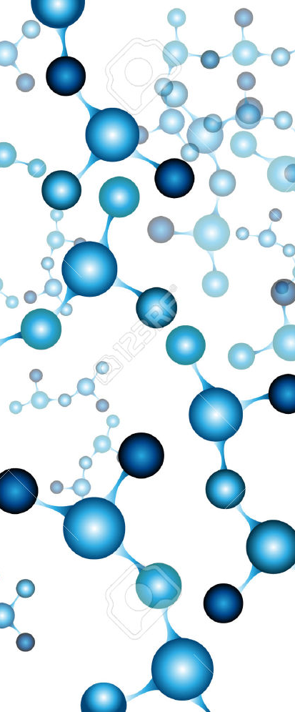
The aim of the study was to investigate water with modified isotopic D/H composition effect on immunological activity of protein-peptide compounds extracted from Sus scrofa immune organs.
Research tasks:
Research WMIC influence on the protein extractability, peptide and protein profiles;
Research WMIC complex extracts and its fractions influence in vivo
WMIC – deuterium depleted water with deuterium concentration 40 ppm
DW – standard distilled water with deuterium concentration 140 ppm
Notes:
WMIC – deuterium depleated water with deuterium concentration 40 ppm
DW – standart distilled water with deuterium concentration 140 ppm

Slide 4
EXTRACTION ALGORITHM
Grinding
Knives with ceramic coating
Extraction
4°С, 0,9 % solution NaCl - WMIC, 4 hours
4°С, 0,9 % solution NaCl - DW, 4 hours
Centrifugation
3500 Rev/min, 8 min,
Plastic tubes
Ultrafiltration
Lyophilic drying
Pressure 2.5 bar
Polyethersulfone membranes with plastic fittings and tanks
Glassware
Pressure 3,3 Pa, Т = (-41±1°С)
Notes:
Proteins and peptides extraction algorithm included

Slide 5
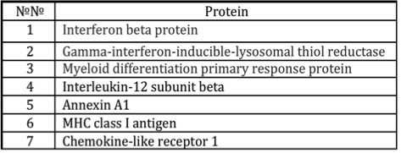
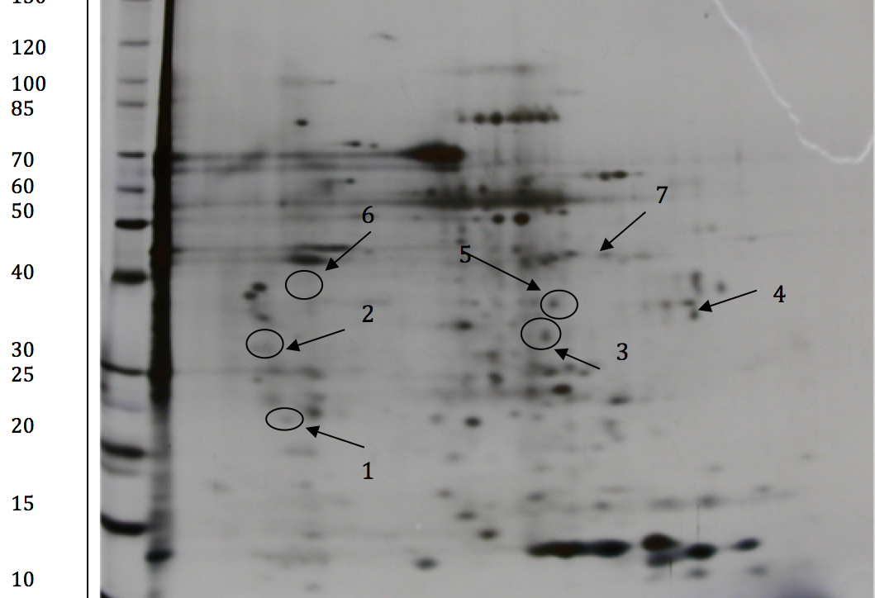
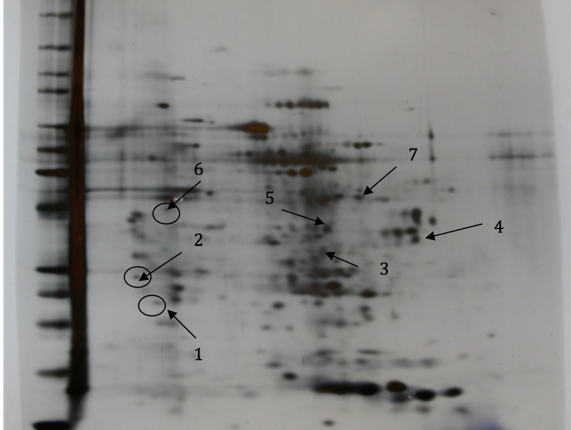
WMIC and DW EXTRACTS COMPARATIVE ANALYSIS
Increase protein concentration from 15 to 50 %
DW
WMIC
WMIC – water with modified isotope composition
DW – distilled water
Notes:
During extraction we get test probes for protein concentration measurement, as you can see while extraction with deuterium depleted water as solubilazing agent protein concentration was increased, especially in first fifteen minutes especially in thymus extract
Increase protein concentration from 15 to 50 %
Identification of protein fractions was performed on DE after trypsinolysis by MALDI-TOF/MS and MS/MS mass spectrometry on Ultraflex MALDI-TOF mass spectrometer
Marked differences: proteins involved in the immune response

Slide 6
IMMUNOLOGICAL REACTIVITY IN VIVO
Study of immune corrective effect was carried out with:
Laboratory animals
Immunodeficiency Model
Intraperitoneal injection
Методы
Cytometry analysis : LYM, MON, GRA; CD4.
N= 58, m = 390 ± 10 г
Male Wistar rats, SPF
Dose: 75 mg/kg
Modulator: cyclophosphamide (Sigma)
Interval: 72 hours,
Repeat count: three times
Research (20 days)
Group А (n=10) – intact animals
Model complete: 12 days after first injection
Group B (n=10) – control animals (IDF model)
Group C (n=10) –20 days treatment, WMIC fraction up to 5 kDa
Group D (n=10) – 20 days treatment, WMIC fraction 5-30 kDa
Immunoassay analysis:
Complement components С1q,С1qA, С1qB, С3,C4, C5
Group E (n=10) – 20 days treatment, WMIC fraction above 30 kDa
IgM, IgG, Il-2, Il-4, Il-6

Slide 7
IMMUNOPHENOTYPING
Lymphocytes, monocytes, granulocytes content.
B
GRA
GRA
GRA
MON
MON
MON
C
LYM
D
LYM
E
LYM
CD4 content
А
B
C
D
E
LYM CD4⁻
CD4
LYM CD4⁻
CD4
LYM CD4⁻
CD4
LYM CD4⁻
CD4
LYM CD4⁻
CD4
А – intact; В – control; С – fraction <5 kDa;
D – fraction 5-30 kDa, E –fraction >30 kDa.

Slide 8
IMMUNOASSAY ANALYSIS RESULT
А – intact; В – control; С – fraction <5 kDa;
D – fraction 5-30 kDa, E –fraction >30 kDa
Notes:
Adaptive immune response activation by stimutating C3 and C4 components synthesis Activated cycle of complementary cascade
Adaptive immune response activation by stimulating C3 and C4 components synthesis

Slide 9
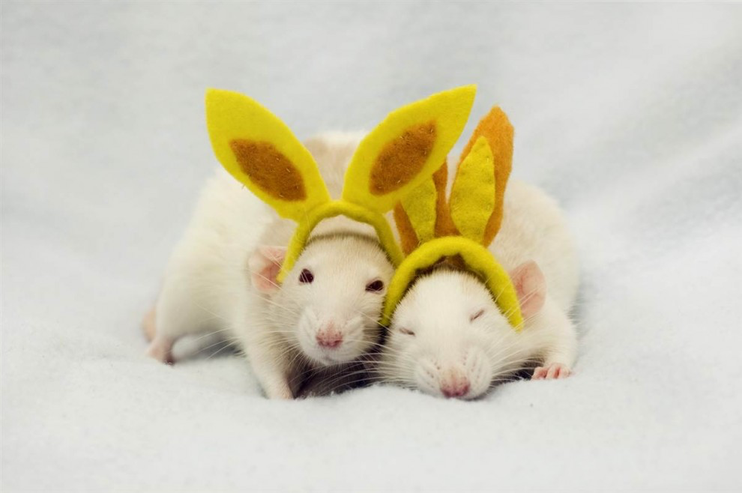
CONCLUSION
Deuterium depleted water intake led to the increase proteins (involved in the immune response) concentration during extraction from animal tissues (spleen, thymus, lymph nodes);
In vivo research showed immune system recovery, adaptive immune response and functional activation of nonspecific immune defense system;
Biomolecules (5-30 kDa), isolated from Sus Scrofa immune tissues by WMIC extraction, showed obvious immunoactivating effect.

Slide 10



This work was supported by Russian Science Foundation (RSF) grant No. 15-16-00008.
“Development of innovative natural adaptogenic stimulants of innate (nonspecific) immunity based on species and tissue-specific biomolecules”
THANK YOU!
Stepan S. Dzhimak
jimack@mail.ru
.
Notes:
Ekaterina Vasilevskaya
Rina715@yandex.ru

