Slide 1
Role of GSK-3β in remote limb ischemic post conditioning against cerebral iSCHEMIC REPERFUSION INJURY
Presented by
R. Sruthi
PhD Scholar
Department of Pharmacy
Under Supervision of
Dr. Rajeev Taliyan
Assistant Professor
Department of Pharmacy

Slide 2
Introduction
Restoration of blood flow with effective oxygenation to an ischemic organ, often paradoxically results in cerebral ischemic stroke, which is the second leading cause of death and acquired adult disability worldwide.
In recent past, extensive exploitation of endogenous mechanism have led to development of effective cerebro protective treatment named ischemic pre/post conditioning (IPC/IPOC)
In addition, the RIPC of femoral artery has been reported to be neuroprotective with better clinical efficacy against certain cerebral disorders possibly by alteration of various secondary messengers including RISK pathway, MAPK and ERK, NMDA, HDAC, GSK-3β and mPTP.
Recent studies over past decade have highlighted the role of GSK-3β and mPTP modulation in cerebral stroke. However, the molecular mechanism for neuroprotection by RIPOC is yet to be explored.
In the present study, we investigated the involvement of GSK-3β and mPTP in the neuroprotective role of RIPOC against cerebral stroke.

Slide 3
Materials and methods
Animals
Male Wistar rats were approved by Institutional Animal Ethics Committee of Birla Institute of Technology & Science, Pilani, India (Protocol No. IAEC / RES / 17 / 07).
Experimental Design
Group1: Sham Control; Group 2: For ischemia reperfusion group (I/R), rats were subjected to 60 min of ischemia followed by 24 hours reperfusion; Group 3: In RIPOC group, after femoral artery I/R, rats were exposed to I/R injury by MCAO. The duration of occlusion and reperfusion of femoral artery was for 60 sec and repeated for four cycles; Group 4: GSK-3β inhibitor, Indirubin -3-monoxime ( IM, 0.2 mg/kg, i.p. ) was administered before reperfusion phase of RIPOC. Group 5: mPTP opener, carboxyatractyloside (CAT, 1mg/kg, i.p.) was administered before reperfusion phase of RIPOC.
Behavioral Parameters
Neurological Scoring (NSS): 18-point NSS was performed [1]. Rotarod Performance: Motor abnormalities were measured by latency to fall [2].
Biochemical Estimation
Oxidative stress marker, malondialdehyde (MDA) were quantitatively estimated as described by Wills [3]. Endogenous anti-oxidant like reduced glutathione (GSH) and catalase were estimated Ellman [4] and Sinha [5] respectively. TNF-α and GSK-3β estimation was performed according to the ELISA kit manufacturer’s instructions.
Histological Examination
Hippocampal DG region has been stained with haematoxylin eosin stain and studied under bright field illumination using ‘‘Optika TCB5’’ microscope [6]. .

Slide 4
Hypothesis

Slide 5
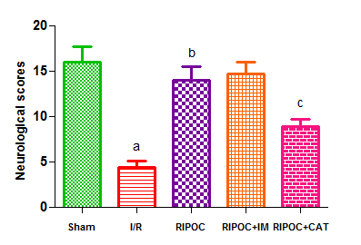
Results
Fig.2. Effect of RIPOC, IM and CAT on neurological scoring.
ªP<0.001 vs sham, ^{b}P<0.001 vs I/R

Slide 6
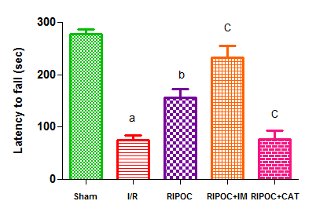
Fig.3. Effect of RIPOC, IM and CAT on rotarod performance.
ªP<0.001 vs sham, ^{b}P<0.05 vs I/R, ^{c}P<0.05 vs RIPOC

Slide 7
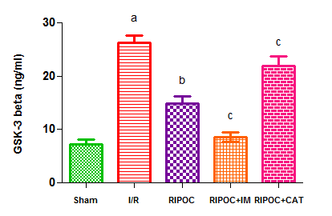
Fig.4. Effect of RIPOC, IM and CAT on GSK-3β activity.
ªP<0.001 vs sham, ^{b}P<0.001 vs I/R, ^{c}P<0.05 vs RIPOC

Slide 8
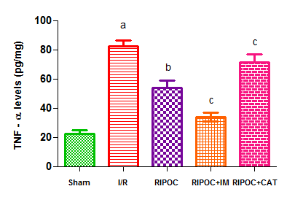
Fig.5. Effect of RIPOC, IM and CAT on TNF-α levels.
ªP<0.001 vs sham, ^{b}P<0.001 vs I/R, ^{c}P<0.05 vs RIPOC

Slide 9
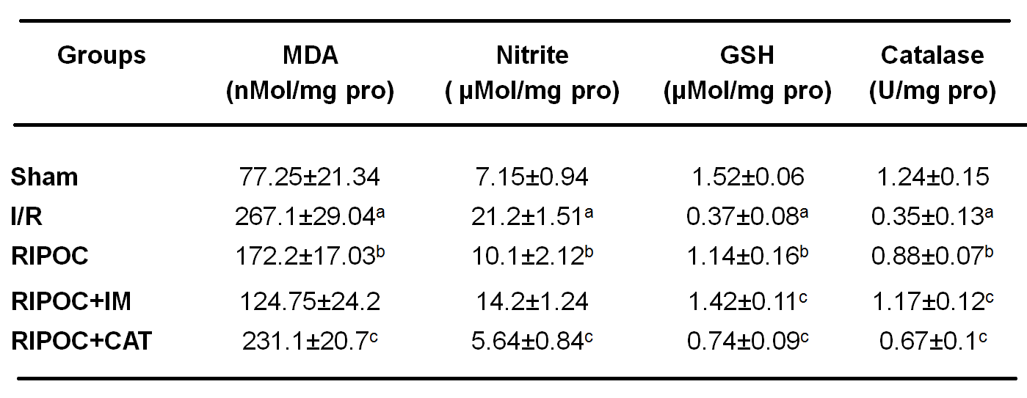
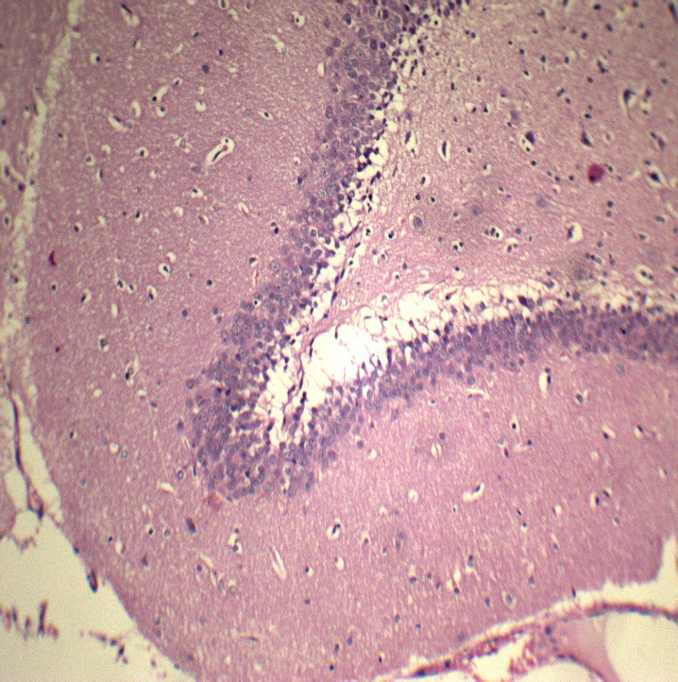
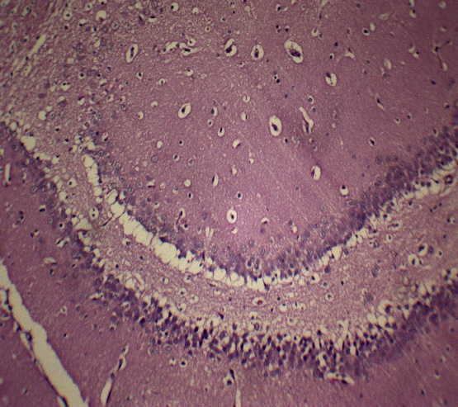
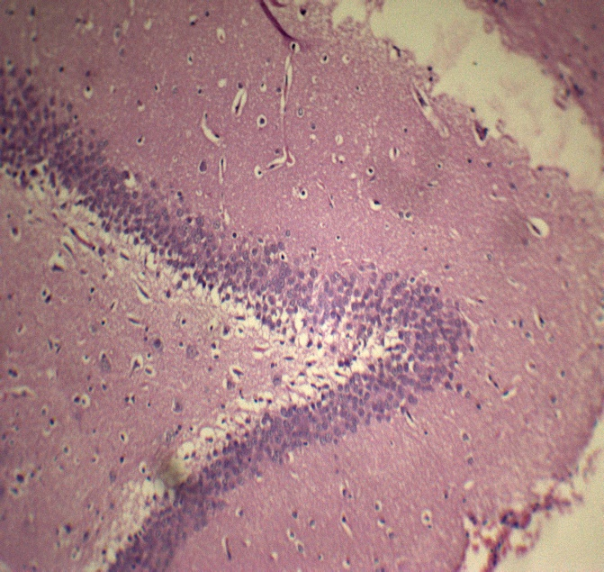
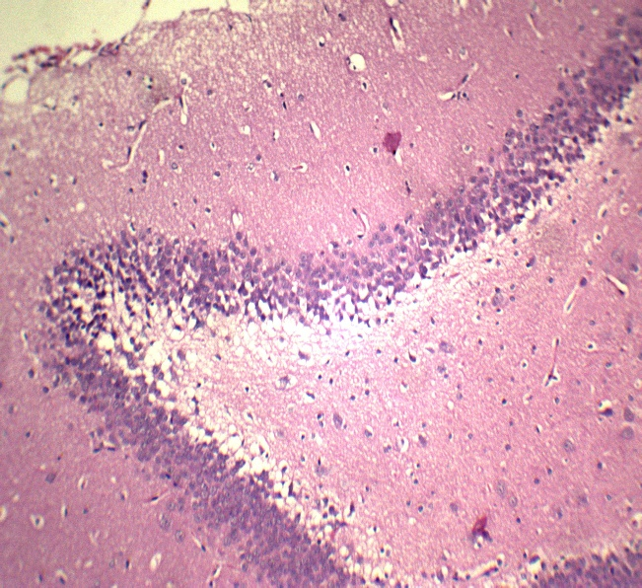
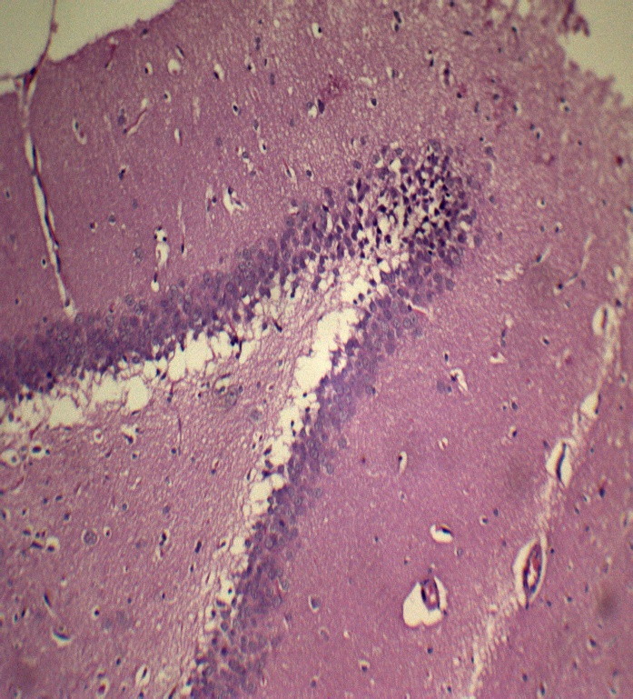
Fig.6. Effect of RIPOC, IM and CAT on biochemical parameters. ªP<0.001 vs sham, ^{b}P<0.001 vs I/R, ^{c}P<0.05 vs RIPOC
SHAM
I/R
RIPOC
RIPOC+IM
RIPOC+CAT
Fig.7. Effect of RIPOC, IM and CAT on dentate gyrus region of hippocampus

Slide 10
Discussion
MCAO induced cerebral stroke resulted in severe neuronal injury as evidenced by behavioral and biochemical abnormalities
RIPOC intervention significantly attenuated the motor impairment besides improving the biochemical and histological parameters
Treatment with IM, before reperfusion provided synergistic neuroprotective role with RIPOC by inhibiting GSK-3β activity
Opening of mPTP by CAT abolished the protective effect offered by RIPOC as evidenced by impaired motor performance, increased oxidative markers, neuroinflammation and high pyknotic count
Thus, the present study strongly indicates the therapeutic neuroprotective role offered by RIPOC against cerebral I/R injury is mediated by mPTP closing and GSK3β inhibition.

Slide 11
References
[1] Sruthi R, Rajeev R, Neuroprotective effect of Hydroxy Safflor Yellow A against cerebral ischemia-reperfusion injury in rats: Putative role of mPTP. J Basic Clinical Physiol Pharmacol (Accepted).
[2] H.K. Eltzschig, T. Eckle, Ischemia and reperfusion from mechanism to translation, Nat Med, 17 (2011) 1391-1401.
[3] E. Wills, Mechanisms of lipid peroxide formation in animal tissues, Biochem J, 99 (1966) 667-676.
[4] G.L. Ellman, Tissue sulfhydryl groups, Arch Biochem Biophys, 82 (1959) 70-77.
[5] A.K. Sinha, Colorimetric assay of catalase, Anal Biochem, 47 (1972) 389-394.
[6] J. Sun, L. Tong, Q. Luan, J. Deng, Y. Li, Z. Li, H. Dong, L. Xiong, Protective effect of delayed remote limb ischemic postconditioning: role of mitochondrial KATP channels in a rat model of focal cerebral ischemic reperfusion injury, J Cereb Blood Flow Metab, 32 (2012) 851-859.
Authors are thankful to DST, New Delhi, India and BITS, Pilani, Rajasthan, India for their financial support for this study

