Slide 1
TRIPLE ABC Technique in clinical assessment in breast cancer diagnosis
By
Prof. Dr. Sribatsa Kumar Mohapatra,
M.S., FRCS, FAIS, DNB
&
Prof. Dr. Brajamohan Mishra,
VSS Institute of Medical Sciences & Research, Burla, Sambalpur

Slide 3
INTRODUCTION:
Triple assessment is the standard assessment in breast cancer diagnosis
Clinical, Radiological & Pathological examination is the standard practice.
Clinical examination remains cornerstone of diagnosis around the world.
As it is cost effective in contrast to Radiological & Pathological examination.

Slide 4
Can be applied anywhere anytime.
Unfortunately there is no standardization of the clinical assessment.
In this paper we have devised a standard method called triple ABC method for clinical assessment.

Slide 5
An innovative triple ABC technique for clinical breast examination for breast disorder
Three sets of ABCs are used .
First ABC stand for
Axila
Breast
Cervical
Area on non affected side

Slide 6
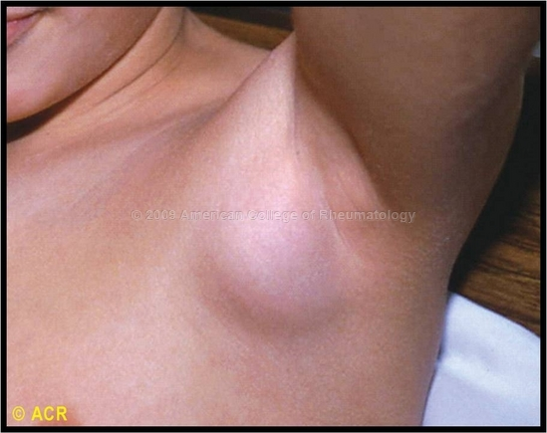
Second ABC stand for affected side
Axilla

Slide 7
Breast

Slide 8
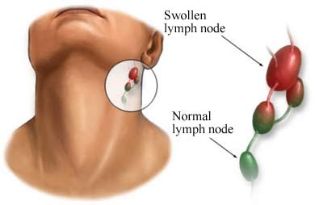
Cervical area

Slide 9
Third ABC stand for
Abdomen
Bone and brain
Chest

Slide 10
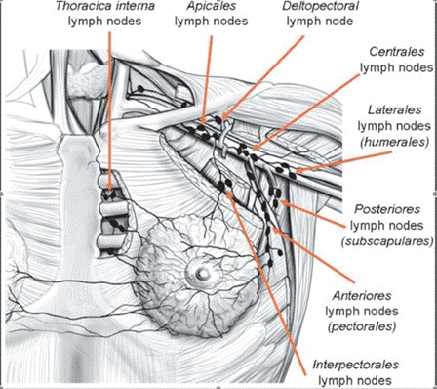
Each ABC is further given five points of importance
Axilla 5-Points
1)Anterior
2)Posterior
3)Central
4)Apical
5)Lateral

Slide 11
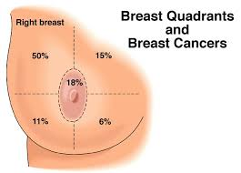
Breast 5-Points
1)Central(nipple areola complex)
2)Upper medial
3)Upper lateral
4)Lower medial
5)Lower lateral

Slide 12
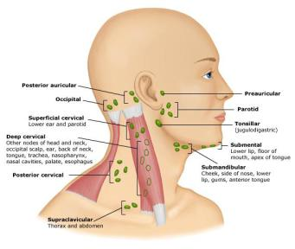
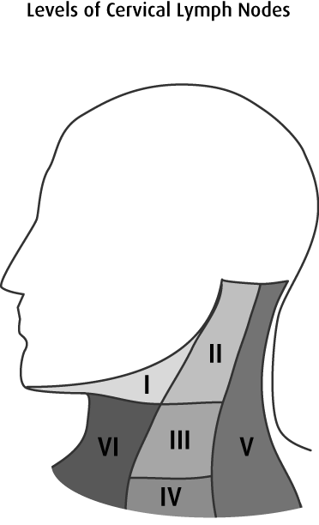
Cervical area 5-Points
1)Level I
2)Level II
3)Level III
4)Level IV
5)Level V

Slide 13
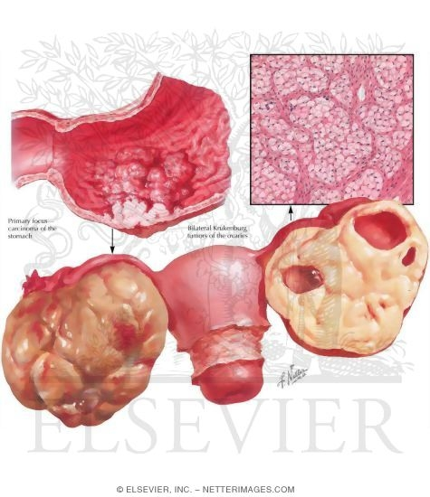
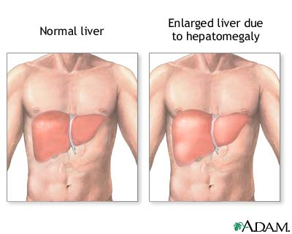
Third ABC
Abdomen 5-Points
1)Lump(krukenberg)
2)Liver

Slide 14
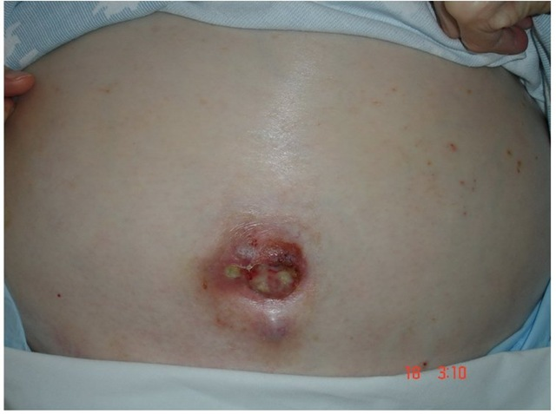
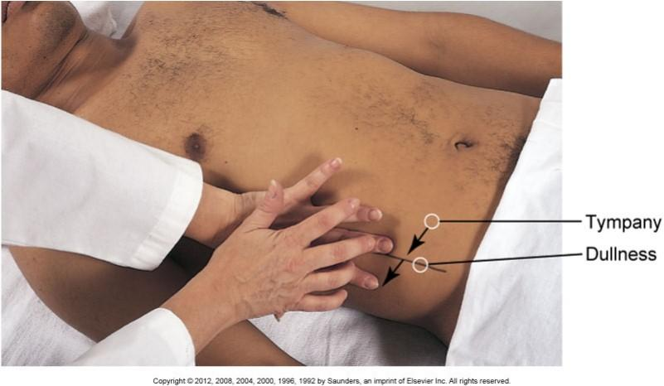
3)Umbilicus
Sister mary joseph nodule
4)Shifting dullness

Slide 15
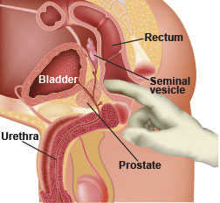
5)Digital rectal examination

Slide 16
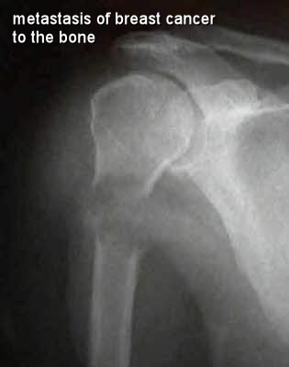
Bone 5-Points
1)Vertebrae
2)Ribs and sternum
3)Proximal femur
4)Proximal humerus
5)Skull and brain

Slide 17
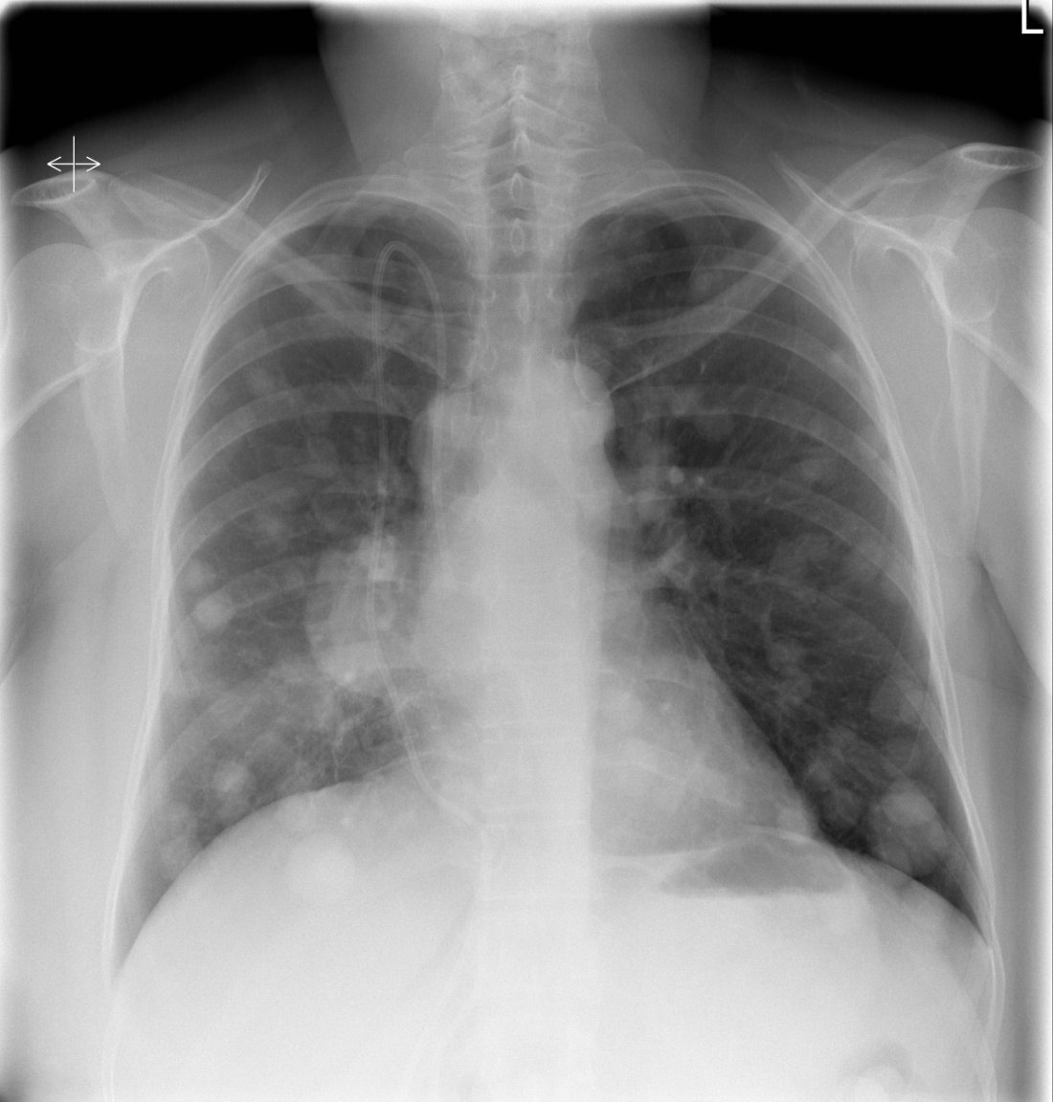
Chest 5-Points
1)Effusion
2)Collapse
3)Consolidation
4)Intercostal fullness
5)Ribs

Slide 18
CONCLUSION:
For easy recall, each ABC are given five points of specific examination.
Can be remembered as A⁵, B⁵, C⁵
This can be learned by beginners, experts, paramedics in centre where radiological and pathological assessment is not available.
This is also cost effective.
Practicing this method in peripheral institution will help in early detection and early referral to advance centre for reducing morbidity and mortality.

Slide 19
REFERENCES:
1. Z. Kaufman, B. Shpitz, M. Shapiro et al., “Triple approach in the diagnosis of dominant breast masses: combined physical examination, mammography, and fine-needle aspiration,” Journal of Surgical Oncology.
2. P. Mendoza, M. Lacambra, P. H. Tan, and G. M. Tse, “Fine needle aspiration cytology of the breast: the nonmalignant categories,” Pathology Research International, vol. 2011.
3. “The uniform approach to breast fine-needle aspiration biopsy. NIH Consensus, Development Conference,” The American Journal of Surgery, vol. 174.
4. K. Dowlatshahi, P. M. Jokich, R. Schmidt, M. Bibbo, and P. J. Dawson, “Cytologic diagnosis of occult breast lesions using stereotaxic needle aspiration. A preliminary report,” Archives of Surgery, vol. 122, no. 11, pp. 1343–1346, 1987.
5. W. P. Evans and S. H. Cade, “Needle localization and fine-needle aspiration biopsy of nonpalpable breast lesions with use of standard and stereotactic equipment,” Radiology, vol. 173, no. 1, 1989.
6. Y.-H. Yu, W. Wei, and J.-L. Liu, “Diagnostic value of fine-needle aspiration biopsy for breast mass: a systematic review and meta-analysis,” BMC Cancer, vol. 12, article 41, 2012.

Slide 20
7. Bland K.I., Beenken S., Copeland E.M., III The Breast. Schwartz’s Princip Surg. (9th edition).
8. Iglehart J.D., Kaelin C.M. Diseases of the breast. Sabiston Text Book of Surgery. (19th edition)
9. Yang W.T., Mok C.O., King W., Tang, Metreweli C. Role of high frequency ultrasonography in the evaluation of palpable breast masses in Chinese women: Alternative to mammography. J Ultrasound Med. 1996;15(9):637–644. [PubMed]
10. Pande A.R., Lohani B., Sayami P., Pradhan Predictive value of ultrasonography in the diagnosis of palpable breast lump. Kathmandu Univ Med J (KUMJ) 2003;1(2):78–84. [PubMed].
11. Fischer’s Mastery of Surgery (6th edition).

Slide 22
Thank You

