Slide 1
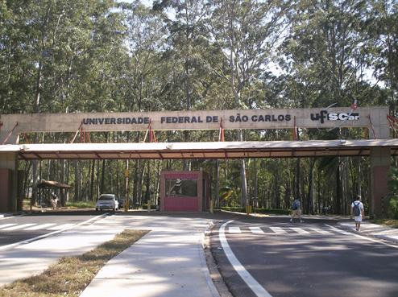
2nd International Conference on HIV/AIDS, STDs, & STIs
October 27-29, 2014 Las Vegas, USA
Decentralizing care of people living with HIV to primary care can be an alternative to sustainability and humanization of the Brazilian program of HIV/Aids control.
Bernardino Geraldo Alves Souto.
Support:
Federal University of São Carlos, São Paulo, Brazil.

Slide 2
Institutional context:
The Brazilian Health System
Tertiary level:
Hospitals.
Secondary level
Ambulatory Services of Specialized Assistance.
Primary level.
Basic Unities of Health Care
(Family Health Strategy and First Aid/Prompt Attendance)

Slide 3
Institutional context:
The Brazilian Program of HIV/Aids is vertical.
Ministry of Health:
Normative and Provider.
Secretaries of State for Health
Intermediary managers and collaborators of the Ministry.
Secretaries of the cities for Health
Providers of assistance and epidemiological informants
Hospitals
Local Services for Specialized Assistance on HIV/Aids.
Guarantee of control and organization of the program, mainly in its logistical and epidemiological aspects.

Slide 4
Assistential Context:
Bureaucratic and standardized
Limits the participation of the subject to their own care;
Loses opportunities to reduce human suffering;
Does not contribute to equity;
Limits efficiency, efficacy and effectiveness.
Municipal Services of Specialized Assistance on STDs/HIV/Aids.

Slide 5
Institutional context:
The Brazilian Program of HIV/Aids is vertical.
Ministry of Health:
Normative and Provider.
Secretaries of State for Health
Intermediary managers and collaborators of the Ministry.
Secretaries of the cities for Health
Providers of assistance and epidemiological informants
Hospitals
Local Services for Specialized Assistance on HIV/Aids.

Slide 6
Institutional context:
The Brazilian Program of HIV/Aids is vertical.
Ministry of Health:
Normative and Provider.
Secretaries of State for Health
Intermediary managers and collaborators of the Ministry.
Secretaries of the cities for Health
Providers of assistance and epidemiological informants
Hospitals
Local Services for Specialized Assistance on HIV/Aids.
Family Health Strategy

Slide 7
Municipal Services of Specialized Assistance on STDs/HIV/Aids.
Family Health Strategy

Slide 8
Municipalized Services of Specialized Assistance on STD/HIV/Aids.
Transference of the care with specialized support to the
Family Health Strategy

Slide 9
Expanded and integral person-centered care promotes the biological, social, emotional and epidemiological coping of HIV.

Slide 10
Bibliografia.
Paula IA, Guibu IA (org.). DST/aids na rede básica: uma integração necessária. São Paulo: Secretaria de Estado da Saúde, 2007.
Souto BGA. Implicações existenciais da infecção pelo HIV. Curitiba, PR, Brasil, CRV, 2014.

