Slide 1
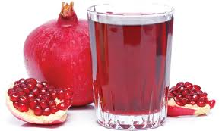
Dynamics of difenoconazole and propiconazole residues on pomegranate over a period of two years under field conditions Dr Soudamini Mohapatra Principal Scientist Pesticide Residue Laboratory, (ISO/IEC 17025:2005) Indian Institute of Horticultural Research, Hessaraghatta Lake, PO, Bangalore

Slide 2
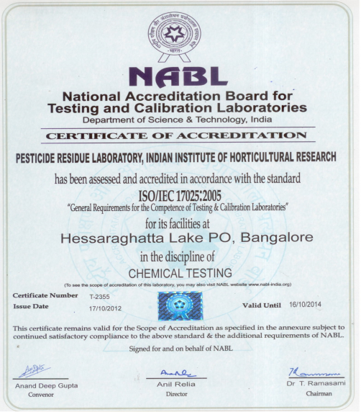
Renewed upto 16th October, 2016

Slide 3
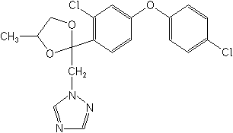
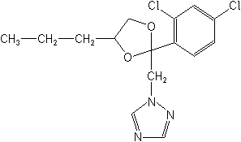
GENERAL INFORMATION
Difenoconazole and propiconazole are broad spectrum fungicides.
They are used for control of Wilt, leaf and fruit spot diseases of pomegranate.
These diseases reduce the yield and marketability due to spotting of the fruits, can cause widespread destruction to pomegranate orchards.
Chemical structure:
Difenoconazole - 1-[2-[2-chloro-4-(4-chlorophenoxy)phenyl]-4-methyl-1,3-dioxolan-2-ylmethyl]-1H-1,2,4-triazole
Propiconazole- 1-[[2-(2,4-dichlorophenyl)-4-propyl-1,3-dioxolan-2-yl]methyl]-1H-1,2,4-triazole

Slide 4
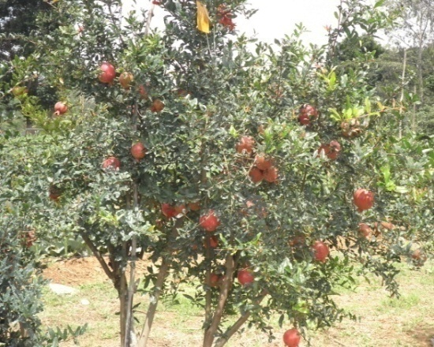
Experimental Details
A field study was undertaken as per good agricultural practices (GAP) to study the residue dynamics of difenoconazole and propiconazole on pomegranate .
Spray application of the 2 fungicides was given to pomegranate crop (variety Baghwa) at the recommended and double dose of 125 and 250 g a.i./ha twice at 15 day intervals during August-October, 2012.
The study was repeated during August-October, 2013.
Residue analysis of pomegranate whole fruits and pulp (aril) was carried out after the second spray for a period of 1 month i.e., on 0, 1, 3, 5, 10, 15, 20, 25, 30, 35 and 40 days.
Analysis of field soil was carried out after 30 days
The environmental parameters such as temperature, humidity and rainfall was recorded.
Experimental Field

Slide 5
RESIDUE ANALYSIS
On every sampling day pomegranate fruits were collected from treated field.
The whole fruits were cut into small pieces and homogenized.
The fruits were washed under running water, peeled and the edible aril was homogenized.
15g of the whole fruit and aril was taken and sample preparation was carried out as per QuEChERS method.
Soil samples were analyzed by QuEChERS method after adding water
The final extract was analyzed by GC.
Confirmatory studies were carried out by GC-MS.

Slide 6
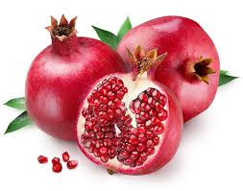
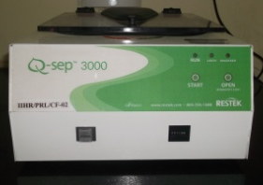
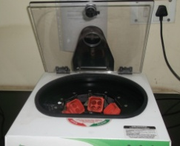
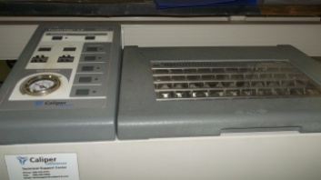
QuEChERS Method
Approximately 2 kg pomegranate fruits were cut into small pieces.
Homogenized in a high volume Robot Coupe homogenizer
⇩
15 g sample was placed in a 50 mL Teflon tube.
⇩
15 mL of 1% acetic acid in HPLC grade acetonitrile was added to the tube.
⇩
6 g anhydrous magnesium sulphate, 1.5g of sodium acetate was added to
the tube, mixed thoroughly by shaking and spinned for 2 min.
⇩
Centrifuged the tubes at 10,000 rpm for 10 min.
⇩
6 mL of the upper acetonitrile extract was placed in a centrifuge tube containing 50 mg primary secondary amine (PSA) sorbent and 150 mg anhydrous magnesium sulphate per mL of extract.
⇩
Shaken the tubes vigorously for 1 min and centrifuged at 10,000 rpm for 10 min.
⇩
3 ml acetonitrile extract was placed in a test tube and concentrated under nitrogen
in a low volume concentrator and reconstituted in n-hexane: distilled acetone (9:1).
⇩
Analyzed by GC and confirmation by GC-MS.

Slide 7
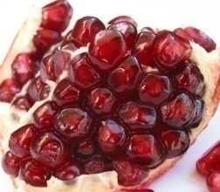
Analytical method validation
The analytical method was validated by studying the parameters such as recovery, linearity, limit of detection (LOD), limit of quantification (LOQ), accuracy and precision, measurement uncertainty etc.
The pomegranate used in the recovery study was grown in the experimental field of IIHR without the application of pesticides.
Pomegranate whole fruit, aril and soil was spiked with difenoconazole and propiconazole at 0.05, 0.25 and 0.50 mg kg⁻¹ with five replications of each treatment.
The precision of the analytical method was measured by the degree of repeatability (for five analyses) and expressed as the percent relative standard deviation.
The linearity was determined in the concentration range of 0.01-1.0 µg/mL
The measurement uncertainty (MU) of the method was calculated by considering all factors contributing to it. The uncertainties were determined individually and the expanded uncertainty was determined by using the coverage factor K=2, to give a confidence level of 95%.

Slide 8
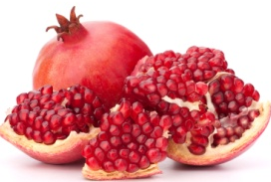
Method validation results
Recovery of difenoconazole and propiconazole from pomegranate whole fruit, aril and soil was in the range of 80.3-97.3% which was within the acceptable range of 70-120% (Method validation and quality control procedures for pesticide residue analysis in food and feed, SANCO/12495/2011).
Matrix effect on recovery was nullified by calculating the recovery percent based on matrix matched standards.
The calibration curve was linear in the range of 0.01-1.0 μg/mL for both analytes with the correlation coefficient (R²) > 0.99
The LOQ of difenoconazole and propiconazole was 0.05 mg/kg.
The precision expressed as relative standard deviation (RSD) remained within a range of 3.2-7.8%.
The MU was in the range of 9.7-17.1%.

Slide 9
RESULTS Residues of difenoconazole on pomegranate
Days after Treatment | Untreated control | Residues of difenoconazole recovered (mg/kg) ± SDª
 |  | 1st year |  | 2nd year
 |  | Application at 125 g a.i./ha | Application at 250 g a.i./ha | Application at 125 g a.i./ha | Application at 250 g a.i./ha
0 | ND | 1.205 ±0.163 | 1.672 ±0.145 | 0.875±0.104 | 1.540±0.090
1 | ND | 1.012 ±0.105 (16.0) | 1.464 ±0.172 (12.4) | 0.700±0.033 (20.0) | 1.236±0.110 (19.7)
5 | ND | 0.724 ±0.048 (40.0) | 0.928 ±0.083 (44.5) | 0.504±0.047 (42.4) | 0.781±0.055 (49.3)
10 | ND | 0.348 ±0.017 (71.1) | 0.460 ±0.018 (72.5) | 0.346±0.026 (60.4) | 0.484±0.030 (68.6)
15 | ND | 0.158 ±0.013 (86.9) | 0.237 ±0.024 (85.8) | 0.216±0.013 (75.3) | 0.325±0.008 (78.9)
20 | ND | 0.102 ±0.006 (91.5) | 0.174 ±0.006 (89.6) | 0.173±0.016 (80.2) | 0.204±0.017 (86.7)
25 | ND | 0.079 ±0.002 (93.4) | 0.143 ±0.007 (91.5) | 0.120±0.005 (86.3) | 0.152±0.013 (90.1)
30 | ND | 0.050±0.001 (95.8) | 0.096 ±0.008 (94.3) | 0.058±0.001 (93.4) | 0.112±0.006 (92.7)
35 | ND | <LOQ | <LOQ | <LOQ | 0.080±0.004 (94.8)
Values in the parenthesis is the dissipation % of residues

Slide 10
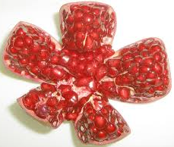
Dissipation of difenoconazole on pomegranate

Slide 11
Rate of residue decay and safety constants of difenoconazole residues on pomegranate
Rate of application (g a.i./ha) | Regression Equation | Regression Coefficient |  | Half-life (days) | Safe waiting Period (days)
1st Year
125 | Y=3.03976-0.0474X |  | 0.99 | 6.4 | 21.9
250 | Y=3.15621-0.0422X |  | 0.98 | 7.1 | 27.3
2nd Year
125 | Y=2.90514-0.0358X |  | 0.99 | 8.4 | 25.4
250 | Y=3.09619-0.0355X |  | 0.99 | 8.4 | 30.8
MRL- 0.1 mg/kg

Slide 12
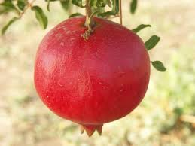
RESULTS Residues of propiconazole on pomegranate
Days after treatment | Control | Residue of propiconazole recovered (mg/kg) ± SDª
 |  | 1st year |  | 2nd year
 |  | Application at 125 g a.i./ha | Application at 250 g a.i./ha | Application at 125 g a.i./ha | Application at 250 g a.i./ha
0 | ND | 0.864±0.095 | 2.045±0.184 | 0.663±0.075 | 1.474±0.146
1 | ND | 0.780±0.078 (9.7) | 1.916±0.173 (6.3) | 0.588±0.043 (11.3) | 1.320±0.138 (10.45)
5 | ND | 0.626±0.057 (27.5) | 1.548±0.108 (24.3) | 0.400±0.038 (39.7) | 0.986±0.073 (33.1)
10 | ND | 0.425±0.032 (50.8) | 1.075±0.101 (47.4) | 0.213±0.018 (67.9) | 0.738±0.047 (50.0)
15 | ND | 0.278± 0.014 (67.8) | 0.714±0.057 (65.1) | 0.160±0.007 (75.8) | 0.502±0.032 (65.9)
20 | ND | 0.155± 0.013 (82.0) | 0.481±0.022 (76.5) | 0.112±0.005 (83.1) | 0.355±0.028 (75.9)
25 | ND | 0.105±0.006 (87.8) | 0.308±0.019 (84.9) | 0.080±0.003 (87.9) | 0.217±0.016 (85.3)
30 | ND | 0.062±0.003 (92.8) | 0.169±0.012 (91.7) | 0.050±0.001 (92.4) | 0.108±0.004 (92.7)
35 | ND | <LOQ | 0.082±0.003 (96.0) | <LOQ | <LOQ

Slide 13
Dissipation of propiconazole on pomegranate

Slide 14
Rate of residue decay and safety constants of propiconazole residues on pomegranate
Rate of application (g a.i./ha) | Regression Equation | Regression Coefficient | Half-life (days) | Safe waiting Period (days)
1st year
125 | Y=2.966200-0.0380X | 0.99 | 7.9 | 33.3
250 | Y=3.37378-0.03818X | 0.99 | 7.9 | 43.8
2nd year
125 | Y=2.78111-0.03653X | 0.99 | 8.2 | 29.6
250 | Y=3.18939-0.03531X | 0.99 | 8.5 | 42.2
MRL- 0.05 mg/kg

Slide 15
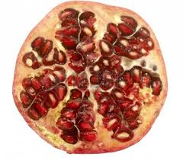
Conclusions
The residue level of both fungicides were high on pomegranate fruits, but the edible aril was residue free.
The thick rind of the fruit could have prevented movement of the residues to the aril.
Washing could remove 25-55% residues, so thorough washing of the fruits should be carried out to prevent transfer of residues by hand contact.
The half-life of degradation of difenoconazole differred to some extent, but that of propiconazole remained almost the same.
Temperature, humidity remained nearly in the same range over 2 years, but rainfall varied. It did not seem to impact the dissipation pattern.
The PHI differed over 2 years period, from food safety point of view the higher valu may be followed.

Slide 16
Acceptable Daily Intake (ADI)
The acceptable daily intake (ADI) for humans is considered to be a level of intake of a chemical that can be ingested daily over an entire lifetime without any appreciable risk to health.
It is calculated by dividing the overall no observed adverse effect level (NOAEL) from the animal studies by a safety factor.
The magnitude of the safety factor is selected to account for uncertainties in extrapolation of animal data to humans, variation between humans, the completeness of the toxicological data base and the nature of the potential adverse effects.
The most common safety factor is 100 which takes into account that humans may be 10 times more sensitive to the chemical than experimental animals and that a proportion of the population may be 10 times more sensitive than the average person.

Slide 17
Maximum Residue Limit (MRL)
Pesticides used on food crops may leave residues on these crops.
Maximum Residue Levels (MRLs) are the upper legal levels of a concentration for pesticide residues in/on food or feed based on good agricultural practices and to ensure the lowest possible consumer exposure.
They act as an indicator of the correct use of pesticides, and ensure compliance with legal requirements for low residues on unprocessed food.
MRLs are trading standards used to ensure that imported and exported food is safe to eat. In practice, they allow the free movement of goods within the exporting and importing countries.
MRLs are set at low levels to ensure that high-level consumers will not consume more than the ADI if they eat large quantities of every food type containing the residues at the MRL.

Slide 18
Maximum Residue Limit (MRL)
While fixing MRL value the following points are taken into account
the acceptable daily intake (ADI)
consumption figures, based on the National Nutrition Survey. This survey provides information on the nutritional status and dietary habits of people. It helps identify how much of a particular food a consumer may eat. The survey measures consumption for average adults, children as well as high-end consumers.
The amount of residue likely to be found at harvest (expressed in mg/kg of the food).

Slide 19
Pre-harvest interval (PHI)
PHI is the time gap between the last spray and the first harvest of the crop to ensure pesticide residue level to remain within the permissible level It is calculated based on the persistence study and MRL Value It is crop and pesticide specific

Slide 20
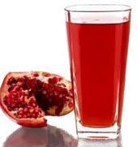
RISK ASSESSMENT OF DIFENOCONAZOLE
To evaluate the possible health hazards of these pesticides from pomegranate consumption the residue data along with the toxicological properties of the compounds Can be utilized.
The prescribed acceptable daily intake of difenoconazole is 0.01 mg/kg bw/day (EFSA).
Considering the body weight of an average adult Indian as 60 kg and the maximum permissible intake (MPI) of this fungicide is 0.6 mg/person/day.
Assuming the consumption of fruits of about 150 g/day the theoretical maximum residue contribution (TMRC) for difenoconazole was 0.25 mg/ day/person at double dose
This was calculated based on the residues obtained on 150 g whole fruit immediately after spray, which is 1.672 mg/kg

Slide 21
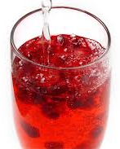
RISK ASSESSMENT OF PROPICONAZOLE
The prescribed acceptable daily intake of propiconazole is 0.04 mg/kg bw/day (EFSA).
Considering the body weight of an average adult Indian as 60 kg and the maximum permissible intake (MPI) of this fungicide is 2.4 mg/person/day.
Assuming the consumption of fruits of about 150 g/day the theoretical maximum residue contribution (TMRC) for propiconazole was 0.3 mg/ day/person at double dose
This was calculated based on the residues obtained on 150 g whole fruit immediately after spray, which is 2.04 mg/kg

Slide 22
THANK YOU

