Slide 1
Phycoremediation of Olive Mill Wastewater (OMW) Using Cyanobacteria for Sustainable Biofertilizer and Biofuel Production
Soha S.M. Moustafa¹ and Hassan I. El Shimi²
¹ Microbiology Department, Soils, Water and Environment Research Institute (SWERI),
Agricultural Research Center (ARC), Egypt
² Chemical Engineering Department, Faculty of Engineering, Cairo University, Egypt
Dubai, UAE in April 25th, 2016

Slide 2
Agenda
Introduction
Objective
Materials
Methodology
Results
Concluding remarks

Slide 3
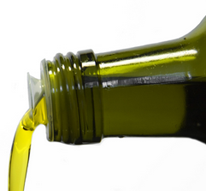
Introduction
Demand for olive oil is rapidly expanding worldwide due to its healthy image.
More than 97% of the world production of olive oil is concentrated in the Mediterranean basin.
Olive oil mill wastewaters (OMW) generated in huge quantities over a short period every year (November - April)

Slide 4
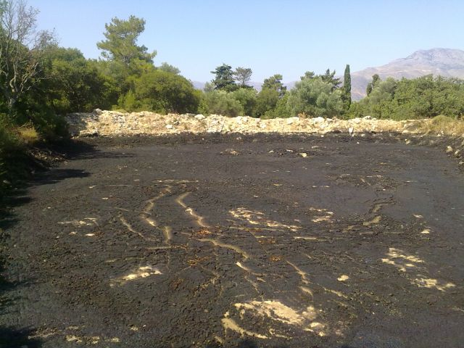
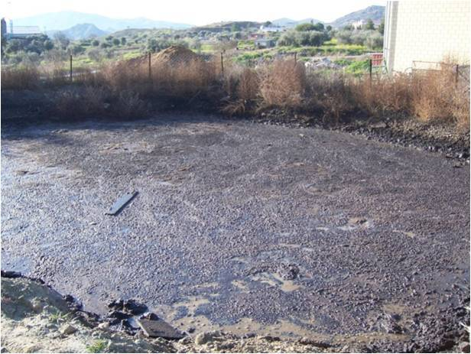
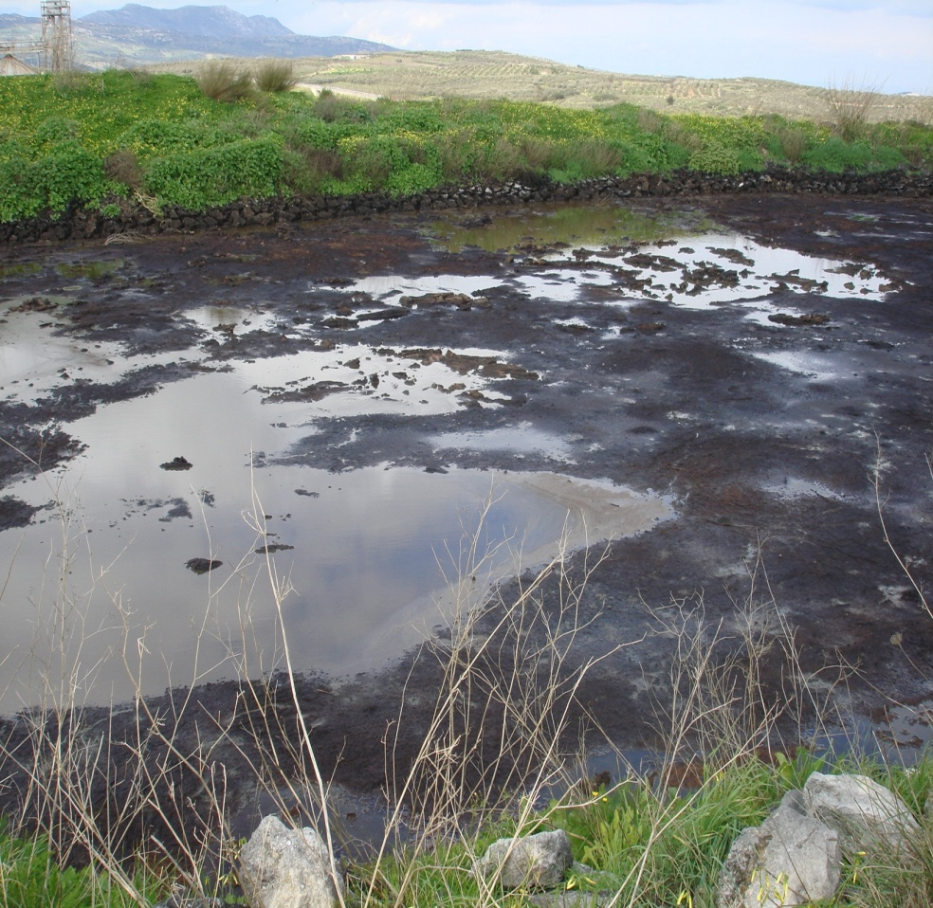
In Mediterranean countries, Several hundred thousands cubic meters of untreated OMW is discharged into rivers, open areas and cesspools and represent significant environmental problems

Slide 5
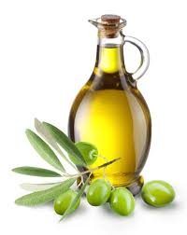
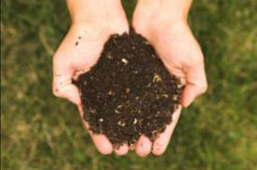
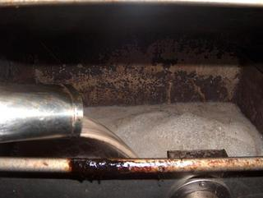
Olive Oil Production
Olive oil production unfortunately, leads to the generation of significant amounts of both solid and liquid wastes.
Olive oil
Olive cake
Olive mill waste water

Slide 6
Olive mill wastewater “OMW”
Olive mill wastewater (OMW), known as alpechin, disposal may cause adverse effects on soils, surface- and ground waters due to organic compounds content (organic acids, lipids, alcohols and polyphenols ) which are considered as phytotoxic.
One ton of olives approximately produces 0.8 ton of OMW which are characterized as acidic (pH 4-5), with an average COD content of 80 g/L, high concentrations of suspended solids (7–15 g/L) and phenolic compounds (2–10 g/L).

Slide 7
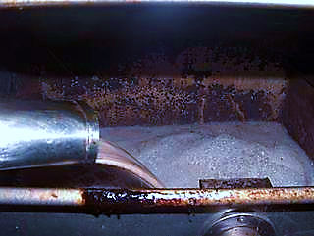
Olive mill wastewater “OMW”
Advantages | Disadvantages
OMW direct disposal in soil can be used as a soil conditioner/ fertilizers amendment and proposed as one of the most suitable methods to restore soil fertility . OMW has the potential to increase organic matter contents of soils (contains more than 94% organic matter) and other nutrients. | The continuous disposal of OMW in soil without any treatment might causes higher levels of soil salinity Unfavorable impact on soil microbial population/ctivity, plants, aquatic ecosystems and even in air media because of its high content s of fatty acid, phenolic compounds, mineral salts, COD and BOD.
The disposal of this waste in rivers increases the organic matter and K, Fe, Zn and Mn contents. | The disposal of this waste in rivers decreases the dissolved oxygen.
This wastewater contains valuable resources of fatty acids, sugars, phosphates, organic matter and a wide range of nutrients that could be recycled | A limiting factor to the biodegradation of OMW is its high content of phenolic antimicrobial and phytotoxic compounds

Slide 8
What the problem?
OMW is difficult to treat by common biological processes due to its high COD, low pH and the presence of organic compounds (phenols, polyphenols and polyalcohols) with low biodegradability and high toxicity, which may explain the lack of a well-established technology for their treatment.

Slide 9
Phycoremediation of OMW into valuable products via microalgae cultivation and formulate liquid bio-organic fertilizer.
Highlight the optimum bioreactors design for biomass production and its utilization in biofuel industry.

Slide 10
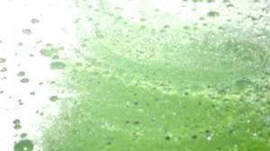
Phycoremediation
Phycoremediation is the process of employing algae for the removal or biotransformation of pollutants, including nutrients and xenobiotics from wastewater and CO2 from waste air with concomitant biomass propagation.

Slide 11
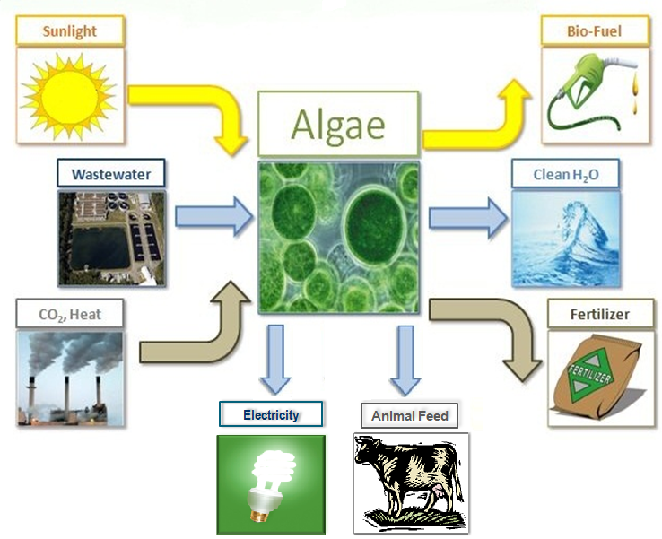
Why Algae?
High nutrient value therefore, can be suitable as a live feed for aquaculture
Removal waste CO₂ due to photosynthetic fixation (carbon credits).
Useful bio-chemicals (nutraceutical, pharmaceutical, bio-fertilizer and bio-fuel) from the algal Biomass.
Cost- effective, ecofriendly and a safe process.

Slide 12
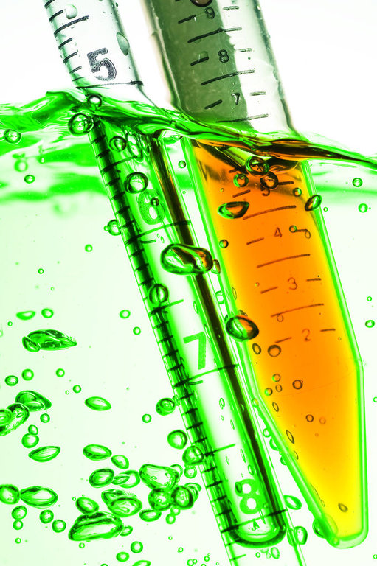
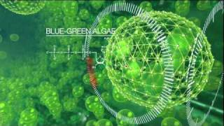
Materials
1)Blue Green Algae
2) Olive Mill Wastewater (OMW)

Slide 13
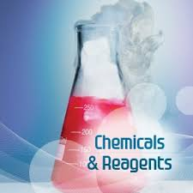
3)
Methanol (99.8% purity) as a reacting alcohol and concentrated sulfuric acid (H₂SO₄ conc.) as a biodiesel transesterification catalyst are supplied from El-Nasr Pharmaceutical Chemicals Company (ADWIC), Egypt.

Slide 14
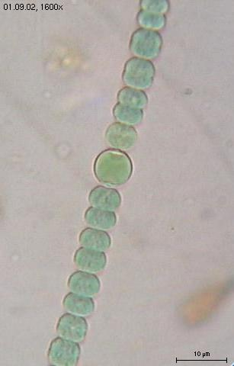
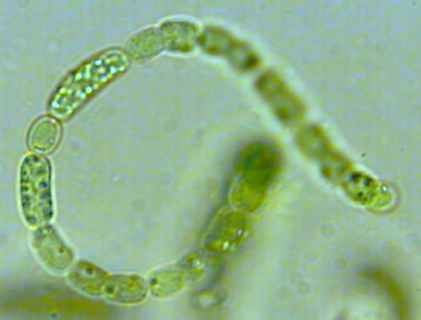
Blue Green Algae (Cyanobacteria)
Three cyanobacteria strains were kindly supplied from Department of Microbiology; Soils, Water and Environment Research Institute (SWERI); Agricultural Research Center (ARC), Giza, Egypt.
Nostoc muscorum
Anabaena oryzae
Spirulina platensis

Slide 15
1)Blue Green Algae (Cyanobacteria)
N₂-fixing Nostoc muscorum and Anabaena oryzae were maintained separately on BG₁₁ medium (Rippka et al., 1979).
The non N₂-fixing Spirulina platensis was grown on Zarrouk medium (Zarrouk, 1966).
Cultures were incubated in growth chamber under continuous shaking (150 rpm) and illumination (2000 lux) at 27± 2°C for 30 days to be used as inoculum for lab experiments.

Slide 16
Table 1: Characterization of cyanobacteria cultures
Parameter | Nostoc muscorum | Anabaena oryzae | Spirulina platensis
pH | 8.2 | 6.70 | 10.45
Optical density at 560 (nm) | 1. 2 | 0.84 | 2.85
Total chlorophyll (mg l⁻¹) | 5.39 | 5.31 | 13.50
Dry weight (g l⁻¹) | 0.85 | 0.55 | 1.84

Slide 17
2) Olive mill wastewater “OMW”
Olive mill wastewater (OMW) was obtained from FIFA farm (km48 of Cairo-Alexandria, Egypt).
The raw OMW samples were generated by the three-phase olive-oil extraction process of 2015 seasons.
Samples were left in tanks to settle for 10 days under laboratory conditions. The light supernatant after the sedimentation was filtered by passing through a sieve (mesh size about 200 μm) and was kept to be used as substrate for cyanobacteria cultivation.

Slide 18
Table 2: Chemical analysis of OMW during 2014 and 2015 seasons
Season | pH | EC ds.m⁻¹ | Organic Matter (%) | Organic carbon (%) | COD (%) | BOD (%) | Total phenols (g/l) | N % | P % | K % | Na % | C/N ratio
Before sedimentation
2014 | 5.20 | 16.70 | 21.20 | 12.60 | 11.75 | 4.15 | 9.46 | 1.62 | 0.68 | 1.14 | 3.11 | 84.92
2015 | 4.82 | 17.33 | 20.42 | 11.60 | 10.25 | 2.85 | 7.70 | 1.18 | 0.78 | 1.46 | 2.89 | 87.94
Average | 5.01 | 17.02 | 20.81 | 12.10 | 11.0 | 3.50 | 8.58 | 1.40 | 0.73 | 1.30 | 3.00 | 86.43
After sedimentation
2014 | 5.40 | 15.71 | 14.11 | 8.18 | 10.01 | 3.51 | 8.56 | 1.20 | 0.70 | 0.47 | 3.00 | 6.81
2015 | 6.75 | 15.33 | 12.75 | 7.40 | 6.67 | 2.65 | 6.82 | 1.10 | 0. 40 | 0.36 | 2.88 | 6.73
Average | 6.07 | 15.75 | 13.43 | 7.79 | 8.34 | 3.08 | 7.26 | 1.15 | 0.55 | 0.42 | 2.94 | 6.77

Slide 19
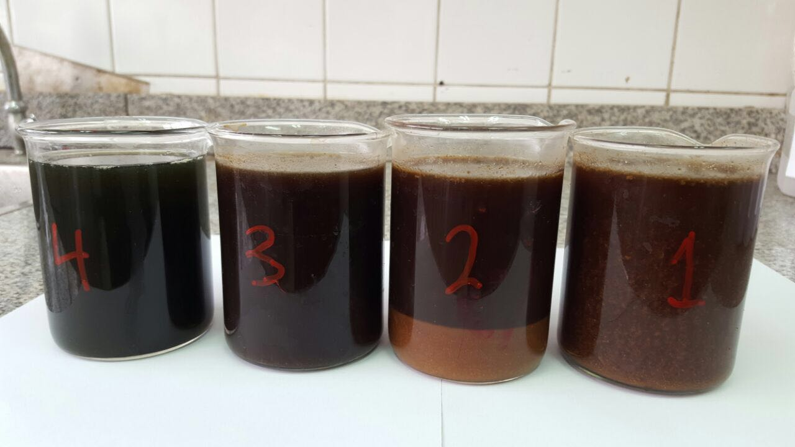
PHYCOREMEDIATION process
(4)
Algal treated OMW
(3)
Supernatant
(2)
Sedimentation stage
(1)
Raw OMW

Slide 20
Phycoremediation Process
Cyanobacteria culture suspensions at log phase, either individually or in a mixture of 1:1:1 v/v, were inoculated at the rate of 20% into 500 ml conical flasks containing 200 ml of different sterilized dilutions of OMW/tap-water (25, 50 and 100% v/v).
In case of Spirulina platensis, all dilutions were supplemented with 5 g/l NaHCO₃ .
The non-inoculated OMW dilutions were used as control.
The cultures were incubated at 27±2°C under continuous shaking (150 rpm) and illumination (2000 Lux) for two weeks.

Slide 21
Up-scaling production of
Cyano-OMW biofertilizer
About 50-liter plastic tanks were used to prepare Cyano-OMW biofertilizer by diluting 20L of non-sterilized OMW with 20L tap water (1:1 v/v).
Tanks were under continuous aeration by air pumps for two days before cyanobacterial inoculation.
10 L of cyanobacterial mixed culture at log phase (1:1:1 v/v) were added to 40 L of OMW-tap water diluted (1:1).
Incubated for two weeks under laboratory conditions and continuous aeration to be applied for one season in the field.

Slide 22
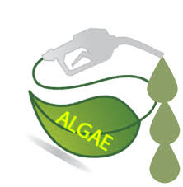
Biodiesel production methodology
System set up
The cultivated cyanobacteria in OMW will be utilized as feedstock for biofuel synthesis based on their chemical composition.
It is proposed to convert the algal lipids into fatty acid methyl esters (FAMEs) or biodiesel using direct transesterification process.
The acid catalyst is firstly dissolved in the reacting alcohol and then fed to the biomass where in-situ transesterification reaction takes place.
At the end of process, the residual cake is removed and distinct layers of biofuel and glycerol are generated.
Refining of products is achieved before storage.

Slide 23
Results
Results indicated that cultivating three cyanobacteria strains, either individually or in combination, on different dilutions of OMW indicated affected significantly on the chemical characteristics of OMW after being exposed to algal growth development for 2 weeks as shown in Table 3.
Figure 1. show the pollutant removal percentages as indidicated by COD and phenolic compounds as affected by cyanobacterial biomass development after cultivation on OMW for two weeks

Slide 24
Table3: OMW specifications after microalgae growing for two weeks
Treatment | OMW % | pH | E.C ds m⁻¹ | D.M g l⁻¹ | COD g l⁻¹ | O.C g l⁻¹ | O.M g l⁻¹ | Total phenols g l⁻¹
Un-inoculated | 25 | 4.00 | 4.20 | 17.21 | 7.00 | 2.63 | 4.53 | 2.75
 | 50 | 4.90 | 6.00 | 23.14 | 10.00 | 3.75 | 6.47 | 4.38
 | 100 | 5.60 | 10.50 | 25.22 | 17.16 | 6.43 | 11.09 | 7.38
Mean value |  | 4.83 | 6.90 | 21.86 | 11.4 | 4.27 | 7.36 | 4.84
Anabaena oryzae | 25 | 4.30 | 1.60 | 18.72 | 2.18 | 0.82 | 1.41 | 1.20
 | 50 | 5.3 | 2.40 | 25.82 | 5.80 | 2.18 | 3.75 | 1.35
 | 100 | 4.50 | 5.00 | 26.11 | 9.20 | 3.45 | 5.95 | 3.75
Mean value |  | 4.70 | 3.00 | 23.55 | 5.73 | 2.15 | 3.70 | 1.99
Nostoc muscorum | 25 | 4.20 | 2.30 | 19.23 | 3.00 | 1.13 | 1.94 | 1.21
 | 50 | 5.20 | 3.00 | 26.05 | 4.65 | 1.75 | 3.01 | 1.75
 | 100 | 4.50 | 4.65 | 25.67 | 7.94 | 2.98 | 5.13 | 3.06
Mean value |  | 4.63 | 3.32 | 23.65 | 5.20 | 1.95 | 3.36 | 1.95
Spirulina platensis | 25 | 8.00 | 2.50 | 20.87 | 2.04 | 0.86 | 1.49 | 0.41
 | 50 | 8.00 | 3.25 | 27.27 | 3.66 | 1.37 | 2.37 | 1.90
 | 100 | 8.50 | 4.50 | 26.02 | 4.20 | 1.58 | 2.72 | 3.30
Mean value |  | 8.17 | 3.42 | 24.72 | 3.30 | 1.27 | 2.19 | 1.87
Mixed Cyanobacteria | 25 | 8.30 | 1.65 | 20.28 | 1.40 | 0.53 | 0.91 | 0.40
 | 50 | 7.50 | 1.45 | 28.32 | 2.20 | 0.82 | 1.42 | 0.27
 | 100 | 8.00 | 4.90 | 26.81 | 2.60 | 0.97 | 1.68 | 3.20
Mean value |  | 7.93 | 2.67 | 25.14 | 2.07 | 0.80 | 1.34 | 1.29
OMW% Average | 25 | 5.76 | 2.45 | 19.26 | 3.12 | 1.19 | 2.06 | 1.19
 | 50 | 6.18 | 3.22 | 26.12 | 5.26 | 1.97 | 3.40 | 1.89
 | 100 | 6.22 | 5.91 | 25.97 | 8.22 | 3.08 | 5.31 | 4.14
E.C.= Electric Conductivity; D.M= Dry Matter; COD= Chemical Oxygen Demand; O.C.= Organic Carbon; O.M.= Organic Matter

Slide 25
Figure 1. Phycoremediation Results

Slide 26
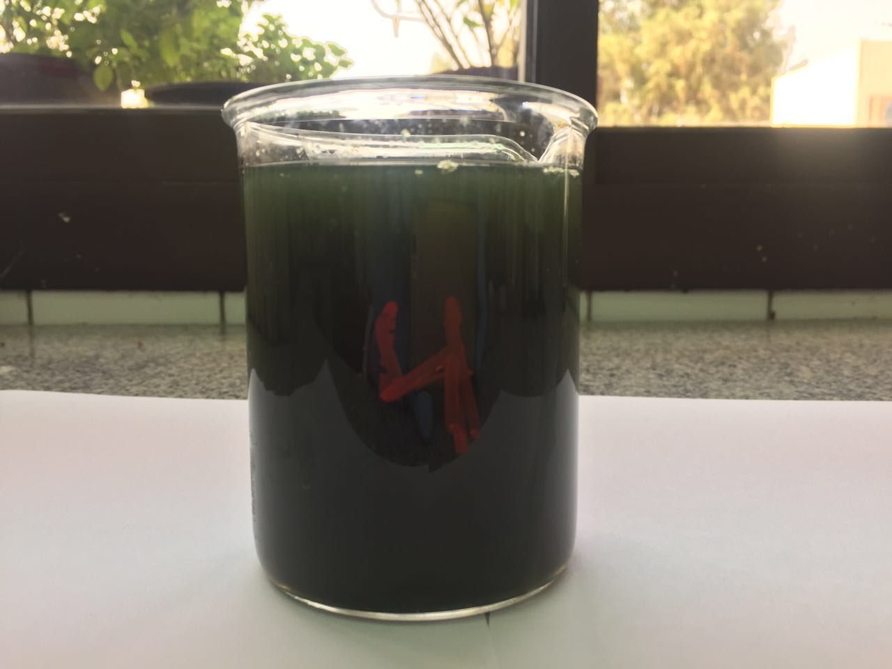
OMW of 50% concentration inoculated with cyanobacterial mixture was selected to be used as biofertilizer (Cyano-OMW) on large scale.
In this concern, a strategy of multiple successive processes (sedimentation, filtration, aeration and bioremediation) was applied for Cyano-OMW large scale production.
The physiochemical and microbiological properties of the bio-formulated Cyano-OMW are listed in Table 4. It proves that the product is neutral (pH 7.5 - 8.5) with moderate EC (2.5 – 3.75), very rich in macro and micro nutrients as well as free from pathogens.

Slide 27
Table 4. Specifications of bio-formulated Cyano-OMW

Slide 28
Bioreactor design for phycoremediation of OMW
Open raceway ponds or vertical tank reactors are available models as bioreactors for simultaneous propagation of algal biomass and nutrients removal from OMW.
The most primitive algae farmers used large open raceways of liquid medium to grow their algae as shown in Figure 2.
The advantages to raceways are that they are inexpensive, can support a large population of algae, and can use effluent water and CO₂ emissions from local industrial plants.
However, open raceways are vulnerable to contamination and it is difficult to find an efficient way to harvest the algae from these large raceways due to the vast area and the constant water flow.
Cyanobacteria can be grown in vertical plastic sheets or photobioreactors (PBRs). These systems are flexible and its design can be optimized according to the features of the cultivated algal species.
PBRs allow growth of many algal strains and provide a protected environment against contamination. PBRs benefits include lower CO₂ losses, lower water use and higher lipids productivity as can be predicted from Figure 3.

Slide 29
Figure 2. Scaled model of a140m² algae open pond bioreactor

Slide 30
Figure 3. Model of PBR investigated in this study

Slide 31
Utilization of cultivated algae in biofuel industry
Once phycoremediation process has completed, the three microalgae strains are collected and dried followed by chemical analysis; to decide which strain can be considered a promising feedstock for biofuel (biodiesel or bioethanol) production. The biochemical analysis of algal biomasses is demonstrated in Table 5.
As well known, the richest the lipids content algae the most suitable for biodiesel synthesis , so Spirulina platensis biomass is suggested for biodiesel production, while the other cyanobacteria are preferred as bioethanol feedstock‘s due to their high carbohydrates content.

Slide 32
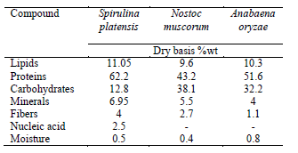
Table 5. Biochemical analysis of algal species investigated in phycoremediation process

Slide 33
In-Situ Transesterification Process
Spirulina platensis was investigated for biodiesel production using the in-situ transesterification technology.
It involves simultaneous addition of alcohol and acid catalyst to biomass; as alcohol extracts the lipids and then catalyzed by the acid into fatty acid alkyl esters (FAAEs).
This methodology is suggested to be economical way in algal lipids transformation into methyl esters (biodiesel) without pre-extracted oilgae.

Slide 34
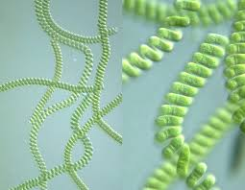
Fatty acid profile of the produced biodiesel
produced was detected by GC-MS that confirming
the predominant fatty acid groups in the Spirulina platensis microalgae are Mystic, C14:0 (22.67% by mol) and Palmitic, C16:0 (49.58% by mol)
as shown in Table 6.
Therefore, Spirulina platensis is a promising feedstock for biofuel synthesis.
The biochemical analysis was demonstrated for Spirulina platensis cake and proved presence of valuable amount of protein (51.5%wt), hence it is suitable to be animal fodder or poultry diet feed.
Considerable amount of nitrogen (500 mg/100g), phosphor (900 mg/100g) and potassium (1475 mg/100g) are involved in Spirulina platensis . These elements are the main nutrients for plant growth, so it is vital as promising plant nutrition element to be used as N-P-K fertilizer “bio-fertilizer”.

Slide 35
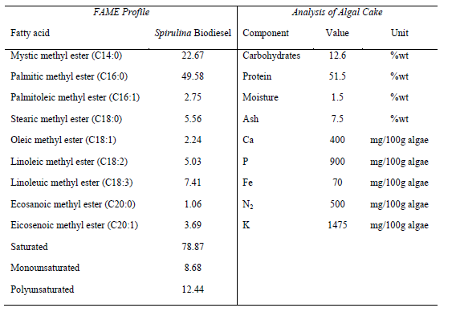
Table 6: Analysis of Spirulina platensis processing products

Slide 36
Figure 4: Phycoremediation process followed by biodiesel production from Spirulina

Slide 37
Conclusion
Phycoremediation is a successful technology for nutrients removal from OMW especially phenolic compounds using 50% OMW and mixed Culture of Spirulina platensis, Nostoc muscorum and Anabaena oryzae
Optimum bioreactor design for OMW phycoremediation is an ongoing exercise however; open ponds or PBRs are feasible.
Biomass production from OMW-Cyanobacteria suspension can be achieved using flocculation followed by centrifugation to obtain 300g dry algae/liter.
Microalgae cultivated via phycoremediation are sustainable feedstock for biofuel industry as C16:0 is the predominant fatty acid in FAME profile.
Algal waste can be utilized as solid biofertilizer, animal fodder or poultry feed.

Slide 38
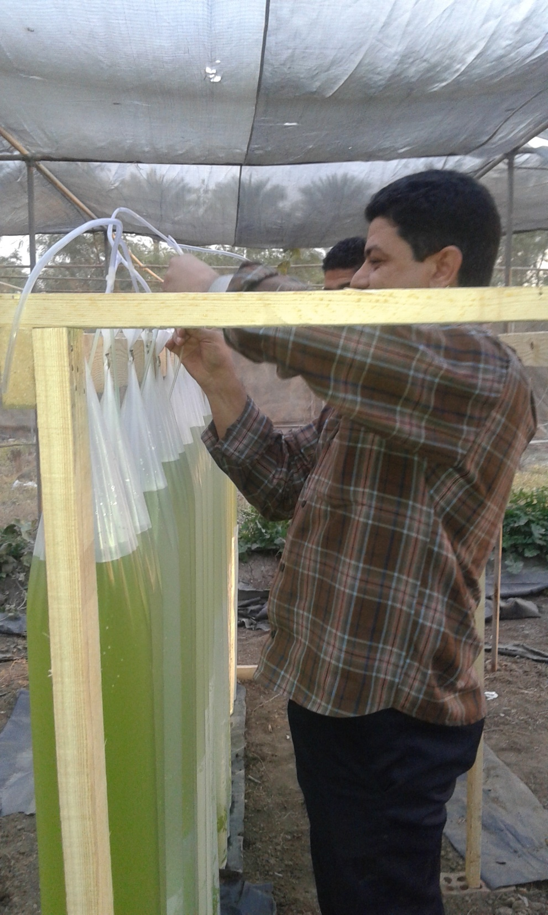

Slide 39
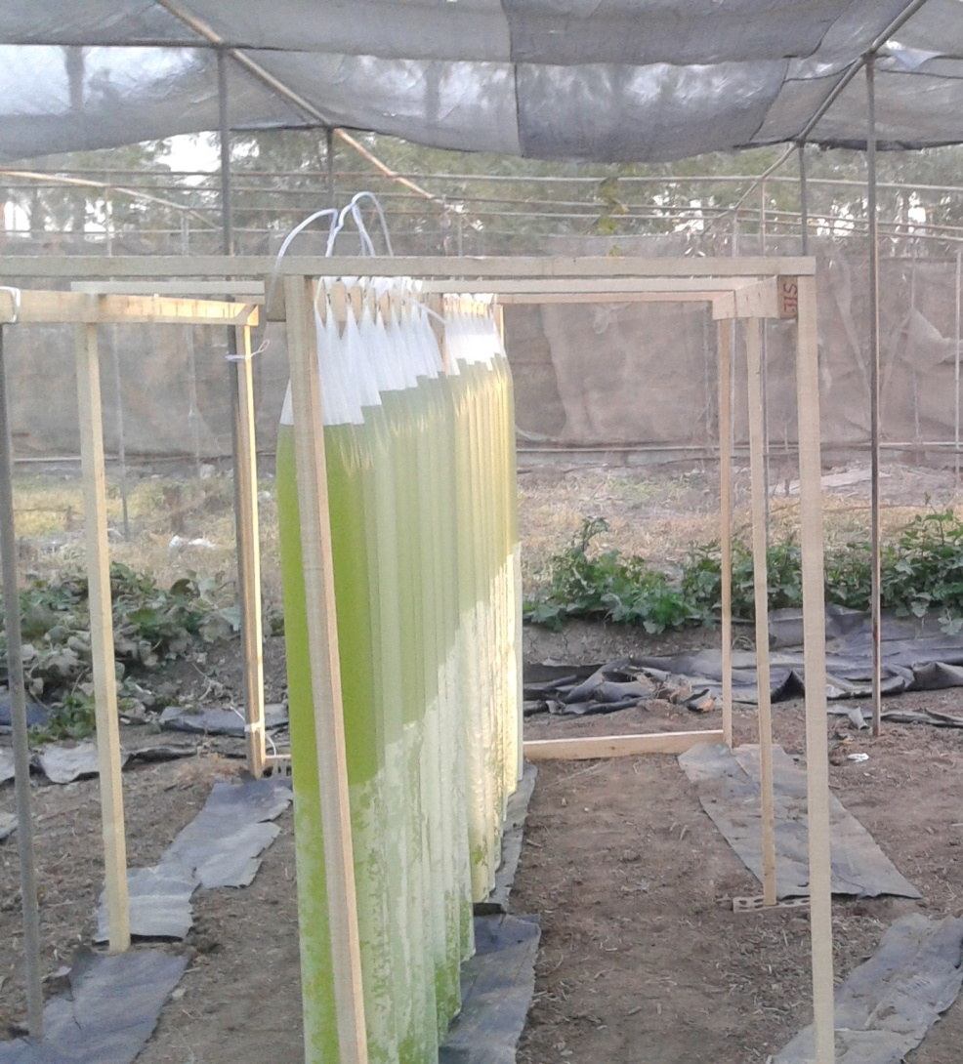

Slide 41
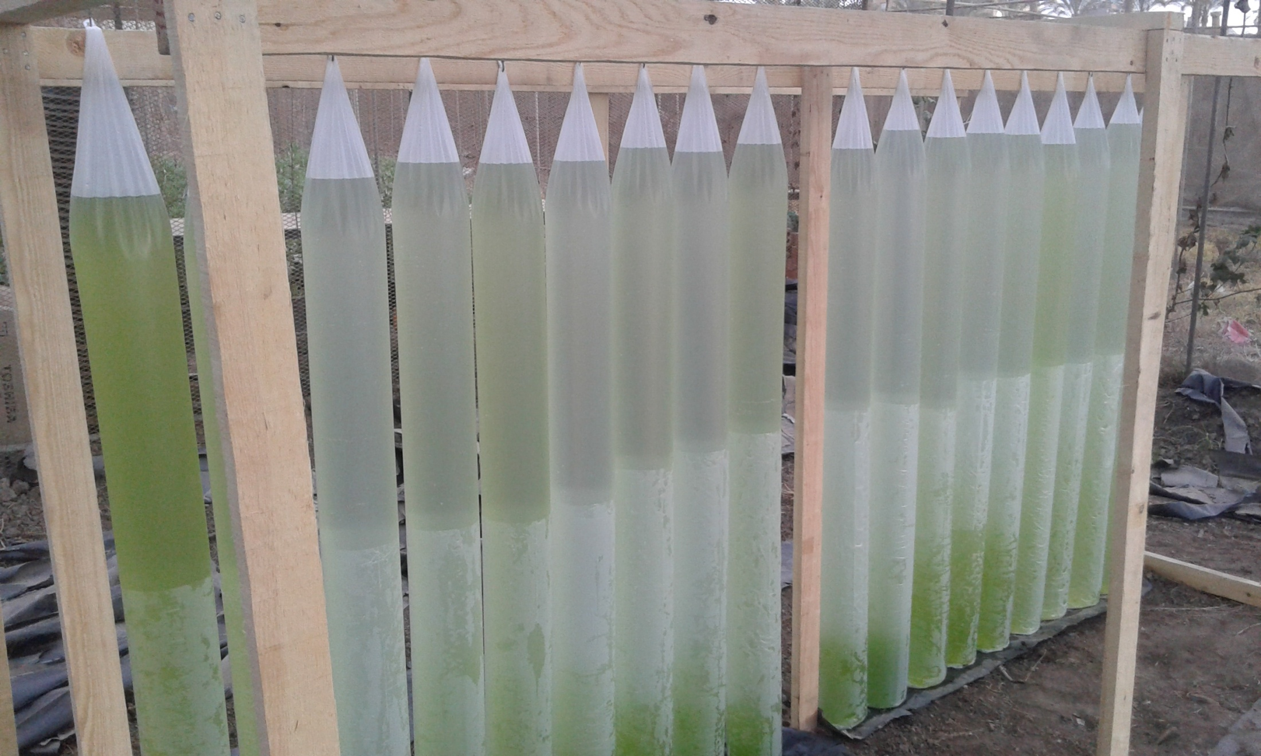

Slide 42
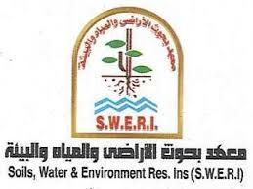
Soils, Water and Environment Research Institute
Objectives:
Conducting applied research to serve the following topics: Survey of land resources -Maximize the output of soil, water and fertilizer unit -Balanced fertilization for plants -Management of soils and water - -Recycling of agricultural residues - Bio-fertilizers and Biological agents production - Improvement of soil productivity - Monitoring of soil and water pollutants.
Conducting extension services and training programs of the above topics.
Quality control of local and imported fertilizers and the inspection of the market.
Providing the services to farmers, organizations and the private sectors throughout the special unit of (soil, water and environment unit) in the field of soils, water, production of biofertilizers (Aukadin, Nemaless, Yeast Solutions and Mixed Solutions) ammonia gas fertilization, agricultural residues recycling and production of land cover, land use and suitability maps.
On farm irrigation development in the old land sharing with agricultural extension sector and ministry of irrigation and water resources.

Slide 43
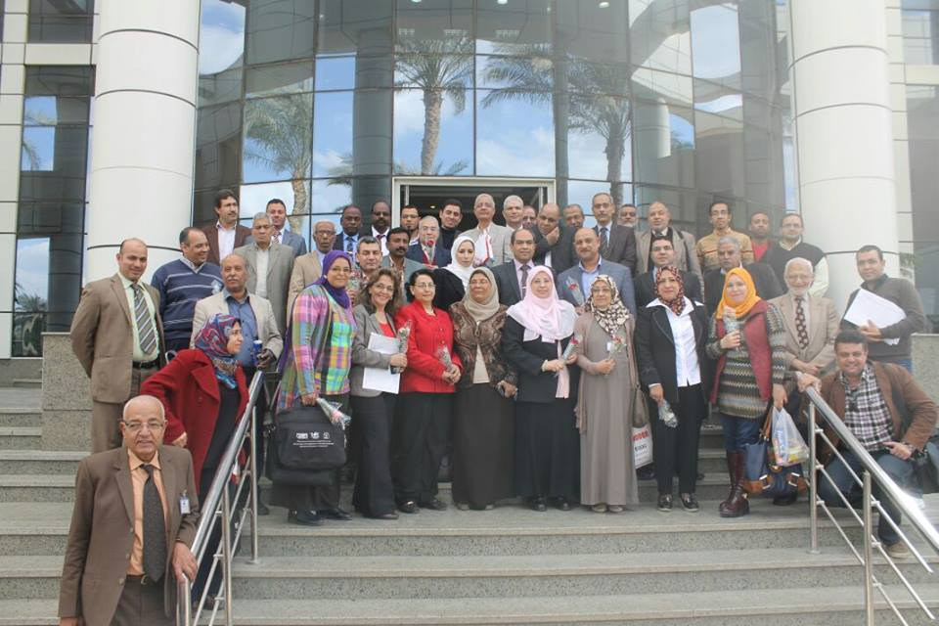
Staff of Agricultural Microbiology Research Department
1STINTERNATIONAL CONFERENCE OF AGRICULTURAL MICROBIOLOGY
"Biotechnology and its applications in the field of sustainable agricultural development”

Slide 44
