Slide 1
ISTA Lab, People, and Packaged Product Certifications
Pong Malasri
Christian Brothers University
2nd International Conference on Food & Beverage Packaging
June 13-14, 2016
Rome, Italy

Slide 2
Outline
Introduction
International Safe Transit Association (www.ista.org)
Lab Certification
Certified Packaging Lab
Certified Packaging Thermal Transport Lab
People Certification
Certified Packaging Lab Professionals (CPLP)
Technician Level, Technologist Level, and Professional Level
Certified Thermal Professionals (CTP)
Level I and Level II
Packaged Product Certification

Slide 3
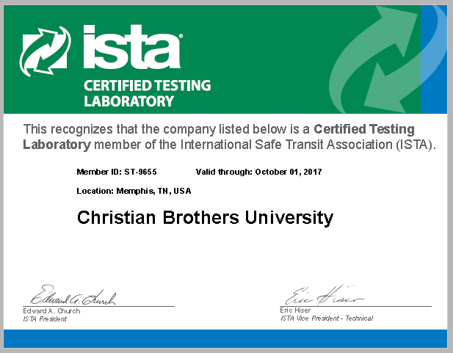
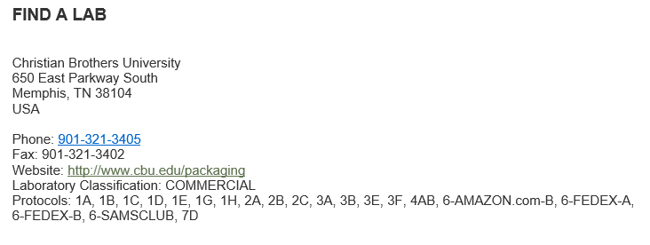
Disclaimer
The speaker is not an official representative of ISTA.
The speaker
Is ISTA Certified Packaging Lab Professional
Oversees CBU ISTA Certified Packaging Lab
Prepares students for ISTA Certified Packaging Lab Technician Exam
Has produced 27 ISTA Certified Packaging Lab Technicians since Spring 2014

Slide 4
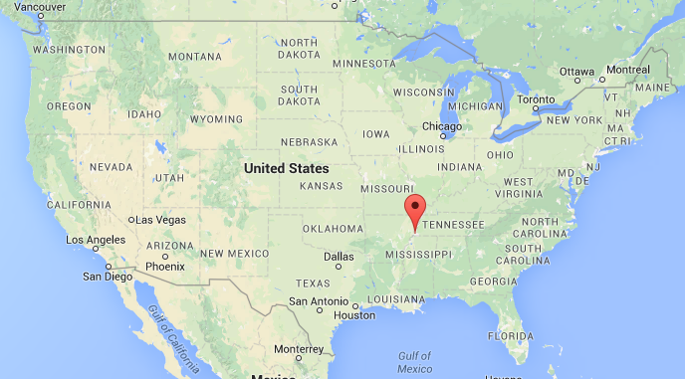
CBU Packaging
Memphis, TN
Major Distribution Center
FedEx, International Paper
Medical Device Companies
Packaging Graduates
BSChE + Packaging Minor
BSME + Packaging Minor
BSEM Packaging Concentration
MSEM Packaging Concentration
Healthcare Packaging Consortium
ISTA Certified Packaging Lab

Slide 5
ISTA
International Safe Transit Association (www.ista.org)
Founded in 1948
Sets standards/protocols for distribution testing
Hosts annual TransPack Forum
Certifies packaged products, test labs & lab professionals

Slide 6
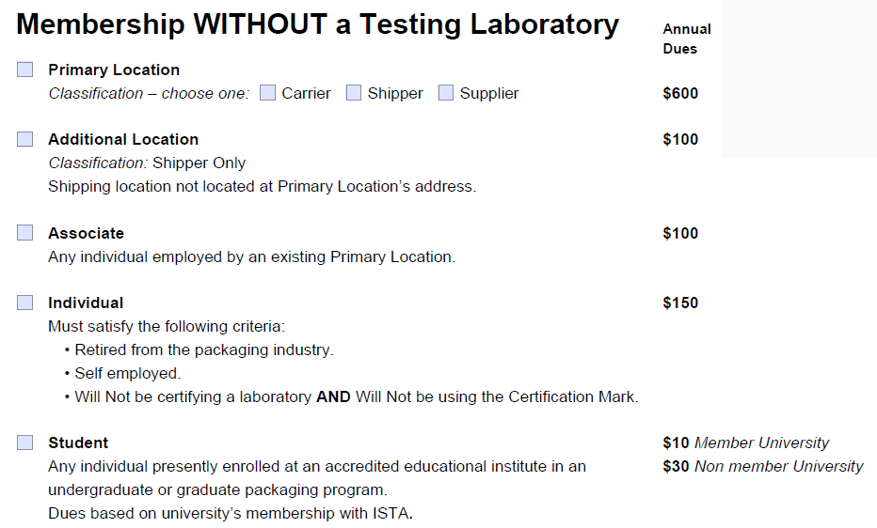
Note: A university without a certified testing lab can be an ISTA member under “Supplier.” Its faculty and staff can then be an Associate member ($100) and its students can be a Student member ($10). A faculty member of a non-member university cannot be an ISTA member but a student can ($30).

Slide 7
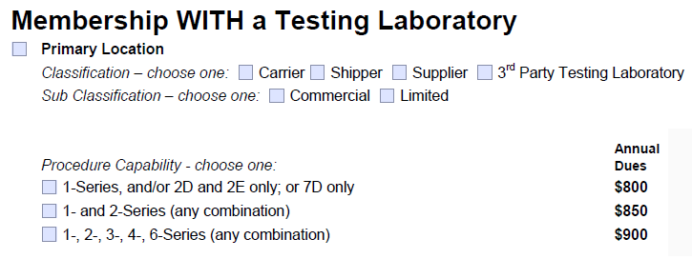

Slide 8
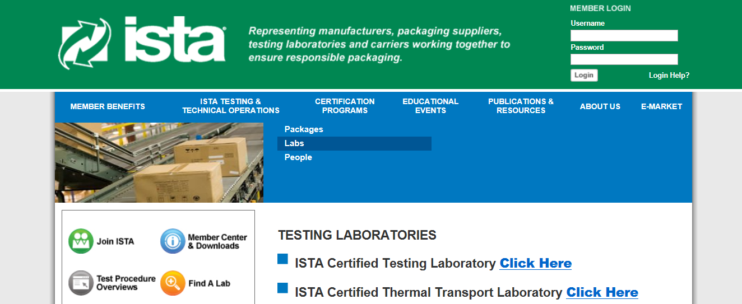
Lab Certification
ISTA Certified Testing Lab
Certified by test procedure
Recertification every two years
ISTA Certified Thermal Transport Lab
Recertification every two years
Annual submission of audit application

Slide 9
Certified Packaging Lab
431 worldwide
U.S. (221)
China (90)
Mexico (9)
France, Germany, Republic of Korea (6 each)
India, Italy (5 each)
Brazil, Indonesia, Ireland, Thailand (2 each)
Belgium, Denmark, Finland, Switzerland (1 each)
Certified Thermal Transport Lab
4 worldwide
U.S. (4) -- CA (1), NJ (2), OH (1)

Slide 10
Equipment Verification Form
ISTA Certified Testing Lab
One form for each equipment
Fixed Displacement Vibration; Vertical Linear/Random Vibration; Inclined Impact Tester; Horizontal Impact Sled; Free Fall Drop Tester; Shock Test System; Compression Tester; Environmental Condition Chamber
No need to have all pieces. Only certified for procedures with available equipment
Important! Calibration/maintenance records

Slide 11
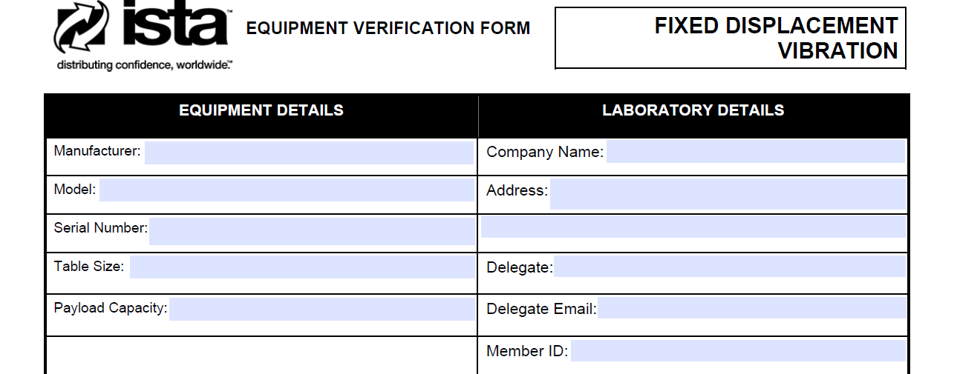
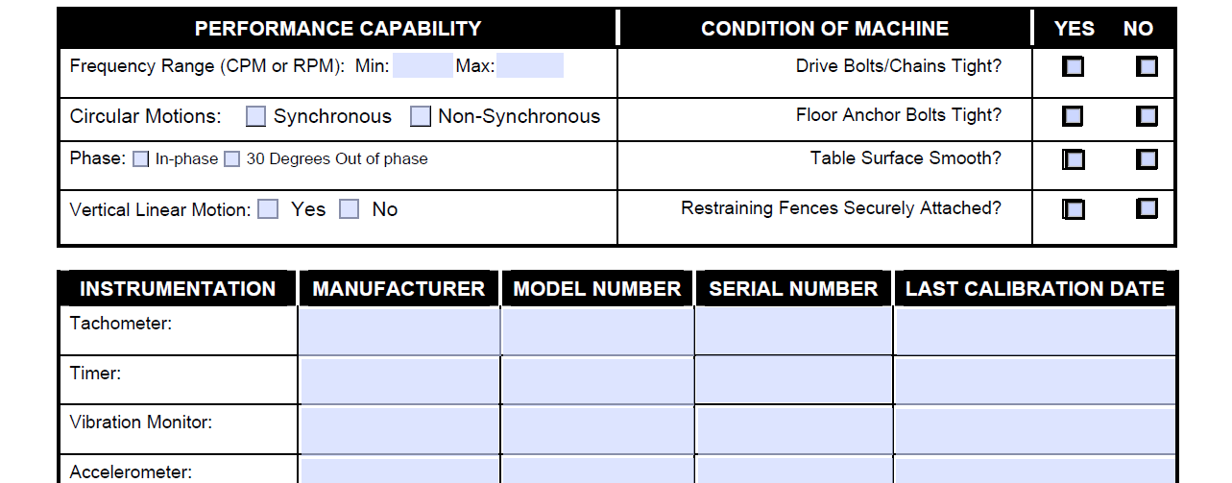

Slide 12
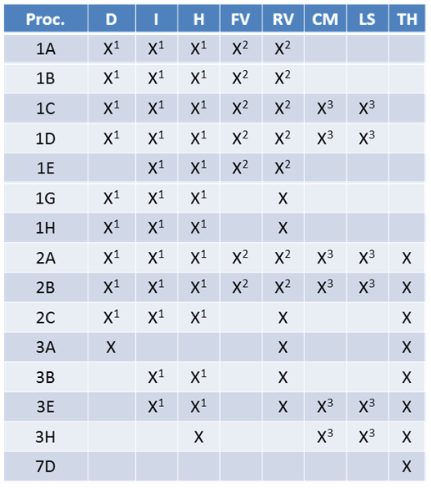
D = Drop Tester
I = Inclined Impact Tester
H = Horizontal Impact Tester
FV = Fixed Displacement Vibration Table
RV = Random Vibration Table
CM = Compression Machine
IS = Load Spreader
TH = Temperature/Humidity Chamber
X¹ Only one is needed
X² Only one is needed
X³ Only one is needed

Slide 13
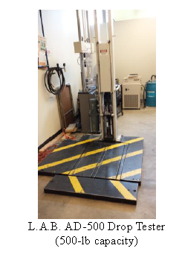
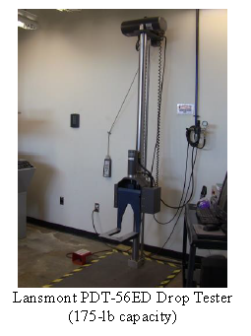
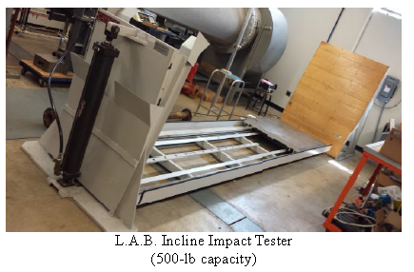
CBU Lab Equipment

Slide 14
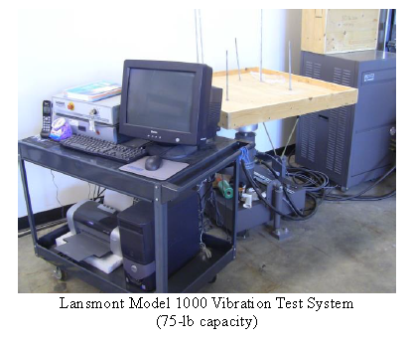
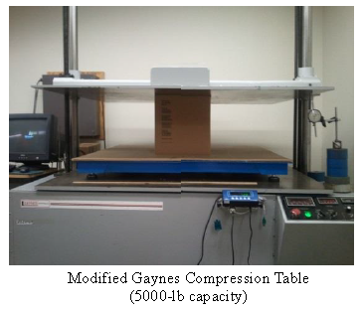
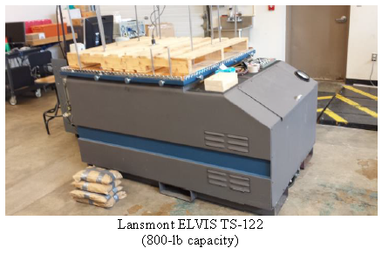

Slide 15
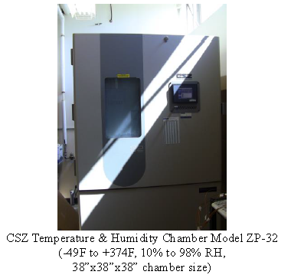
D = Drop Tester
I = Inclined Impact Tester
H = Horizontal Impact Tester
FV = Fixed Displacement Vibration Table
RV = Random Vibration Table
CM = Compression Machine
IS = Load Spreader
TH = Temperature/Humidity Chamber

Slide 16
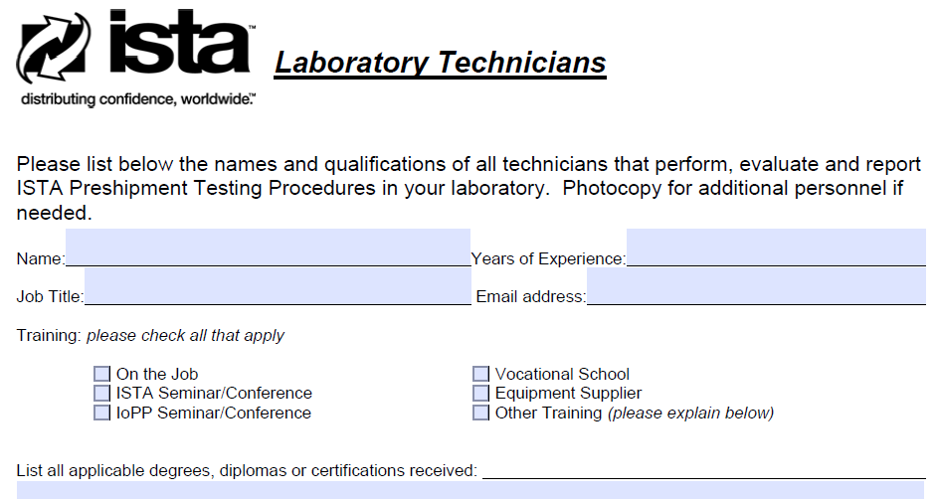
Lab Technician Form
Having a CPLP is a plus but not a requirement.

Slide 17
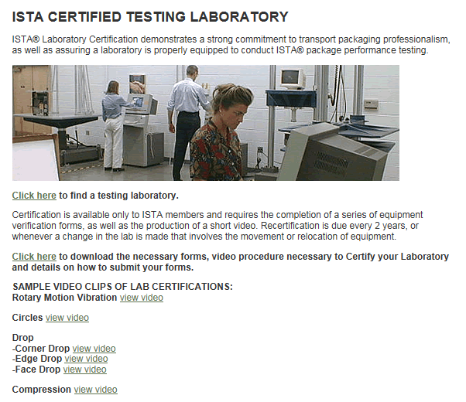
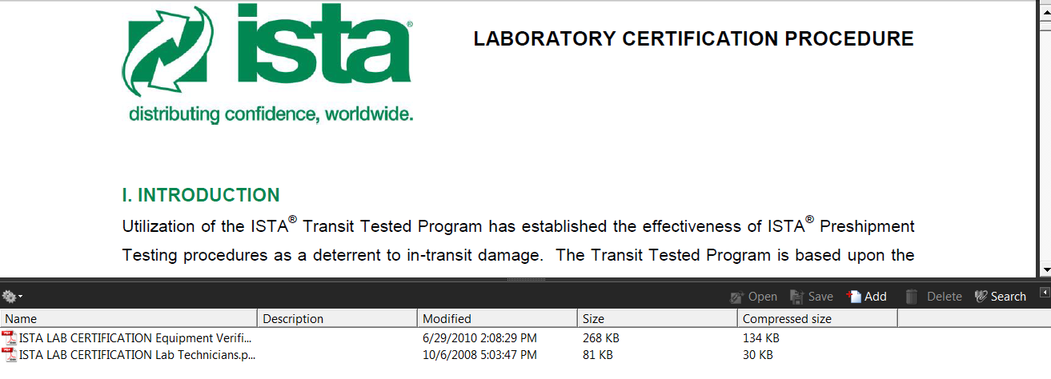

Slide 18
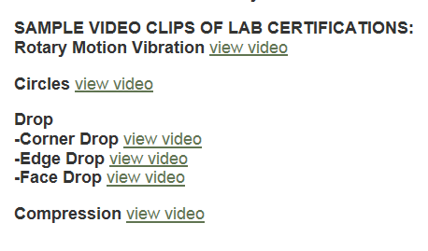
ISTA Lab Certification Process
Fill out forms describing each piece of lab equipment
Carry out and document a detailed procedure of checks for each test system
Video record critical portions of this process
Submit application/materials to ISTA for approval
http://ista.org/pages/certification/testing-laboratories.php#testing

Slide 19
Sample Check Lists for Video Taping
Category | Function to Tape
A1/A2: Vibration | Overall view Frequency run-through Levelness of table Phase relationship (circles – rotary motion only) Sample testing: Use of test box and metal shim
C1/C2: Drop/Shock | Overall view Release mechanism shown Sample testing: Drops on end, side, corner, edge
D: Compression | Overall view Sample testing: Consistent compression rate Sample testing: Platen deflection Controls view
E: Environmental Chamber | Overall view Controls view

Slide 20
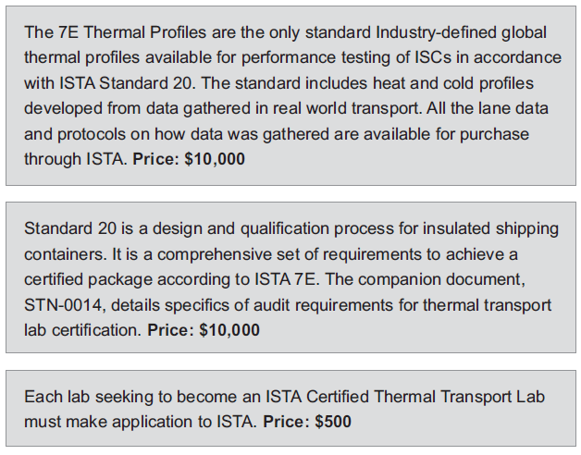
Certified Thermal Transport Lab

Slide 21
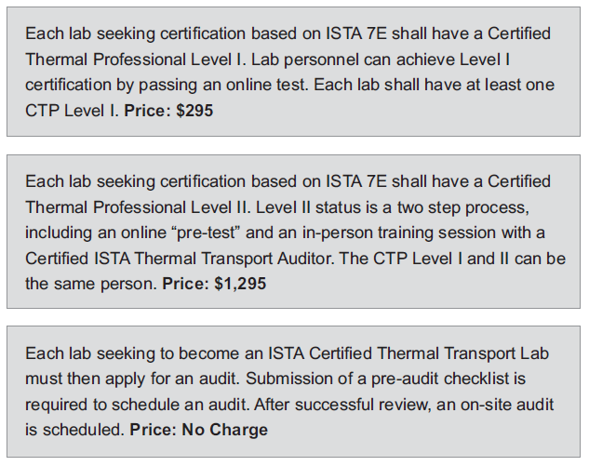
$425
$450

Slide 22
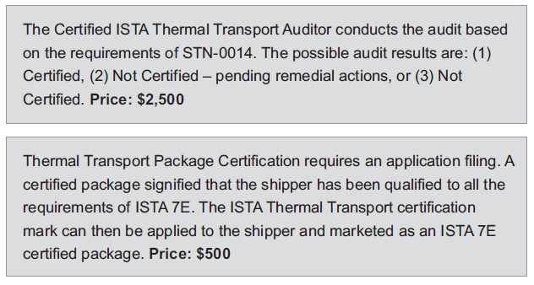

Slide 23
CPLP
Certified Packaging Lab Professionals
Level I – Technician
Minimum of 6 months employment in packaging industry
Only for ISTA members
Passing two-hour exam
Recertification every three years
Level II – Technologist
Minimum of 1 year employment in packaging industry
Technician certification
Passing two-hour exam
Recertification every three years
Level III – Professional
Based on a resume of industry participation and achievements
Technician and technologist certifications
Minimum of 3 years employment in the packaging industry
Lifetime certification – No recertification

Slide 24
(As of 6/13/2016)
CPLP Technician | CPLP Technologist | CPLP Professional
376 worldwide USA (267) China (65) Mexico (7) Canada (6) Japan (5) Philippines, Vietnam (4 each) Singapore, Sweden (3 each) Germany, Ireland, Netherlands, Spain (2 each) Brazil, India, Malaysia, UK (1 each) | 192 worldwide USA (129) China (14) UK (9) Netherlands (8) Mexico (7) Denmark (5) Malaysia (3) France, Germany, Japan, Korea, Philippines (2 each ) Australia, Finland, India, Ireland, Taiwan, Singapore, Spain (1 each) | 26 worldwide USA (19) Mexico (4) China, Malaysia, UK (1 each)

Slide 25
CPLP Contents
Technician Level
Basic laboratory operations
Procedures & protocols
Conduct of the essential ISTA shock/drop/impact, vibration, compression, and atmospheric tests
Technologist Level
Advanced procedures & protocols including those from other organizations
Random vibration
Dynamic material testing
Instrumentation
Enhanced simulation (ISTA 4AB)

Slide 26
Professional Level
Category | Scoring | Max
1. Number of years engaged in activities related to transport packaging | 5-10 points for each full year (no credit for partial years), highest points for responsible activities most directly related to packaging laboratories and testing. | 100
2. College or university degrees | 5-30 points for undergraduate degree, 10-30 additional points for advanced degree, 10-40 additional points for doctorate. Highest points for packaging degrees. | 100
3. Other formal education related to transport packaging or associated subjects | 3-10 points for each successfully-completed semester- or term-length course. Highest points for packaging courses. | 40

Slide 27
Category | Scoring | Max
4. Attendance at transport-packaging-related short courses or seminars, or at major transport-packaging-related educational events or conferences | 3 points for each successfully-completed seminar or course relating to transport packaging | 45
5. Attendance at major packaging shows or exhibitions (Pack Expo, Westpack/Eastpack/Southpack/Midpack, Interpack, Tokyo Pack, etc.). | 1-3 points for each event attended. Highest points for high levels of responsibility regarding attendance, exhibiting, results, etc. | 20
6. Presentations at packaging-related meetings or conferences. Can range from short presentations at local technical society meetings or similar to major presentations at national or international conferences | 2-10 points for each, depending on presentation. Highest points for transport- packaging presentations at national or international conferences with large audiences. | 60

Slide 28
Category60 | Scoring | Max
7. Publication of papers, articles, etc. related to transport packaging | 2-10 points for each, depending on publication. Highest points for sole authorship of major articles in major publications. | 60
8. Membership in packaging professional organizations or technical societies | 1-20 points per year, depending on participation and responsibility. Highest points for high offices in national or international organizations. | 60
9. Packaging-related honors, awards, certifications, competitions entered/won, patents, etc | 3-15 points for each, depending on commendation. Highest points for national or international recognition. | 60

Slide 29
Category60 | Scoring | Max
10. Teaching or lecturing at Packaging-related classes or seminars | 3-30 points for each, depending on class/seminar. Highest points for sole responsibility for major courses and large classes. | 100
11. Other activities and accomplishments related to transport packaging not otherwise covered above, or other factors for consideration (i.e. expert witness, media appearance regarding packaging, public newspaper articles on packaging, education not covered above, advisory boards, etc.). | Additional points awarded at the discretion of ISTA's Certification Committee | 50
A minimum score of 320 is required for CPLP Professional certification. 320 of 695 = 46% |  | 695

Slide 30
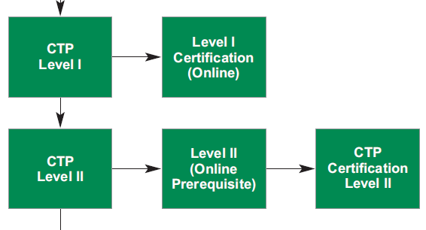
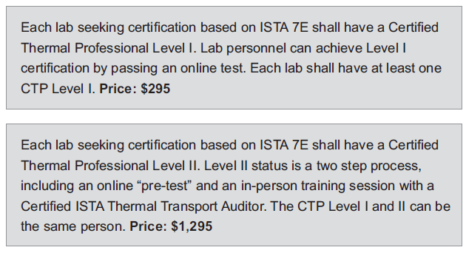
CTP (Certified Thermal Professional)
$425
$450

Slide 31
Package Certification
For Shipper members
ISTA Transit Tested Certification Mark, used by an ISTA Shipper Member and licensed by ISTA, shows that a package has passed ISTA pre-shipment lab testing performed by an ISTA Certified Testing Lab and reviewed by ISTA.
ISTA Thermal Certification Mark, for Insulated Shipping Containers – ISCs, shows that the container has been designed and tested in accordance to ISTA Standard 20 by an ISTA Certified Thermal Transport Lab and reviewed by ISTA.

Slide 32
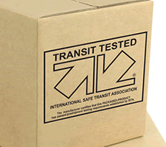
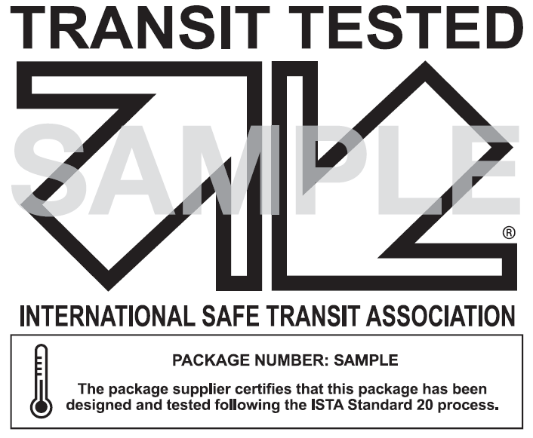

Slide 33
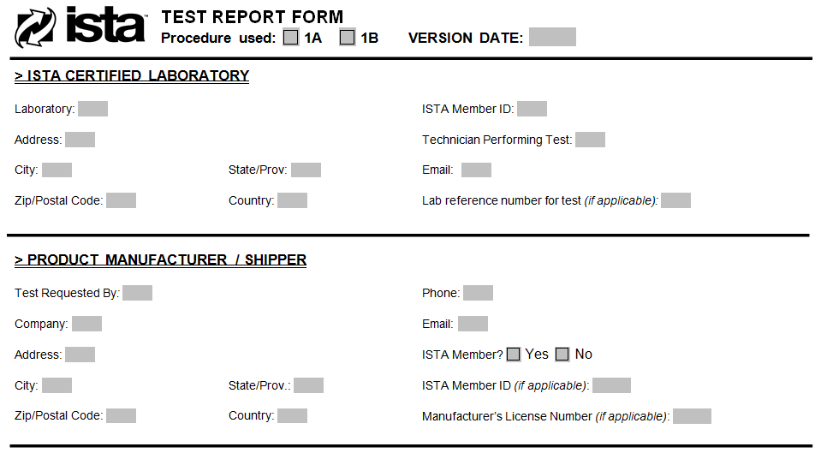
Sample of ISTA Test Report Form

Slide 34
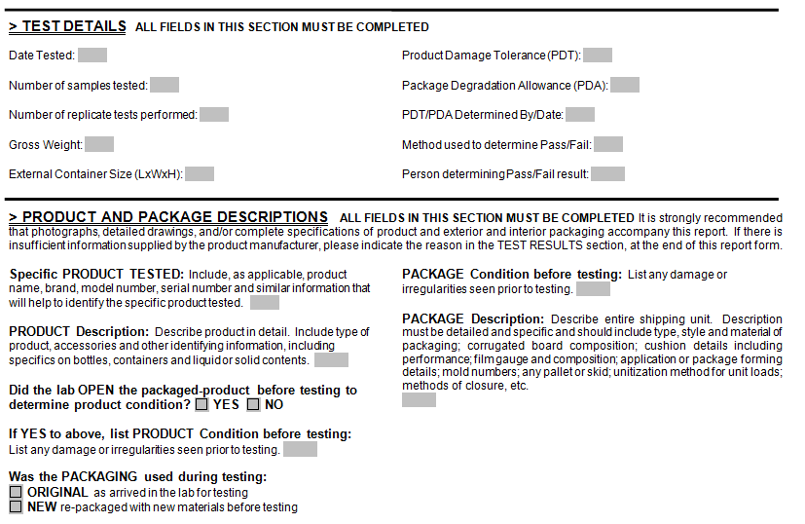

Slide 35
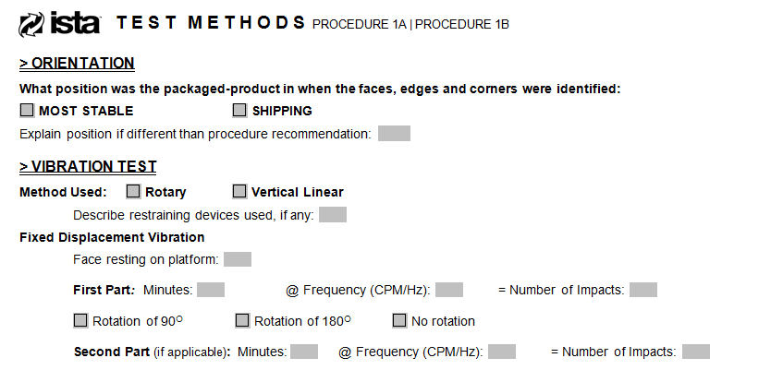

Slide 36
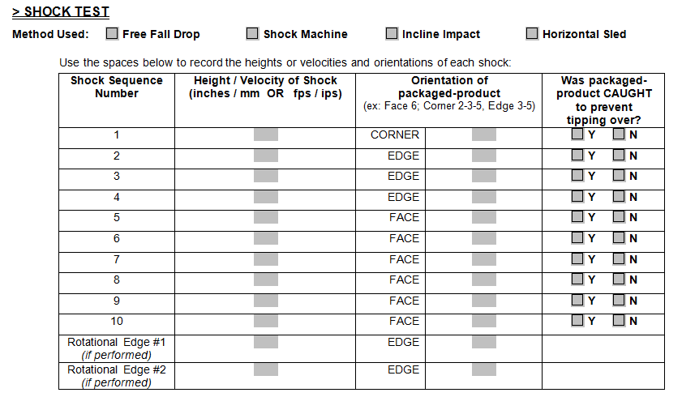
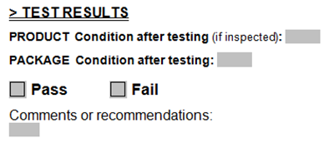

Slide 37
References
CBU Packaging Lab Equipment Maintenance Practice, CBU, January 2013.
Certified Packaging Laboratory Professional Program: Technician, Revision 0210, ISTA.
Laboratory Certification Procedure, ISTA, January 2015.
www.ista.org

Slide 38
Conclusions
Lab Certification
Certified Packaging Lab
Certified Packaging Thermal Transport Lab
People Certification
Certified Packaging Lab Professionals (CPLP)
Technician Level, Technologist Level, and Professional Level
Certified Thermal Professionals (CTP)
Level I and Level II
Packaged Product Certification
Revenue
Industry Relation
Well Maintained Equipment for R&D
Name Recognition
Distribution Packaging Curriculum
Student Job Opportunities

