Slide 1
Factors associated with blood pressure control in hypertensive patients and glycemic control in type 2 diabetes in rural community in central Thailand
5th Year Medical Students Phramongkutklao College of Medicine

Slide 2
Non-communicable disease (NCD)
According to WHO “heart disease, stroke, cancer, chronic respiratory diseases and diabetes, are the leading cause of mortality in the world.”¹
1. WHO, NCD factsheet 2015

Slide 3
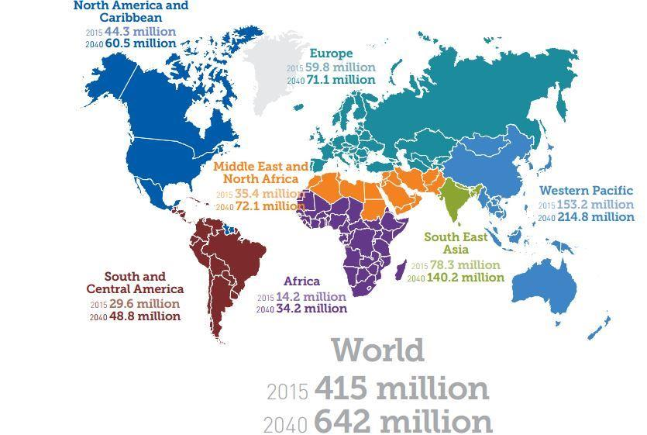
Global DM
Credit : IDF atlas, seventh edition 2015

Slide 4
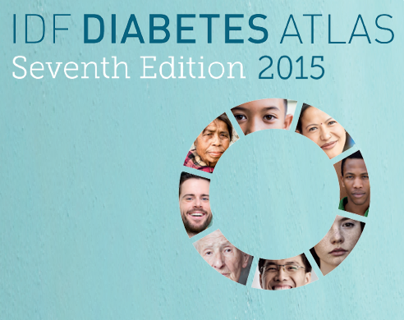
DM in Thailand
Based on International Diabetes Federation (IDF) (2015)
Prevalence of diabetes in adult : 4,175,600
Estimate cases of undiagnosed diabetes patients : 2,223,500

Slide 5
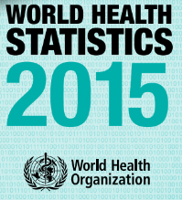
Hypertension
Global estimated prevalence = 1/3 of the global population.²
Caused 7.5 million death and 57 million disabled persons.
In Thailand
Estimated prevalence of HTN = 11 million people³
Or about 20% of total adult population in Thailand²
2. WHO, world health statistics 2015
3. National Health Security Office

Slide 6
Previous study
Hypertension
Prevalence of uncontrolled Hypertension
Hospital setting : 35.7% ¹
Community setting : 61.5% ²
Type 2 Diabetes Mellitus(T2DM)
Prevalence of uncontrolled type 2 DM
Hospital setting : 64.6% ¹
Community setting : 38.9%³
1. National Health Security Office of Thailand
2. Tangjatuporn et al.,2012
3. Siddiqui FJ et al.,2015
Notes:
มีประเด็นใดบ้างที่ทำให้ community ต่างจาก hospital พูดประเดนกว้างๆ

Slide 7
Objectives
To determine prevalence and factors associated with uncontrolled blood sugar in type 2 diabetic patients
To determine prevalence and factors associated with uncontrolled blood pressure in hypertensive patients

Slide 8
Methods
T2DM
Associated factors
Questionnaire
Quantitative
Uncontrolled
Diabetic patient
HbA_{1c}
Controlled
Diabetic patient
Cut point for uncontrolled patients
is serum HbA_{1C} > 7 mg% according to ADA¹ goal
1. American diabetes association. Standards of Medical Care in Diabetes—2015:
Summary of Revisions. Diabetes Care 2015; 1(supplement 1): S33-S40.

Slide 9
Methods
Hypertension
Associated factors
Questionnaire
Quantitative
Uncontrolled
blood pressure
Blood pressure
JNC-8¹ goal for uncontrolled blood pressure was used to classify uncontrolled to controlled patients
Controlled
blood pressure
1. Paul A. James, MD; Suzanne Oparil, MD; Barry L. Carter, PharmD; William C. Cushman, MD; Cheryl Dennison-Himmelfarb, RN, ANP, PhD; Joel Handler, MD5; et al.. 2014 Evidence-Based Guideline for the Management of High Blood Pressure in Adults Report From the Panel Members Appointed to the Eighth Joint National Committee (JNC 8). JAMA 2014; 311(5).

Slide 10
Inclusion criteria
Age > 20 years old
History of hypertension and/or T2DM
Stay in community while data are collected
Exclusion criteria
Pregnancy or lactation
Not consent
Unable to communicate
Notes:
Patient that selected to be volunteer in this project must have criteria about

Slide 11
Questionnaire
Adapted from National Health Security Office ¹
The eight-item Morisky Medication Adherence Scale (MMAS-8)² (Cronbach’s Alpha = 0.61) to describe the medication taking behavior of patients (Thai version)³
1. National Health Security Office, 2015
2. Morisky et al., 1986
3. Psychometric properties of the Thai version of the 8-item Morisky Medication Adherence
Scale in patients with type 2 diabetes.

Slide 12
Morisky Medication Adherence Scale (MMAS-8)
Is a questionnaire designed by Donald E. Morisky to predict patients drug compliance in 1986.

Slide 13
Ethical Approval
This project was reviewed and approved by Institutional Review Board of Royal Thai Army Medical Department.
Participants were given information about study procedure and an inform consent has been done.

Slide 14
Results

Slide 15
Study information
Conducted in Tha Kradan, Sanamchaiket, Chachoengsao.
Study period : 21 – 25 Nov 2015
Total enrollment : 283 persons
Notes:
Sample size =
178 DM
HT 197

Slide 16
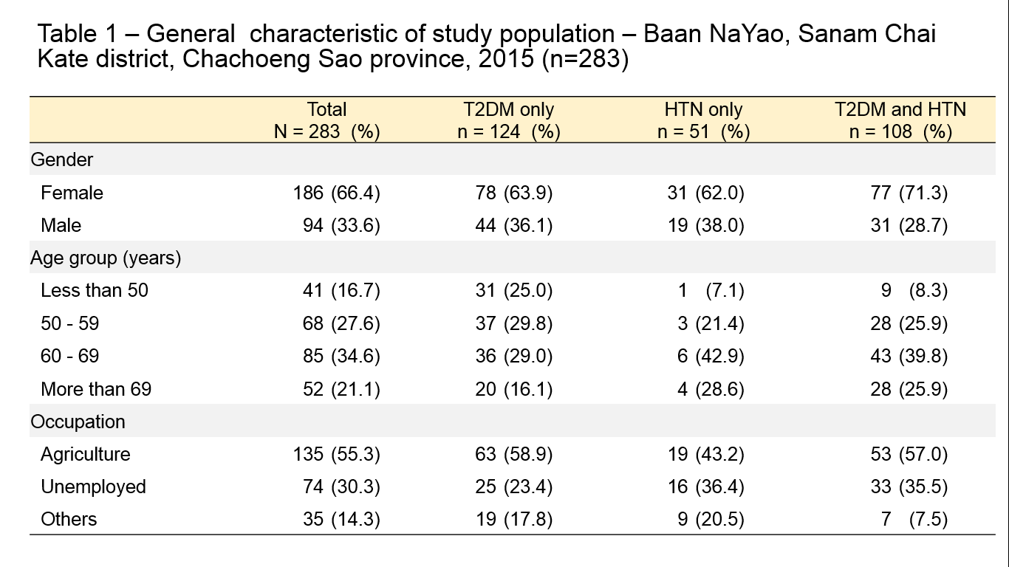
Table 1 :General characteristics of study population (N=283)

Slide 17
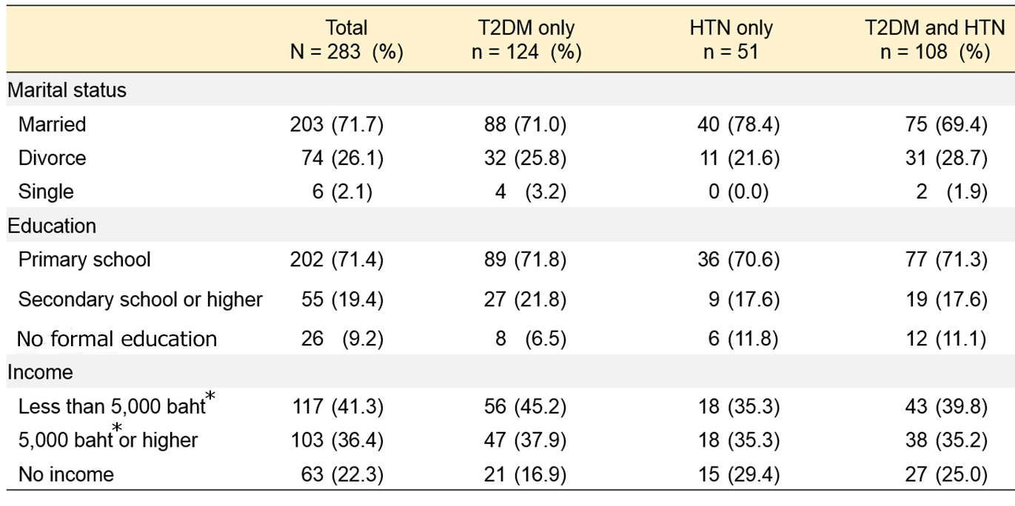
Table 1 :General characteristics of study population (N=283)
* 35.71 Baht = 1 US dollar as of 25 February 2016

Slide 18
Prevalence of uncontrolled diseases
Diabetes
Uncontrolled : 54.4 %
Controlled : 45.6 %
Hypertension
Uncontrolled : 42.2 %
Controlled : 57.8 %

Slide 19
Multivariate Analysis to Determine Factors Associated with Glycemic Control in T2DM patients
Factors | Controlled [ n(%) ] | Uncontrolled [ n(%) ] | Adjusted odds ratio | 95% CI | P-value
BMI (kg/m²)*
Normal weight | 31 (52.5) | 28 (48.5) | 1
Obesity | 34(47.2) | 38(52.8) | 2.36 | 1.03 – 5.39 | 0.04
Missed Medication
No | 48(56.5) | 37(43.5) | 1
Yes | 22(28.9) | 54(71.1) | 2.35 | 1.21 – 4.54 | 0.01
After adjusted by age, duration of T2DM diagnosis, gender, education, patients' right,
Fear of adverse effect, regular doctor follow-up, poor attitude, dietary control
*According to WHO. Appropriate body-mass index for Asian populations and its implications for policy and intervention strategies.
Lancet 2004; 363: 157–63. January 10, 2004

Slide 20
Multivariate Analysis to Determine Factors Associated with Blood Pressure Control in Hypertensive patients
Factors | Well-controlled [ n(%) ] | Poor-controlled [ n(%) ] | Adjusted odds ratio | 95% CI | P-value
MMAS-8
Adherence | 36 (67.9) | 17 (32.1) | 1
Non -adherence | 31 (49.2) | 32 (50.8) | 2.19 | 1.02 – 4.67 | 0.044
After adjusted by gender, age, BMI*, co-morbid, dietary control
*According to WHO. Appropriate body-mass index for Asian populations and its implications for policy and intervention strategies.
Lancet 2004; 363: 157–63. January 10, 2004

Slide 21
Discussion
Our prevalence uncontrolled diabetes patients (54.4%) is higher than Siddiqui FJ et al¹.’s study(38.9%) possible reasons
Dietary behavior
Physical inactive
Sedentary lifestyle
1. Siddiqui FJ et al. uncontrolled diabetes mellitus: prevalence and risk factors among people with type 2 diabetes mellitus in an Urban District of Karachi, Pakistan. Diabetes Res Clin Pract. 2015 Jan;107(1)

Slide 22
Discussion
Compare to previous study on HTN prevalence(61.5%), this study have lower prevalence.
A cohort study conducted by Ojji DB, et al¹, revealed that 8.4% of hypertensive patients with co-morbid conditions tend to have poor hypertensive control. (We found no association).
1. Ojji DB .Risk factor profile and comorbidities in 2398 patients with newly diagnosed
hypertension from the Abuja Heart Study, et al. Medicine (Baltimore) 2015.

Slide 23
Conclusion
Appropriate medication usage and dietary promotion among rural population can enhance disease control.
Primary healthcare and preventive medicine approaches can raise awareness among rural population.
Recommend that further study should be conduct to gain better in possible factors.

Slide 24
Acknowledgement
People of Baan Na Yao District
Baan Na Yao health promotion hospital
Sanamchaiket hospital
Col. Assistant Professor Dr. Ram Rangsin
Lt. Col. Sarawut Jindarat
Lt. Col. Tanongson Tienthavorn
Lt. Col. Phunlerd Piyaraj
Capt. Picha Suwannahitatorn
Capt. Anupong Sirirungreung
2nd Lt. Ploypun Narindrarangkura
2nd Lt. Sirachat Nitchapanit

Slide 25
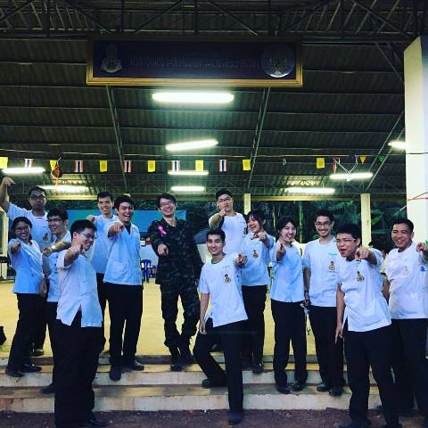
Acknowledgement

Slide 26
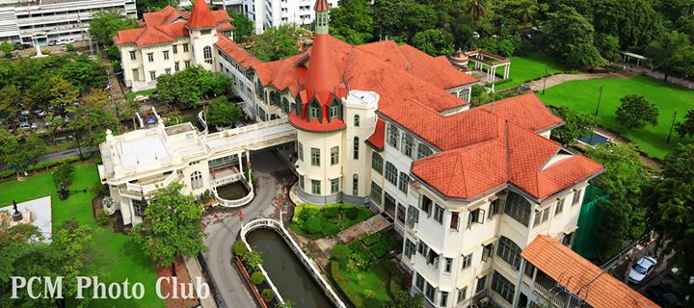
Thank you for your attention

Slide 27
Question?

Slide 28
Qualitative result

Slide 29
Demographic Data
 | Controlled HT | Uncontrolled HT | Controlled DM | Uncontrolled DM | Provider
Total | 6 | 6 | 3 | 5 | 20
Gender Male Female | 3 3 | 3 3 | 1 2 | 2 3 | 3 18
Average age | 64 | 59 | 63 | 65 | 54
Education None Primary Secondary | 1 5 0 | 0 6 0 | 0 3 0 | 0 4 1 | 0 17 3

Slide 30
Demographic Data
 | Controlled HT | Uncontrolled HT | Controlled DM | Uncontrolled DM | Provider
Occupation Unemployed Working | 5 1 | 3 3 | 1 2 | 2 3 | 0 20
Status Single Married Divorced | 0 5 1 | 3 2 1 | 1 2 0 | 1 4 0 | 7 10 3

Slide 31
Focus Group Discussion : Provider
About hypertension and diabetes mellitus
Knowledge
“We lack of instruments , it’s too old and already broken. When we have to use it, we have to borrow it form hospital”
(62 years old woman, provider)
Cause
Behavior
“Sometimes health officer is forget to prescript drug and making wrong appointment date”
(54 years old woman, provider)
“Sometime drug is out of stock. We go to get drug but drug in stock is not enough”
(46 years old man, provider)
“We used to have aerobic exercise, but now the audio is broken and organizer don’t have enough time, so there is only the stage left”
(55 years old woman, provider)
“Distance to hospital is the most troublesome problem, there are about 60 km. and the road is just repaired”
(58 years old woman, provider)
“There are 3 types of diabetes including fat diabetic, thin diabetic and rot wound ”
(46 years old woman, provider)
“The villagers like to eat salty sweet and spicy food
They do hard work and they want it. If they didn’t eat spicy food, they will have abdominal discomfort”
(53 years old woman, provider)
“Nowadays rice isn’t as safe as in the past, there are a lot of chemical agents. Sometimes you can get diabetes from sticky rice”
(62 years old woman, provider)
“Blood pressure 120/80 is normal, if it over or lower than that it is hypertension or hypotension”
(62 years old woman, provider)
Diet
Exercise
Health care service and environment

Slide 32
Focus Group Discussion : Hypertension
“Sometimes I don’t take drug because it need to take everyday so I’m bored”
(66 years old woman, farmer)
“In my free time I usually walk around the house and go into the fruit garden. So, I think this equals to exercise”
(63 years old woman, farmer)
“I’m see everybody in my village have hypertension so I don’t care”
(58 years old woman, farmer)
“I was given medications at sanitarium. I didn’t go to the hospital. The doctor told me it was far, so he came here every Thursdays instead. He didn’t bring any drugs; using only those in the sanitarium only”
(72 years old woman, farmer)
“Since I live here for 10 years,I never come to see doctor”
(60 years old man, farmer)
About hypertension
Knowledge
Cause
Behavior
“When I’m finish my work, it so tired and don’t have time to exercise
”
(67 years old woman, farmer)
“I like to eat pickled fish ,it must be salty to have great taste”
(61 years old woman, farmer)
“Stress ,high fat intake and salty food”
(68 years old woman, farmer)
“I’m think over 130mmHg is hypertension”
(68 years old woman, farmer)
Diet
“I used to smoke when I was a teenager. But now I stopped smoking for 30 years already”
(62 years old woman, farmer)
“It may be cause by stress from my son. He was jailed. How much money is out there. He buys a new car but not sending money”
(62 years old woman, farmer)
“I don’t know anything. The doctor just said I had hypertension , dyslipidemia and allergic rash.””
(62 years old woman, farmer)
“I don’t use fish sauce. I eat tofu, vegetables and nuts”
(65 years old woman, farmer)
Exercise
Health care service and environment

Slide 33
Group interviews : DM
I don’t know anything but I feel dizzy ,palpitation and fainting
(68 year-old woman, poor control)
When I finished my work, I felt so tired and didn’t have time to exercise (44 year-old man poor control)
The doctor didn’t forbid to eat anything specifically but restricted the amount. I ate everything ; not fear death only tired.
(68 year- old woman poor control)
Sometimes I forget taking medications. Because it is not convenient (68year-old woman well control)
About T2DM
I got my medications from sanitation. I waited so long, like a day, same as when I went to the hospital(44 year-old man poor control)
I don’t know. I can’t remember
(73 year-old woman poor control)
Knowledge
Causes
Well, yummy food and spicy food are needed to be restricted. They cause diabetes
(54 year-old woman well control)
(54 year-old woman poor control)
Behavior
After pills, shake nausea vomiting diarrhea
(54 year-old woman, well control)
Well, I take medications after each meals just like the doctor’s order and exercise by walking daily (47 year-old woman well control)
I exercise everyday. I work as a masseuse so my work is exercise (42 year-old woman well control)
Diet
Yes, I heard. I think it is about eating sweetie food. (47 year-old woman poor control)
Yep, it is quite difficult actually because Sanam Chai Khet hospital is about 60 km away. I wouldn’t go if not necessary (54 year-old woman well control)
Heath care
Services and
environment
Exercise

