Slide 1


Bacterial Spores as Probiotics: Mode of Action
Professor Simon Cutting
School of Biological Sciences
Royal Holloway University of London
Egham, Surrey
TW20 0EX, UK
s.cutting@rhul.ac.uk

Slide 2
Sporulation in Bacilli
Use of Bacillus spores as probiotics
How do they work?

Slide 3

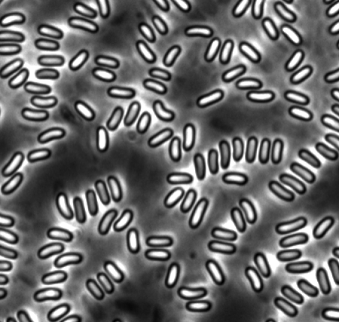
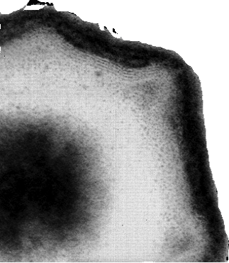
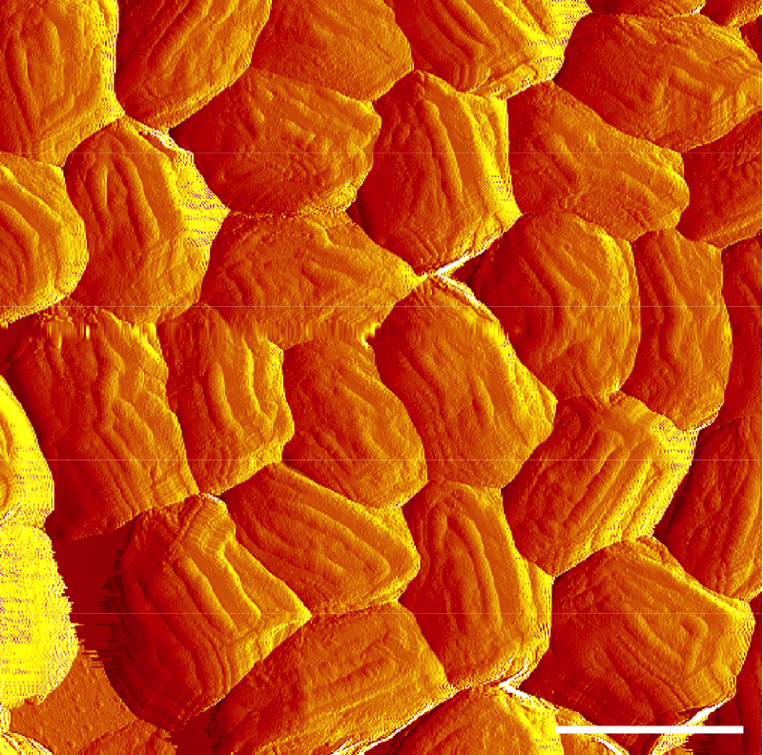
Plate colony Phase Microscopy Electron microscopy Atomic Force microscopy

Slide 4
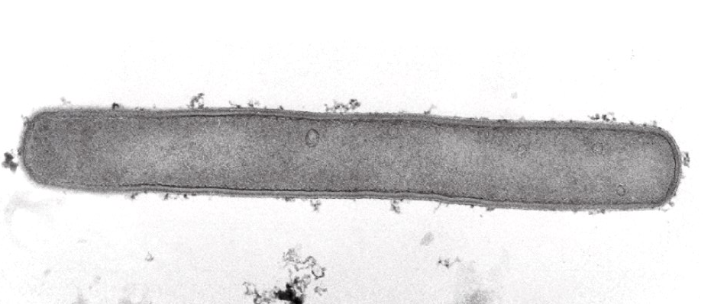
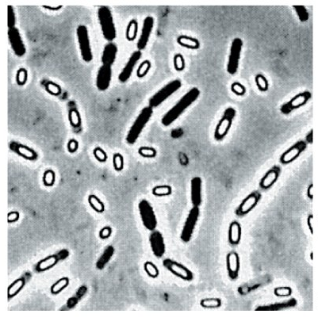
Life cycle of Bacillus species
Vegetative Growth
Sporulation

Slide 5
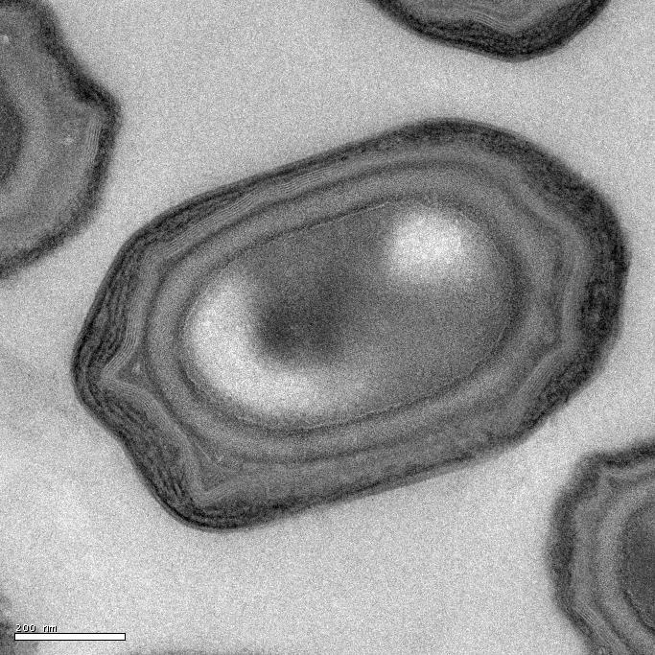
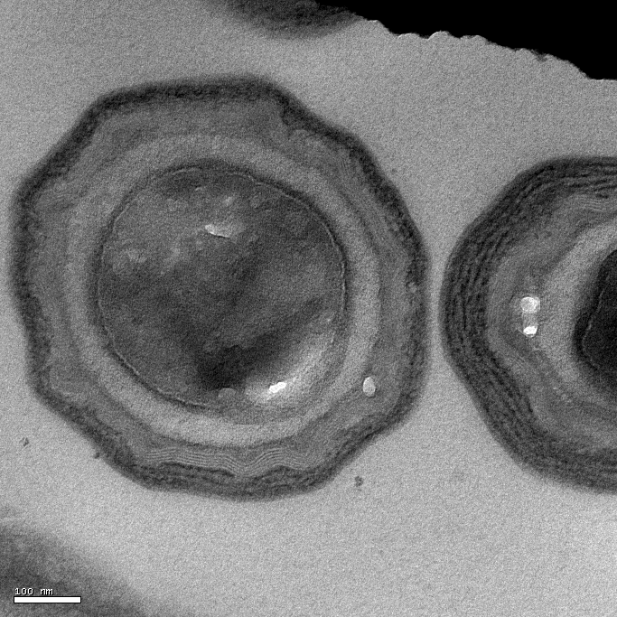
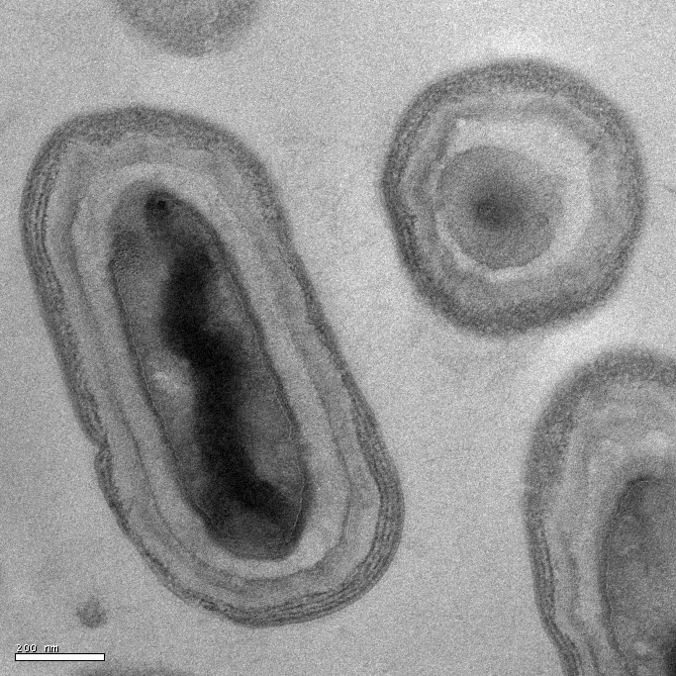
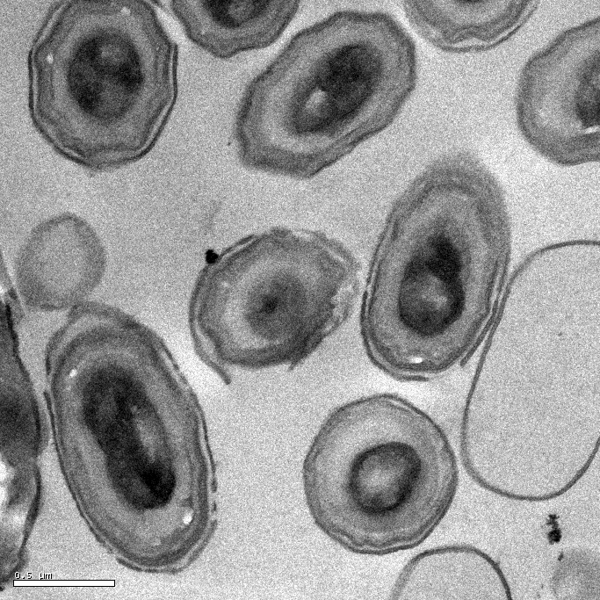
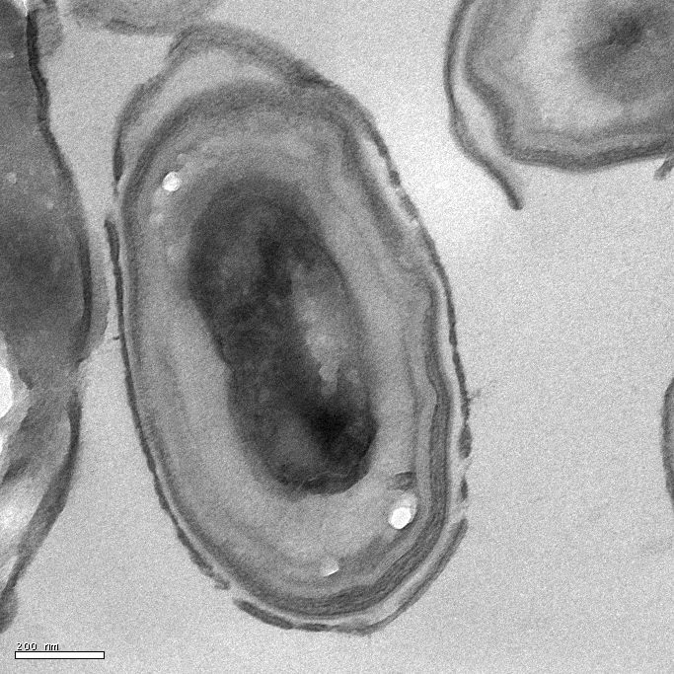
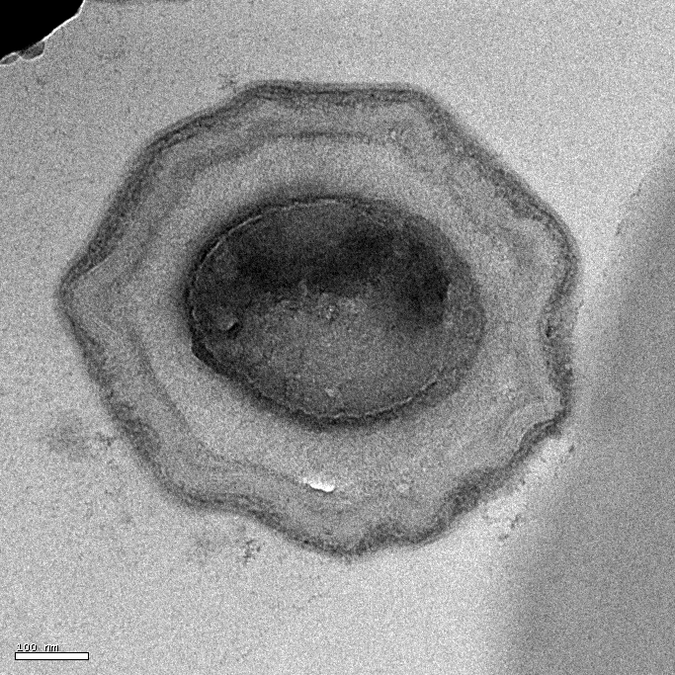
Spores of different isolates of B. subtilis
A
B
C
200 nm
100 nm
200nm
D
E
F
0,5 µm
200 nm
100 nm

Slide 6
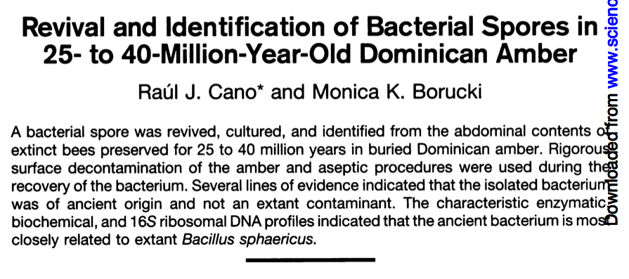
Spores are very robust
Science (1995). 268: p1060-4
Resistance to UV irradiation
Temp 65ºC-80ºC
Extreme heat-short term (<8 min) to 235ºC
Resistance to solvents and noxious chemicals

Slide 7
Use As Probiotics, Dietary Supplements and Nutrafoods

Slide 8
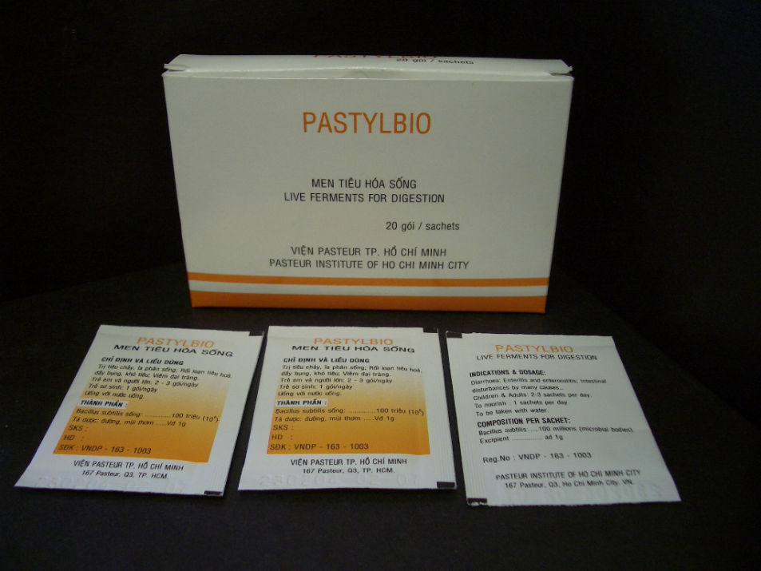
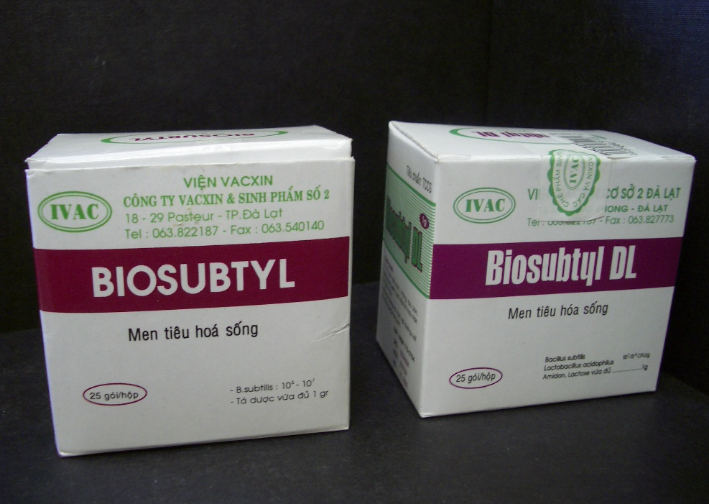
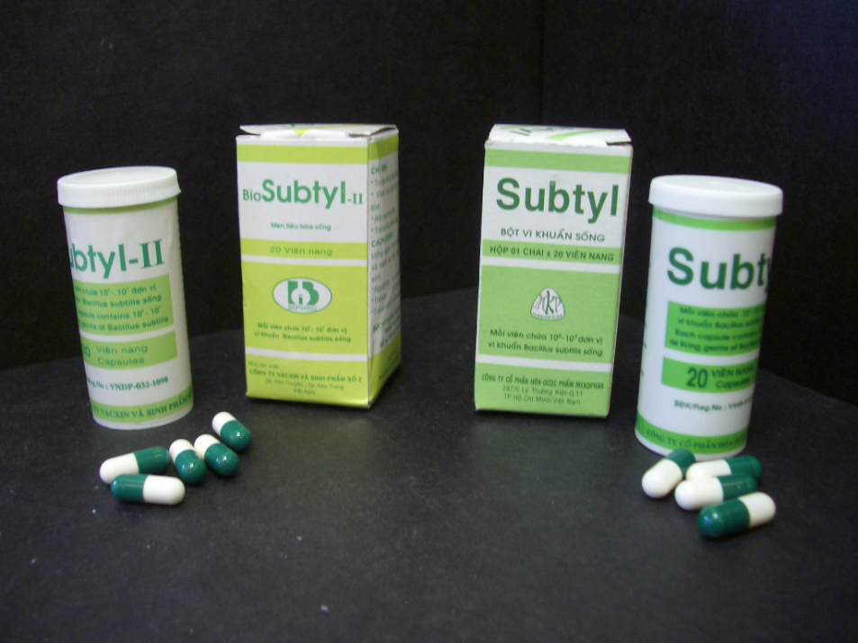
Dietary supplements, food supplements
B. subtilis, B. cereus, B. coagulans (aka Lactobacillus sporogenes), B. clausii
GanedenBC³⁰. Spores of B. coagulans added to muffins and baked foods, alcohol, chocolate in the USA etc.
B. subtilis has registration for food use in the UK (2007) and Italy (<1991)
B. coagulans has GRAS status in the USA (2008)

Slide 9
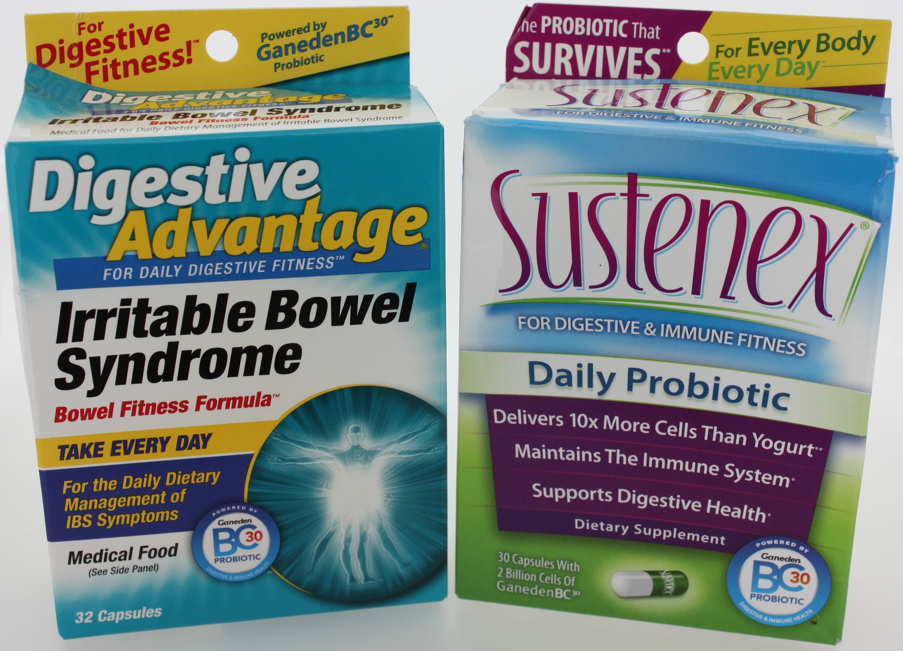

Slide 10
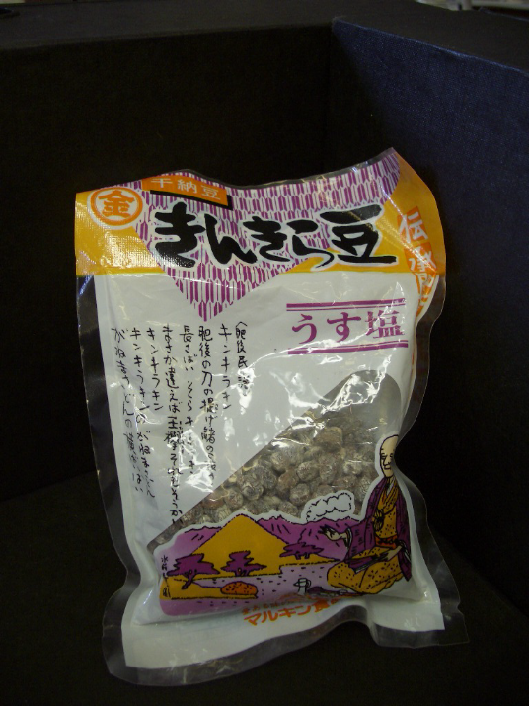
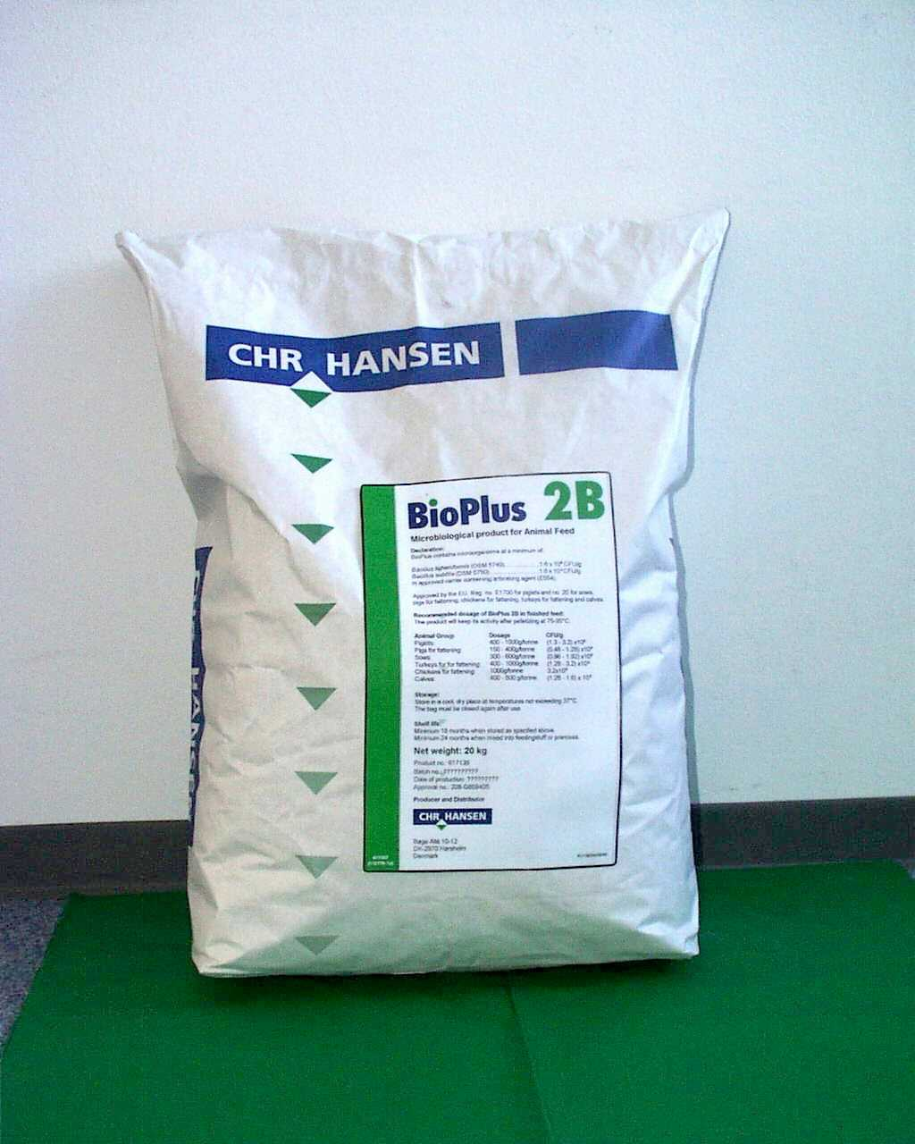
Natto
B. subtilis var. Natto
Japanese staple
BioPlus 2B
Spores of B. subtilis & B. licheniformis
Animal feed
Christian Hansen (Denmark)

Slide 11
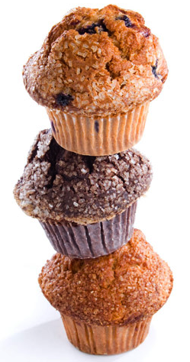
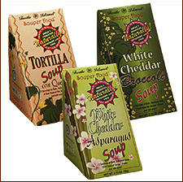
Main Street Gourmet (USA)
obtained from Isabella’s Healthy Bakery
“Activate”
Probiotic muffins impregnated with spores
Turtle Island Soup (USA)
“Souper Food”
Soups fortified with spores

Slide 12
Survival of spores incorporated in biscuits (McVities) after 84 days
Spores count / gram
These are background counts
And are Bacillus spores present in your biscuit mix. The biscuit mix is not sterile and data shows that cereals, wheat etc have a basal level of spore counts.
Before cooking
0 7 14 28 42 56 84
Days
Starting CFU
HU58 Tube 1 + 1kg mix = 6.57 X 10⁸ spores/g
PXN21 Tube 1 + 1kg mix = 1.33 X 10⁹ spores/g

Slide 13

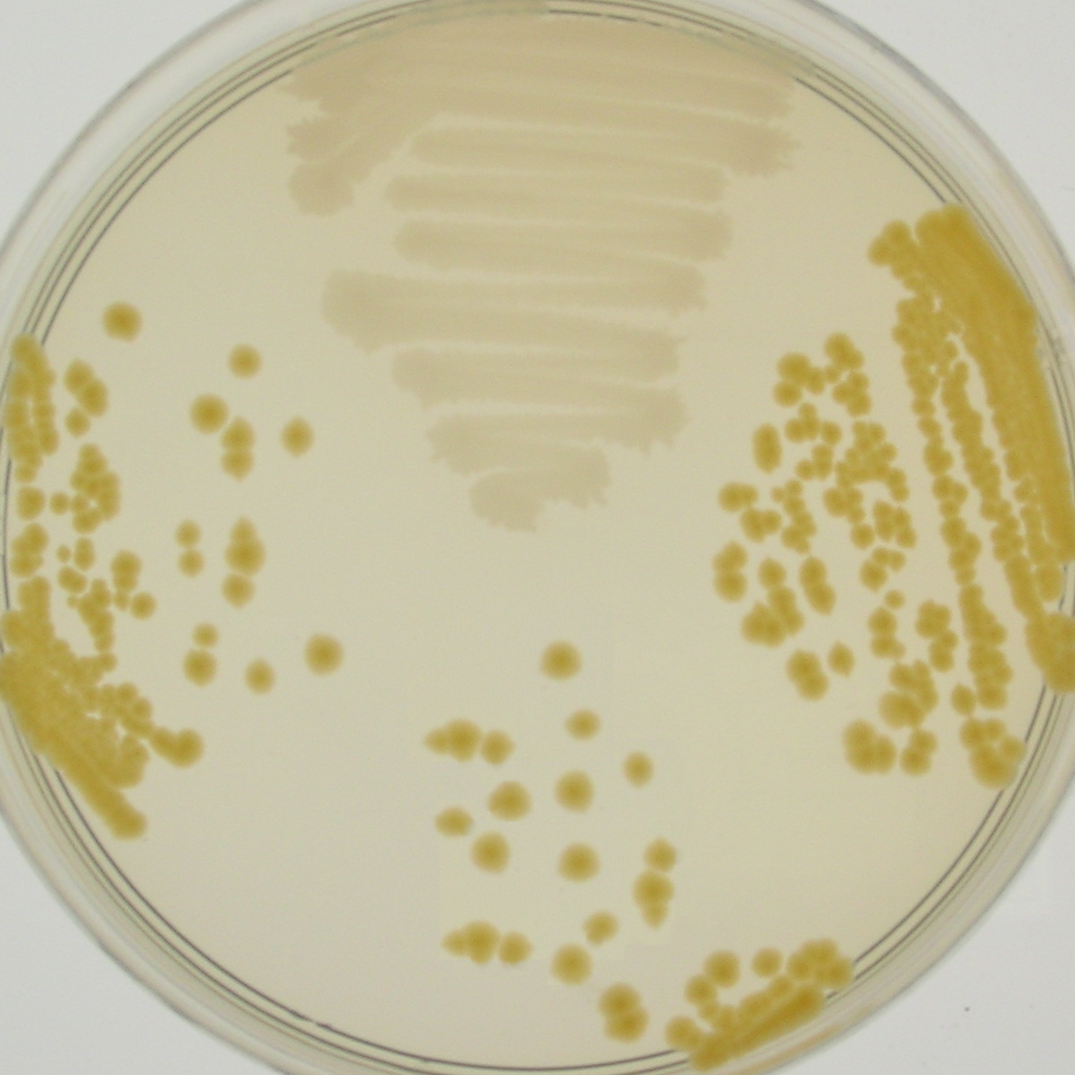
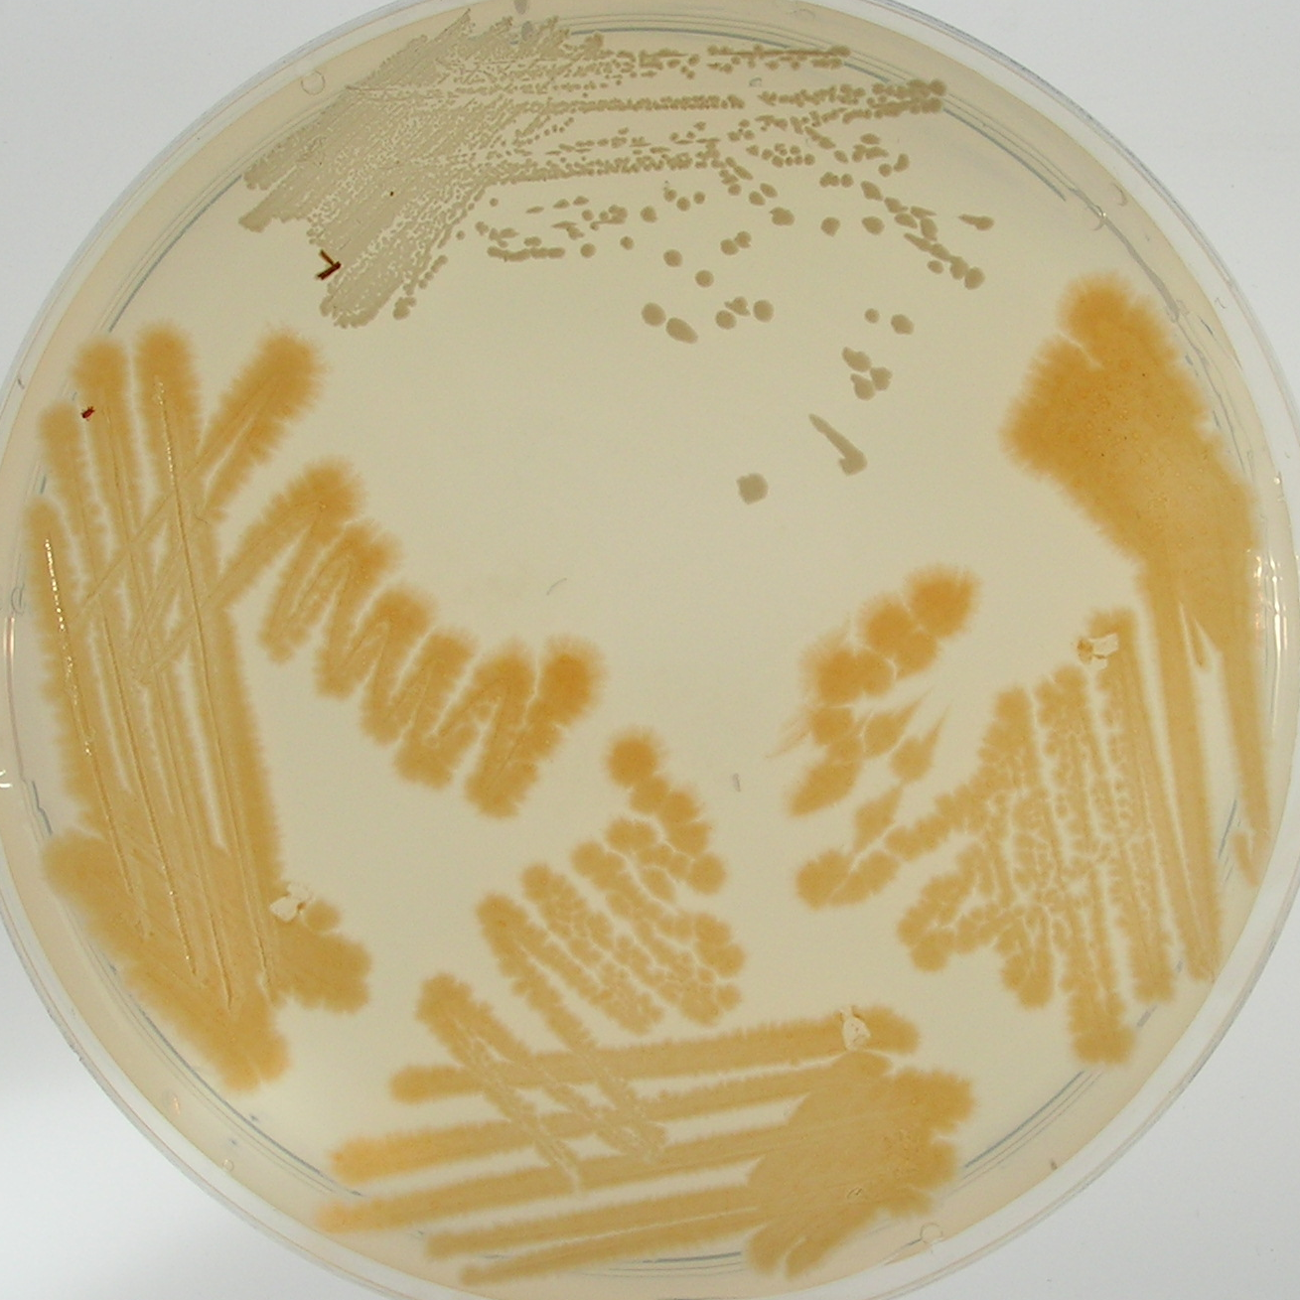
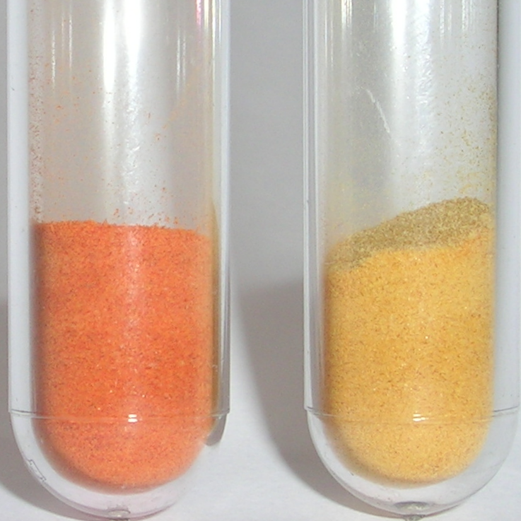
Pigmented GIT isolates of B. indicus
Vegetative
Cells
Vegetative Growth
Sporulation
Spores

Slide 14
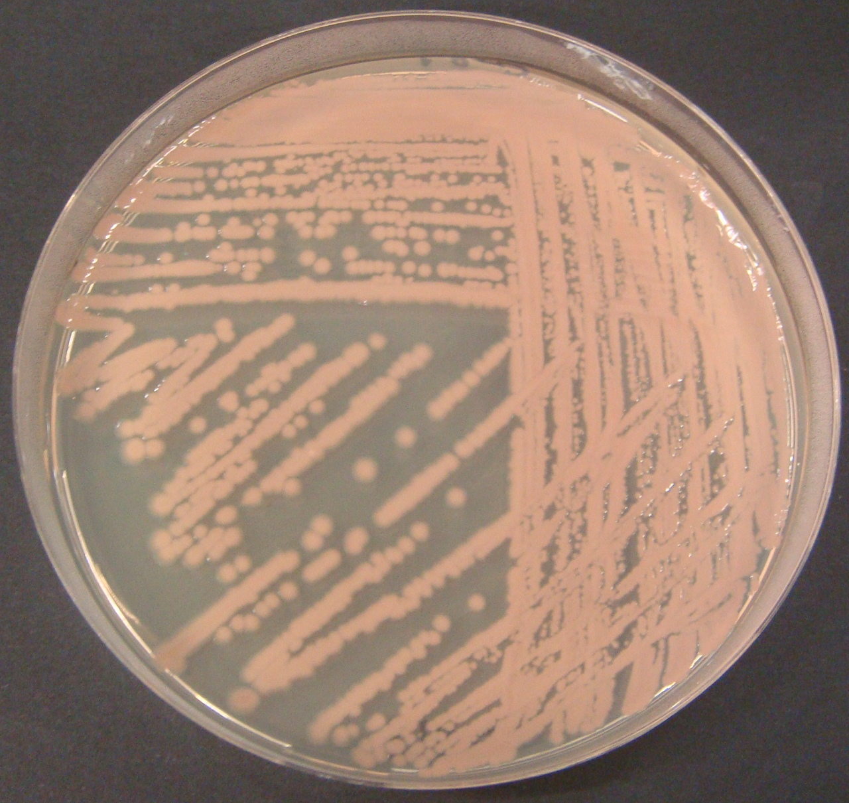
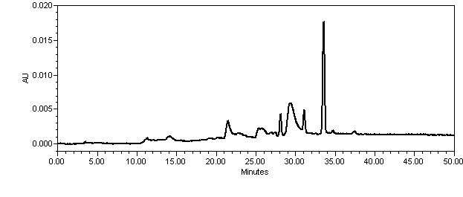
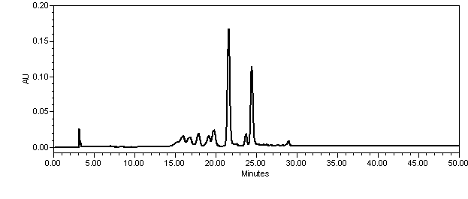
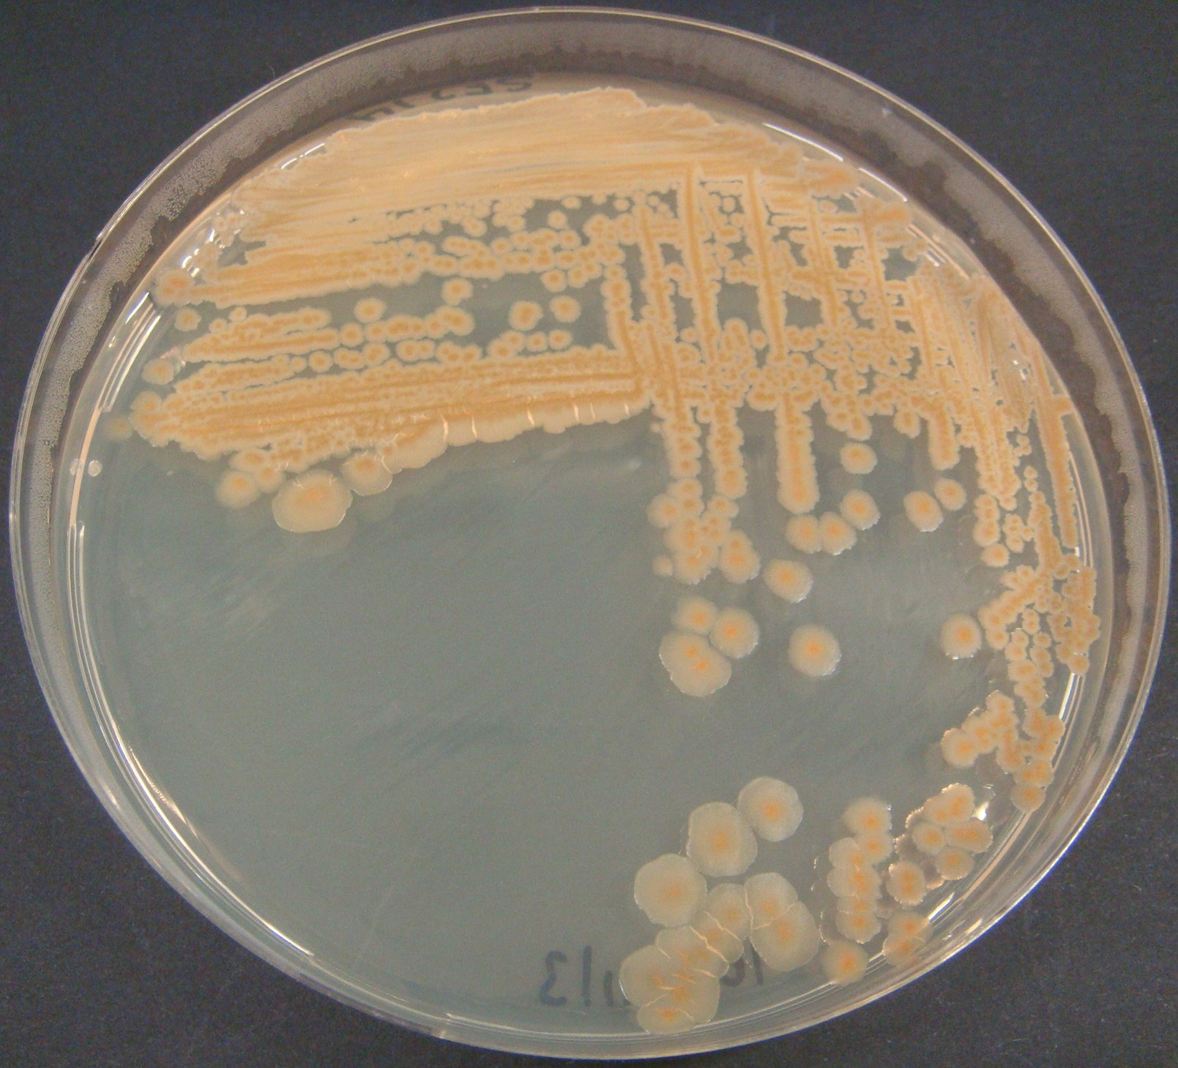
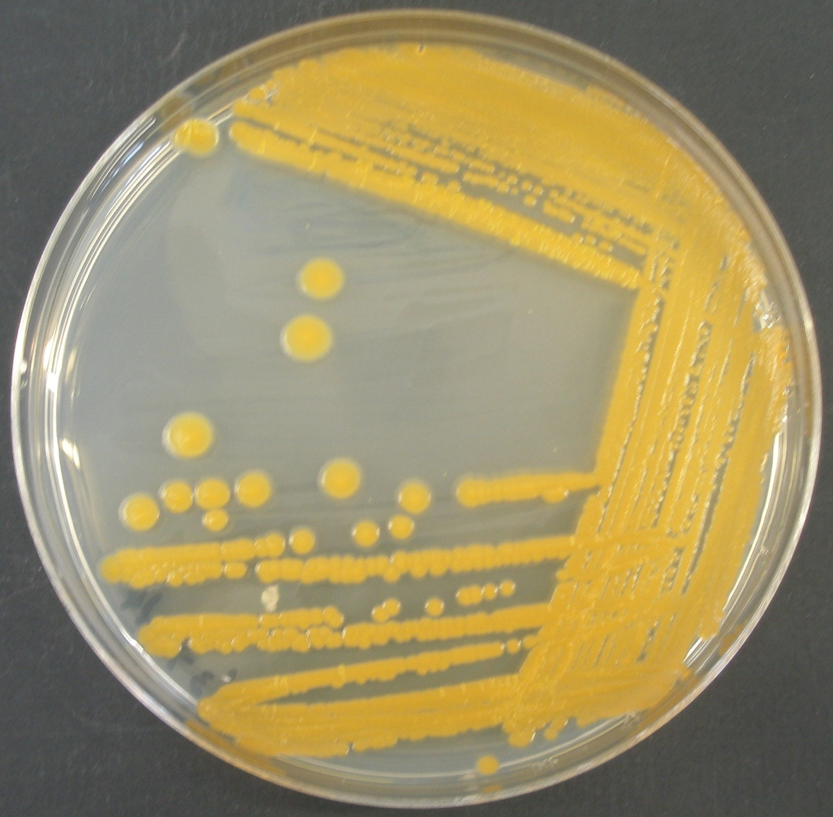
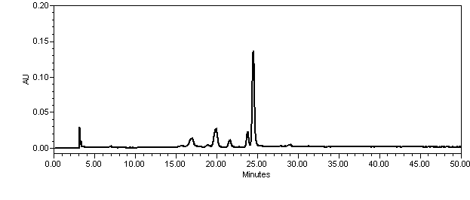
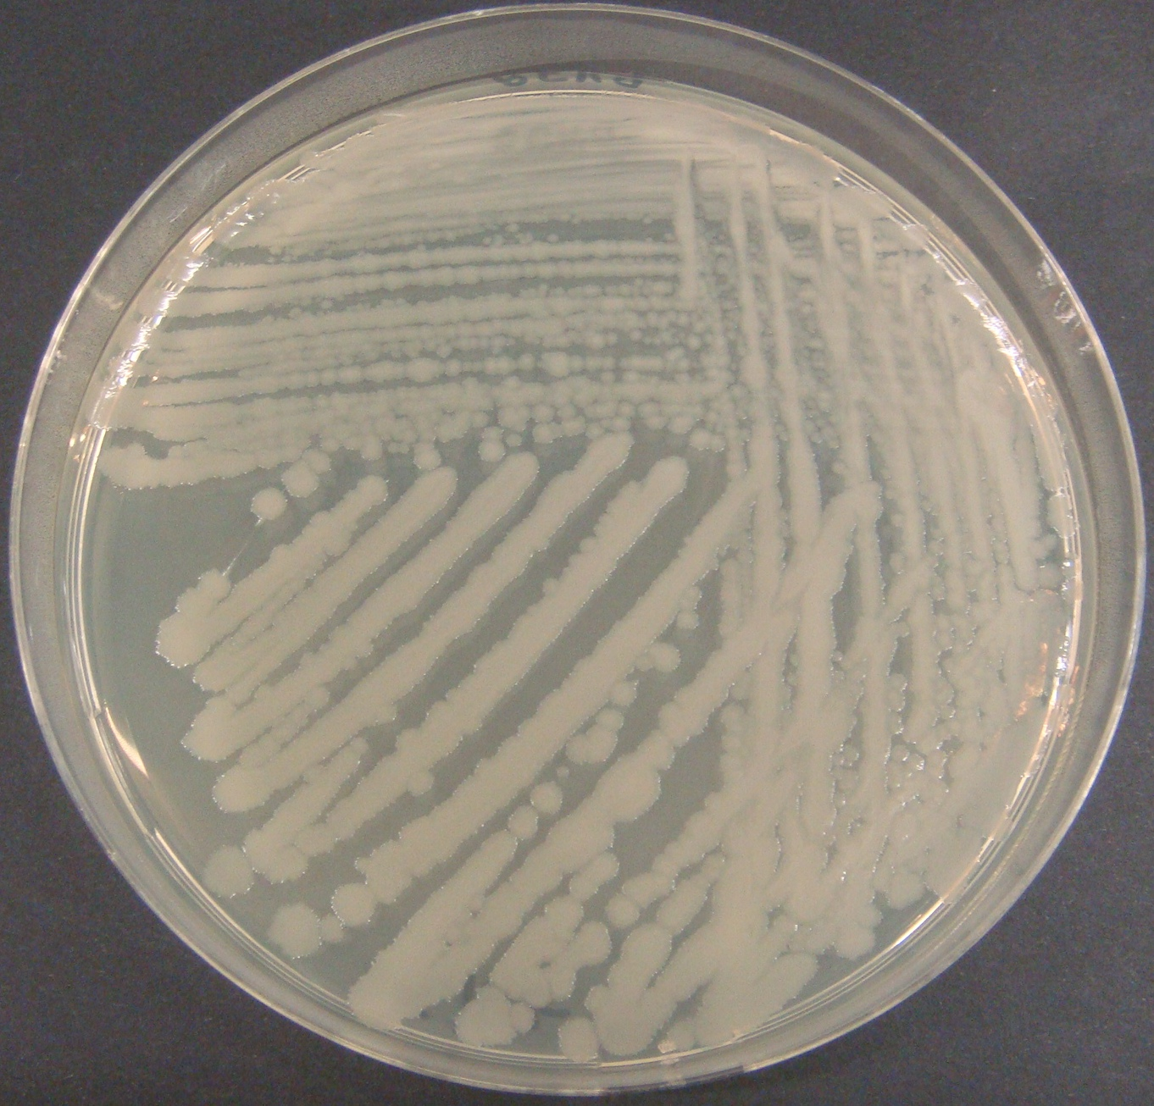
Initial Carotenoid Characterisation
A.
P1-492 nm λ max
450nm
GB1
B.
P2-467 nm λ max
450nm
SF223
P3-455 nm λ max
Absorbance (arbitrary units)
450nm
C.
3
P3-455 nm λ max
HU28
Retention time (minutes)
0.20
D.
450nm
PY79
0.10
0.00
Retention time (minutes)

Slide 15
Bacillus Carotenoids are Gastric Stable
100
50
% Carotenoid
0m 20m 60m
HU36 cells incubated with simulated gastric fluid (SGF)
Carotenoids first extracted from HU36 spores and then incubated in SGF
β-carotene as a control

Slide 16
IN VIVO BIOAVAILIBILITY RESULTS
Bioavailability = % of carotenoids recovered in plasma + liver + adipose tissue in rats
Bacterial carotenoids are bioavailable (HU36>GB1)
mainly recovered in liver and adipose tissue
D I E T
A G R I C U L T U R E
E N V I R O N M E N T

Slide 17
CONCLUSIONS
Bacterial carotenoids are
- more stable
than standard carotenoids
(towards dietary iron in micellar system)
- better antioxidants
than standard carotenoids
Notes:
We cannot say that HU36 are more bioavailable than GB1 since their bioaccessibility and absorption effieceincy are similar. Maybe the catabolism of GB1 is higher (more eliminated) than hU36

Slide 18
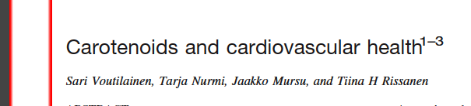
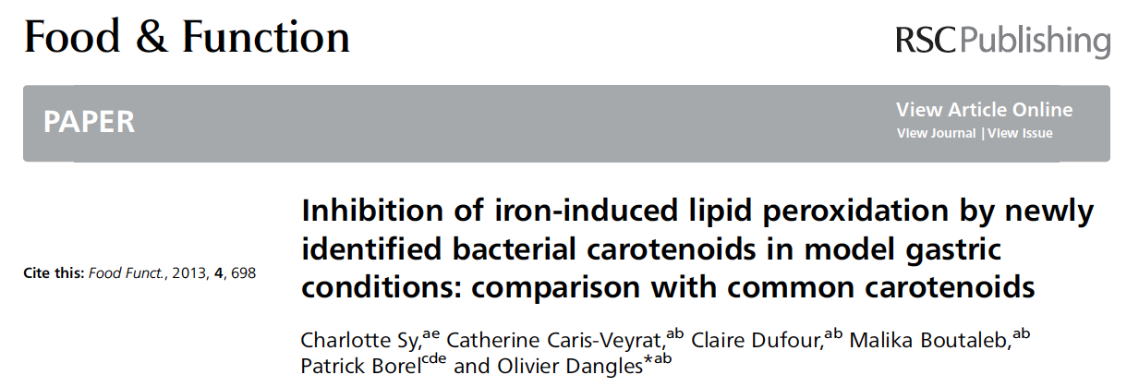
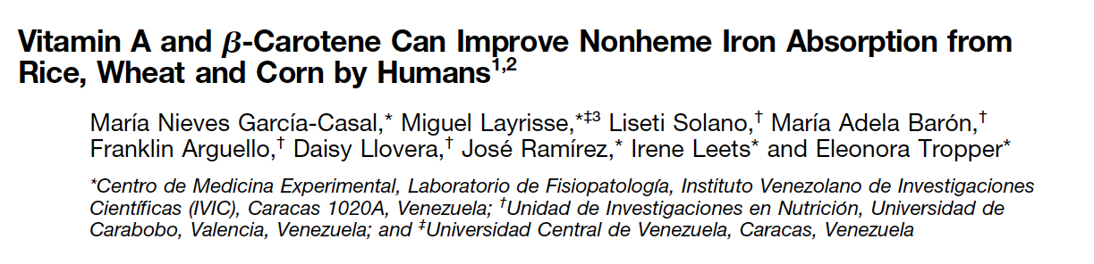
QPS Species of Bacillus that carry Carotenoids
Bacillus megaterium (Yellow/Orange) and Bacillus pumilus (red)
Use for prevention of CardioVascular Disease (CVD)
Potential anti-cancer agent
Iron deficiency since carotenoids enhance iron uptake

Slide 19
Bacillus species are gut commensals
Found in the human gut at ~10⁴ spores/g of feces
Recovered from ileal biopsies
30% of the gut flora are spore formers
Most Bacilli produce bile salt hydrolase
Some species have evolved into pathogens (B. anthracis and B. cereus)
Can persist for up to 1 month in the gut of the mouse

Slide 20
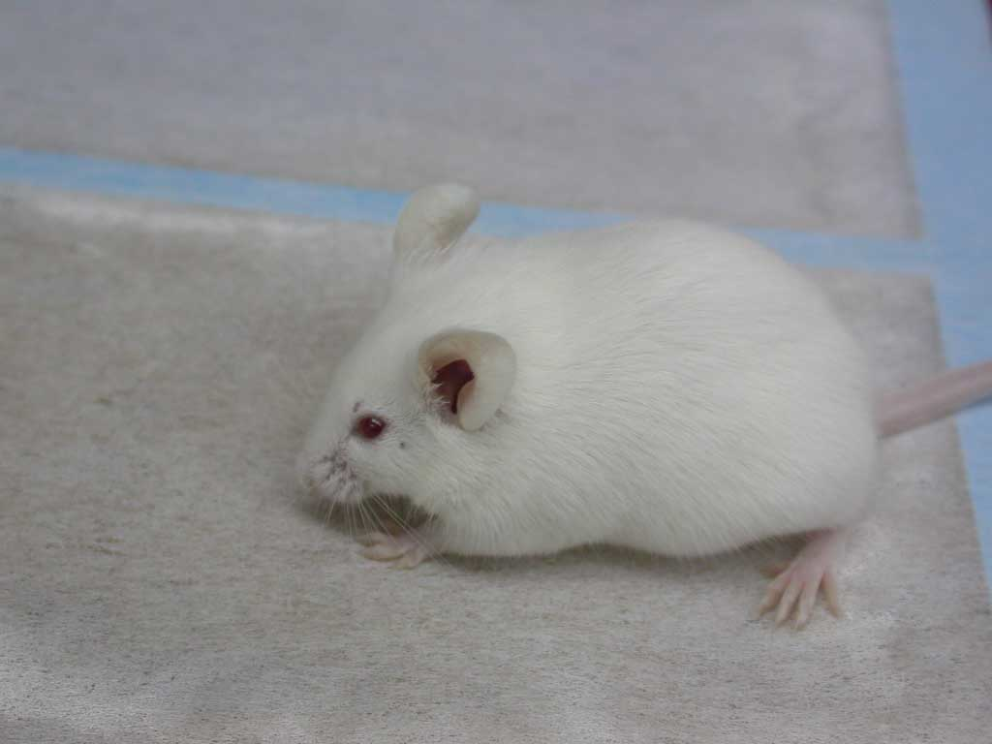
Analysis of Spore Counts in Faeces Shows More
Spores Excreted than Inoculated by a Factor of 3-6
Individual mice given single dose of spores and shed
heat-resistant cfu determined in faeces
No. of heat-resistant spores in faeces

Slide 21
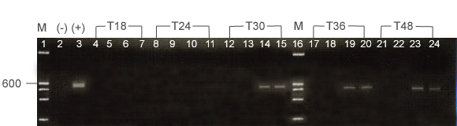
Germination, proliferation and sporulation in the GI-tract
1) Construction of chimeric gene, expressed during germination/growth or during sporulation
Bacillus gene
Foreign gene
559 bp
FcotB1
RtetC5
466 bp
FcotB2
RtetC5
2) Dose mice with spores, extract mRNA and quantify expression
I
I
I
I, ileum, C, colon
C
C
C

Slide 22
Approx. 10-16% of spores germinate and then re-sporulate in the GI-tract
18h
24h
30h
Mouse
Duodenum
Jejunum
Ileum
Large int.
Duodenum
Jejunum
Ileum
Large int.
Duodenum
Jejunum
Ileum
Large int.
1
-
++
-
-
-
++
-
-
-
+
-
-
2
-
++
+
-
-
++
-
-
-
+
-
-
Germination
3
-
++
-
-
-
++
+
-
-
+
-
-
4
-
++
-
-
-
++
-
-
+
-
-
Naïve
-
-
-
-
n/a
n/a
n/a
n/a
n/a
n/a
n/a
n/a
1
-
-
-
-
-
-
-
-
-
-
+
+
2
-
-
-
-
-
-
-
-
-
-
+
+
Sporulation
3
-
-
-
-
-
-
-
-
-
-
+
+
4
-
-
-
-
-
-
-
-
-
-
+
+
Naïve
-
-
-
-
n/a
n/a
n/a
n/a
n/a
n/a
n/a
n/a
36h
48h
Mouse
Duodenum
Jejunum
Ileum
Large int.
Duodenum
Jejunum
Ileum
Large int.
1
-
-
-
-
-
-
-
-
2
-
-
-
-
-
-
-
-
Germination
3
-
-
-
-
-
-
-
-
4
-
-
-
-
-
-
-
-
Naïve
n/a
n/a
n/a
n/a
-
-
-
-
1
-
-
+
+
-
-
+
±
2
-
-
+
+
-
-
+
±
Sporulation
3
-
-
+
+
-
-
+
±
4
-
-
+
+
-
-
+
±
Naïve
n/a
n/a
n/a
n/a
-
-
-
-
Measure germination by using a vegetative Bacillus gene chimera
Measure re-sporulation by using a sporulation Bacillus gene chimera

Slide 23
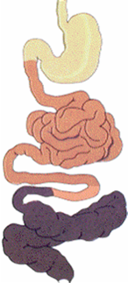
Fate of Spores
taken up by cells of
lymphoid tissues
e.g. M-cells of Peyer’s patches
germinate *
replicate **
re-sporulate **
germinate ***
* Casula & Cutting. 2002. Appl Environ Microbiol 68:2344-52
** Hoa et al. 2001. Appl Environ Microbiol 67:3819-23
*** Duc et al. 2004. Vaccine 22:1873-85

Slide 24
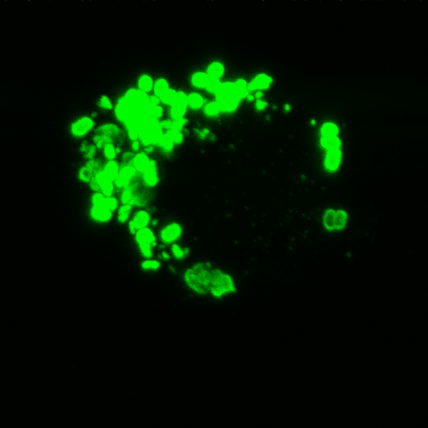
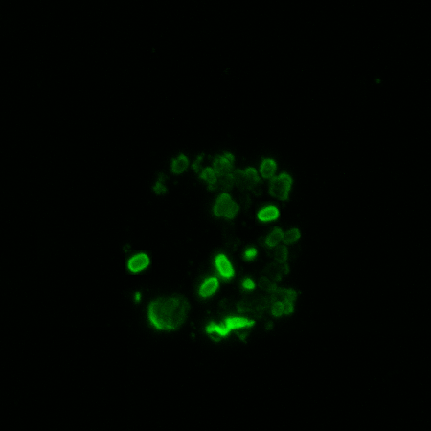
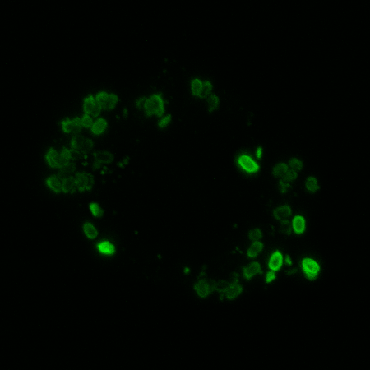
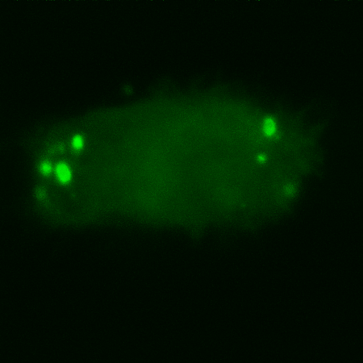
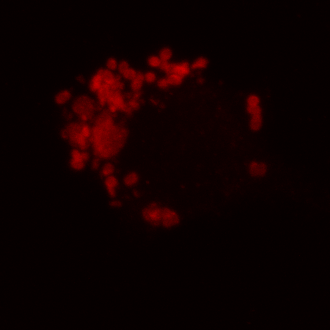
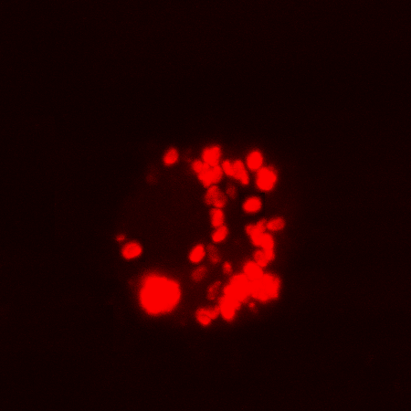
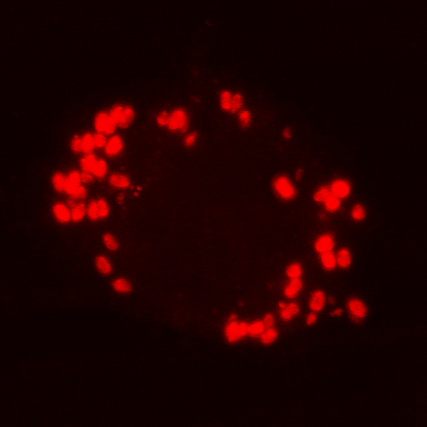
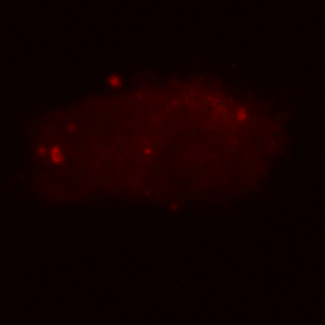
Phagocytosis of rrn0-lacZ spores by macrophage-like cell line, RAW264.7
Ingestion and prolonged survival could induce CTL responses
45m 2h 5h 24h
Anti-spore labelling
45m 2h 5h 24h
Anti-β-Gal labelling (vegetative gene expression*)

Slide 25
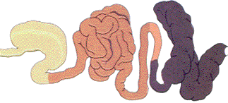
Small Intestine
Nutrient rich
Spore germination &
dissemination to GALT
Stomach
Spores survive intact
vegetative Bacillus killed
Colon
Re-sporulation
GIT
Consumption of
plants and spores
Excretion of spores
into the soil
Bacillus as a gut commensal
Commonly found in the human GI-tract at 1 X 10⁴/g
Symbiotic interactions
with plants
spores
vegetative cells

Slide 26
Mechanisms for Probiosis
1) Stimulation of innate immunity
2) Synthesis of antimicrobials that kill pathogens
3) Adsorption of toxins in the GI-tract
4) Rebalancing the gut microflora

Slide 27
Innate Immunity

Slide 28
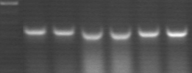


1) Immune Stimulation
Cytokine mRNA in vivo
200
IFN-γ
180
β-actin
TNFα
IFNγ
160
140
120
% expression
100
TNF-α
80
60
40
20
0
0
100
200
300
Hours after inoculation
IFN-γ
Th1 response
Cellular immunity
& IgG2a

Slide 29
Evidence for Innate Immunity and Induction by Non-Recombinant Spores carrying no antigen
1. C. difficile infection
o.g.
i.p.
Day 15
60
Survival after infection (hours)
50
40
Naive
PY79
rA26-39
+ rB15-24
PP108
PP142
rA26-39
+ rB15-24
Vaccination experiment
Shaded box shows increased survival of hamsters pre-dosed with B. subtilis PY79 spores
and then challenged with C. difficile

Slide 30
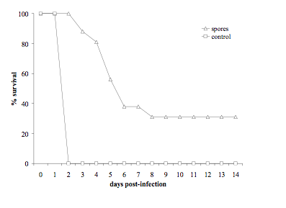
2. Anthrax
In this study the spores were delivered via the intra-peritoneal (i.p.) route to provide protection against an i.p. challenge with B. anthracis STI spores. The spores were administered to mice 48h and 24h prior to challenge with B. anthracis (approx 100 MLD) and protection afforded against anthrax was monitored. Results showed that pre-exposure administration of the B. subtilis spores was able to provide partial protection against anthrax infection in mice (expt done at Porton Down).

Slide 31
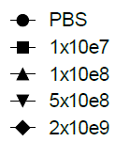
3. Influenza
27 days
Challenge with live H5N2
Day 1/i.n.
Day 14/i.n.
120
Survival rates
100
80
Survival (%)
60
40
20
0
0
1
2
3
4
5
6
7
8
9
10
11
12
13
14
Days post challenge
No antigen-immunotherapy

Slide 32
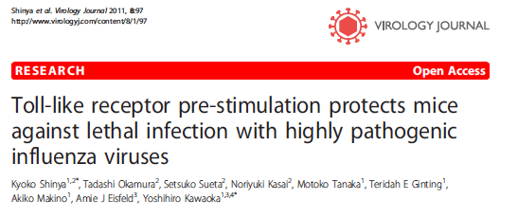

Slide 33
Induction of innate immunity. Spores stimulate NF-Kβ pathway via interaction with Toll-like receptors
10⁶ 10⁷ 10⁸ 10⁶ 10⁷ 10⁸ 1ng 10ng 20ng 10⁷ media
PY79^{K} latex beads LPS VC

Slide 34
Clostridium difficile Infection (CDI)
Major nosocomial pathogen
~4,000 deaths per annum in the UK
No vaccine
Protective antigen thought to be toxin A and toxin B
All vaccines under development are parenteral
Emergence of the 078 ribotype from pigs to humans

Slide 35
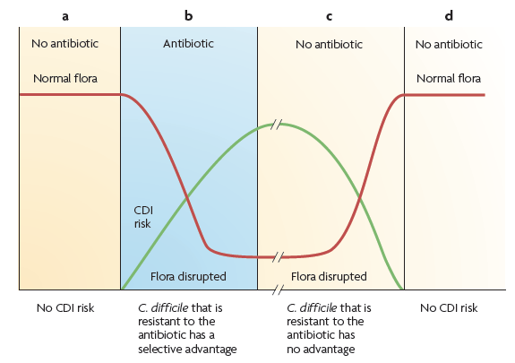
In ~30% of patients, CDI can return in 2-3 weeks (relapse or recurrence)

Slide 36

Effect on C. difficile infection, pre and post dosing
Mice dosed every day for 7 days pre infection or every day post infection
Kaplan-Meier survival plot for mice infected with C. difficile VPI 10463. Groups received oral doses of live B. subtilis PXN21 spores as treatment either pre or post infection. Post infection slightly better

Slide 37
Pre-dosing effect is likely to be due to innate immunity
Post-dosing effects could be due to subtraction of toxin the GI-tract?

Slide 38
Adsorption to Spores
+
B. subtilis spores
-Net negative charge
-hydrophobic
toxin
Ionic and hydrophobic
interactions

Slide 39


In vitro binding of toxin to spores
Caecal extracts from post-dosed mice
Toxin A
Toxin A Toxin B
Toxin B
1 caecum extracts post-dosing
2 caecum extracts no spores
3 caecum extracts no C. difficile
4 purified toxins
5 = toxin detected in supernatants of caecal extracts

Slide 40
Secretion of beneficial molecules in the GI-tract
Most Bacilli produce Nattokinase, a protease that reduces blood clotting
Antimicrobials. Depends on species and strain but, Plipastatin, Bacilysin, Subtilosin, Fengycin, Iturins, etc
Many strains can be administered together with antibiotics and this allows temporary restoration of the gut microflora during prophylaxis

Slide 41

Spores, and Specifically Sporulation are Important for Development of the GALT

Slide 42
Summary
Gut commensals
Spore probiotics are ‘live’ entities that germinate in the GI-tract, proliferate and then re-sporulate
They promote a healthy GALT
Stability
They have unique resistance properties enabling them to be stored at room temperature indefinitely
Efficacy
Proven by worldwide use
Emerging clinical trial data
Mechanism
Stimulate innate immunity
Somehow promote GALT development
Adsorption of toxins
Secretion of antimicrobials

Slide 43


Dr. Hong Huynh Siamed Hasseni
Dr. Irene Bianconi Saba Anwar
Dr. Lluis Sempere William Ferreari
Dr. Stephanie Willing Celia Rodriqgues
Dr. Anil Chandrashekran Emma Popescu
Ms. Krisztina Hitri Jacob Goonesana
Ms. Nicola Byrne Alex Curilovs
Phase 1/2a clinical trial
2013
www.cdvax.org

Slide 44

Suppression of C. difficile infection is not dose dependent
Kaplan-Meier survival plot for mice infected with C. difficile VPI 10463. Groups received oral doses of live B. subtilis PXN21 spores post infection at a concentration of either 10⁹ or 10⁷ spores per dose.

Slide 45

Live spores rather killed spores are needed for suppression of C. difficile infection

Slide 46
hydrophobicity
100
0
80
-20
60
-40
ζ (mV)
% Hydrophobicity
40
-60
SURFACE CHARGE
zeta potential
20
-80
0
0
1
2
3
4
5
6
7
8
pH
At all pH values spore is negative charged, but as pH drops below pI protein becomes + charged
At all pH values, spore is hydrophobic and thus able to interact with hydrophobic molecules such as LPS, virions, etc

