Slide 1
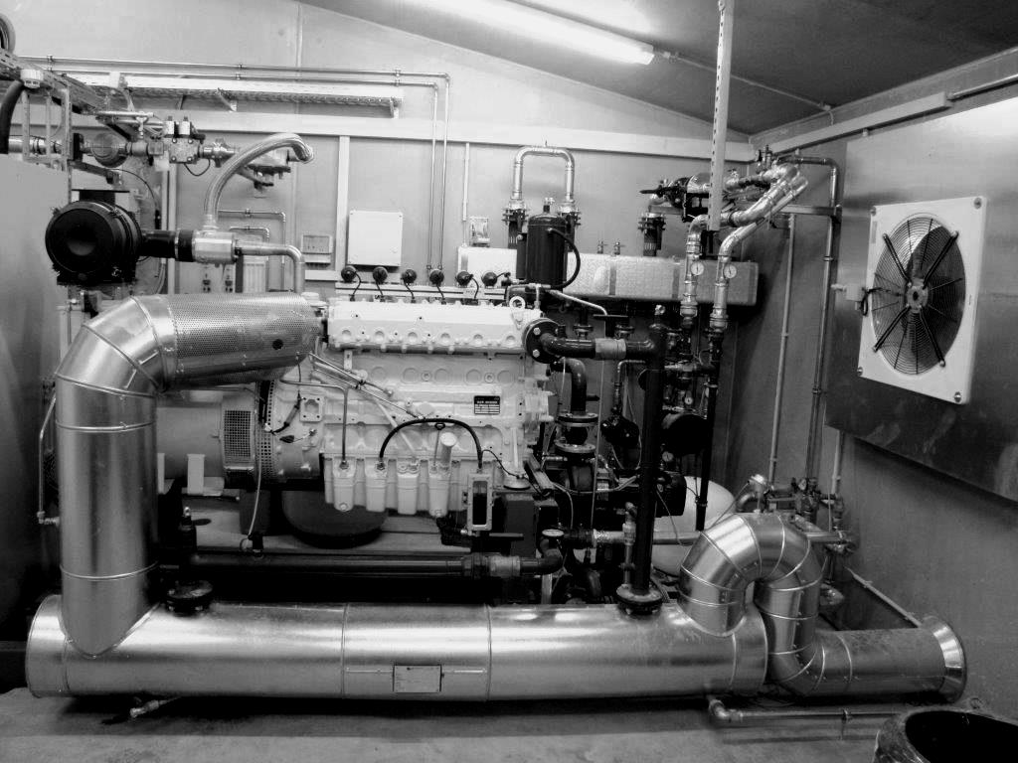

Environmental impact and technical requirements of flexible energy supply from biogas-driven cogeneration units
Institute for Agricultural Engineering and Animal Husbandry
M. Sc. Simon Juan Tappen
Madrid - June, 29th 2017

Slide 2
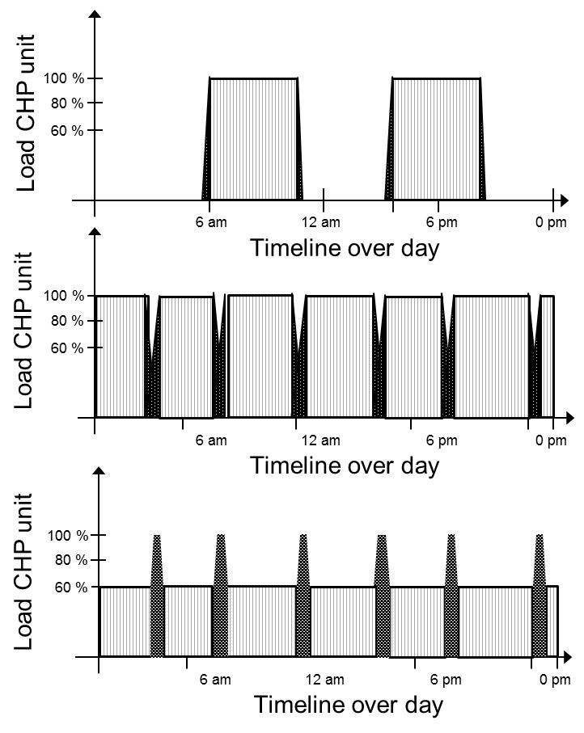
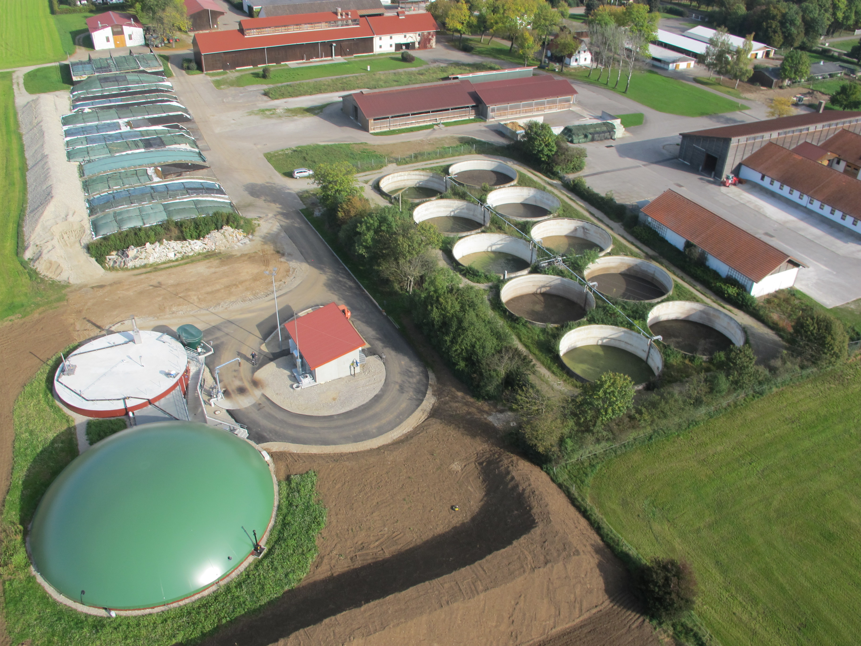
Why is biogas so important in the renewable energy sector?
1. Flexibility
2. Can be stored
3. Multiple pathways
4. Decentralization

Slide 3
Material & Methods / Overview
On field measurements of 10 biogas-driven cogeneration units (P_{el} = 30 – 549 kW) :
  Flexibility: Full load, 80 % / 60 % load
  Four measurements, one each half year
  Electrical effeciency η_{el} (DIN 3046-1 conformity, real time measurements)
  Emissions: nitrogen oxide (NOx), total hydrocarbons (THC) / methane slip, carbon monoxide (CO), (standardized)

Slide 4
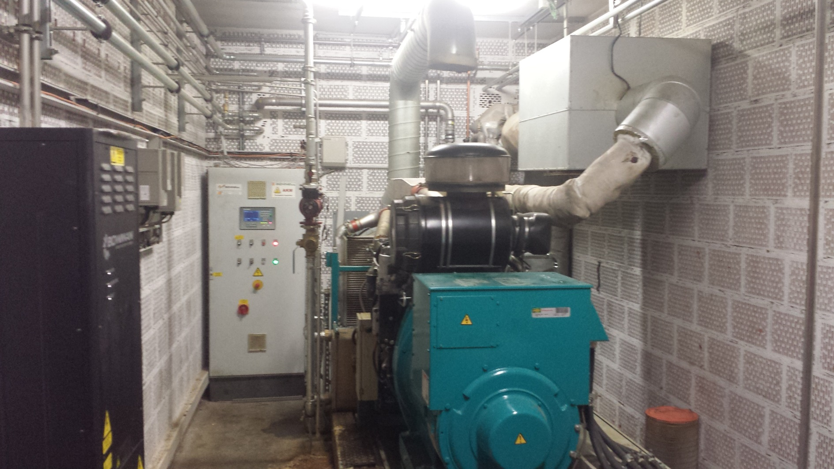
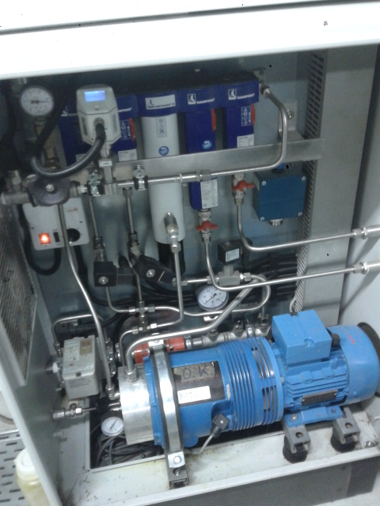
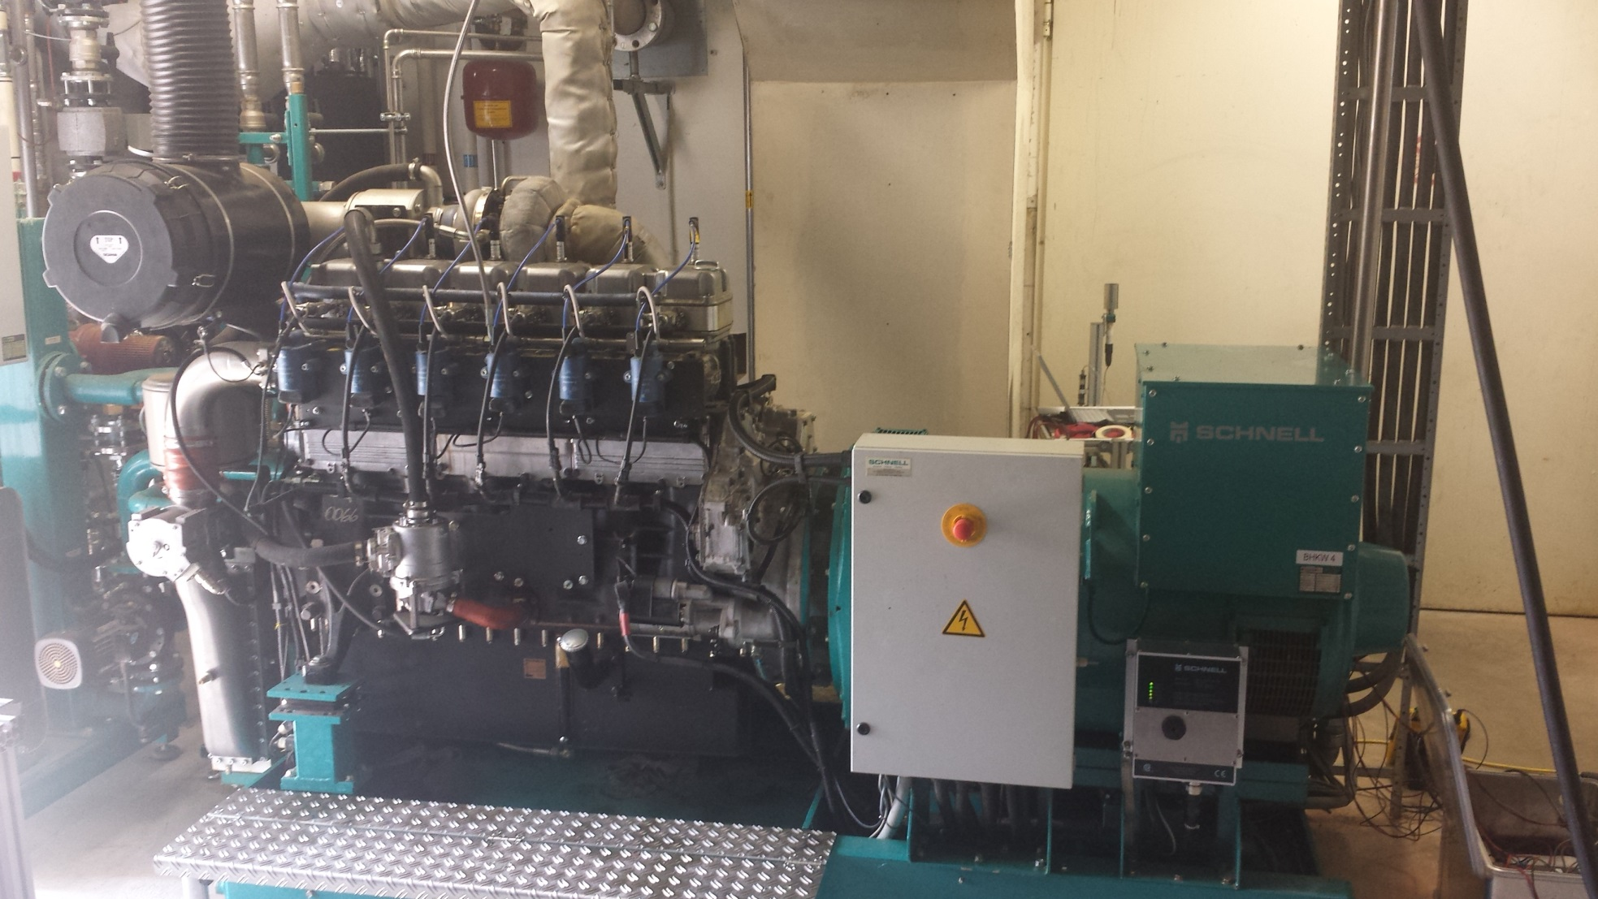
Results: Electrical efficiency

Slide 5
Results: Electrical efficiency
Maximum value of electrical efficiency depends on technology and on power output (size)
Electrical efficiency decreases with reduced load
  at 80 % load: - 1.0 … 2.6 % (absolute)
  at 60 % load: - 2.1 … 6.4 % (absolute)
  Relative share of auxiliary power increases

Slide 6
Results: Emission values - part load response

Slide 7
Results: Emissions vs. el. efficiency
CATEGORY A
CATEGORY B

Slide 8
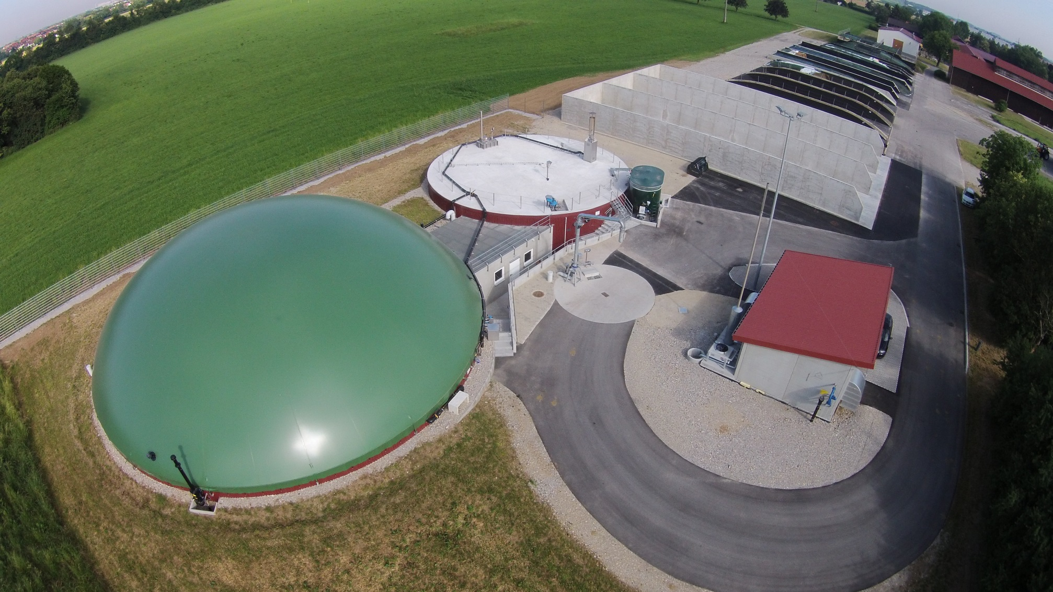
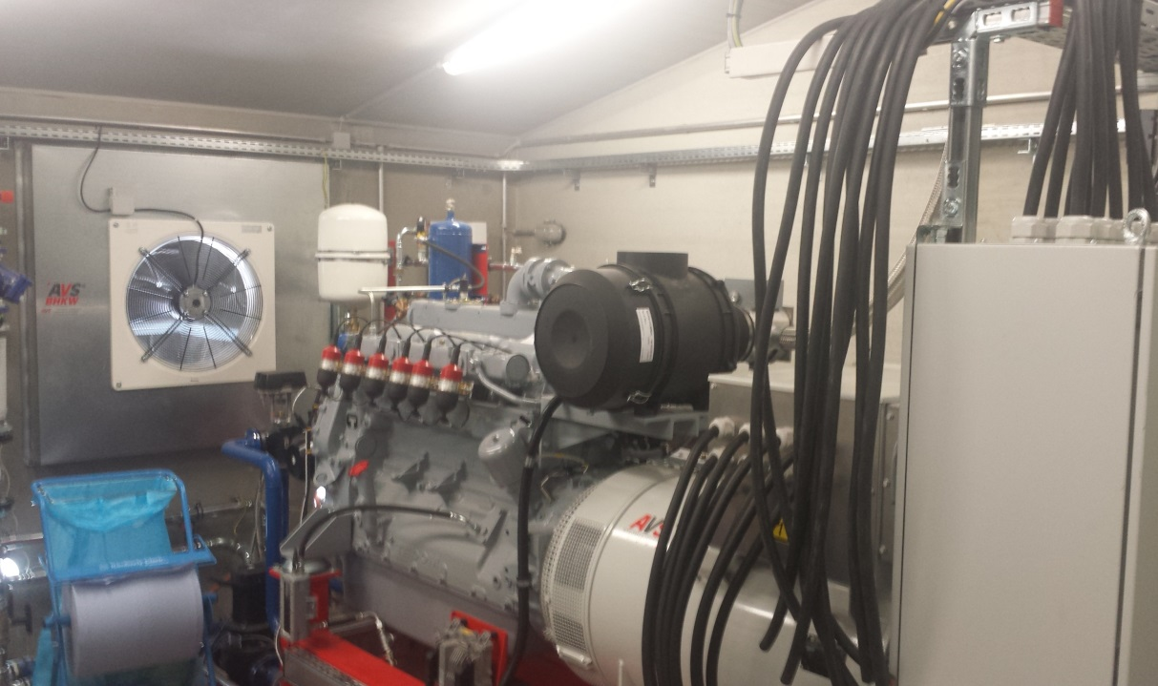
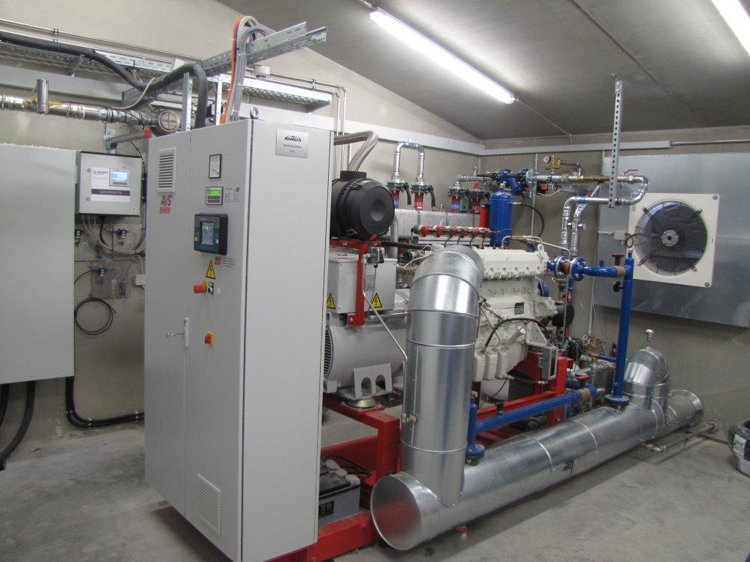
Example for demand-driven electricity generation
Experimental biogas plant in Grub (Munich): supplier of the demand of research facility by flexible generation of electricity
203 kW gas Otto engine
75 kW gas Otto engine
Objective: maximizing the potential regarding the decentralisation of the research faicility ➔evaluation of automatisation, efficiency and feasibility
„Technological“ (CHP units) and „biological“ (fermentation) flexiblity

Slide 9
Results: Energy development - week 12 / 2017
80 – 85 % of the demand for electricity
by the whole research facility can be covered by the biogas plant
concerning present biological and technological criteria
Monday | Tuesday | Wednesd.| Thursday | Friday | Saturday | Sunday

Slide 10
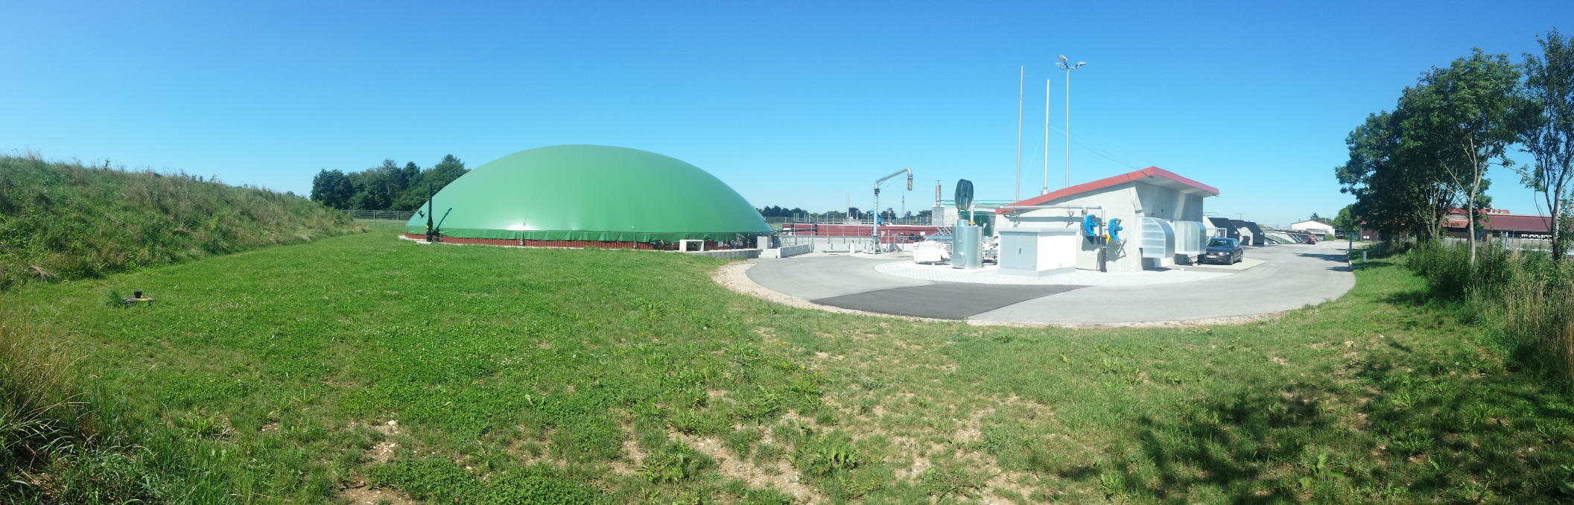

THANK YOU FOR YOUR KIND ATTENTION
Contact: M. Sc. Simon Juan Tappen
Mail: simon.tappen@lfl.bayern.de
Phone: +49 (0) 8161 71 - 4113
Fax: +49 (0) 8161 71 - 4048

