Slide 1
About OMICS Group
OMICS Group is an amalgamation of Open Access Publications and worldwide international science conferences and events. Established in the year 2007 with the sole aim of making the information on Sciences and technology ‘Open Access’, OMICS Group publishes 500 online open access scholarly journals in all aspects of Science, Engineering, Management and Technology journals. OMICS Group has been instrumental in taking the knowledge on Science & technology to the doorsteps of ordinary men and women. Research Scholars, Students, Libraries, Educational Institutions, Research centers and the industry are main stakeholders that benefitted greatly from this knowledge dissemination. OMICS Group also organizes 500 International conferences annually across the globe, where knowledge transfer takes place through debates, round table discussions, poster presentations, workshops, symposia and exhibitions.

Slide 2
OMICS International Conferences
OMICS International is a pioneer and leading science event organizer, which publishes around 500 open access journals and conducts over 500 Medical, Clinical, Engineering, Life Sciences, Pharma scientific conferences all over the globe annually with the support of more than 1000 scientific associations and 30,000 editorial board members and 3.5 million followers to its credit.
OMICS Group has organized 500 conferences, workshops and national symposiums across the major cities including San Francisco, Las Vegas, San Antonio, Omaha, Orlando, Raleigh, Santa Clara, Chicago, Philadelphia, Baltimore, United Kingdom, Valencia, Dubai, Beijing, Hyderabad, Bengaluru and Mumbai.

Slide 3


Evaluation of histopathologic and histomorphometric changes of Adrenal gland and lymphatic organ following consumption of Methylphenidate in male mice
Islamic Azad University
Fazelipour, S¹. Kiaei, M.² Tootian, Z.³ Kiaei, SB. ⁴ Gharahjeh, M.⁵
¹Department of Anatomy, Tehran Medical Sciences Branch, Islamic Azad University. Tehran-Iran.
² Doctor of Pharmacist
³Department of Basic Sciences, Faculty of Veterinary Medicine, University of Tehran. Tehran-Iran.
⁴Doctor of Medicine
⁵Student of Medical, Tehran Medical Sciences Branch, Islamic Azad University. Tehran-Iran.
International Conference and Expo on Drug Discovery & Designing August 11-13, 2015 Frankfurt, Germany

Slide 4


ADHD
Attention deficit hyperactivity disorder (ADHD), is a neurodevelopmental psychiatric disorder which there are significant problems with executive functions that cause attention deficits, hyperactivity, or impulsiveness which is not appropriate for a person's age. These symptoms must begin by age six to twelve and persist for more than six months for a diagnosis to be made.

Slide 5
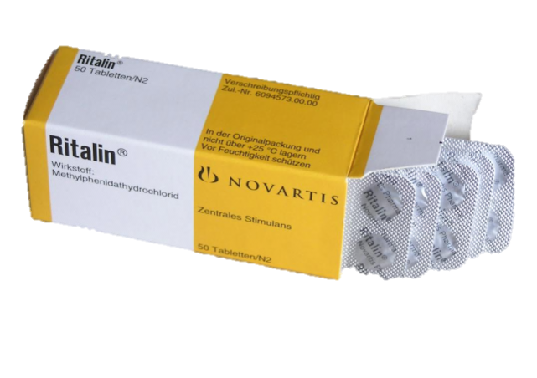
Methylphenidate
Methylphenidate, commonly known as Ritalin, is the most prescribed medication, in behavioral disorders.
This medication is one of the isomers of Amphetamine. This product is a white crystallized powder, odorless and water soluble, and applied as a treatment in children with behavior syndrome. Some researches have shown that Ritalin could induce encephalic maintenance, and thus is used in controlling unfavorable signs such as, absence of concentration, attention deficiency and hyperactivity. Also it is used in adults with maintained disorders from childhood. Due to widely usage of Ritalin in ADHD treatment, many investigations have be­en performed.

Slide 6

The objective of this study
It was to evaluate the effects of methylphenidate on the mice adrenal glands and lymphoid tissues through histological, histometrical, histopathological and histochemical methods.

Slide 7

Material and Methods
In this study 30 adult male Balb/c mice were used. At first male mice were weighed and then divided into three groups: two experimental and one control group. In experimental groups they were orally administered MPH hydrochloride at daily (2mg/kg and 10mg/kg body weight) and water, respectively by gavages for 40 days. At the end of the study, animals were weighed and then were anesthetized for blood cells analysis, which blood samples were collected by cardiac puncture. Then their spleen, thymus, lymph nodes and adrenal glands were dissected out and processed for Hematoxylin and eosin staining method by means of routie histological techniques.

Slide 8
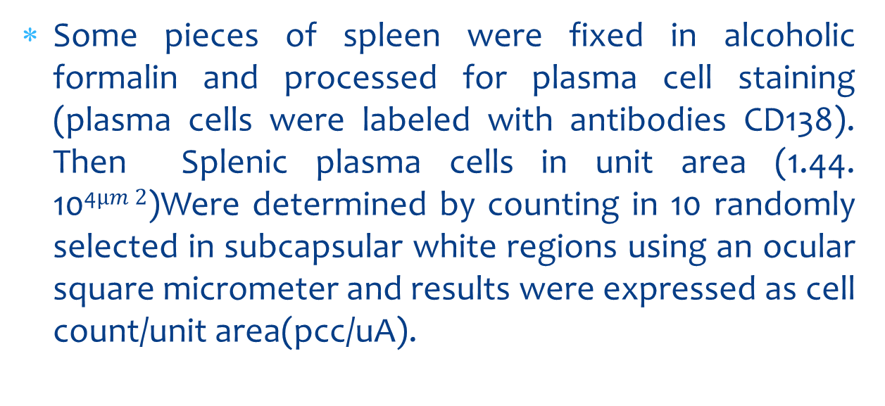
Material and Methods
Some pieces of spleen were fixed in alcoholic formalin and processed for plasma cell staining (plasma cells were labeled with antibodies CD138). Then Splenic plasma cells in unit area (1.44. 10⁴$µm 2$)Were determined by counting in 10 randomly selected in subcapsular white regions using an ocular square micrometer and results were expressed as cell count/unit area(pcc/uA).

Slide 9
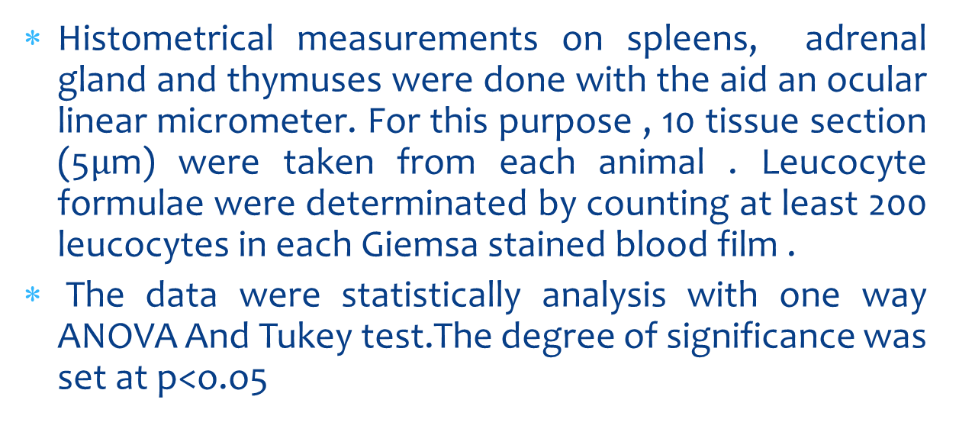
Material and Methods
Histometrical measurements on spleens, adrenal gland and thymuses were done with the aid an ocular linear micrometer. For this purpose , 10 tissue section (5$µ$m) were taken from each animal . Leucocyte formulae were determinated by counting at least 200 leucocytes in each Giemsa stained blood film .
The data were statistically analysis with one way ANOVA And Tukeytest.The degree of significance was set at p<o.o5

Slide 10
Results
Body weight differences
It also affects on the body weight. So the following results were deduced. The obtained results from primary and secondary weighing the mice showed that the difference between primary and secondary weights, in treatment groups had a significant reduction in comparison with the control group (P<0.05).

Slide 11
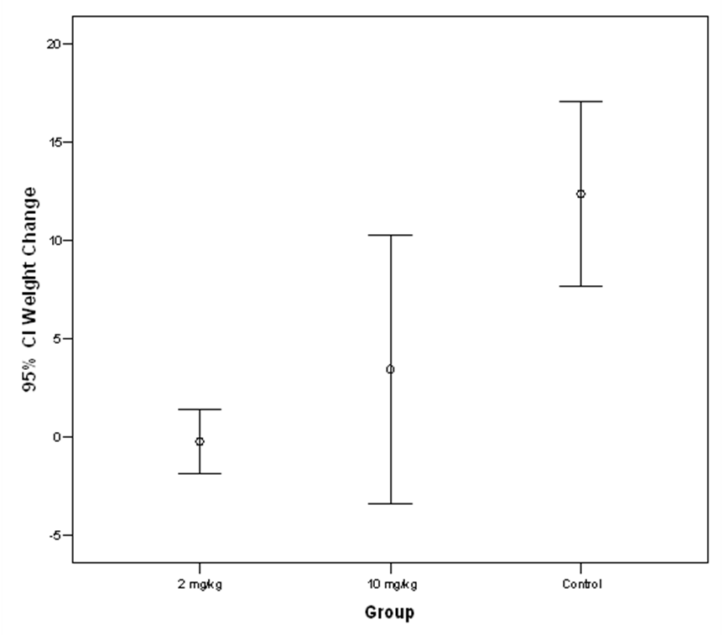
Figure1: The decrease statistically significant body weight differencese in experimental groups compared with control group P < 0.05).

Slide 12
Results
The changes in lymphoid organs provide morphological evidences for MPH induced immune suppression.

Slide 13
Results
Adrenal glands
Along with these, observation of the thickening of the adrenal cortex and medulla might show that MPH induced immune suppression may occur via increased glucocorticoid secretion.

Slide 14
Results
Adrenal glands of the control animals displayed typical morphology with a larger cortical area and a centrally located medulla region. Overall thickness of adrenal cortex has increased in the treatment group compared to those of the controls. Statisticaly analysis has showed that Methylphenidate with different doses could increase thickness of the glomerulosa and fasciculate layers of the adrenal cortex, and decrease in the reticularis layer. On the other hand, the thickness of capsule were decreased in experimental group and also the medullary layer were increased significant changes were seen in treatment group in compared with control group (p<0.05).
Besides some significant changes in Serum levels of cortisol that were measured by radioimmunoassay technique ,but no significantly histopathological

Slide 15
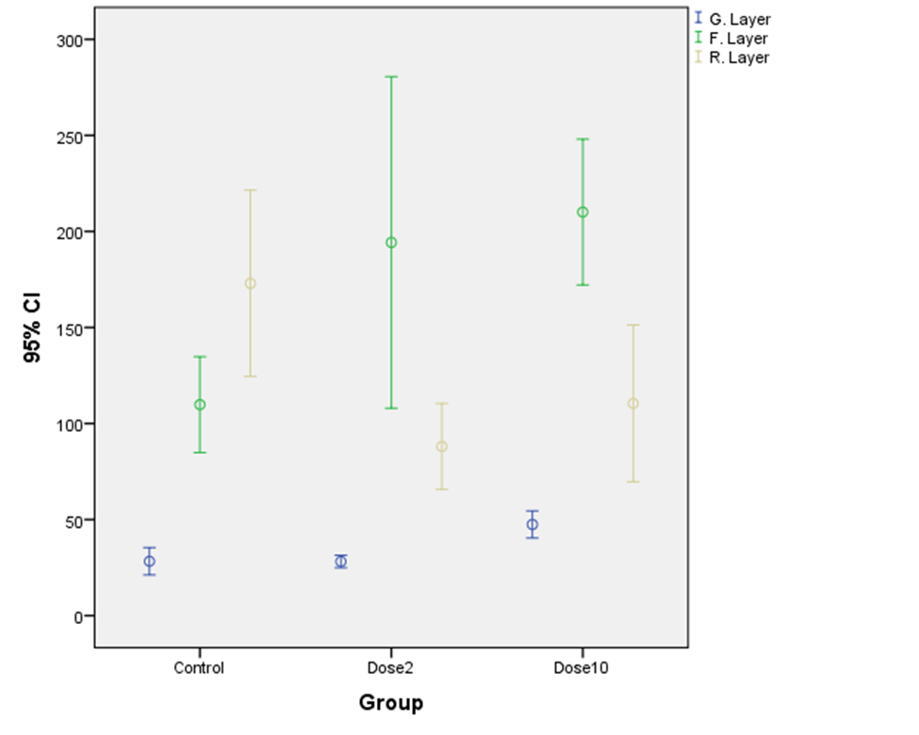
Figure2: Statistical analysis has showed Thickness of adrenal cortex(glomerulosa and fasciculate layers ) has increase significantly in the treatment groups compared with control group and decrease in reticular layer (p<0.05).

Slide 16
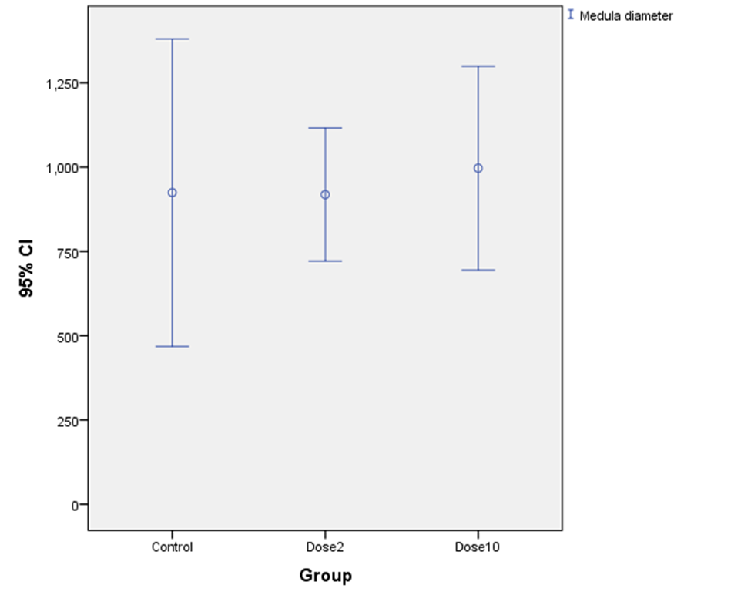
Figure3 : Also the medullary layer was increased significantly in experimental((10mg/kg methylphenidate)group compared with control group.

Slide 17
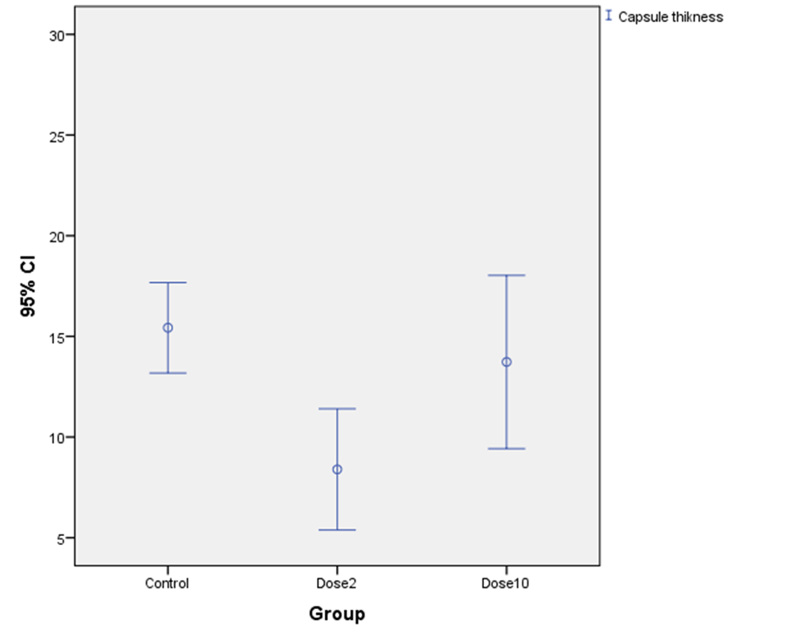
Figure4: The thickness of capsule has decreased significantly in treatment(2mg/kg methylphenidate)group compared with control group(p<0.05).

Slide 18
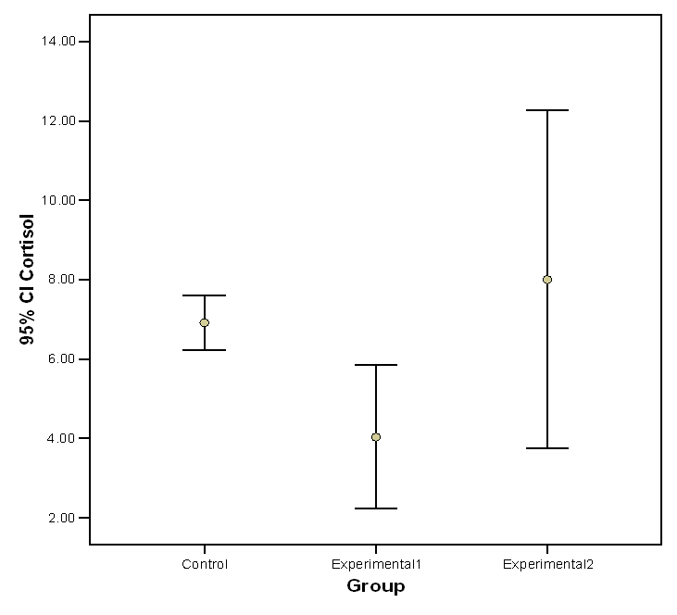
Figure 5 : Statistically analysis has showed increase significantly serum level of cortisol in the treatment(10mg/kg) groups compared with control group .

Slide 19
Results
Mesenteric lymphatic node
Mesenteric lymphatic nodes of the control group had larger cortical areas which were occupied by lymphoid follicles, paracortical zones formed by lymphatic cords and medullary areas containing large lymphatic sinuses. All sinuses were heavily filled with lymphocytes. The thickness of the capsules of lymph nodes was significantly increased in treated groups. Germinal center of lymphoid follicle were significantly decrease in experimental groups (p<0.05).

Slide 20
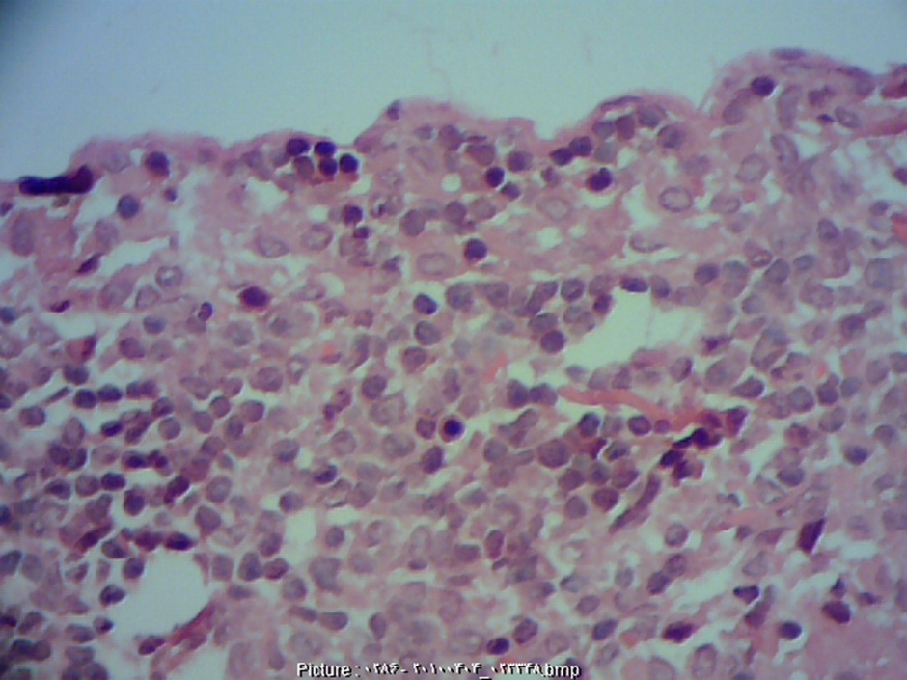
Figure 6 : Photograph of capsule of lymphatic node in the experimental groups (H&E,400x).

Slide 21
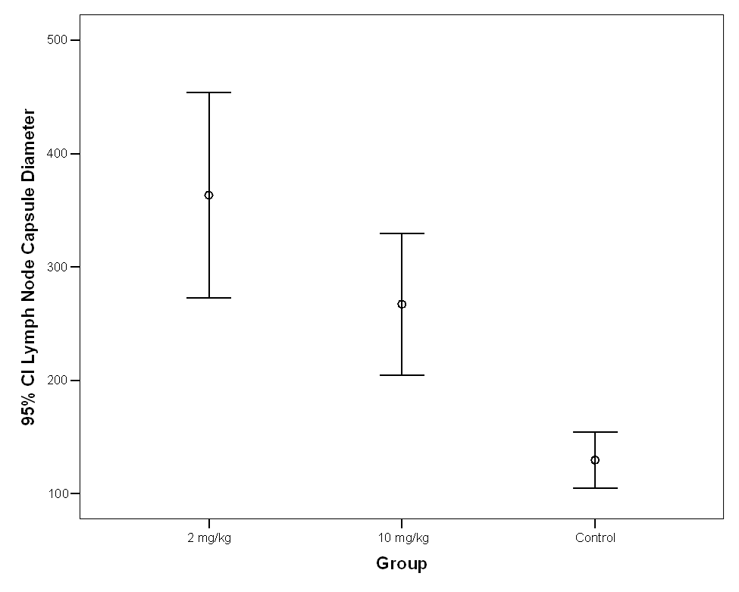
Figure 7 : Statistically analysis has showed increase significantly capsule of lymph node in the treatment groups compared with control group (p<0.05)..

Slide 22
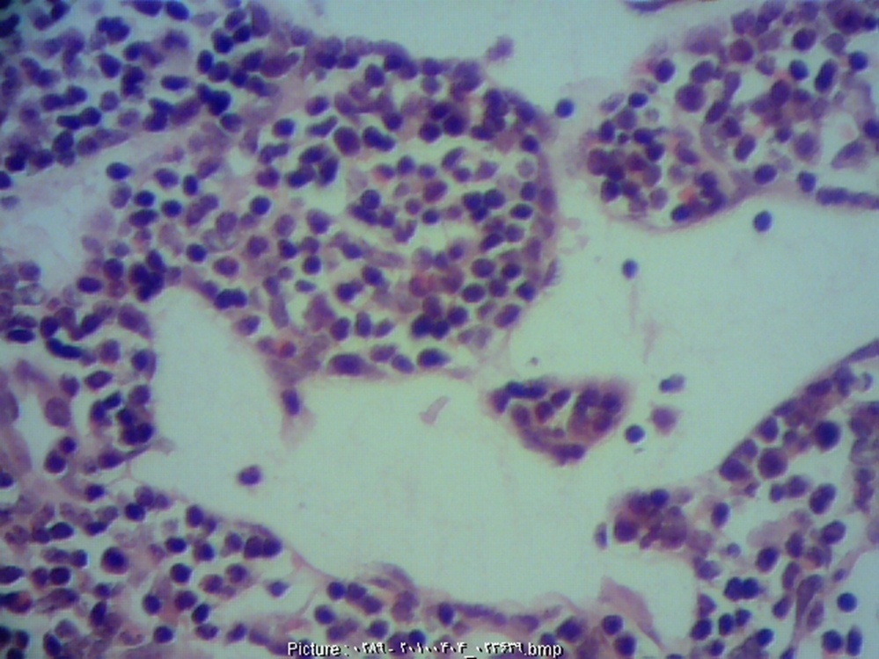
Figure 8: Photograph of dilatation in medullary sinuses of lymph node in the experimental groups (H&E,400x).

Slide 23
Figure 9: Statistically analysis showed that methylphenidate could decrease the diameter of Germinal center of lymph node in experimental groups(p<0.05).

Slide 24
Results
Thmus
Lymphoid tissue of the thymus organized as a dense cellular cortex and lesser cellular medulla. The thickness of the capsules and medulla were decreased significantly in experimental groups (p<0.05).

Slide 25
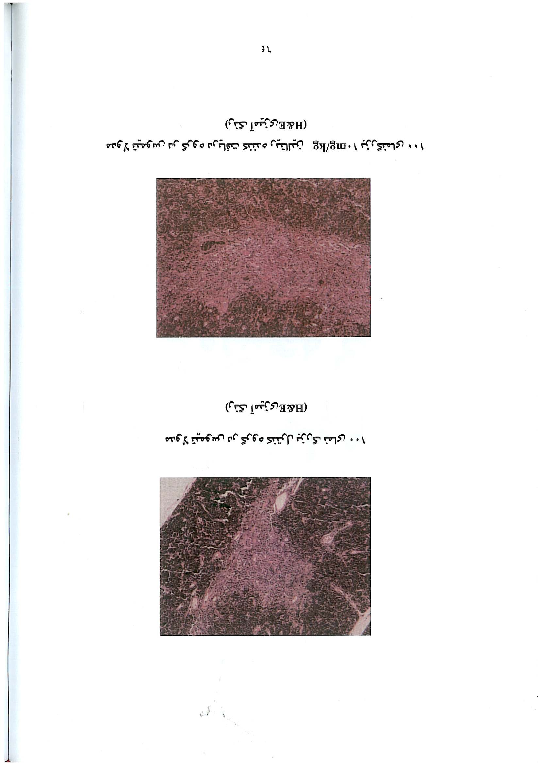
Figure10: (A):Photograph of medullary thymus in control group(H&E,400x). (B) : Photograph of medullary thymus in the experimental groups(H&E,400x).

Slide 26
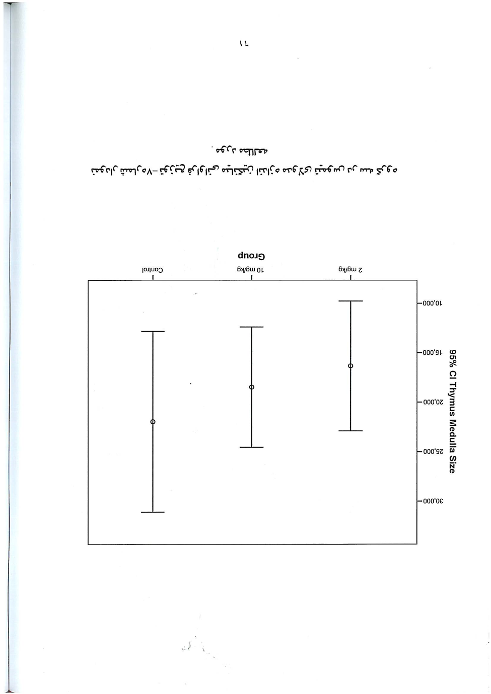
Figure11: Statistically analysis showed that methylphenidate could decrease medulla of thymus in experimental groups(p<0.05).

Slide 27

Figure 12: The thickness of capsule of thymus was decreased significantly in experimental (2mg/kg) group ( P<0.05).

Slide 28
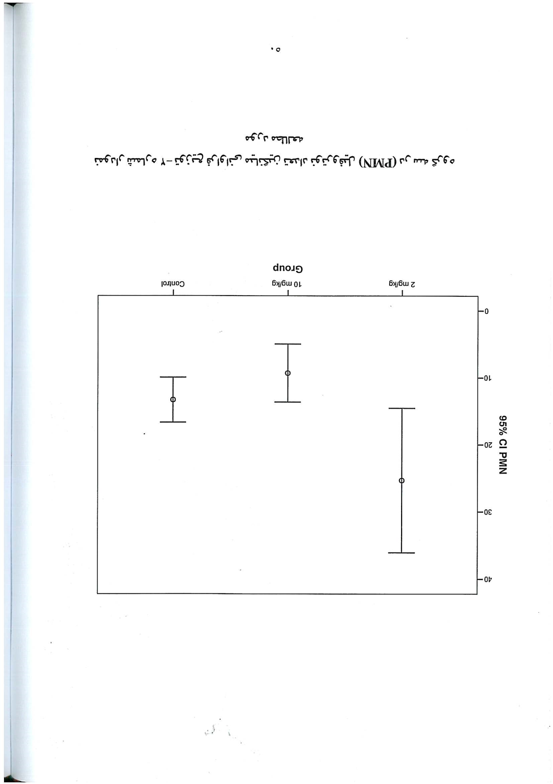
Figure 13: percentage of the peripheral blood neutrophil cell increases significantly in experimental (2 mg/kg) group( p<0.05).

Slide 29
Figure 14: The thickness of capsule of thymus was decreased significantly in experimental (2mg/kg) group ( P<0.05).

Slide 30
Figure 15: percentage of the peripheral blood neutrophil cell increases significantly in experimental (2 mg/kg) group( p<0.05).

Slide 31
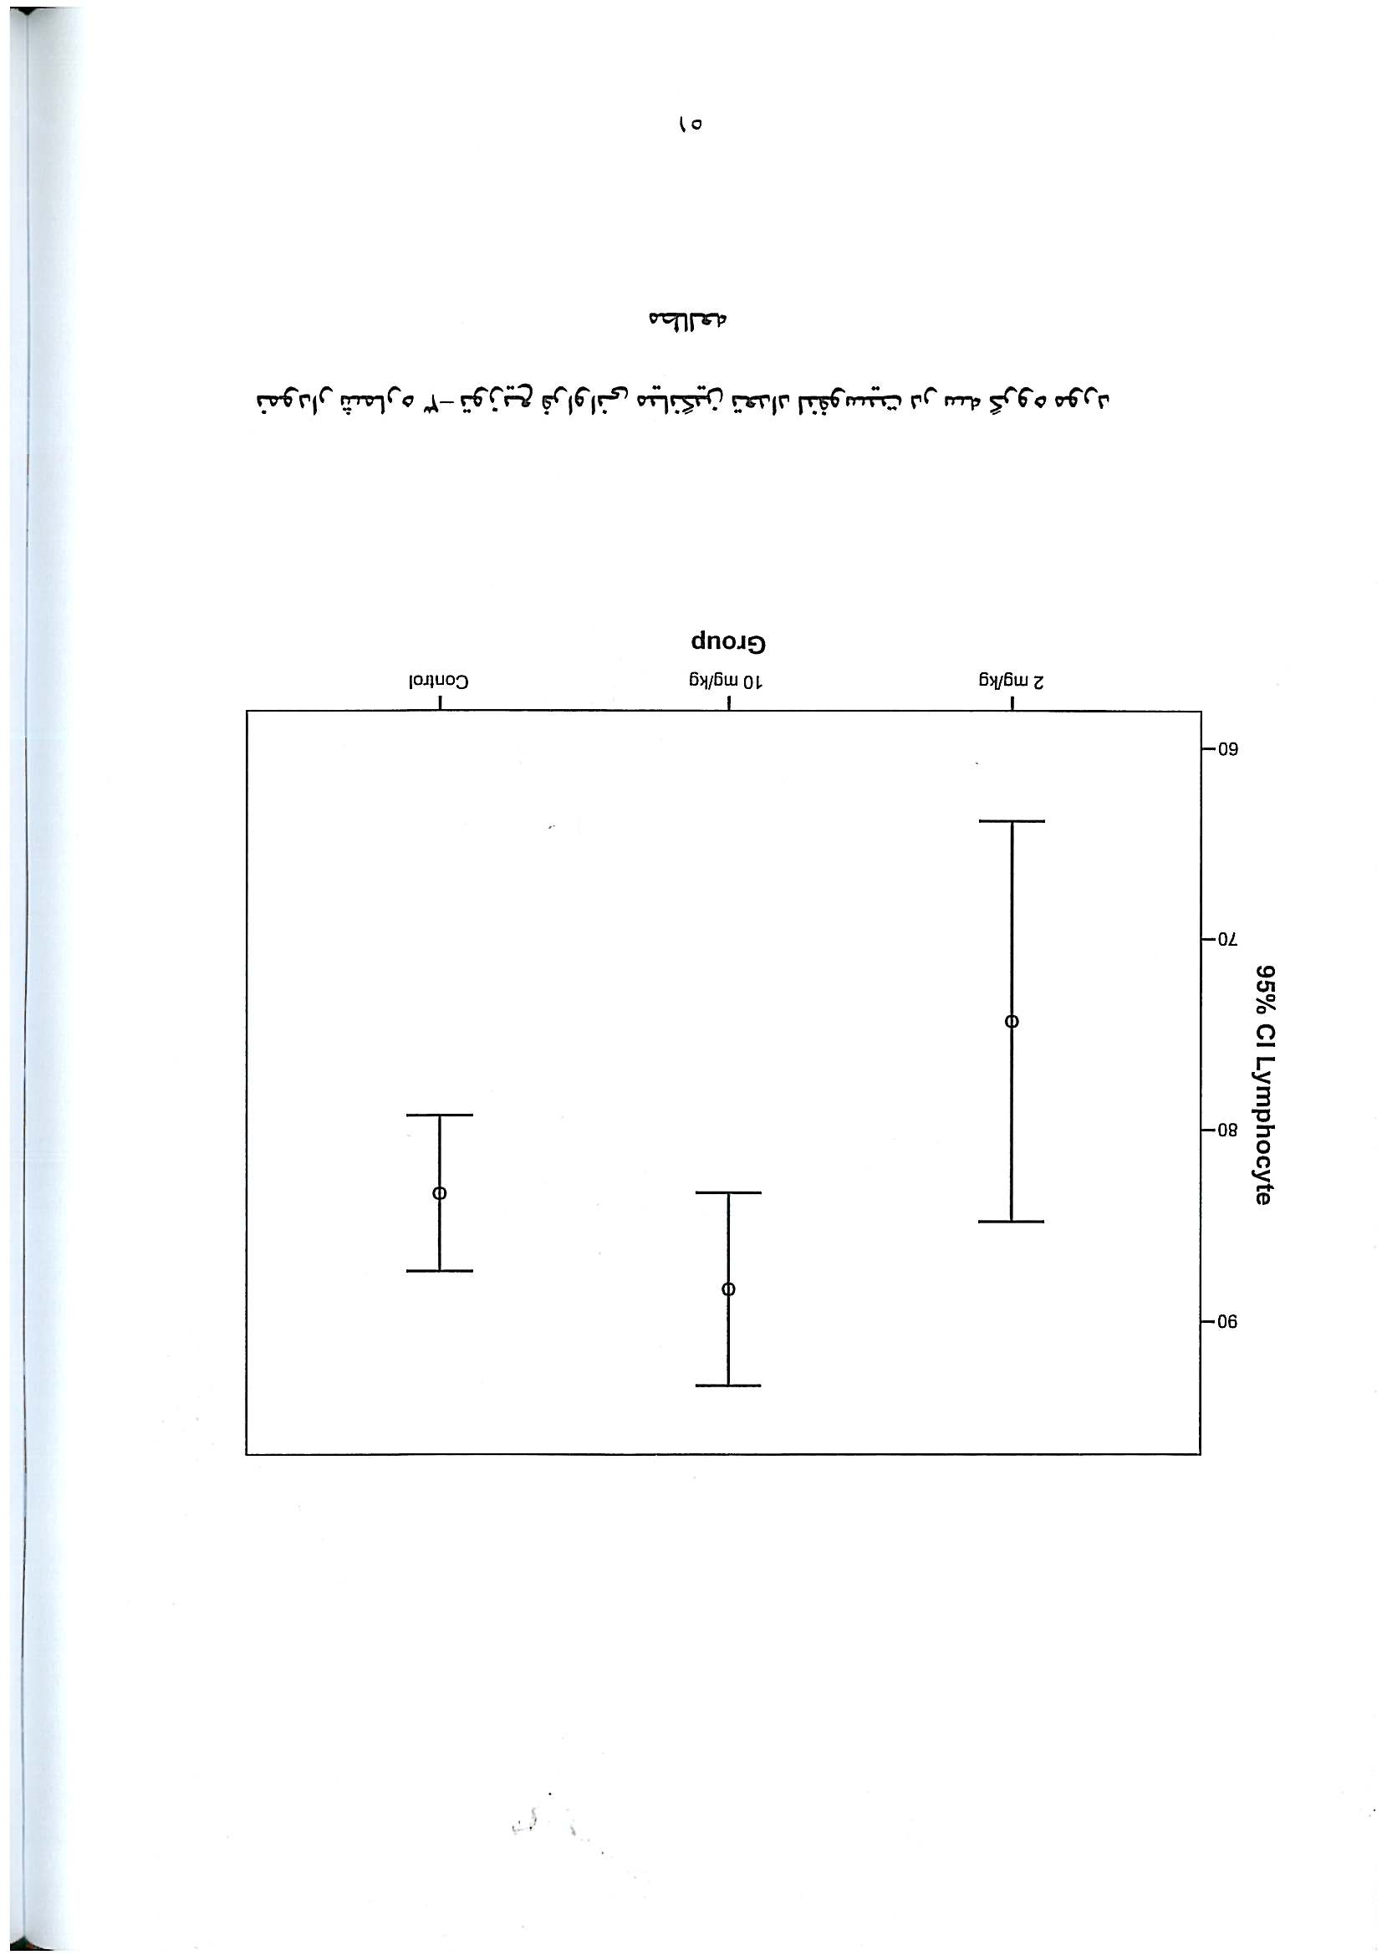
Figure 16: percentage of the peripheral blood lymphocytes decrease significantly in experimental (2mg/kg) groups p<0.05.

Slide 32
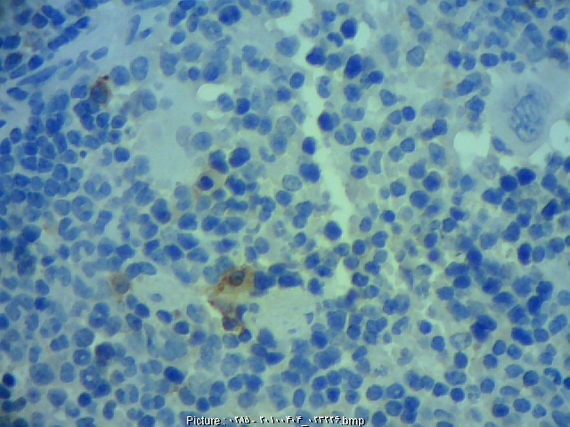
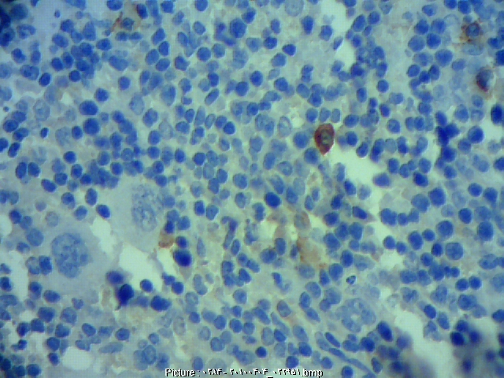
Figure 17: (A): Photograph of splenic plasma cell in control group(H&E,400x). (B): Photograph of splenic plasma cell in the experimental groups(H&E,400x).

Slide 33
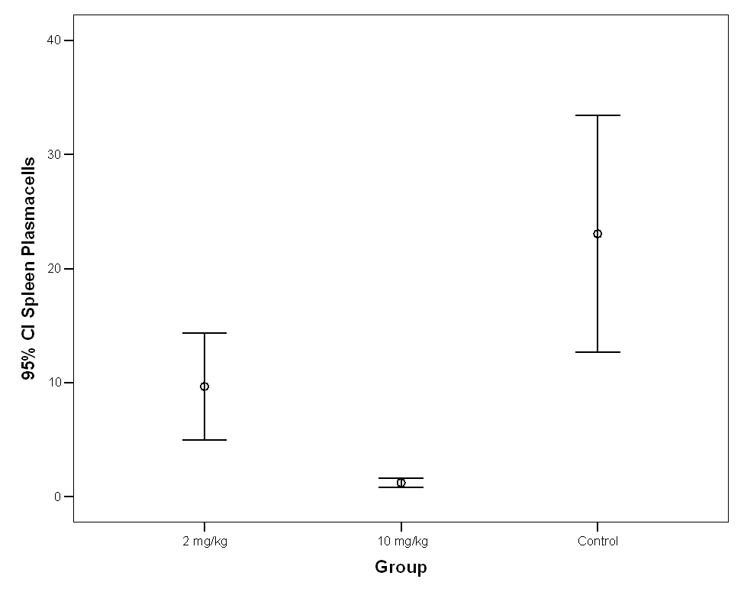
Figure 18: Statistically analysis showed that methylphenidate could decrease splenic plasma cells in experimental groups(p<0.05).

Slide 34
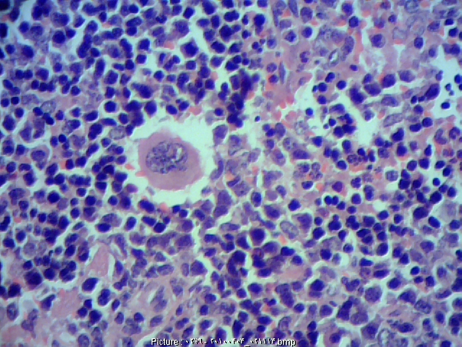
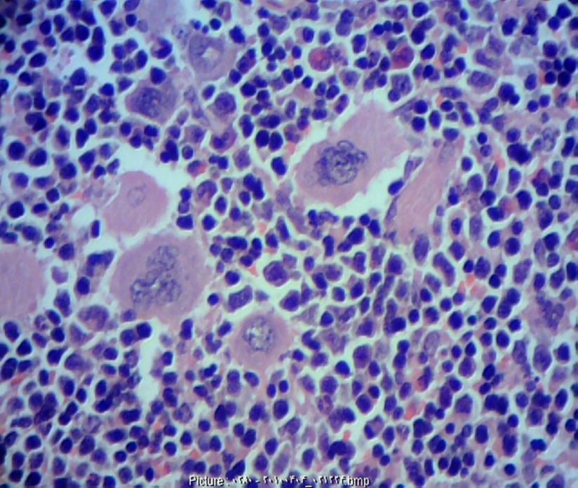
Figure 19: (A): Photograph of megakaryocytes in control group (H&E,400x). (B): Photograph of megakaryocytes in the experimental groups(H&E,400x).

Slide 35
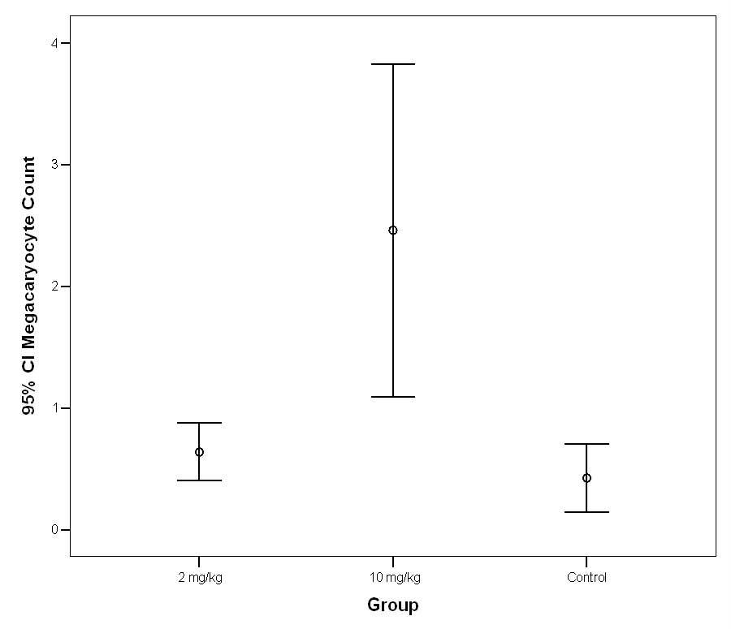
Figure 20: Statistically analysis showed that methylphenidate could increase megakaryocytes in experimental groups(p<0.05).

Slide 36
Discussion and conclusion
The results of this study have revealed that Methylphenidate MPH hydrochloride administration at a dose of 2 and 10 mg/kg for 40 days caused profound detrimental effects on mice lymphatic organs ,and immune suppression possibly occurs via an alternative pathway which is an indirect mechanism of action mediated by to possible ways ,hypothalamic- pituitary- adrenal axis (HBA) activation resulting in high serum level of adrenal corticosteroids, or activation of sympathetic nervous system and concominant catecholamine release .and also decrease peripheral lymphocyte percentage,were observed in the MPH treated animals and hypertrophy of adrenal medullae and fasciculate layer of cortex might give some morphological evidence for MPH induced immune suppression.

Slide 37
Let us meet again..
We welcome you to our future conferences of OMICS International
2nd International Conference and Expo
on
Drug Discovery & Designing
On
October -31 November-02, 2016 at Istanbul, Turkey
http://drug-discovery.pharmaceuticalconferences.com/

Slide 38
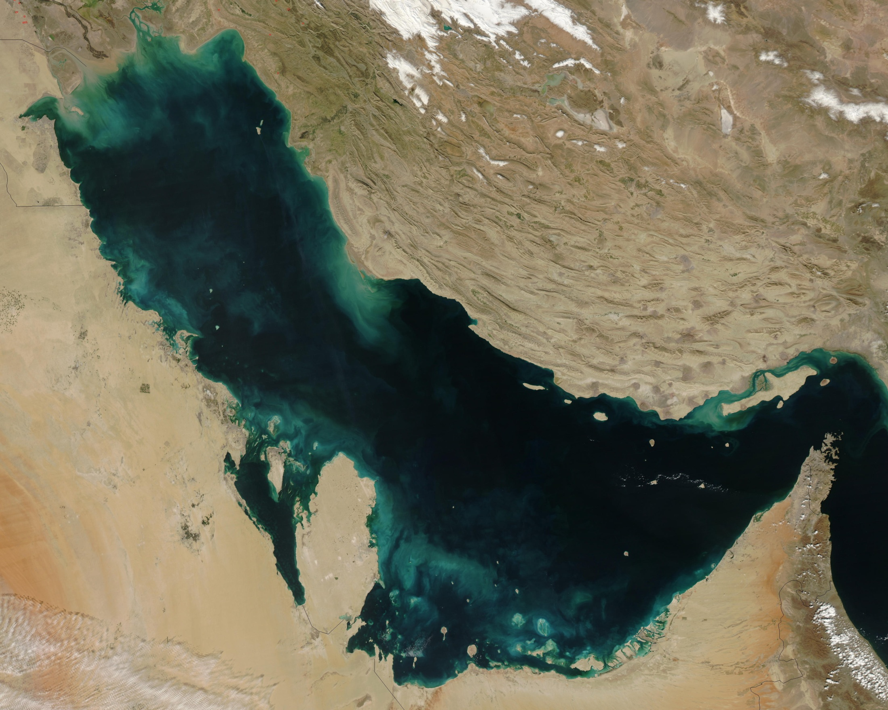
IRAN
Persian Golf
با تشکر از توجه شما
Thank you for your attention
Vielen Dank für Ihre Aufmerksamkeit

