Slide 1
4th Global Summit on Toxicology August 24-26, 2015
Philadelphia, USA
DOES ANTILEISHMANIAL GLUCANTIME® CAUSE DNA DAMAGE BY OXIDATIVE STRESS?
Silma Regina Ferreira Pereira, PhD Federal University of Maranhão, Brazil
silma.pereira@ufma.br/silmaregina@yahoo.com.br
Notes:
Good morning. I am Dr. Silma Pereira from Brazil. It is a pleasure to be here and have the opportunity to talk about the effects of Glucantime on DNA.
Glucantime is a pentavalent antimonial used to treat Leishmanaisis, which is an endemic disease in Brazil.

Slide 2
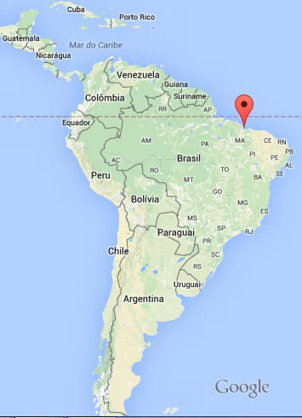
4th Global Summit on Toxicology August 24-26, 2015
Philadelphia, USA
In 2013, 558 cases and 49 deaths were documented in the State of Maranhäo, Brazil.
Notes:
,……… specially in my State, Maranháo, affecting the most deprived socioeconomic groups. In 2013, for exemple, 558 cases and 49 deaths were documented just in the State of Maranhäo

Slide 3
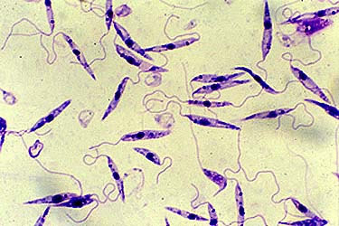
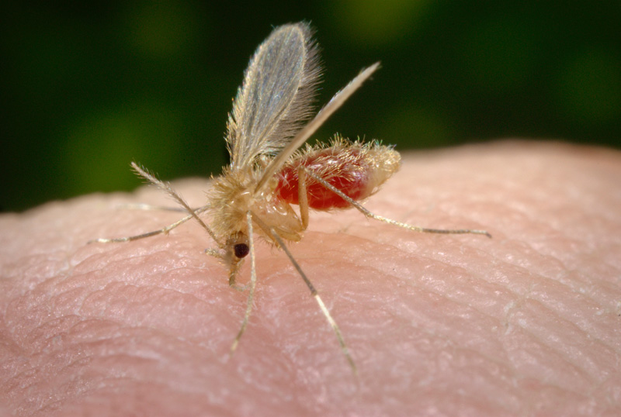
4th Global Summit on Toxicology August 24-26, 2015
Philadelphia, USA
Leishmaniasis:
Neglected tropical disease caused by over 20 Leishmania species which are transmitted by the bite of infected female phlebotomine sandflies.
Notes:
Leishmaniasis is a neglected tropical disease caused by over 20 species of the protozoan parasite Leishmania which are transmitted by infected female phlebotomine sandflies.
Wild and domesticated animals, and humans themselves can act as reservoirs of infection. More than 12 million people are affected around the world.

Slide 4
4th Global Summit on Toxicology August 24-26, 2015
Philadelphia, USA
Leishmaniasis:
Three main forms of the disease
Visceral leishmaniasis
Cutaneous leishmaniasis
Mucocutaneous leishmaniasis
Notes:
There are 3 main forms of the disease:

Slide 5
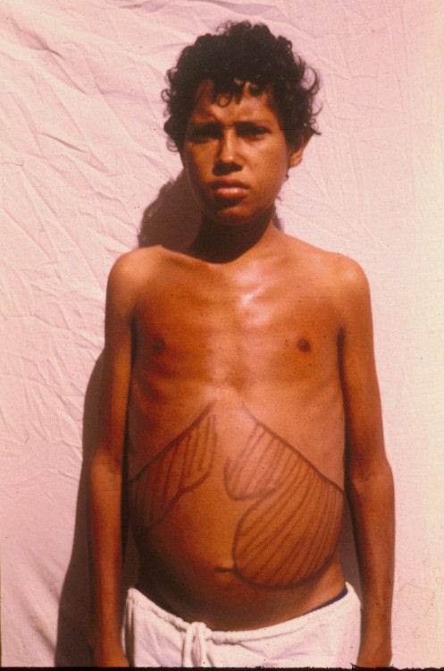
4th Global Summit on Toxicology August 24-26, 2015
Philadelphia, USA
Leishmaniasis:
Three main forms of the disease
300,000
estimated cases
Visceral leishmaniasis
Cutaneous leishmaniasis
over 20,000
deaths annually
Mucocutaneous leishmaniasis
(WHO, 2015)
Notes:
Visceral leishmaniasis (also known as kala-azar) is fatal (fei ro) if left untreated. It is characterized by irregular fever, weight loss, enlargement of the spleen and liver, and anemia.

Slide 6
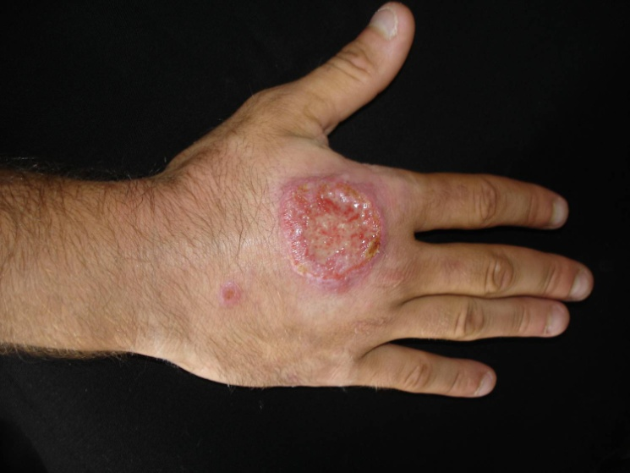
4th Global Summit on Toxicology August 24-26, 2015
Philadelphia, USA
Leishmaniasis:
Three main forms of the disease
Visceral leishmaniasis
Cutaneous leishmaniasis
1 million
cases of (CL)
reported in the last
5 years
Mucocutaneous leishmaniasis
(WHO, 2015)
Notes:
2) Cutaneous leishmaniasis is the most common form and causes skin lesions

Slide 7
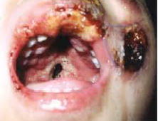
4th Global Summit on Toxicology August 24-26, 2015
Philadelphia, USA
Leishmaniasis:
Three main forms of the disease
Visceral leishmaniasis
Cutaneous leishmaniasis
Mucocutaneous leishmaniasis
It is hard to treat and presents poor prognosis. It is not clear which factors contribute to the evolution of the cutaneous disease into this late form.
Notes:
3) Mucocutaneous leishmaniasis leads to partial or total destruction of mucous membranes. The majority of mucocutaneous leishmaniasis cases occurs in Bolivia, Brazil and Peru.

Slide 8
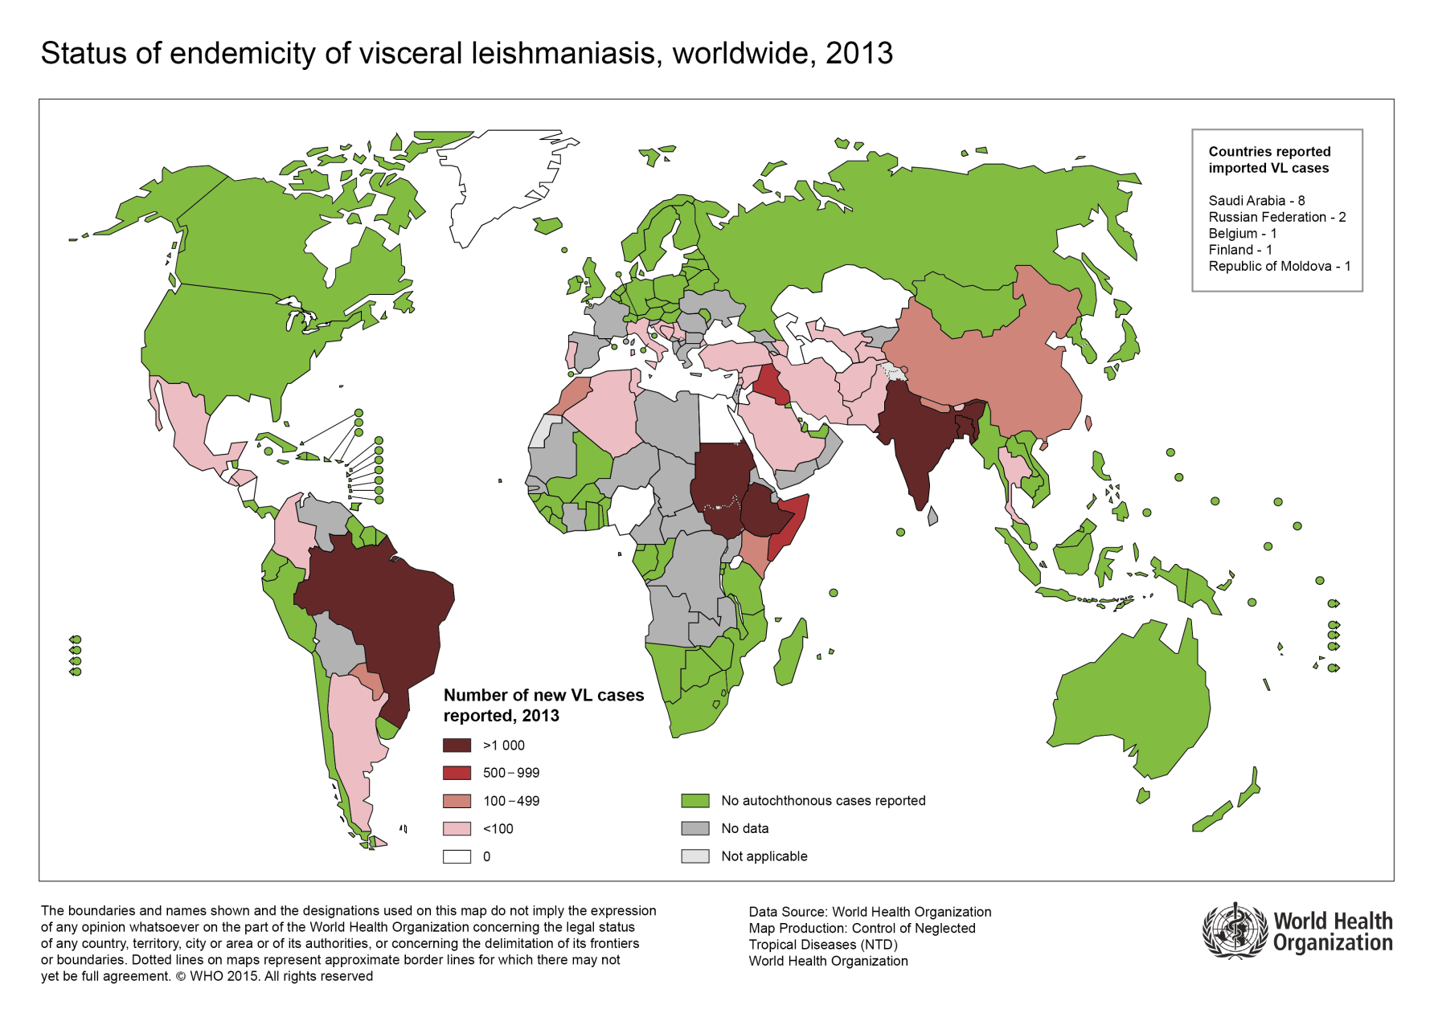
4th Global Summit on Toxicology August 24-26, 2015
Philadelphia, USA
Visceral Leishmaniasis
310 million
people are at
risk of infection
in six countries that report over 90% of VL cases
worldwide
Notes:
In fact, Visceral leishmaniasis is widely distributed around the world and is a public health problem in 88 countries.
More than 90% of cases occur in Bangladesh, Brazil, Ethiopia, India, South Sudan and Sudan.

Slide 9
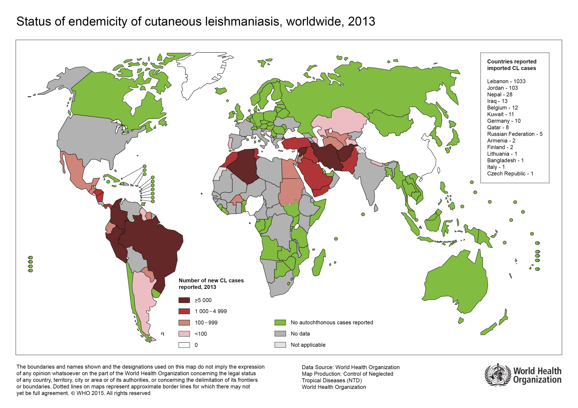
4th Global Summit on Toxicology August 24-26, 2015
Philadelphia, USA
Cutaneous Leishmaniasis
Notes:
But, Cutaneous leishmaniasis is more widely distributed with about one-third of cases occurring in the Americas, the Mediterranean basin, and western Asia.

Slide 10
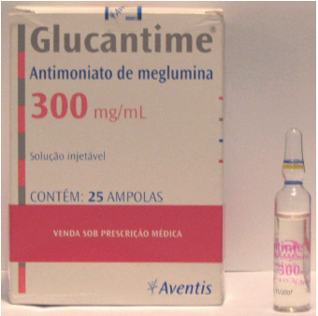
4th Global Summit on Toxicology August 24-26, 2015
Philadelphia, USA
Treatment
First-choice drug
World Health Organization
Proposed structural formula of meglumine antimoniate. Adapted from Frézard et al, 2008.
Pentavalent antimony (SbV)
20 mg of Sb/kg/day for 20–30 days
Notes:
Regarding treatment, Glucantime® (N-methyl-glucamine antimoniate) is the first-choice drug recommended by the World Health Organization for the treatment of all types of leishmaniasis.
However, many adverse effects are observed such as skeletal and muscle aches, nausea, vomiting and diarrhea. These patients may develop cardiac, liver and kidney complications, usually in the end of the treatment.

Slide 11
4th Global Summit on Toxicology August 24-26, 2015
Philadelphia, USA
GLUCANTIME
®
Does it cause DNA damage? How?
Notes:
Despite being used for over six decades, the mechanisms of action and toxicity of pentavalent antimonials, like Glucantime, remain unclear. Because of this, we decided to investigate if and how this drug interacts with mammalian DNA.

Slide 12
4th Global Summit on Toxicology August 24-26, 2015
Philadelphia, USA
Methods
GENOTOXICITY
Comet Assay (Singh et al. 1988; Tice et al. 2000)
In vitro (human lymphocytes)
In vivo (Mice leukocytes)
Comet Assay - Modified for Detection of Oxidized Bases Using the Repair Endonuclease Fpg (formamidopyrimidine glycosylase).
kit FPG FLARETM (Trevigen, Gaiythersburg, MD) Gajski et al (2012).
Notes:
Trying to understand that, we performed Comet assay in vitro using human lymphocytes and in vivo Comet assay using mice leukocytes. Furthermore, comet assay followed by FPG digestion was performed, which removes oxidized Guanine.

Slide 13
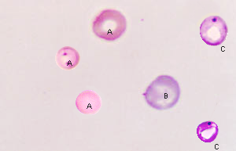
4th Global Summit on Toxicology August 24-26, 2015
Philadelphia, USA
Methods
MUTAGENICITY
CELL DEATH
In vivo Micronucleus Test (Mice erythrocytes)
Apoptosis Assay (Human leukocytes)
(Dive et al. 1992)
Notes:
To investigate mutagenicity, we carried out Micronucleus Test using mice erytrocytes. In addition, we investigated if the drug drug could cause cell in human lymphocytes in vitro.

Slide 14
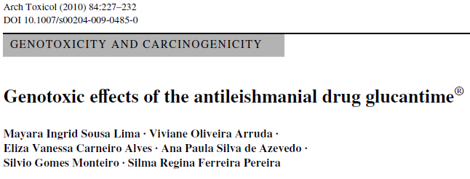
4th Global Summit on Toxicology August 24-26, 2015
Philadelphia, USA
Results
Notes:
Previously, in 2010, using systems with and without bioconversion, we demonstreated that Glucantime cause DNA damage In vivo but not In vitro.

Slide 15
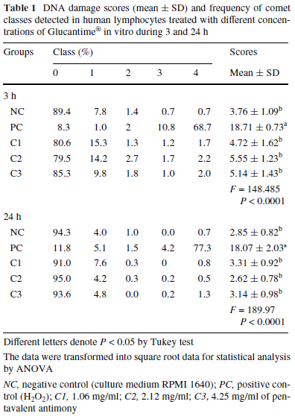
4th Global Summit on Toxicology August 24-26, 2015
Philadelphia, USA
Glucantime® does not induce DNA damage in vitro
Notes:
Table 1 presents DNA damage scores detected in human lymphocytes in vitro for 3 and 24 hours of treatment.
As we can see, there was no difference for any of the groups treated with Glucantime® compared to the negative control, for both periods of time.

Slide 16
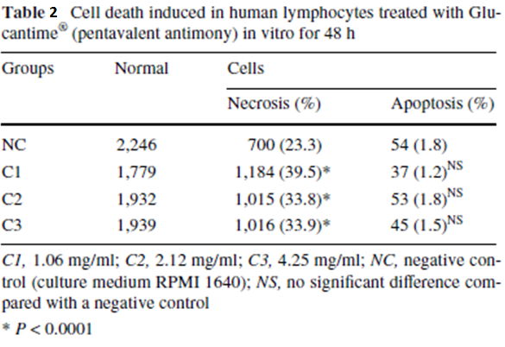
4th Global Summit on Toxicology August 24-26, 2015
Philadelphia, USA
Glucantime® does not induce DNA damage in vitro
Glucantime® does not induce apoptosis, but induces cell death by necrosis in vitro
Notes:
Cells were also exposed to the drug for 48 h, allowing them to go through DNA repair mechanisms. Using this system we investigated if the drug was able to cause cell death.
Regarding apoptosis, We didn’t find any difference among the groups treated with Glucantime.
But the drug was able to increase cell death by necrosis.
These results emphasize those obtained from in vitro comet assays.
So, Glucantime wasn`t able to cause dna damage or apoptosis in vitro, without metabolization.

Slide 17
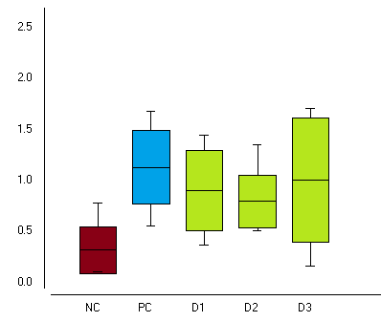
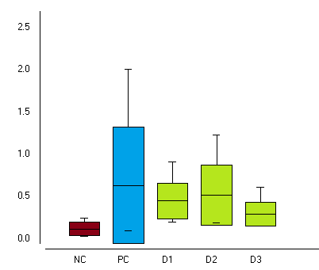
4th Global Summit on Toxicology August 24-26, 2015
Philadelphia, USA
Glucantime® induces DNA damage in vivo
NC (Water)
PC-Cyclophosphamide (50mg/kg)
(A) Leukocytes 24 h
(B) Macrophages 3 h
Glucantime®
b
b
b
b
b
DNA DAMAGESCORES
b
a
b
b
a
Figure 1: (A) DNA damage score detected by Comet assay performed in leukocytes from swiss mice treated for 24 hours and (B) in resident peritoneal exudate macrophages (B) for 3 hours. Different letters means p<0.05 by Tukey test (A) and p<0.05 by the Student NewmanKeuls test (B).
D1, 200mg/kg; D2, 400mg/kg; D3, 800mg/kg
Notes:
On the other hand, in vivo tests performed in leukocytes from mice treated for 24 hours and in macrophages for 3 hours, showed an increase in DNA damage for all groups, for both cell types.
And its important to mention that There was no difference among all groups treated with Glucantime and the positive control treated with clophosphamide (saiclo), A RECOGNIZED GENOTOXIC DRUG.

Slide 18
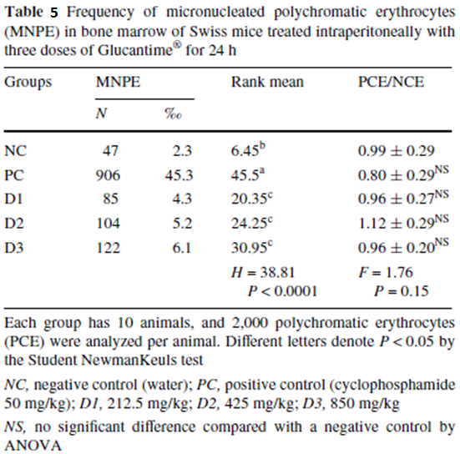
4th Global Summit on Toxicology August 24-26, 2015
Philadelphia, USA
Glucantime® does not induce DNA damage in vitro
Glucantime® does not induce apoptosis but induces cell death by necrosis in vitro
Glucantime® induces DNA damage in vivo
Glucantime® presents mutagenic effect in vivo
Notes:
Knowing that Glucantime presents genotoxic effect in vivo, the next step was to evaluate if Glucantime could cause mutations.
Table 3 presents the frequency of micronucleated erytrocytes observed in all groups treated with Glucantime for 24 hours.
All groups receiving Glucantime presented a higher frequency of micronucleated cells compared to the negative control.

Slide 19
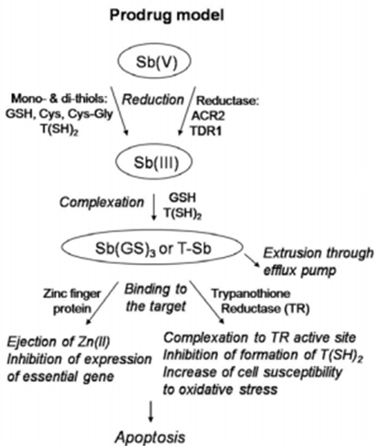
4th Global Summit on Toxicology August 24-26, 2015
Philadelphia, USA
Glucantime® is a promutagen that requires metabolization to exert its mutagenic action
Antileishmanial Activity
“Prodrug Model” proposed for the mechanism of action of pentavalent antimonials against leishmaniasis (Frézard et al, Molecules 2009, 14, 2317-2336).
Notes:
From all these results, we suggest that Glucantime is a promutagen that requires metabolization to exert its mutagenic action.
Ours results support the idea that pentavalent antimony acts as a prodrug that is transformed into the more toxic trivalent form (Sb III) to exert its antileishmanial activity.

Slide 20
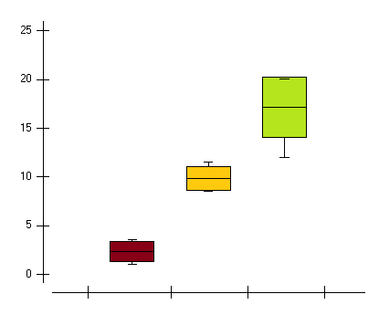
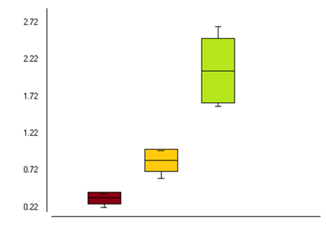
4th Global Summit on Toxicology August 24-26, 2015
Philadelphia, USA
Glucantime® increases Genotoxicity and Mutagenicity caused by Leishmania infection
Water
Infection by L. infantum chagasi (45 days)
(B) Mutagenicity
(A) Genotoxicity
Infection + Glucantime (800mg/kg for 24h)
c
c
b
FREQUENCY OF MICRONUCLEATED CELLS
DNA DAMAGE SCORES
b
a
a
NC INF GLU
NC INF GLU
Figure 2- DNA damage scores (A) and frequencies of micronucleated erytrocytes (B) detected in BalbC mice infected by Leishmania infantum chagasi. Different letters represent p<0.01 by Tukey’s test.
Notes:
Glucantime action was also evaluated (ee VAL you ay tid) in BalbC mice infected by L. infantum chagasi, which causes visceral leishmanisis.
As we can observe IN Graph A and B, the infection itself increased DNA damage and the frequency of micronucleated cells.
Genomic lesions and mutations further increased when these infected animals were treated with Glucantime for 24 h.
Moreover, the activity of the superoxide dismutase enzyme was higher in infected animals compared to the negative control. In addition, there was no difference between infected animals and those infected animals receiving Glucantime, suggesting the occurrence of oxidation in both groups that presented genotoxic and mutagenic effects.

Slide 21
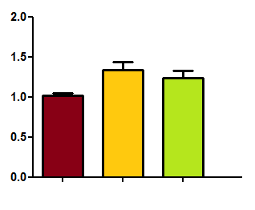
4th Global Summit on Toxicology August 24-26, 2015
Philadelphia, USA
Leishmania infection increases SOD activity
Water
Infection by L. infantum chagasi (45 days)
(C) SOD
Infection + Glucantime (800mg/kg for 24h)
b
a,b
SOD activity (U/mL)
a
NC INF GLU
(C) Superoxide dismutase activity detected in BalbC mice infected by Leishmania infantum chagasi. Different letters represent p<0.01 by Tukey’s test.
Notes:
Moreover, the activity of the superoxide dismutase enzyme was higher in infected animals compared to the negative control. In addition, there was no difference between infected animals and those infected animals receiving Glucantime, suggesting the occurrence of oxidation in both groups that presented genotoxic and mutagenic effects.

Slide 22
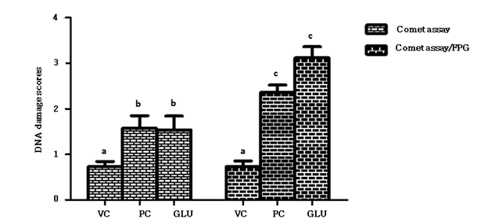
4th Global Summit on Toxicology August 24-26, 2015
Philadelphia, USA
Glucantime® itself causes oxidative damage in DNA base
Uninfected animals
Figure 3: DNA damage scores detected by Comet assay and Comet assay followed by FPG digestion. VC: Vehicle control (Dimethyl sulfoxide 1%); PC: Positive control (cyclophosphamide 50mg/kg); GLU: Glucantime (800mg/kg). Different letters denote p<0.01 by T test.
Notes:
From that, using uninfected animals, we investigated if Glucantime itself could have caused DNA damage by oxidation. As we can see in this graph, the DNA damage obtained by comet assay followed by FPG digestion (which removes oxidized guanine) was higher than that obtained (ub TAYN d) from conventional comet assay. Same results were observed regarding ciclophosphamide. Hence, these results suggest that Glucantime® itself induces oxidative damage in DNA base.

Slide 23
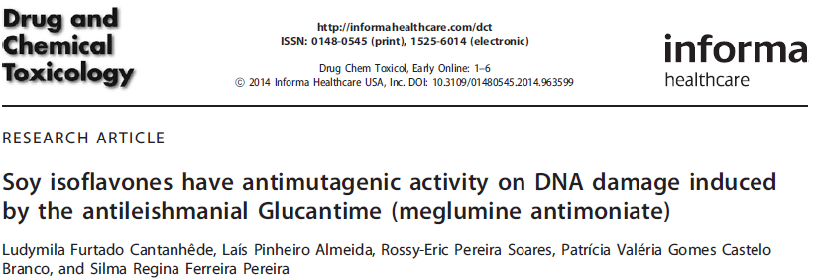
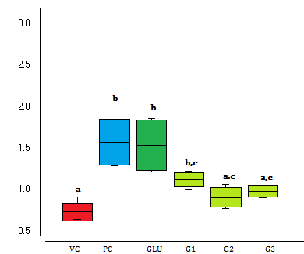
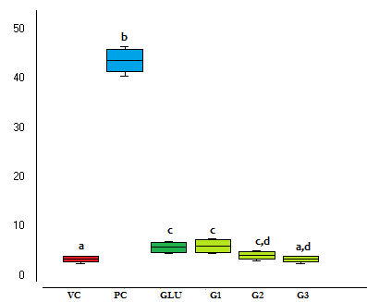
Genistein, a potent antioxidant, reduces DNA damage caused by Glucantime®
4th Global Summit on Toxicology August 24-26, 2015
Philadelphia, USA
Dimethyl sulfoxide 2%
Cyclophosphamide (50mg/kg)
(A) Antigenotoxicity
(B) Antimutagenicity
Glucantime (800mg/kg)
Glucantime + Genistein
(G1=5mg/kg; G2=10mg/kg; G3=20mg/kg)
68,9% reduction
Frequency of micronucleated erythrocytes
DNA damage scores
Figure 4: (A) DNA damage scores detected by in vivo Comet assay in peripheral blood leukocytes and (B) frequency of micronucleated polychromatic erythrocytes (MNPE) in bone marrown from Swiss mice treated with Genistein (3 days) and Glucantime (24h). Different letters means p<0.05 by the Student NewmanKeuls test (A) and p<0.05 by Tukey`s test (B).
Notes:
To reinforce that Glucantime was inducing DNA damage by oxidation, we performed antimutagenic tests using compounds
which have significant protective effects against oxidative stress, as Isoflavones, and Vitamin C.
Previously, we demonstrated that soy isoflavones present antimutagenic effects on DNA damage induced by Glucantime.
Here, we carried out assays using Genistein, an isoflavone and potent antioxidant. Genistein was able to reduce genotoxicity and mutagenicity induced by Glucantime, achieving basal frequencies observed in the negative controls.

Slide 24
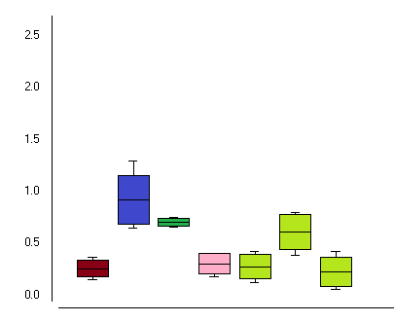
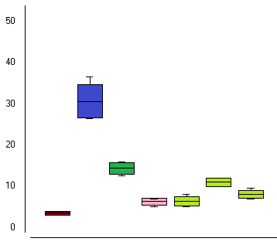
4th Global Summit on Toxicology August 24-26, 2015
Philadelphia, USA
Vitamin C presents antimutagenic activity on DNA damage caused by Glucantime®
Water (Negative control)
Vitamin C (ascorbic acid 60 mg/kg)
Cyclophosphamide (50mg/kg)
Vitamin C + Glucantime
PRE= pre-treatment
SIM=simultaneous
POST=post-treatment
Glucantime® (800mg/kg)
(A) Antigenotoxicity
b
(B) Antimutagenicity
107% reduction
DNA damage scores
b
Frequency of micronucleated erythrocytes
b,c
c,d
c
c,d
a
a
a
a
a,e
a
d,e
a
NC PC GLU VITC SIM PRE POST
NC PC GLU VITC SIM PRE POST
Figure 5: (A) DNA damage scores detected in peripheral blood leukocytes and (B) frequency of micronucleated polychromatic erythrocytes (MNPE) in bone marrown from Swiss mice treated with Vitamin C and Glucantime (24h). Different letters means p<0.01 by Tukey’s test.
Notes:
Similarly, vitamin C was able to reduce the genotoxic and mutagenic effects caused by the antileishmanial Glucantime.
The protective effect was observed when both drugs were administered (ad MIN is terd) simultaneously or when vitamin C was administered after Glucantime.
However, when the animals received Vitamin C prior to Glucantime, the protective effect wasn't observed.
So, from this data Vitamin C presents antimutagenic activity in simultaneous and post-treatment

Slide 25
4th Global Summit on Toxicology August 24-26, 2015
Philadelphia, USA
Summary
Glucantime (Pentavalent antimonial) does not induce DNA damage and apoptosis in vitro, without metabolization;
Infection by Leishmania itself cause mutation in mammalian cells;
Glucantime® increases even more the frequency of mutations in infected animals;
SOD activity increases in infected animals treated with Glucantime ®;
Glucantime® is a promutagen which requires metabolization to exert its mutagenic action;
Glucantime® induces oxidative damage in DNA base.
Genistein and Vitamin C present high efficiency to prevent genomic lesions and mutations caused by the antileishmanial Glucantime®.
Notes:
In summary`…….

Slide 26
4th Global Summit on Toxicology August 24-26, 2015
Philadelphia, USA
The antileishmanial Glucantime® does cause DNA damage by oxidative stress!
®
How?
Notes:
In conclusion, asnwering our first question, we suggest that Glucantime cause DNA damage by oxidative stress.

Slide 27
4th Global Summit on Toxicology August 24-26, 2015
Philadelphia, USA
Other Questions
Is there any differential gene expression in mammalian cells due to oxidative stress induced by Glucantime?
Does Vitamin C decrease the antileishmanial activity of Glucantime?
Notes:
But, other questions arise.
So, our group is now conducting experiments with infected mice treated with Glucantime and Vitamin C to DETERMINE( DE ter min) the parasite load and the expression of genes involved in mechanisms LIKE apoptosis, DNA repair and oxidative stress. We’re trying to figure out if vitamin C could be used to protect DNA damage without affecting the antileishmanial activity of Glucantime.

Slide 28
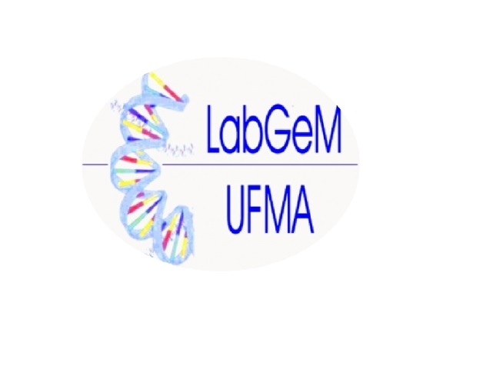
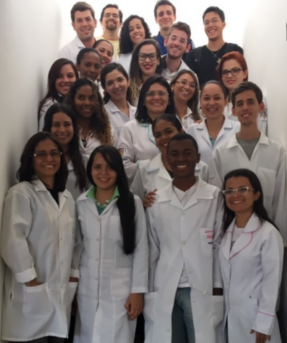
4th Global Summit on Toxicology August 24-26, 2015
Philadelphia, USA
Acknowledgments
Notes:
I would like to thank all my students and collegues and to the funding agencies which support this research, Fapema and CNPq and The Federal University of Maranhäo

Slide 29
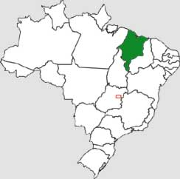
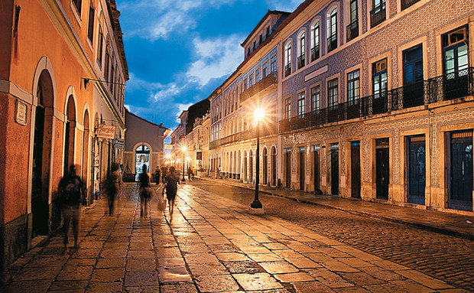
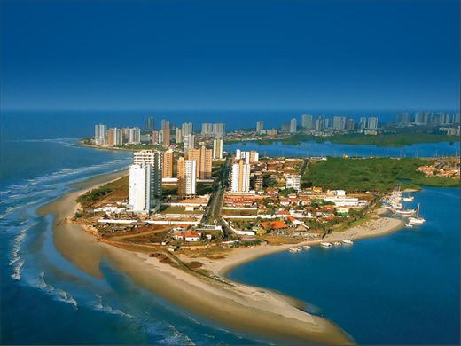
4th Global Summit on Toxicology August 24-26, 2015
Philadelphia, USA
Thank you!
Maranhão, Brazil
Notes:
Thank you! Now, I would like to open the floor to questions. And before we go, here some pictures of my city, in Maranháo State, and as you can see we have more than just leishmanaisis. Thanks.

