Slide 1
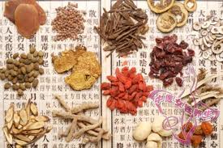
Renoprotective effects of Citral on accelerated and severe lupus nephritis mice by inhibiting activation signal of NLRP3 inflammasome and enhancing Nrf2 activation
Shuk-Man Ka, PhD
Associate Professor
Academy of Medicine,
National Defense Medical Center, Taipei, Taiwan
Sep 2015

Slide 2
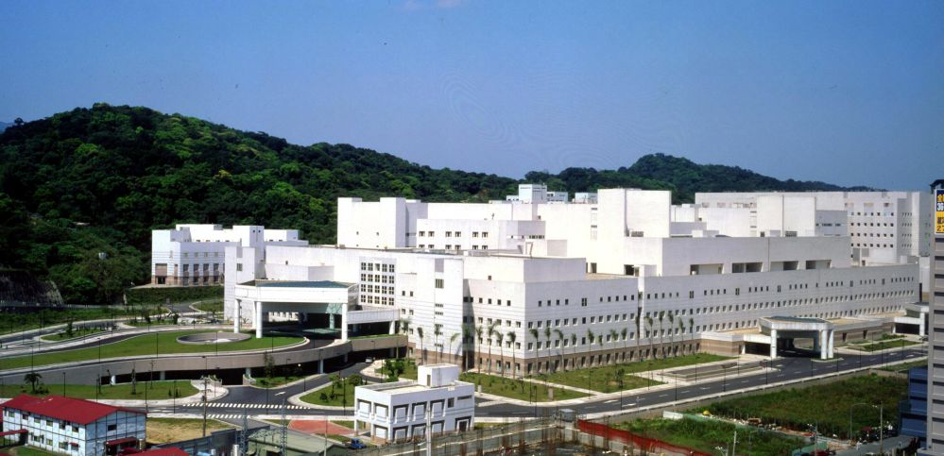
Validation of renoprotective components from TCM against renal inflammation
Maria, Shuk-Man Ka, PhD
Associate Professor and Project Leader
Academy of Medicine,
National Defense Medical Center,
Taipei, Taiwan, ROC
Ann Chen, MD, PhD
Professor and Head
Department of Pathology and Lab Medicine, Tri-Service General Hospital, National Defense Medical Center, Taipei, Taiwan, ROC
Notes:
About CKD: use the table of CKD from the 科專計畫 (there is a table illustrating 5 stages of CKD). Mention that over the past 3 years, you’ve served as a principle investigator in the first sub-project of the CKD project, and your role is to do all the screening tasks, and during this period you published xx papers for the team.

Slide 3
中醫藥典籍/文獻報告/藥學、醫學最新相關訊息
Potential candidates (Candidate compounds/extracts)
(Screening)
(Cell models)
(Macrophages；Mesangial cells)
細胞存活率及 IC50 分析
(Survival and toxicity)
氧化壓力調節作用
(Reactive oxidative stress)
Nrf2 anti-oxidative signal pathway
(Western blotting)
Inflammatory/fibrosis signal pathway
(Real-time PCR, Western blotting, ELISA)
總評估 (Ranking)
(Validation)
動物模式
(CKD models)
臨床表現；病理；免疫與分子分析
(Clinical/pathology/molecular analyses)
中草(植物)藥作用機轉分析
(Mode/mechanism of action)
專 利 (Patent)
技 轉 (Tech transfer)

Slide 4
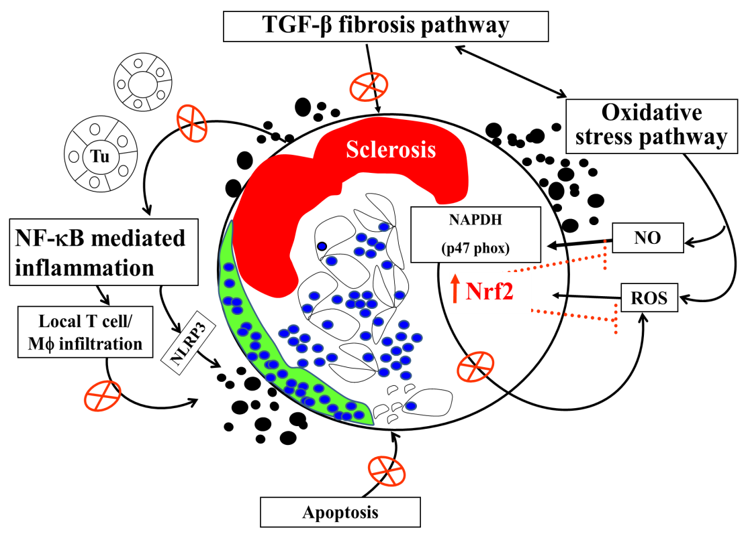
Tsai PY, Ka SM, Chang JM, Lai JH, Dai MS, Jheng HL, Kuo MT, Chen P, Chen A. Arthritis Rheum. 2012 Jan;64 (1):232-42.
Tsai PY, Ka SM, Chang JM, Chen HC, Shui HA, Li CY, Hua KF, Chang WL, Huang JJ, Yang SS, Chen A. Free Radic Biol Med. 2011 Aug 1;51 (3):744-54.
Yang SM, Ka SM*, Hua KF, Wu TH, Chuang YP, Lin YW, Yang SS, Lin SH, Chang JM, Chen A. Free Radic Biol Med. 2013 Apr 6;61C:285-297.
Tsai PY, Ka SM*, Chao TK, Chang JM, Lin SH, Li CY, Kuo MT, Chen P, Chen A. Free Radic Biol Med. 2011 Jun 1;50 (11):1503-16.
Kuo-Feng Hua, Ju-Ching Chou, Yulin Lam, Yu-Ling Tasi, Ann Chen, Shuk-Man Ka, Zhanxiong Fang, May-Lan Liu, Feng-Ling Yang, Yu-Liang Yang, Yi-Chich Chiu, Shih-Hsiung Wu. PLoS ONE, 2013. Oct 7;8(10):e76754
Chen-Lung Ho, Chai-Yi Lin, Shuk-Man Ka, Ann Chen, Yu-Ling Tasi, May-Lan Liu, Yi-Chich Chiu, Kuo-Feng Hua. PLoS ONE, 2013 Oct 4;8(10):e75738.
Kuo-Feng Hua, Shun-Min Yang, Tzu-Yang Kao, Jia-Ming Chang, Hui-Ling Chen, Yung-Jen Tsai, Ann Chen, Sung-Sen Yang, Louis Kuoping Chao, Shuk-Man Ka. PLOS ONE 2013 Oct 28;8(10):e77794.
Yang SM, Hua KF, Lin YC, Chen A, Chang JM, Kuoping Chao L, Ho CL, Ka SM*. PLoS One. 2013 Sep 17;8(9):e74871.
Tsai PY, Ka SM, Chang JM, Chang WL, Huang YJ, Hung LM, Jheng HL, Wu RY, Chen A. Am J Physiol Renal Physiol. 2011 Oct;301 (4):F751-64.
Ka SM, Kuo YC, Ho PJ, Tsai PY, Hsu YJ, Tsai WJ, Lin YL, Shen CC, Chen A. Rheumatol, 2010 ;49(10):1840-51
1. Among the 225 candidate compounds, 75 items passed the screening of the cell model platform, and totally 9 items were further validated in the mouse models of CKD; 6 items were proved to be reno-protective.
2.
Notes:
Our data show that (1) several of renoprotective components, including [a], [b], [c] ………. were verified and they were show capable of ameliorating proteinuria, hematuria, renal disfunction, and severe renal lesions in the mouse models of CKD ; (2) The mechanisms for renoprotection of those compounds includes enhancing Nrf2 antioxidant signaling pathway and decreasing renal NLRP3 inflammasome activation, as well as inhibiting apoptosis pathway; and [3] the employment of nanotechnology to increase the beneficial effects of these candidate renoprotective compounds is highly desirable.
Citral has several of renoprotective effects in a FSGS mouse model, including preventing the glomerular EPHLs, glomerular hyalinosis/sclerosis, and mononuclear leukocyte infiltration.
These effects were closely associated with reduced oxidative stress, apoptosis and activation of the Nrf2 pathway before the progression of the FSGS model.
3. 由於慢性腎臟病多數並非單一致病因所導致（例如：發炎、氧化壓力、細胞凋亡、血液動力學之異常、凝血之異常，與補體路徑活化等），在臨床前期（Preclinical stage），可考慮以動物模式平台（即非單一種動物模式），結合發炎細胞（如：巨噬細胞）與腎臟本身的細胞（如：腎臟膈細胞）之實驗，共同分析驗證候選成分之作用，並同時評估生效之機轉，將能加速未來在慢性腎臟病之早期診斷與防治方面皆能更有效達成。
In recent years, oxidative stress has drawn considerable attention because of its potential role in the pathogenesis of systemic lupus erythematosus (SLE) [1-4]. Patients with lupus nephritis, a major cause of mortality and morbidity of SLE, show impaired oxidative status [5] and which associated with the progression of lupus nephritis [5-7]. Oxidative stress defined as an excess of pro-oxidant species not counterbalanced by an adequate endogenous and exogenous antioxidant defense system [8, 9], can induce inflammation by activating nuclear factor-kappaB (NF-κB) and stimulating the subsequent production of pro-inflammatory cytokines and chemokines [10, 11] to promote chronic kidney disease [12, 13].

Slide 5
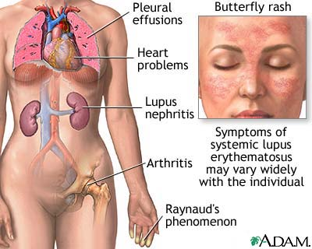
Systemic lupus erythematosus (SLE)
A chronic autoimmune connective tissue disease that can affect any part of the body.
The disease occurs nine times more often in women than in men, especially child-bearing female
Produce autoantibodies
→ inflammation and tissue damage
Kidney involvement of SLE is a common, major complication and can lead to end-stage renal disease (uremia).
Crispin et al., 2010, Trends Mol Med

Slide 6
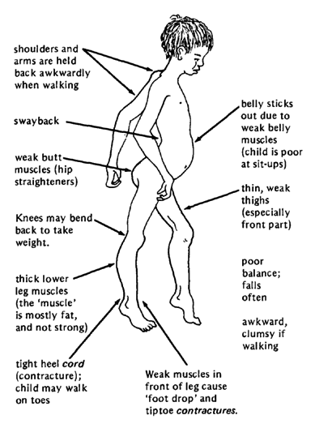
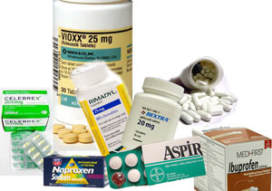
Current treatment for lupus nephritis
.
The current therapy for ASLN is to the mainly use corticosteroids or combined corticosteroids with other cytotoxic agents or immunomodulators (such as cyclophosphamide, azathioprine or cyclosporine), although many of them are found to have severe systemic side effects.
Cyclosphosphamide
Chlorambucil
Mycophenolate mofetil
NSAIDs
ACE inhibitors
Molino C et al., Eur J Intern Med, 20: 447-453, 2009; Yee CS et al., Ann Rheum Dis, 63: 525-529, 2004; Benseler SM et al., Rheumatology (Oxford), 48: 176-182, 2009.

Slide 7
Current use of Chinese herbal medicines
Herbal medicines have been widely used around the world since ancient times.
Traditional herbs are now widely acknowledged for their immunomodulatory and antiinflammatory activities.
Kuo-Feng Hua et al., PLoS One 2013 8:e77794; Yang SM et al., Free Radic Biol Med. 2013 6. doi:pii; Yang SM et al., PLoS One. 2013 8:e74871; Tsai PY et al., Arthritis Rheum. 2012 64:232-42.; Tsai PY et al., Free Radic Biol Med. 2011 50:1503-16; Tsai PY et al., Free Radic Biol Med. 2011 51:744-54; Tsai PY et al., Am J Physiol Renal Physiol. 2011 301:F751-64.

Slide 8


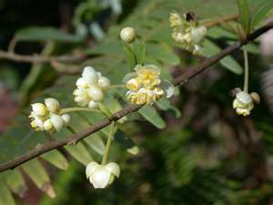
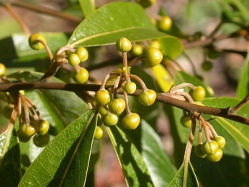
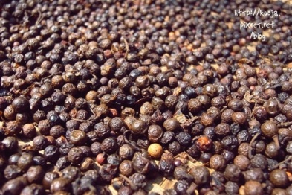
Citral, a pure compound extract from Litsea cubeba

Slide 9
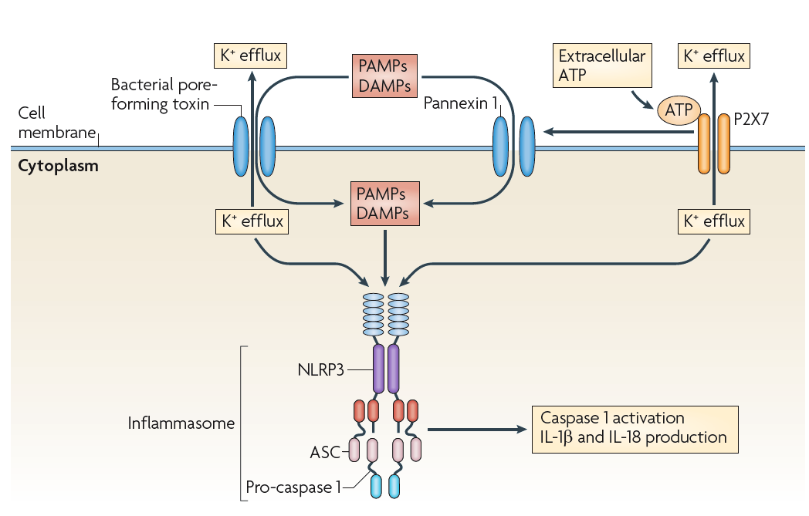
NLRP3 inflammsome
Jurg Tschopp and Kate Schroder, Nature 10: 210-215, 2010
PAMPs, pathogen-associated molecular patterns; DAMPS, danger associated molecular patterns; ASC, apoptosis-associated speck-like protein containing a CARD; NACHT, nucleotide-binding and oligomerization domain;LRR, leucine-rich repeat; PYD, pyrin domain

Slide 10
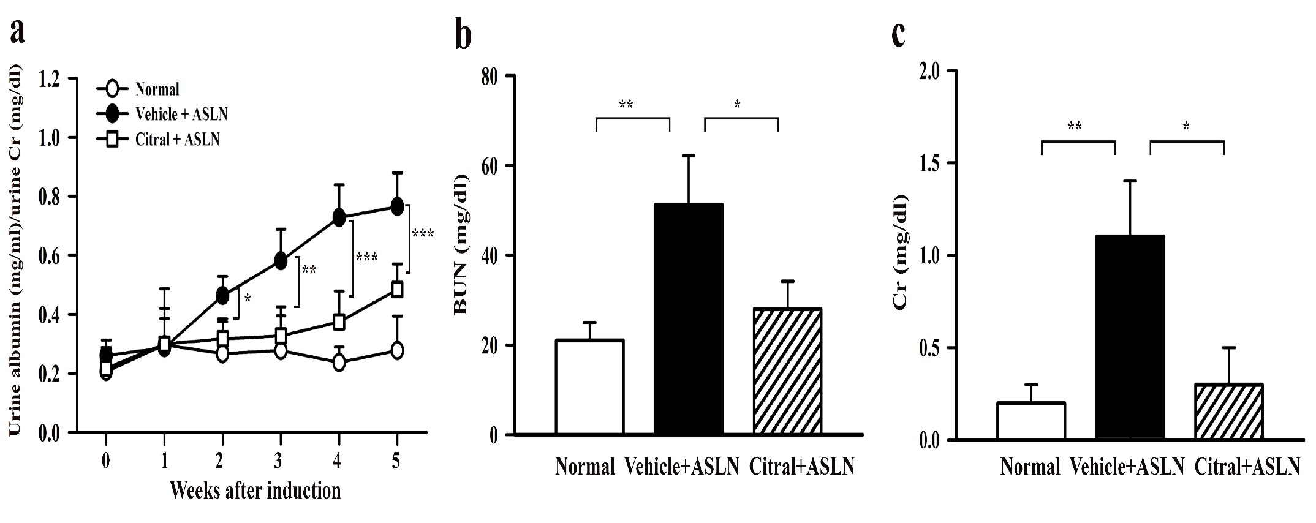
Albuminuria and renal function

Slide 11
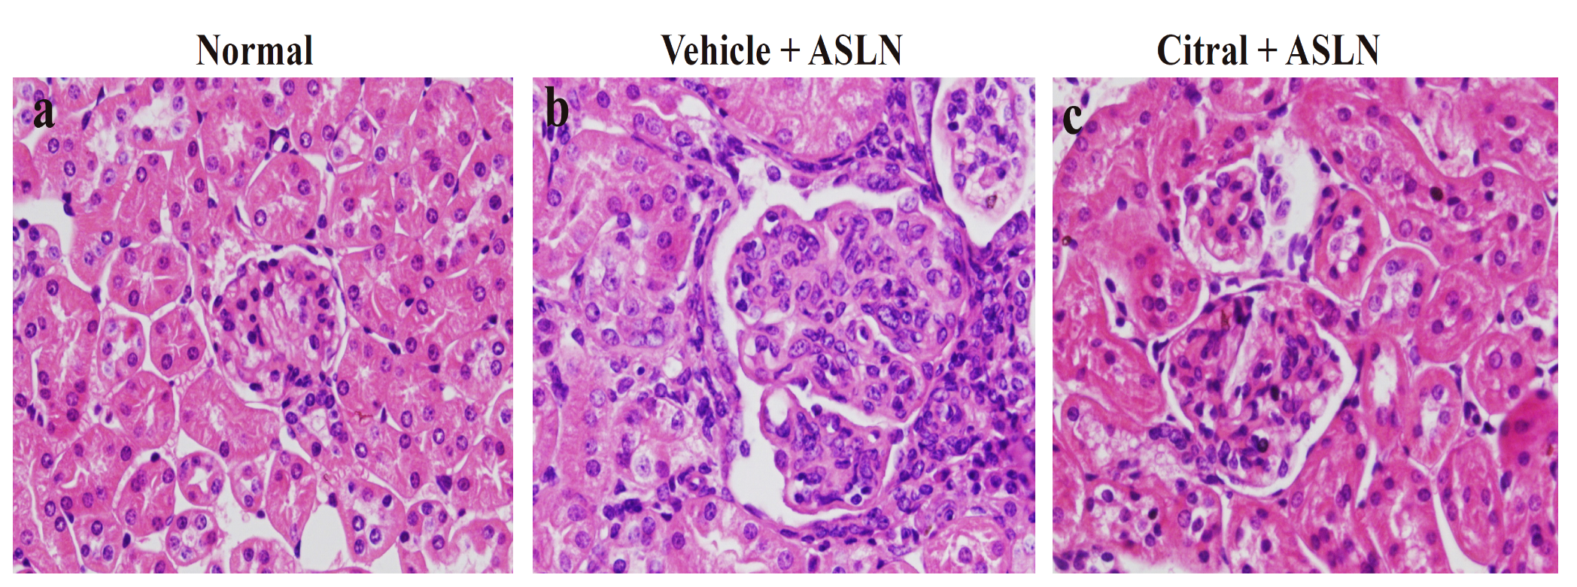
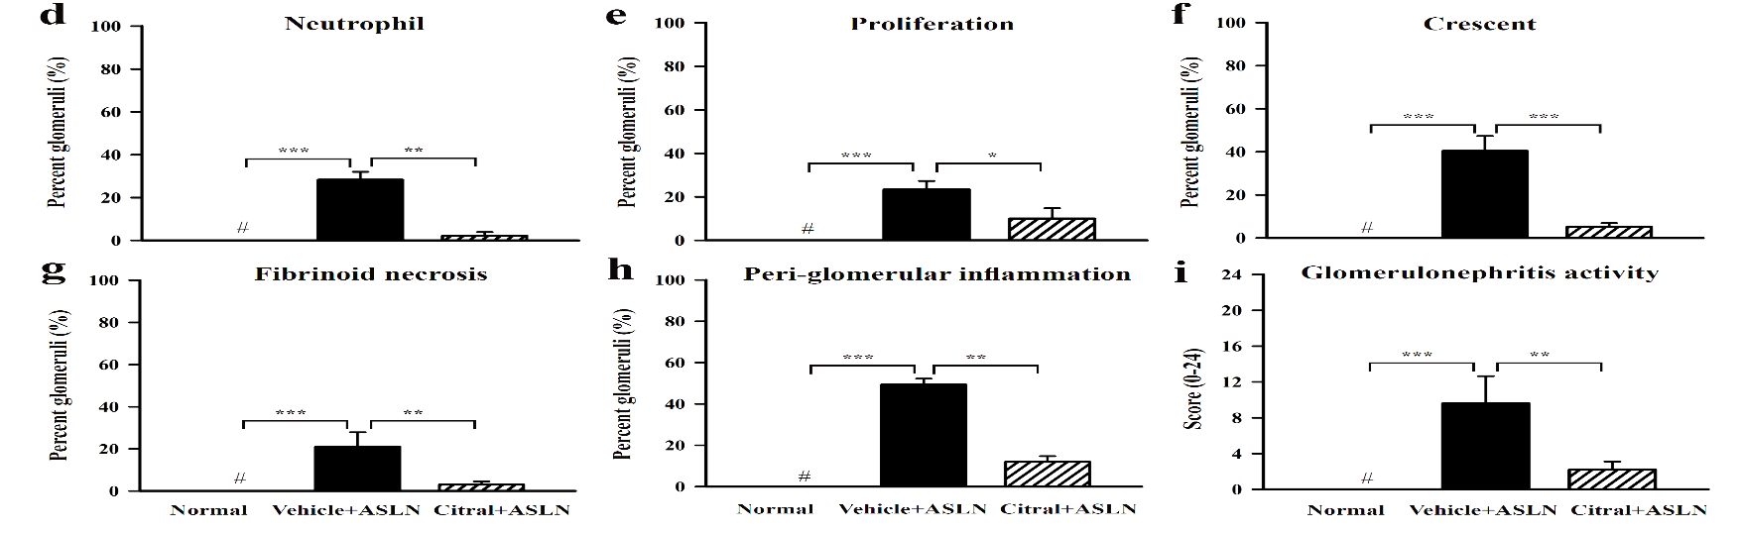
Renal pathology

Slide 12
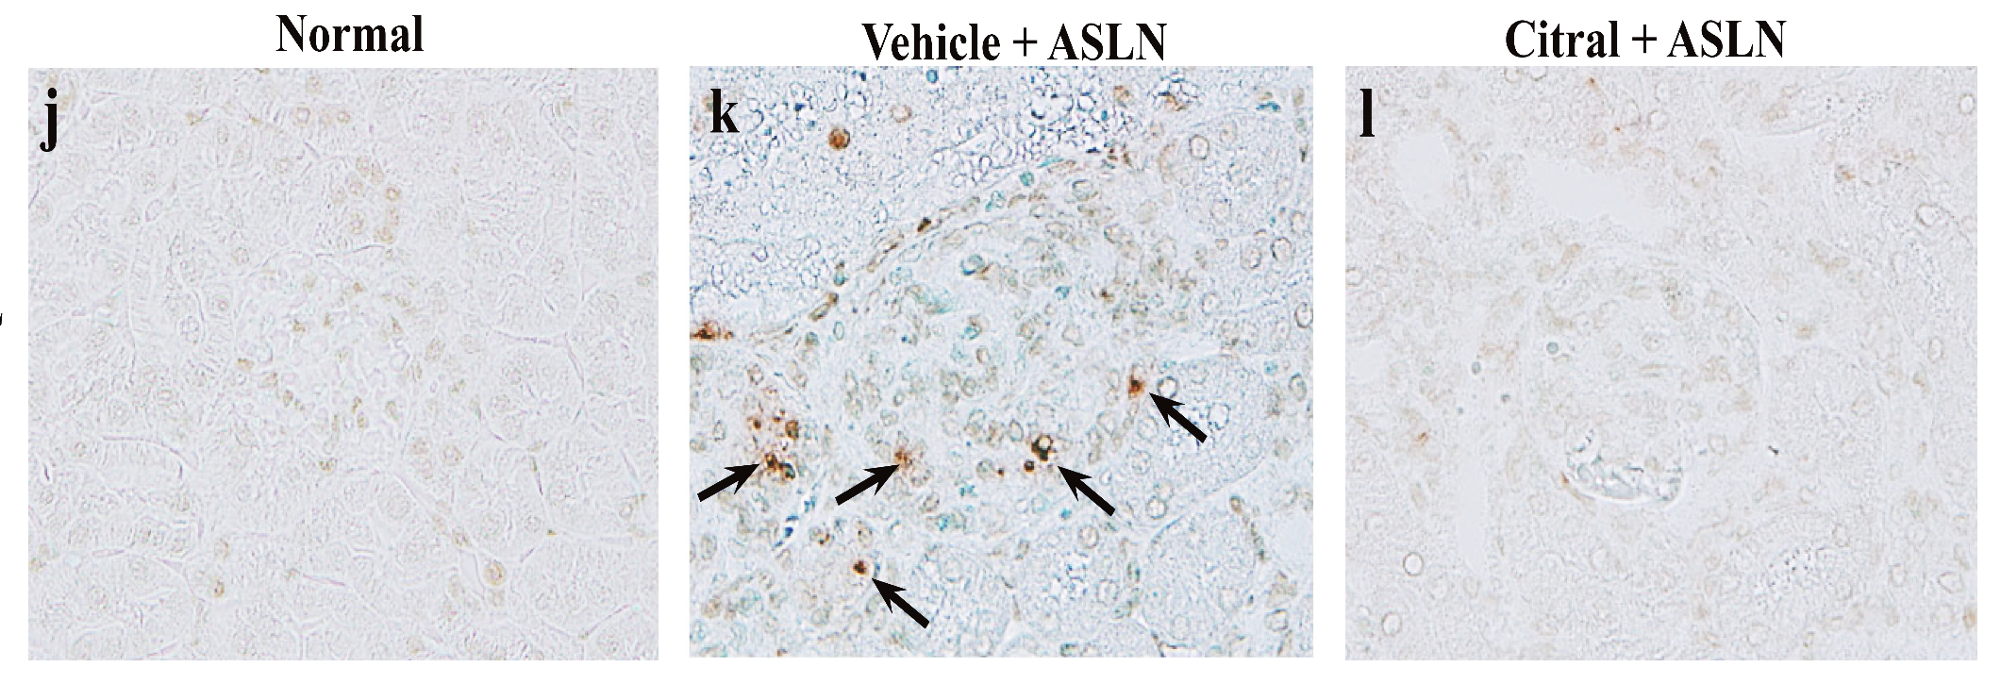
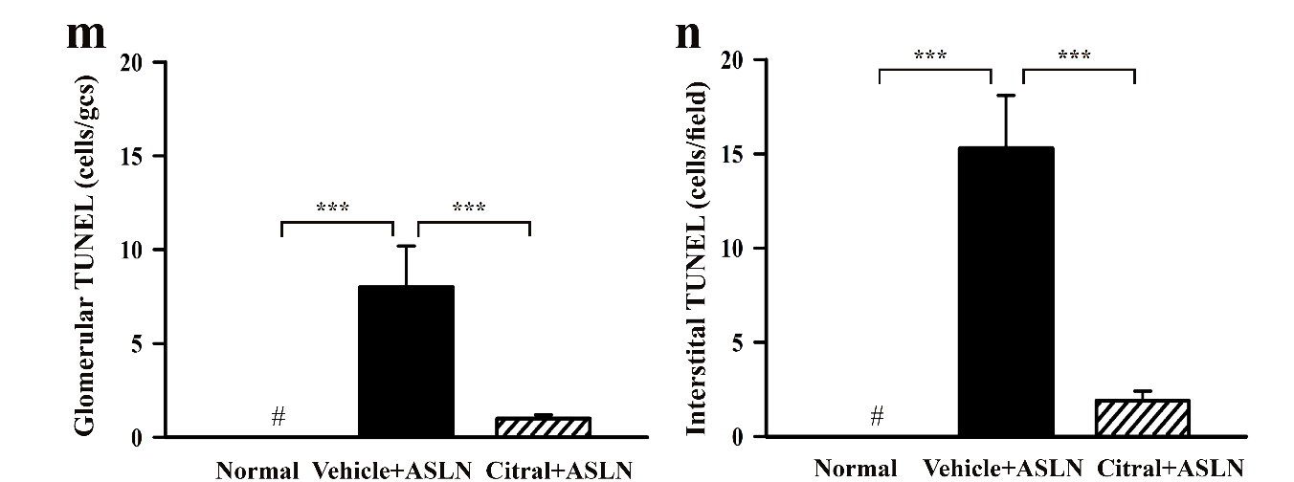
Renal apoptosis

Slide 13
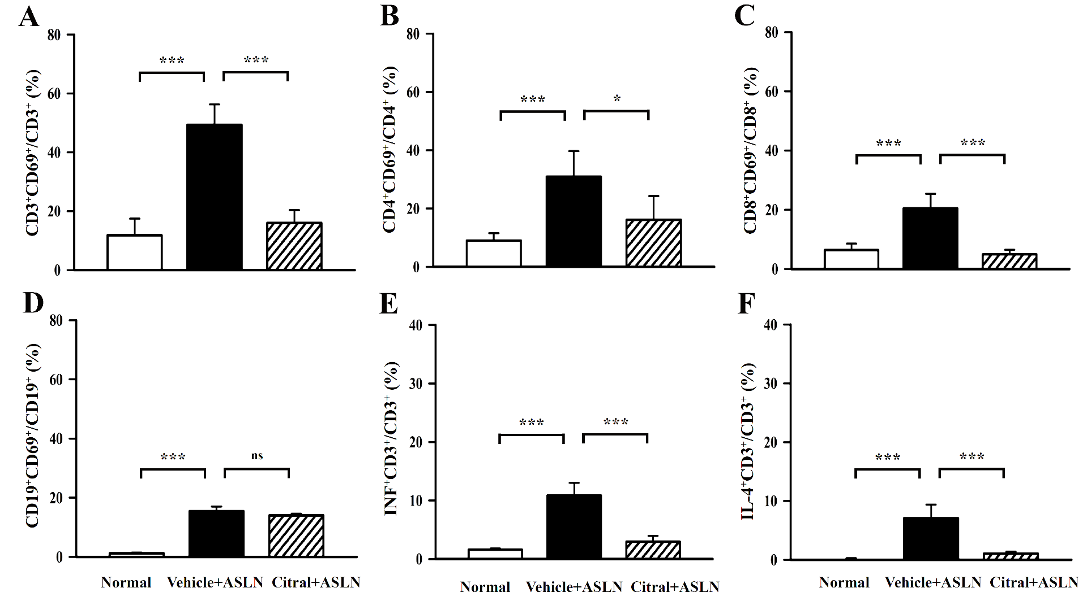
Systemic T cell activation

Slide 14
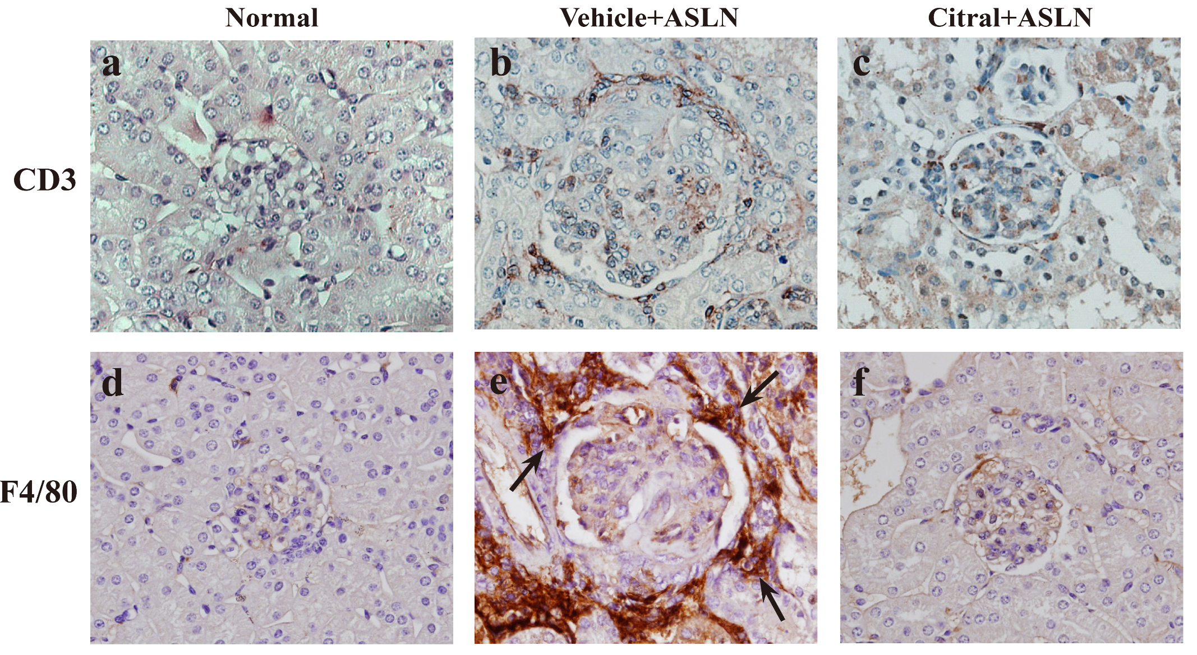
Renal T cell and macrophage infiltration

Slide 15
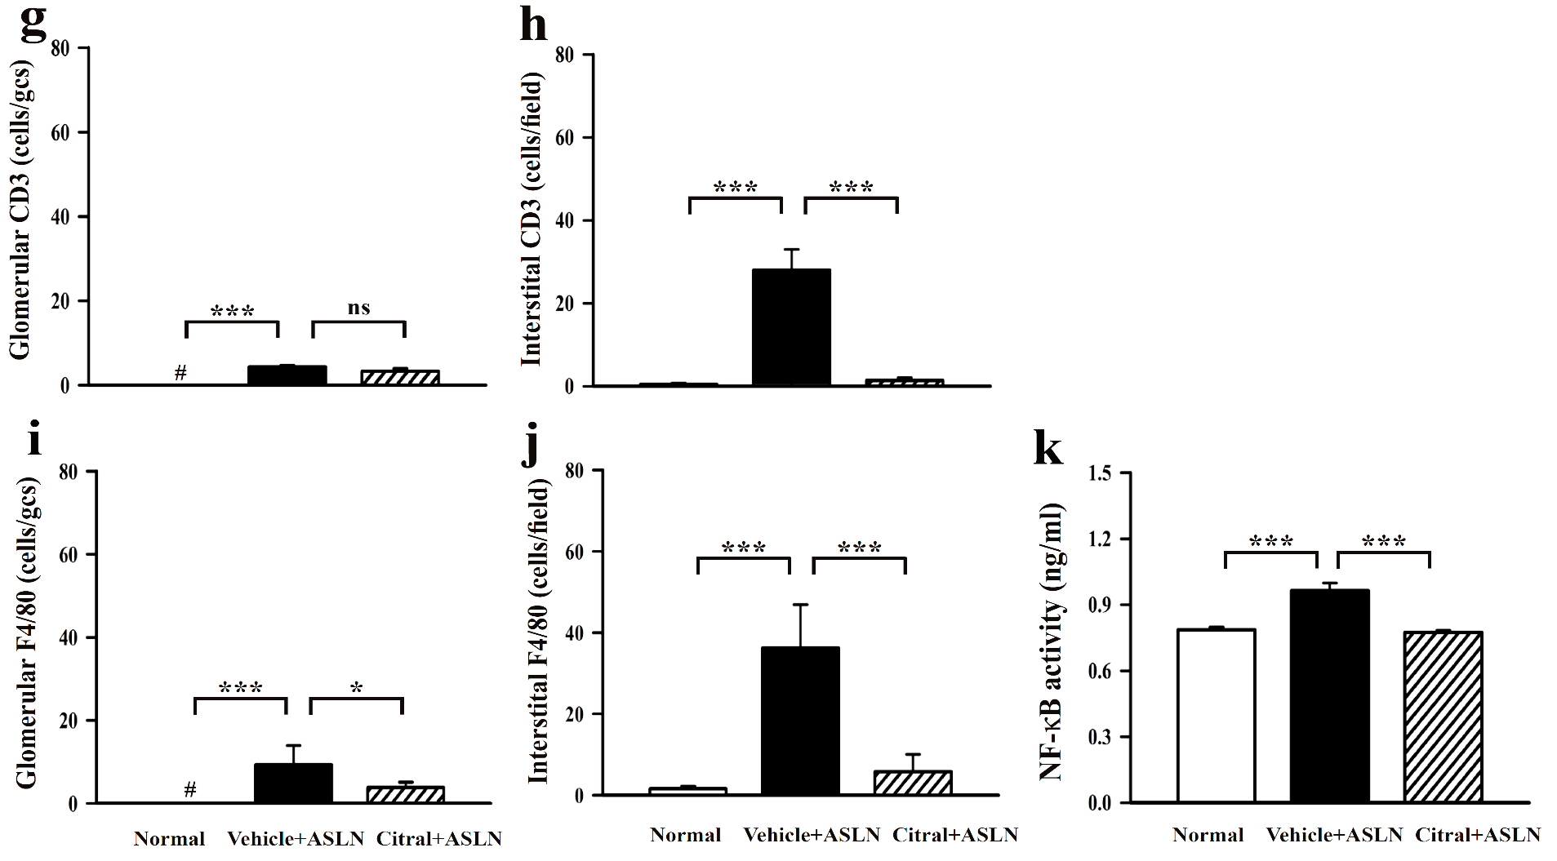
Quantitative analysis

Slide 16
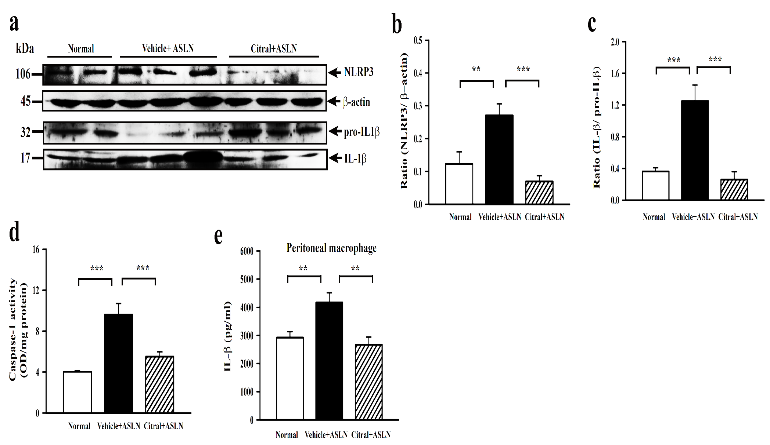
Renal NLRP3 inflammasome signal pathway

Slide 17
NLRP3 inflammasome -- priming signal

Slide 18
NLRP3 inflammasome -- activation signal

Slide 19
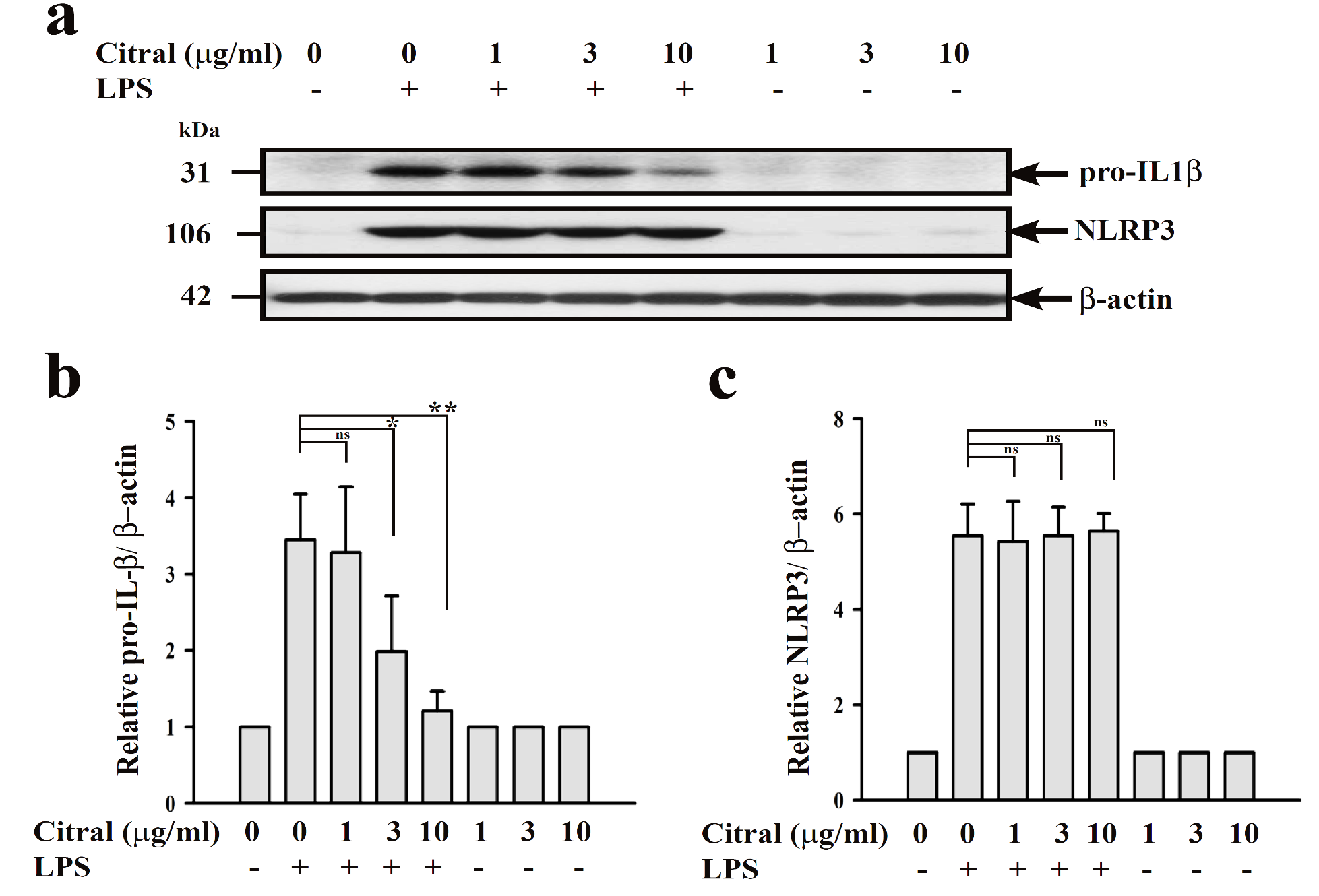
NLRP3 inflammasome–pro-IL-b and NLRP3

Slide 20
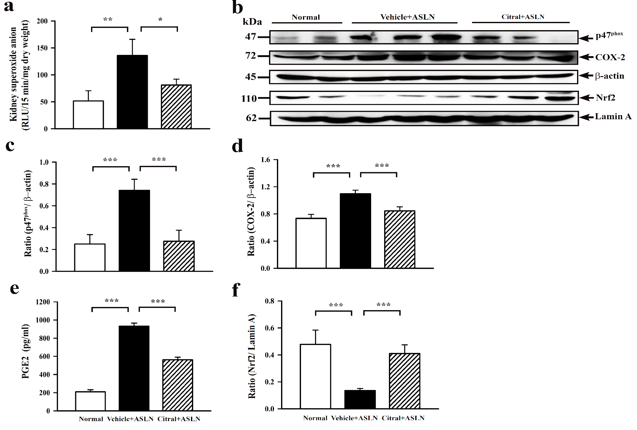
Renal Nrf2 pathway activation

Slide 21
Discussion and conclusion
Citral inhibited the development of the lupus nephritis model (ASLN), as demonstrated by its effects of reducing albuminuria and improving renal function as well as renal histopathology.
The major mechanism (mode) of action of Citral for its renoprotective effect involves inhibition of the activation signal of NLRP3 inflammasome and enhanced activation of Nrf2 antioxidant pathway.
Further studies should include pharmacology and toxicology for the compound that is derived a commonly used traditional Chinese medicine (TCM).
This work has been considered by Arthritis Ther Res (In revision)

Slide 22
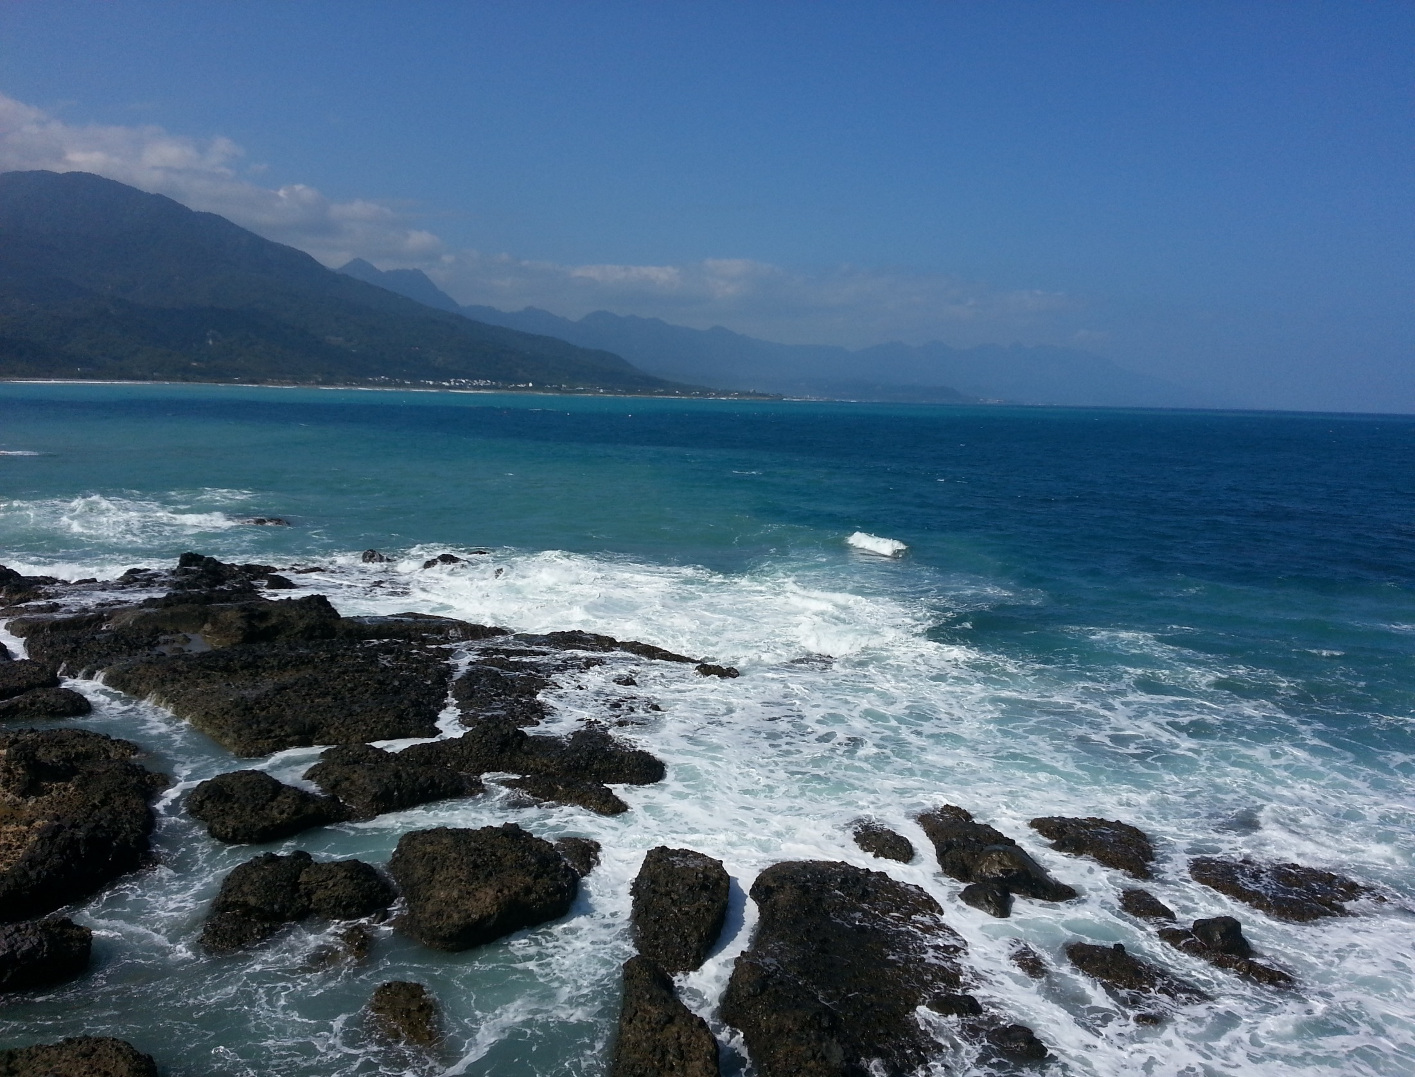
Acknowledgements
Ministry of Science and Technology, Taiwan
1. MOST 103-2321-B-016-002
2. NSC102-2320-B-016-006-MY3
Tri-Service General Hospital, National Defense Medical Center, Taiwan
TSGH-C104-073
Taitung county, Taiwan

Slide 23

Sky lantern festival, Taipei
Thank you very much

