Slide 1
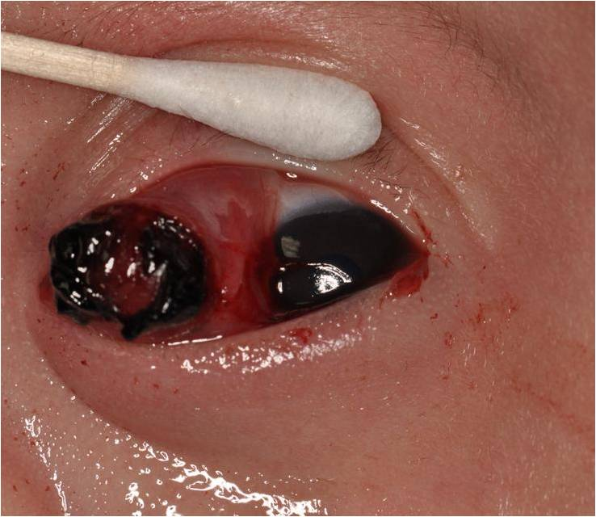
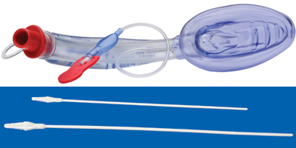
Anesthetic challenges when elective case becomes emergent
Shridevi Pandya Shah MD
Asst Professor
Dept of Anesthesiology
Rutgers-NJMS

Slide 2
Conflicts of interest: none

Slide 3
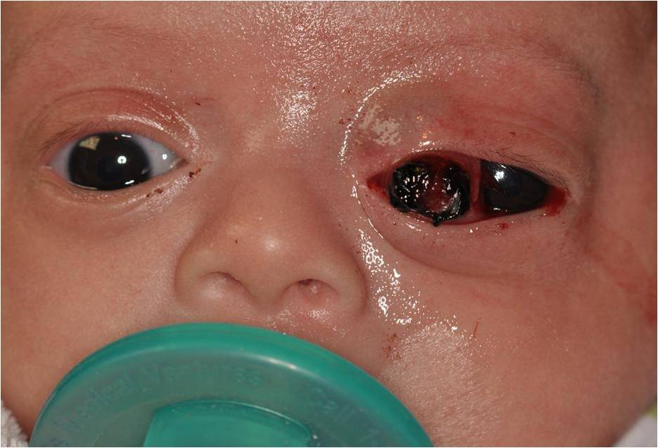
Case
8-week-old girl born at 36 weeks gestation with birth weight of 4 lbs and 3 oz ,found at 4 weeks of age to have left eye discharge without other significant findings
At 5 weeks mother noted bleeding from medial corner of left eye with some swelling on lateral aspect of eye
At 6 weeks progressive protruding friable mass with inconclusive needle aspiration performed at the referring center that led to more bleeding
Notes:
?cancel the slide

Slide 4
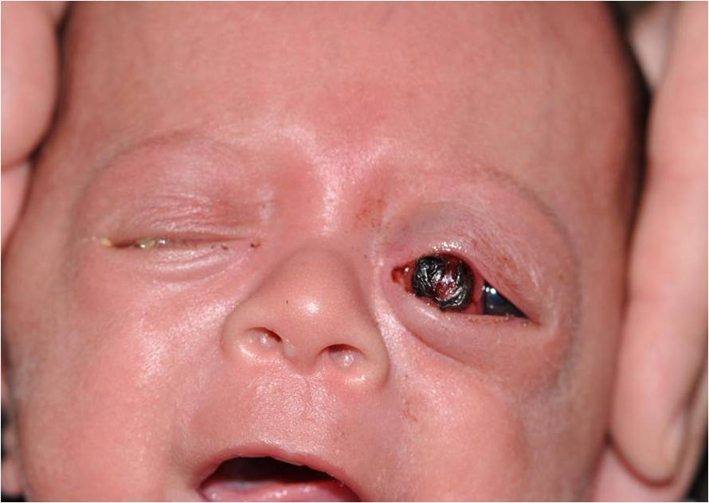
Preoperative anesthesia evaluation
Preoperative interview: low birth weight, NICU stay for poor feeding but otherwise non contributory
no formal pediatric clearance , most recent H&P in chart
baby did have ECHO at birth - no congenital cardiac issues, genetic tests pending in view of low birth weight, failure to thrive, low set ears and slight micrognathia
some runny nose, afebrile and chest clear
Preoperative IV
Hemoglobin,
type and cross and cross

Slide 5
Hemodynamic instability
Airway
Oxygenation and ventilation
Postoperative management

Slide 6
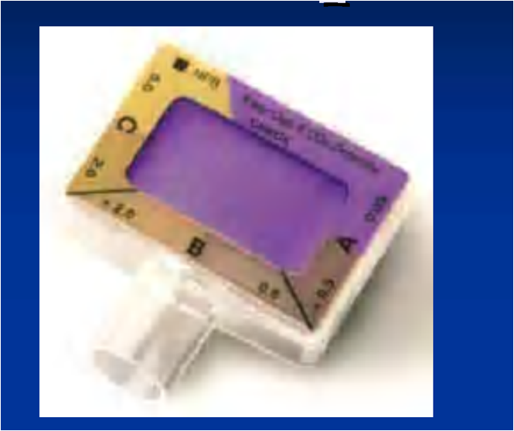
Challenges in operating room
Labile vital signs
mask ventilation
Direct laryngoscopy revealing grade III Cormack Lehane view of glottis
Rapid desaturation limiting time to laryngoscopy
Unable to CONFIRM placement of Endotracheal tube with Glide Scope
Unable to detect ETCO2
Decision to abort laryngoscopy
Air Q LMA insertion
successful blind intubation thru LMA

Slide 7
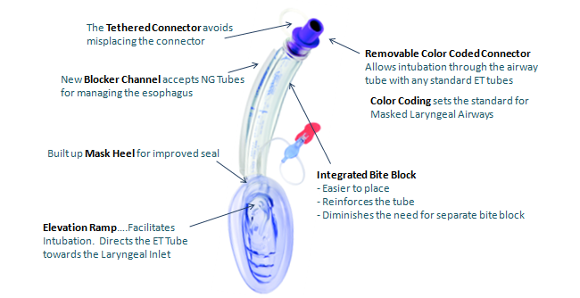

Slide 8
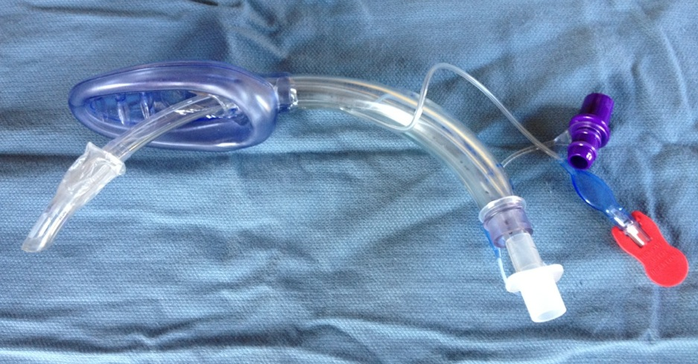

Slide 9
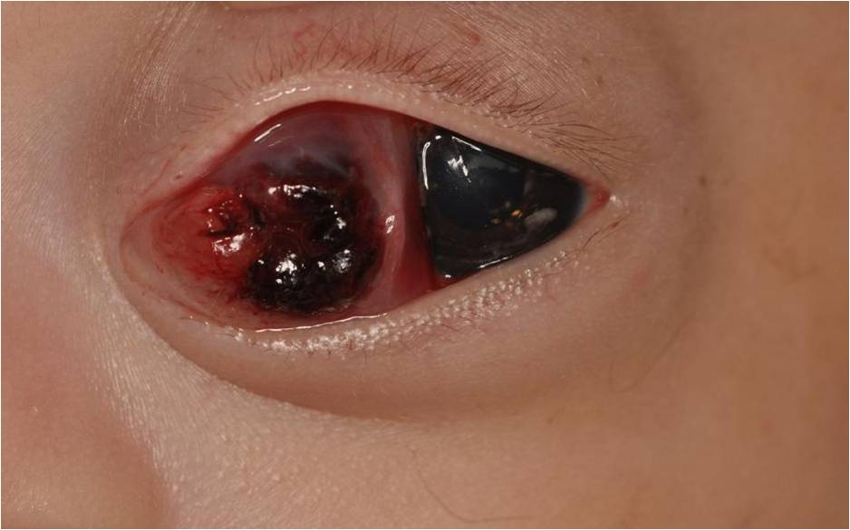
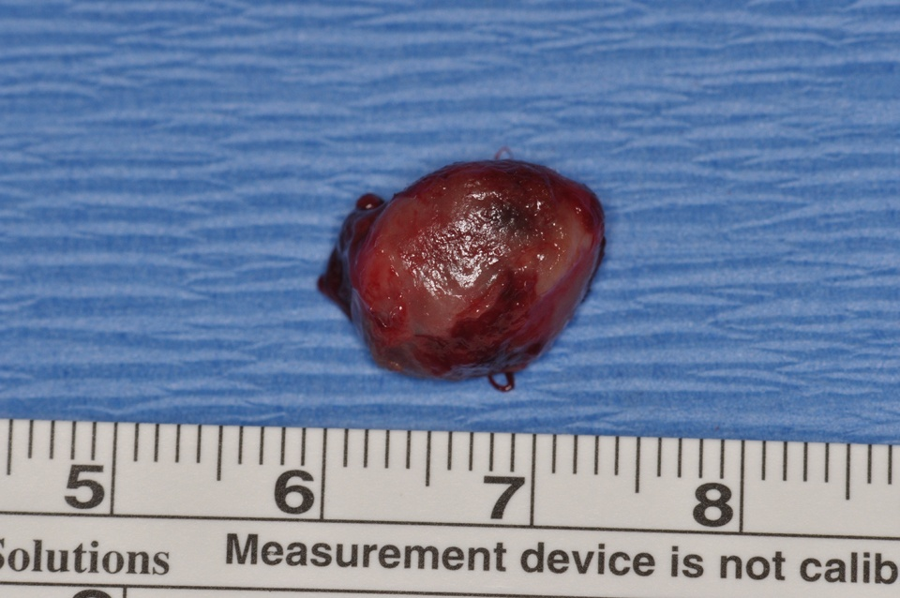
Our Patient
Histopathologic exam of the specimen revealed Hemangiopericytoma of the orbit, She was found to have Trisomy 15

Slide 10
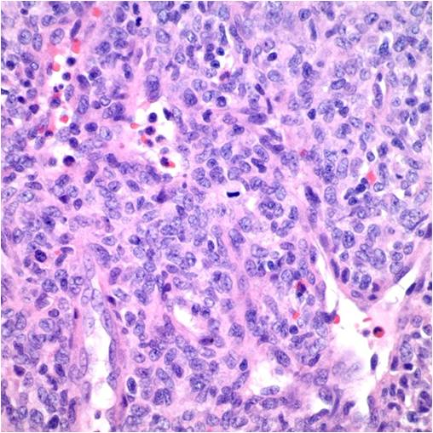
Hemangiopericytoma Facts
Encapsulated hypercellular , hypervascular lesions derived from pericytes and present as solitary, deep, soft tissue masses with insidious growth
HPC is a rare m in adults and extremely rare in children
The majority of cases follow a benign clinical course
Recurrent lesions have a more malignant course and can metastasize
There is no correlation between mitotic rate and the clinical behavior

Slide 11
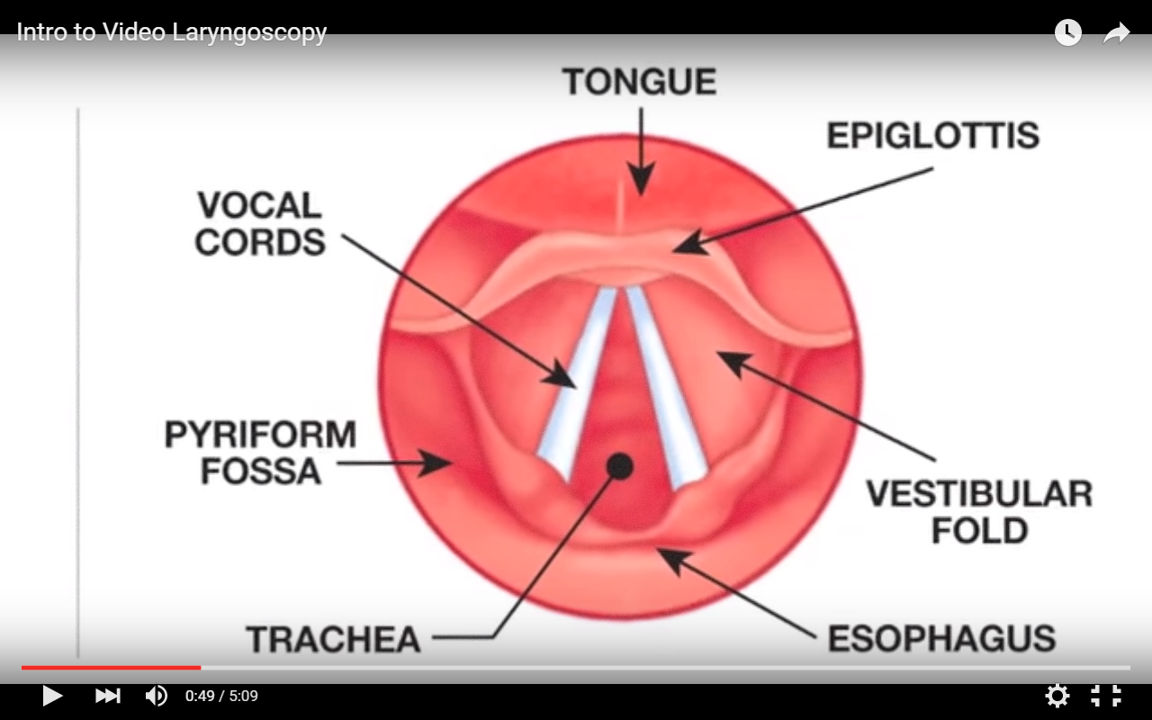

Slide 12
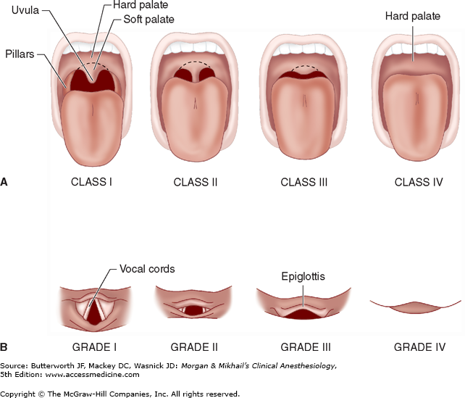
Cormack Lehane view

Slide 13
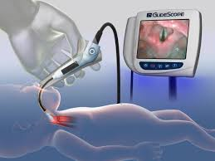
Glottic and supraglottic structures in infant - epiglottis,
vallecula, pyriform fossa, larynx and hypopharynx.

Slide 14
Anatomy and assessment of pediatric airway: Review article by Lola ADEWALE
,Pediatric anesthesia
2009

Slide 15
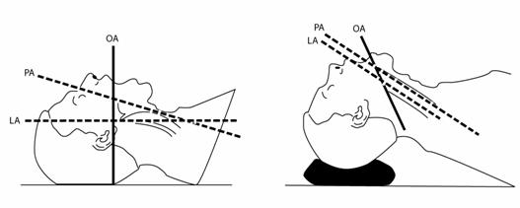
Comparison of the rate of successful endotracheal intubation between the “sniffing” and “ramped” positions in patients with an expected difficult intubation – a prospective randomized study Ju-Hwan Lee, Hoe-Chang Jung, Ji-Hoon Shim, and Cheol Lee Department of Anesthesiology and Pain Medicine, Wonkwang University School of Medicine, Iksan, Korea
2015

Slide 16
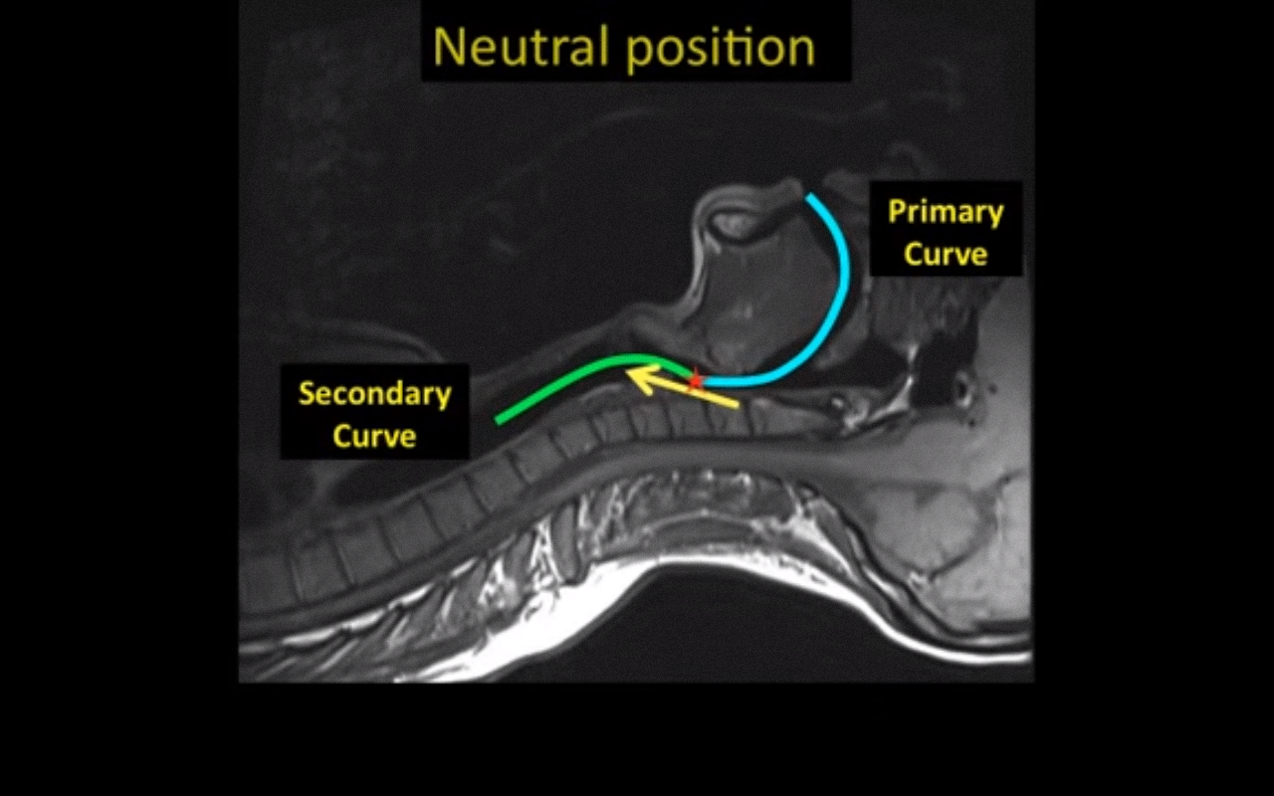
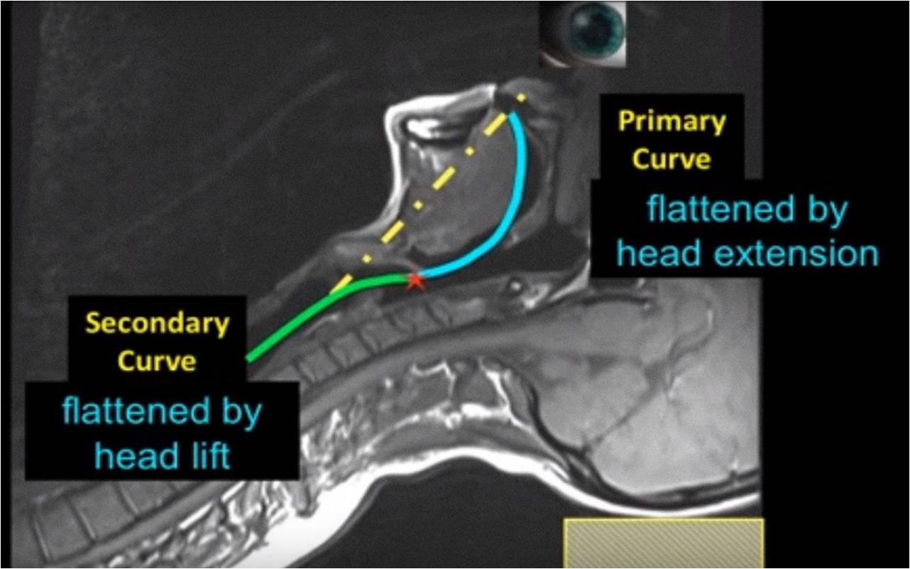
Hyper extended
position
Changes in airway configuration with different head and neck
Positions using magnetic resonance imaging of normal airways:
A new concept with possible clinical applications
Greenland et al ,British journal of anesthesia
2010

Slide 18
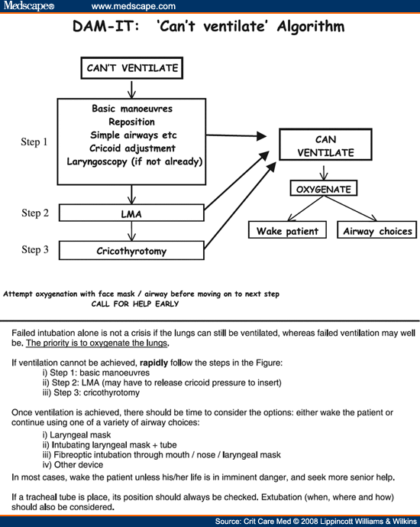

Slide 19
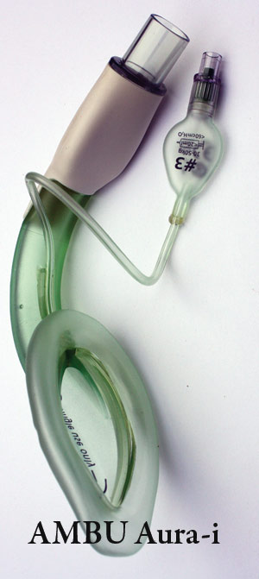
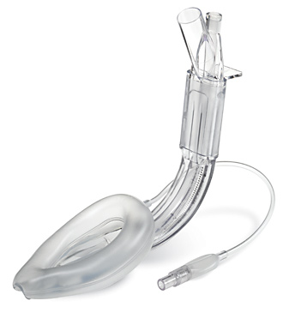
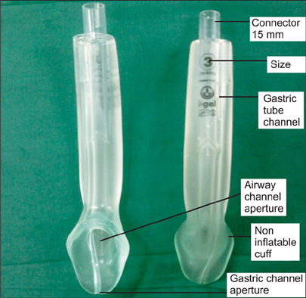
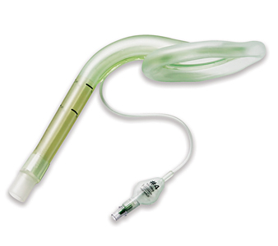
LMA Supreme
I gel LMA
Air Q
LMA
LMA flexible
Ambu aura once

Slide 21
Laryngeal mask airway History
LMAs- 1st Generation- airway tube only
2nd generation-gastric channel, improved pharyngeal seal and integral bite block
1788-first reference to tracheal intubation in humans
1878- first administration of anesthetic using endotracheal tube
1882-birth of extraglottic airway management
1908-Hewitt airway
1933- Guedel airway
1934-1st cuffed oropharyngeal airway
1940-Berman airway
1968-1st esophageal obturator
1981-1st human use of laryngeal mask
2000-1st reusable second generation SAD
2003-2010 single use second generation LMA

Slide 22
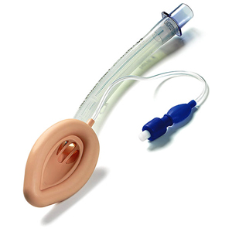
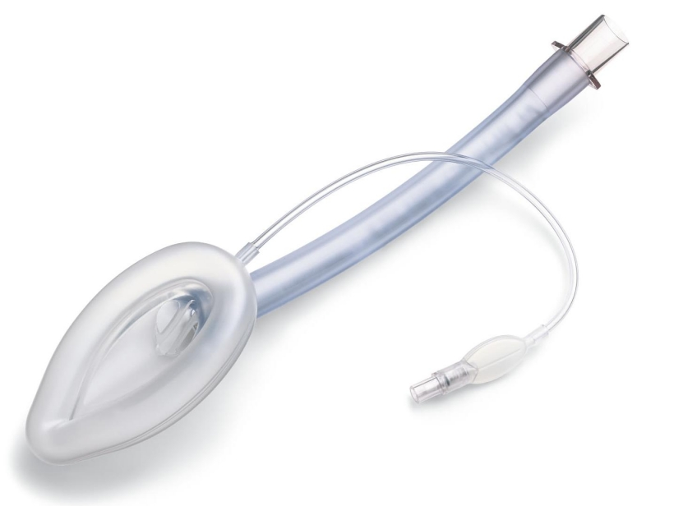
LMA Classic AND LMA Unique
LMA Classic is first generation, versatile, reusable airway with aperture bars used extensively
LMA Unique is single use airway packaged sterile and ready for use, suited for areas where a reusable device is not practical, economical or desirable

Slide 23
2014
2013

Slide 24
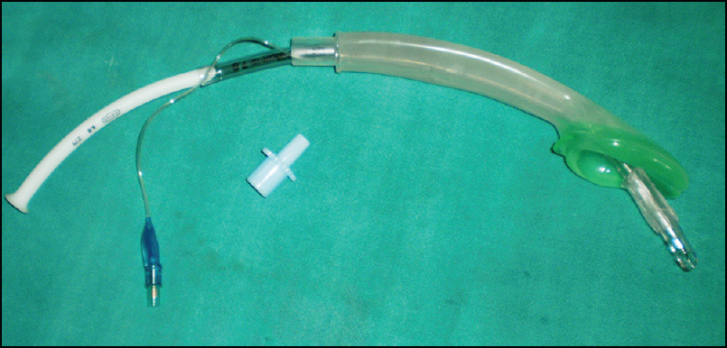
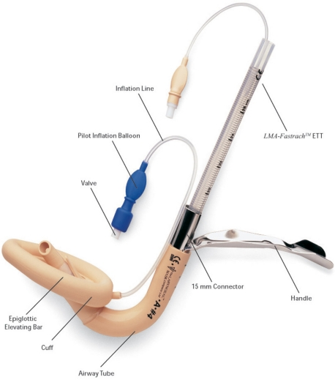
Intubating LMAs
Air Q LMA
I gel LMA
Ambu aura once
LMA fastrach

Slide 25
i gel, LMA fastrach and air Q permit direct passage of endotracheal tube
Used as a rescue device for ventilation after induction of anesthesia
Conduit for fiberoptic intubation
Use of Aintree intubation catheter where difficulty encountered passing endotracheal tube through LMA
Evaluation of glottic view through Air-Q Intubating Laryngeal Airway in the supine and lateral position
And assessing it as a conduit for blind endotracheal intubation in children in the supine position
Pandey RK et al, Pediatric anesthesia
2015
To assess the efficacy of i-gel for ventilation, blind tracheal intubation and nasogastric tube insertion
Geeta Bhandari, Anesthesia Essays and researches
2013

Slide 26
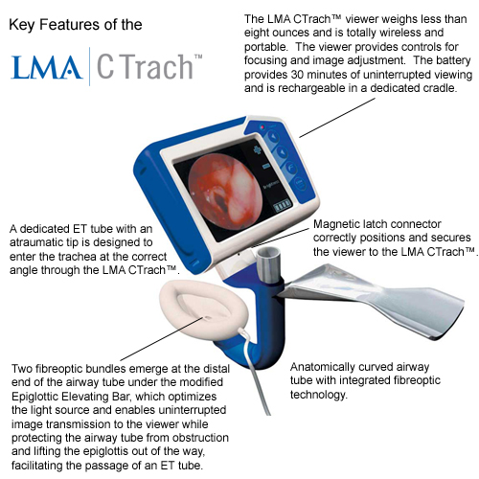
The LMA CTrachTM, a new laryngeal mask airway for endotracheal intubation under vision : evaluation in 100 patients
^{E.H.C. Liu,} ^{British Journal of Anesthesia}
2006

Slide 28
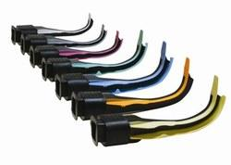
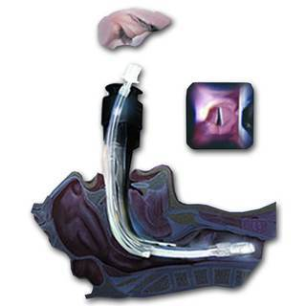
Air traq
Has a built in channel for the tracheal tube
Available in all pediatric sizes
Used successfully in children with difficult airways
May be more difficult to use in small infants
Directs the tube leftward, requires manipulation of the device as a unit to help guide the tube in the trachea.
May be used with a bougie or in combination with the fiberoptic bronchoscope

Slide 29
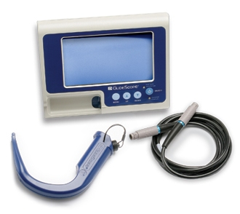
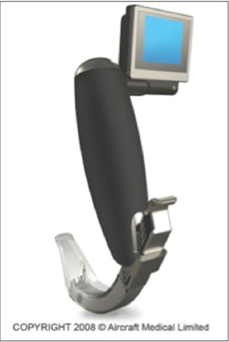
GlideScope
McGrath Video
A comparison of the Glide Scope to the McGrath videolaryngoscope in patients
Woo Jae kyong Hun Kim et al, Korean society of Anesthesiologists
2011

Slide 30
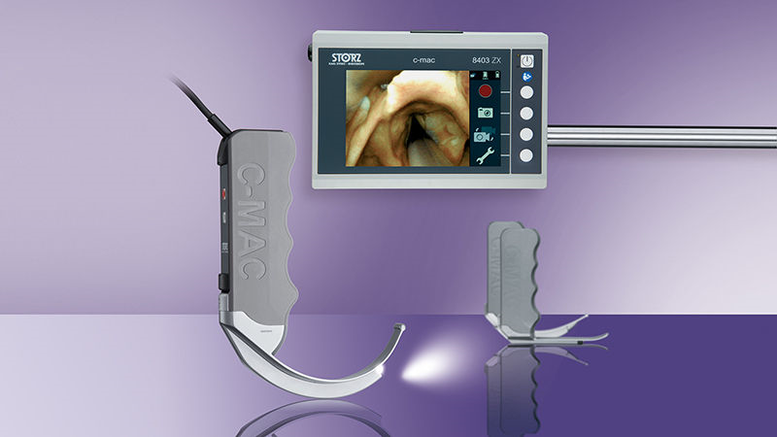
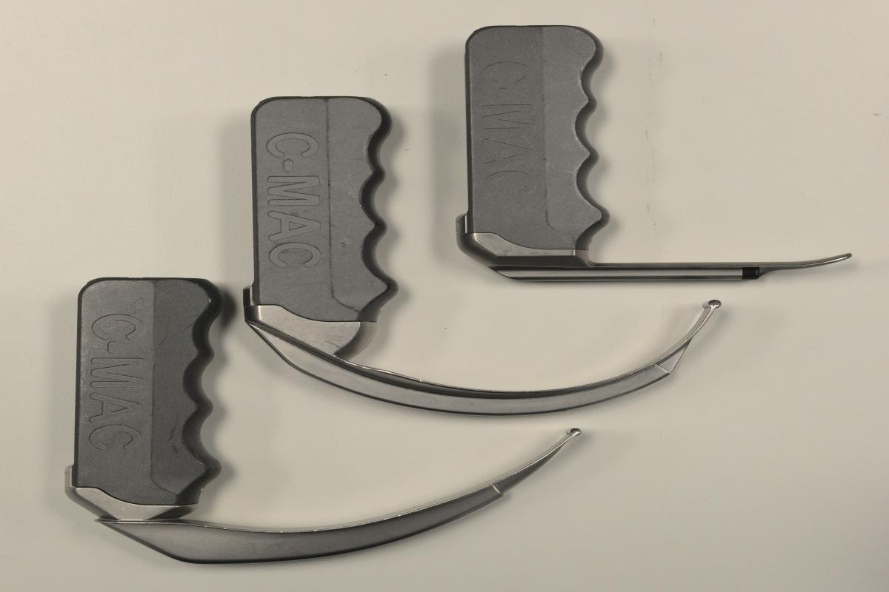

Slide 31
Better view of glottis than Mcintosh blade with GlideScope and Storz CMAC
Views are comparable among GlideScope and Storz CMAC
Devices like bougie may be needed for assistance since better glottic view don’t directly translate into ease of intubation
A comparison of the GlideScope video laryngoscope to the C-MAC video laryngoscope for intubation in the emergency department
Mosier J et al, ANN Emerg med
2013
Comparison of the GlideScope, CMAC,storz DCI with the Mcintosh laryngoscope during simulated difficult laryngoscopy:a manikin study
David W Healy et el, BMC anesthesiology
2012

Slide 32
A randomized comparison between Cobra PLA and classic laryngeal mask airway and laryngeal tube during
Mechanical ventilation for general anesthesia
Ratajczyk P et al , Anesth intensive her
2013
The cobra PLA versus LMA unique in children
Ron M Walls, Anesth and analgesia
2008

Slide 33
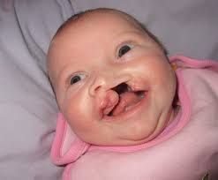
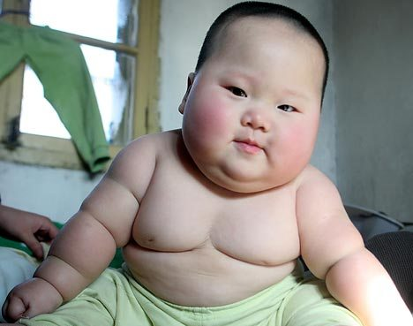
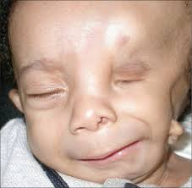
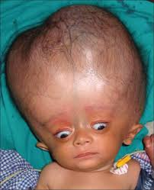

Slide 34
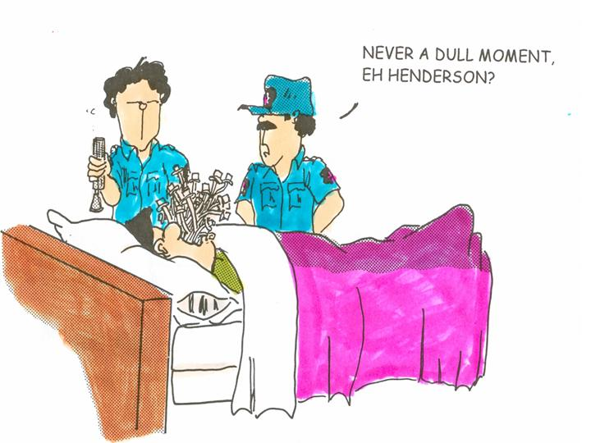
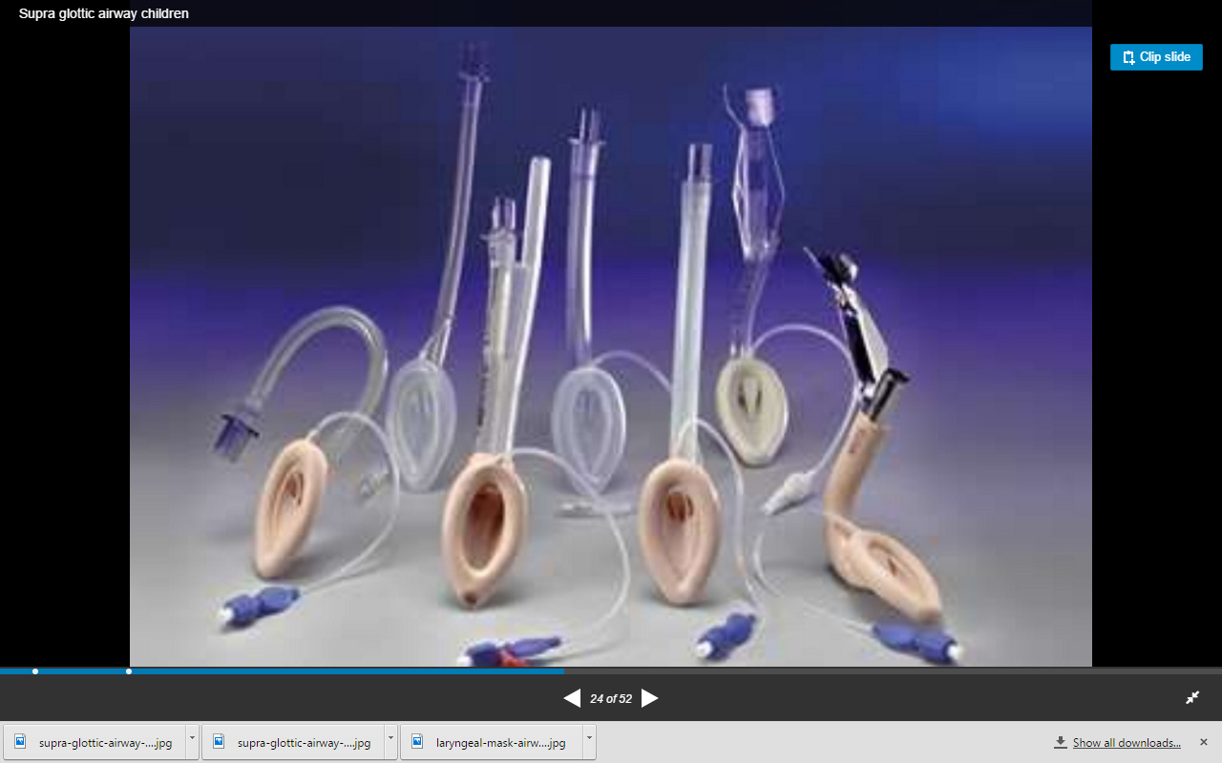
Esophageal intubation is not a sin !

Slide 35
Thank you

