Slide 1
Mammographic screening
Is it relevant to
developing countries?

Slide 2
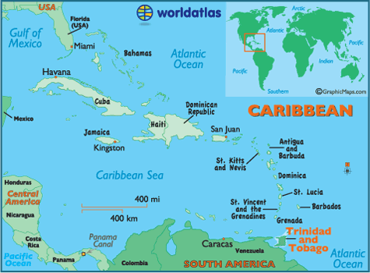

Slide 4
1.3 million
African/South Asian
250 annually
2:1 death ratio

Slide 5
Screening
First world guidelines
Is this appropriate?
33% < 50

Slide 6
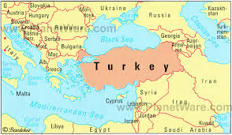
20% < 40

Slide 7
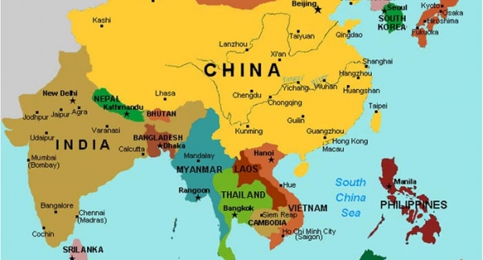
30% <40

Slide 8
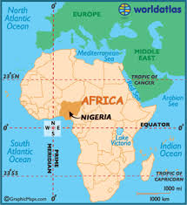
15% < 30
26-45 age group

Slide 9
Onset >50

Slide 10
Life expectancy
India | Nigeria | Turkey | First world
62 | 53 | 78 | > 80

Slide 11
In Perspective: Age
Premenopausal
Peak incidence in the young
Short life expectancy
Mammography screening?

Slide 12
Mammography requirements
Specialized equipment
Trained personnel
Cost factors

Slide 13
Mammography requirements
2010 African study
One Mammogram machine for 6 million
Elkin et al 2012
1.65 machines for 100,000 population
India Privatized health care
Faruqui et al 2007

Slide 14
Social Issues
Education
Socioeconomic conditions
Compliance/follow-up
Opoku 2012: 2% screening

Slide 15
Presentation
70% India
75% Turkey
Trinidad and Tobago

Slide 16
In Perspective
Paucity of available services
Paucity of awareness
Advanced stage

Slide 17
Clinical Breast Exam (CBE)
Ineffective
First world source of data
Okonkwo et al 2008, India
CBE more cost effective
Abuidris et al 2013, Africa
Trained volunteers improve detection

Slide 18
CBE
CBE
Improve education
Breast self-examination
Detect malignancies

Slide 19
Other Barriers
Fears, religion, myths, mistrust
Remennick, Israel 2006
Herbalist, traditional healers
Opuku, Ghana 2012

Slide 20
Persisting Controversies
Mortality reduction
2108 patients for 11 years to prevent one death
1000 patients screened for 20 yrs → 5.7 mortality reduction
Duffy 2010

Slide 21
Persisting Controversies
Overdiagnosis
6.4% overdiagnosis with each mammogram
1 in 3 false diagnosis over 10 yrs
Imore 1998

Slide 22
Persisting Controversies
Interval presentation
25%
Sylvia 2011
42% radiologically inapparent
No histological difference

Slide 23
Persisting Controversies
Increased mortality in young screened patients
Miller 2014
Ineffective in reducing deaths
Gotzsche 2000

Slide 24
Persisting Controversies
Non-aggressive disease
23% increased risk if mastectomy
25% radiotherapy
Gotzsche 2000
1.3 million overdiagnosis over 30 yrs
Bleyer 2012

Slide 25
Conclusion
Young age of presentation
Unavailability of mammography
Socioeconomic/education factors
Persistent controversies

Slide 26
Way forward
Re-examine the role of CBE
Educate

