Slide 1
Harmonic Elimination in a MPPT Based Solar Powered Cascaded Multilevel Inverter Using NR Techniques for Micro Grid
Mrs. SHIMI S.L
Assistant Profrssor
DEPARTMENT OF ELECTRICAL ENGINEERING
NATIONAL INSTITUTE OF TECHNICAL TEACHERS’ TRAINING AND RESEARCH
CHANDIGARH

Slide 2
Motivation of Using Cascaded H-bridge Multilevel Inverter for Solar Applications
Isolated and Constant dc source for each H-bridge
MPPT algorithm on each photovoltaic module separately
Innovation on System Architecture for Solar Electric Conversion
Constant Voltage Tracker/Maximum Power Point Tracking (CVT/MPPT) algorithm
Harmonic elimination in PV fed CHMLI using NR techniques

Slide 3
Block Diagram of the Proposed System
Cascade Multilevel Inverter
Micro Grid
dc- dc Converter
PV Array
MPPT/CVT
Algorithm
NR-SHE Algorithm
Optimized
Firing Angles α

Slide 4
Inferences Drawn Out of Literature Review
The multilevel converter technology is a promising technology for high power electric devices because of its high voltage operation, high efficiency and low electromagnetic interference (EMI). The desired output of a multilevel converter may be synthesized by several dc voltages sources. With an increasing number of dc voltage sources, the converter output voltage waveform approaches a nearly sinusoidal waveform.
Very little work has been reported in regard of application of a multilevel inverter with equal and unequal dc voltage source for H-bridge from renewable zero-pollution energy resources, such as wind, solar, bio and geothermal.
The cascaded H-bridge multilevel inverter topology requires an isolated and constant dc source for each H-bridges, thus allowing the integration of renewable energy sources such as wind generators, PV arrays, fuel cells, etc. to the smart grid.
In literature the switching angles for multilevel inverter have been calculated by time-consuming equations offline. Alternate approaches were developed to calculate the switching angle in real time but these approaches were not extended for unequal dc sources.
Switching angles can be calculated offline and stored in lookup table. But for some operating points the solutions might be missing. This also involves large memory space for program code.
The performance of cascaded multilevel inverter is compared based on computation of switching angle using Newton Raphson approach. The genetic algorithm method has not succeeded to find switching angles for some modulation indexes which have solutions.

Slide 5
Soft computing research is concerned with the integration of artificial intelligent tools such as neural networks, fuzzy logic technology, evolutionary algorithms, etc. in a complementary hybrid framework for solving real world problems.
A maximum power point tracking (MPPT) strategy is needed for maximizing the energy harvested from each string of the PV module.
Various MPPT methods, with their merits and demerits are available in the literature. P and O method has been widely used due to its simplicity.
The ANN based controller reflects better maximum power point tracking performance as compared to the conventional PID controller and avoids the tuning of controller parameters.
The harmful effects of non-uniform irradiance (due to partial shading) on the performance of a PV module are one of the main causes of overheating of shaded cells which reduces the energy yield of the module.
Hybrid combination of the fixed and two motor based Sun tracking type PV system with fractional order controller for maximum power point tracking also improves the efficiency of PV generation systems.
MATLABTM/SIMULINKTM have emerged as popular tools and are widely used for modelling, control and simulation purposes of various electrical systems, including the component of solar PV generator and under a variety of operating conditions.

Slide 6
Proposed Work
Modeling of solar photovoltaic module with dc-dc converter for a cascade multilevel inverter.
In this proposed model the MPPT algorithms Perturb and Observe (P&O), Incremental Conductance (INC), Artificial Neural Network (ANN) and Adaptive Neuro Fuzzy Inference System (ANFIS) will be designed.
The real time implementation of the MPPT algorithms on the photovoltaic array using Dspace control desk, ds1104 hardware and MATLAB/SIMULINK will be carried out.
The comparison of the conventional MPPT algorithms Perturb and Observe and Incremental Conductance with artificial intelligent based MPPT algorithm will be done.

Slide 7
To calculate the switching angle for the proposed model of equal and unequal dc sources for the cascade multilevel inverter.
To determine the optimal level ‘m’ at which the THD is well within the range and switching losses are minimum.
To develop a Newton Raphson based MATLAB optimized look up table model for firing the cascade multilevel inverter .
To compare the Total Harmonic Distortion (THD) for all the above cases.
The proposed work will be implemented using MATLAB/SIMULINK.
Hardware implementation of the 11 level cascade multilevel inverter for equal dc sources will be carried out and the Total Harmonic Distortion (THD) will be calculated.
Cost effectiveness of the existing and proposed system will be analyzed.

Slide 8
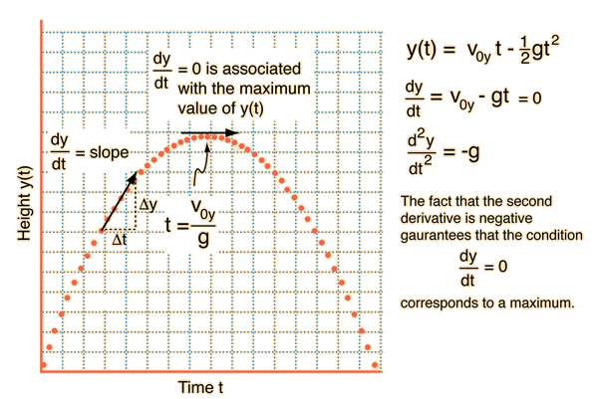
The height of a projectile that is fired straight up is given by the motion equations

Slide 10
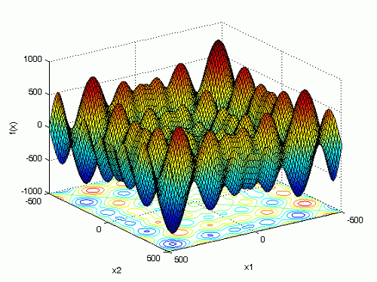

Slide 11
Partial Shading of Solar Panels

Slide 14
Table 1: Vikram Solar Modules Specifications
Description | Vikram Solar
Number of cells in series (nCells) | 36
Maximum power ( Pmp) | 37 W
Maximum power voltage (Vmp) | 17 V
Maximum power current (Imp) | 2.25A
Open circuit voltage (Voc) | 21.77 V
Short circuit current (Isc) | 2.4 A
Maximum power temp. coefficient (TempC_Pmp) | -9.770e-001 W/deg.C
Maximum power voltage temp. coefficient (TempC_Vmp) | -1.230e-001 V/deg.C
Maximum power current temp. coefficient (TempC_Imp) | -1.079e-003 A/deg.C
Open circuit voltage temp. coefficient (TempC_Voc) | -1.200e-001 V/deg.C
Short circuit current temp. coefficient (TempC_Isc) | -5.016e-003 A/deg.C
Series resistance of PV model (Rs) | 0.450 ohms
Parallel resistance of PV model (Rp) | 1442.84 ohms
Diode saturation current of PV model (Isat) | 2.6762e-006 A
Light-generated photo-current of PV model ( Iph) | 2.4 A
Diode quality factor of PV model Qd | 1.5

Slide 15
PV Modeling
$$I=N_{p}I_{pv}−N_{p}I_{o}\left[\exp\left(\frac{V+R_{s}I}{AV_{t}a}\right)−1\right]−\frac{V+R_{s }I}{R_{p}}$$
(1)
Rs
I
+
where,
Ipv : photovoltaic current
I₀ : saturation current
Rs : equivalent series resistance
Vt =NskT/q : thermal voltage
Rp : equivalent parallel resistance
a : diode ideality constant
RsH
V
_
Single diode model of a PV cell

Slide 16
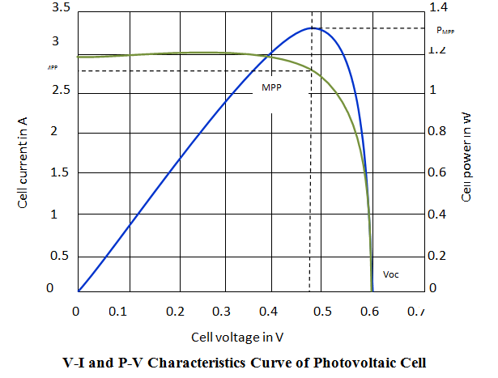

Slide 17
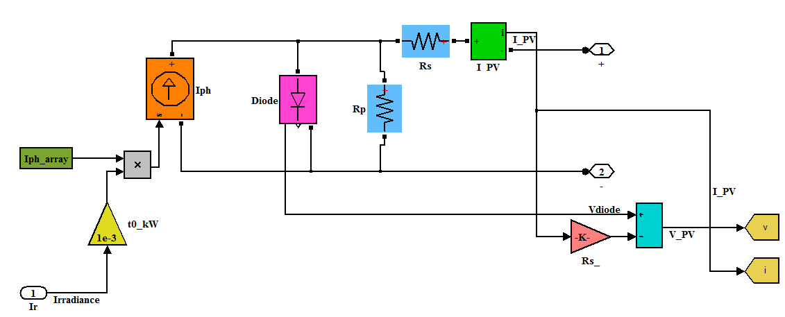
MATLAB/SIMULINK Model of PV Module

Slide 18
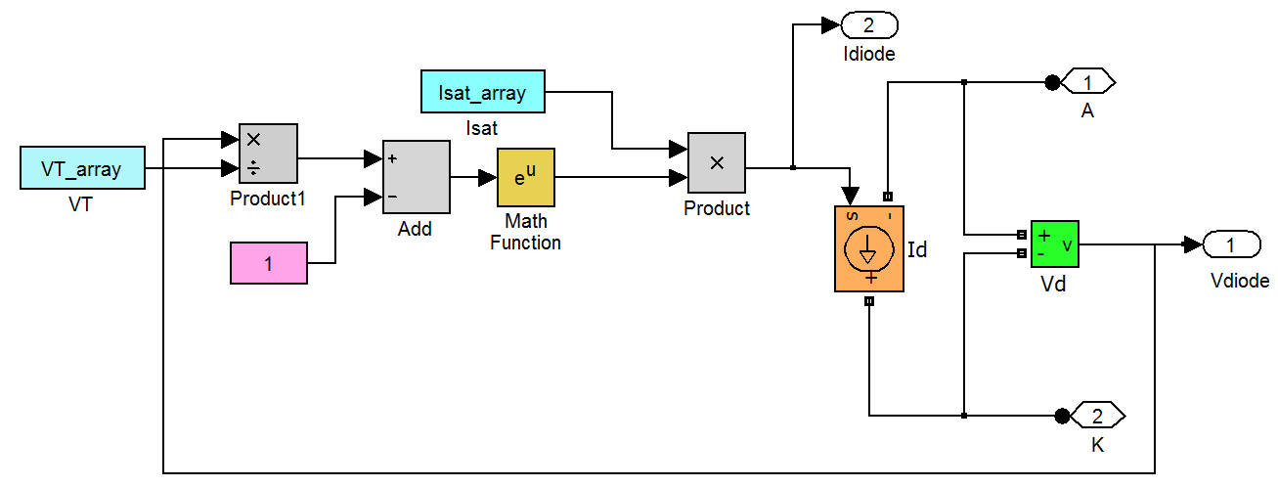
MATLAB/SIMULINK Model of the Diode Characteristics
Id=Isat*exp(Vd/V_{T} -1) (2)
$V_{T}=k∗\frac{T}{q}∗Q_{d}∗Ncell∗Nser$ (3)
Where,
Id = Diode current (A)
Vd = Diode voltage (V)
Isat = Diode saturation current (A)
V_{T} = Temperature voltage = k*T/q*Qd*Ncell*Nser
T = Cell temperature (K),
k = Boltzman constant = 1.3806e-23 J.K^-1
q = Electron charge = 1.6022e-19 C
Qd = Diode quality factor
Ncell= Number of series-connected cells per module
Nser = Number of series-connected modules per string

Slide 19
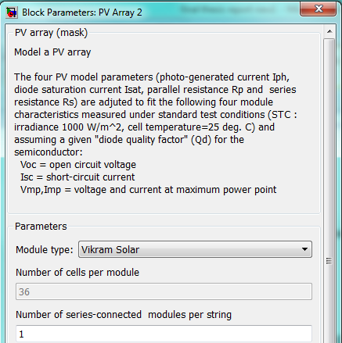
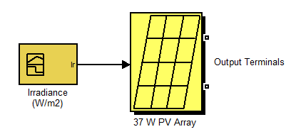
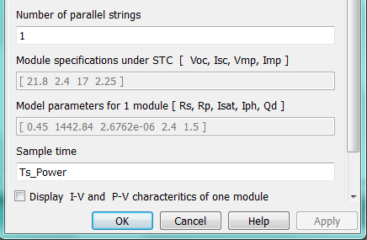
Masked PV Array Dialog Box
Irradiance = 1000 W/m²
Temperature = 25 ºC
Spectrum of x = 1.5 i.e, AM (Air Mass)

Slide 20
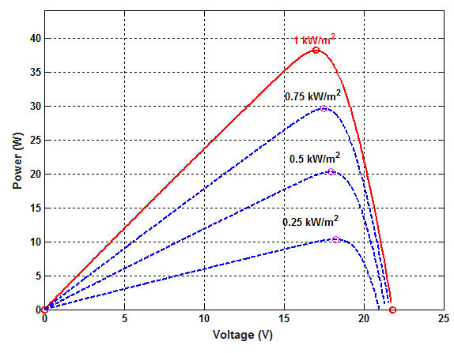
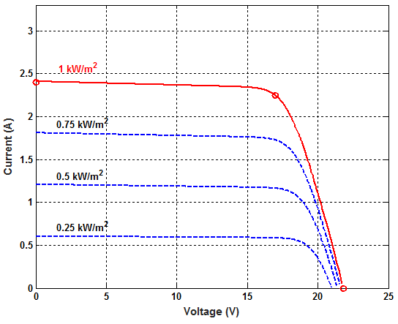
PV Characteristics of the PV Module
at Constant Temperature of 25ºC
VI Characteristics of the PV Module
at Constant Temperature of 25ºC

Slide 21
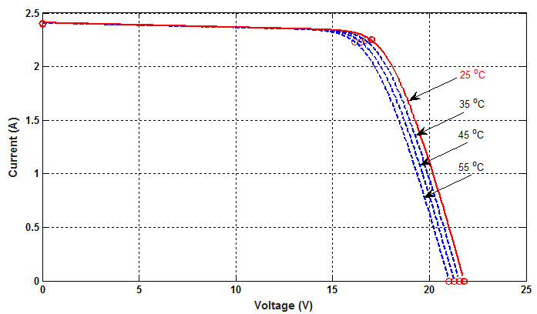
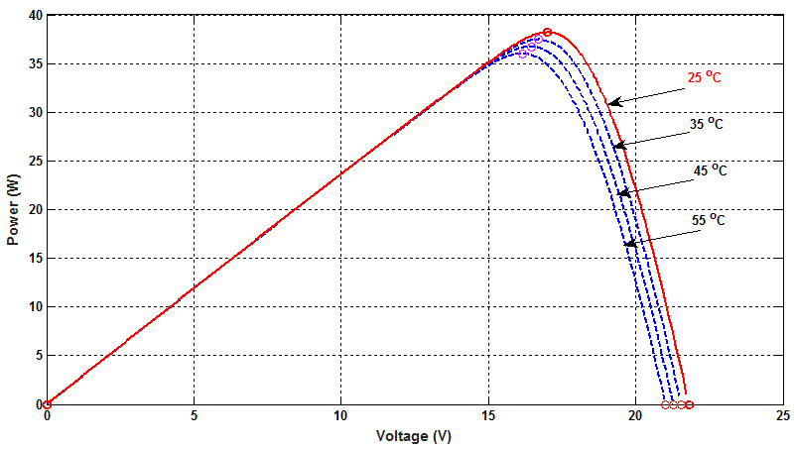
VI Characteristics of the PV Module for Constant Radiation of 1000W/m²
PV Characteristics of the PV Module for Constant Radiation of 1000W/m²

Slide 22
Switching Mode Regulator (Buck Converter)

Slide 23
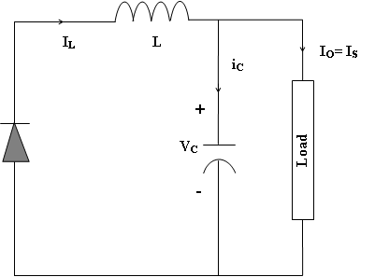
Equivalent Circuit (a) Switch ON (b) Switch OFF
$L_{C}=L=\frac{R(1 –D)}{2f}$ (10)
$C_{C}=C=\frac{1 –D}{1Lf^{2}}$ (11)
For a switching frequency of 80 KHz and inductance current ripple $(∆I)$ of 10% the${ L}_{c}$ and ${ C}_{c}$ are approximated as 1mH and 100µF respectively

Slide 24
Parameters of Buck Converter
Sr. No. | Parameter | Value
1 | Inductor (L) | 1mH
2 | Inductor series resistance (R_{L}) | 80 mΩ
3 | Output capacitor (C_{o}) | 100 µF
4 | Output capacitor ESR (R_{co}) | 30 mΩ
5 | Input capacitor (C_{i}) | 100 µF
6 | Input capacitor ESR (R_{ci}) | 30 mΩ
7 | Switching frequency (f_{s}), | 80 KHz
8 | Input voltage | 20 V
9 | Duty-ratio (D) | Variable
10 | Load resistance | 9 Ohm

Slide 25
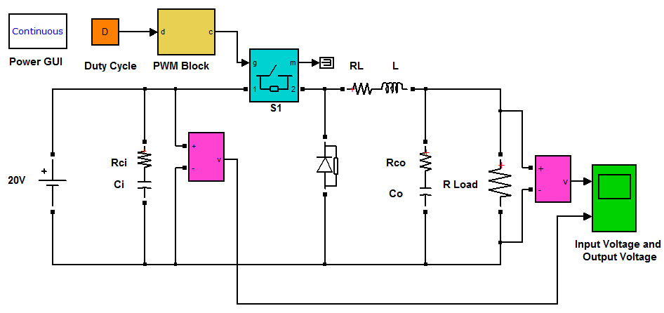
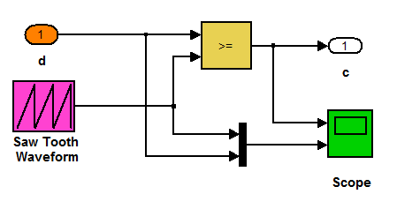
MATLAB/SIMULINK Model of Buck Converter
Components of PWM Block Subsystem

Slide 26
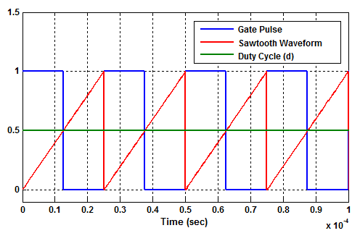
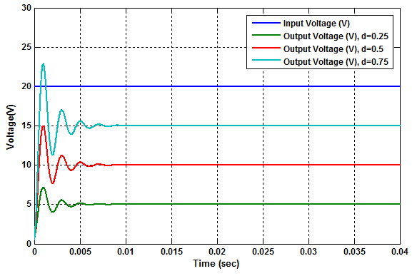
PWM with 0.5 Value of Duty-cycle
Input and Output Voltages Waveforms of Buck Converter
Back

Slide 27
Block Diagram of the Proposed System
Buck Converter
Load
Radiation Sensor
PV Current Sensor
PV Array
Temperature Sensor
Duty
Cycle
PV Voltage
Sensor
Dspace
ds1104
Output Voltage
Sensor
PC with MATLAB/ SIMULINK (MPPT Algorithm)

Slide 28
MPPT Algorithms
Perturb and Observe
Incremental Conductance
Neural Network
Adaptive Neuro Fuzzy Inference System (ANFIS)

Slide 29
Perturb and Observe

Slide 30
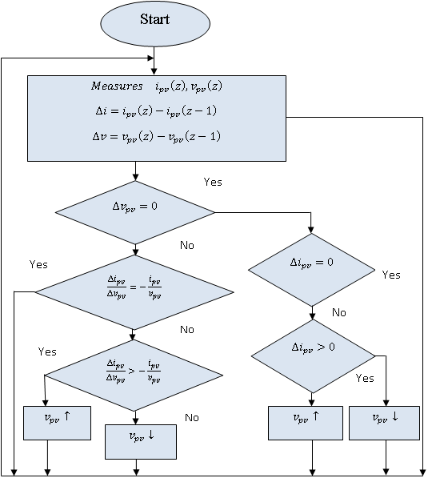
Incremental Conductance

Slide 31
Neural Network
A two-layer feed-forward network with sigmoid hidden neurons and linear output neurons
Levenberg-Marquardt back propagation algorithms for training the network.
TABLE 2: ANN DATA SET, MEAN SQUARE ERROR AND REGRESSION
 | Samples 7609 | MSE | Regression
Training | 5327 | 2.92492e-9 | 1.90887e-1
Validation | 1141 | 2.82180e-9 | 1.93351e-1
Testing | 1141 | 2.88905e-9 | 1.79767e-1

Slide 32
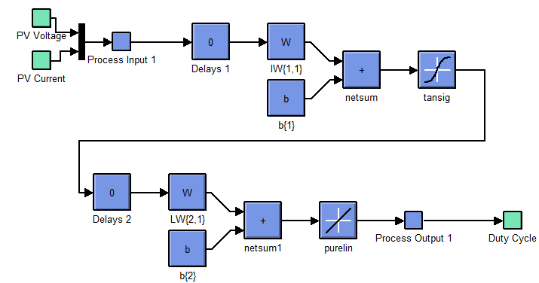
MATLAB/SIMULINK ANN Model

Slide 33
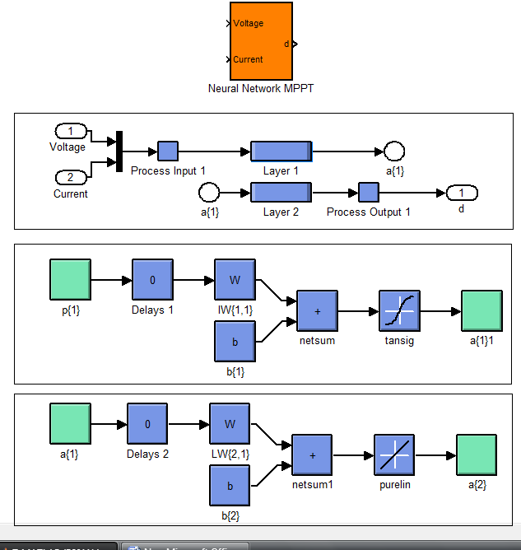

Slide 34
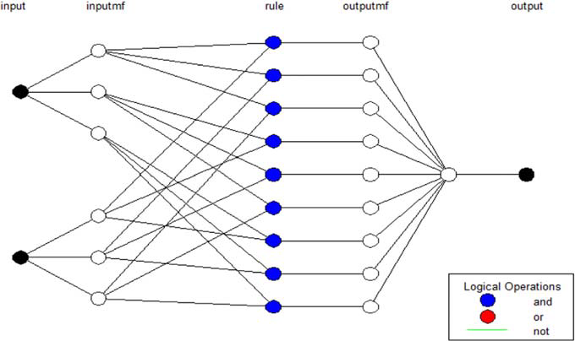
MATLAB/SIMULINK ANFIS Model

Slide 35
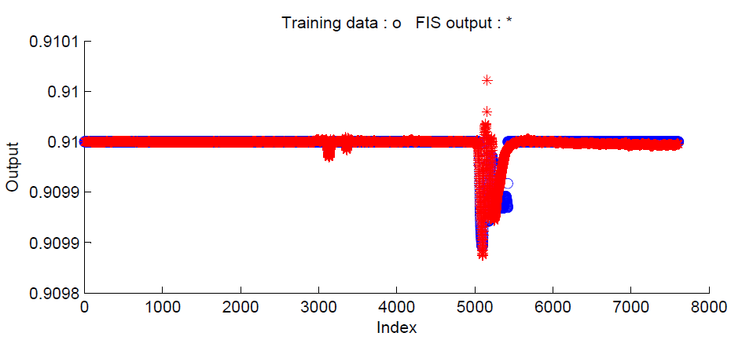
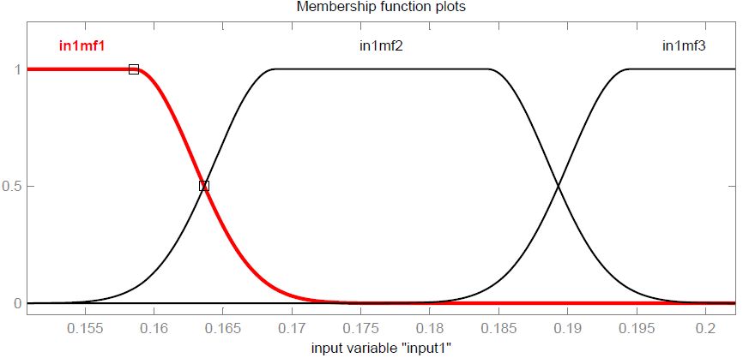
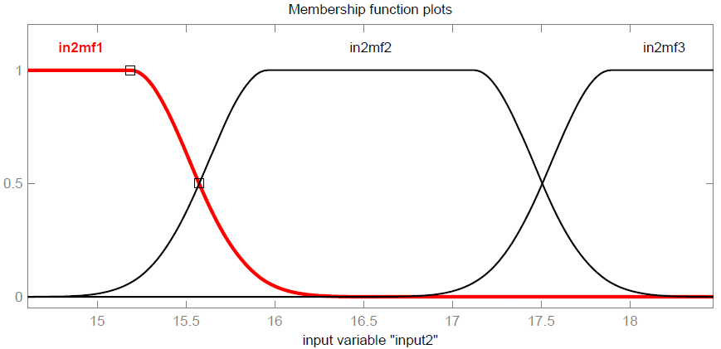
Training Data and ANFIS Output
Membership Function of ANFIS Input (Current)
Membership Function of ANFIS Input (Voltage)

Slide 36
Fuzzy inference rules
If (current is in1mf1) and (voltage is in 2mf1) then (duty cycle is out1mf1)
If (current is in1mf1) and (voltage is in2mf2) then (duty cycle is out1mf2)
If (current is in1mf1) and (voltage is in2mf3) then (duty cycle is out1mf3)
If (current is in1mf2) and (voltage is in2mf1) then (duty cycle is out1mf4)
If (current is in1mf2) and (voltage is in2mf2) then (duty cycle is out1mf5)
If (current is in1mf2) and (voltage is in2mf3) then (duty cycle is out1mf6)
If (current is in1mf3) and (voltage is in2mf1) then (duty cycle is out1mf7)
If (current is in1mf3) and (voltage is in2mf2) then (duty cycle is out1mf8)
If (current is in1mf3) and (voltage is in2mf3) then (duty cycle is out1mf9)

Slide 37
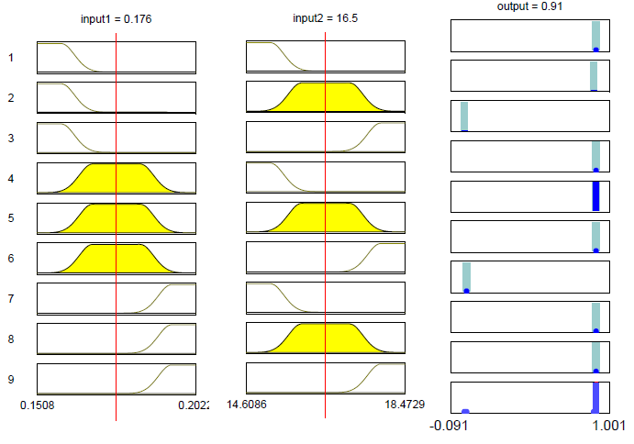
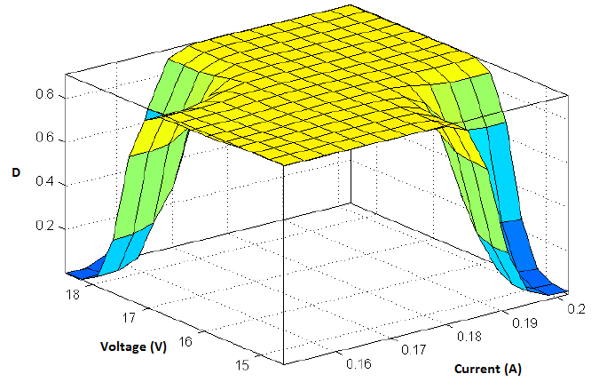
Surface Between Two Inputs (V, I) and One Output (D)
Rules Fired for Specific Input Voltage and Current

Slide 38
Efficiency of MPPT Algorithm
$η_{MPPT}=\frac{\int_{0}^{t}{P_{MPPT}\left(t\right)dt}}{\int_{0}^{t}{P_{max}\left(t\right)dt}}$ (2)
Maximum Power (P_{max} ) Prediction Model
(a) Short-circuit Current Isc
(b) Open-circuit Voltage Voc
(c ) Fill Factor FF
$I_{sc}=I_{sco}{\left(\frac{G}{G_{0}}\right)}^{α}$ (3)
${ V}_{oc}=\frac{V_{oc0}}{1+β\left(\frac{G_{0}}{G}\right)}{\left(\frac{T_{0}}{T}\right)}^{γ}$ (4)
$FF={FF}_{0}\left(1−\left(\frac{R_{s}}{\left(\frac{V_{oc}}{I_{sc}}\right)}\right)\right)$ (5)
${FF}_{0}=\frac{v_{oc−ln⁡(v_{oc}+0.72)}}{1+v_{oc}}$ (6)

Slide 39
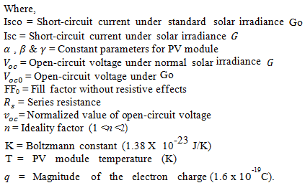
$v_{oc}=\frac{V_{oc}}{{nKT}/q}$ (7)
(d) Maximum Power Output (Pmax)
$P_{max}=FF∗Voc∗Isc$ (8)
$P_{max}=\frac{v_{oc−ln⁡(v_{oc}+0.72)}}{1+v_{oc}}∗\left(1−\left(\frac{R_{s}}{\left(\frac{V_{oc}}{I_{sc}}\right)}\right)\right)∗\frac{V_{oc0}}{1+β\left(\frac{G_{0}}{G}\right)}{\left(\frac{T_{0}}{T}\right)}^{γ}∗I_{sco}{\left(\frac{G}{G_{0}}\right)}^{α}$ (9)

Slide 40
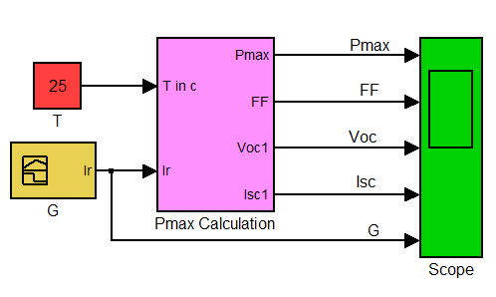
MATLABTM / SIMULINKTM Model of Maximum Power Output (Pmax)

Slide 41
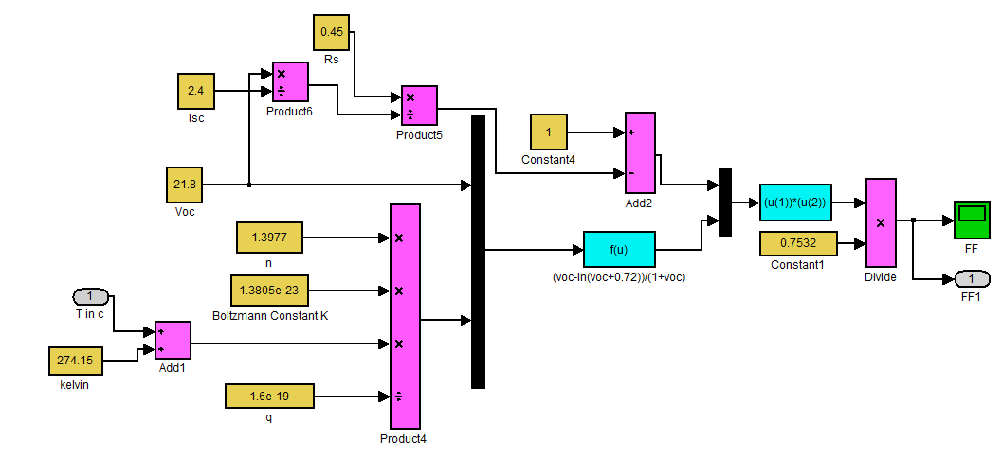
Sub-System for Fill Factor

Slide 42
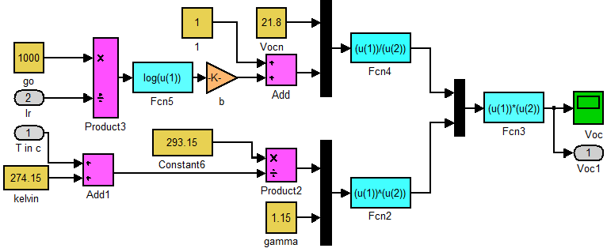
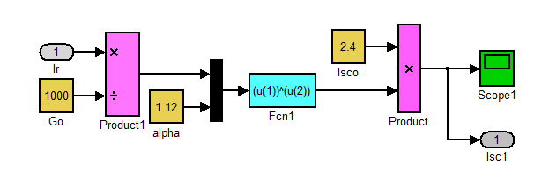
Sub-system for Open Circuit Voltage
Sub-system for Short Circuit Current

Slide 43
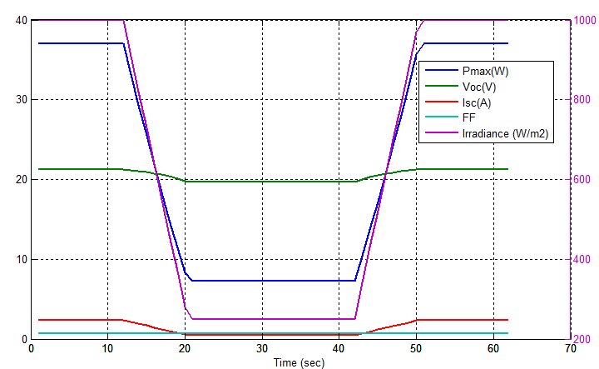
Response of Pmax, Voc , Isc , FF & Irradiance

Slide 44
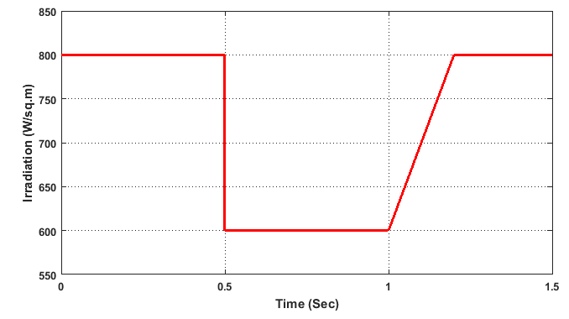
Modelling of Stand-alone PV System with Buck Converter
Test Pattern of Solar Radiation (W/m²)
MPPT Parameter Sub-system for P&O

Slide 45
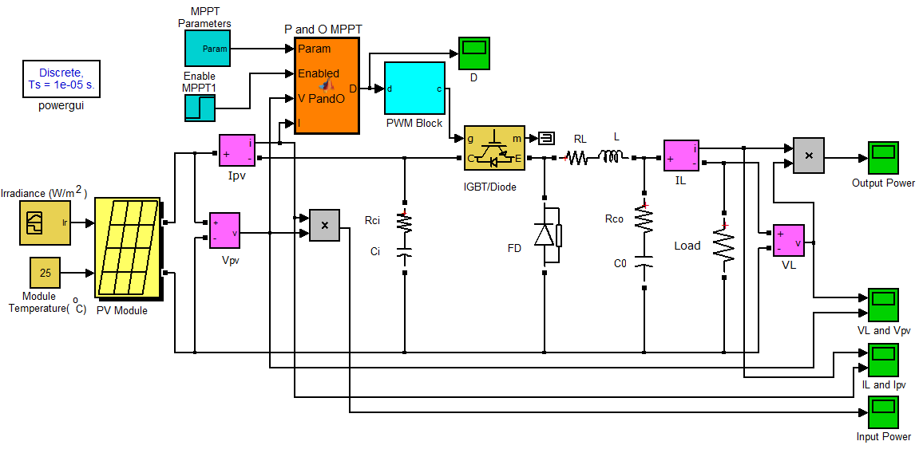
MATLABTM/SIMULINKTM Model of the Stand-alone PV System with Buck Converter Applied with P&O MPPT Algorithm

Slide 46
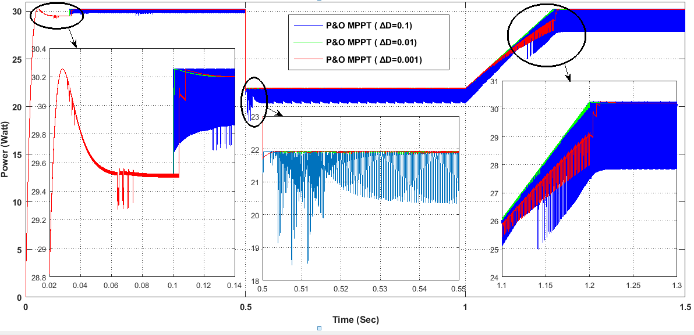
Response of Input Power Applied with P&O Algorithm

Slide 47
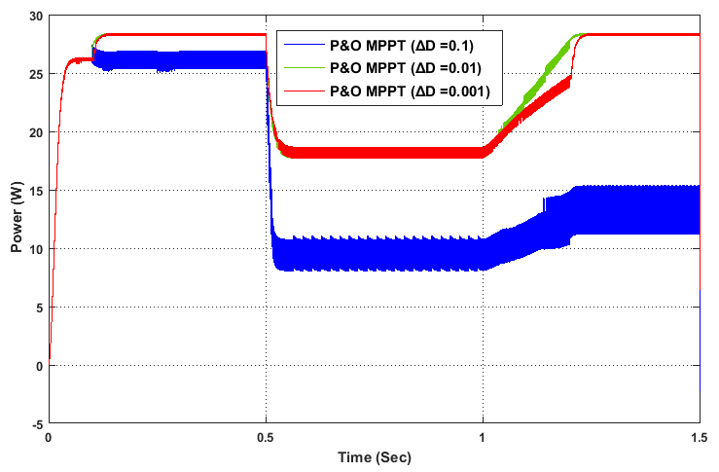
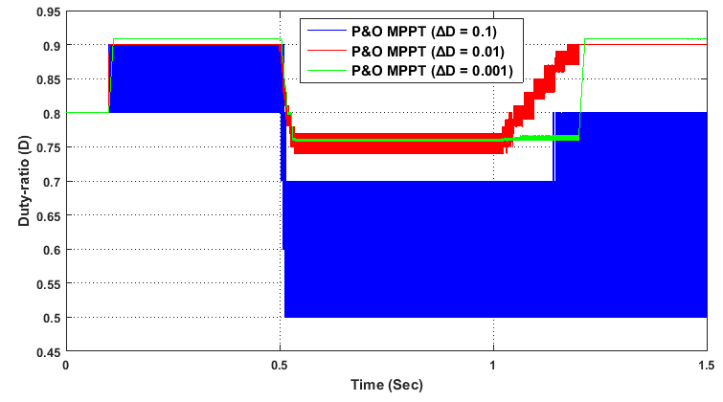
Response of Output Power Applied with P&O MPPT Algorithm
Variation in Duty-ratio Applied with P&O MPPT Algorithm

Slide 48
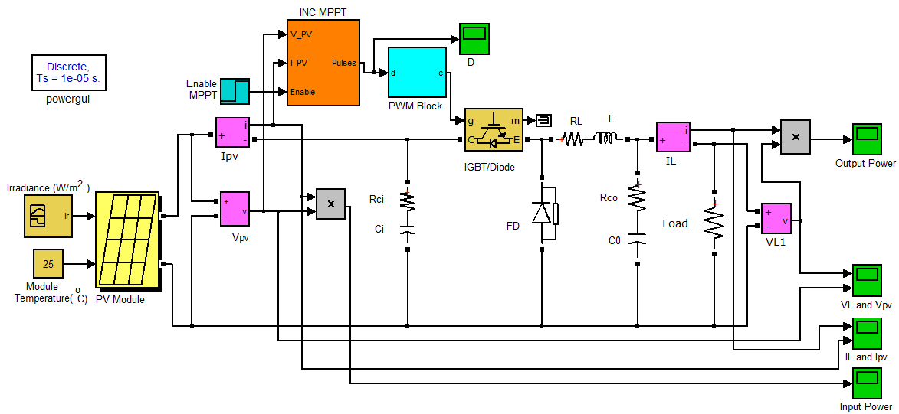
MATLABTM/SIMULINKTM Model of the Stand-alone PV System with Buck Converter Applied with INC MPPT Algorithm

Slide 49
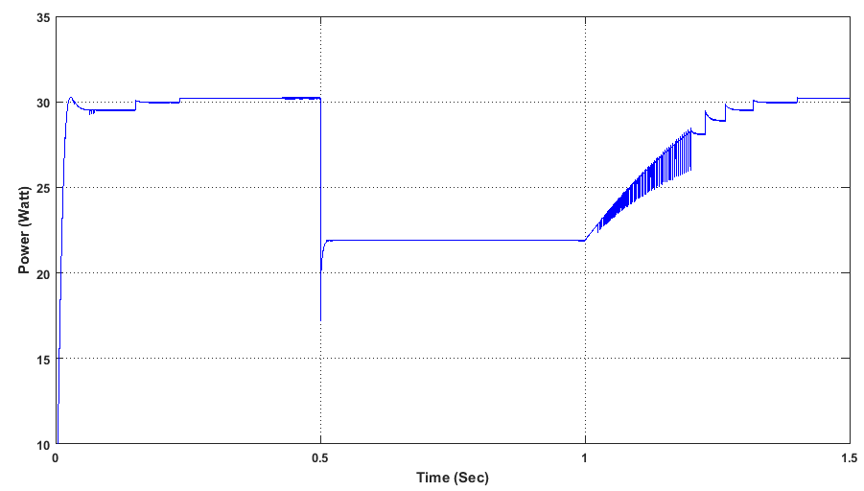
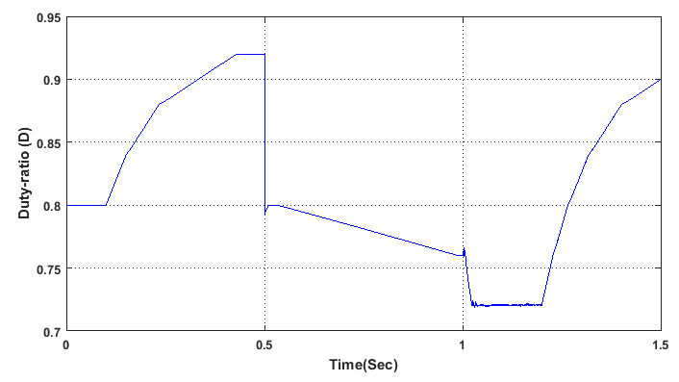
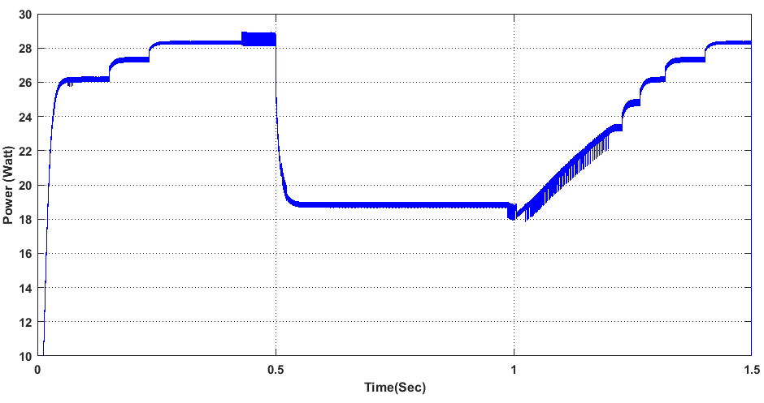
Response of Input Power Applied with INC MPPT Algorithm
Variation in Duty-ratio Applied with INC MPPT Algorithm
Response of Output Power Applied with INC MPPT Algorithm

Slide 50
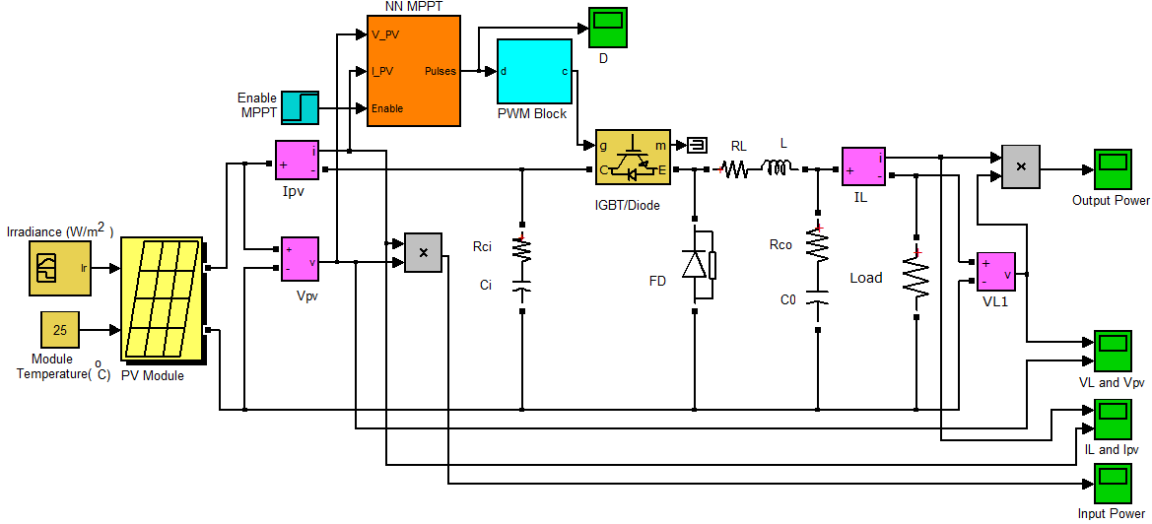
MATLABTM/SIMULINKTM Model of the Stand-alone PV System with Buck Converter Applied with NN MPPT Algorithm

Slide 51
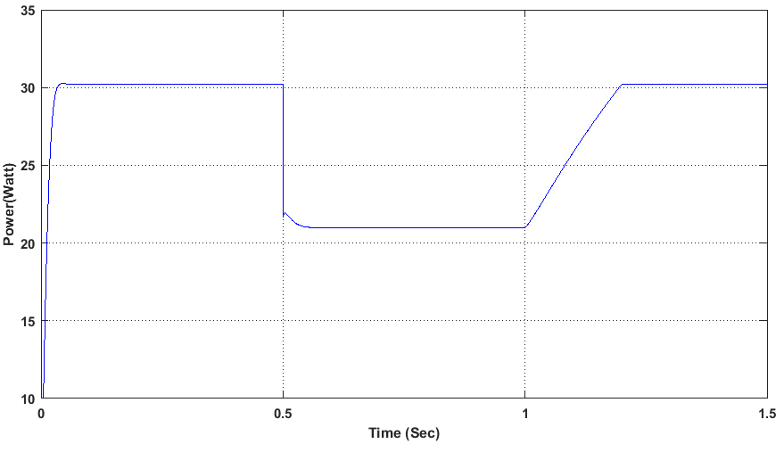
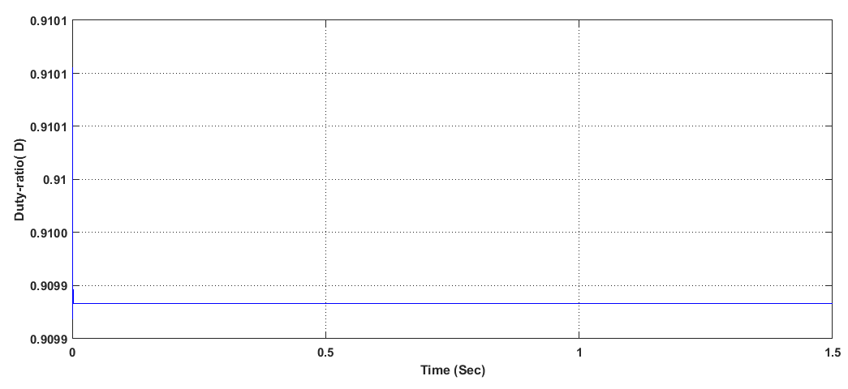
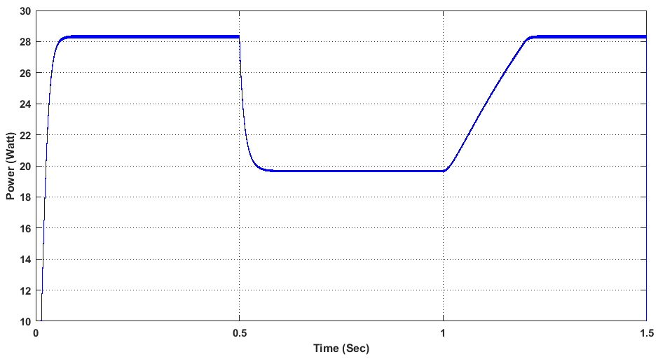
Response of Input Power Applied with NN MPPT Algorithm
Variation in Duty-ratio Applied with NN MPPT Algorithm
Response of Output Power Applied with NN MPPT Algorithm

Slide 52
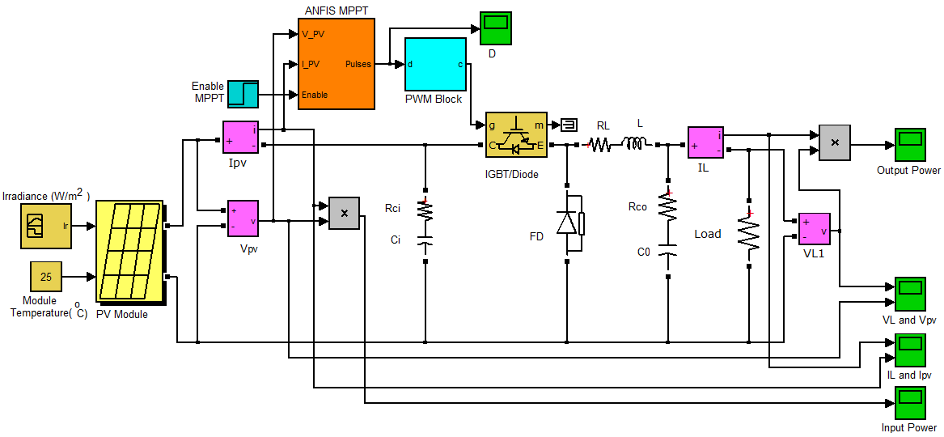
MATLABTM/SIMULINKTM Model of the Stand-alone PV System with Buck Converter Applied with ANFIS MPPT Algorithm

Slide 53
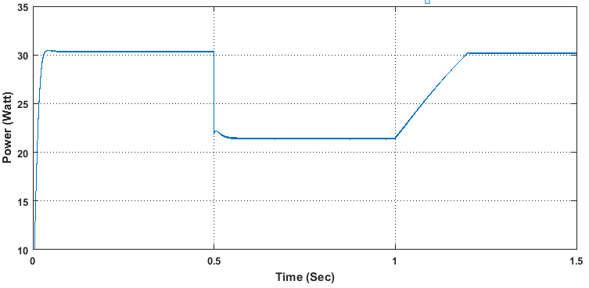
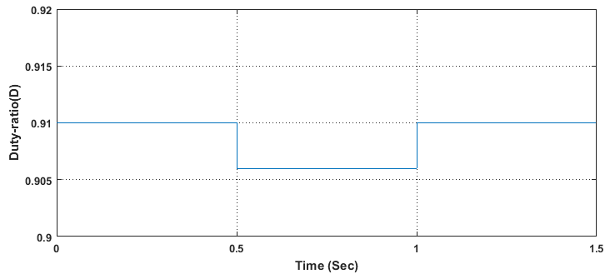
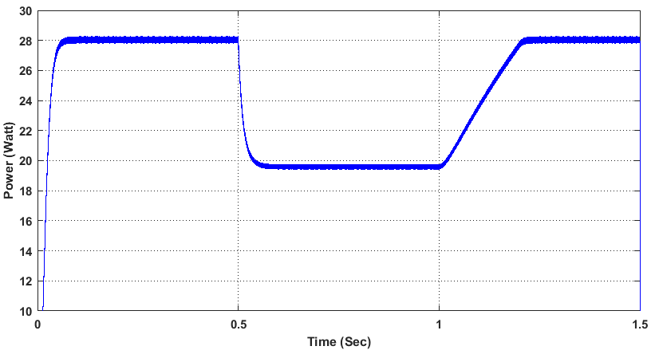
Response of Input Power Applied with ANFIS MPPT Algorithm
Variation in Duty-ratio Applied with ANFIS MPPT Algorithm
Response of Output Power Applied with ANFIS MPPT Algorithm

Slide 54
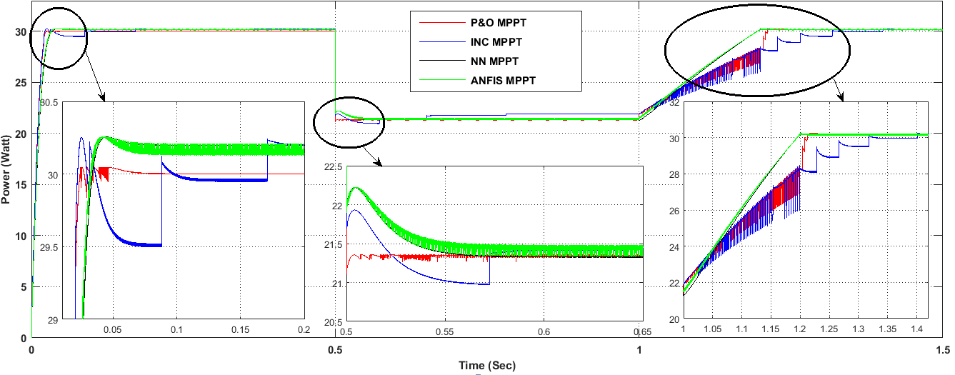
Comparative Analysis of MPPT Controllers
Response of Different MPPT Algorithms for Variation in Irradiation According to Test Pattern

Slide 55
Proposed ANFIS / Constant Voltage Tracker (CVT) Algorithm

Slide 56
Output Voltage Corresponding to Irradiance Level
Back
Output Power Corresponding to Irradiance Level

Slide 57
Experimental Setup for Performance Evaluation of PV Module at Outdoor Condition

Slide 58
Performance Characteristics (a) Efficiency 9.95% (b) Efficiency 14.63 %

Slide 59
Solar Module Analyzer 12A V110906 Software

Slide 60
Experimental Setup for Performance Evaluation of PV Module at Laboratory Condition

Slide 61
Performance of 37 W PV Module at Laboratory and Outdoor Conditions
Condition | Angle of PV panel Tilt | Irradiation W/m² | Temperature ºC | Voc (V) | Isc (mA) | Vm (V) | Im (mA) | Pm (W) | 𝜂 (%)
Lab | 0⁰ | 450 | 30 | 18.71 | 129 | 17.93 | 126 | 2.254 | 1.446
 | 45⁰ | 450 | 30 | 18.99 | 246 | 17.97 | 185 | 3.312 | 2.124
Outdoor | 0⁰ | 923 | 32 | 18.20 | 1071 | 14.33 | 1043 | 14.94 | 7.640
 | 45⁰ | 923 | 32 | 19.07 | 1904 | 14.77 | 1777 | 26.26 | 11.25

Slide 62
The performance evaluation of 37W Vikram Solar PV module was carried out using MECO solar module analyzer in laboratory and outdoor conditions. The experimental study reveled that 37 W Vikram Solar PV module gave better efficiency in the outdoor environmental condition, an average of 12% as mentioned in its data sheet. But, there was a very large variations in irradiationa and temperature over a few samples taken for a test period. All though the efficiency of the PV module inside the laboratory was low, it was better for experimenting different MPPT Algorithms as all algorithms need to be tested under similar conditions for comparision.

Slide 63
Experimental Results
Parameters of the Utilized PV Panel
P_{max} (W) | 37
V_{mp} (V) | 17
I_{mp} (A) | 2.25
V_{oc} (V) | 21.77
I_{sc} (A) | 2.4
Efficiency (%) | 12.01

Slide 64
Block Diagram of the Proposed MPPT/CVT System

Slide 67
Subsystem
Maximum Power Prediction Model in MATLABTM/ SIMULINKTM Environment

Slide 68
Real Time Data Acquisition using P&O

Slide 69
Real Time Data Acquisition using INC Algorithm

Slide 70
Real Time Data Acquisition using INC

Slide 71
Real Time Data Acquisition using Neural Network

Slide 72
Real Time Data Acquisition using ANFIS

Slide 73
Theoretical) (W)
e
Delay in dynamic Response
Max Steady State Error
Initial Offset
Experimental Results of P&O Algorithm with Delta Value D=0.1
Theoretical) (W)
e
Max Steady State Error
Delay in dynamic Response
Initial Offset
Experimental Results of P&O Algorithm with Delta Value D=0.01

Slide 74
Delay in dynamic Response
Max Steady State Error
Initial Offset
Experimental Results of P&O Algorithm with Delta Value D=0.001
Max Steady State Error
Delay in dynamic Response
Theoretical) (W)
Initial Offset
e
Experimental Results of INC MPPT Algorithm

Slide 75
Delay in dynamic Response
Max Steady State Error
Initial Offset
Experimental Results of NN MPPT Algorithm
Max Steady State Error
Delay in dynamic Response
Initial Offset
Experimental Results of ANFIS MPPT Algorithm

Slide 76
Real Time Data Acquisition using ANFIS & CVT

Slide 77
I/P & O/P Voltage Comparison of ANFIS/CVT

Slide 78
MPPT Algorithm Comparison
MPPT method |  | Efficiency ( %) | Over-shoot ( %) | Settling time ( sec) | Delay in dynamic response ( sec) | Max. Steady state error ( %) | Sensors used
PO (ΔD=0.1) |  | 77.60 to 79.39 | No | 0.48 | 0.06 | 15.14 | Voltage, Current
PO (ΔD=0.01) |  | 81.00 to 81.60 | No | 0.41 | 0.039 | 12.77 | Voltage, Current
PO (ΔD=0.001) |  | 81.23 to 84.37 | No | 0.40 | 0.04 | 12.03 | Voltage, Current
INC PI |  | 86.32 to 87.25 | 3.35 | 1.78 | 0.001 | 7.35 | Voltage, Current
NN |  | 87.35 to 90.10 | 2.185 | 0.6439 | 0.038 | 3.88 | Voltage, Current
ANFIS |  | 87.15 to 93.31 | 6.56 | 5.35 | 0 | 3.55 | Voltage, Current
ANFIS & CVT | ≥12V | NA | 7.28 | 0.18 | 0.1 | 9 | Input and Output Voltage , Current
 | <12V | 87.15 to 93.31 | 6.56 | 5.35 | 0 | 3.55
Back

Slide 79
Conclusion
The MPPT algorithms Perturb and observe , incremental conductance, neural network, adaptive neuro fuzzy inference system (ANFIS) and ANFIS & CVT were discussed, implemented and compared . The modeling of the PV array was performed in MATLAB/SIMULINK. It was conclude that ANFIS model gave fast response and less oscillations compared to Perturb and Observe , Incremental Conductance and Neural Network models . The proposed ANFIS & CVT model tracks 12V for voltage more than 12V and tracks the maximum power point according to ANFIS algorithm for voltage less than 12V. This algorithm is suitable for a PV powered multilevel inverter which requires an isolated constant dc supply at its input.

Slide 80
Cascaded H-bridge Inverter
V_{dcm}
S₁
S₂
V_{a}
V_{a[(m-1)/2]}
S₃
S₄
V_{dc1}
S₁
S₂
V_{a}
n
S₃
S₄
(a)
(a) Single Phase Cascaded H-bridge Inverter Topology with m Levels
(b) Output Phase Voltage with Non Equal dc Source
(b)

Slide 81
Selective Harmonic Elimination Technique
(10)
(11)
(12)
(13)
(14)
(16)
(17)

Slide 82
Block Diagram of the Proposed Harmonic Elimination System

Slide 83
I_{g1}(1-4)
Negative
Logic
I_{g2}(1-4)
……
I_{gL}(1-4)
PLL
Frequency (50Hz)

Slide 84
MATLAB/SIMULINK Modeling of CHMLI

Slide 85
Phase A
Phase B
Phase C
Firing Pulses for Phase A

Slide 87
Newton Raphson - SHE
The algorithm for the Newton-Raphson method is as follows:
Step 1 Assume any random initial guess for switching angles (say $α_{0}$ )
The switching angle matrix is :
$α^{j }={[{α_{1}}^{j }+{α_{2}}^{j }+{α_{3}}^{j }+{α_{4}}^{j }+{α_{5}}^{j }]}^{T}$
Step 2 Set modulation index to zero.
Step 3 Evaluate the non-linear system matrix $F^{j} ,$ the Jacobian matrix ${ \frac{∂f}{∂α}}^{j}$ and the harmonics amplitude matrix $T$ represented below:
The non-linear system matrix,
$F^{j}=\left[\begin{aligned}\cos\left({α_{1}}^{j}\right)+\cos\left({α_{2}}^{j}\right)+\cos\left({α_{3}}^{j}\right)+\cos\left({α_{4}}^{j}\right)+\cos\left({α_{5}}^{j}\right) \\ \cos\left({5α_{1}}^{j}\right)+\cos\left({5α_{2}}^{j}\right)+\cos\left({{5α}_{3}}^{j}\right)+\cos\left({5α_{4}}^{j}\right)+\cos\left({{5α}_{5}}^{j}\right) \\ \cos\left({7α_{1}}^{j}\right)+\cos\left({7α_{2}}^{j}\right)+\cos\left({{7α}_{3}}^{j}\right)+\cos\left({7α_{4}}^{j}\right)+\cos\left({7α_{5}}^{j}\right) \\ \cos\left({9α_{1}}^{j}\right)+\cos\left({9α_{2}}^{j}\right)+\cos\left({{9α}_{3}}^{j}\right)+\cos\left({9α_{4}}^{j}\right)+\cos\left({9α_{5}}^{j}\right) \\ \cos\left({11α_{1}}^{j}\right)+\cos\left({{11α}_{2}}^{j}\right)+\cos\left({11α_{3}}^{j}\right)+\cos\left({{11α}_{4}}^{j}\right)+\cos\left({11α_{5}}^{j}\right) \end{aligned}\right]$
(18)
(19)

Slide 88
the Jacobian matrix,
${\frac{∂f}{∂α}}^{j}=\left[\begin{aligned}−\sin\left({α_{1}}^{j}\right) −\sin\left({α_{2}}^{j}\right) −\sin\left({α_{3}}^{j}\right) −\sin\left({α_{4}}^{j}\right) −\sin\left({α_{5}}^{j}\right) \\ −5sin\left({{5α}_{1}}^{j}\right) −5\sin\left(5{α_{2}}^{j}\right) −5\sin\left(5{α_{3}}^{j}\right) −5sin\left(5{α_{4}}^{j}\right) −5\sin\left(5{α_{5}}^{j}\right) \\ −7sin\left({{7α}_{1}}^{j}\right) −7sin\left(7{α_{2}}^{j}\right) −7\sin\left(7{α_{3}}^{j}\right) −7sin\left(7{α_{4}}^{j}\right) −7\sin\left(7{α_{5}}^{j}\right) \\ −9sin\left(9{α_{1}}^{j}\right) −9sin\left(9{α_{2}}^{j}\right) −9sin\left(9{α_{3}}^{j}\right) −9sin\left(9{α_{4}}^{j}\right) −9sin\left(9{α_{5}}^{j}\right) \\ −11sin\left(11{α_{1}}^{j}\right)−11sin\left({{11α}_{2}}^{j}\right)−11\sin\left(11{α_{3}}^{j}\right)−11sin\left(11{α_{4}}^{j}\right)−11\sin\left(11{α_{5}}^{j}\right)\end{aligned}\right]$
and the corresponding harmonic amplitude matrix,
$T={[m_{i}\frac{3π}{4} 0 0 0 0]}^{T}$
The solutions must satisfy the following condition:
$0≤α_{1}≤α_{2}{≤α}_{3}≤α_{4}{≤α}_{5}≤\frac{π}{2}$
Step 4 Compute correction Δα during the iteration using relation,
$∆α={\frac{∂f}{∂α}}^{j} \left(α_{j}\right)(T$-$F^{j}$)
Step 5 Update the new switching angles as,
$α\left(k+1\right)=α\left(k\right)+∆α(k)$
Step 6 To obtain a feasible solution of switching angles by executing the following
transformation: $α\left(k+1\right)=\cos^{−1}{(abs(\cos{(α\left(k+1\right))))}}$
(20)
(21)
(22)
(23)
(24)
(25)

Slide 89
Optimized Switching Angles using NR for 11 Level Inverter
NR Algorithms

Slide 90
11 Level Cascaded H-bridge Inverter Applied with NR-SHE Algorithm for 0.8 Value of MI
Line Voltage Waveform
Phase Voltage Waveform
Current Waveform

Slide 91
Harmonic Spectrum at 0.8 MI for NR-SHE Algorithm for a 11 level Cascaded H-bridge Inverter
Line Voltage Spectrum
Phase Voltage Spectrum
Current Spectrum

Slide 92
Magnitude of Harmonic Contents (%) up to 19th Order for 11 Level
Cascaded H-bridge Inverter Applied with NR-SHE Technique
Technique Used | 11 Level Cascaded H-bridge Inverter Magnitude of Harmonic Contents (%) up to 19th Order
 | Line Voltage (THD 5.55%) 105.8 peak (74.83 rms) |  |  |  | Phase Voltage (THD 7.93%) 61.14 peak (43.23 rms) |  |  |  | Current (THD 5%) 0.6063 peak (0.4287 rms)
 | Harmonic Order | Even Harmonic | Harmonic Order | Odd Harmonic | Harmonic Order | Even Harmonic | Harmonic Order | Odd Harmonic | Harmonic Order | Even Harmonic | Harmonic Order | Odd Harmonic
NR | 0th | 0.00 | 1th | 100 | 0th | 0.00 | 1th | 100 | 0th | 0.01 | 1th | 100
 | 2nd | 0.00 | 3rd | 0.02 | 2nd | 0.00 | 3rd | 0.60 | 2nd | 0.00 | 3rd | 0.02
 | 4th | 0.00 | 5th | 0.09 | 4th | 0.00 | 5th | 0.04 | 4th | 0.00 | 5th | 0.07
 | 6th | 0.00 | 7th | 0.08 | 6th | 0.00 | 7th | 0.06 | 6th | 0.00 | 7th | 0.09
 | 8th | 0.00 | 9th | 0.06 | 8th | 0.00 | 9th | 3.26 | 8th | 0.00 | 9th | 0.06
 | 10th | 0.00 | 11th | 0.10 | 10th | 0.00 | 11th | 0.10 | 10th | 0.00 | 11th | 0.11
 | 12th | 0.00 | 13th | 0.02 | 12th | 0.00 | 13th | 0.02 | 12th | 0.00 | 13th | 0.03
 | 14th | 0.00 | 15th | 0.09 | 14th | 0.00 | 15th | 1.04 | 14th | 0.00 | 15th | 0.08
 | 16th | 0.00 | 17th | 2.65 | 16th | 0.00 | 17th | 2.58 | 16th | 0.00 | 17th | 2.62
 | 18th | 0.00 | 19th | 1.89 | 18th | 0.00 | 19th | 1.88 | 18th | 0.00 | 19th | 1.86

Slide 93
Comparison of Magnitude (Peak Value) and THD values of Line Voltage, Phase Voltage and Current of 7, 9 and 11 Level CHMLI
$V1=Mi(4∗\frac{N_{dc} ∗Vdc}{π})$
Level | Harmonic Elimination Method | MI | Line Voltage |  | Phase Voltage |  | Current
 |  |  | Magnitude Peak Value | THD (%) | Magnitude Peak Value | THD (%) | Magnitude Peak Value | THD (%)
11 | NR | 0.8 | 105.8 | 5.55 | 61.14 | 7.93 | 0.6063 | 5

Slide 94
Comparison of THD Values Using NR, GA and PSO Techniques for PV Powered CHMLI
Level | Harmonic Elimination Method | MI | Switching Angle (Radians) |  |  |  |  | Computational Time (s) | THD Value (%)
 |  |  | $α_{1}$ | $α_{2}$ | $α_{3}$ | $α_{4}$ | $α_{5}$
11 | NR | 0.8 | 0.1147 | 0.3306 | 0.4744 | 0.7878 | 1.0863 | 0.006 | 5. 55

Slide 95
The simulation results depicted that the NR based selective harmonic elimination algorithms can eliminate the deadliest lower order harmonics. And thereafter, drastically decrease the total harmonic distortion (THD) of the output voltage of cascaded H-bridge multilevel inverters with micro-grid. Further, it is concluded that the 11 level was found to be the optimal level for a CHMLI as the THD was brought below the recommended 5% according to IEEE 519 standard. Thus the hardware validation of the harmonic elimination problem for CHMLI has been considered for an 11 level inverter.
Back

Slide 96
Block Diagram of the Hardware Implementation of 3 Φ MLI
1. Intelligent Power Module (Power Circuit)
2. Firing Pulse for H-bridge Inverter
(a) Optocoupler (b) Gate Driver
(c ) AND Gate (d) Schmitt Trigger
(e) FPGA Based Spartan 3A DSP Board
3. Protection Circuit
4. Regulated Power Supply
5. Signal Conditioning Circuit
6. Constant and Isolated dc Supply for MLI
7. 3 Φ Induction Motor Load
8. Power Quality Analyzer
9. PC with MATLAB/SIMULINK and Xilinx
Software Packages

Slide 97
ICS525-01 Setting for 20 MHz
S₂ | S₁ | S₀ | R₆ | R₅ | R₄ | R₃ | R₂ | R₁ | R₀ | V₈ | V₇ | V₆ | V₅ | V₄ | V₃ | V₂ | V₁ | V₀
0 | 1 | 0 | 0 | 0 | 0 | 0 | 0 | 0 | 1 | 0 | 0 | 0 | 0 | 0 | 0 | 1 | 0 | 0
Firing Pulses and Carrier Waves for H-bridge

Slide 98
5 μs Delay Between the MOSFETs on the Same Leg

Slide 99
Complete Laboratory setup of 3 Φ 11 Level Cascaded H-bridge Inverter
Spartan®-3A DSP FPGA CHMLI
CHMLI
Power Quality Analyzer
3Φ Induction Motor

Slide 100
Experimental Results for 11 Level Inverter (a) Output Line Voltage (b) Phase Voltage and (c) Current at M=0.8 (NR-SHE)
(a)
(b)
(c)

Slide 101
Experimental Results for 11 Level Inverter (a) Line Voltage FFT Analysis (b) Phase Voltage FFT Analysis and (c) Current FFT Analysis at M=0.8 (NR-SHE)
(a)
(b)
(c)
(b)
(c)
(d)
Fig. 12

Slide 102
Optimum Switching Angles and Minimum THD using NR-SHE, GA-SHE and PSO-SHE
Technique | Method | Mi | Alpha 1 | Alpha 2 | Alpha 3 | Alpha 4 | Alpha 5 | Line Voltage THD (%) | Phase Voltage THD (%) | Current THD (%)
NR | Simulation | 0.8 | 0.1147 | 0.3306 | 0.4744 | 0.7878 | 1.0864 | 5.55 | 7.93 | 5
 | Hardware | 0.8 | 0.1147 | 0.3306 | 0.4744 | 0.7878 | 1.0864 | 4.8 | 6.7 | 3.3

Slide 103
Comparison of Harmonic (%) for 11 Level Inverter with NR
Technique | Harmonics | Line Voltage (%) |  | Phase Voltage (%) |  | Current (%)
 |  | Practical | Simulation | Practical | Simulation | Practical | Simulation
NR | THD | 4.8 | 5.55 | 6.7 | 7.93 | 3.3 | 5.00
 | 3rd | 1.7 | 0.02 | 1.8 | 0.60 | 0.8 | 0.02
 | 5th | 0.6 | 0.09 | 0.5 | 0.04 | 0.3 | 0.07
 | 7th | 0.9 | 0.08 | 0.6 | 0.06 | 0.2 | 0.09
 | 9th | 0.2 | 0.06 | 3.0 | 3.26 | 0.2 | 0.06
 | 11th | 0.4 | 0.10 | 0.3 | 0.10 | 0.1 | 0.11
 | 13th | 0.3 | 0.02 | 0.3 | 0.02 | 0.1 | 0.03
 | 15th | 0.1 | 0.09 | 1.4 | 1.04 | 0.1 | 0.08

Slide 104
Cost of Cascaded H-bridge 11 Level Inverter
Mohammadreza Derakhshanfar in [15] has done a comparative analysis of three topologies (i) cascaded H-bridge (ii) flying capacitor clamped and (iii) diode clamped multilevel inverters. The analysis was based on parameters such as cost, weight and switching power losses of 2 level, 5 level and 9 level inverters with two different IGBTs and one MOSFET. The investigations revealed that cascaded H-bridge topology has the lowest cost and weight, but higher switching power loss as compared to the other two topologies. In this study, the switching strategy used for firing an 11 level cascaded H-bridge inverter is the selective harmonics elimination technique. This scheme operates at fundamental switching frequency of 50Hz, thus, switching power loss can be neglected.

Slide 105
Cost of 11 level Cascaded H-bridge Inverter Experimental Setup
S.No | Description of Items |  | Price (Rs)
1 | FPGA Board
 | a) | Base Board | 60000
 | b) | Emulator | 10000
 | c) | Necessary Connecting Cable (JTAG to USB) | 5000
 | d) | Built in Power Supply (SMPS) | 5000
2 | 3-Ø 11 Level Cascaded H - Bridge Inverter
 | a) | Power Circuit ( MOSFET with Head Sink) | 70000
 | b) | Driver Circuit (15 Nos) | 70000
 | c) | Isolation Circuit (15 Nos) | 40000
 | d) | Sensors | 10000
 | e) | Signal Conditioning Circuit | 10000
 | f) | Protection Circuit | 10000
 | g) | Necessary Power Supply for the Above Circuits | 25000
 | h) | 15 Nos of Isolation Transformers | 55000
 | i) | Base Plate for Transformers | 5000
 | j) | Connectors, Meters & Cables | 3000
 | k) | Frame Work | 15000
 | l) | Accessories | 5000
3 | Induction Motor with Load Setup
 | a) | Induction Motor (0.25 hp) | 10000
 | b) | Load Setup (Spring Balance) | 8000
 | c) | Sensor (QEP) | 4000
Grand Total |  |  | 4,20,000

Slide 106
Conclusion
The MPPT algorithms Perturb and Observe , Incremental Conductance, neural network, Adaptive Neuro Fuzzy Inference System (ANFIS) and ANFIS & CVT were discussed, implemented and compared . The modeling of the PV array was performed in MATLAB/SIMULINK. It was conclude that ANFIS model gave fast response and less oscillations compared to Perturb and Observe , Incremental Conductance and Neural Network models . The proposed ANFIS & CVT model tracks 12V for voltage more than 12V and tracks the maximum power point according to ANFIS algorithm for voltage less than 12V. This algorithm is suitable for a PV powered multilevel inverter which requires an isolated constant dc supply at its input.

Slide 107
NR-SHE algorithm gives better performance in THD minimization ($≤$5%) as per IEEE-519.
The drawback of the conventional Newton Raphson algorithm is that, the results obtained using this method may oscillate between the local minima and maxima without converging if the initial guess is not close to the optimal point. Thus, this system is well suited for solar based induction motor drive applications and in micro- grids where renewable sources of energy such as solar, wind and fuel cells need to be interfaced with the grid. Further, the present research work is found to be prospective to the future research in the area of solar powered cascaded multilevel inverter.

Slide 108
Future Scope
Modelling and developing new topologies of cascaded multilevel inverter with less number of switches and dc sources, thus, minimizing the switching losses.
Hybrid Maximum Power Point Tracking (MPPT) algorithms for hybrid wind generators, photo-voltaic system and fuel cell based systems can be developed.
Partial shading effect of Photo-voltaic system.
Integration of Renewable Energy Sources With Smart Grid

Slide 109
The multilevel inverters along with intelligent control strategies can become a promising technology in high power inverter applications such as integration of distributed energy sources with smart grid.
More accurate strategies for safe operation of PV fed grid interactive system integrated with cascaded multilevel inverter in islanding mode can be developed.

Slide 110
Zero polluting Distributed Generator (DG) such as wind generators with ac-dc converter, fuel cell, a hybrid coal and Photo-Voltaic system etc. can be used as the dc input to the cascaded multilevel inverter which can further be integrated to the smart grid.
Performance enhancement of smart grids interfaced with Distributed Generators (DGs) using cascaded multilevel inverter as FACTS devices can be incorporated.
Design and development of hybrid zero polluting sources (PV arrays, wind generators and Fuel cell) based cascaded multilevel inverter for smart grid with Phase Lock Loop (PLL) based synchronization and its validation using digital controller such as Opal RT, Typoon based Hardware in Loop (HIL) systems and Field Programmable Gate Array (FPGA) based processors to obtain more accurate results may be undertaken.

Slide 111
Acknowledgements
Financial support of TEQIP II and Director NITTTR, Chandigarh, India.
Technical support from faculty of PEC University of Technology, Chandigarh, India and NITTTR , Chandigarh.

Slide 112
References
[1] Farid Khoucha, Mouna Soumia Lagoun, Abdelaziz Kheloui, and Mohamed El Hachemi Benbouzid, “A comparison of symmetrical and asymmetrical three-phase H-bridge multilevel inverter for DTC induction motor drives” , IEEE Trans. Energy Convers., vol. 26, no. 1, pp. 64 - 72 , Mar. 2011.
[2] T. M. Underland and N. Mohan, “ Overmodulation and loss consideration in high- frequency modulated transistorized induction motor drives”, IEEE Trans. Power Electron. ,vol. 3, no. 4, pp. 447 - 452 ,Oct. 1988.
[3] S. Khomfoi, V. Kinnares, and P. Viriya, “ Influence of PWM characteristics on the core losses due to harmonic voltage in PWM fed induction motors”, in Conf. Rec. IEEE Power Eng. Soc. Wint. Meeting, Singapore, Jan. 2000, pp. 365-369.
[4] E. Cengelci, S. U. Sulistijo, B. O. Woom, P. Enjeti, R. Teodorescu, and F. Blaabjerg, “ A new medium voltage PWM inverter topology for adjustable speed drives”, in Conf. Rec. IEEE - IAS Annu. Meeting, St. Louis, Oct. 1998, pp. 1416-1423.
[5] L.M. Tolbert, F. Z. Peng, and T. G. Habetler, "Multilevel converters for large electric drives” , IEEE Trans. Ind. Appl., vol. 35, no. 1, pp. 36-44, Jan./Feb.1999.
[6] M. Bouzguenda, A. Gastli , A. H. Al Badi, and T. Salmi, “ Solar photovoltaic inverter requirements for smart grid application”, in Proc. IEEE PES on ISGT- Middle East, Jeddah, Dec. 2011, pp.1 – 5.
[7] J. Rodriguez, J. S. Lai, and F. Z. Peng, “ Multilevel inverters: Survey of topologies, controls, and applications”, IEEE Trans. Ind. App., vol. 49, no. 4, pp. 724-738, Aug. 2002.
[8] J. S. Lai and F. Z. Peng, “ Multilevel converters – A new breed of power converters”, IEEE Trans. Ind. App., vol. 32, no. 3, pp. 509-517, May /June 1996.
[9] R. H. Baker and L. H. Bannister, "Electric power converter” , U.S. Patent 3 867 643, Feb. 1975.
[10] Alireza Nami, Firuz Zare, Arindam Ghosh, and Frede Blaabjerg, , “ A hybrid cascade converter topology with series-connected symmetrical and asymmetrical diode-clamped H-bridge cells”, IEEE Trans. Power Electron., vol. 26, no. 1, pp. 51-65, Jan. 2011.
[11] Ghoreishy, Hoda Zare, Firuz Hassanpour, Hamid Ledwich, and Gerard F, “ A new common-mode voltage reduction technique for multilevel inverters”, in Proc. IEEE Australasian Universities Power Engineering Conference, Perth , 2007, pp. 62-67.
[12] Krishna Kumar Gupta , Shailendra Jain , A Novel Multilevel Inverter Based on Switched DC Sources, IEEE Trans. on Ind. Electron. , vol. 61 , Issue: 7 , pp. 3269 - 3278, July 2014.
[13] S.Albert Alexander, T.Manigandan and N.Senthilnathan, “ Digital switching scheme for cascaded multilevel inverters”, in Conf. Rec. IEEE Int. Conf. on Power Syst., Kharagpur, Dec. 2009, pp. 1-6.
[14] C. K. Duffey and R. P. Stratford, “ Update of harmonic standard IEEE-519: IEEE recommended practices and requirements for harmonic control in electric power systems”, IEEE Trans. Ind. Appl., vol. 25, no. 6, pp. 1025-1034, Nov./Dec. 1989.
[15] Mohammadreza Derakhshanfar, “Analysis of different topologies of multilevel inverters”, Master of Science Thesis, Department of Energy and Environment, Division of Electric Power Engineering, Chalmers University of Technology Göteborg, Sweden, 2010.

Slide 113
[16] H. S. Patel and R. G. Hoft, “ Generalized harmonic elimination and voltage control in thyristor inverters: Part II –Voltage control technique”, IEEE Trans. Ind. Appl., vol. 10, pp. 666-673, Sept./Oct. 1974.
[17] P. N. Enjeti, P. D. Ziogas, and J. F. Lindsay, “ Programmed PWM techniques to eliminate harmonics: A critical evaluation”, IEEE Trans. Ind. Appl., vol. 26, no. 2, pp. 302 – 316, March/April 1990.
[18] J. N. Chiasson, L. M. Tolbert, K. J. McKenzie, and Z. Du, “ A new approach to solving the harmonic elimination equations for a multilevel converter”, in Conf. Rec. IEEE Ind. Appl. Soc. Annual Meeting, Salt Lake City, Oct. 2003, pp. 640-645.
[19] Tolbert L.M. , Chiasson, J. McKenzie, and K. Zhong Du, “ Elimination of harmonics in a multilevel converter with non-equal dc sources” , in Proc. IEEE 18th Annual Conf. on Applied Power Electronics Conference and Exposition, Feb. 2003, pp. 75-82.
[20] Basil M. Saied, Qais M. Alias, and Ahmed S. Alsoufy, “ Intelligent systems based selective harmonic elimination (SHE) for single phase voltage source inverter”, Int. J. Al-Rafidain Eng., vol.16, no.3, Aug. 2008.
[21] M.S. A. Dahidah and V. G. Agelidis, “ Selective harmonic elimination PWM control or cascaded multilevel voltage source converters: A generalized formula”, IEEE Trans. Power Electron., vol. 23, no. 4, pp. 1620-1630, July 2008.
[22] Li Li, Dariusz Czarkowski, Yaguang Liu, and Pragasen Pillay, “ Multilevel selective harmonic elimination PWM technique in series-connected voltage inverters”, IEEE Trans. Ind. Appl., vol. 36 , pp. 160 – 170, Jan./Feb. 2000.
[23] N. Farokhnia S.H, Fathi N. Yousefpoor, and M.K. Bakhshizadeh, “ Minimisation of total harmonic distortion in a cascaded multilevel inverter by regulating voltages of dc sources”, Int. J IET Power Electron., vol. 5, Iss. 1, pp. 106–114, 2012.
[24] Jagdish Kumar, Biswarup Das, Pramod Agarwala,” Optimized Switching Scheme of a Cascade Multi-level Inverter”, Electric Power Components and Systems, Vol. 38, Issue 4, pp. 445- 464, February 2010.
[25] Zhong Du, Leon M. Tolbert and John N. Chiasson, “ Harmonic elimination for multilevel converter with programmed PWM method”, in Conf. Rec. IEEE 39th IAS Annual Meeting Ind. Appl. Conf., Oct. 2004, pp. 2210 - 2215.
[26] P.Palanivel and Subhransu Sekhar Dash,” Control of three phase cascaded multilevel inverter using various novel multicarrier pulse width modulation techniques”, in Conf. Rec. IEEE Region 10th Conf. TENCON, Fukuoka, Nov. 2010, pp. 59 – 64.
[27] V. Antony Albert, V. Rajasekaran, and S. Selvaperumal, “ Harmonic elimination of H-bridge seven level inverter” , European J. of Scientific Research , vol.65, no.4, pp. 594-600, 2011.
[28] Nima Yousefpoor, Seyyed Hamid Fathi, Naeem Farokhnia, and Hossein Askarian Abyaneh, “ THD minimization applied directly on the line-to-line voltage of multilevel inverters”, IEEE Trans. Ind. Electron., vol. 59, no. 1, Jan. 2012
[29] P. Palanivel and Subhransu Sekhar Dash, “ Analysis of THD and output voltage performance for cascaded multilevel inverter using carrier pulse width modulation techniques”, Int. J IET Power Electron., vol. 4, Iss. 8, pp. 951–958, 2011.
[30] P.Palanivel and Subhransu Sekhar Dash, “ Implementation of THD and output voltage of three phase cascaded multilevel inverter using multicarrier pulse width modulation techniques”, in Conf. Rec. IEEE international conf. on Sustainable Energy Technologies , Sri Lanka , Dec. 2010, pp. 1-6.

Slide 114
[31] Suman Debnath and Rup Narayan Ray, “ THD optimization in 13 level photovoltaic inverter using genetic algorithm”, Int. J. of Eng. Research and Appl., vol. 2, Iss. 3, pp. 385-389,May-June 2012.
[32] Maruthu Pandi Perumal and Devarajan Nanjudapan, “ Performance enhancement of embedded system based multilevel inverter using genetic algorithm”, J. of Elect. Eng., vol. 62, no. 4, pp. 190–198, 2011.
[33] C. B. Venkatramanan, K. S. Jayakumar, and B. Yuvarani, “ SHE-PWM control for cascaded voltage source multilevel inverter based on GA optimization”, European J. of Scientific Research, vol.69, no.3, pp. 449-460, 2012.
[34] P. Maruthu Pandi and N.Devarajan, “ Optimization of power quality in cascaded multilevel inverter-genetic algorithm approach”, in Conf. Rec. IEEE 2nd Int. Conf. on Computing, Communication and Networking Technologies, Tamil Nadu, July 2010, pp. 1-7.
[35] Burak Ozpineci, Leon M. Tolbert and John N. Chiasson, “ Harmonic Optimization of Multilevel Converters Using Genetic Algorithms”, in Conf. Rec. IEEE 35th Annual Power Electron. Specialists Conf., vol5, June 2004, pp. 3911 - 3916.
[36] Al Othman A.K and Abdelhamid T.H, “Elimination of harmonics in multilevel inverters with non-equal dc sources using PSO” , Elsevier J. on Energy Conversion and Management vol. 50, iss. 3, pp. 756–764, March 2009.
[37] H. Taghizadeh and M. Tarafdar Hagh, “ Harmonic elimination of cascade multilevel inverters with nonequal dc sources using particle swarm optimization”, IEEE Trans. Ind. Electron., vol. 57, no. 11,pp. 3678 – 3684, Nov. 2010.
[38] S.Sridhar Prasanna, Guru Raj Ramakrishnan, R.Ramapraba, and Ranganath Muthu, “ Microcontroller based maximum power point tracking control for PV fed space vector controlled three phase induction motor”, in Conf. Rec IEEE Region 10th Conf. TENCON, Hyderabad, Nov. 2008. pp. 1-4.
[39] Md Fahim Ansari , S. Chatterji, and Atif Iqbal, “ Fuzzy logic-based MPPT controllers for three-phase grid-connected inverters”, Int. J. Sustainable Energy, pp. 1-10 DOI:10.1080/14786451.2011.605948, 2011.
[40] Faete Filho, Yue Cao, and Leon M. Tolbert, “11-level cascaded H-bridge grid-tied inverter interface with solar panels”, in Conf. Rec IEEE 25th Annual Conf. on Applied Power Electronics Conference and Exposition , Palm Springs, Feb. 2010, pp. 968 - 972.
[41] E. Villanueva, P. Correa, and J. Rodriguez, “Control of a single phase H- bridge multilevel inverter for grid-connected PV applications”, in Conf. Rec IEEE Power Electronics and Motion Control Conference, Poland, Sept. 2008, pp. 451-455
[42] F.Bouchafaa, D.Beriber, and M.S.Boucherit, “ Modelling and simulation of a gird connected PV generation system with MPPT fuzzy logic control”, in Conf. Rec IEEE Int. Multi-Conference on Systems, Signals and Devices, Amman, June 2010, pp.1-7.
[43] Bailu Xiao, Ke Shen, Jun Mei, Faete Filho, and Leon M. Tolbert, “ Control of cascaded H-bridge multilevel inverter with individual MPPT for grid-connected photovoltaic generators”, IEEE Energy Conversion Congr. and Exposition, Raleigh, Sept. 2012, pp. 3715 – 3721.
[44] Bailu Xiao, Faete Filho, and Leon M. Tolbert, “ Single-phase cascaded H-bridge multilevel inverter with nonactive power compensation for grid-connected photovoltaic generators”, Proc. of IEEE Energy Conversion Congr. and Exposition, Sept. 2011, pp. 2733 – 2737.

Slide 115
[45] Xianglian Xu,Jian Chen, Shunjie Li, Ka Hu, and Liang Yu, “ FPGA implementation of CPS-SPWM for grid connected photovoltaic system” , in Conf. Rec. IEEE Power and Energy Eng. Conf. , Wuhan, 25-28 March 2011, pp.1-4.
[46] Cicero da Silveira Postiglione, and Marcelo Godoy Simoes, “ dSPACE based implementation of a grid connected smart inverter system”, in Conf. Rec. IEEE 12th Workshop on Control and Modelling for Power Electronics, Boulder, June 2010, pp.1-5.
[47] J.Surya Kumari, Ch. Sai Babu and D.Lenine, “ Evolutionary computing Based Multilevel H-Bridge Cascaded Inverter with Photovoltaic System” , in Conf. Rec. IEEE Int. Conf. on Advances in Recent Technologies in Communication and Computing, Kottayam, Oct. 2010, pp 120 –125.
[48] Saliha Arezki and Mohamed Boudour, “ Solutions to the iinstability problem of the dc input voltages of neutral point clamping multilevel inverter in photovoltaic chain connected to the network”, IEEE 2nd Int. Symp. on Environment Friendly Energies and Applications , Tyne , June 2012, pp. 13 – 19.
[49] S. Y. Mosazadeh, S. H. Fathi and H. Radmanesh, “ New High Frequency Switching Method of Cascaded Multilevel Inverters in PV Application”, in Conf. Rec. IEEE Conf. on Power Engineering and Renewable Energy, Bali, July 2012, pp. 1-6.
[50] I.Abdalla, J. Corda, and L. Zhang, “ Multilevel dc-Link Inverter and Control Algorithm to Overcome the PV Partial Shading”, IEEE Trans. Power Electron., vol. 28, no. 1,pp. 14-18 Jan. 2013.
[51] Faete Filho, LeonM.Tolbert, Yue Cao, and Burak Ozpineci, “ Real-time selective harmonic minimization for multilevel inverters connected to solar panels using artiﬁcial neural network angle generation” , IEEE Trans. Ind. Appl., vol.47, no.5, pp. 2117 - 2124, Sept./Oct. 2011.
[52] Yue Cao and Leon Tolbert, “ Multilevel dc-ac converter interface with solar panels”, Pursuit: The Journal of Undergraduate Research at the University of Tennessee, vol 1, iss.1, pp. 83-88, April 2010.
[53] B. Kavidha and K. Rajambal, “ Transformerless cascaded inverter topology for photovoltaic applications”, Proc. of IEEE Int. Conf. on Power Electronics, Chennai, Dec. 2006, pp. 328 – 331.
[54] S. Ali Khajehoddin, Praveen Jain, and Alireza Bakhshai, “ Cascaded multilevel converters and their applications in photovoltaic systems” , Canadian 2nd Solar Buildings Conf. Calgary, June 2007, pp. 1-6.
[55] Faete Filho, L. M. Tolbert, B. Ozpineci, and Y. Cao, “ Real time selective harmonic minimization for multilevel inverters connected to solar panels using artificial neural network angle generation,” IEEE Trans. Ind. Appl. , vol. 47, no. 5, Sept./Oct. 2011, pp. 2117-2124.
[56] Surin Khomfoi, Nattapat Praisuwanna, and L.M. Tolbert, “A hybrid cascaded multilevel inverter application for renewable energy resources including a reconfiguration technique”, in Conf. Rec. IEEE conf. on Energy Conversion Congress and Exposition, Atlanta, Sept. 2010, pp. 3998 – 4005.
[57] Marcelo C. Cavalcanti, Alexandre M. Farias, Kleber C. Oliveira, Francisco A. S. Neves, and Joao L. Afonso, “Eliminating leakage currents in neutral point clamped inverters for photovoltaic systems” , IEEE Trans. Ind. Electron., vol. 59, no. 1, pp. 435 - 443, Jan. 2012.
[58] M. Thiagarajan and P.Pavunraj, “Multilevel inverter for PV system employing MPPT Technique” , Int. J. IJERT, vol. 1, Iss. 5,pp. 1-6, July 2012.

Slide 116
[59] Nayeem Mahmud, Yilmaz Sozer, and Iqbal Husain, “ Energy capture improvement of a solar PV system using a multilevel inverter”, in Conf. Rec. IEEE Energy Conversion Congr. and Exposition, Phoenix , Sept. 2011, pp. 3933 - 3940.
[60] Oscar Lopez, Jacobo Alvarez, Jesus Doval Gandoy, Francisco D. Freijedo, Andres Nogueiras, Alfonso Lago, and Carlos M. Penalver, “ Comparison of the FPGA implementation of two multilevel space vector PWM algorithms”, IEEE Trans. Ind. Electron., vol. 55, no. 4, pp. 1537 - 1547, April 2008.
[61] N. A. Azli, L. Y. Teng, and P. Y. Lim, “ Implementation of a single carrier multilevel PWM technique using field programmable gate array (FPGA)”, IEEE 7th Int. Conf. on Power Electronics and Drive Systems, Bangkok, Nov. 2007, pp. 836 – 841.
[62] P.Palanive and Subhransu Sekhar Dash, “ A FPGA based variable switching frequency multi-carrier pulse width modulation for three phase multilevel inverter”, IEEE Int. Conf. on Control, Automation, Communication and Energy Conservation, Tamilnadu , June 2009, pp. 1-4.
[63] Xianglian Xu,Jian Chen, Shunjie Li, Ka Hu, and Liang Yu, “ FPGA implementation of CPS-SPWM for grid connected photovoltaic system”, IEEE Asia-Pacific Power and Energy Engineering Conf., Wuhan, March 2011, pp. 1- 4.
[64] William Christopher, R.Ramesh, J.Parthiban, B.Saravanan, Rakesh Kumar, and S.Pallavan, “ Microcontroller based single-phase simplified seven-level inverter for PV system”, IEEE 5th India Int. Conf. on Power Electronics, Delhi, Dec. 2012, pp. 1 – 6.
[65] T. Ilakkia and G. Vijayagowri, “ Hybrid PV/wind system for reduction of harmonics using artificial intelligence technique” , IEEE Int. Conf. on Advances in Engineering, Science and Management, Tamil Nadu, March 2012, pp. 303 – 308.
[66] C.S.Kiruba Samuel and K.Ramani, “ Multilevel inverter control for wind-photovoltaic generation systems”, IEEE Int. Conf. on Computing, Electronics and Electrical Technologies , Tamil Nadu , March 2012, pp. 457 - 462.
[67] Mahesh S Narkhede, Sourindra Chatterji, Smarajit Ghosh, “Optimal dispatch of renewable energy sources in smart grid pertinent to virtual power plant”, Int. IEEE Conf. on Green Computing, Communication and Conservation of Energy (ICGCE), Chennai, ISBN : 978-1-4673-6126-2, Dec. 2013, pp. 525 - 529.
[68] Joshua Earnest, Wind Power Technology, Second Edition, PHI Learning Private Limited, 2011.
[69] R.K. Nema, Savita Nema, and Gayatri Agnihotri, “ Computer simulation based study of photovoltaic cells/modules and their experimental verification”, Int. J. of Recent Trends in Eng., vol1, no. 3, pp. 151-156, May 2009.
[70] O. Gil-Arias and E. I. Ortiz-Rivera, “ A general purpose tool for simulating the behavior of PV solar cells, modules and arrays”, 11th Workshop on Control and Modelling for Power Electronics, Aug. 2008, pp. 1-5.
[71] I. H. Altas1 and A.M. Sharaf, “ A photovoltaic array simulation model for MATLAB/SIMULINK GUI environment”, Int. Conf. on Clean Electrical Power (ICCEP) , Capri, May 2007, pp. 341 – 345.
[72] J. Surya Kumari and Ch. Sai Babu, “ Mathematical modelling and simulation of photovoltaic cell using MATLAB/SIMULINK environment”, Int. J. of Electrical and Computer Engineering, vol. 2, no. 1, pp. 26-34, Feb. 2012.
[73] Huan-Liang Tsai, Ci-Siang Tu, and Yi-Jie Su, “ Development of generalized photovoltaic model using MATLAB/SIMULINK”, Proc. of the World Congr. on Engineering and Computer Science , San Francisco, Oct. 2008, pp. 1-6 .

Slide 117
[74] M. Abdulkadir, A. S. Samosir, and A. H. M. Yatim, “ Modelling and simulation based approach of photovoltaic system in simulink model”, ARPN J. of Engineering and Applied Sciences, vol. 7, no. 5, pp. 616-623, May 2012.
[75] M.S. Mahmodian , R. Rahmani , E.Taslimi, and S. Mekhilef , “ Step by step analyzing, modelling and simulation of single and double array PV system in different environmental variability”, Int. Conf. on Future Environment and Energy , Singapore, vol.28, 2012, pp.37-42.
[76] J.A. Ramos Hernanz, J.J. Campayo, J. Larranaga, E. Zulueta, O. Barambones, J. Motrico U. Fernandez Gamiz, and I. Zamora , “ Two photovoltaic cell simulation models in MATLAB/SIMULINK”, Int. J. on Technical and Physical Problems of Engineering, , vol4, no 1, Iss. 10, pp. 45-51, March 2012.
[77] Sonal Panwar and Dr. R.P. Saini, “ Development and simulation of solar photovoltaic model using MATLAB/SIMULINK and its parameter extraction”, Int. conf. on Computing and Control Engineering , Coimbatore , April 2012, pp. 1-8.
[78] Tarak Salmi, Mounir Bouzguenda, Adel Gastli, and Ahmed Masmoudi , “ MATLAB/ SIMULINK based modelling of solar photovoltaic cell”, Int. J. of Renewable Energy Research, vol.2, no.2, pp. 213- 218, 2012.
[79] Sabir Rustemli, Furkan Dincer, and M. Nuri Almali, “ Research on effects of environmental factors on photovoltaic panels and modelling with MATLAB/SIMULINK”, PRZEGLAD ELEKTROTECHNICZNY (Electrical Review), ISSN 0033-2097, R. 88 NR 7a, pp. 63-66, 2012
[80] Mohamed Azab, “ Improved circuit model of photovoltaic array”, Int. J. of Electrical Power and Energy Systems Engineering, vol. 2, iss.3, pp. 185-188, 2009.
[81] S. Sheik Mohammed, “ Modelling and simulation of photovoltaic module using MATLAB/SIMULINK” , Int. J. of Chemical and Environmental Engineering, vol. 2, no.5, pp. 350-355, Oct. 2011.
[82] U. Boke, “ A simple model of photovoltaic module electric characteristics”, European Conf. on Power Electronics and Applications, Sept. 2007, pp.1-8.
[83] Marcelo G, Gazoli J, and Filho E, “ Comprehensive approach to modelling and simulation of photovoltaic arrays”, IEEE Trans. Power Electron., vol. 24, no. 5, pp.1198-1208, May 2009.
[84] Weixiang Shen, Yi Ding, Fook Hoong Choo, Peng Wang, Poh Chiang Loh, and Kuan Khoon Tan, “ Mathematical model of a solar module for energy yield simulation in photovoltaic systems”, Int. Conf. on Power Electronics and Drive Systems, Taipei, 2009, pp 336 – 341.
[85] Arjyadhara Pradhan, S.M Ali, Sthita Prajna Mishra, and Subhranga Mishra, “ Design of solar charge controller by the use of MPPT tracking system”, Int. J. of Advanced Research in Electrical, Electronics and Instrumentation Engineering, vol. 1, Iss. 4, Oct. 2012.
[86] Kon Chuen Kong, Mustafa bin Mamat, Mohd. Zamri Ibrahim, and Abdul Majeed Muzathik, “ New approach on mathematical modelling of photovoltaic solar panel”, Int. J. on Applied Mathematical Sciences, vol. 6, no. 8, pp. 381 – 401, 2012.
[87] G.Venkateswarlu and Psangameswar Raju, “SIMULINK based model of photovoltaic cell”, Int. J. of Modern Engineering Research,vol.2, Iss..4, pp-2668-2671, July-Aug. 2012.

Slide 118
[88] R.Ramaprabha and B. L. Mathur, “ MATLAB based modelling to study the influence of shading on series connected SPVA”, 2nd Int. Conf. on Emerging Trends in Engineering and Technology, Dec. 2009, pp. 30-34.
[89] Dzung D Nguyen and Brad Lehman, “ Modelling and simulation of solar PV arrays under changing illumination conditions”, IEEE COMPEL Workshop, Rensselaer Polytechnic Institute, USA, July 2006, pp. 295 - 299.
[90] J. Rizk, and Y. Chaiko, “ Solar tracking system: More efficient use of solar panels”, Proc. of World Academy of Science, Engineering and Technology, Vol. 43, July 2008, pp. 314.
[91] Md. Ismail Hossain, Shakil Ahamed Khan, and Md. Shafiullah, “ Power maximization of a photovoltaic system using automatic solar panel tracking along with boost converter and charge controller”, IEEE 7th Int. Conf. on Electrical and Computer Engineering, Bangladesh, Dec. 2012, pp. 900 – 903.
[92] N. Barsoum and P.Vasant, “ Simplified solar tracking prototype. transaction in controllers and energy”, Global J. of Technology , pp. 38-45 ,2010.
[93] T. Tudorache and L. Kreindler , "Design of a solar tracker system for PV power plants”, Acta Polytechnica, Hungarica, vol. 7, no. 1, pp. 23-39, 2010.
[94] A. Ponniran,A Hashim, and A Jore, “ A design of low power single axis solar tracking system regardless of motor speed”, Int. J. of Integrated Engineering, vol. 3, no. 2, pp. 5-9, 2011.
[95] Tiberiu Tudorache, Constantin Daniel Oancea, and Liviu Kreindler, “ Performance evaluation of a solar tracking PV panel”, U.P.B. Sci. Bull., Series C, vol. 74, iss. 1, pp. 3-10 , 2012.
[96] Alin Argeseanu, Ewen Ritchie and Krisztina Leban, "New low cost structure for dual axis mount solar tracking system using adaptive solar sensor”, 12th Int. Conf. on Optimization of Electrical and Electronic Equipment, OPTIM 2010, pp. 1109-1114.
[97] Nader Barsoum, “ Implementation of dual-axis solar tracking pilot project”, Trans. on Energy, Biotechnology, Planning and Environment, ISSN: 2229-8711 Online Publication, , pp. 49-56, June 2011.
[98] Ahmed Rhif, “ A sliding mode control for a sensorless tracker: Application on a photovoltaic system”, Int. J. of Control Theory and Computer Modelling , vol.2, no.2, pp. 1-14, March 2012.
[99] Md. Ismail Hossain, Shakil Ahamed Khan, and Md. Shafiullah, “ Power maximization of a photovoltaic system using automatic solar panel tracking along with boost converter and charge controller “, 7th Int. Conf. on Electrical and Computer Engineering , Bangladesh, Dec. 2012, pp. 900-903.
[100] A. Kassem and M. Hamad, “ A microcontroller-based multi-function solar tracking system”, IEEE conf. SysConf, Montreal , April 2011, pp. 13-16.
[101] Eftichios Koutroulis, Kostas Kalaitzakis, and Nicholas C. Voulgaris, “ Development of a microcontroller-based, photovoltaic maximum power point tracking control system”, IEEE Trans. on Power Electron., vol. 16, no. 1, pp. 46 – 54, Jan. 2001.
[102] Sathish Kumar Kollimalla, Mahesh K Mishra, “ Variable perturbation size adaptive P&O MPPT algorithm for sudden changes in irradiance”, IEEE Trans. on Sustainable Energy, vol. 5,Issue 3, pp. 718-728, 2014.
[103] C. Liu, B. Wu, and R. Cheung, “ Advanced algorithm for MPPT control of photovoltaic systems”. Proc. of 2nd Canadian Solar Buildings Conf., Montreal, Aug. 2004, pp. 1-7.

Slide 119
[104] R. Leyva, C. Alonso, I. Queinnec, A. Cid-Pastor, D. Lagrange and L. Martínez-Salamero, “ MPPT of Photovoltaic Systems Using Extremum–Seeking Control”, IEEE Trans. on Aerosp. and Electron. Syst., vol. 42, no. 1, pp. 249 – 258, Jan. 2006.
[105] Yu-En Wu, Chih-Lung Shen, and Chia-Yu Wu, “ Research and improvement of maximum power point tracking for photovoltaic systems”, 8th Int. Conf. on Power Electronics and Drive Systems, Taipei, Taiwan, 2009, pp. 1308-1312.
[106] M. Azab , “ A new maximum power point tracking for photovoltaic systems”, Int. J. of Electrical and Electronics Engineering, vol. 3, no.11, pp. 702-705, 2009.
[107] Mohammed A. Elgendy, Bashar Zahawi, and David J. Atkinson, “ Assessment of Perturb and Observe MPPT Algorithm Implementation Techniques for PV Pumping Applications”, IEEE Tran. on Sustainable Energy, vol. 3, no. 1, pp. 21-32, Jan. 2012.
[108] D. K. Sharma, G. Purohit, “ Advanced Perturbation and Observation (P&O) Based Maximum Power Point Tracking (MPPT) of a Solar Photo-Voltaic System”, IEEE 5th Int. Conf. on Power Electronics, India , Dec. 2012, pp. 1 – 5.
[109] I. Abdalla, L. Zhang and J. Corda, “ Voltage-hold perturbation and observation maximum power point tracking algorithm (VH-P&O MPPT) for improved tracking over the transient atmospheric changes”, European Conf. on Power Electronics and Applications (EPE), 2011, pp. 1-10.
[110] Moacyr A. G. de Brito, Leonardo P. Sampaio, Luigi G. Jr., Guilherme A. e Melo and Carlos A. Canesi, “ Comparative analysis of MPPT techniques for PV applications”, Int. Conf. on Clean Electrical Power, Ischia , June 2011, pp. 99 - 104.
[111] Md Fahim Ansari , S. Chatterji and Atif Iqbal, “ Automatic maximum power point tracker for solar PV modules using dSPACE software”, Int. J. of Sustainable Energy, vol. 29, iss. 3, pp. 151-163, 2010.
[112] S.Gomathy, S.Saravanan and S. Thangavel, “ Design and implementation of maximum power point tracking (MPPT) algorithm for a standalone PV system”, Int. J. of Scientific and Engineering Research, vol. 3, iss. 3, pp. 1-7, 2012.
[113] F. Huang , D. Tien, and James Or, “ A new microcontroller based solar energy conversion modular unit”, Proc. of IEEE Power Conversion Conf., Nagaoka, Aug 1997, pp. 697 - 700.
[114] F. Huang , D. Tien, and James Or , “ A microcontroller based automatic sun tracker combined with a new solar energy conversion unit”, Proc. of IEEE Int. Conf. on Power Electronic Drives and Energy Systems for Industrial Growth, Dec. 1998, pp.488 - 492.
[115] Vladimir V. R. Scarpa, Simone Buso, and Giorgio Spiazzi, “ Low-complexity MPPT technique exploiting the PV module MPP locus characterization”, IEEE Tran. Ind. Electron., vol. 56, no. 5, pp. 1531 - 1538 , May 2009.
[116] Y. Hoseynpoor and T. PirzadehAshraf , “ Maximum power point tracking and reactive power control of single stage grid connected photovoltaic system”, Research J. of Applied Sciences, Engineering and Technology, vol.3, iss. 12, pp. 1430-1436, Dec. 2011.
[117] M. Lokanadham and K.V. Bhaskar , "Incremental conductance based maximum power point tracking (MPPT) for photovoltaic system”, Int. J. of Engineering Research and Applications, vol. 2, iss. 2, pp 1420-1424, 2012.
[118] A. Durgadevi and S. Arulselvi , “ ANFIS modelling and experimental study of standalone photovoltaic battery charging system”, Int. J. of Modern Engineering Research, vol.2, iss. 4, pp. 2516-2520, 2012.

Slide 120
[119] I.H Altas and A.M Sharaf , “ A novel on-line MPP search algorithm for PV arrays”, IEEE Tran. on Energy Conversion, vol. 11, no. 4, pp. 748 – 754, Dec. 1996.
[120] Savita Nema, R.K.Nema, and Gayatri Agnihotri, “ MATLAB / SIMULINK based study of photovoltaic cells / modules / array and their experimental verification”, Int. J. of Energy And Environment, vol. 1, iss. 3, pp.487-500, 2010.
[121] Kinal Kachhiya, Makarand Lokhande, and Mukesh Patel, “ MATLAB/ SIMULINK model of solar PV module and MPPT algorithm”, National Conf. on Recent Trends in Engineering & Technology, Gujarat, May 2011, pp. 1-5.
[122] Siwakoti Y.P, Chhetri B.B, Adhikary B, and Bista D, “ Microcontroller based intelligent dc/dc converter to track maximum power point for solar photovoltaic module”, in Conf. Rec. IEEE Conf. on Innovative Technologies for an Efficient and Reliable Electricity Supply , Waltham , Sep.2010, pp 94-101.
[123] Guan-Chyun Hsieh, Hung-I Hsieh, Cheng-Yuan Tsai, and Chi-Hao Wang, “ Photovoltaic power increment aided incremental conductance MPPT with two phased tracking”, IEEE Trans. on Power Electron., vol. 28, no. 6, pp. 2895 – 2911, June 2013.
[124] M.A Elgendy, B.Zahawi, and Slid D.J. Atkinsou, “ Comparison of directly connected and constant voltage controlled photovoltaic pumping systems” , IEEE Trans. Sust. Energy , vol.1, no.3, pp.184-192, Oct. 2010.
[125] Petru Lucian Milea, Adrian Zafiu, Marin Dragulinescu, and Orest Oltu, “ MPP tracking method for PV systems, based on a three points prediction algorithm”, U.P.B. Sci. Bull., Series C, vol. 72, iss. 4, pp. 149-160, 2010.
[126] Jung-Sik Choi, Do-Yeon Kim, Ki-Tae Park, Jung-Hoon Choi, and Dong-Hwa Chung, “ Tracking system and MPPT control for efficiency improvement of photovoltaic”, Int. Conf. on Control, Automation and Systems, Korea, Oct. 2008, pp. 1341-1344.
[127] Lin C., Huang C., Duc Yi. And Chen J, "Maximum photovoltaic power tracking for the PV array using the fractional-order incremental conductance method” , Elsevier J. on Applied Energy, vol. 88, p.p. 4840–4847, 2011.
[128] Hadeed Ahmed Sher, Ali Faisal Murtaza, Abdullah Noman, Khaled E. Addoweesh, Kamal Al-Haddad, and Marcello Chiaberge, A New Sensorless Hybrid MPPT Algorithm Based on Fractional Short-Circuit Current Measurement and P&O MPPT, IEEE Transactions on Sustainable Energy ,vol.6 ,iss. 4, pp. 1426 - 1434 ,2015.
[129] Joung-Hu Park, Jun-Youn Ahn, Bo-Hyung Cho and Gwon-Jong Yu, “ Dual-module-based maximum power point tracking control of photovoltaic systems”, IEEE Trans. Ind. Electron., vol. 53, no. 4, pp. 1036 – 1047, Aug. 2006.
[130] Mohamed Azab, “ A new maximum power point tracking for photovoltaic systems”, Int. J. of Electrical and Electronics Engineering, vol. 3, iss. 11, pp. 702-705, 2009.
[131] T. Kitano, M. Matsui, and D. h. Xu, “ Power sensor-less MPPT control scheme utilizing power balance at dc link-system design to ensure stability and response”, 27th Annual Conf. of the IEEE Industrial Electronics Society, IECON ‘01, Denver, vol.2 , Nov./Dec. 2001, pp. 1309 - 1314.
[132] Lopez-Lapena O, Penella, M.T and Gasulla M, “ A new MPPT Method for low-power solar energy harvesting” , IEEE Trans. on Ind. Electron., vol. 57, no. 9, pp. 3129-3138, Sept. 2010.

Slide 121
[133] Elshaer and Mohamed A. and Mohammed O, “ Smart Optimal Control of dc-dc Boost Converter in PV Systems” , IEEE/PES Transmission and Distribution Conf. and Exposition, Latin America, 2010, pp. 403-410.
[134] Hasan A. Yousef , “ Design and Implementation of a Fuzzy Logic Computer-Controlled Sun Tracking System”, Proc. of IEEE Int. Symp. on Industrial Electronics, Slovenia, vol.3, 1999,pp. 1030 - 1034.
[135] ChangChun Wang , MingChuan Wu , KuangJang Lin, and ChiiRuey Lin, “ Analysis and research maximum power point tracking of photovoltaic array”, Proc. of the Int. Symp. on Computer Communication Control and Automation (3CA), Tainan , May 2010, pp. 196 – 200.
[136] A.M.A. Mahmoud, Mashaly H.M, Kandil S.A , and Nashed M.N.F, “ Fuzzy logic implementation for photovoltaic maximum power tracking”, Proc. of the IEEE Int. Workshop on Robot and Human Interactive Communication, Japan, Sept. 2000, pp. 155 – 160.
[137] S. A. Khan and M.I. Hossain, “ Design and implementation of microcontroller based fuzzy logic control for maximum power point tracking of a photovoltaic system”, 6th Int. Conf. on Electrical and Computer Engineering, Dhaka, Bangladesh,2010, pp. 322-325.
[138] Gustavo Ozuna, Carlos Anaya, Diana Figueroa, and Nun Pitalua, “ Solar tracker of two degrees of freedom for photovoltaic solar cell using fuzzy logic”, Proc. of the World Congr. on Eng., vol 2, London, 2011, pp.1-4.
[139] T.Balamurugan and S.Manoharan , “ Fuzzy controller design using soft switching boost converter for mppt in hybrid system”, Int. J. of Soft Computing and Engineering, vol. 2, iss. 5, pp. 87-94, 2012.
[140] Maziar Rezaei Rad, Mani Rezaei Rad, ShahabeddinAkbari, and Seyyed Abbas Taher, “ Using ANFIS, PSO, FCN in cooperation with fuzzy controller for MPPT of photovoltaic arrays “, Advance in Electrical Engineering Systems, vol. 1, no. 1, pp. 1-9, 2012.
[141] G. Balasubramanian and S. Singaravelu, “ Fuzzy logic controller for the maximum power point tracking in photovoltaic system”, Int. J. of Computer Applications, vol. 41, no.12, pp. 22-28, 2012.
[142] N.Tkouti, A.Moussi , “ Optimisation of the photovoltaic grid connected system using fuzzy logic control”, Courrier du Savoir – N°06, University Mohamed Khider, Biskra, Algerie, June 2005, pp.43-47.
[143] Zhou Yan and Zhu Jiaxing, “Application of fuzzy logic control approach in a microcontroller-based sun tracking system”, IEEE, WASE Int. Conf. on Information Engineering, Hebe, vol. 2, Aug 2010, pp. 161 - 164.
[144] M.K. Wu and S. Widodo , “ Single input cerebellar model articulation controller (CMAC) based maximum power point tracking for photovoltaic system”. IEEE Int. Symp. on Computer, Communication, Control and Automation, Tainan , May 2010, pp. 439 - 442.
[145] Yi-Hsun Chiu, Yi-Feng Luo, Jia-Wei Huang, and Yi-Hua Liu, ”An ANN-based maximum power point tracking method for fast changing environments”, Joint 6th IEEE Int. Conf. on Soft Computing and Intelligent Systems and 13th Int. Symp. on Advanced Intelligent Systems , Japan, Nov. 2012, pp. 715 - 720.
[146] S. D. Anitha and S. Berclin Jeya Prabha, ”Artificial neural network based maximum power point tracker for photovoltaic system”, 2nd Int. Conf. on Sustainable Energy and Intelligent System, Chennai, Tamil Nadu, July 2011, pp. 130-136.

Slide 122
[147] A. M. Zaki, S. I. Amer and M. Mostafa , “ Maximum power point tracking for pv system using advanced neural networks technique”, Int. J. of Emerging Technology and Advanced Engineering, vol. 2, Iss. 12, pp. 58-63, 2012.
[148] Farzad Sedaghati, Ali Nahavandi, Mohammad Ali Badamchizadeh, Sehraneh Ghaemi and Mehdi Abedinpour Fallah, “ PV maximum power-point tracking by using artificial neural network”, Mathematical Problems in Engineering, Hindawi Publishing Corporation, Article ID 506709, 2012, pp. 1-10, doi:10.1155/2012/506709.
[149] Rai A, Kaushika N, Singh B, and Agarwal N, “ Simulation model of ANN based maximum power point tracking controller for solar PV system”, Elsevier J. on Solar Energy Materials & Solar Cells, vol. 95, pp. 773–778, 2011.
[150] R. I. Putri and M. Rifa’I, “ Maximum power point tracking control for photovoltaic system using neural fuzzy”, Int. J. of Comput. and Elect. Eng., vol.4, no.1, pp. 75-81, 2012.
[151] R. M. Kamel and K. Nagasaka , “ MPPT operation for PV grid-connected system using RBFNN and fuzzy classification”, World Academy of Science, Engineering and Technology , vol. 41, pp. 97-105, 2010.
[152] Aymen Chaouachi , Rashad M. Kamel, and Ken Nagasaka, “ A novel multi-model neuro-fuzzy-based MPPT for three-phase grid-connected photovoltaic system”, Elsevier J. on Solar Energy, vol. 84, iss. 12 , pp. 2219–2229, 2010.
[153] Donny Radianto, “ Partial shading detection and MPPT controller for total cross tied photovoltaic using ANFIS”. ACEEE Int. J. on Elect. and Power Eng., vol. 03, no. 02, pp. 1-5, 2012.
[154] Boutabba Tarek, Drid said, and M.E.H. Benbouzid, “ Maximum power point tracking control for photovoltaic system using adaptive neuro- fuzzy “ANFIS” “, IEEE 8th Int. Conf. and Exhibition on Ecological Vehicles and Renewable Energies , March 2013, pp. 1-7.
[155] Mohamed D. Krachai and A. Midoun , “ High efficiency maximum power point tracking control in photovoltaic-grid connected plants”, Faculty of elect. Eng. and informatics, Technical University of Kosice, Slovak Republic, vol. 7, ISSN 1335-8243, pp. 1-4, 2007.
[156] Abdulaziz M. S. Aldobhani and Robert John, “ Maximum power point tracking of PV system using ANFIS prediction and fuzzy logic tracking”, Proc. of the Int. Multi Conf. of Engineers and Computer Scientists, Hong Kong, vol. 2, 2008, pp. 1-8.
[157] Kashif Ishaque, Zainal Salam, Muhammad Amjad and Saad Mekhilef, “ An improved particle swarm optimization (PSO) – based MPPT for PV with reduced steady-state oscillation”, IEEE Trans. on Power Electron., vol. 27, no. 8, pp. 3627 – 3638, Aug. 2012.
[158] Trihan Esram and Patrick L. Chapman, “ Comparison of photovoltaic array maximum power point tracking techniques”, IEEE Trans. on Energy Conversion, vol. 22, no. 2, pp. 439 – 449, June 2007.
[159] Ashwani Kumar, Ram Kumar Mittapalli , Congestion management with generic load model in hybrid electricity markets with FACTS devices, International Journal of Electrical Power & Energy Systems, Vol 57, pp. 49-63, May 2014.
[160] Subudhi B, “A comparative study on maximum power point tracking techniques for photovoltaic power systems”, IEEE Trans. on Sustain. Energy, vol 4 , Iss. 1 , pp. 89 – 98 , 2013.
[161] Hohm, D.P, “Comparative study of maximum power point tracking algorithms using an experimental, programmable, maximum power point tracking test bed”, Conf. Rec. of 28th IEEE Photovoltaic Specialists Conf., Anchorage , 2000, pp. 1699 - 1702.

Slide 123
[162] G. Prakash, C. Subramani, C. Bharatiraja, Mohammad Shabin, A low cost single phase grid connected reduced switch PV inverter based on Time Frame Switching Scheme, Elsevier J. on Electrical Power & Energy Systems , vol. 77, pp. 100-111, May 2016.
[163] Ruben E. Perez and Kamran Behdinan, “Particle Swarm Optimization in Structural Design “, Book Chapter 21, Swarm Intelligence: Focus on Ant and Particle Swarm Optimization, Book edited by: Felix T. S. Chan and Manoj Kumar Tiwari, Itech Education and Publishing, Vienna, Austria pp. 373-397, Dec. 2007.
[164] https://en.wikipedia.org/wiki/Renewable_energy
[165] Antonio Luque, 2011,"Will we exceed 50% efficiency in photovoltaics?", J. Appl. Phys. Vol. 110, http://dx.doi.org/10.1063/1.3600702
[166]Perlin, 1999 ,‘Solar Energy’, vol. 38, p.29–30, http://en.wikipedia.org/wiki/Solar_energy
[167] Liu L, Li H, Xue Y, Liu W ,Decoupled active and reactive power control for large-scale grid-connected photovoltaic systems using cascaded modular multilevel converters, IEEE Trans. on Power Electronics, vol. 30, Issue 1, pp.176-187, Jan. 2015
[168] Nayan Kumar, Tapas Kumar Saha, Jayati Dey, Modeling, control and analysis of cascaded inverter based grid-connected photovoltaic system, Elsevier J. on Electrical Power & Energy Systems, vol. 78, pp. 165-173, June 2016.
[169] K. Jain, J. Mao, and K. M. Mohiuddin, “Artiﬁcial neural networks: A tutorial”, J. comput., vol. 29, no. 3, pp. 31–44, Mar 1996.
[170] R. Aggarwal and Y. Song, “Artiﬁcial neural networks in power systems I: General introduction to neural computing” ,Power Eng. J., vol. 11, no. 3, pp. 129–134, June 1997.
[171] R. Aggarwal and Y. Song, “Artiﬁcial neural networks in power systems II: Types of artiﬁcial neural networks,” Power Eng. J., vol. 12, no. 1, pp. 41– 47, Feb. 1998.
[172] Dale Van Cleave and Kuldip S. Rattan, “ Tuning Of Fuzzy Logic Controller Using Neural Network”, Proc. of the IEEE National Aerospace and Electronics Conf., Dayton, Oct. 2000, pp. 305 – 312.
[173] Jyh shing Roger Jang, “ANFIS (adaptive-network-based fuzzy inference system), systems, man and cybernetics”, IEEE Trans. on Systems, Man, and Cybernetics, vol 23 , iss. 3 , pp. 665 – 685, May/June 1993.

Slide 124
Thank you.
Questions, Comments, …?
Shimi.reji@gmail.com
9417588987

