Slide 1
At this presentation we introduce a new challenge to developing a novel treatment for HIV Under Title
the Antibodies of Reverse Transcriptase System. A Novel Approach to Inhibit HIV-1 Infection by actively neutralizing
By
Dr. Sherif Salah
consultant of clinical immunology
faculty of vet. Medicine, University of Cairo

Slide 2
According to UNAIDS epidemic data 2011, 34 million people are living with HIV, only 25% of them receive treatment, 72% of infected children did not receive any treatment.
The estimated no. of the newly infected people is about 7000 person every day .
The great majority of the infected people are living in sub Saharan AFRICA.

Slide 3
The annual cost of supporting a HIV patient on the current treatment is approximately between 14000and 20000 dollar/year, this for outpatient medical support regardless of the cost of the expenditure analysis needed.
The current medications for HIV patient if he takes them for life time could be well over 400,000 dollar. 2.3 billion $ /year is the expected cost for treating HIV patients all over the world.

Slide 4
In identifying the mechanism by which HIV-1 causes disease two major hypothesis have been forwarded
The first hypothesis :
HIV-1 cause loss of CD4 T-lymphocyte by directly infecting and killing these cells.
The second
Base on observation that infected and uninfected are affected.

Slide 5
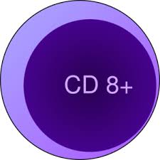
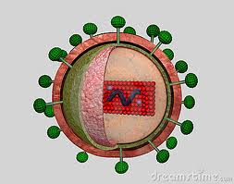
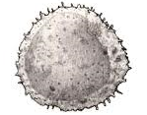
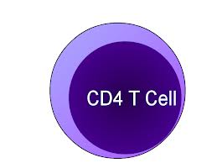
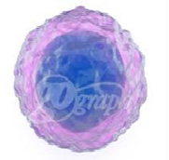
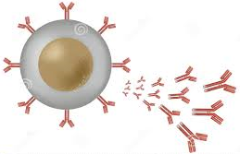
A novel hypothesis for pathophysiology of HIV-1
CD8 try to outcome the HIV and exhausted from long standing activation
Abs inhibits the CD4 T- cell
Lyses of CD8 and aging Of CD4 T- cell
HIV-1 stimulate the B-cells
Plasma cells to produce Abs

Slide 6
. The HIV-1 antibodies
is our target
To stop its production
To paving the way for CD4 T-cell

Slide 7
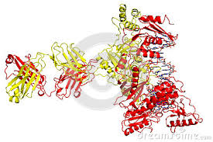
Our combination: VK 25 RD In Vial form 6 ml a liquid pharmaceutical compositions comprise 120 units of both 1-AMV RT (Avian Myeloblastosis Virus ) 2-DNA polymerase in specific acceptable pharmaceutical organic solvent
1-RT HIV-1 enzyme is an essential part of the virus.

Slide 8
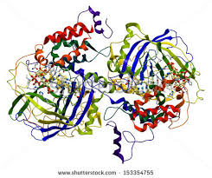
2- DNA, polymerases
Why we use these components ?

Slide 9
1- Generation of cross reactive antibodies to inhibit the reverse transcriptase (RT) of human immunodeficiency virus type-1(HIV-1)

Slide 10
Novel role for DNA polymerases
In immune cells
remodeling and regulation.

Slide 11
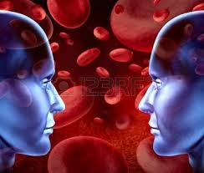
1-Materials and Methods
10 patients (3 female and 8 male) were eligible for inclusion in this study if they were between 5-40 years
Five patients take the treatment
[ Test group ]
Five who participated in the study by blood samples donates only
[ Control group ]

Slide 12
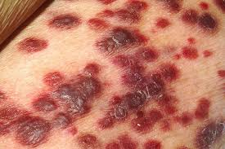
Patient’s inclusion criteria
1-All were positive for HIV antibodies and confirmed by (HIV-RNA-PCR) 2-having signs and symptoms of HIV. (Mild fever, weight loss, diarrhea, lymphadenopathy and opportunistic infections 3-were never having been treated with any antiretroviral drugs

Slide 13
Study site
This study applied between October 2011 and February 2014 in R & D center, (as a private center).
. All of them consented to take the therapy in the form of S/C injection two times daily for 24 weeks.

Slide 14
Consent for participation to taking a novel treatment for HIV.
This treatment under trails, not approved
The preclinical studies for this treatment (Toxicological study) are very save and there is no any unexpected side effects had been recorded.
I consent voluntarily to participate as a participant in this research, having the right that to withdraw from the research at any time without in any way affecting my medical care. I have read the foregoing information, or it has been read to me. I have had the opportunity to ask questions about it and any questions that I have asked have been answered for my satisfaction.
Name of Participant__________________
Signature of Participant ___________________
Date ___________________________
Day/month/year

Slide 15
Exclusion criteria
Patients were excluded if they had any chronic diseases (Diabetes, renal & liver affection, hypertension, cancer) or Hepatitis viral infection (HCV & HBV)

Slide 16
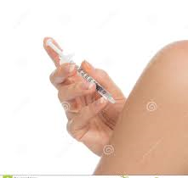
Injectable material
In Vial form 6 ml liquid pharmaceutical compositions

Slide 17
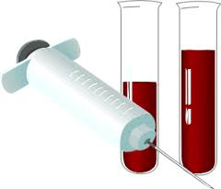
Serological testing
Ten blood samples were collected before the treatment and at week 6,12,18,24 from both groups and examined for the following Immunological tests
Quantitative HIV-PCR,
CD4 count
HIV antibody
Anti –RT AMV antibodies

Slide 18
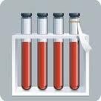
The aim of our trails
1-1 Detection of (Anti-RT AMV) monoclonal antibodies.
This test to prove that serum samples of all treated patients with the novel therapy formed anti-RT AMV Abs

Slide 19
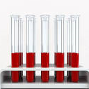
Test group
Control group
Serum sample
Serum sample
Serial dilution was made0.2,0.4,0.8,1.6 and 3.2 for every serum sample of both groups at week 6,12,18 and 24.

Slide 20
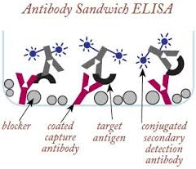
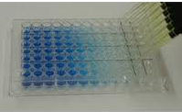
100 u from every dilution was added to coated well
Elisa wells was coated with 1 ug/ml RT-AMV
To allow for Ag & Abs reaction
Conjugate was added
Addition of substrate
Reading the wells with autoreader
Detection of Anti-RT AMV Antibodies in serum diluted samples of both groups

Slide 21
1-2 Determine the inhibitor
effect of Anti-RT AMV on
RT HIV-1 biological activity

Slide 22
100 u +200 u
G1
Test group
Control group
100 u +200 u
G2
Serial dilution for specific Abs to Rat-HIV-1
1-2 Determine the inhibitor effect of Anti-Rt AMV on RT HIV-1 biological activity

Slide 23
To confirm that:
1- serum samples of test group has an anti-RT Abs to AMV-RT .
2- This Abs has the ability to bind the RT-HIV-1 by cross reactivity and can stop it's biological activity.
3-also to confirm that specific anti-RT HIV-1 has not able to stop the HIV-1 RT in serum sample of control group that not treated with the novel therapy.

Slide 24
Results
We collected the results of all immunological data before starting the treatment regimen and during week 6, 12, 18 and 24 to comparing the difference .

Slide 25
It showed surprisingly
A- undetectable viremia
(reference range < 16 copies/ml).
B- significant elevation in
CD4+ T-lymphocytes above 500 cells/ml .
C- HIV antibodies by enzyme-linked immunosorbent assay (ELISA) testing were negatives for about 4 patients from 5.

Slide 26
Patients clinical presentation:
The patients reported a significant improvement of their clinical picture, and the constitutional symptoms of HIV infection (AIDS) :
No diarrhea , disappearance of muscle ache and opportunistic infection, weight gain and no notable lymph nodes beside marked improvement of the psychological conditions

Slide 27
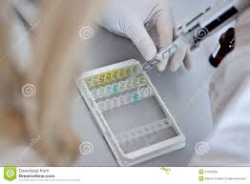
1-1 serological test reports
For formation of neutralizing mAbs to AMV RT enzyme during week 6, 12, 18 and 24.

Slide 28
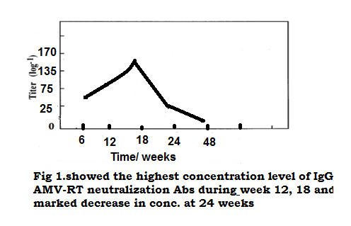
Fig 1. Show the increasing in the concentration level of neutralizing Abs at 12, 18 and marked decrease in his level at 24, 48

Slide 29
Successful test of the hypothesis
Comparing the results of
(HIV-RNA-PCR),
Of test group ( G 2)
Specific mAbs to HIV-1 RT Sample( G 1)

Slide 30
Follow up: after 48 weeks
All volunteers are physically and psychologically good and their immunological data still give below detection limits by HIV-1 RNA –PCR,HIV-1 Abs negative and CD4 T-cell over 600 cells/μL

Slide 31
Table 1. immunological tests for all patients before treatment. (Test group include patients from (X1-X5)
(Control group from X6- X10)
parameters | X1 | X2 | X3 | X4 | X5 | X6 | X7 | X8 | X9 | X10
CD4 | 270 | 315 | 180 | 170 | 150 | 340 | 303 | 178 | 349 | 213
PCR | 92.000 | 105.000 | 470.000 | 4300 | 315.000 | 367.000 | 4.000 | 34.000 | 1.900 | 24.000
HIV Ab | +ve | +ve | +ve | +ve | +ve | +ve | +ve | +ve | +ve | +ve
Wt | 67 | 62 | 79 | 77 | 71 | 58 | 64 | 67 | 28 | 25

Slide 32
Table 2. 6 weeks after the beginning of the treatment.
parameters | X1 | X2 | X3 | X4 | X5 | X6 | X7 | X8 | X9 | X10
CD4 | 430 | 400 | 455 | 670 | 340 | 430 | 290 | 201 | 231 | 240
PCR | 2300 | -ve | 4000 | -ve | 32.000 | 210.000 | 1.200 | 18.000 | -ve | 6.000
HIV Ab | +ve | +ve | +ve | +ve | +ve | +ve | +ve | +ve | +ve | +ve
Wt | 66 | 66 | 78 | 70 | 70 | 56 | 62.4 | 61 | 27 | 24

Slide 33
Table 3. 12 weeks after the beginning of the treatment
.
parameters | X1 | X2 | X3 | X4 | X5 | X6 | X7 | X8 | X9 | X10
CD4 | 570 | 560 | 600 | 650 | 800 | 390 | 460 | 210 | 223 | 255
PCR | -ve | 4.000 | -ve | -ve | -ve | 128.000 | -ve | 2000 | -ve | 450
HIV Ab | +ve | +ve | +ve | +ve | +ve | +ve | +ve | +ve | +ve | +ve
Wt | 71 | 64.5 | 83 | 70.4 | 73 | 55 | 65 | 59 | 26.3 | 25.7

Slide 34
Table 4: After18 weeks from the beginning of treatment, these tests are done for all patients,
Parameters | X1 | X2 | X3 | X4 | X5 | X6 | X7 | X8 | X9 | X10
CD4 | 540 | 530 | 780 | 610 | 670 | 500 | 340 | 190 | 240 | 310
PCR | -ve | -ve | -ve | 1.620 | 1.300 | 12.000 | -ve | -ve | -ve | -ve
HIV Ab | +ve | -ve | -ve | +ve | +ve | +ve | +ve | +ve | +ve | +ve
Wt | 73 | 65 | 82 | 71 | 71 | 58 | 63 | 58 | 25 | 23

Slide 35
Table 5: 24 weeks from the beginning of the treatment.
Parameters | X1 | X2 | X3 | X4 | X5 | X6 | X7 | X8 | X9 | X10
CD4 | 810 | 670 | 760 | 665 | 700 | 278 | 300 | 300 | 320 | 400
PCR | -ve | -ve | -ve | -ve | -ve | -ve | -ve | -ve | -ve | -ve
HIV Ab | -ve | -ve | -ve | Equivocal | Slightly +ve | +ve | +ve | +ve | +ve | +ve
Wt | 73 | 64 | 82.2 | 70.2 | 68 | 55 | 62 | 60.5 | 23 | 25
CD4 normal range:350-500 cells/μL

Slide 36
Conclusion Recent Treatment:
The recent trend of treating HIV/AIDS is to combine at least three drugs from two different classes , these classes include :
1- non-nucleoside reverse transcriptase inhibitors (NNRTIs )
2-nucleoside reverse transcriptase inhibitors (NRTIs), protease inhibitors (PIs),
3-fusion inhibitors and integrase inhibitor .

Slide 37
The side effects of these drugs are remarkable. They never lead to complete cure whatever the time they take but they aim to
ameliorate the clinical picture,
increase CD4 cell count
decrease the viral load.

Slide 38
But when we Stop the treatment the HIV-1 spread again and more CD4 T-cell infections.

Slide 39
. At the present time there is a need for new drugs .
The results described in this study
support our hypothesis.

Slide 40
This study introduces a new strategy for HIV (AIDS) cure differing from all conventional methods .

Slide 41
.Our medication (VK 25 RD)
once become available
it will be a promising
life saving drug
this is a world dream for the last three decades

Slide 42
So we emphasize that a further
extended and tedious study is needed
to evaluate the
benefits and values of the compound

Slide 43
Thank you

