Slide 1
Illiteracy and Utilization of Breast Cancer Screening : A Case Study of Saudi Women over 60 Years of Age
Shareef Alqahtani, MBBS, MPH
Surgery Resident at KFSH-Dammam
(@ShareefQahtani)

Slide 2
Disclosure
None

Slide 3
SA Population Size (2014)*
Total Population 29 million
TFR is about 3.1, BR 23/1000 population
Male: Female LE 74:78 years
40.2 million by 2025
* World Bank. World Databank: World Development Indicators (1960 - 2014). 2014 04/13/2015]; Available from: http://databank.worldbank.org/data.

Slide 4
Introduction
Female population > 60 years: 7%
65 to 70% are illiterate
Health indicator: facing challenges
One of the important health care needs is cancer-screening

Slide 5
BC in Saudi Arabia *
22.4/100,000 (the most common)
One in every 4 cases
Presentation: Advanced stages
No national screening programs
Dependent on education campaigns
Younger women > better health literacy
* Al Diab A, Qureshi S, Al Saleh K., Al Qahtani F, Aleem A, Alghamdi M, Alsaif A, Bokhari A, Qureshi V, Qureshi M. Review on Breast Cancer in the Kingdom of Saudi Arabia. Middle-East Journal of Scientific Research 14 (4): 532-543, 2013.

Slide 6
Objective
To determine if illiteracy among Saudi women over 60 years of age affect utilization of breast cancer screening (CBE & Mammography)?

Slide 7
Data
Saudi Elderly National Survey (SENS)
To assess the health needs for > 60 years
Cross sectional population based, MOH
Sample size was calculated for cluster sampling adjusted for DE and non-response
A RCST using probability to proportion to size to select participants

Slide 8
Methodology
Analysis: survey command in STATA 13.1
Sampling design and weight
Logistic regression with binary outcome, adjusted for age, income, region & comorbidities

Slide 9
Results
1461 women were eligible
1328 (88%) were illiterate
Regression(multivariate) showed a statistical significant effect of illiteracy on the utilization of breast cancer screening (OR=0.54, 95% CI: 0.30- 0.97, p= 0.038)

Slide 10
Table 1. Participates Characteristics
 | Illiterate | Not illiterate
 | n= 1328 (88.2%) | n= 133 (11.8%) | P-value
Age (years) |  |  | <0.001
60-65 | 430.91 (41.38) | 85.8 (65.34)
66-70 | 220.71 (21%) | 18.48 (14.01)
71-75 | 147.14 (14.13) | 21,12 (16.10)
76-80 | 115.61 (11.37) | 5.01 (3.84)
81-85 | 63.06 (5.95) | 1.32 (0.71)
86-90 | 31.53 (3.25) | 0%
>90 | 22.59 (2.15) | 0%
Monthly Income (SR) |  |  | <0.001
>10000 | 399.2 (3%) | 32.6 (14%)
7,500-9,999 | 322.4 (2%) | 25.4 (3%)
5,000-7,499 | 170.4 (5%) | 30.2 (13%)
2,500-4,999 | 108.4 (17%) | 40.8 (24%)
<2,500 | 50.6 (73%) | 3 (45%)
Comorbidities
DM | 133.5 (56%) | 14.3 (63%) | 0.4059
HTN | 98 (33%) | 9.3 (23%) | 0.7736
IHD | 56 (11%) | 6.4 (14%) | 0.0853
Note: Sample size varies across different variable because of incomplete/missing data. Survey weight was used in our calculation. Multiple imputation was used for missing data

Slide 11
Table 2. Regression Model
 | Univariate Analysis (Unadjusted) |  | Multivariate Analysis (Adjusted)
 | OR (95% CI) | P Value | OR (95% CI) | P Value
Illiterate | 0.58(0.33-1.02) | 0.056 | 0.54 (0.30- 0.97) | 0.038*
Age
60-65 | Ref. |  | Ref.
66-70 | 1.05 (0.63- 1.72) | 0.854 | 1.35 (0.78-2.34) | 1.36
71-75 | 1.36 3(0.71 -2.54) | 0.356 | 1.45 (0.81- 2.73) | 1.49
76-80 | 1.142 (0.64- 2.04) | 0.65 | 1.52 (0.79- 2.85) | 1.49
81-85 | 0.54 (0.18- 1.61) | 0.266 | 0.88 (0.31- 2.48) | 0.88
86-90 | 0.67 (0.149- 2.98) | 0.593 | 0.50 (0.07- 3.44) | 0.51
>90 | 2.027 (0.59- 6.95) | 0.257 | 2.99 (0.79- 11.22) | 2.99
Monthly Income
>1000 | Ref. |  | Ref.
9,999-7,500 | 0.65 (0.11-3.88) | 0.635 | 0.72 (0.11- 4.97) | 0.72
7,499-5,000 | 0.71 (0.31-1.61) | 0.405 | 0.71 (0.29- 1.70) | 0.71
4,999-2,500 | 0.51 (0.18-1.39) | 0.185 | 0.54 (0.18- 1.67) | 0.54
<2,500 | 0.44 (0.16-1.24) | 0.12 | 0.54 (0.18- 1.65) | 0.55
Comorbidities
DM | 1.89 (0.95-3.76) | 0.07 | 1.89 (0.91- 3.91) | 1.89
HTN | 1.20 (0.64- 2.27) | 0.57 | 0.96 (0.53- 1.72) | 0.96
IHD | 1.64 (0.48- 5.60) | 0.42 | 0.98 (0.25- 3.83) | 0.98

Slide 12
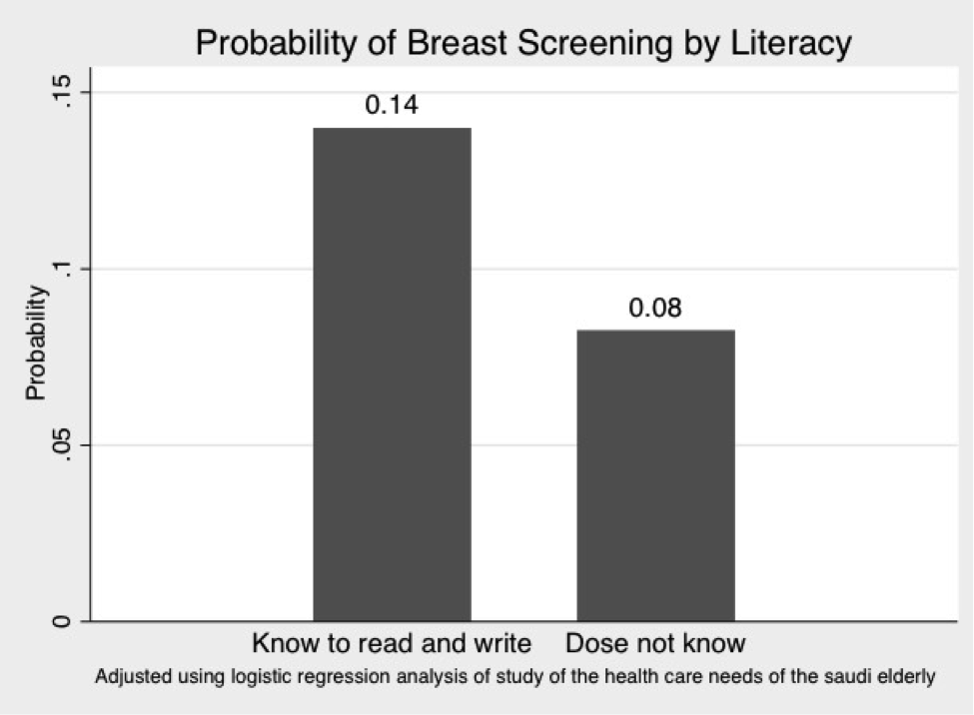
Adjusted Probability

Slide 13
Conclusion
Illiteracy among Saudi women over 60 years of age may contribute to low level utilization of breast cancer screening

Slide 14
Recommendations
For the first time
Health initiatives for women > 60 years should include (+/-) illiteracy as a factor that might interfere with improving health of elderly women
Age is a major risk factor, all women over 50 years should be screened
Future studies to assess illiteracy effect on health

Slide 15
Acknowledgments
Johns Hopkins Surgery Center for Outcomes Research (@JSCOR)
Dr. Melissa Camp
KFSH-Dammam (@KFSHDammam)

Slide 16
References
Central Department of Statistics and Information,General statistics. Riyadh, Saudi Arabia, Ministry of Economy and Planning, 2013. http://www.cdsi.gov.sa/english.
Sait WA, Al-Amoudi SM, Tawtai DA, Abduljabbar HS. The knowledge of breast cancer among young Saudi females. Saudi Med J. 2010 Nov;31(11):1242-4.
Koriech, O.M. and R. Al-Kuhaym, 1994. Profile of cancer in Riyadh Armed Forces Hospital. Annals of Saudi Medicine, 14: 187-94.

