Slide 1
The Incidence and Influencing factors of functional disability in Chinese Patients with Rheumatoid Arthritis
West China School Of Nursing, West China Hospital, Sichuan University, China
Shangping Zhao，Yanling Chen, Hong Chen
Notes:
Good morning， Ladies and gentleman。 I’m shangping zhao, a nursing graduate student in my second year.I come from west china school of medicine, west china hospital, sichuan university. It is my honor to be here and share our team’s work with you. Today my topic is the incidence and influencing factors of functional disability in Chinese patients with rheumatoid arthritis.

Slide 2
Contents
Background
Purpose
Methods
Results
Conclusions
Notes:
I will introduce my topic from background, purpose,methods, results, and conclusion

Slide 3
Background
Rheumatoid Arthritis: RA
A chronic, autoimmune and Invasive arthritis
Immortal tumor:
Disability，Discomfort，Dollar cost，Drug toxicity，Death
Notes:
Rheumatoid Arthritis is a chronic, autoimmune and Invasive arthritis. It was regarded as immortal tumor, including disability, discomfort, dollar cost, drug toxicity and death

Slide 4
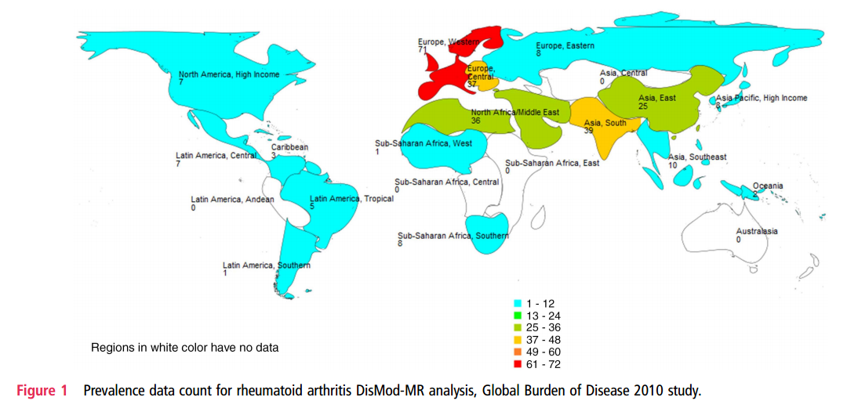
0.42%, 5400 000
Cross M. Smith E. Hoy D. et al. Annals of the Rheumatic Diseases. 2014,73(7):1316-22.
Zeng XF. et al. Chinese Journal of Evidence-based .2013,13 (3): 300-7.
Notes:
This map is showing the global burden of RA in 2010. the prevalence of the east asia is 0.25%-0.36% . The prevalence of China is 0.42%, it means 5.4 million person who was suffering from RA.

Slide 5
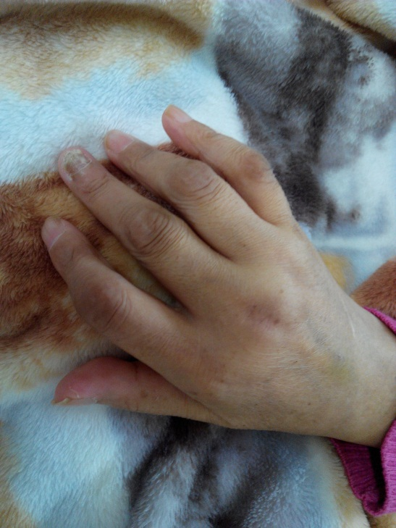
Background
Morning stiff
Pain
Tender
Swelling
Functional disability rate: 20% in 1 year, 60% in 10 years
Ding YM, et al. Shanghai Journal of Preventive Medicine.2000, 12 (10):489-90
Notes:
the most common symptom was seen on joints, such as morning stiff, pain , swelling and tender. AS the disease progresses, functional disability was seen common in RA.one study show functional disability could reach up to 20% in 1 year, 60% in 10 years.

Slide 6
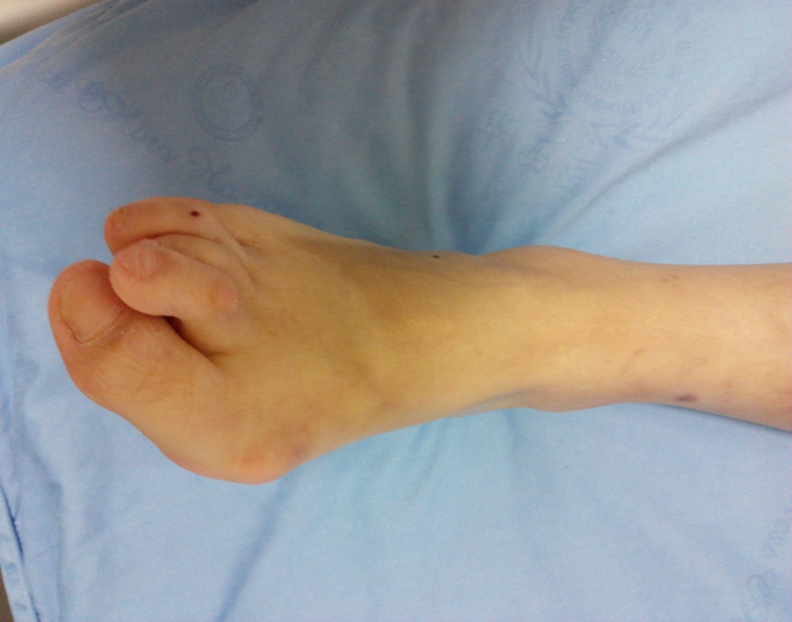
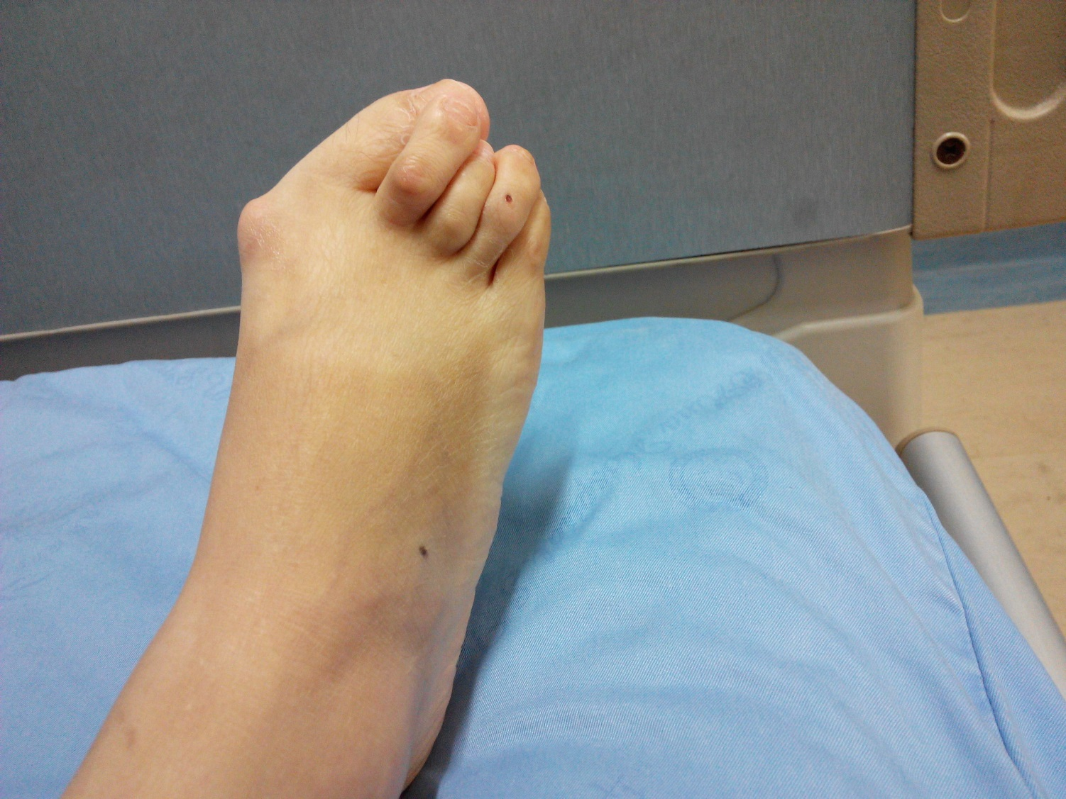
functional disability--feet
2 years
Notes:
This is a 2 year duration patients, because of her deformed feet, she cannot walk for a long time.

Slide 7
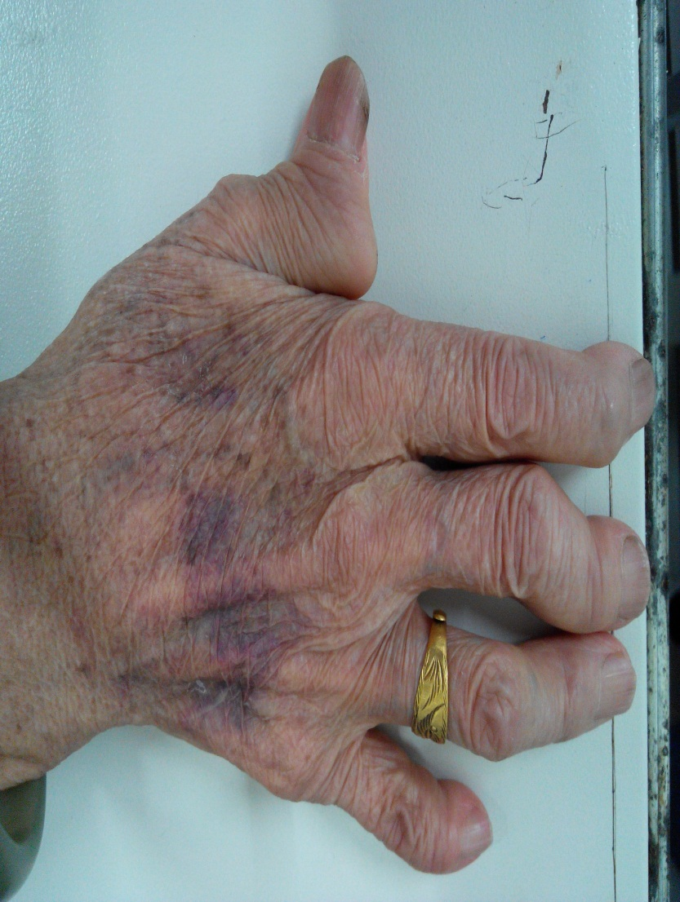
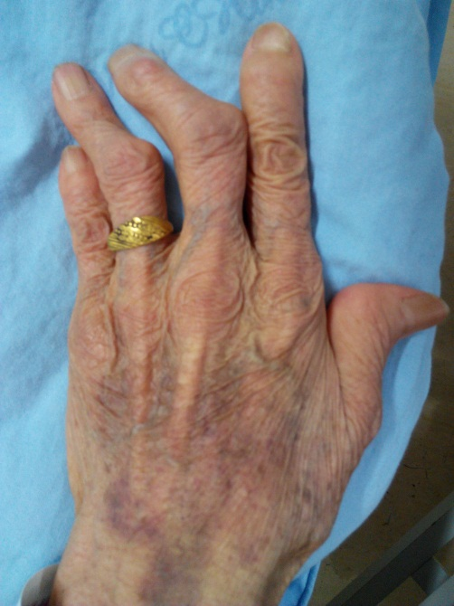
functional disability--hands
>20 years
Notes:
This is a more than 20 years duration patient, she even cannot open a bottle by her fingers. Functional disability directly reduced RA patients’ activities and decreased the quality of life. so If we nurses know where we can intervene, maybe we could do some help for patients.

Slide 8
Purpose
Investigate the incidence of functional disability in Chinese patients with RA
Analyze influencing factors of functional disability in Chinese patients with RA
Provide reference for intervention on functional disability of RA
Notes:
Based on the background, our purpose is to investigate the incidence and analyze influencing factors of functional disability in Chinese patients , and in order to provide reference for health education.

Slide 9
Methods
A cross-sectional survey
Convenience sampling in Rheumatic Outpatient in West China Hospital
September to December 2013
Demographic data，social support，pain， fatigue， functional disability
Notes:
Our study was a cross-sectional survey, using convenience sampling in rheumatic outpatients in west china hospital. We implemented in September to December in 2013.and collected Demographic data，social support，pain， fatigue， functional disability.

Slide 10
measurements -1
Demographic data
age
gender
marital status
education level
residence
family monthly income per capita (FMIPC)
medical payment forms
disease duration
hospitalized times
total cost of treatment (TCT)

Slide 11
measurements -2
Social support
Social Support Rating Scale，Higher scores indicate more social support
Pain, fatigue
Visual Analog Scale
Functional disability
Health Assessment Questionnaire-Disability Index (HAQ-DI)，Higher score of HAQ-DI indicates more damage of physical function

Slide 12
Results-1
Statistical description
607 of 653 participants
Notes:
We had 607 questionnaires completely. All analysis were included 607 participants.81% were female, 88% were married.

Slide 13
Statistical description
Notes:
36% were the primary school or below of educational level , 34% were the junior high school of educational level.44 % came from rural residence.

Slide 14
Statistical description
Notes:
40% only had the income less than 1000 a month, but 59% should pay their treatment all by themselves.

Slide 15
Statistical description
Variables | Mean±SD or Median | Range
Age (years) | 50 | 18, 88
Disease duration（month） | 50 | 1, 492
VAS of Pain | 5.25 ± 2.91 | 0, 10
VAS of Fatigue | 4.15 ± 2.87 | 0, 10
Social support rating scale | 40.67 ± 7.68 | 20, 58

Slide 16
Statistical description
 | Mean | SD
HAQ-DI | 0.665 | 0.675
dressing and grooming | 0.679 | 0.788
arising | 0.539 | 0.695
eating | 0.479 | 0.719
walking | 0.565 | 0.719
hygiene | 0.720 | 0.862
reaching | 0.997 | 1.039
gripping | 0.651 | 0.779
other activities | 0.687 | 0.792

Slide 17
Statistical description
58.5% of patients had functional disability.
Notes:
Mild, moderate and severe of functional disability was 42.7%, 7.1% and 8.7%, respectively

Slide 18
Results-2
Univariate analysis
Variable | HAQ-DI | P
Gender | t=1.386 | 0.166
Marital status | F=1.500 | 0.213
Education level | F=15.682 | <0.001
Residence | F=12.647 | <0.001
FMIPC (Yuan) | F=10.364 | <0.001
Medical payment forms | F=0.992 | 0.189
FMIPC:family monthly income per capita

Slide 19
Univariate analysis
 |  | HAQ-DI
Education level | Primary school or below | 0.86 ± 0.68 | F=15.682 | <0.001**
 | Junior high school | 0.66 ± 0.68
 | Senior high school | 0.51 ± 0.63
 | College or above | 0.30 ± 0.44
Residence | Urban | 0.49 ± 0.64 | F=12.647 | <0.001**
 | Suburban | 0.71 ± 0.70
 | Rural | 0.79 ± 0.67
family monthly income per capita (Yuan) | <1000 | 0.79 ± 0.64 | F=10.364 | <0.001**
 | 1000-2000 | 0.70 ± 0.71
 | 2000-3000 | 0.62 ± 0.74
 | >3000 | 0.36 ± 0.49

Slide 20
Table 3 Multivariate regression of functional disability of patients with rheumatoid arthritis（N=607, Adjusted R2=0.384）
Included variables | B | P | 95% Confidence internal (95%CI)
Suburban | 0.125 | 0.047* | 0.002,0.248
Rural | 0.154 | 0.006* | 0.045,0263
Age | 0.012 | <0.001** | 0.009, 0.016
Disease duration | 0.000 | 0.007* | 0.000, 0.001
Hospitalized times | 0.025 | 0.001* | 0.011, 0.039
Overall cost for treatment | 0.002 | <0.001** | 0.001, 0.002
Pain | 0.094 | <0.001** | 0.079, 0.109
Subjective social support | -0.019 | <0.001** | -0.028, -0.010
Available social support | -0.024 | 0.019* | -0.044, -0.004

Slide 21
Results-Multivariate regression
Adjusted R²=0.384
Pain, age, disease duration, total cost for treatment and hospitalized times was negative factors
Subjective and available social support was positive factors

Slide 22
Conclusion
Functional disability is a common symptom in our study.
When providing patient education, nurses should consider more about patients with RA who live in rural residence, have a low level of income and education and long disease duration.
Pain management with a sound social support system is a possible good intervention

Slide 23
Thank you
for your attention !

