Slide 1
About OMICS Group
OMICS Group International is an amalgamation of Open Access publications and worldwide international science conferences and events. Established in the year 2007 with the sole aim of making the information on Sciences and technology ‘Open Access’, OMICS Group publishes 400 online open access scholarly journals in all aspects of Science, Engineering, Management and Technology journals. OMICS Group has been instrumental in taking the knowledge on Science & technology to the doorsteps of ordinary men and women. Research Scholars, Students, Libraries, Educational Institutions, Research centers and the industry are main stakeholders that benefitted greatly from this knowledge dissemination. OMICS Group also organizes 300 International conferences annually across the globe, where knowledge transfer takes place through debates, round table discussions, poster presentations, workshops, symposia and exhibitions.

Slide 2
About OMICS Group Conferences
OMICS Group International is a pioneer and leading science event organizer, which publishes around 400 open access journals and conducts over 300 Medical, Clinical, Engineering, Life Sciences, Phrama scientific conferences all over the globe annually with the support of more than 1000 scientific associations and 30,000 editorial board members and 3.5 million followers to its credit.
OMICS Group has organized 500 conferences, workshops and national symposiums across the major cities including San Francisco, Las Vegas, San Antonio, Omaha, Orlando, Raleigh, Santa Clara, Chicago, Philadelphia, Baltimore, United Kingdom, Valencia, Dubai, Beijing, Hyderabad, Bengaluru and Mumbai.

Slide 3
PPPM as a new model of and thus a unique tool in global restructuration of national and international healthcare services
Dr Sergey Suchkov, MD, PhD
Professor in Immunology & Medicine
I.M.Sechenov First Moscow State Medical University and
A.I.Evdokimov Moscow State Medical & Dental University,
Moscow, Russia
EPMA (European Association for Predictive, Preventive and Personalized Medicine),
Brussels, EU
Dr Olga Golubnitschaja, PhD
Professor in Medicine
Department of Radiology,
Rheinische Friedrich-Wilhelms-University of Bonn,
Bonn, Germany
EPMA (European Association for Predictive, Preventive and Personalised Medicine),
Brussels, EU

Slide 4
Over the course of its history, medicine has given special attention to the already diseased individual, focusing on a type of disorder (nosology) rather than on one’s health or the so-called pre-nosological (or pre-illness) conditions, the latter being left in the shade.
Those speculations along with latest advances in science and technology combined with worldwide practice and personal experience have led us to conclude that the key link in the modern healthcare strategy, namely, a link of predictive, preventive and personalized medicine (or PPPM) is missing.
The link, I would stress, that might exert reliable control over morbidity, mortality and disabling rates and significantly reduce the cost of treatment for those who had fallen ill.

Slide 5
To achieve the practical implementation of PPPM concept, it is necessary to create a fundamentally new strategy based upon the pre-early (subclinical) recognition of biomarkers of hidden imbalances and defects long before the illness clinically manifests itself.
This strategy would give a real opportunity to secure preventive measures whose personalization could have a significantly positive influence on demographics! (next Fig)

Slide 6
Impacts to be assumed for
the practical implementation of
predictive biomarkers into PPPM
to predict the likelihood of developing disease
to estimate the length of the asymptomatic period
to provide predictive information about disease course, severity, and complications
to serve as a warning to avoid potential disease-triggering factors
identify high-risk individuals who might be suitable candidates for preventive intervention trials

Slide 7
PPPM as the big change to forecast, to predict and to prevent is rooted in a big and new science to be rooted from the achievements of genomics, proteomics, metabo-lomics and bioinformatics which are being implemented into the daily practice to secure visualizing of lesion foci that was previously unknown to clinicians (next two Figs)

Slide 9
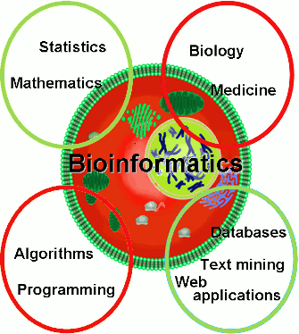

Slide 10
In reality,
Genomics
as a set of molecular tools
to probe genome and to thus identify and
to select genomic biomarkers
has allowed for identifying newer genes and newer genetic variations that affect health
to form subclinical and predictive risks
to be screened and unveiled, and then
the subclinical pathology to be diagnosed, monitored and terminated
to prevent illness (next two Figs)

Slide 11
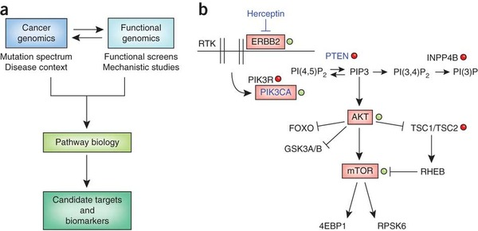
Genomic biomarkers and their impact into pathway-targeted cancer therapies
Routine sequencing of cancer genomes will identify many new genes that are involved in cancer;
Detailed mechanistic studies will be required to determine how these genes contribute to tumorigenesis and how they influence therapeutic efficacy
Genomic
biomarkers
Genomic
biomarkers
Genomic
biomarkers

Slide 12
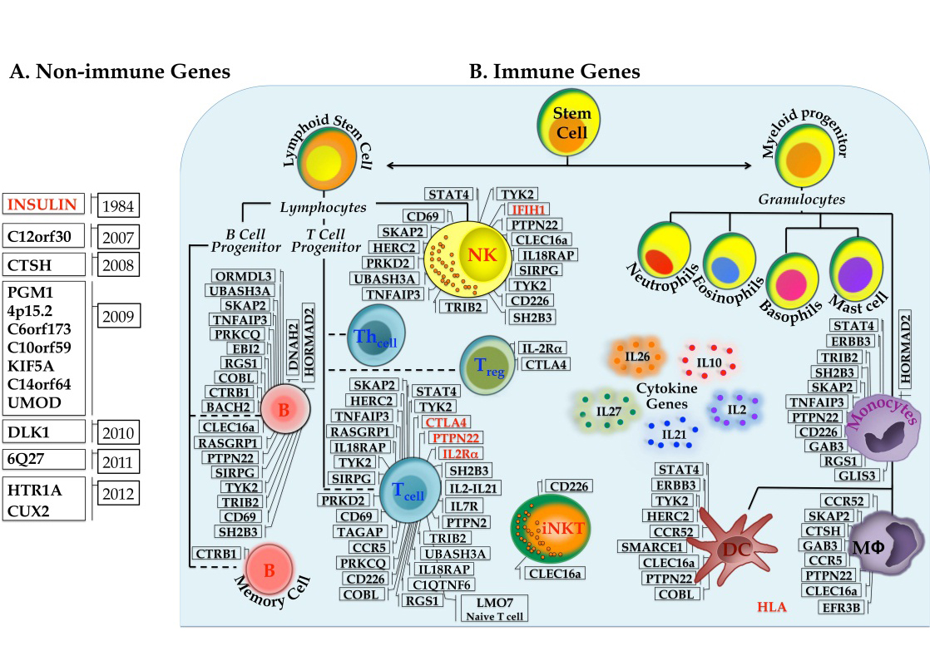
Autoimmunity-related genomic biomarkers
(interaction of T1D associated genes - gene networks)

Slide 13
As an allied portion of genomics and thus
an area of study to examine the impact of
genetic variations on the response to
medications is pharmacogenomics.
The latter is aimed at tailoring drug therapy at
a dosage that is most appropriate for
an individual patient, with the potential benefits of increasing the clinical efficacy and safety.
Pharmacogenomics will thus guide
therapeutic decisions and monitor the response
to therapy on one hand and
speed the development of novel therapeutics,
on the other one.

Slide 14
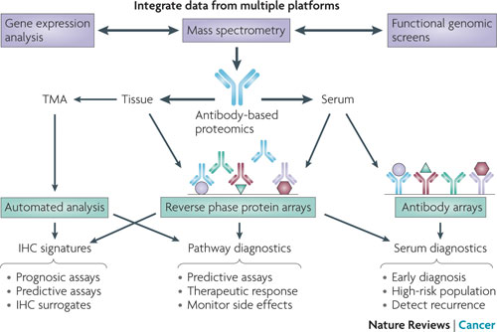
Well, genes
can say a lot about an individual’s predisposition
to a disease,
but cannot reveal
what is happening in cells at the protein level.
The latter would attribute to proteomics
to identify
individual proteins
and their epitopes
to be valuable for predictive diagnosing and thus may eventually have a great impact on PPPM
Predictive & Prognostic
Diagnosing
Predictive & Prognostic
Diagnosing
Predictive & Prognostic
Diagnosing

Slide 15
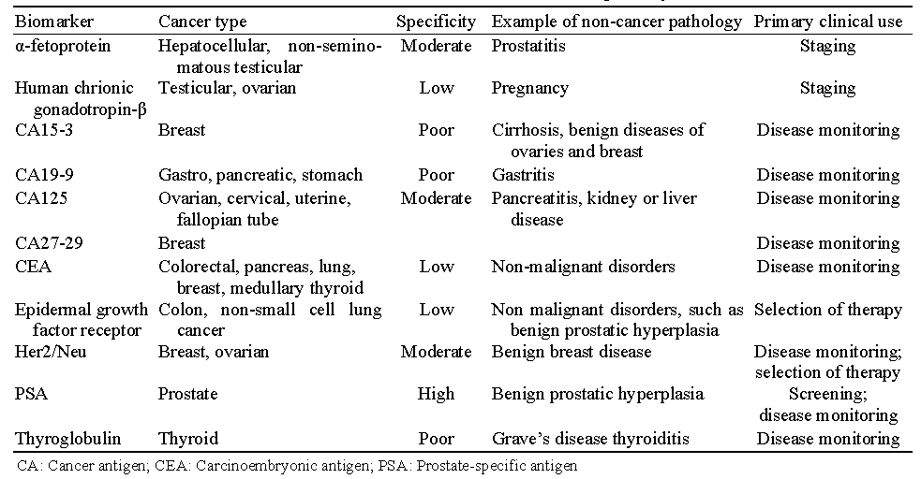
Proteomics, in turn, is the study of the proteins and protein pathways involved in a disease for identifying subclinical defects and imbalances suitable for preventive intervention using the appropriate proteins as biomarkers.
Among the latter are cancer- and autoimmunity-related biomarkers.
Autoimmune disorder | Autoantigen
Multiple sclerosis (MS) | Myelin basic protein (MBP), myelin oligodendrocyte glycoprotein (MOG) and others
Autoimmune myocarditis | Cardiac myosine
IDDM1 | Insulin, GAD-65
Graves disease (diffuse toxic goiter) | TSH receptor (TSHR)
Hashimoto’s thyroiditis (autoimmune thyroiditis) | Thyroid peroxidase (TPO), thyroglobulin (TG)
Systemic lupus erythematosus (SLE) | dsDNA
Rheumatoid arthritis (RA) | Citrullinated cyclic peptide, IgM

Slide 16
Meanwhile,
a combination of genomic and proteomic biomarkers
are becoming of great significance to predict risks of the chronization and thus of disabling since
chronic diseases are preceded by
a long subclinical (symptom-free) phase or
a period of latency
(next Fig)

Slide 17
A stepwise progression of autoaggression
Stage of subclinical autoaggression
Stage of
full-term autoaggression
Clinical illness
Subclinical (cryptic) latency
A stepwise (subclinical-clinical) course to be developed

Slide 18
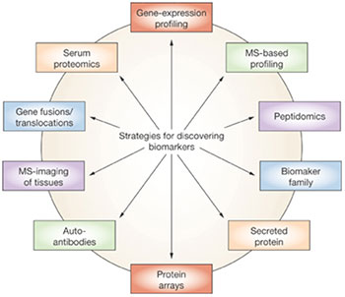
Genomic biomarkers
Proteomic
biomarkers
Genomic biomarkers
Proteomic
biomarkers
Proteomic
biomarkers
Proteomic
biomarkers
Next-
Fig. 32

Slide 19
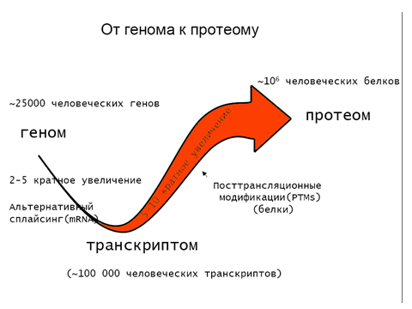
In reality,
proteomics per se is the continuation of functional genomics and, at the same time, a prologue to metabolomics
Genome Proteome
10⁶ human proteins
25,000 human genes
Proteome
Genome
Transcriptomic modifications
Posttranslational
modifications (PTMs) of proteins
Alternative splicing (mRNA)
Metabolome
Transcriptome

Slide 20
The latter (metabolomics) illustrates the functional state of the cell at the level of metabolism on a real time basis, requiring the use of the term 'metabolome', demonstrating a set of metabolic pathways in the cell at a given time point

Slide 21
Tissue-derived information
we would accumulate might be combined with the:
● individual's medical records;
● family history;
● data from imaging;
●instrumental and laboratory tests
to develop
personalized and preventive treatments.
But, in this sense, how is the whole databank provided by omics-technologies
could be comprehended?

Slide 22
It is bioinformatics
to suit the goal by applying mathematical modeling techniques to thus secure constructing and maintaining unified biobanks and databanks necessary for personal health monitoring based on principles of
genotyping and phenotyping.
As a result, the patient becomes a data carrier, whilst learning about possible risks of a disease,
and the physician can reasonably select a kind of preventive and personalized protocol
rooting from the predictive assays made
(next two Figs)

Slide 23
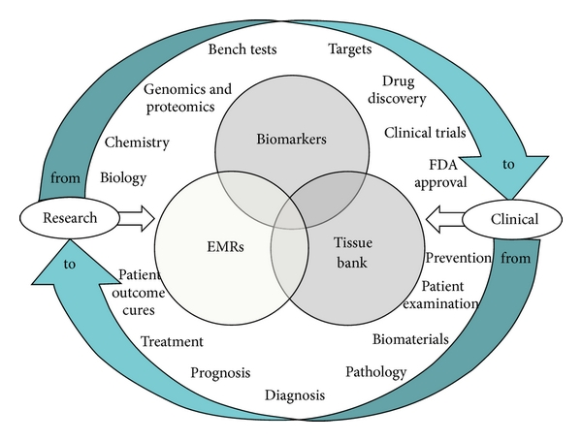
Bioinformatics
would service PPPM
The diagram shows the integrated “knowledge environment” that enables clinicians to query critical information from across disparate data sources to find relationships between an individual patient’s EMR information of persons-at-risk family records

Slide 24
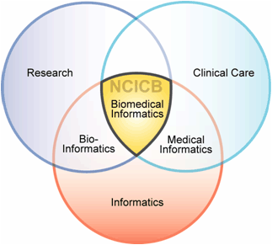
By integrating bioinformatics and clinical informatics,
both offers unique infrastructure, tools, techniques and applications
to bridge those areas.
This facilitates the sharing of data and information across diverse disciplines and professional sectors

Slide 25
Biobanks would provide
the proper information about patient's proteomic, genetic and metabolic profiles
to be used to tailor medical care due to
the individual's needs and personalized scenarios.
An understanding of the factors underlying
the burden of a disorder and later on
of the clinical illness
would provide policymakers, healthcare providers and medical educators with an opportunity
to guide preventive initiatives at both
individual and community levels (next Fig)

Slide 26
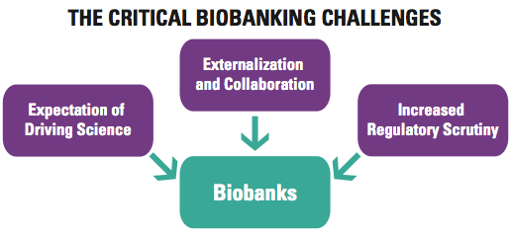
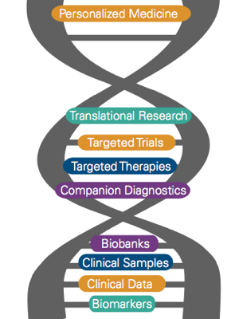
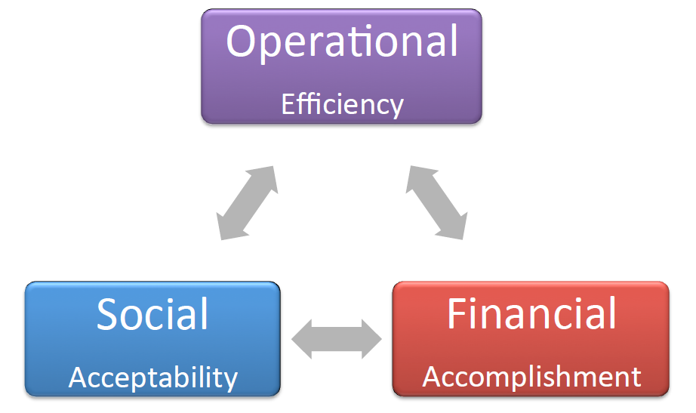
PPPM
Biobanking as applicable to PPPM
Impact on Sustainability in Three Main Dimensions of Biobanking

Slide 27
Well, two key objectives of PPPM are:
(i) screening for subclinical imbalances and defects with a pre-selection of suitable targets for the next step of PPPM protocol, i.e., drug-based prevention;
(ii) repair of the imbalances and defects mentioned to restore the function and to thus prevent
the clinical illness
PPPM is thus a model of healthcare services
being tailored to the individual and
dictates a construction of
PPPM-based algorithms
to diagnose, to predict, and to prevent in time!

Slide 28
● Predictive branch of PPPM is mainly designed
to meet the interests of healthy individuals,
its purpose being to determine
whether susceptibility to a particular disease
is increased or not.
●● Preventive branch is aimed at taking measures
to avoid development of clinical manifestations rather than cure or treat it on manifestation.
●●● Personalized medicine proposes the customization of healthcare, being tailored to the individual patient and/or to the person-at-risk
by the mutual integration of:
family history, medical records and other information including genomic, proteomic and metabolomic
biomarkers-based profiles
to be integrated via bioinformatics

Slide 29
PPPM thus uses diagnostic and predictive tests of newer generations based on biomarkers,
to individually determine the health conditions
a person is predisposed to and to reveal biomarkers of the probable or the already existing
pathological processes, and thus
to select the targets.
PPPM-oriented survey should be based on
biomarkers and algorithms to differ essentially from those employed in traditional clinical strategies, namely,
algorithms for predictive and subclinical diagnostics on one hand, and
(ii) algorithms for preventive therapy,
on the other one

Slide 30
Individuals, selected in the first stage, undergo
the second stage, which uses a panel of
phenotypic biomarkers, while monitoring every:
● potential patients,
● persons-at-risks predisposed to the disease,
and/or
● persons at subclinical stages of the disease.
By illustration and irrespective of the underlying mechanism, the proven predictive ability to accompany the diagnostic and
predictive tests has been documented for:
HLA-related biomarkers in combination with autoAbs and other biomarkers (e.g., cytokines, autoreactive CTLs, etc) to monitor chronic autoimmune inflammation (T1D, MS, SLE);
(ii) genomic biomarkers in combination with
cancer-associated antigens and other biomarkers (e.g., components of the signaling pathways defined) to monitor cancerogenesis

Slide 31
A strategy of preventive treatment
should contain, at least, two critical steps.
For chronic autoimmune and/or
infectious diseases:
quenching of autoagression or blocking the infectious process; and,
(ii) restoration of the tissue affected.
For cancerogenesis:
killing the malignancy and prevention of metastatic formation;
(ii) restoration of the primary tissue affected.

Slide 32
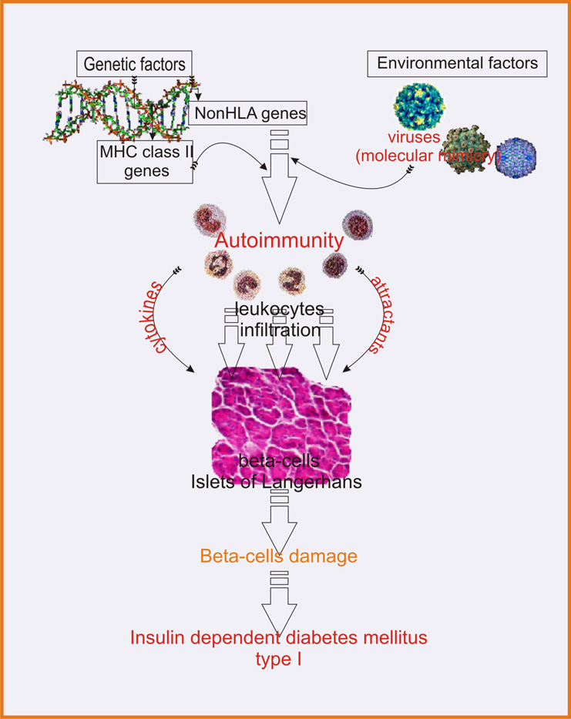
T1D is a chronic autoimmune inflammation comprising stages of subclinical pathology and clinical manifestations and resulting in a destruction of pancreatic beta-cells capable of producing insulin
Subclinical stage
T1D
Clinical stage

Slide 33
A stepwise development of T1D
Factors
to provoke
T1D
Population of β-cells
to function
T1D
clinical manifestations
Benign autoimmunity
(autoimmune insulitis)
Genetic predisposition
Pathogenic autoimmunity
(latent or asymptomatic
insulin deficiency
Clinical illness
НТГ
Glucose
intolerance
100% death of β-cells
Stage 1
Stage 2
Stage 3
Stage 4
Stage 5
Stage 6
A subclinical stage is characterized by depletion of β-cells and fall in insulin secretion levels to have a biased burst.
Clinical manifestations link to β-cell death to illustrate ceasing in insulin secretion.

Slide 34
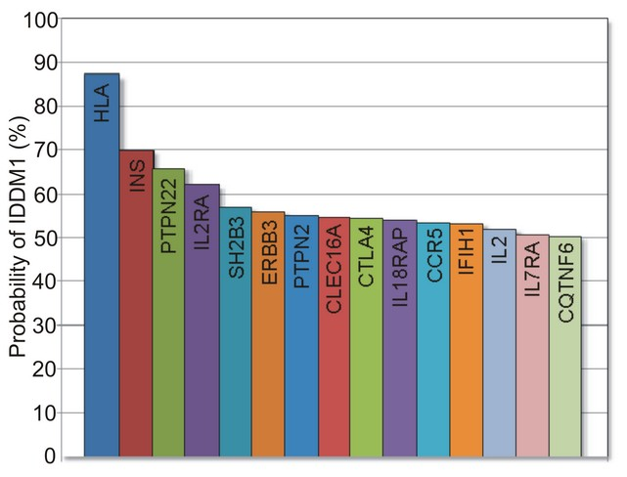
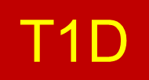
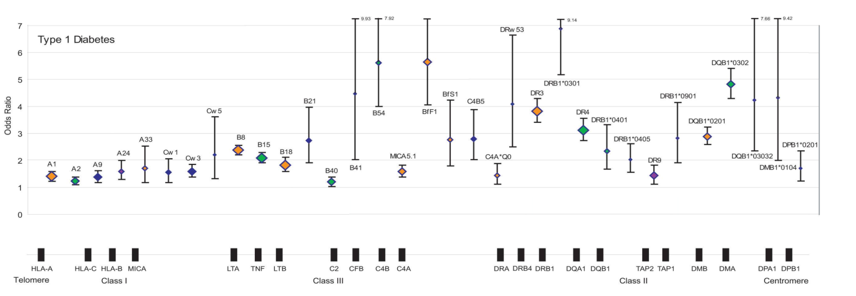
For this model, about half of the total risk is genetically predisposed, and
about half of the risk is in the HLA and other regions to be useful for
gene-based predictive testing!
HLA-I
HLA-III
HLA-II

Slide 35
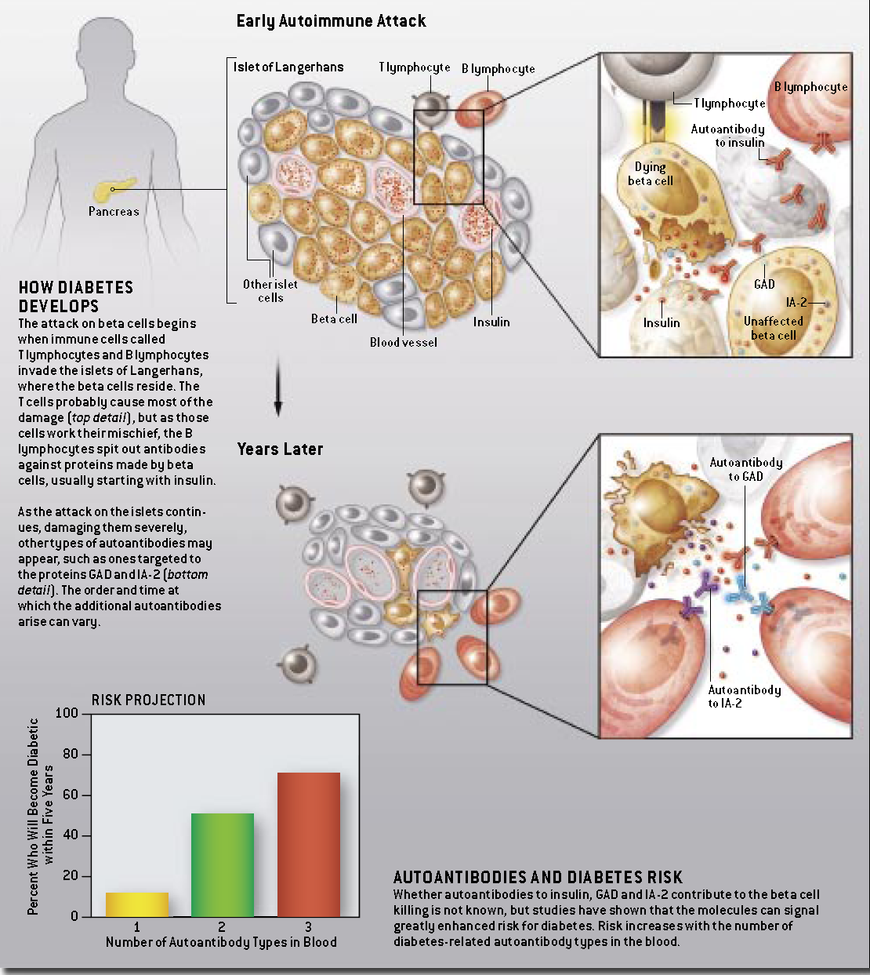
Subclinical stages are also determined by identification of
proteomic biomarkers, i.e., antiislet autoAbs as early as
5-10 years before the clinical onset of disease (Fig. 54)

Slide 36
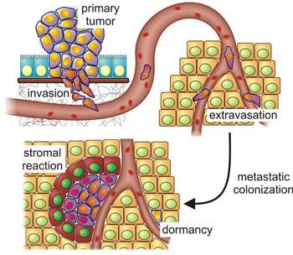
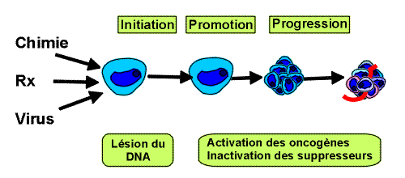
Tumor initiation is provided by oncogenic mutations and
inactivation of tumor-suppressor genes
and depends on the stepwise acquisition of specific functions by
cancer stem cells (CSC) and circulating tumor cells (CTCs) to be identified by
genomic tailoring approach on one hand and proteomic-immunonomic approaches,
on the other hand (Fig. 56)
Three different steps are described during cancerogenesis:
Initiation is a rapid and irreversible DNA lesion which occurs after exposure to a carcinogen (physical carcinogen, chemical carcinogen, viral carcinogen)
Promotion is due to prolonged, repetitive or continuous exposure to substances which maintain and stabilize the initiated lesion
Progression is the acquisition of non-controlled multiplication properties, independence acquisition, loss of differentiation, local invasion and metastasis

Slide 37
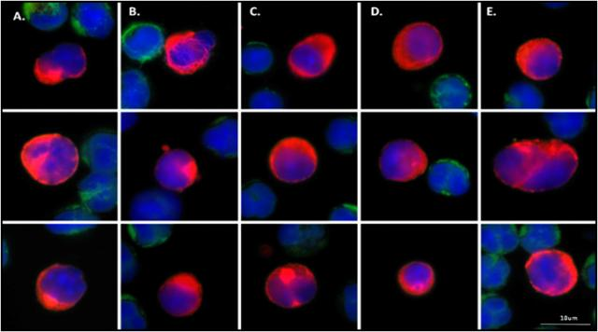
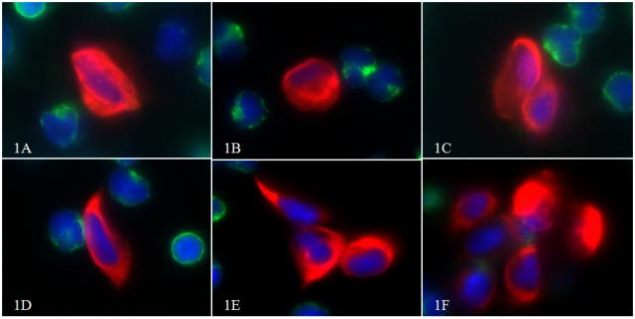
Colon cancer
Breast cancer
Lung cancer

Slide 38
PPPM is a new healthcare model that
notifies people of the health conditions
they’re disposed to and it reveals the biomarkers and thus the agents to improve and to thus secure the health and individual biosafety.
Meanwhile, implementation of PPPM would require the adjusted technology for proper interpretation of diagnostic and predictive data before
the current model “physician-patient”
could be gradually displaced by
a “medical advisor-healthy persons-at-risk” model.
This approach should be based on postulates which will change the incarnate culture and
social mentality.

Slide 39
First of all, it is the impact of human responsibility for the own health and for the health of
their children, and active involvement into
the preventive measures for strengthening of
the public health and country’s biosafety.
Secondly, a creation of legal basis to satisfy all society needs for the protection of individual health – regulations of the state insurance
in the PPPM.
And, thirdly, for sure, it’s necessary to radically change the system of medical training,
and designing novel approaches to build the
academic schools of new generations

Slide 40
Due to our viewpoint, all healthcare professionals of the future should be educated to deliver patient-centric care as members of interdisciplinary teams, emphasizing evidence-based practice,
quality improvement approaches and bioinformatics.
That concerns the need for novel training programs since the society is in bad need of large-scale dissemination of
novel systemic thinking and minding.
And upon construction of the new educational platforms
in the rational proportions, there would be not a primitive physician created but a medical artist to be able to enrich
flow-through medical standards with creative elements to gift
for a patient a genuine hope to survive but, in turn, for a person-at-risk – a trust for being no diseased.
So, the existing medical education would strongly need to be restructured to involve along with traditional graduate and
post-graduate training, pre-graduate preliminaries to disclose
for schoolchildren the mysteries of the evidence-based medicine and PPPM as the entity

Slide 41
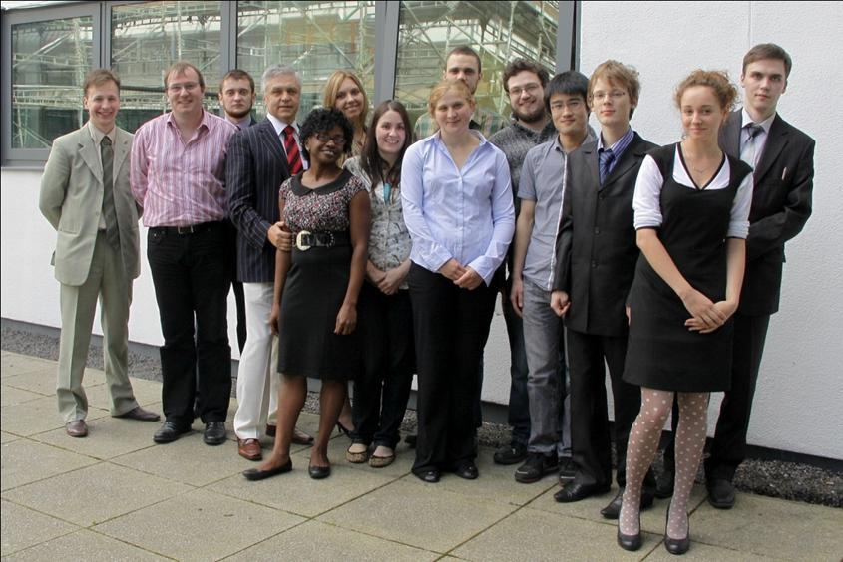
Based on current trends and own experience,
we have tried a
non-canonical approach towards reshuffling
the traditional educational tandem
“School-University”
to create a team of
talented and gifted teenagers to be engaged into PPPM-related areas.
The Team has been given
a roof under the aegis of
European Association of Predictive, Preventive and Personalized Medicine (EPMA), Brussels, EU,
and started up
to move ahead now
The First Anglo-Russian Students’ Workshop
on PPPM and Translational Medicine
Lancaster University
4th September 2012
Location: TR1/TR2 Gordon Manley building
Chairs: Professors Frank Martin, PhD (UK)
Director, Environmental and Biophotonics Center, and Chairman, Dept for Biochemistry, Lancaster University, UK
Professor Sergey Suchkov, MD, PhD (Russia)
Dept of Pathology, School of Pharmacy, I.M.Sechenov First Moscow State Medical University, and Dept of Clinical Immunology, Moscow State Medical & Dentistry University, First Vice-President and Dean, School of PPPM, University of World Politics and Law, Moscow, Russia

Slide 42
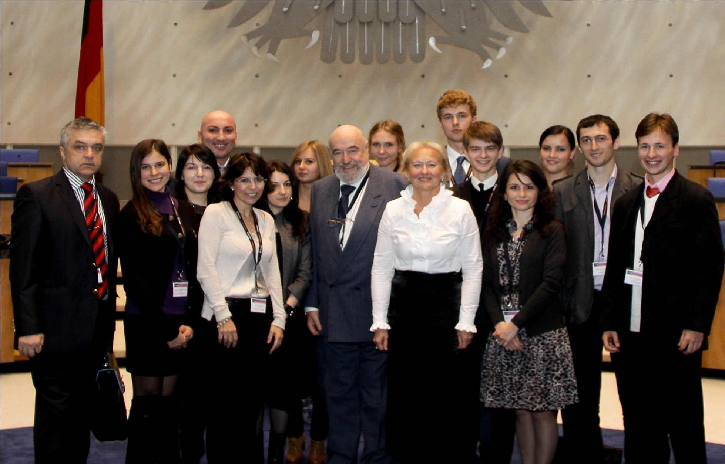
EPMA-World Congress 2011
September 15th19th, Bonn, Germany
International Research Team of Youngers

Slide 43
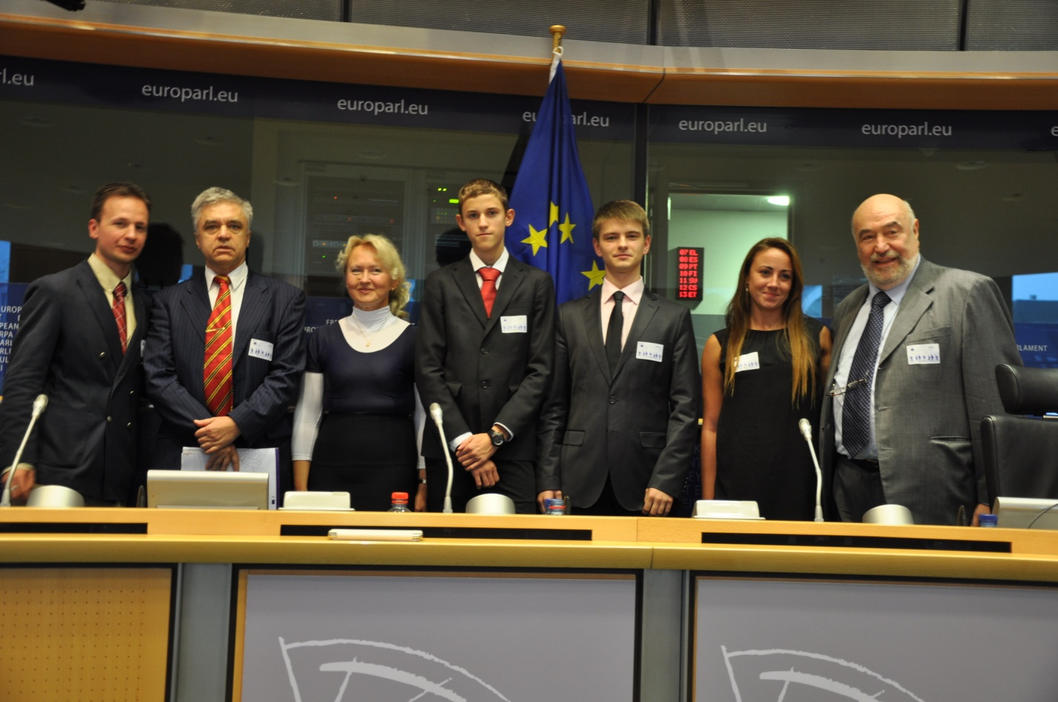
EPMA World Congress 2013
Europarliament, Brussels, EU, Sep 2013
Section For Young Professionals (Session)

Slide 44
Our global challenge is that
the new guidelines should create
the robust juristic and economic platforms for
advanced medical services utilizing
the cost-effective models of risk assessments followed by
tailored preventive treatments
focused on the precursor stages of
chronic diseases

Slide 45
Some comments:
Individuals to be under regular monitoring that helps to detect pathological shifts at subclinical stages
have a higher life expectancy and are able-bodied up to
8–15 years more than those under traditional treatment.
This means that the society would save more than
US$20,000–40,000 per person annually.
At the community level, the annual savings from each individual may vary from several thousands to several tens of thousands U.S. dollars.
In the area of oncology, for instance, the latter means that
as little as a 10 percent reduction in cancer
would translate into a savings of 4.4 trillion US dollars
to society.
As you might feel, besides the scientific and clinical challenges, there are economic hurdles.

Slide 46
The opportunity arises for unusual and, even extraordinary, strategic partnerships between:
► governments, academic and business sectors.
The healthcare industry, public policy sector, and consumer industries
will be required to develop
new and creative business models and products.
And, no doubt, next generations will speak about the XXI century as a time,
when medicine became
preventive and personalized, and its outcomes – predictive and guarantied.
http://biomarkers.conferenceseries.com/
http://biomarkers.conferenceseries.com/

Slide 47
Let Us Meet Again
We welcome you all to our future conferences of OMICS Group International
Please Visit: www.omicsgroup.com
www.conferenceseries.com
http://biomarkers.conferenceseries.com/

