Slide 1
Translational tools as applicable to autoimmune disorders: antibody-proteases as a generation of highly informative and unique biomarkers to monitor subclinical and clinical stages of demyelination in multiple sclerosis (MS)
Dr Sergey Suchkov, MD, PhD
Professor in Immunology & Medicine
I.M.Sechenov First Moscow State Medical University and
A.I.Evdokimov Moscow State Medical & Dental University,
Moscow, Russia
EPMA (European Association for Predictive, Preventive and
Personalized Medicine), Brussels, EU
ISPM (International Society for Personalized Medicine), Tokyo, Japan
PMC (Personalized Medicine Coalition), Washington, DC, USA

Slide 2
New preventive therapies for autoimmune and inflammatory diseases require
greater understanding of patient or
persons-at-risks subsets and the ability
to personalize targeted therapies for either of
those subsets.
To secure the promising future for the trend,
a key effort in the modern healthcare strategy
to implement PPPM (predictive, preventive and personalized medicine) into the practice
should have been made!
In this sense, the identification and application of diagnostic, predictive and prognostic biomarkers remains the holy grail of PPPM-related platforms, algorithms and protocols.

Slide 3
Biomarkers enable early diagnosis,
guide targeted therapy and monitor the activity and therapeutic responses across the diseases.
So, it is necessary to identify biomarkers of
newer generations and to create simultaneously
a fundamentally new strategy based upon
subclinical recognition of those biomarkers
long before the disease clinically manifests itself.
Among the best-validated predictive biomarkers are autoimmunity-related ones to predict risks of the chronization and thus disabling
since chronic autoimmune diseases are preceded
by a long subclinical (symptom-free) phase
(Fig 4-6).

Slide 4
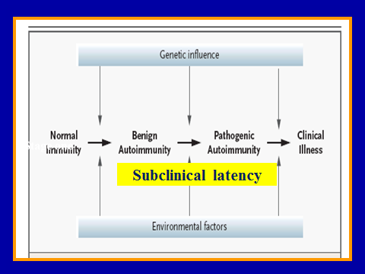
A stepwise progression of autoaggression
Stage of subclinical autoaggression
Stage of
full-term autoaggression
Clinical illness
Subclinical (cryptic) latency
A stepwise (subclinical-clinical) course to be developed

Slide 5
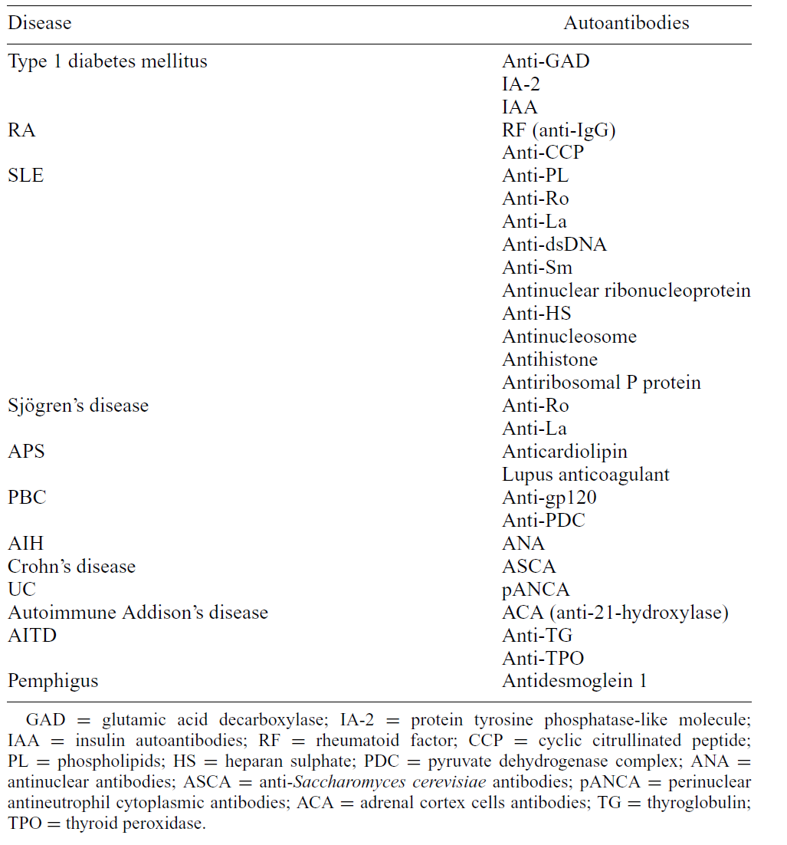
Predictive Abs as biomarkers to monitor chronic autoimmune diseases
(due to Y.Shoenfeld)

Slide 6
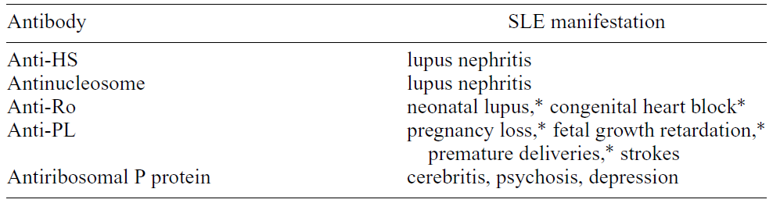
Autoantibodies as biopredictors of specific disease manifestations in SLE
from Y. Shoenfeld

Slide 7
Meanwhile, the utility of
predictive biomarkers (including autoAbs) to monitor chronic autoimmune inflammation and to predict stepwise transitions
is dependant on three key parameters,
which must be carefully assessed:
● sensitivity, ● specificity and
● positive predictive value.
So, accurate prediction is vital for prevention of autoaggression, and the targeted
preventive treatment could thus be given to those individuals who are most likely
to develop the disease.

Slide 8
MS is just one of the
chronic tissue-specific autoimmune diseases
resulting in a destruction of myelin by different tools,
including:
● autoreactive CTLs and ●autoAbs (Fig 9-11)

Slide 9
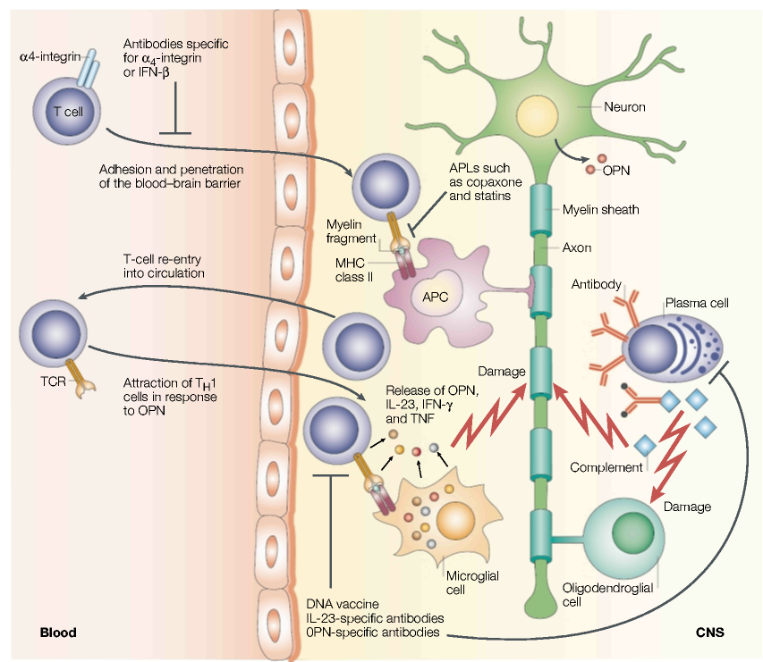
MS: autoimmunity, demyelination and neurodegeneration
Anti-myelin autoAbs and autoreactive CTLs are able to to make oligodendrocytes and axons damaged in direct and indirect ways to result in demyelination and neurodegeneration, respectively
Neuron
T cell
Myelin sheath
CTLs
Axon
Antimyelin Abs
Damage
TCR
Complement
Damage
Microglia
Oligodendrocyte
Blood
CNS

Slide 10
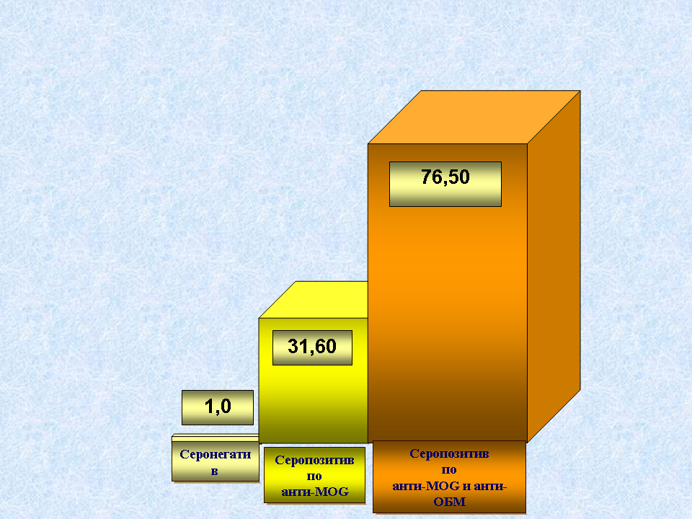
Antimyelin autoAbs
are key biomarkers
and biopredictors
of demyleination
Sero-negative
Anti-MOG &
Anti-MBP seropositive
Anti-MOG sero-
positive

Slide 11
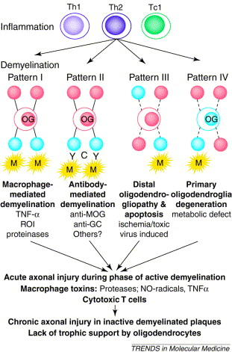
Antibody-mediated mechanisms of demyelination in MS
Notes:
Summary of pathogenetic mechanisms involved in the formation of multiple sclerosis lesions. Inflammation: evidence indicates that T helper 1 (Th1) cells have a role in inducing inflammatory reactions in the central nervous system. Proinflammatory cytokines released from Th1 cells activate macrophages, which are responsible for the majority of demyelination and axonal injury. In addition, however, T helper 2 (Th2) cells and cytotoxic, class i-restricted cytotoxic t cells (tc1 might modify the outcome of the lesions. Demyelination: myelin sheaths and oligodendrocytes (OG) can be destroyed, possibly by different mechanisms in different individuals. This results in distinctly different patterns of demyelination in active lesions. Demyelination may be induced by macrophages (M) and/or their toxic products (resulting in pattern I), by specific demyelinating antibodies and complement (C, resulting in pattern II), by degenerative changes in distal processes, in particular those of periaxonal oligodendrocytes (distal oligodendrogliopathy), followed by apoptosis (resulting in pattern III) or by a primary degeneration of oligodendrocytes followed by myelin destruction (resulting in pattern IV). Possible mediators of myelin and oligodendrocyte destruction include tumor necrosis factor α (TNF-α), reactive oxygen intermediates (ROI), antibodies against myelin oligodendrocyte glycoprotein (anti-MOG) or galactocerebroside (anti-GC). Axonal injury: axonal injury follows acute destruction of myelin sheaths. In the active phase of demyelination, axonal injury is likely to be induced by macrophage toxins or by the direct effects of cytotoxic T cells. The chronic axonal injury observed inactive plaques may be caused by a lack of trophic support by glial cells, such as oligodendrocytes, but could also involve inflammatory mediators, produced by macrophages, that persist in most active chronic lesions.

Slide 12
The crucial step in the pathogenesis of MS is a primary myelin damage which is mediated by autoAbs to trigger a release of separate and pathogenically valuable myelin-associated epitopes into the bloodstream.
Those epitopes act as sensitizing factors to generate autoAbs more and more, which, in turn, would drive the demyelination and thus the disease progression (Fig. 13)

Slide 13
MS: autoimmunity, demyelination and neurodegeneration
Anti-myelin autoAbs and autoreactive CTLs are able to to make oligodendrocytes and axons damaged in direct and indirect ways to result in demyelination and neurodegeneration, respectively
Neuron
T cell
Myelin sheath
CTLs
Axon
Antimyelin Abs
Damage
TCR
Complement
Damage
Microglia
Oligodendrocyte
Blood
CNS

Slide 14
At present, a spectrum of myeline-associated autoAbs occurring in MS patients has been confirmed to be very large.
Along with canonical Abs, some of the families proven to occur are Abs possessing with catalytic activity (catAbs or abzymes) and thus to belong to Abs with a feature of functionality!
Meanwhile, the likelihood of autoAbs and biochemical evidence of MS has been proven to be proportional to the presence of antimyeline autoAbs, and anti-MBP Abs, in particular!

Slide 15
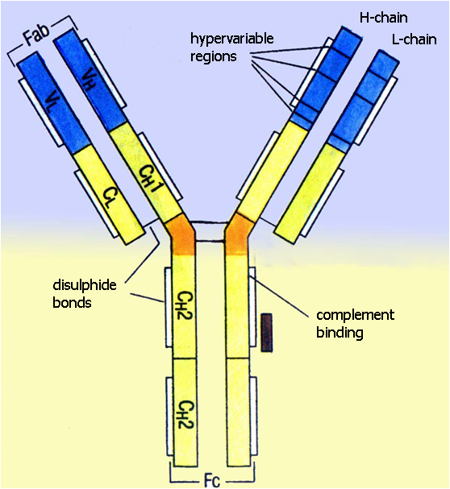
CatAbs (or abzymes) are multivalent Igs, presumably, of IgG iso-type, endowed with a capacity to hydrolyze the Ag substrate.
The property mentioned is buried in the Fab-fragment of the Ig mole-cule and is appearing to sound as a functional property of the Ab molecule.
In this sense, proteolytic Abs (or Ab-proteases) as a significant portion of the big family of abzymes represent Abs endowed with a capacity to provide targeted proteolytic effect.
Catalytic
portion

Slide 16

The first example of Ab-proteases was an IgG found in bronchial asthma (BA) patients
to hydrolyze vasointestinal peptide (VIP) which played a major role in
the respiratory disfunction
VIP
VIP
Targeted site
to be cut
Targeted site
cut
The anti-VIP catalytic Abs binds a seven-amino acid subsequence of VIP distant from the cutting site
(shown as a gap)
Notes:
2

Slide 17
The other example is a family of
Ab-proteases
detectable in
autoimmune myocarditis (AIM)
to cleave cardiac myosin (CM) or
in autoimmune thyroiditis
to cleave thyroid autoAgs
as the major cardiac and thyroid autoAgs, respectively, and
thus informative biomarkers
to monitor the courses (Fig 18,19).

Slide 18
1
2
3
4
5
6
7
8
9
ТG
ТPO
(А)
(B)
Ab-mediated hydrolysis of allogeneic TG and TPO
Electrophoresis was done in SDS-PAGE; (А) и (B) – electrophoresis of proteolytic products of TG and TPO, respectively; Lanes (1) amd (2) – human reference ТГ and ТРО, respectively; Lanes (2)/(3) and (4) – anti-ТГ autoAbs isolated from sera of AIT and DTG patients, respectively; (6)/(7)andи (8)/(9) – anti-ТРО autoAbs isolated from sera of DTG and AIT patients, respectively; TG – thyroglobulin; ТРО – thyroid peroxidase; Аbs – antibodies; PAGE – polyacrilamide gel; AIT and DTG – autoimmune thyroiditis and diffuse toxic goiter, respectively; HC – healthy controls; SDS – sodium dodecyl sulphate

Slide 19
Ab-proteases in autoimmune myocarditis

Slide 20
A situation of much greater interest is occured in MS which is
a chronic autoimmune inflammation in the central nervous system restricted by a specialized tissue and resulting in demyelination, axon loss and development of disability.
The crucial step is
a primary myelin damage
which is mediated by autoAbs to trigger
a release of separate and pathogenically valuable tissue- (myelin)-associated epitopes into the bloodstream (Fig. 21)

Slide 21
MS: autoimmunity, demyelination and neurodegeneration
Anti-myelin autoAbs and autoreactive CTLs are able to to make oligodendrocytes and axons damaged in direct and indirect ways to result in demyelination and neurodegeneration, respectively
Neuron
T cell
Myelin sheath
CTLs
Axon
Antimyelin Abs
Myelin
Damage
TCR
Complement
Damage
Microglia
Oligodendrocyte
Blood
CNS

Slide 22
We have established that anti-MBP autoAbs from MS patients and mice with EAE exhibited
MBP-specific proteolytic cleavage of the MBP molecule

Slide 23

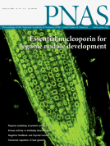
Autoantibodies to myelin basic protein catalyze site-specific degradation of their antigen

Slide 24
The activity of Ab-proteases markedly differs between: MS patients and healthy controls
Indexes | MS patients (n=332) | Healthy controls (n=128)
Ab-proteases (68%) | 154,66 ±72,40 | 1,99 ±0,71

Slide 25
The activity of Ab-proteases markedly differs in patients with different courses of MS
Number of MS patients |  | Serum presence of Ab-proteases | Ab-mediated proteolytic activity
Of type | at a stage of
Remittent | Exacerbation | 24 (18%) | 97,3±30,1
 | Remission | 7 (5% ) | 8,8±2,5
Secondary- progradient | Progression | 20 (15%) | 288,9±39,9
 | Stabilization | 5 (4%) | 25,3±15,0
Primary- progradient | Progression | 18 (14%) | 93,2±21,2
 | Stabilization | 8 (6%) | 20,1±10,2

Slide 26
And, finally, the activity demonstrated also significant correlation with scales of demyelination, neurological deficiency and thus with the disability of the patients
(it is seen from the EDSS scores)

Slide 28
That is great, well, but of the greater value is
a sequence specificity of
Ab-proteases
which was analyzed by screening peptide cleavage products
by a combination of reverse-phase chromatography, SDS electrophoresis, Western blot analysis, and mass-spectrometry due to SELDI protocol (Fig 29,30)

Slide 29
The SELDI Process and ProteinChip® Arrays
Sample goes directly onto the ProteinChip™ Array
Proteins are captured, retained and purified directly on the chip (affinity capture)
Array is “read” by Surface-Enhanced Laser Desorption/Ionization (SELDI)
Retained proteins can be processed directly on the chip
Trace proteins (targets/markers)
Laser
Sample
ProteinChipTM Array
“Homogeneous” Capture Surface

Slide 30
Specific hydrolysis of MBP by proteolytic Abs isolated from MS patient was shown by SELDI
AB# 187
AB# 361
Ab# 98 1ug
Ab# 3
Ab# 82
Treatment of MBP with different Ab. 5ug of MBP/1ug of Ab. #98 additionally 0.1ug. All data normalized according to ion current and are pretty quantitative.
Ab# 98 0.1ug
187, 361 - MS patients ; 3 - SLE control, 98 - SJL/J mouse control and 82 – control NZB mouse
MBP in buffer
Control Ab

Slide 31
Sequence specificity of the MBP-targeted proteolysis by anti-MBP autoAbs harvested from MS patients and EAE animals
As you might see, Ab-mediated proteolysis of MBP results in generating a set of peptides with MW ranged in various but fixed boundaries to suit common principles of the molecular architectonics of MBP.
The final statistical data revealed FIVE sites of preferential proteolysis
Cleavage at those sites occurred at a similar rate
as determined by 32^{P}-MBP degradation assay.

Slide 32
43-170
82-98
81-103
Very interestingly, most of those sites
(as a set defined) are located within the 43-170 region of MBP which are just immunodominant!

Slide 33
43-170
82-98
81-103
Two sites from the set located within 43-170 sequence, would comprise 81-103 and 82-98 subsequences that whilst being sequence-specific, highly immunogeneic and encephalitogeneic both as well, proved to be specific and major inducers of very aggressive EAE in SJL mice

Slide 34
43-170
82-98
81-103
Moreover, both 81-103 and 82-98 subsequences
have been proven to be major MBP targets to be attacked by Ab-proteases obtained from patients with
secondary-progradient courses of MS, progression phase (SPPP), and with remittent course of MS, exacerbation phase (REP), both are known as most aggressive ones!

Slide 35
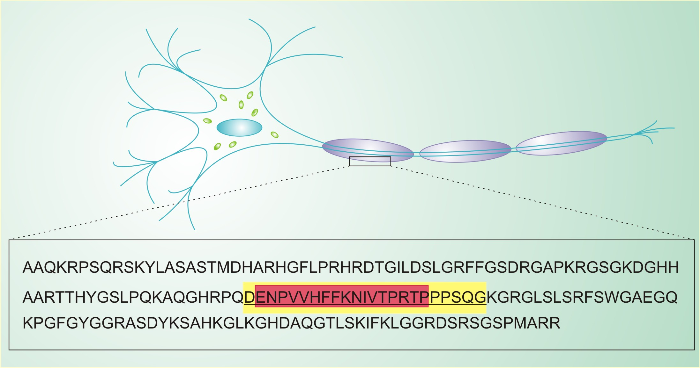
The extra two sites from the same 43-170 set are located within
43-68 and 146-170 subsequences that whilst being sequence-specific but low immunogeneic and encephalitogeneic both, proved to be inducers of moderate EAE
43-170
43-68
146-170

Slide 36
As we have established, the most immunogeneic and encephalitogeneic epitopes of immunodominant category responsible for generating aggressive bursts of demyelination are concentrated in three areas of MBP molecule:

Slide 37
43-170
82-98
81-103
The strongest one is in the smallest 82-98 subsequence

Slide 38
43-170
82-98
81-103
a weaker epitope is formed by a longer 81-103 subsequence

Slide 39
43-170
82-98
81-103
an epitope with the lowest immunogeneic and encephalitogeneic properties
is formed by a rather long 143-170 sequence defined

Slide 40
Low- and highly-immunogenicity epitopes
43-170 – immunodominant area of the chain to accumulate the epitopes:
81-103 - is a sequence-specific immunogeneic epitope
82-98 - is a subsequence-specific highly immunogeneic & highly encephalitogenic epitope
43-170
82-98
81-103

Slide 41
43-170
82-98
81-103
The length of the sequences to be attacked by Ab-proteases correlate reversibly with the immunogenicity of those

Slide 42
The final step of our studies concerned the evolution of
Ab-associated proteolytic activity
at different stages of the disease progression.
For those purposes, we have been monitoring MS patients, their direct relatives and healthy volonteers
for around 4 years

Slide 43
The activity of Ab-proteases among MS patients, their direct relatives and healthy volunteers
(at a starting point of monitoring)
Indexes | MS patients (n=332) | Relatives of MS patients (n=1448) | Healthy controls (n=128)
Ab-proteases | 154,66 ±72,40 | 3,04 ±2,59 | 1,99 ±0,71
Apart from MS patients with the diagnosis confirmed,
71% and 18% of the relatives were initially seropositive for
anti-MBP autoAbs with no proteolytic activity (“disarmed” Abs) and MBP-specific but low-active Ab-proteases, respectively.
Neither of those seropositive relatives regardless to type of Abs demonstrated neither clinical manifestations nor instrumental or laboratory signs of MS

Slide 44
The relatives
being seropositive for
Ab-proteases
were being monitored for
a long time whilst demonstrating a stable growth of
MBP-targeted Ab-associated proteolytic activity
when were being under
the study

Slide 45
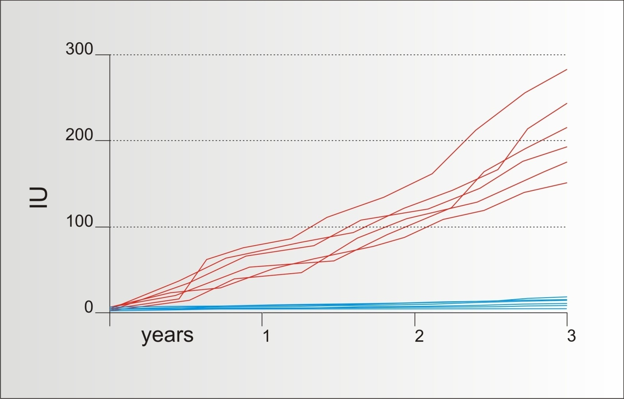
Stable growth of the MBP-targeted Ab-associated proteolytic activity during 2-3 years when were being under the study
74-78% of the relatives being seropositive for Ab-proteases monitored for 2-3 years have been demonstrating stable growth of the MBP-targeted Ab-associated proteolytic activity during the time span when were being under the study

Slide 46
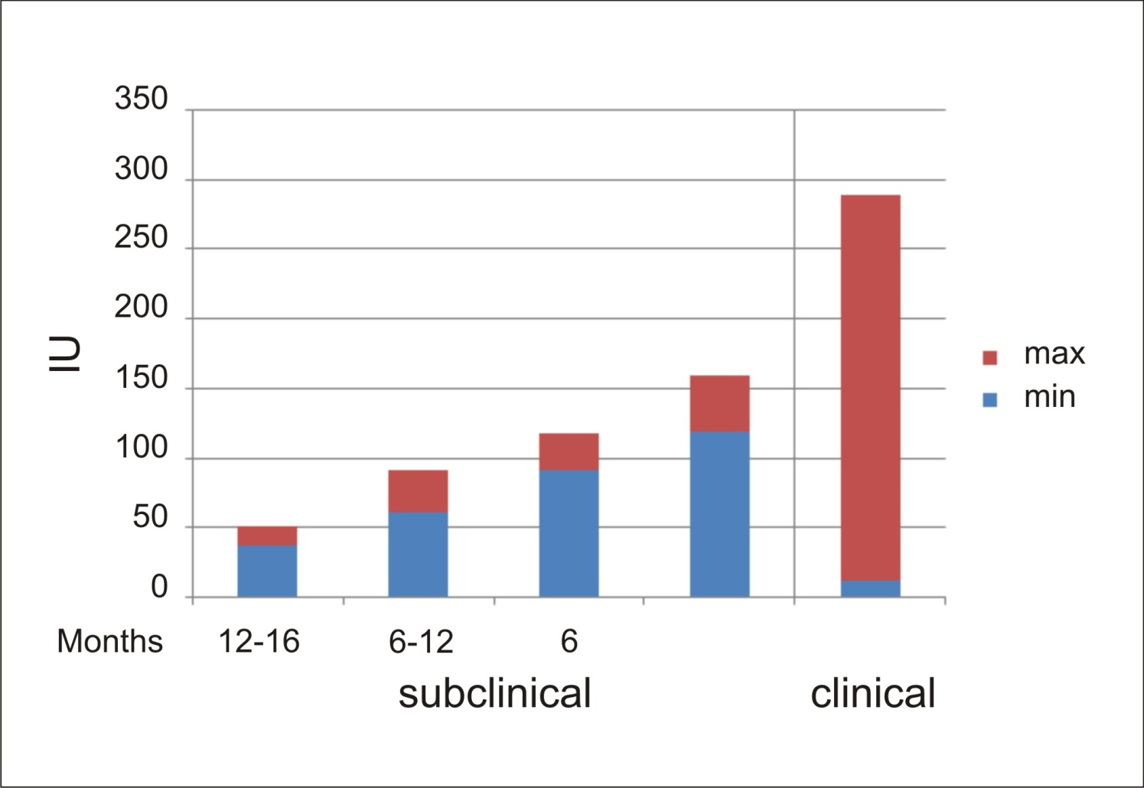
Evolution of MBP-targeted Ab-associated proteolytic activity in the subclinical and clinical courses of MS progression

Slide 47
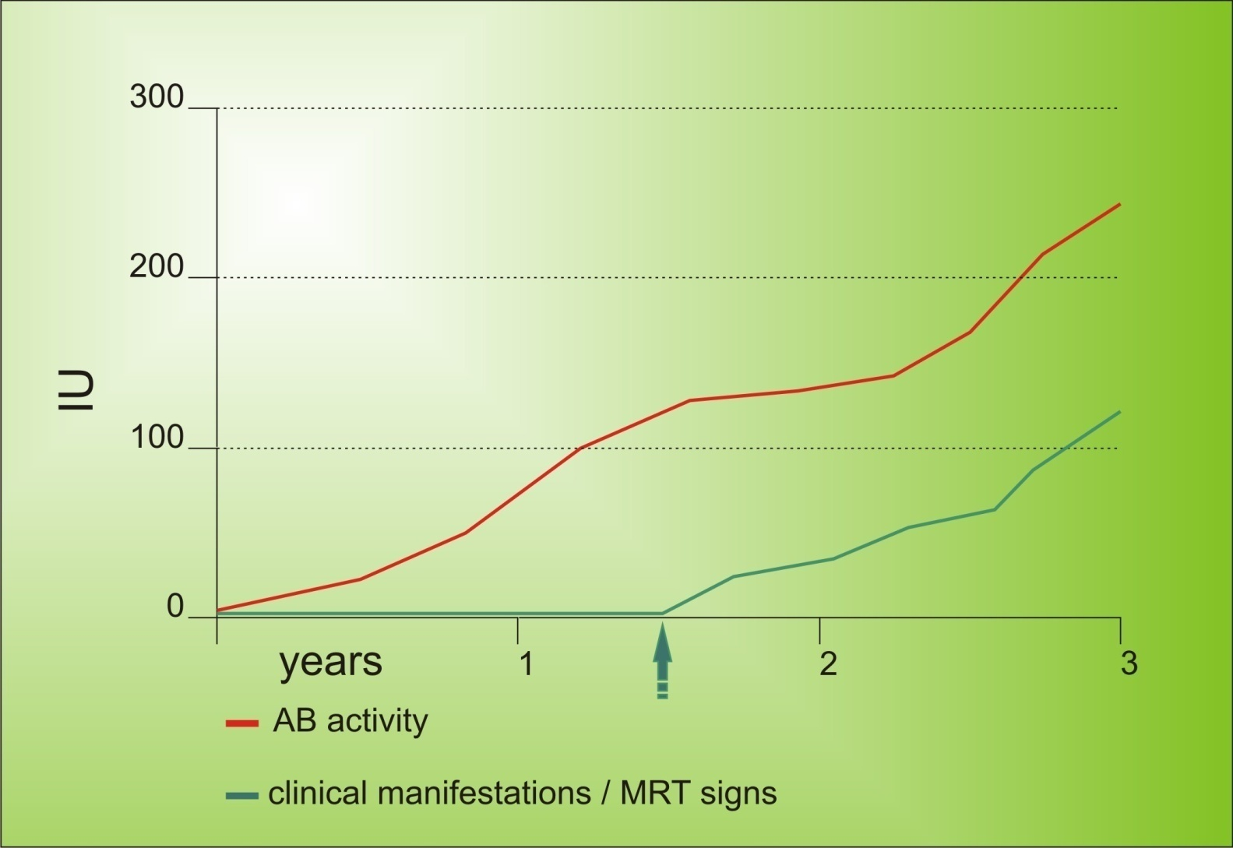
And when the activity reached its mid-level, we identified in those patients primary clinical and MRI manifestations to be coincided with the Ab-associated proteolytic activity.
And then the proteolytic activity was being further escalated due to the time of progression, type of the disease, and disability of the person

Slide 48
Meanwhile,
a substantial proportion (around 34%) of relatives demonstrating
low-active Ab-proteases with
no trends to grow
had had subclinical evidence of
latent autoimmunity
(Th growing, rise of AutoAbs, etc)
without developing
clinically overt disease
Look at the evolution of the MBP-targeted Ab-associated proteolytic activity!

Slide 49
The activity of Ab-proteases is first registered at the very early (subclinical) stages of the disease, when Ab-proteases are low-active, the inflammation is minimized, and the manifestations are thus moderate.
Indexes | MS patients (n=332) | The direct relatives (probands) initially seropositive for Ab-proteases (n=633) |  |  |  |  | Healthy controls (n=28)
Ab-proteases (68%) | 154,66 ±72,40 | initially | In 6 months | In 12 months | In 2 years | In 3 years | 1,99 ±0,71
 |  | 3,08± 0,71 | 29,66± 3,99 | 44,23± 5,13 | 97,01± 6,11 | 129,77± 18,45

Slide 50
At this point, Ab-proteases would attack presumably low-immunogeneic epitopes.
Low-active Ab-proteases are typical for moderate cases of EAU in animals and for most of MS remittent (moderate) types in humans
Low-immunogenicity
epitopes
43-68
146-170

Slide 51
As the disease progresses to transform from subclinical into clinical stages, the activity of Ab-proteases is being escalated to reach the indices we have established for MS patients with a diagnosis of clinical illness confirmed
Indexes | MS patients (n=332) | The direct relatives (probands) initially seropositive for Ab-proteases (n=633) |  |  |  |  | Healthy controls (n=28)
Ab-proteases (68%) | 154,66 ±72,40 | initially | In 6 months | In 12 months | In 2 years | In 3 years | 1,99 ±0,71
 |  | 3,08± 0,71 | 29,66± 3,99 | 44,23± 5,13 | 97,01± 6,11 | 129,7± 18,45
Progression of demyelination

Slide 52
Moreover, in exacerbations of the remittent course (ERP) or in secondary-progradient courses, progression phase (SPPP), the highest activity of Ab-proteases to attack the highly-immunogenic epitotes occurs as well!!!!
And, when bursts of the Ab-associated proteolytic activity were evident, the pre-early stages of the exacerbation could be predicted, even at no seeing any clinical manifestations.
MS patients |  | Epitopes | Ab-mediated proteolytic activity
Of type | at a stage of
Remittent | Exacerbation | High-immunogenicity | 97,3±30,1
 | Remission | Low-immunogenicity | 8,8±2,5
Secondary- progradient | Progression | High-immunogenicity | 288,9±39,9
 | Stabilization | Low-immunogenicity | 25,3±15,0
Primary- progradient | Progression | High-immunogenicity | 93,2±21,2
 | Stabilization | Low-immunogenicity | 20,1±10,2

Slide 53
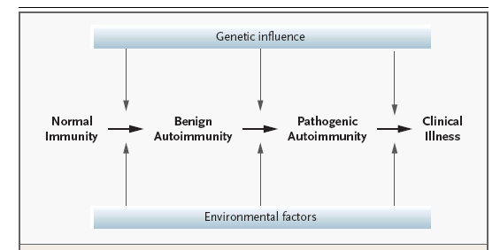

And moreover again, along with changes of the sequence specificity, when we saw an extensive growth of the activity, we could predict transformations into the clinical course, i.e., changing of a remitting type (moderate one) into the secondary progradient type (severe one) prior to changing of the clinical manifestations
Ab-Proteases
as Biomarkers and Biopredictors to monitor
MS-related demyelination
MS
Subclinical stage
MS
Clinical stage

Slide 54
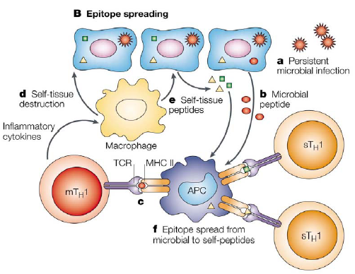
It is so much important to stress that a spread from one type of epitope to the other one could also be a combinatorial biomarker event to serve as a biopredictor of the interstage transitions and to be a biomarker for monitoring MS patients and persons at-risk at both subclinical and clinical stages to use a panel of specific Abs defined
Лупатов А.Ю.

Slide 55
There is a regular sequence in the development of autoAbs of different specificities and functionality
illustrating a phenomenon of epitope spreading.
That “immune escalation” illustrating re-orienting of the sequence specificity to accent the more important targeted sites for proteolysis might be an early prognostic and predictive sign of progressing demyelination and thus the clinical illness to come.
It is not excluded that the accretion of multiple MBP-associated autoepitopes is an indication of an ongoing autoimmune demyelination. In fact, we found that spread from one sequence to another
could also be used prognostically in the development of chronic autoimmune inflammation and thus degeneration (demyelination and axon loss) (Fig. 56).
Лупатов А.Ю.

Slide 56

Epitope spreading and changing of sequence specificity of
Ab-proteases during the evolution of demyelination
Epitope spreading
Primary infection
to trigger mimickry
Myelin-associated peptides (MAP)
Viral peptides (VP)
MAP-Th1-
cell
VP-Th1-cell
APC
MAP-Th1-
cell
Epitope spreading in a direction
from viral epitopes towards
tissue autoepitopes
43-68
81-103
146-170
Multiple sclerosis

Slide 57
As it is known,
canonical autoAbs
play neither predictive nor discriminative role to affect the subclinical stage of MS.
Meanwhile,
sequence-specific Ab-proteases
have proved to be greatly informative and thus valuable as biomarkers to monitor MS
at both subclinical and clinical stages!
Therefore, the proposed predictive value of MBP-targeted Ab-proteases for
the development of MS is being challenged!
Лупатов А.Ю.

Slide 58
So, the activity of Ab-proteases in combination with their sequence-specificity to attack well-defined but separate sets of epitopes to be released from MBP during Epitope Spreading, would confirm a high practical value of Ab-proteases to monitor both clinical and subclinical courses of chronic autoimmune inflammation (eg, MS) to predict the clinical illness!
Low-immunogenicity
epitopes
High-immunogenicity
epitopes
43-68
43-170
146-170
81-103
82-98
Types of
MS courses
Remission
Exacerbations
Progression
Stabilzation

Slide 59
The primary translational potential of this knowledge is in the
rational design of new therapeutics
to exploit the role of the key pathways in influencing disease.
In this sense and in terms of PPPM,
Ab-proteases can be programmed
and
re-programmed
to suit the needs of the body metabolism or
could be designed for the development of principally new catalysts
with no natural counterparts

Slide 60
Of tremendous value
in this sense are
Ab-proteases
directly affecting the physiologic remodelling of
Tissues
with multilevel architectonics
(for instance, myelin).

Slide 61
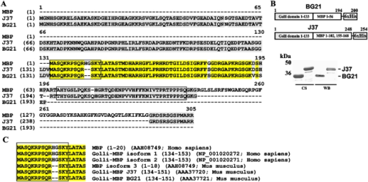
Look: by changing sequence specificity of the Ab-mediated proteolysis one may reach reduction of a density of negative shots made by Ab-proteases against MBP as a target and thus could minimize the overall hegative effect within the myelin sheath and, finally, minimizing scales of demyelination.
82-98
SHOTS
SHOTS
SHOTS
SHOTS
81-103
SHOTS
43-68
SHOTS
146-170

Slide 62
Targeted Ab-mediated proteolysis
could be also applied to isolate
from Ig molecules catalytic domains directed against encephalitogenic autoepitopes or domains containing segments to exert proteolytic activity.
So, further studies on Ab-mediated MBP degradation and other targeted
Ab-mediated proteolysis
may provide biomarkers of new generations and thus a supplementary tool for
Assessing the disease progression and
predicting disability of the patients and
persons-at-risks

