Slide 1
Dr. Senthilkumar Gandhidasan MD, MPH, MHI Senior Radiation Oncology Registrar Liverpool Hospital, Australia
Clinical leadership – an essential requirement for successful health information system implementation
Dr Ping Yu
Senior Lecturer
Faculty of Informatics
University of Wollongong, Australia
Prof. Andrew Miller
Radiation Oncologist
Illawarra Cancer Care Centre
Wollongong, Australia
HITC 2014 – 21st Oct 2014

Slide 2
Disclosure
Disclosure:
I have no conflicts of interest to disclose.

Slide 3
Background
Background:
Health information system (HIS) implementation
large challenge due to high cost and frequent failures
HIS aims to eliminate and reduce human error and improve efficiency of health care.
Factors influencing success – positive user attitudes, leadership, training/ user support, ill-defined project objectives
Poorly studied in the oncology setting
Sydney
2 radiation oncology departments have implemented Oncology Information System (LANTIS®) 2002-2003 and preliminary discussion reveals “different levels of usage” 5 years post implementation

Slide 4
Clinical Workflow
Clinical Workflow:
Patient enters clinic (listed)
Patient seen by clerical staff (queued)
Plan reviewed
CT simulation
Seen by doctor – enters notes, diagnosis, plan
Plan approved – prescription approved
Physics check
Patient has treatment – seen in treatment reviews (acute toxicity)
Discharged from follow up
Patient seen in follow up (late toxicity)

Slide 5
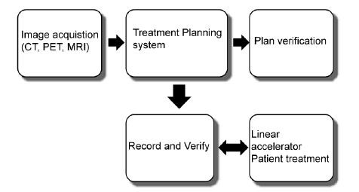
Process Flow
Schematic of a typical radiation therapy process flow
Notes:
RO is one of the most IT-demanding areas of the hospital. Computer programs such as Treatment Planning Systems (TPS), Treatment Management Systems (TMS), Treatment Delivery Systems (TDS), RO specific EMR (RO EMR), and image viewing systems (e.g.Picture Archiving and Communication Systems (PACS)) are used on a routine basis. The term “Record and Verify (R&V)” has been used to describe systems that receive data from the TPS and interact with the TDS to deliver radiation. All of these systems, controls, and networks must operate smoothly if the RO process is to be safe and efficient.
Because image manipulation is not usually done through the imaging device software, the images are sent to the treatment planning system (TPS). This transfer is most often accomplished via a local area network, but could also be through some transportable media such as DVDs.
The TPS is the heart of the RO process. It consists of hardware and software specifically designed for RO. Images are uploaded and prepared for the treatment planning process. Physicians delineate areas to be treated on CT images, for example, and generate a prescription that includes a set of treatment parameters. These parameters include the amount of radiation (absorbed dose) to be delivered to the target, as well as limitations on the maximum amount of radiation to be delivered to uninvolved areas in the patient. A dosimetrist or physicist then works with the TPS to achieve the physician’s goals. In some cases, plan information is sent to remote workstations for review and approval by other medical specialists. The resultant treatment plan is a combination of images, contours, calculated radiation dose distributions, and parameters used to control the treatment machine. These data, frequently consisting of hundreds of megabytes per patient, are then stored on the local hard drive of the TPS. Older data are eventually archived and removed.
In order to execute the treatment plan, the parameters that control the linear accelerator (linac) are then transferred from the TPS to a database accessible by the RO EMR. Before final approval of the treatment, a physicist reviews the plan. In the case of complex plans such as IMRT, the treatment is delivered to a test phantom and measurements of the radiation distribution are compared to calculated values. This involves yet another transfer of data among systems.
Once the plan has been reviewed and approved, the plan in the RO EMR is electronically signed and released for treatment. This EMR may not be from the same manufacturer as either the TPS or linac, so communication and networking compatibility issues require careful consideration. The linac itself consists of many computer-controlled subsystems that may or may not be affected by network issues.
The RO EMR controls, verifies, and records all aspects of each individual treatment. Patients are typically treated once a day, five days a week, for a period of two to seven weeks, depending on the type of cancer. Each time the patient is treated, the linac requests the treatment parameters from the EMR, positions the beam-defining devices, informs the EMR database of its positions, and waits for the EMR to verify that the positions are within tolerance. Once the linac receives the approval, it delivers the radiation and sends the delivered treatment information to the EMR so that it can record the dose and treatment parameters that were used to treat the patient. This process of downloading, verifying, treating, and recording is repeated for every single treatment field. For simple cases, patients may be treated by anywhere from 1 to 4 fields, while for IMRT, as many as 100 fields may be used. It is important that the network infrastructure efficiently handle the transfer of these large amounts of data - otherwise, patient treatment could be either delayed or compromised. The interaction between the linac and the EMR also requires real-time support; the patient must be treated as quickly as possible in order to minimize the chance that the patient has moved from the target position.
Those who interact with the RO EMR must recognize that incorrect data or the incorrect operation, use, installation, and maintenance of this EMR can have disastrous consequences, potentially delivering fatal doses of radiation in a very short time. The RO EMR is very different from the typical concept of an EMR in that the RO EMR supplies critical information for the control of radiation treatment machines. Nor is it the Record and Verify system of the early days of computer-controlled treatment deliveries, because it contains much more information than what is required to monitor a treatment. Appropriate permission levels must be given to users so that only those who fully understand the linac control data in the EMR are allowed access to it.
There are many hardware, software, and networking issues in RO. Integration of all of these systems is essential for proper and efficient treatment of the patients. This integration may be provided by a single vendor, multiple vendors, or may have to be performed by local personnel. Each process generally has its own hardware and software. It is not uncommon to find Windows, UNIX and Linux operating systems, which all need to communicate. Changes to hardware, software, and network infrastructure all need to be tested to preserve proper integration. It is therefore essential that the RO personnel have trained, cooperative and accessible IT support. Conversely, the IT personnel need to have the support and cooperation of the RO department.

Slide 6
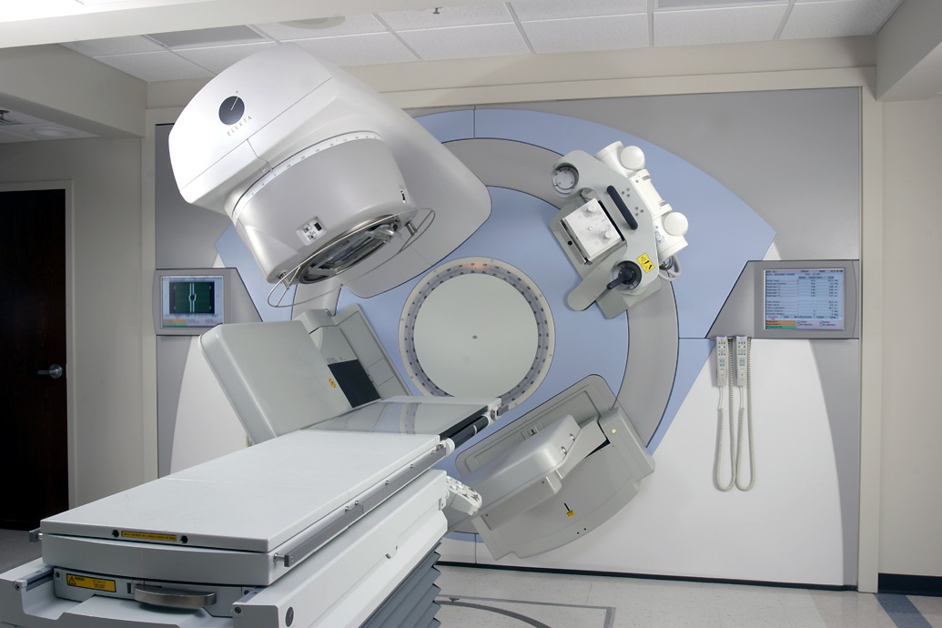
Linear Accelerator
Linear Accelerator:

Slide 7
Objectives
Objectives:
To identify
differences in the implementation practices and usage of LANTIS®
critical factors and strategies for success
advantages or disadvantages in the health care delivery
To understand
impact of different implementation practices on the clinical practice

Slide 8
Methods
Methods:
Interview questions based on literature review
computer use
implementation
evaluation of current LANTIS® use
current clinical workflow
Validity assessed by 2 radiation oncologists in a third hospital

Slide 9
Methods
Methods:
Focussed, open-ended, semi-structured interviews (30-45 min) in Hospital A and B
13 of 15 radiation oncologists
discussion was recorded and transcribed - analysis by coding concepts (NVIVO® software)
Two researchers independently conducted the coding to ensure that the coding was accurate and comprehensive.
The final interpretation was reached through discussion and consensus.

Slide 10
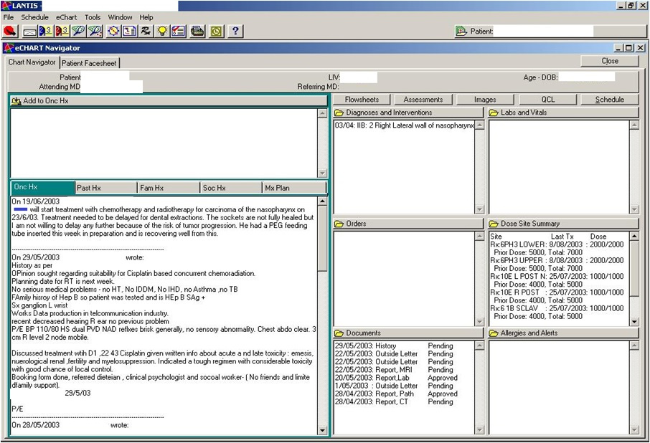

Slide 11
Results
Results:
Functionalities used by Radiation Oncologists | Hospital A
Patients listed | Yes
Patients queued | Yes
Patient history and examination results | Yes
Electronic Radiation prescription | Yes
Electronic Approval of prescription | Yes
Acute side effects recorded at weekly treatment review (electronic RTOG assessments or notes) | Yes
Disease outcome & late side effects recorded during follow up (electronic RTOG assessments or notes) | Yes

Slide 12
Results
Results:
Functionalities used by Radiation Oncologists | Hospital A | Hospital B
Patients listed | Yes | Yes
Patients queued | Yes | No
Patient history and examination results | Yes | No
Electronic Radiation prescription | Yes | No
Electronic Approval of prescription | Yes | No
Acute side effects recorded at weekly treatment review (electronic RTOG assessments or notes) | Yes | No
Disease outcome & late side effects recorded during follow up (electronic RTOG assessments or notes) | Yes | No

Slide 13
Results
Pre-implementation phase
Hospital A
Single radiation oncology department established satellite centre 25 km away
Paper file transportation cumbersome > need for paperless system
State Health Department - took ownership leading to bulk purchase of oncology information systems for entire state

Slide 14
Results
Pre-implementation phase
Hospital A | Hospital B
Single radiation oncology department established satellite centre 25 km away | DORIS in 1980s containing 50,000 patients basic demographic data (home grown system)
Paper file transportation cumbersome > need for paperless system
State Health Department - took ownership leading to bulk purchase of oncology information systems for entire state

Slide 15
Results
Implementation process
 | Hospital A | Hospital B
Aim | To become paperless To improve patient care through increased efficiency | To transfer DORIS data into LANTIS

Slide 16
Results
Implementation process
 | Hospital A | Hospital B
Aim | To become paperless To improve patient care through increased efficiency | To transfer DORIS data into LANTIS
Difficulties | Organizational, Size, getting everyone on board, finance | Loss of project manager- management made no replacement Loss of director

Slide 17
Results
Implementation process
 | Hospital A | Hospital B
Aim | To become paperless To improve patient care through increased efficiency | To transfer DORIS data into LANTIS
Difficulties | Organizational, Size, getting everyone on board, finance | Loss of project manager- management made no replacement Loss of director
Strategies | Clear vision from leader, Support from General Manager and NSW Dept. of Health, Project Manager, supportive training | Project Manager who understood the clinical workflow and technical knowledge for data transfer

Slide 18
Results
Similarities between two departments
Profile of radiation oncologist
Age, computing skills
Attitudes of the radiation oncologists
positive, not too enthusiastic, not negative
Evaluation by the radiation oncologists
“implementation is a success”
“implementation is still incomplete”
User support and training adequate
Perception of the Project manager
Competent
Achieved goals

Slide 19
Results
Comparison of Project leaders of implementation
 | Hospital A | Hospital B
Project leader for the IS introduction | Radiation Oncologist | Radiation Oncologist
A computer expert? | No | No
A senior staff member? | Yes | Yes
In a position of authority? | Yes | Yes

Slide 20
Results
Comparison of Project leaders of implementation
 | Hospital A | Hospital B
Project leader for the IS introduction | Radiation Oncologist | Radiation Oncologist
A computer expert? | No | No
A senior staff member? | Yes | Yes
In a position of authority? | Yes | Yes
Was there a absence of leadership either at or immediately after the implementation? | No | Yes
Able to articulate a ‘paperless’ vision at start of project? | Yes | No

Slide 21
Results
Comparison of Project Manager of implementation
 | Hospital A
Project Manager (day to day running of IS introduction) | Senior Radiation Therapist
A computer expert? | No
A senior staff member? | Yes
Supported by higher authority to change clinical practice? | Yes
Was there a vacancy or gap in the project manager role at or immediately after the implementation? | Yes
Understand the clinical workflow? | Yes
Perceived to be competent in their role of implementation? | Yes
Achieve the aim of the implementation? | Yes

Slide 22
Results
Comparison of Project Manager of implementation
 | Hospital A | Hospital B
Project Manager (day to day running of IS introduction) | Senior Radiation Therapist | Radiation Physicist
A computer expert? | No | Yes
A senior staff member? | Yes | No
Supported by higher authority to change clinical practice? | Yes | No
Was there a vacancy or gap in the project manager role at or immediately after the implementation? | Yes | Yes
Understand the clinical workflow? | Yes | Yes
Perceived to be competent in their role of implementation? | Yes | Yes
Achieve the aim of the implementation? | Yes | Yes

Slide 23
Results
Advantages in Hospital A over Hospital B in health care delivery
Efficient - Data
Never ‘missing”, Real time, entire multidisciplinary team adds data (med onc, pall care, etc), wide accessibility
Quality assurance of data
Improved quality of data and reduced error
standard prescription, now legible
Research Database
Statistics on workflow – process reports
Changed clinical workflow
Checklist functionality
Disadvantage – disaster when the system crashes

Slide 24
Results
Results:
Functionalities used by Radiation Oncologists | Hospital A 2007 | Hospital B 2007
Patients listed | Yes | Yes
Patients queued | Yes | No
Patient history and examination results | Yes | No
Electronic Radiation prescription | Yes | No
Electronic Approval of prescription | Yes | No
Acute side effects recorded at weekly treatment review (electronic RTOG assessments or notes) | Yes | No
Disease outcome & late side effects recorded during follow up (electronic RTOG assessments or notes) | Yes | No

Slide 25
Results
Results updated:
Functionalities used by Radiation Oncologists | Hospital A 2007 | Hospital B 2007 | Hospital B 2014
Patients listed | Yes | Yes | Yes
Patients queued | Yes | No | Yes
Patient history and examination results | Yes | No | Yes
Electronic Radiation prescription | Yes | No | No
Electronic Approval of prescription | Yes | No | No
Acute side effects recorded at weekly treatment review (electronic RTOG assessments or notes) | Yes | No | No
Disease outcome & late side effects recorded during follow up (electronic RTOG assessments or notes) | Yes | No | No

Slide 26
Results
Results updated:
Hospital B acquires a new head of department
Leadership and aim of implementation to be paperless
Training
User support
Increased usage by multidisciplinary team
Obstacles more easily overcome

Slide 27
Conclusion
Conclusion:
OIS has changed work practice
easier to use and safer than the paper-based system
Supports previous literature - positive user attitudes, leadership, training/ user support
Critical factors for success in this case study
Strong clinical leadership within the department
Clear vision prior to implementation
Advantages in health care delivery
Timeliness of data and benefits through the organization of data most appreciated

Slide 28
Key points:
OIS implementation is a culture change in the workplace
Don’t need IT expertise to implement the information systems side, project management skills are desirable
Clinical leadership essential
Implement slow and steady seems to more effective
Obstacles to implementation are common (resistance to change, getting everyone on board)
Advantages of having an oncology information system outnumber the disadvantages

Slide 29
Acknowledgements
Acknowledgements:
Project supervisors
Radiation oncologists in both departments
Informatics department of University of Wollongong for providing NVIVO software
Yiyu Qiu – independently conducted coding
Rashmi Nigam, Swapna Nair, Gowri Lachmana – transcription
Dr. Tony Sara

Slide 30
Questions ?

