Slide 1
About OMICS Group
OMICS Group International is an amalgamation of Open Access publications and worldwide international science conferences and events. Established in the year 2007 with the sole aim of making the information on Sciences and technology ‘Open Access’, OMICS Group publishes 400 online open access scholarly journals in all aspects of Science, Engineering, Management and Technology journals. OMICS Group has been instrumental in taking the knowledge on Science & technology to the doorsteps of ordinary men and women. Research Scholars, Students, Libraries, Educational Institutions, Research centers and the industry are main stakeholders that benefitted greatly from this knowledge dissemination. OMICS Group also organizes 300 International conferences annually across the globe, where knowledge transfer takes place through debates, round table discussions, poster presentations, workshops, symposia and exhibitions.

Slide 2
About OMICS Group Conferences
OMICS Group International is a pioneer and leading science event organizer, which publishes around 400 open access journals and conducts over 300 Medical, Clinical, Engineering, Life Sciences, Phrama scientific conferences all over the globe annually with the support of more than 1000 scientific associations and 30,000 editorial board members and 3.5 million followers to its credit.
OMICS Group has organized 500 conferences, workshops and national symposiums across the major cities including San Francisco, Las Vegas, San Antonio, Omaha, Orlando, Raleigh, Santa Clara, Chicago, Philadelphia, Baltimore, United Kingdom, Valencia, Dubai, Beijing, Hyderabad, Bengaluru and Mumbai.

Slide 3
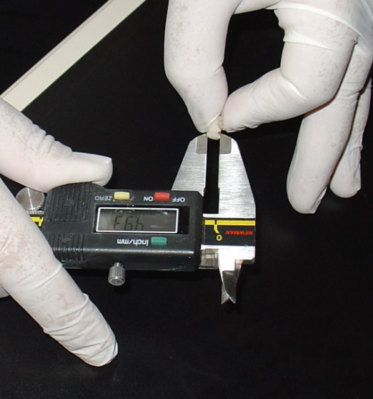
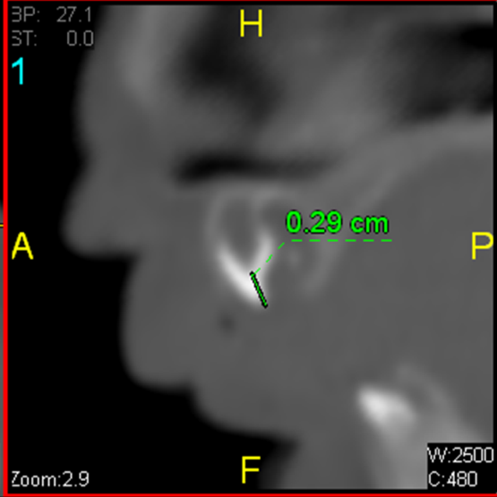
DIRECT AND INDIRECT AGE ESTIMATION METHODS FOR DECIDUOUS TEETH
Prof. Dr. P. Sema AKA (presenter),
Dr. Murat YAGAN, MD, Assoc.
Prof. Nergis CANTURK, MD,
Assist. Prof. Rukiye DAGALP, PhD
3rd International Conference on Forensic Research & Technology. October 06-08, 2014. San Antonio, USA.

Slide 4
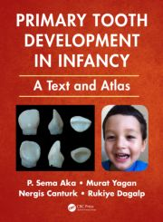
This presentation and a book* entitled «Primary Tooth Development in Infancy: A Text and Atlas» which will be published in January 2015, are the end products of a long span research , which has been prepared by a group of researchers: P. Sema Aka, Murat Yagan, Nergis Canturk, Rukiye Dagalp.
This new publication will be the first atlas to show serial photographs of fetal and infant teeth in six aspects with all details and could be observed from the following *website of CRC Press, Taylor & Francis Group: http://www.crcpress.com/product/isbn/9781482238518

Slide 5
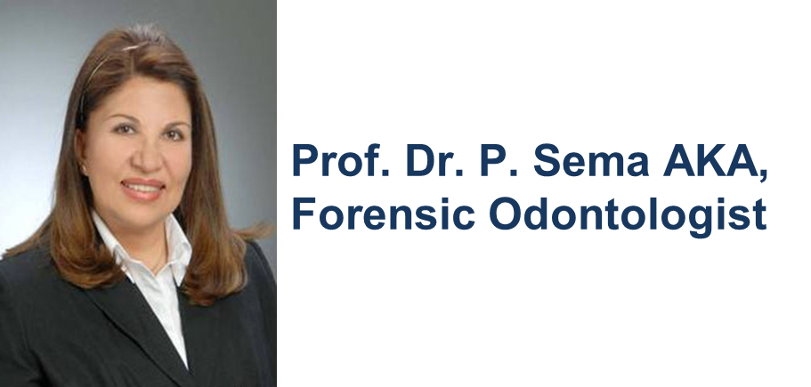
Graduated from the Dental Faculty of Ankara University in Turkey in 1979, earned PhD. degree in 1983, Associate Professorship in 1986, and full Professorship in 1993, at the age of 38 years. She has international publications in the field of dental sciences and forensic odontology. Prof. Aka is the founder of the Forensic Odontology Unit and head of the Forensic Odontology Committee of the “Forensic Scientists Society.” She is one of the editors of the Turkish Journal of Forensic Sciences. Prof. Aka retired from Ankara University in 2007 and recently working as an independent researcher.

Slide 6
RESEARCH TEAM
Dr. Murat YAGAN, MD, Forensic Physician
Forensic Medicine Specialist. Institution of Forensic Medicine, Directorship of Afyonkarahisar Agency Department, Afyonkarahisar, Turkey.
Assoc. Prof.
Nergis CANTURK MD, Forensic Physician. Ankara University, Institute of Forensic Sciences, Head of Department of Criminalistics, Ankara, Turkey
Assist. Prof. Rukiye DAGALP, PhD
Statistician, Ankara University,
Faculty of Science, Department of Statistics, Ankara, Turkey.

Slide 7
Age estimation from primary teeth is an important matter for forensic odontology, which can be solved with the application of direct or indirect age estimation methods that are functions of tooth measurements. The most distinctive teeth among these are the central incisors because of their early development.

Slide 8
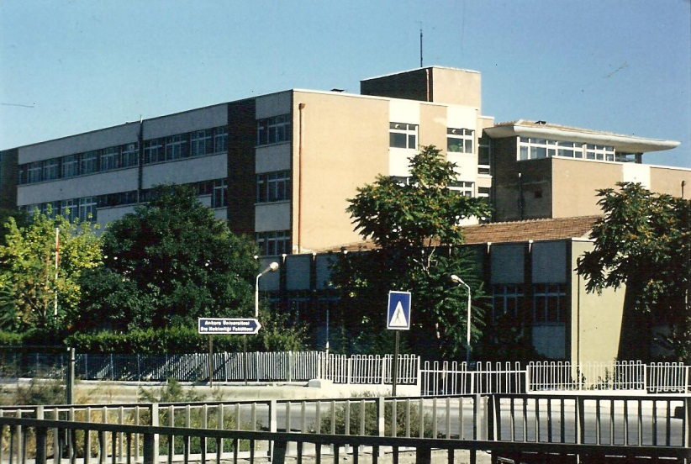
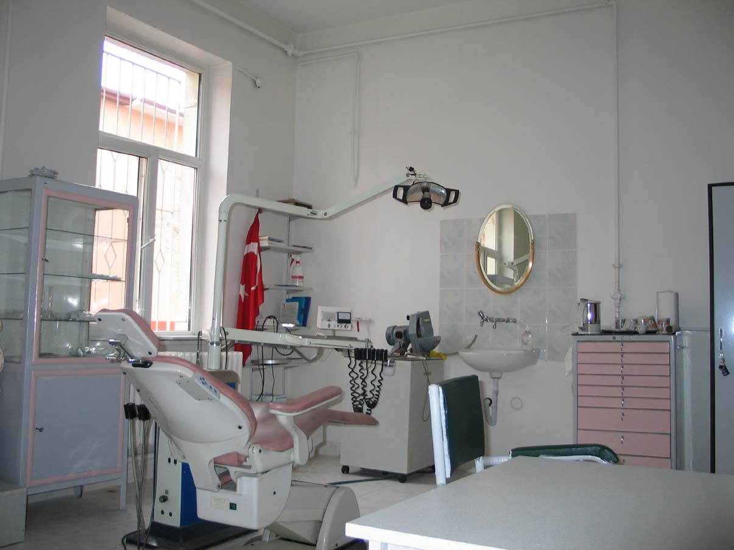
The cases shown in this research were examined under the legal permission of the Council of Forensic Medicine, Ministry of Justice, Turkey (Project number and date: B.03.1.ATK.0.01.00.08/237, May 30, 2006) and University of Ankara (Number and date of decision: 103-2692, December 4, 2006).
University of Ankara, Faculty of Detistry and Unit of Forensic Odontology.

Slide 9
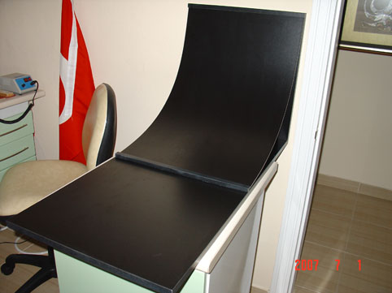
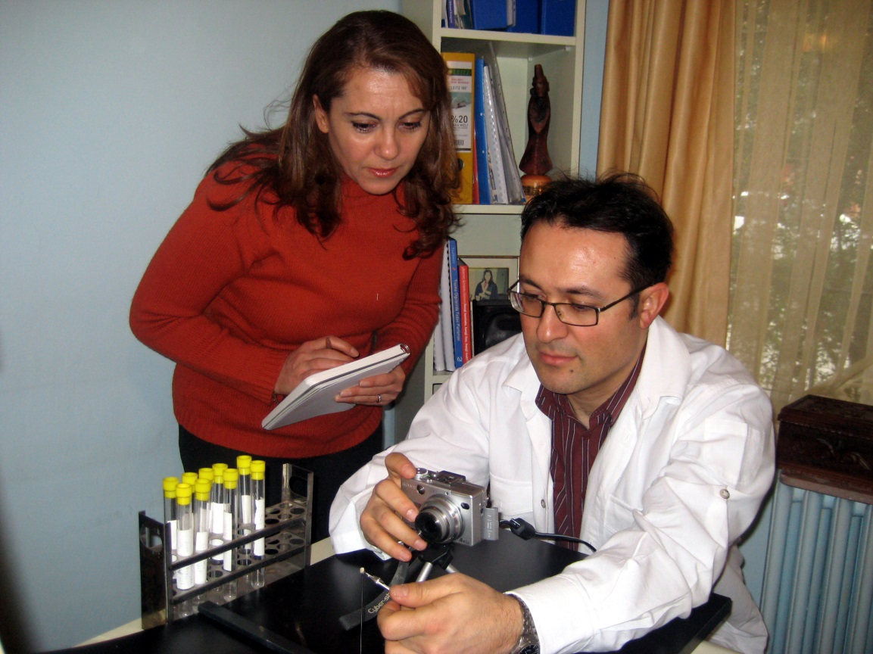
Macro shots are made with dijital Sony DSC V1 camera on a black infinite background.
Photos are obtained from five outer and one from the root direction of 480 deciduous teeth.
YAGAN and DAGALP
during the photographing step.

Slide 10
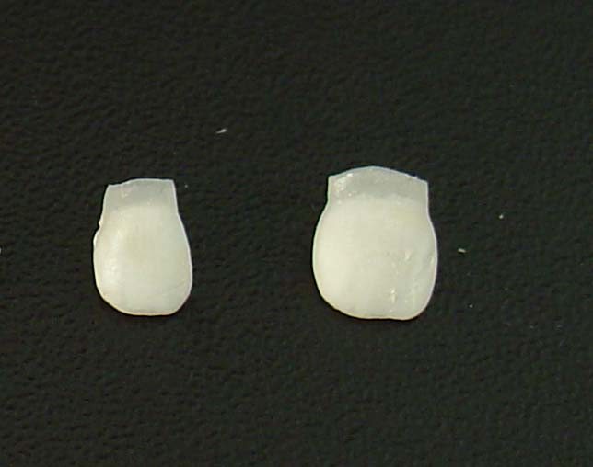
Spherical incisal crowns of the deciduous dentition

Slide 11
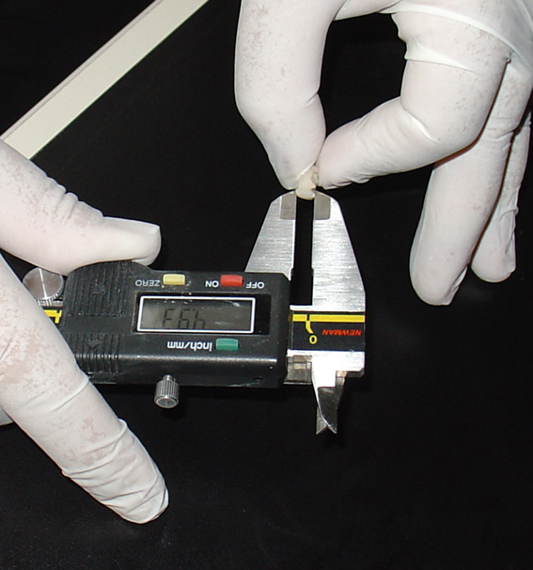
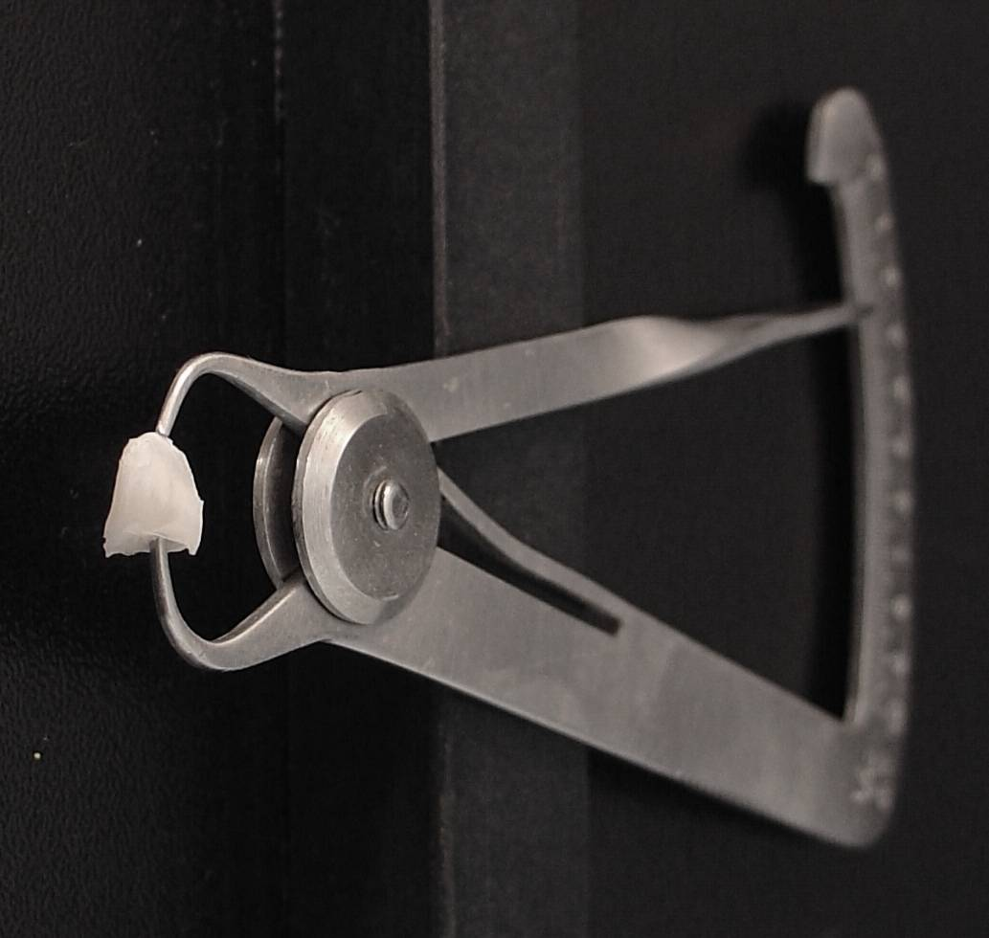
The aim of this study is to determine the age of fetuses or infants by measuring the tooth development from the five aspects as; mesio-distal (MD), bucco-lingual (BL), crown height (CH), crown thickness (CrT) and root height (RH) dimensions. Measurements were taken with TWO TYPES OF COMPASSES in millimeters.
Dental metal thickness compass, (Fara Dental, Germany), used for (CrT) dimensions.
Digital Vernier compass, (Mitutoyo, Japan), used for MD, BL, CH, and RH dimensions.

Slide 12
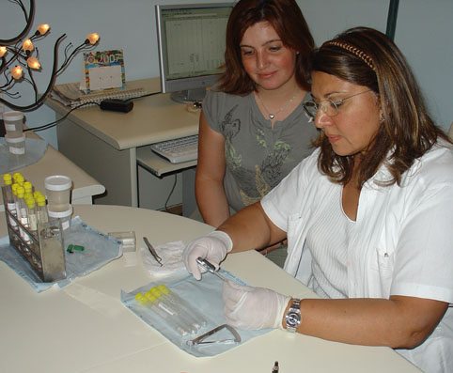
Arithmetical average of two measurements were were calculated to produce the data, which were statistically processed by regression analysis and various regression formulas were derived.
AKA and CANTURK
during the measuring step.

Slide 13
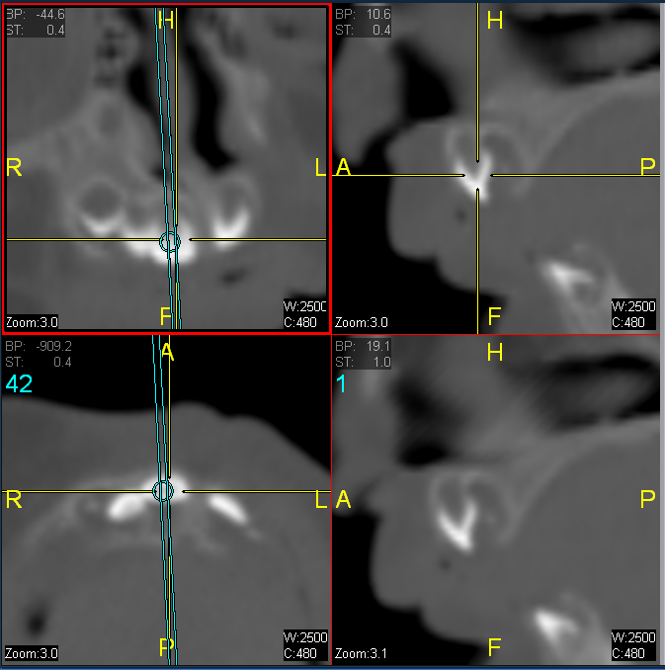
Age of teeth could also be estimated through the calculation of indirectly obtained data from the computerized tomography (CT) digital image measurements, where new regression formulas were derived.

Slide 14
This method was proposed as Virtual Dental Identification (VirDent-ID) by the authors PS. Aka and N. Canturk, and is a matter of choice instead of traditional methods. Same dental measurements were tested on the image measurements and reliable results were obtained.
The results revealed that age could be estimated from various tooth dimensions within an accuracy of ± 0–2 weeks for both methods.

Slide 15
The best measurements for age estimation can be obtained from the longest vertical dimension, which is the tooth height, and the best age estimation formula was also generated from the tooth height.

Slide 16
In conclusion, age formulas derived from direct or indirect measurements of fetus or infant tooth development stages may be used as an aid for dental identification, until the completion of upper central primary tooth development.
Additionally a user-friendly age estimation software is also prepared for quick and easy age estimation from both direct manual and indirect virtual dental measurements taken from the Computerized Tomography images which will be present in the text and atlas entitled «Primary Tooth Development in Infancy».

Slide 17
AUTHORS RELATED REFERENCES :
Aka PS, Canturk N, Dagalp R, Yagan M. Age determination from central incisors of fetuses and infants. Forensic Sci Int. 2009 Jan 30;184 (1-3):15-20.
Dagalp R, Aka PS, Canturk N, Kedici I. Age estimation from fetus and infant tooth and head measurements. Int J Legal Med. 2014 May;128 (3): 501-8.
Canturk N, Atsu SS, Aka PS, Dagalp R. Neonatal line on fetus and infant teeth: An indicator of live birth and mode of delivery. Early Hum Dev. 2014 Aug; 90(8):393-7.
Aka PS , Canturk N, Aka Canturk Oral Autopsy Method for the Dental Identification of Fetus and Infant Cases Forensic Medicine and Anatomy Research, 2014, 2, 48-50.

Slide 18
Atsu SS, Gokdemir K, Kedici PS. Human dentinal structure as an indicator of age. J Forensic Odontostomatol. 1998 Dec;16 (2):27-9.
Kedici PS, Atsu S, Gokdemir K, Sarikaya Y, Gurbuz F. Micrometric measurements by scanning electron microscope (SEM) for dental age estimation in adults. J Forensic Odontostomatol. 2000 Dec;18(2):22-6.
Bilge Y, Kedici PS, Alakoç YD, Ülküer KU, İlkyaz YY. The identification of a dismembered human body: a multidisciplinary approach. Forensic Sci Int. 2003 Nov 26;137 (2-3):141-6.
Iscan MY, Kedici PS. Sexual variation in bucco-lingual dimensions in Turkish dentition. Forensic Sci Int. 2003 Nov 26; 137(2-3):160-4.
* «Kedici» was the old surname of P. Sema AKA between 1976 - 2004.

Slide 19
Let Us Meet Again
We welcome you all to our future conferences of OMICS Group International
Please Visit: www.omicsgroup.com
www.conferenceseries.com

