Slide 1
The Relationship of Hospital’s Quality and Accreditation Applications with Asymmetric Information A Theoretical Assessment
Selden COSKUN
Isık University, Turkey
Global Health Economics Summit ,Berlin 2016

Slide 2
Aim & Method
The increase effect that the hospital's quality system and accreditation applications to asymmetric information.
Study and publications
National
International

Slide 3
Health Care Sector
Discrete Vs. Concrete
Attitude of healthcare personnel
Trust
Informing
Bureaucracy
Asymmetric Information

Slide 4
Asymmetric Information
This means that one party to a transaction has better information available to it than does the other party to the transaction
Health Care Sector
Area of law
The consumers of the hospitals or other health care providers have less information on the service to evaluate technically.

Slide 5
Supplier-Induced Demand
Customer is addicted to supplier
Asymmetric information
The supplier is the one who demands the service and who supplies the service

Slide 6
Quality
Customer Expectations
Vs.
Actual Customer Perception

Slide 7
Quality Performance
Customer Surveys
Legal Audits
Statistical Methods
Third Party Audits
(WHO 2003)

Slide 8
Accreditation
1917 First step
1951 Foundation
1987 JCAHO
2005 Other than hospitals

Slide 9
Quality in Turkey’s Health Care Sector
1980’s
Import / Export
Authorization
ISO / Accreditation / EFQM

Slide 10
The QMS in 2013
Around 500 private hospitals
All authorized
~ 100 ISO 9001
~ 10 EFQM
~ 50 JCI

Slide 11
Asymmetric Information & Quality Relationship
In short term
In long term
Notes:
In short term , QMS will limit the supply and because of the cost increase service manufacturing at equilibrium will decrease
In long term, according to the asym ınf. and the induced demand increase the above decreases will come back to the equl. point . So only the price will be at the end increased.

Slide 12
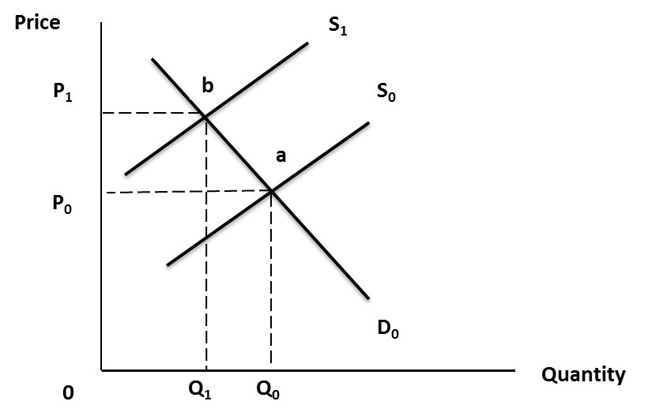
Accreditation Effect to Cost (Cerqueira,M.)
Notes:
With QMS the supply line goes to right ,quantity decrease

Slide 13
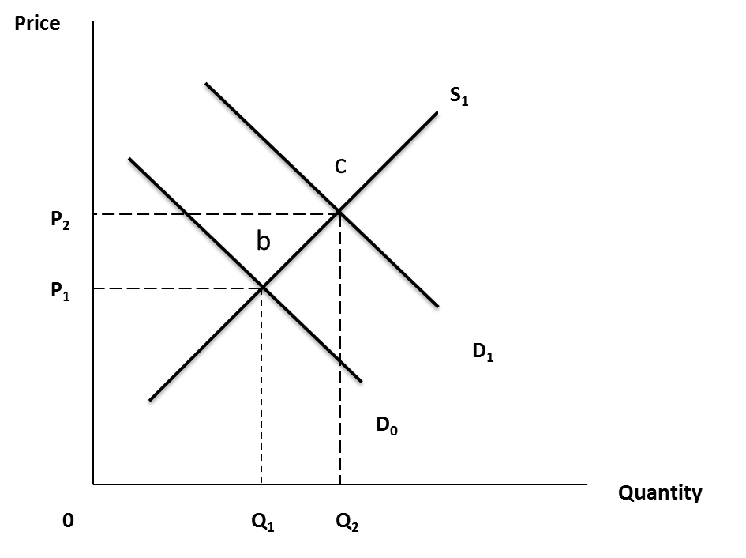
Asymmetric Information Effect to Cost (Cerqueira,M.)

Slide 14
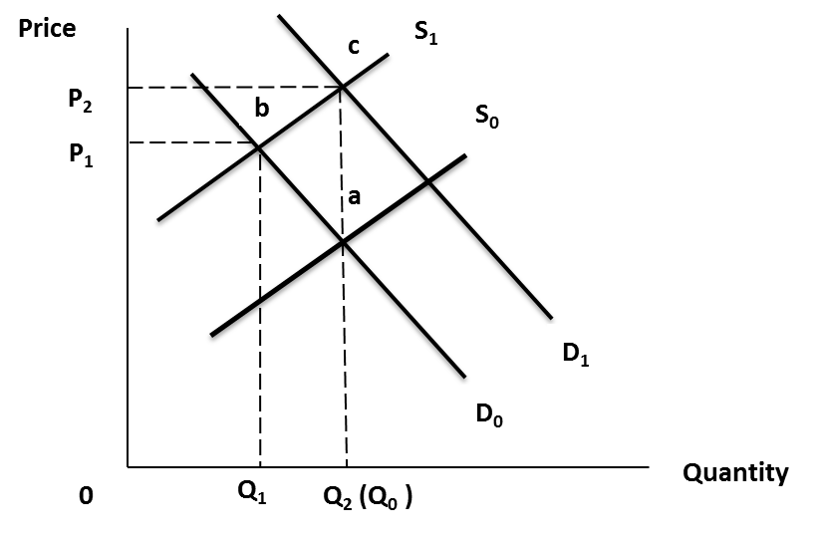
Resultant Graph: The Reflection of Changes
Notes:
As Asymmetric Inf. increases the induced demand also increase ( papers)

Slide 15
As an Assessment,
The resultant graph has showed that QMS doesn’t effect in long term the supply and demand lines just increases the prices as theoretically.
The QMS should not be managed by just only profit motivation also the establishment way of organizational system is important.
The necessity of QMS should be analyzed.

Slide 16
THANK YOU… selden.coskun@isikun.edu.tr

